Slide 1
A new observational solar irradiance composite
Margit Haberreiter
Micha Schöll, Thierry Dudok de Wit, Matthieu Kretzschmar, Stergios Misios, Klairie Tourpali, Werner Schmutz
PMOD/WRC
Feb 14, 2017
Acknowledgement: This project received funding by the European Commission
Notes:
TO do:
Sonnenbild von Davos, Sonne+haze, Strandbild Kauai....

Slide 2
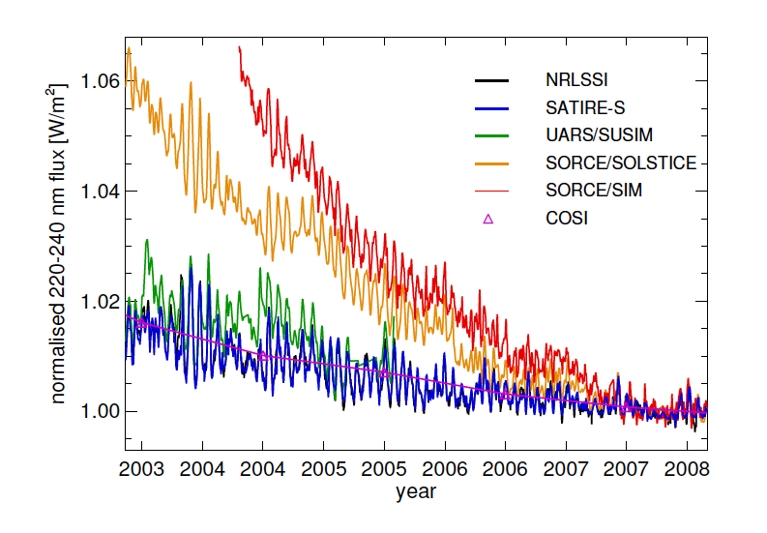
2. Existing data and models do not agree
Ermolli et al., 2013, ACP
Notes:
Understand the physical processes behind solar spectral irradiance variations

Slide 3
Individual steps towards the SSI observational composite
Quality checked datasets
  a) short-term uncertainty (noise) evaluation
  b) long-term uncertainty (degradation) evaluation
Extension of datasets to first space observations (Nov 1978)
  using expectation maximization (Dudok de Wit, 2011)
  increased uncertainty for extrapolated values
Temporal decomposition of the datasets into 13 time scales (1 day to 22 years) for each wavelength;
Weighted average of the SSI timeseries at all scales;
Combined uncertainty at each wavelength and scale;
Absolute scaling of composite

Slide 4
1.a Quality checked SSI Data

Slide 5
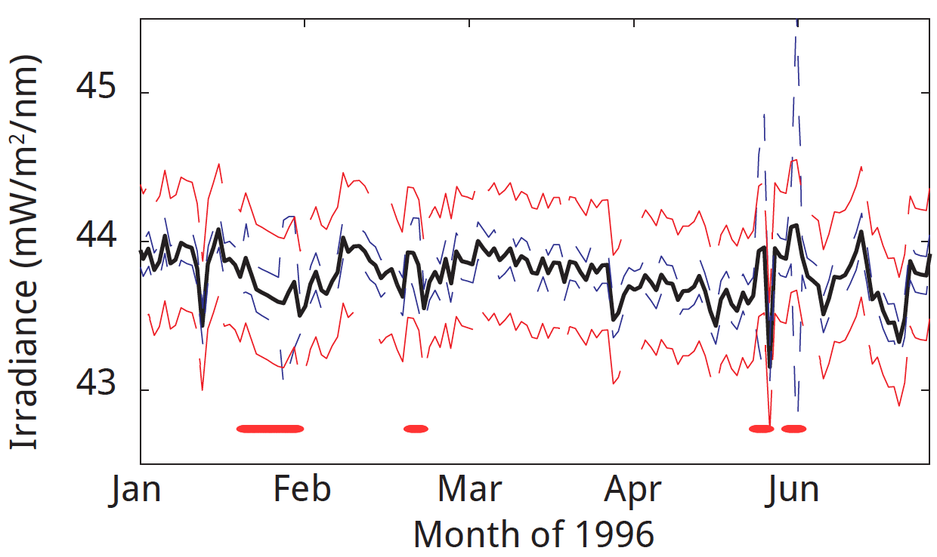
1.a Quality check of SSI Data with short-term uncertainty
Example: UARS/SOLSTICE 248.5 nm
Measurement
Precision - PI
Precision - SOLID
Schöll et al., 2016, SWSC, A14, DOI: 10.1051/swsc/2016007

Slide 6
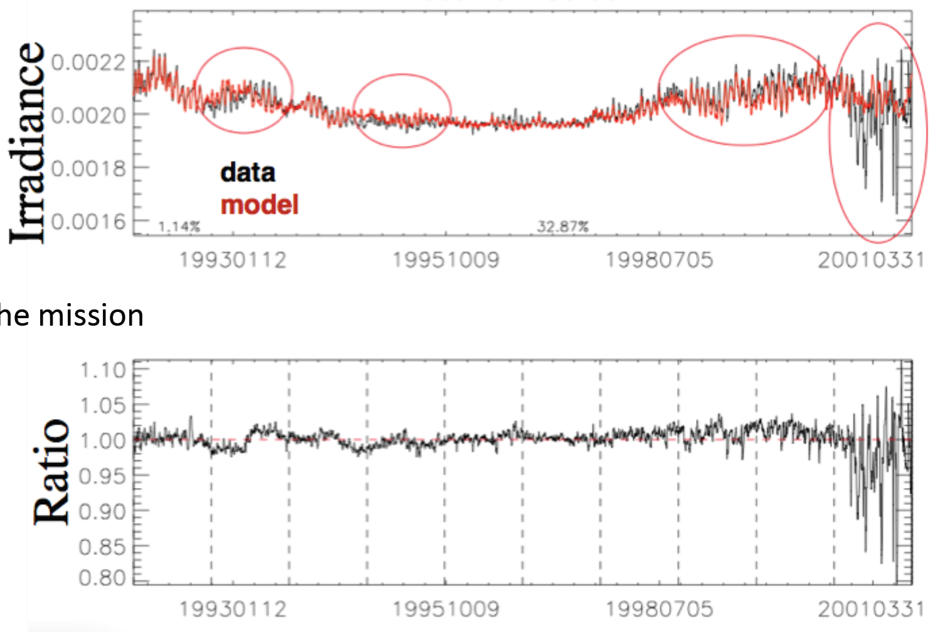


1.b Quality checked datasets / long-term degradation evaluation
Example: UARS/SOLSITCE 180.5nm
Courtesy:
Matthieu
Kretzschmar
Stability:

Slide 7
2. Extension of individual SSI datasets
Multi-scale decomposition (next step) can only be performed on regularly sampled time series with no missing data
Approach:
  Expectation-maximization (Dudok de Wit, 2011)
  Makes use of the correlation between specific SSI bands and the set of proxies to fill the gaps
  Two temporal scales with a cut-off at 81 days
  Extension of each dataset to Nov 1, 1978 (start of the space observations) and Dec 31, 2014 into the “future”

Slide 8
Proxy datasets used for gap filling

Slide 9
Evaluation of SORCE/SIM Data
SIM for years
2010, 2011, 2012
Wehrli et al., 2013:
Statistically significant scaling law
With slope 1.65 between TSI and SPM@500nm

Slide 10
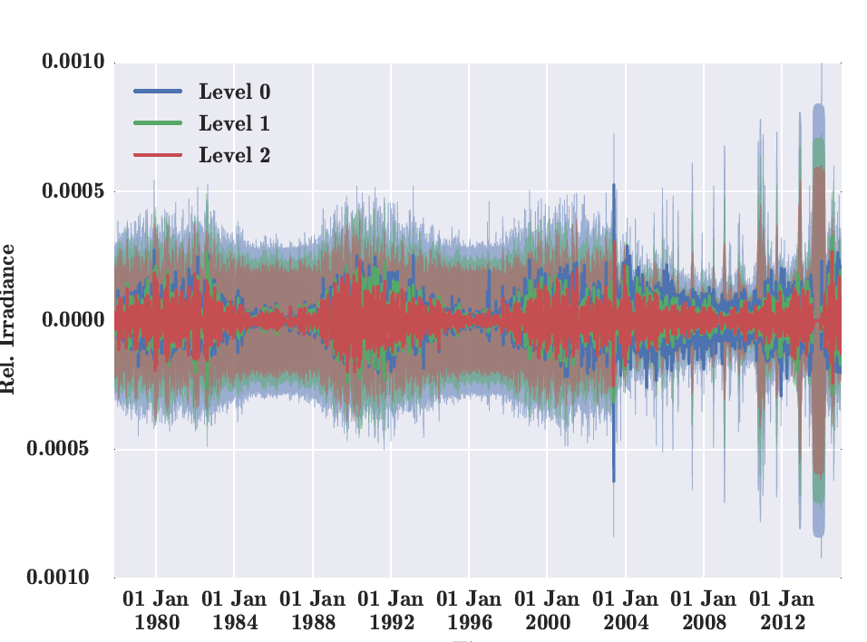


3. Temporal decomposition of the datasets
Example: SORCE/SOLSTICE
a=1d
a=2d
a=4d
Scale a
Level j
j=1 day, ….,
22 yrs

Slide 11
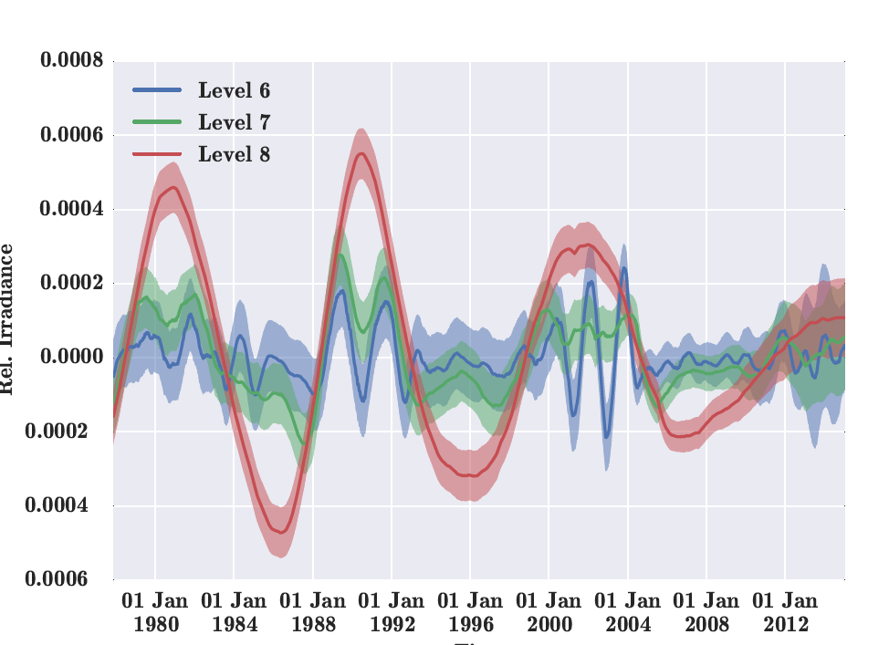
3. Temporal decomposition of the datasets
Example: SORCE/SOLSTICE
a= 64d
a=128d
a=256d

Slide 12
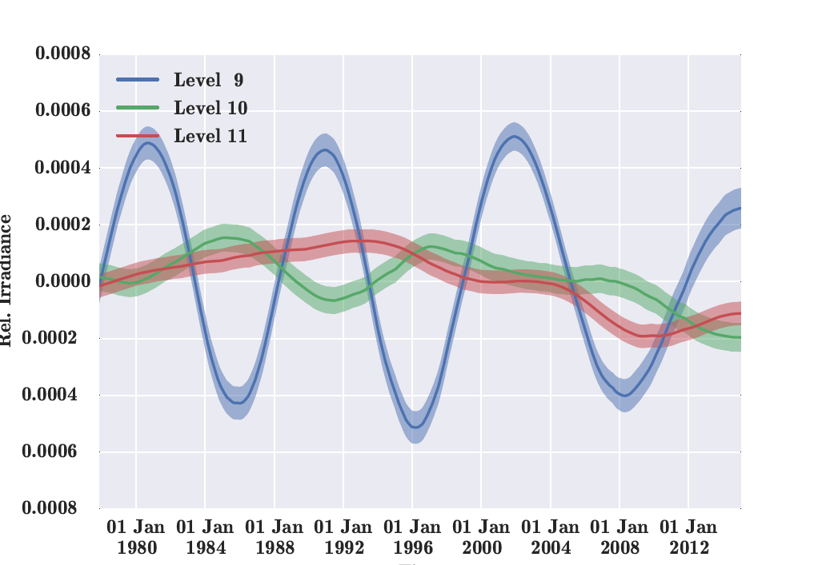
3. Temporal decomposition of the datasets
Example: SORCE/SOLSTICE
a= 1.4 y
a= 2.8 y
a= 5.6 y

Slide 13
3. SSI datasets and SOLID composite

Slide 14
3. SSI datasets and SOLID composite

Slide 15
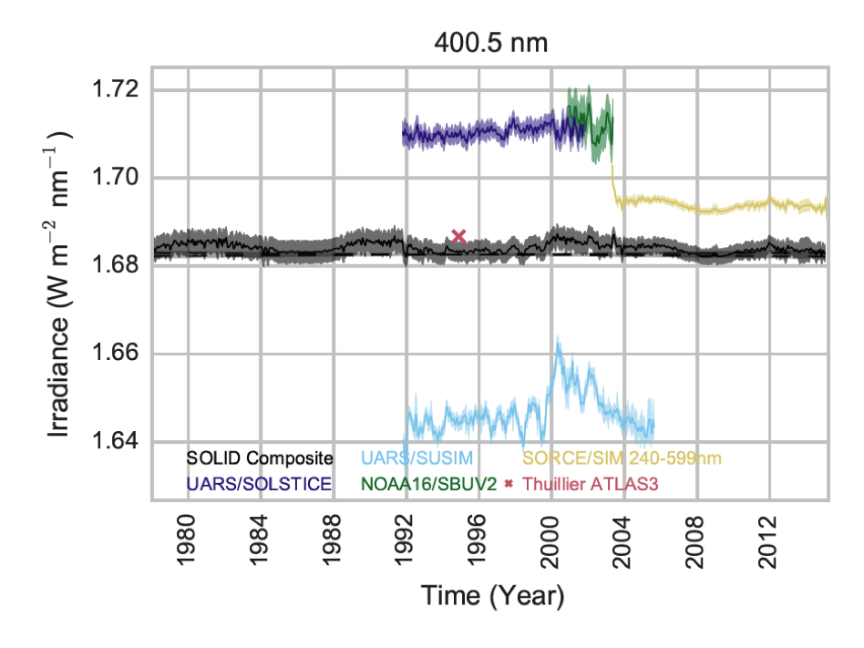
3. SSI datasets and SOLID composite

Slide 16
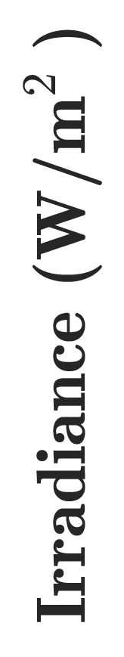

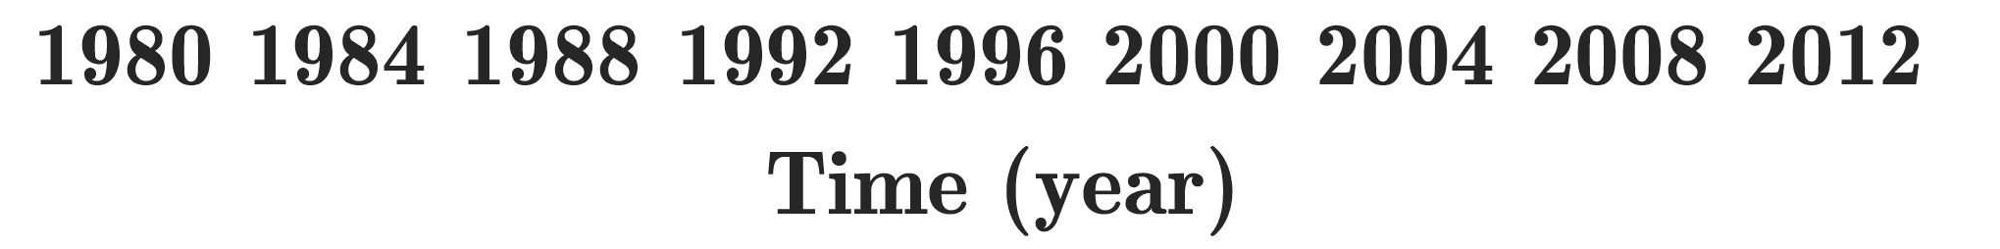
SOLID Composite - Comparison

Slide 17

SOLID Composite Comparison at 350-400nm

Slide 18
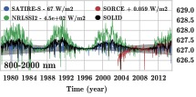
SOLID Composite Comparison at 800 – 2000 nm

Slide 19
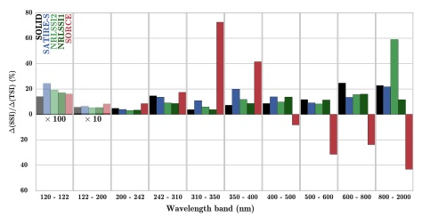
Relative change of SSI relative to TSI
Ozone Formation
Ozone Destruction
2003 versus 2008

Slide 20
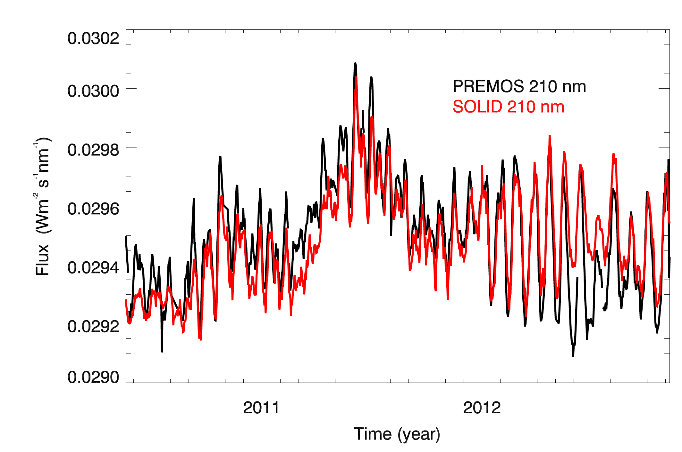
SOLID Composite versus PREMOS

Slide 21
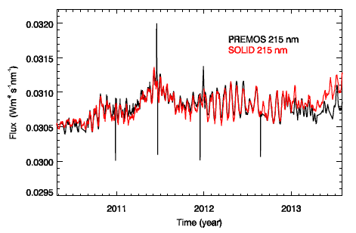
SOLID Composite versus PREMOS

Slide 22
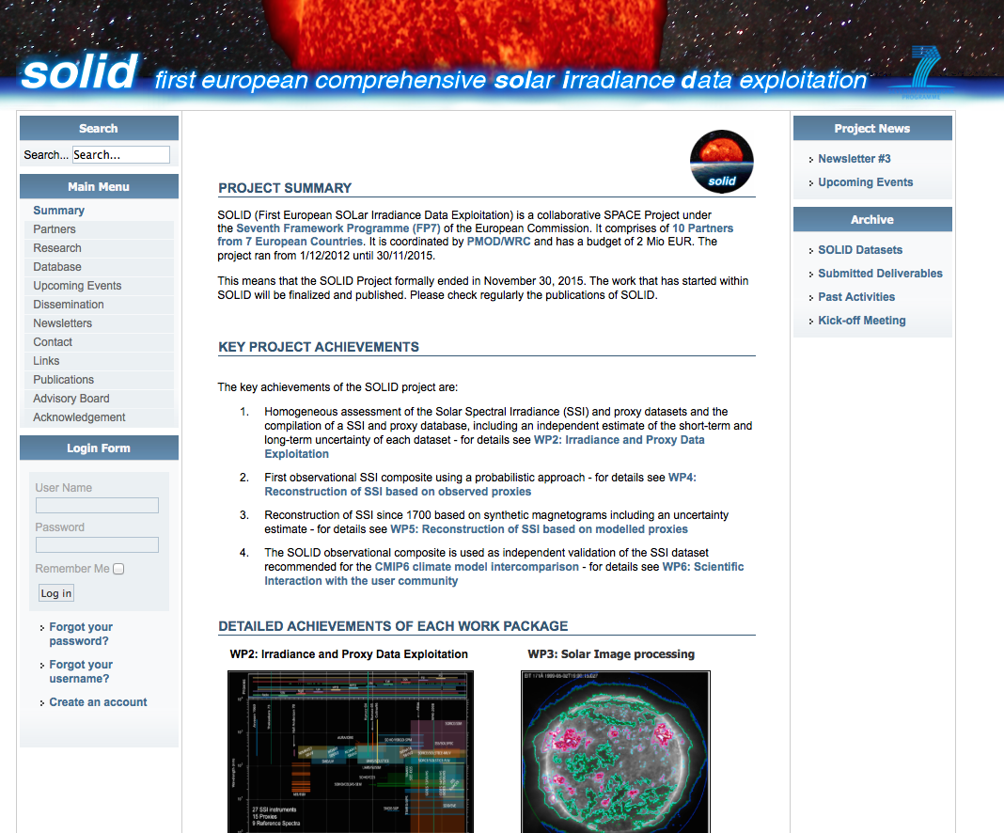
Further information
SOLID SSI observational
composite available
Nov 1, 1978 – Dec 31, 2014
Resolution:
< 623 nm: 1nm
>623 nm: 2nm and higher
Haberreiter et al., 2017, JGR, under review
Matthes, et al, 2017, GMD, under review
http://projects.pmodwrc.ch/solid/

Slide 23
Heating Rate
Gray-shaded
area:
SOLID uncertainty

Slide 24
Heating Rates

Slide 25
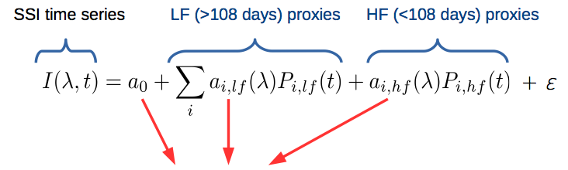
1.b Quality check of SSI Data – Stability
Challenge: there is no way to independently estimate instrument stability without a monitoring system of instrument degradation
SOLID approach :
  Each time series is fitted with a combination of proxies
  Each proxy is decomposed into two scales
  Long-term (LF) > 108 days
  Short-term (HF) < 108 days
Coefficients are fitted for each wavelength
Courtesy Kretzschmar

Slide 26
Stability UARS/SOLSITCE 180.5nm
Courtesy:
Matthieu
Kretzschmar
Stability:
Courtesy Kretzschmar

