Slide 1
Inter-Calibration Activities and Products within the Atmospheric SIPS
Robert Holz, Frederick Nagle, Liam Gumley, Alexa Ross, Ralph Kuehn, Greg Quinn, Steve Dutcher, Bruce Flynn, Walter Wolf*,
Jaime Daniels*, Steve Platnick**, Kerry Meyer**,
Christina Hsu** and Andrew Sayer**
Space Science and Engineering Center, University of Wisconsin
*National Oceanic and Atmospheric Administration
**NASA Goddard

Slide 2
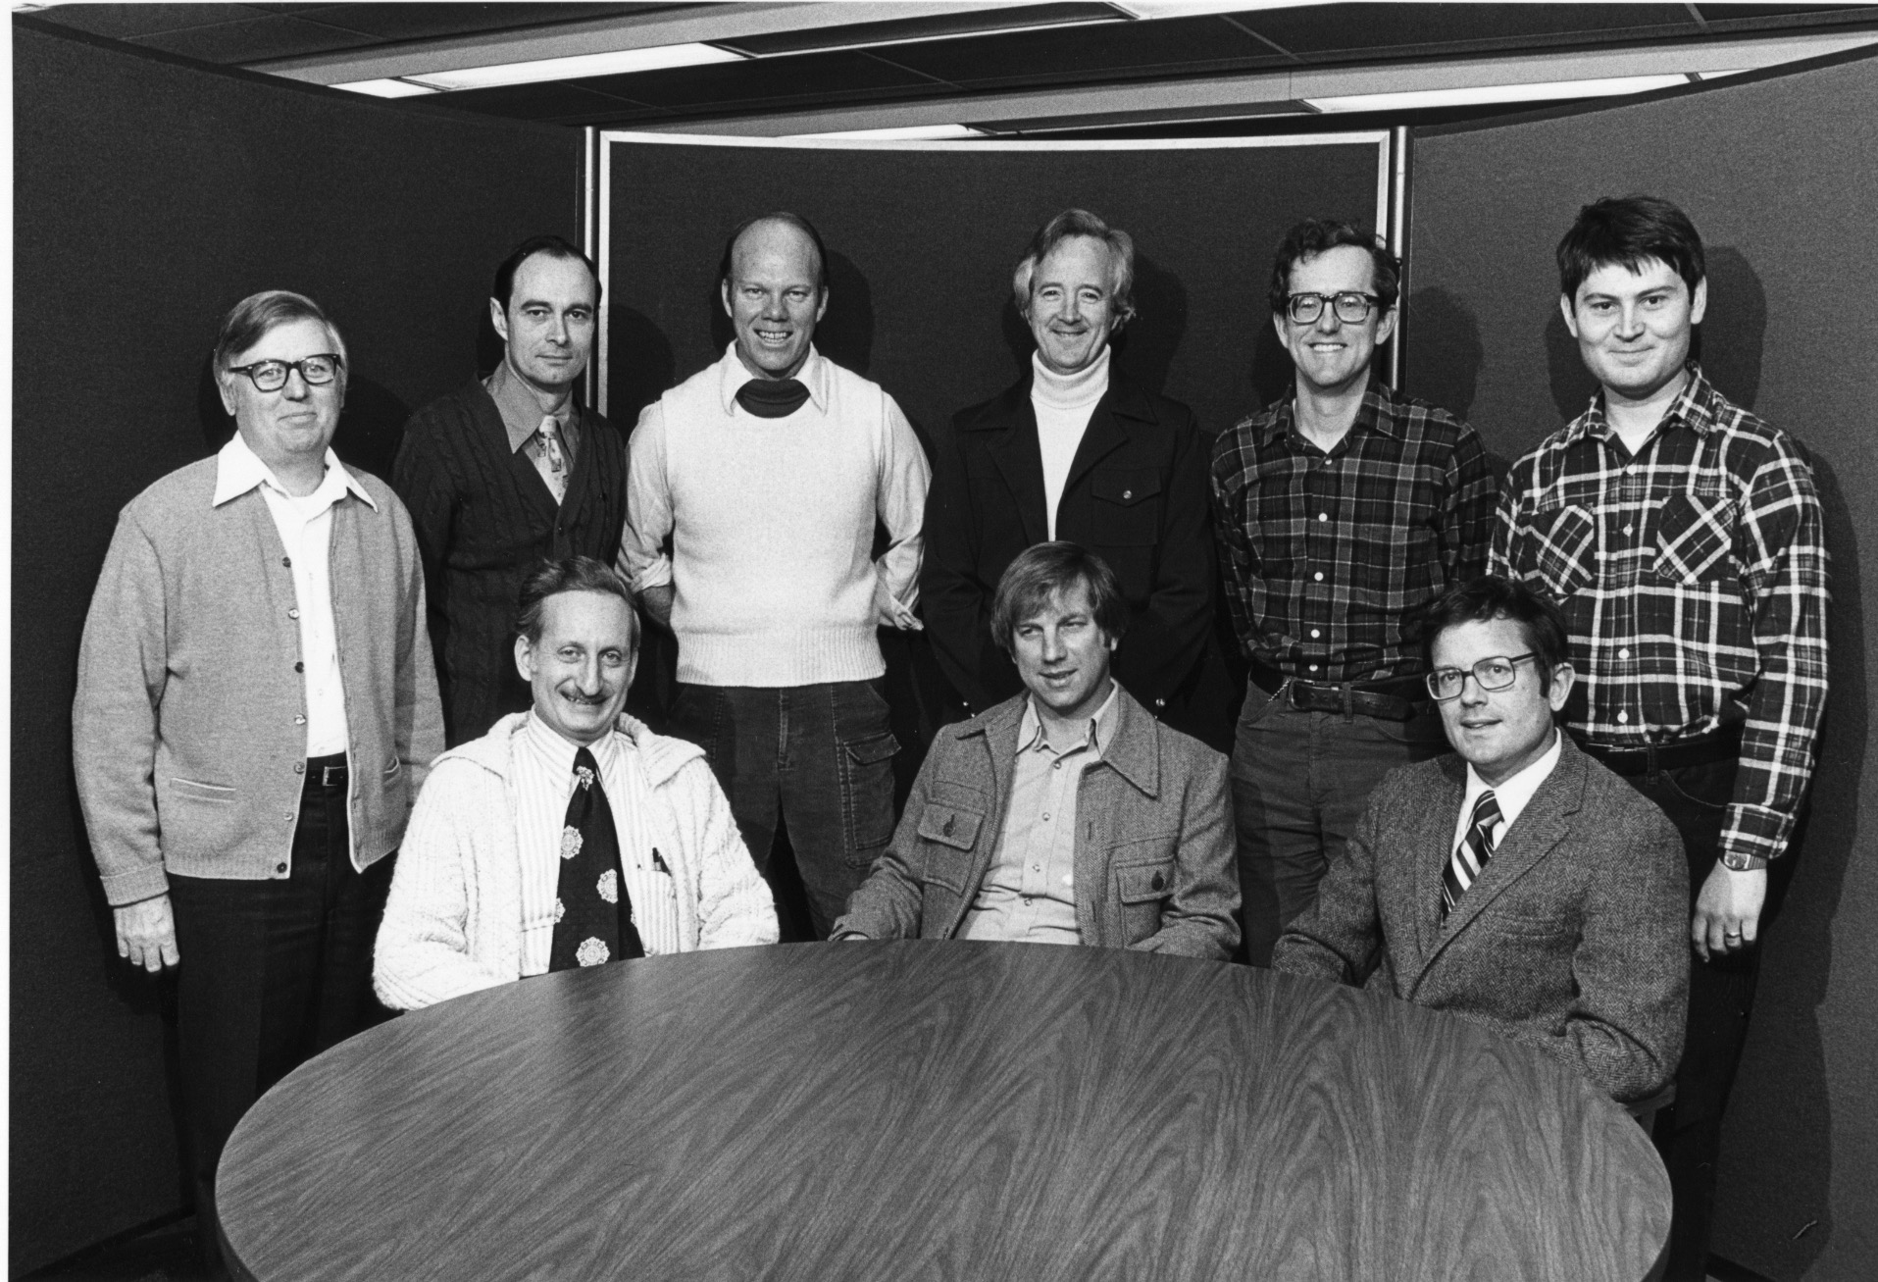
Background
NOAA Feds Arrive at UW Madison 1976

Slide 3
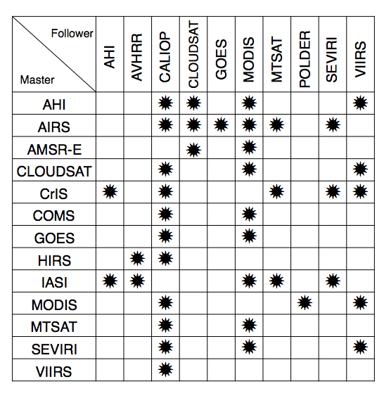
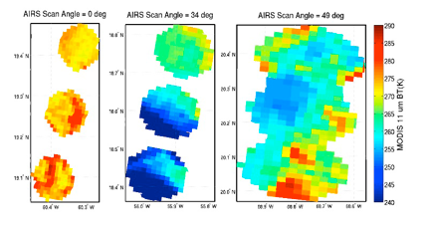
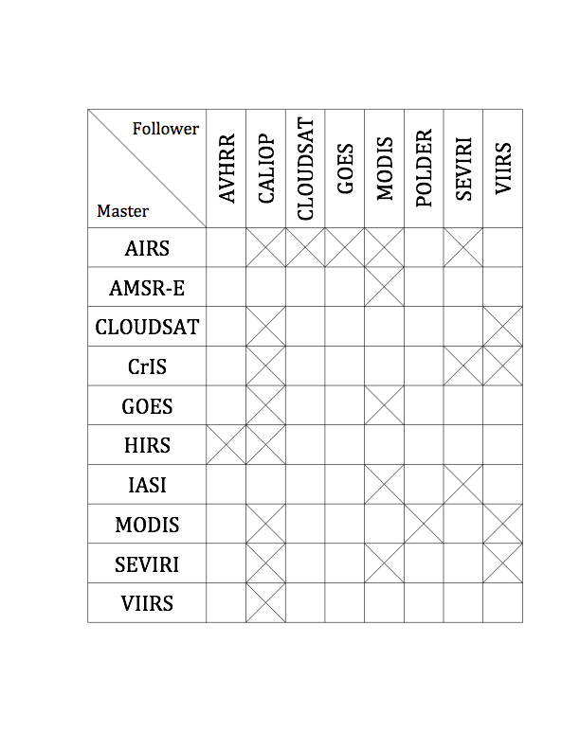
Physical Collocation
The physical collocation projects the instrument master FOV on the earth surface and then identifies each follower pixel within the master footprint. For AHI we the software can collocate a VIIRS granule in approximately
The current instruments supported by the collocation software

Slide 4
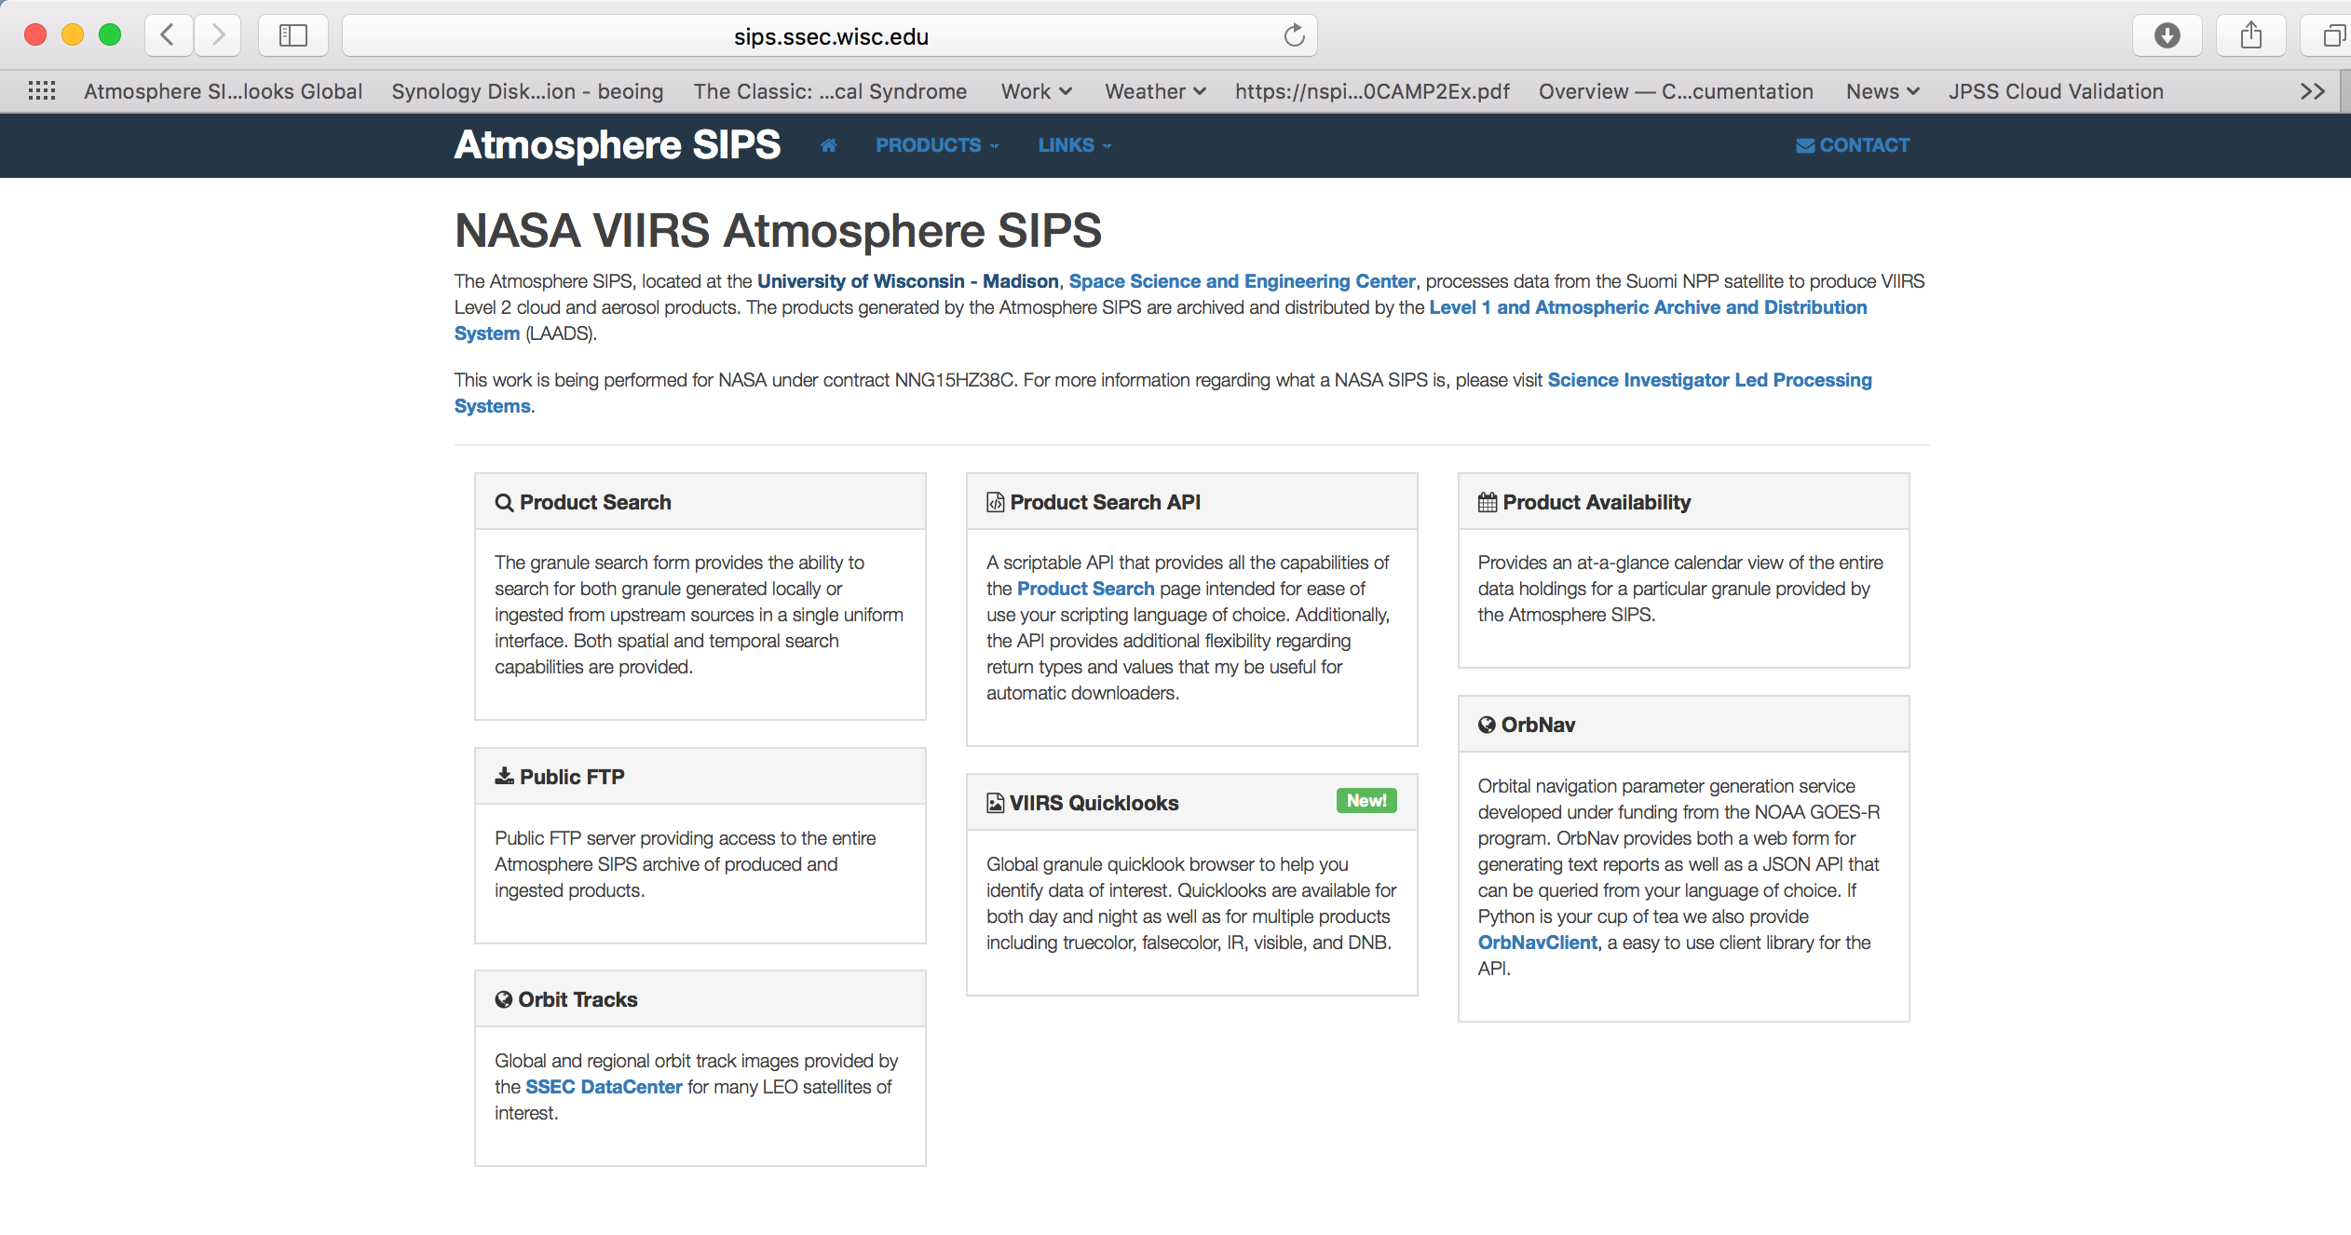

Slide 5
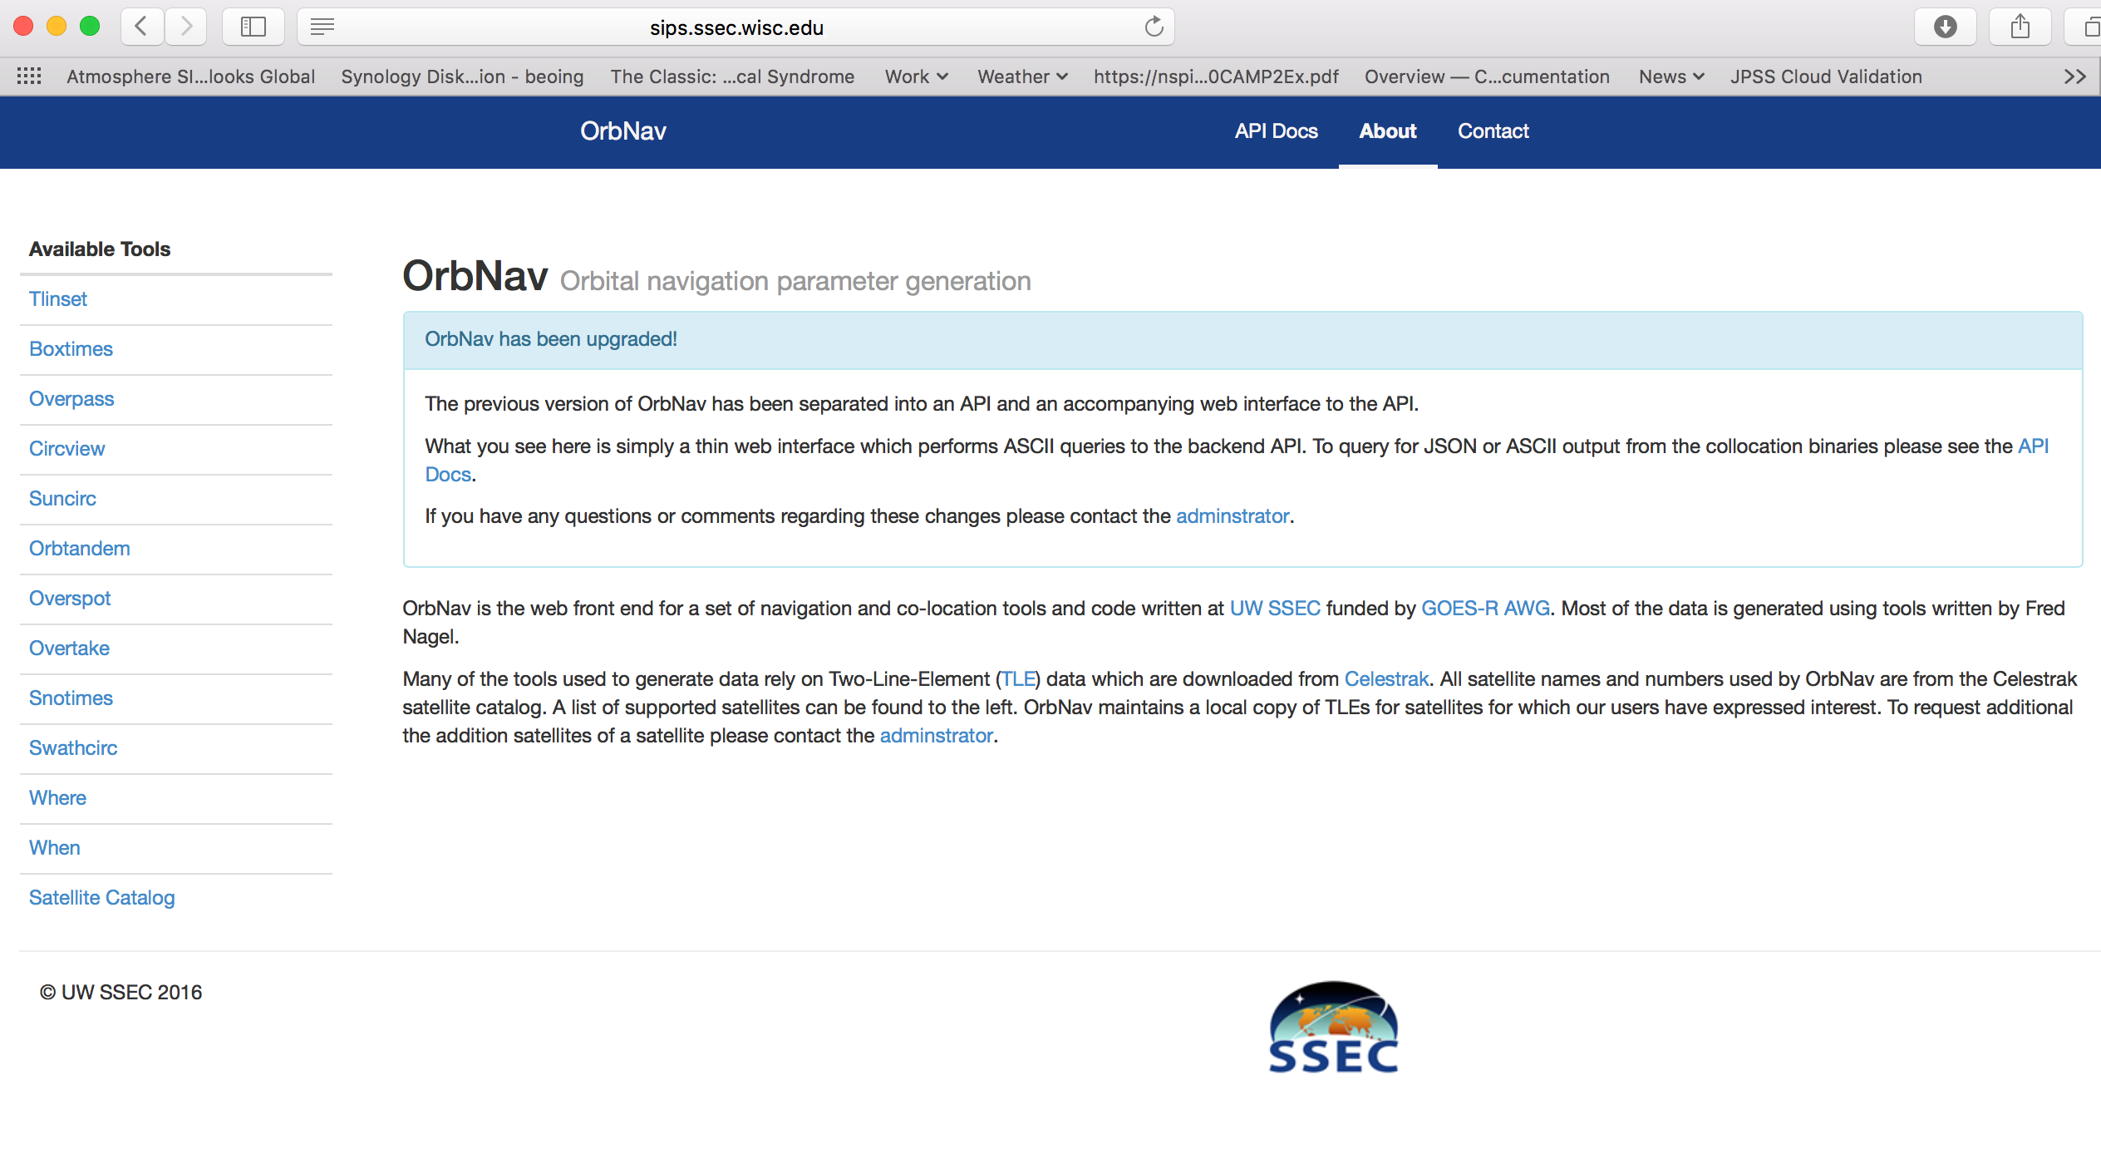
http://sips.ssec.wisc.edu/orbnav/#/tools/snotimes

Slide 6
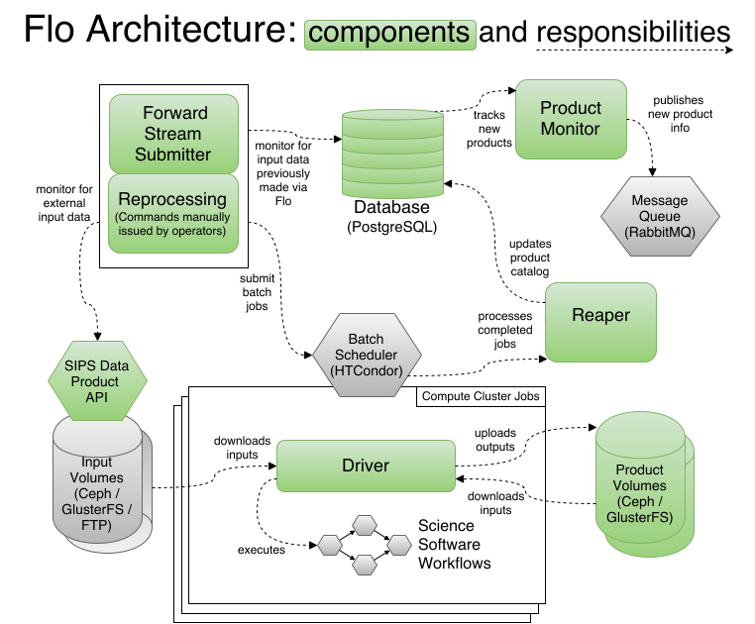

Slide 7
MODIS to VIIRS NASA Cloud Products Continuity Challenges
Relative radiometric calibration in solar reflectance channels
Spectral coverage (key challenge)
VIIRS 2.25µm vs. MODIS 2.13µm channel (impacts cloud effective particle radius)
VIIRS missing CO₂ and H₂O absorption channels present on MODIS (impacts cloud detection, height, multilayer detection)
Spatial resolution/sampling
VIIRS (750, 375m) vs. MODIS (1000, 500, 250m)
M-band “bow-tie” pixel removal

Slide 8
MODIS to VIIRS Cloud Optical Properties
Starting point: SIPS Match Files
MYD02 L1B vs. NASA VIIRS L1B v2
March 2012 – November 2016
Includes MYD06 geophysical parameters for co-located pixels having similar observation times and sun-satellite view geometries.
This analysis
MODIS and VIIRS view zenith and scattering angle match to < ±1º
Liquid phase clouds over oceans, ±60º latitude, low heterogeneity scenes
MODIS CTP (MYD06) + MODIS COT,CER from 265K LUT + VIIRS 265K LUT + atmospheric correction differences => Expected VIIRS TOC (top-of-cloud)

Slide 9
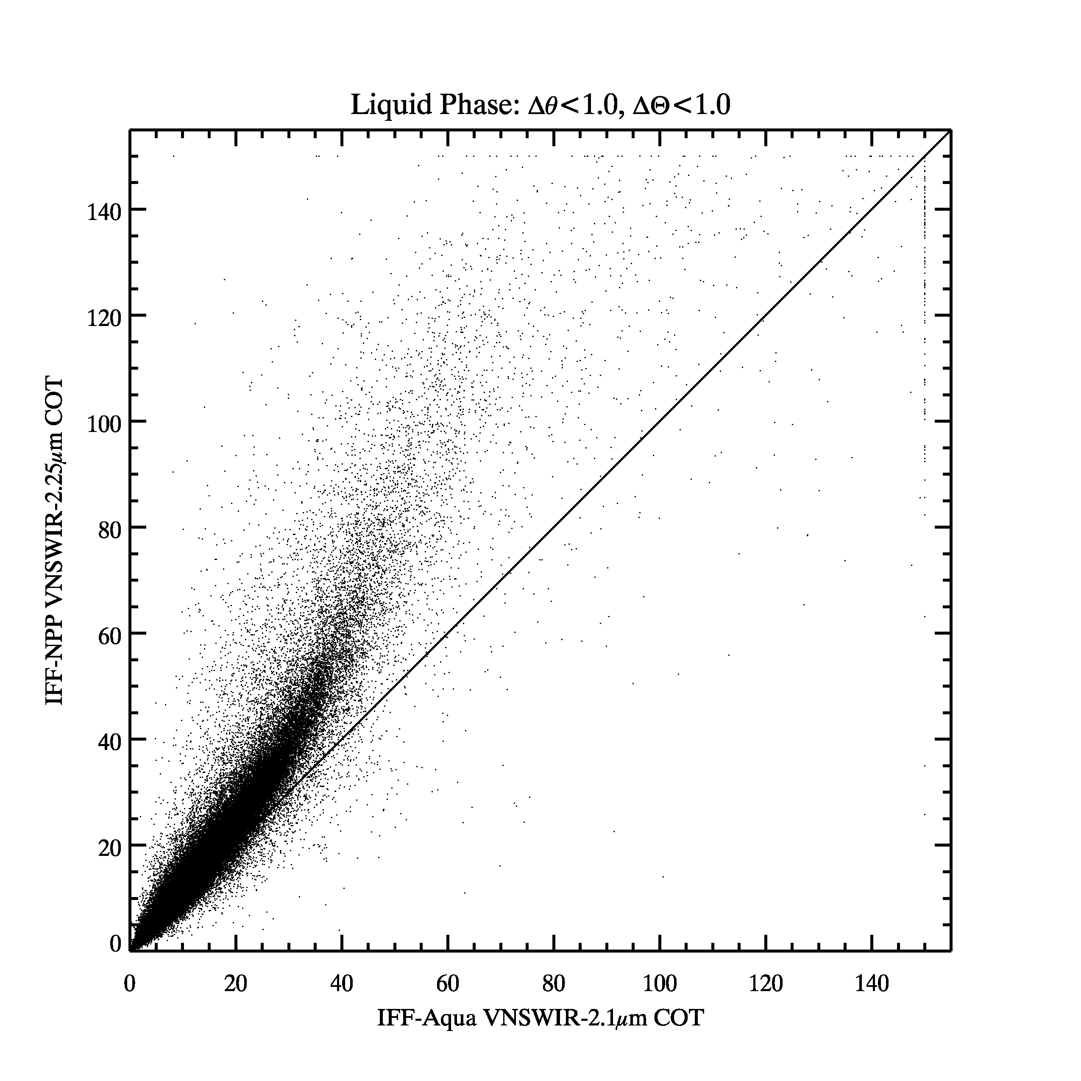
VIIRS vs MODIS Liquid Cloud Optical Thickness Inter-Comparison July 2014 Test Granule

Slide 10
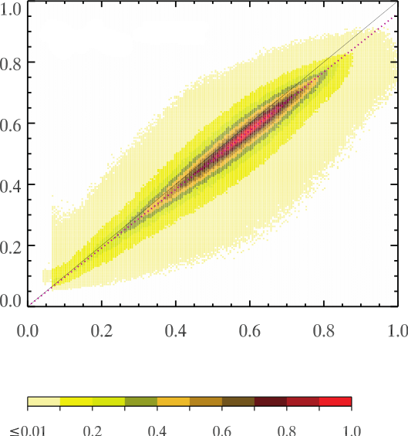
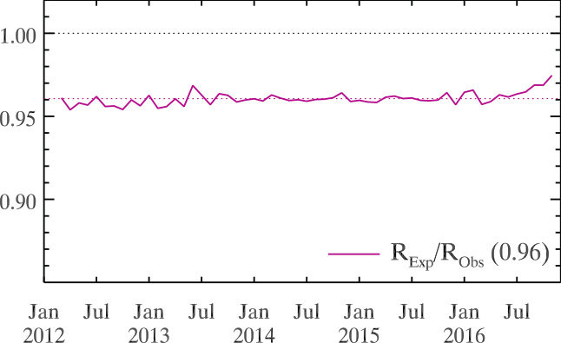
SIPS Match file analysis (2012-2016)
VIIRS Expected
(from MODIS Retrievals)
M7, Feb 2014
M7 Bias Correction
(Expected / Obs)
VIIRS Observed
Normalized PDF
VIIRS Channel | M5 (0.67µm) | M7 (0.87µm) | M8 (1.24µm) | M10 (1.61µm) | M11 (2.25µm)
Radiometric Bias Correction (Expected VIIRS TOC/Observed) | 0.94 | 0.96 | 0.98 | 0.98 | 0.97
CPC, 21 March 2017, Meyer et al

Slide 11
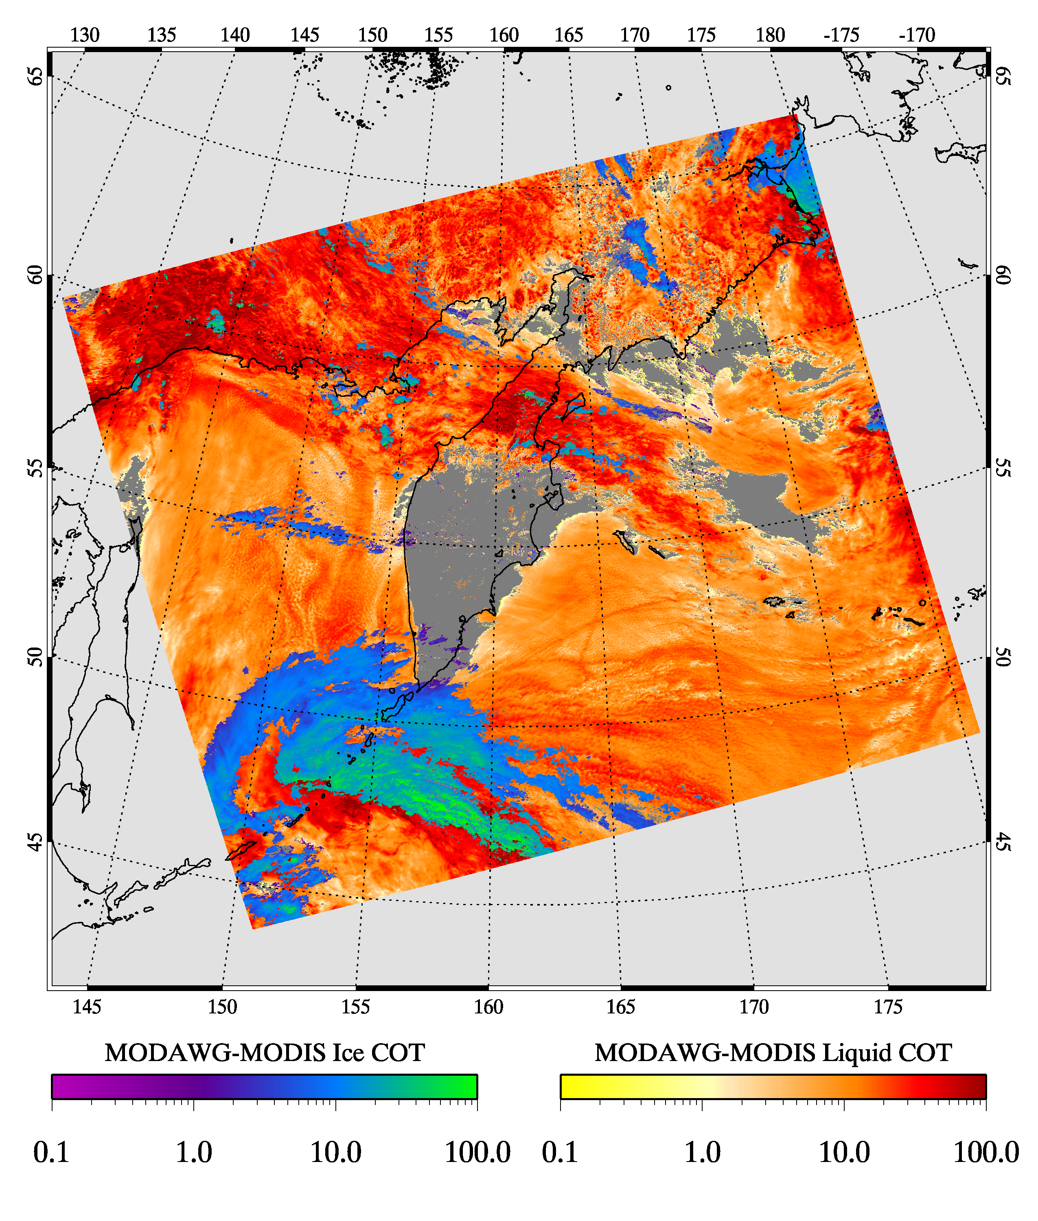
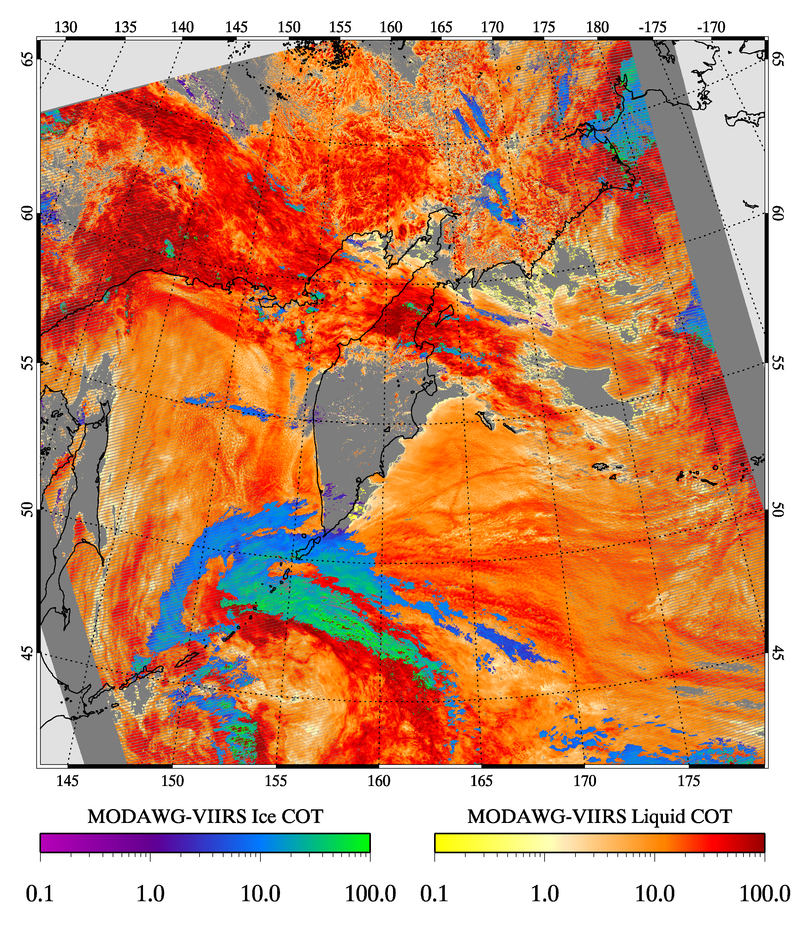
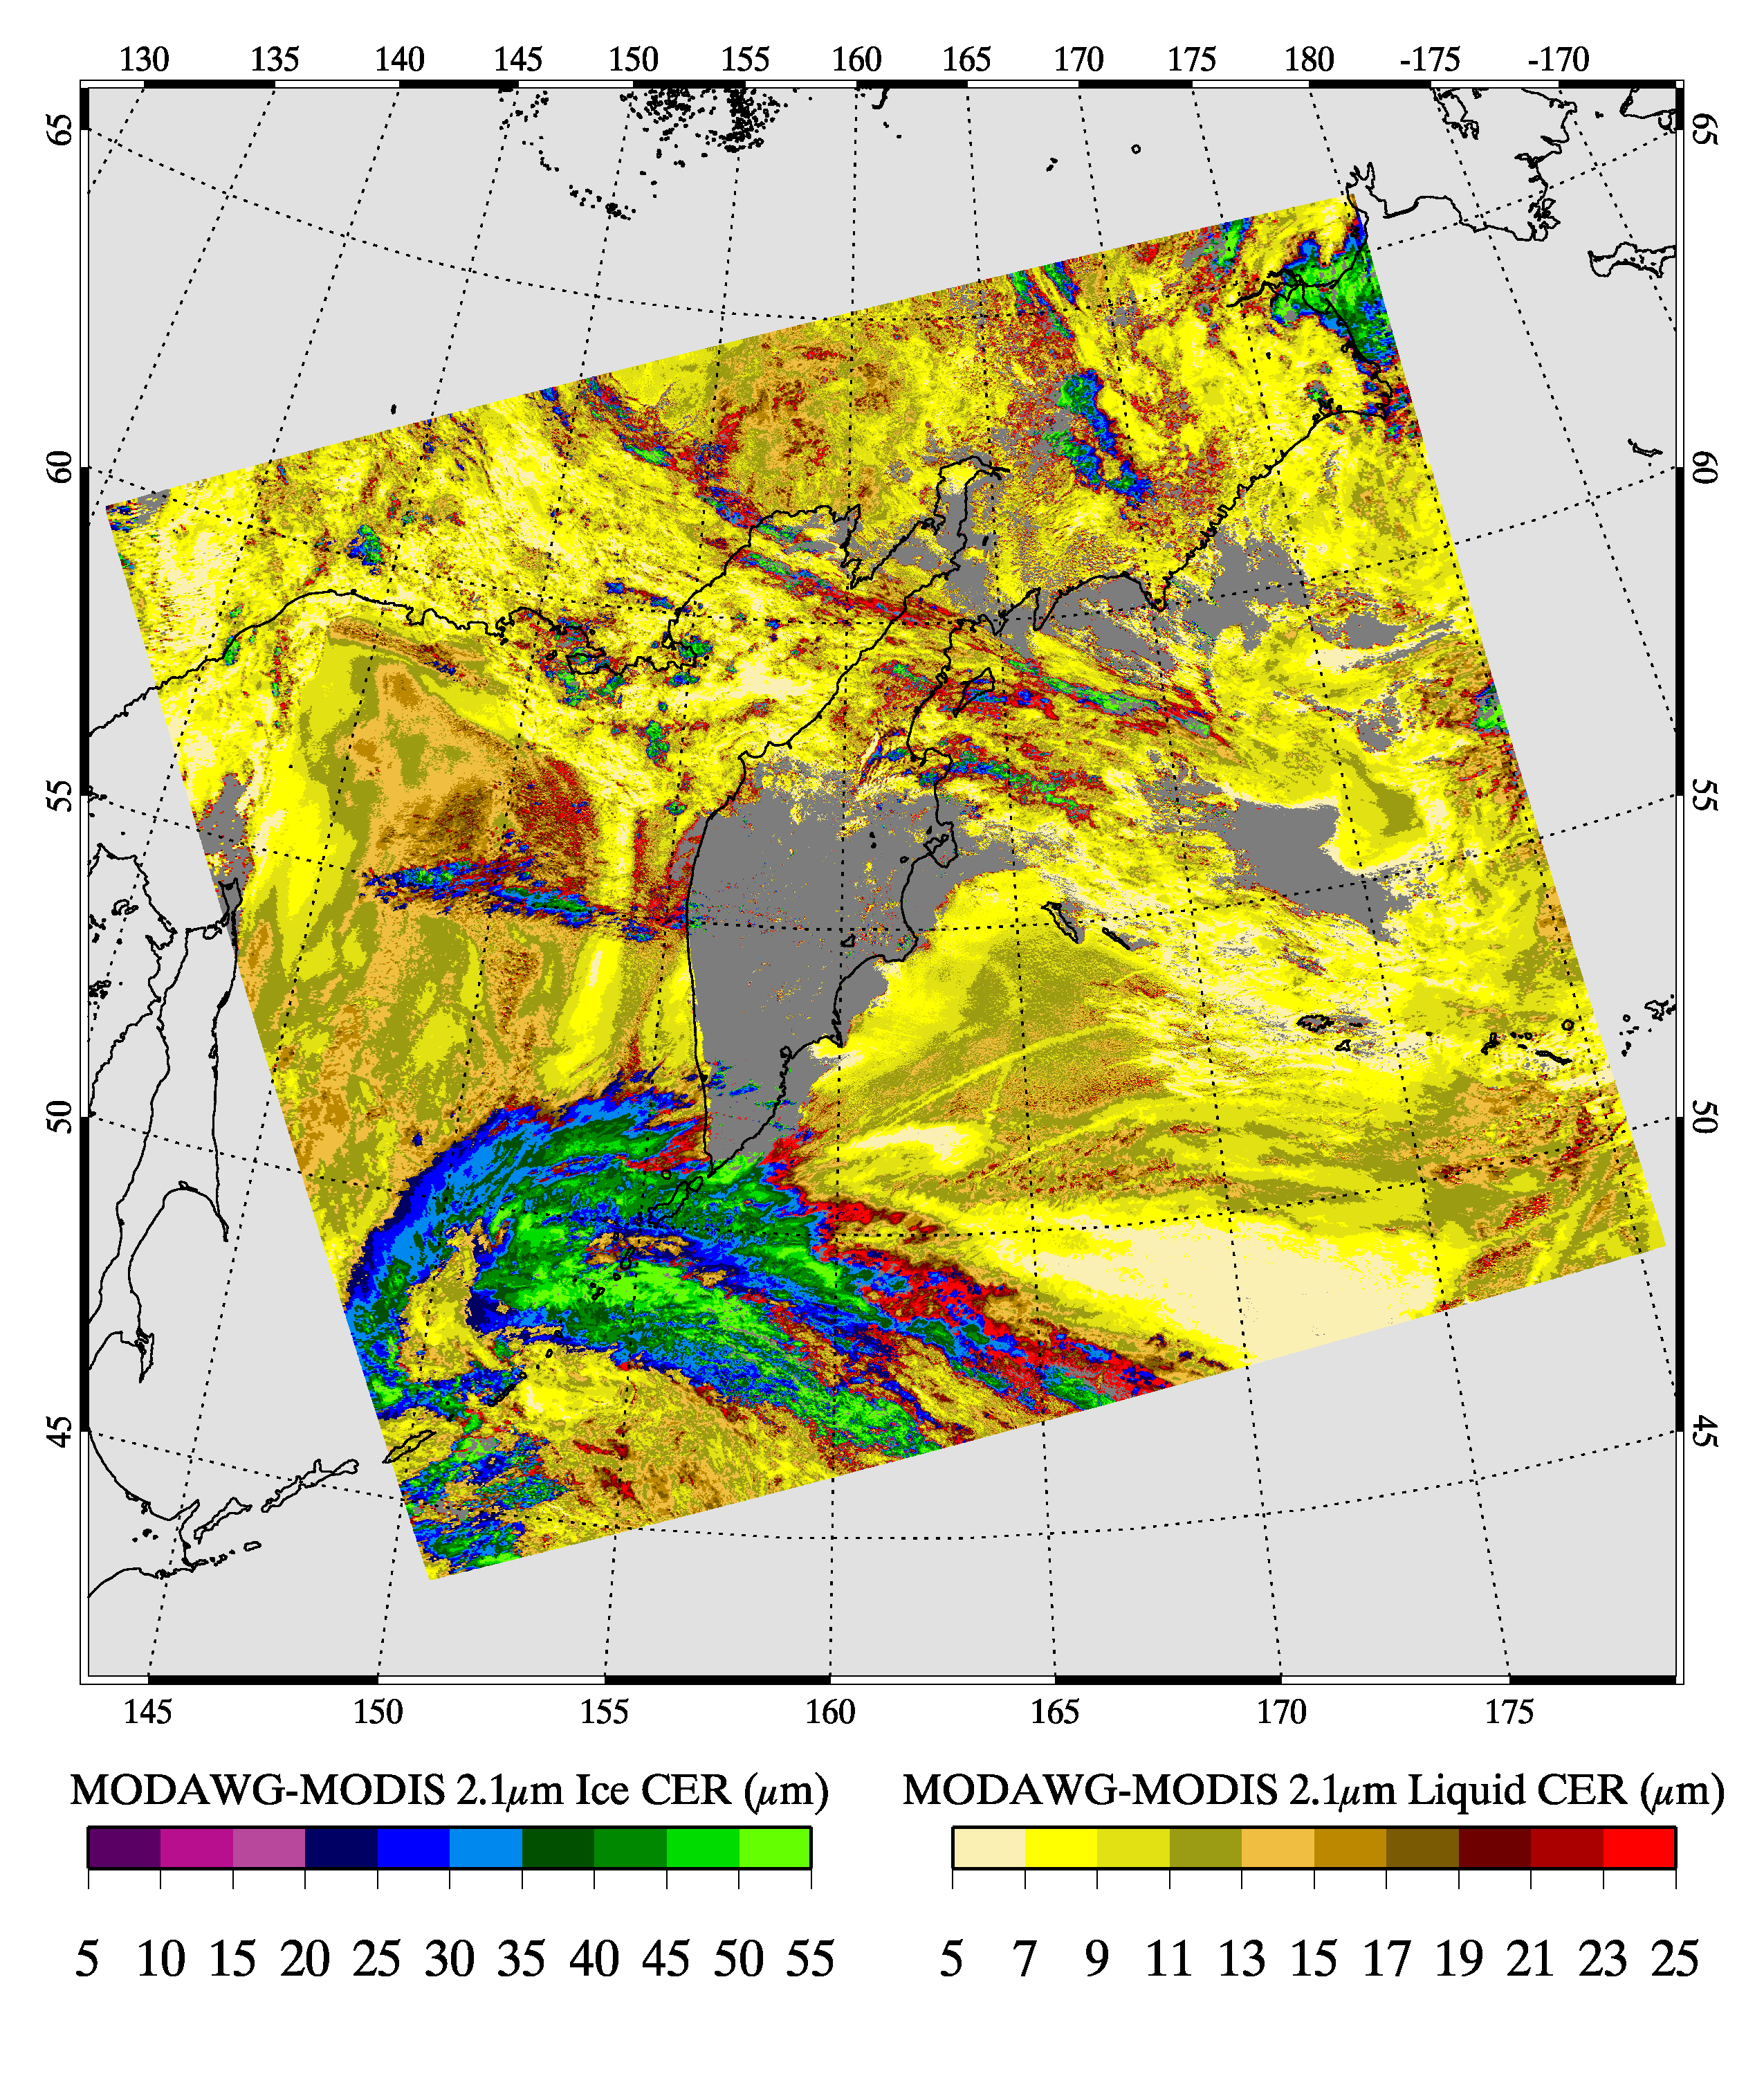
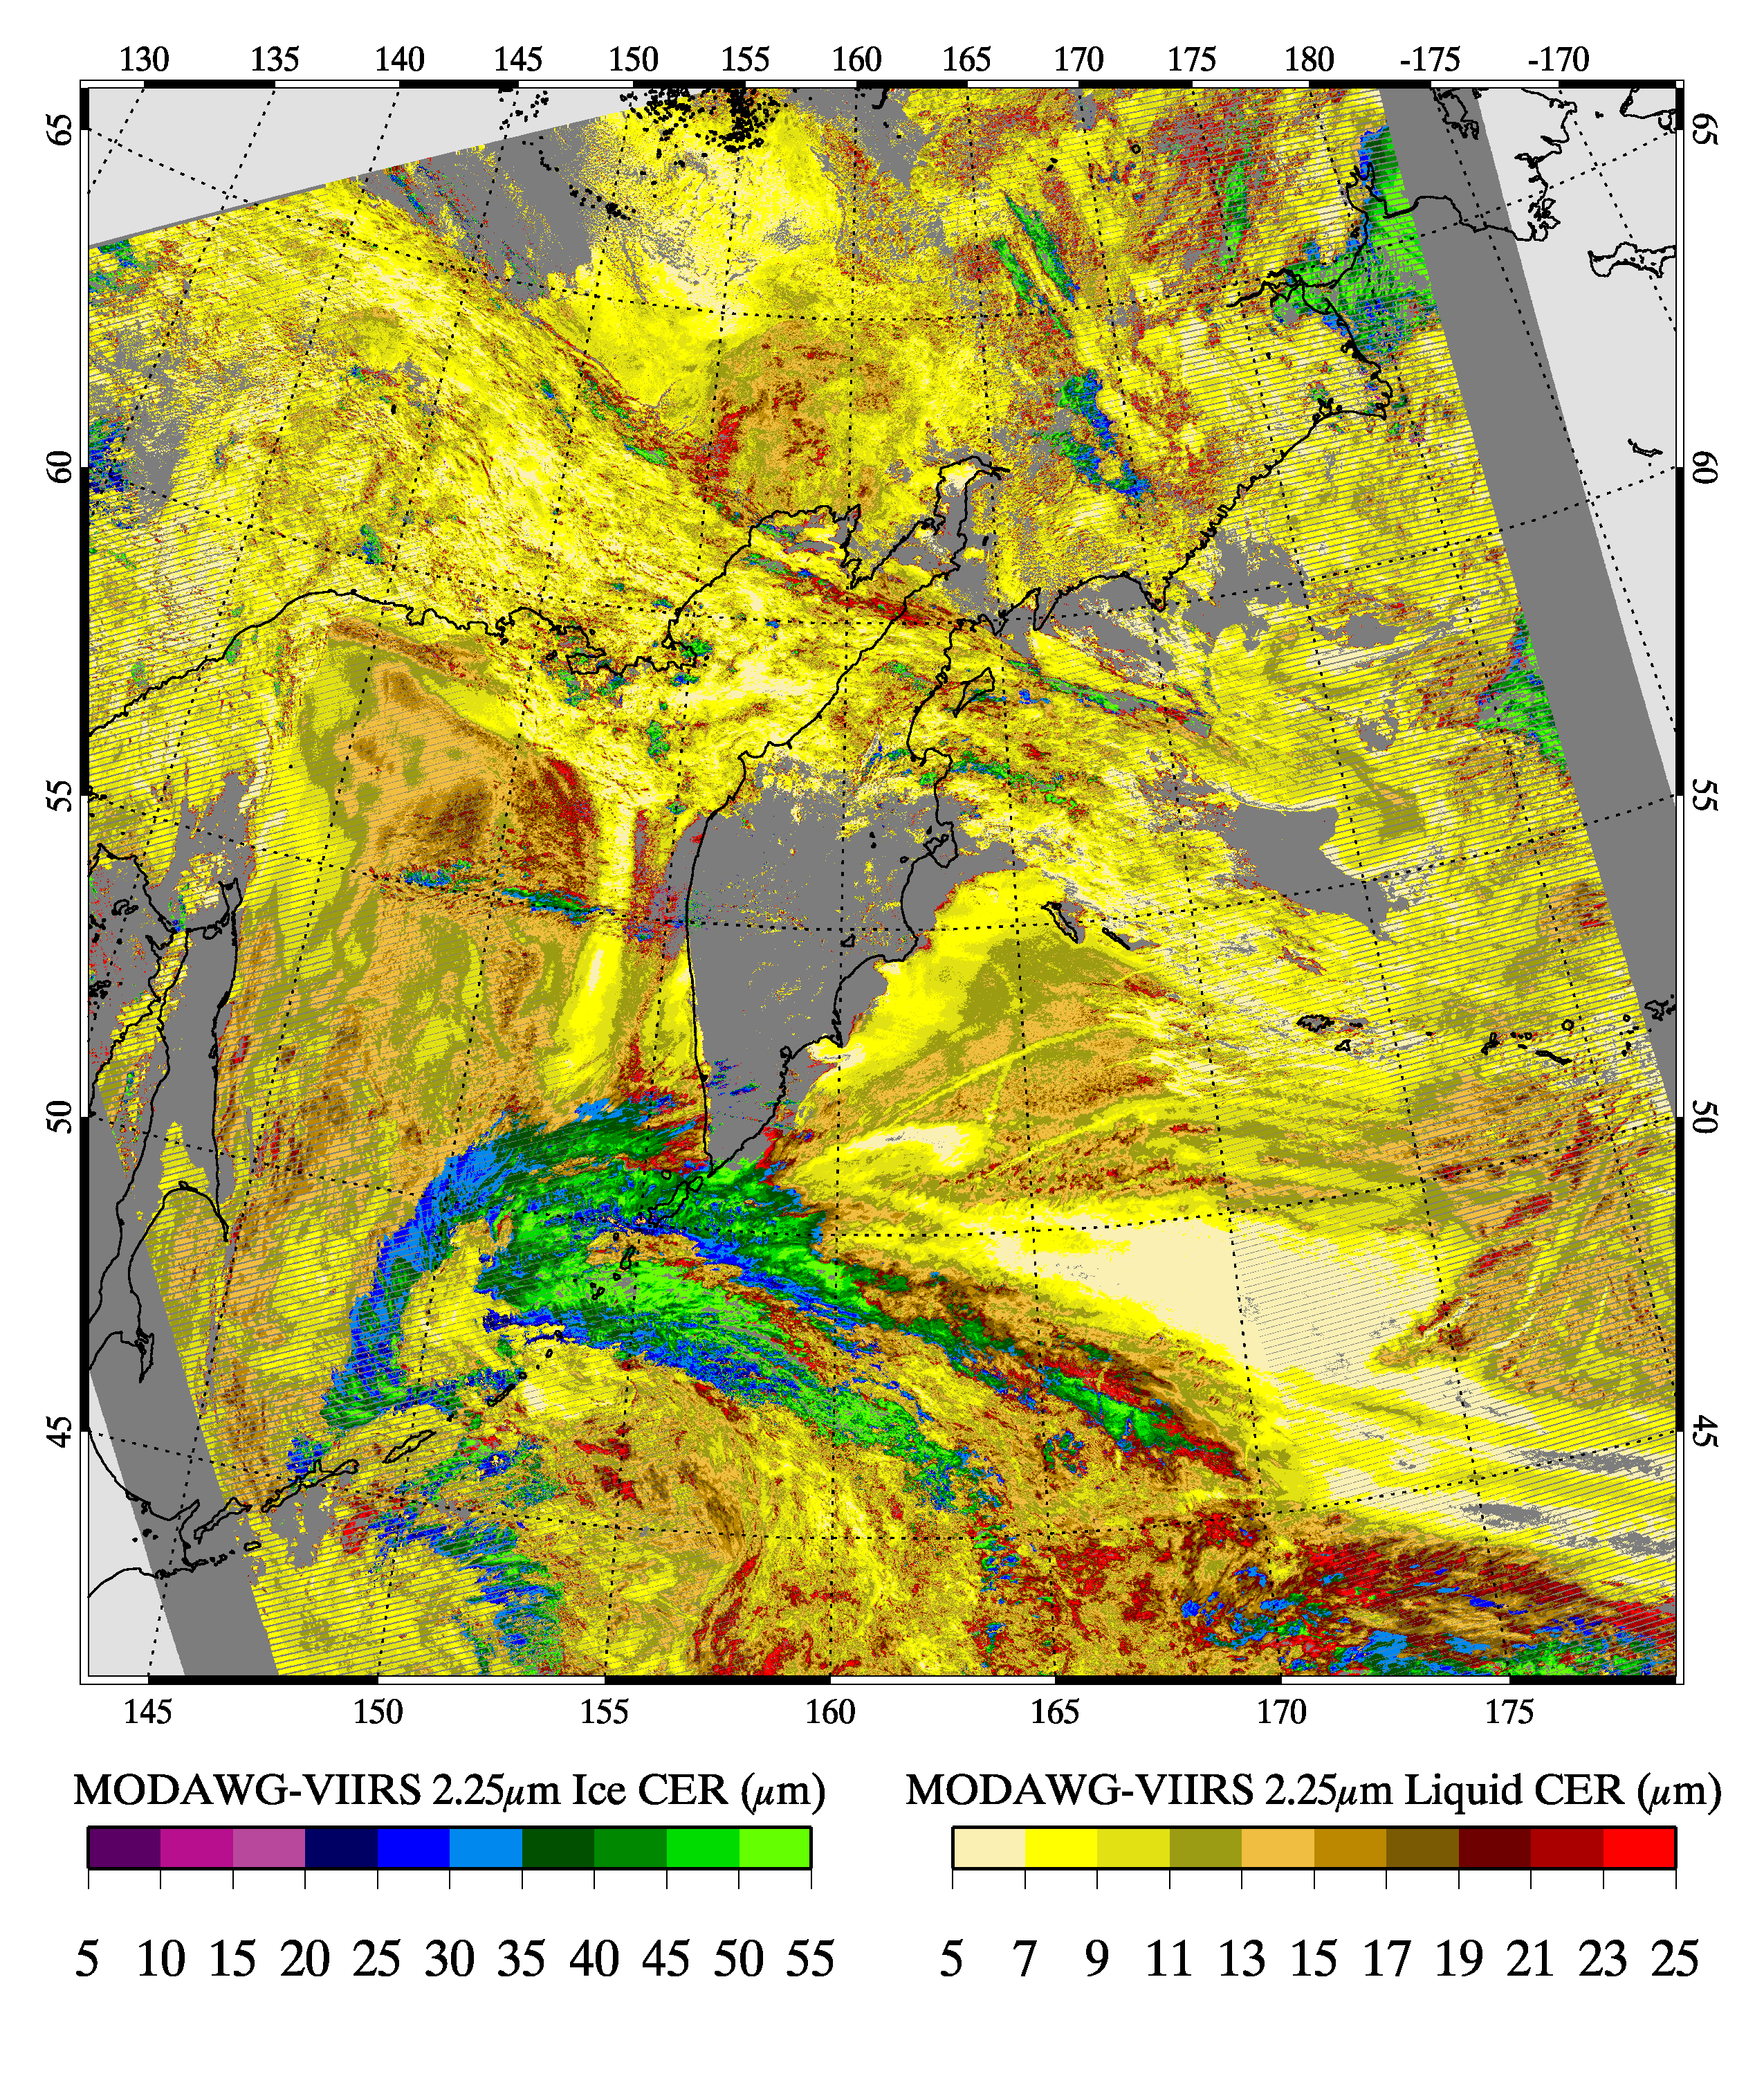
”Golden Granule” 6 July 2014
CPC, 21 March 2017, Meyer et al
MODAWG MODIS
MODAWG VIIRS
Roughly simultaneous nadir overpass
MODIS granule 0200 UTC
VIIRS granules 0154, 0200 UTC
COT
COT
265K Liquid Phase LUTs
CER
(λ=2.13µm)
CER
(λ=2.25µm)

Slide 12
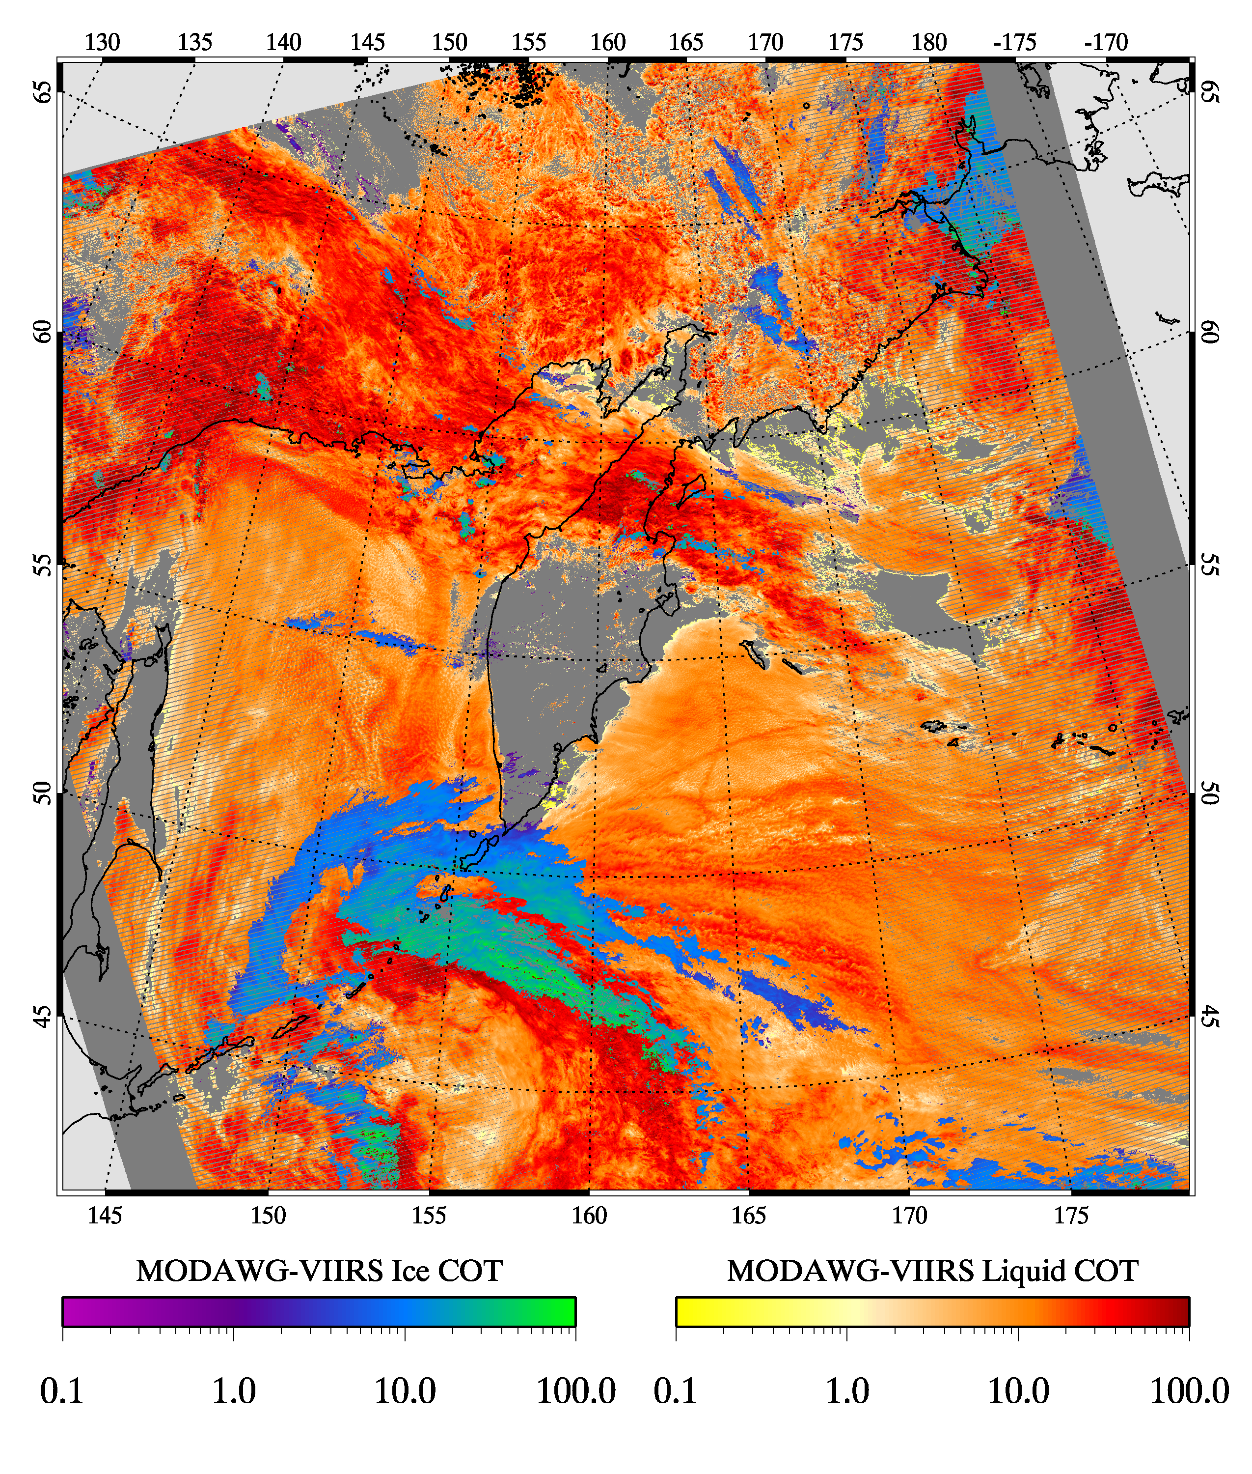
”Golden Granule” 6 July 2014
CPC, 21 March 2017, Meyer et al
MODAWG MODIS
MODAWG VIIRS
Roughly simultaneous nadir overpass
MODIS granule 0200 UTC
VIIRS granules 0154, 0200 UTC
COT
COT
265K Liquid Phase LUTs
w/VIIRS Radiometric Bias Correction
CER
(λ=2.13µm)
CER
(λ=2.25µm)
CPC, 21 March 2017, Meyer et al

Slide 13
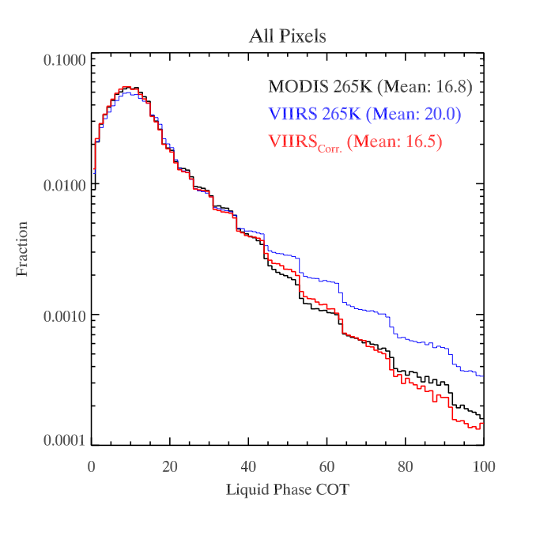
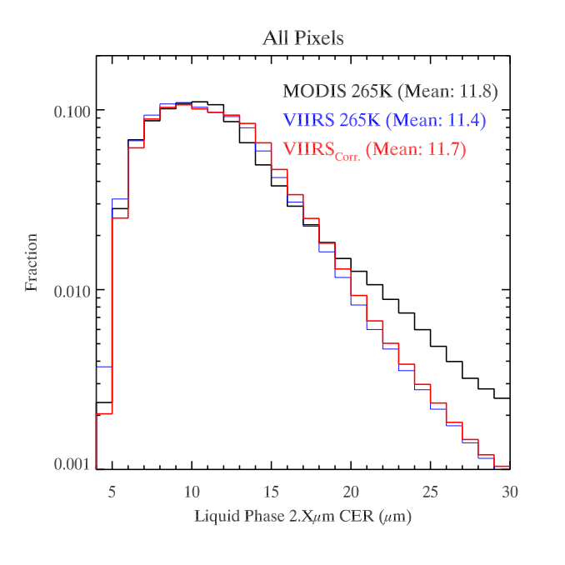
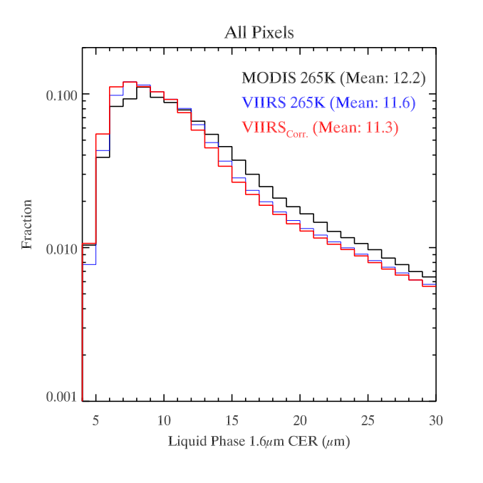
“Golden Granule” case study: Liquid water COT, CER retrieval sensitivity to VIIRS radiometric biases
CPC, 21 March 2017, Meyer et al
COT
CER (2.Xµm)
CER (1.6µm)

Slide 14
Cross-calibration of S-NPP VIIRS moderate resolution reflective
solar against bands MODIS Aqua over dark water scenes
(In Review Atmospheric Measurement Techniques)
A. M. Sayer, N. C. Hsu , C. Bettenhausen, R. E. Holz, J. Lee, G. Quinn, and P. Veglio
NASA Goddard Space Flight Center, Greenbelt, MD, USA
Goddard Earth Sciences Technology And Research (GESTAR), Universities Space Research Association (USRA),
Columbia, MD, USA
Adnet Systems, Inc, Bethesda, MD, USA
Space Science and Engineering Center, University of Wisconsin, Madison, WI, USA
Earth Systems Science Interdisciplinary Center (ESSIC), University of Maryland, College Park, MD, USA

