Slide 1
PATMOS-x AVHRR Calibration Update
Andrew Heidinger NOAA/NESDIS/STAR
Mike Foster, Denis Botambekov, Andi Walther UW/CIMSS

Slide 2
Updates for 2017
Annual Updates continue for support for GSICS and the NCEI CDR Program.
Channel 3a (1.6μm) now included
METOP-B included
Website is now available for public dissemination
VIIRS being explored as a reference
Overestimation in Channel-2 (0.86 μm) being explored.

Slide 3
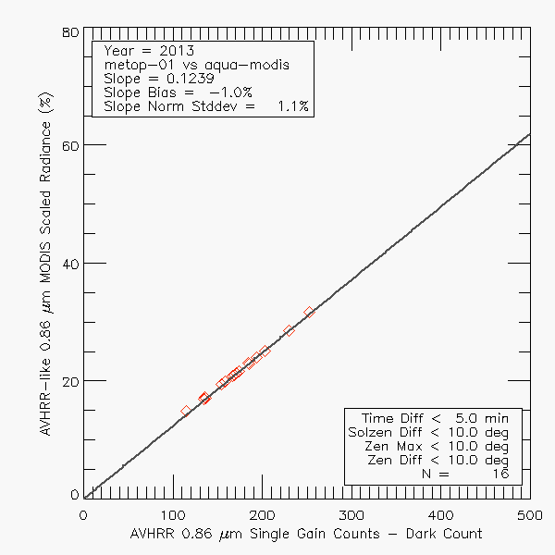
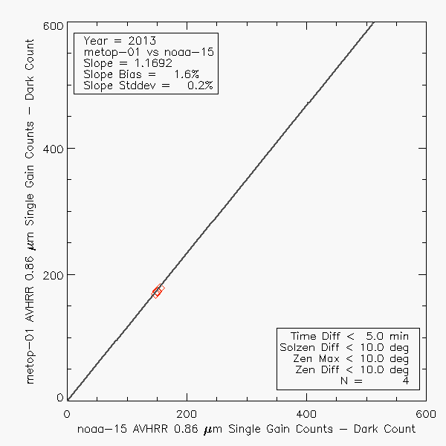
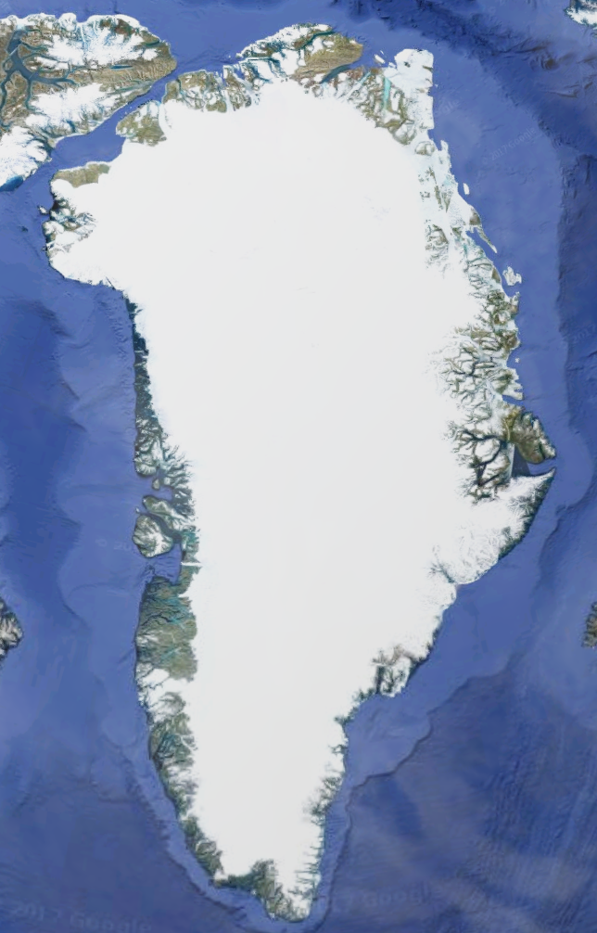
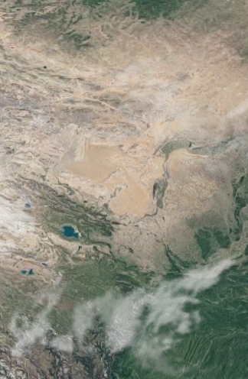
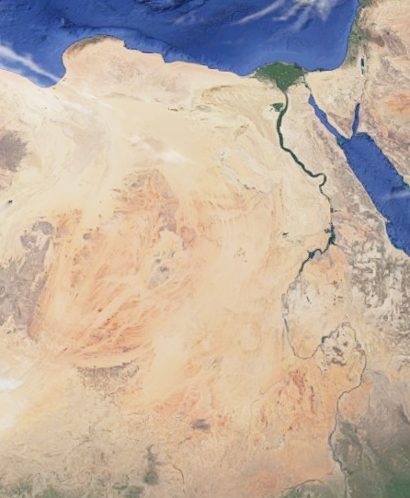
PATMOS-x Solar Calibration Method
1. Arctic SNO observations between MODIS and AVHRR. MODIS 0.94 mm channels used for spectral adjustment
2. Arctic SNO observations between two AVHRRs. Provides constraints on calibration slopes.
3. Comparison to 4 reference sites calibrated by MODIS. NWP TPW and Ozone used for spectral adjustment.
Greenland
Taklimakan
Libya-1
DOME-C
4. AVHRR/AVHRR SNO data can convert one AVHRR’s calibration data to another

Slide 4
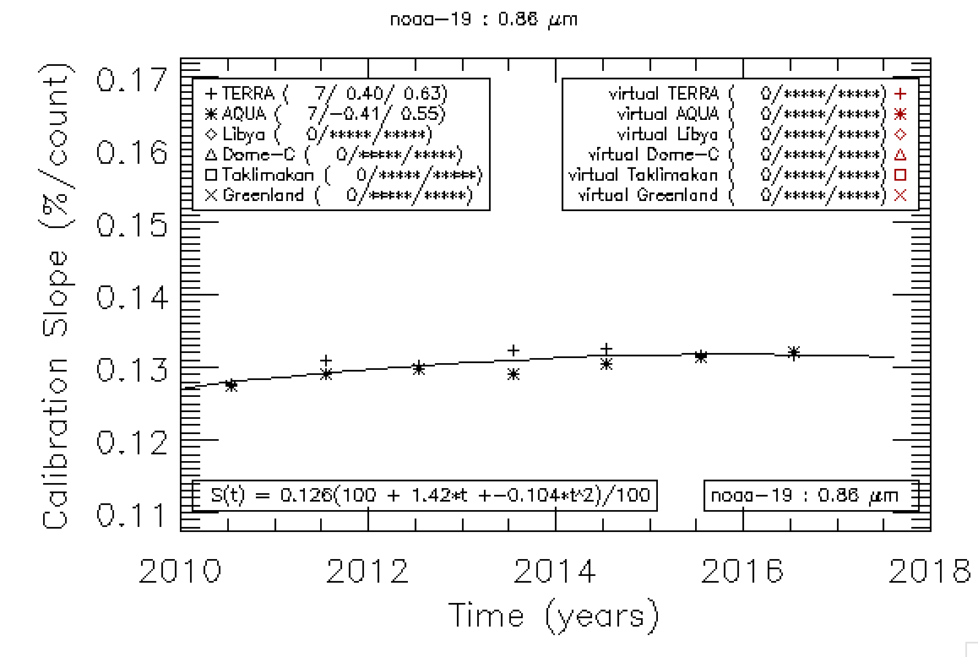
NOAA-19 Ch2 Calibration with Just MODIS SNO

Slide 5
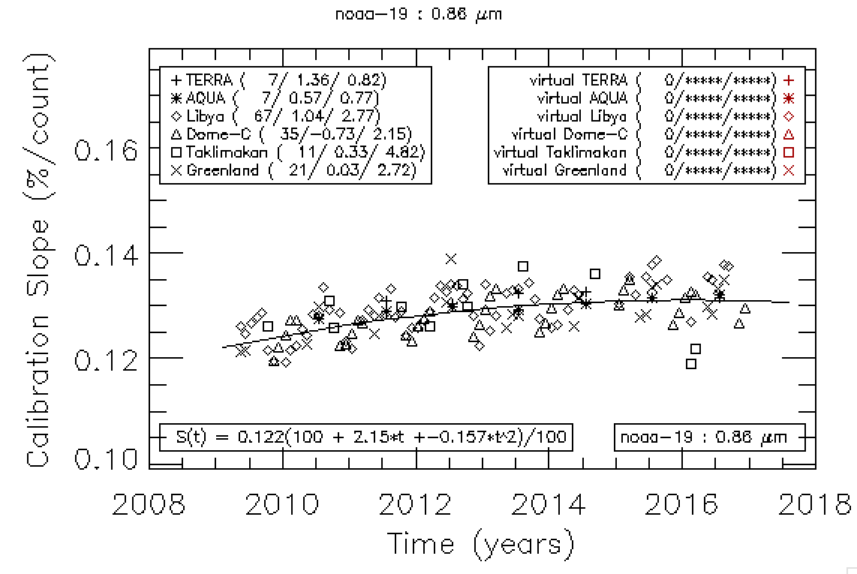
NOAA-19 Ch2 Calibration with MODIS SNO and Reference Sites

Slide 6
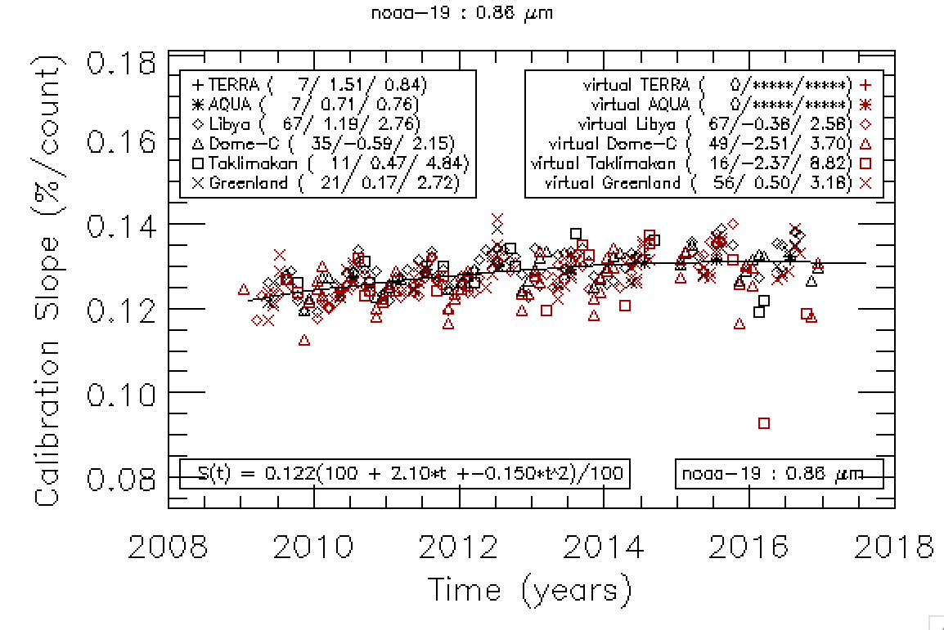
NOAA-19 Ch2 Calibration with all Data Sources

Slide 7
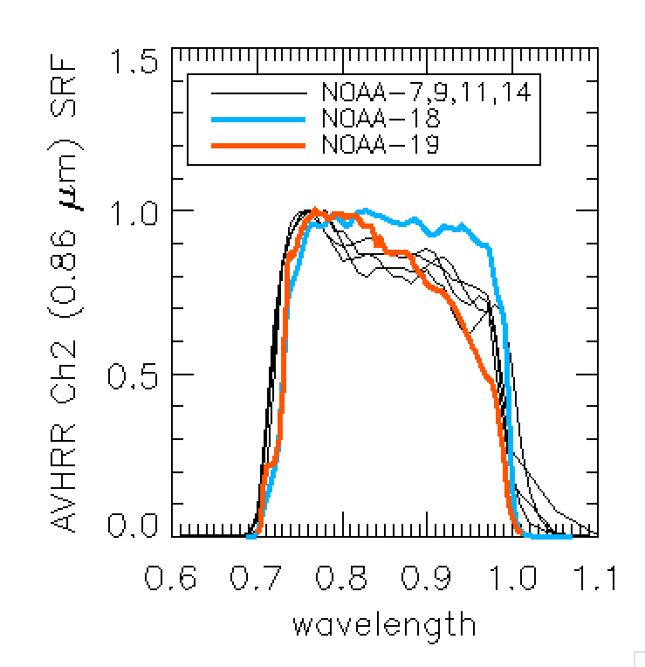
Channel 2 Issues
The AVHRR Ch2 SRF (right) encompasses the 0.94 μm water vapor band the O₂ A-band.
The MODIS and VIIRS analogous channels are narrower and avoid these absorption bands.
A spectral adjustment is necessary to use MODIS and VIIRS as a reference to calibration AVHRR.
In 2010, we developed a method to use MODTRAN fits based on the MODIS Ch17 and Ch18 which occur in the 0.94 μm water-vapor band for the MODIS/AVHRR SNO adjustments.
For non-SNO data, we use NWP and MODTRAN fits based on TPW.
The adjustments are big (20%).
Evidence (based on the LaRC SBAF site) indicates our Ch2 calibration is 2% too high.
Variations in the AVHRR Ch2 SRF (image on right) complicates the correction and demands use of RTMs and NWP.

Slide 8
Including VIIRS as a Reference Instrument for PATMOS-x AVHRR Calibration

Slide 9
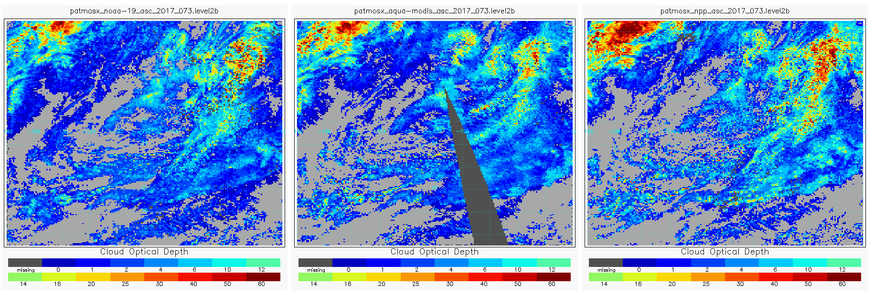
Comparison to VIIRS using Cloud Optical Depth
Day 73, Year 2017
To compare our PATMOS-x AVHRR calibration to VIIRS, we compare cloud optical depth computed from the NOAA Enterprise Cloud Algorithms over 20x20 degree box off of California.
Optical depth retrieval handles angular and spectral adjustments
Only the 0.65 μm reflectance is used.
NOAA-19/AVHRR
AQUA/MODIS
SNPP/VIIRS
False Color RGB
Cloud Optical Depth

Slide 10
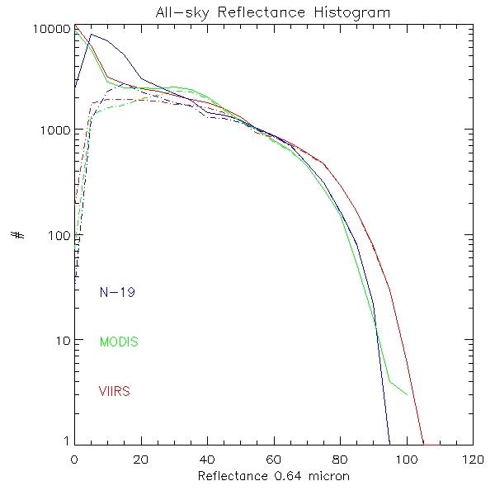
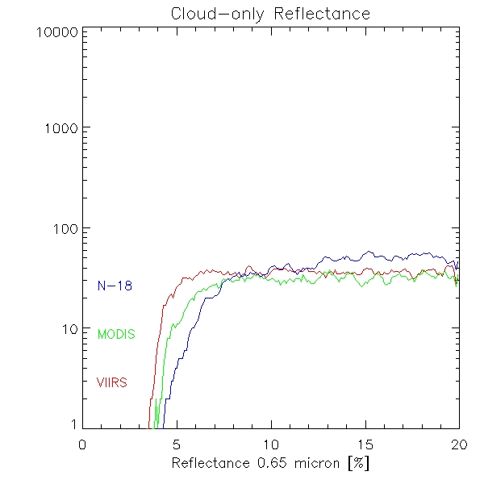
Calibration impact on Cloud Products
Calibration differences in visible channels have an impact on cloud products, particular on cloud mask and cloud optical properties
Top image shows frequency of occurrence of visible reflectance for VIIRS/NPP, MODIS-AQUA and AVHRR/N-19 for all sky ( solid lines) and cloud-only ( dashed lines)
Bottom image shows histogram for low reflectance with finer bin-size
VIIRS/NPP shows more extreme values (more bright and more very low) reflectance values.
Comparison of averaged reflectance values may be in sync with MODIS and AVHRR, but different extreme values impact cloud mask and COD differently.
Notes:
This shows our issue with MODIS and VIIRS. VIIRS has more low reflectance and bright reflectance. My theory was that finer resolution necessarily leads to more extreme values due to non-existing smoothing to MODIS resolution. You can mention this.. To summarize these images show how calibration differs

Slide 11
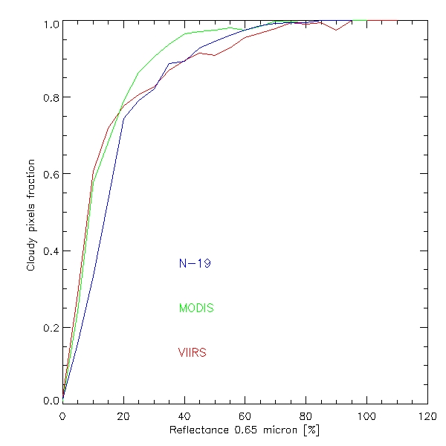
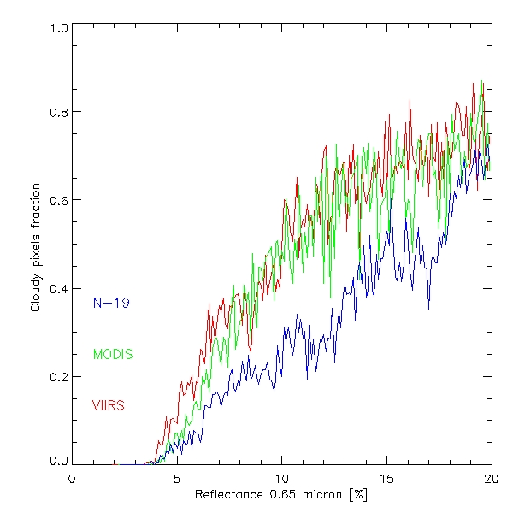
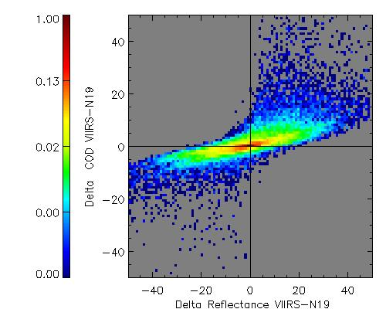
Calibration impact on Cloud Optical Thickness
Cloud mask retrieval usually include coefficients pre-computed by learning methods applying comparison of measurements to truth data.
Calibration differences are in this way considered in these retrieval coefficients.
Impact is assumed as low.
Calibration has a greater non-linear impact on Cloud Optical Thickness results. Small differences in bright cloud reflectance lead to big differences in COD.
Image illustrates quantitative impact of reflectance differences between VIIRS/NPP and AVHRR/N19
Notes:
Last slide shows that there are differences. Cloud mask is okay, because we train with different calibration and the retrieval adjust the differences. Images show cloud fraction as a function of visible reflectance. There are only small differences.
But COD has a bigger impact. For some constellations a reflectance difference of 3 percent lead to an error in COD of 10. The colors are logarithmic.
Ther may be better images..

Slide 12
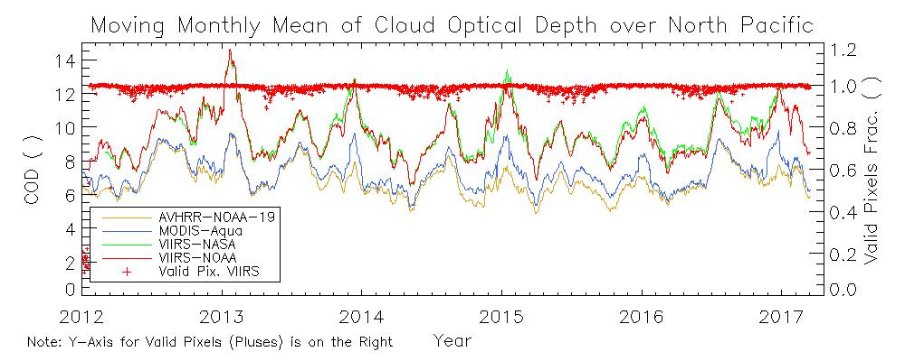
Comparison to VIIRS using Cloud Optical Depth
NASA and NOAA VIIRS Calibrations seem similar
Both are about 4% higher than MODIS
AVHRR follows MODIS since we are tied to the MODIS Calibration.
These differences prevent us from using VIIRS as a reference.
Notes:
This shows that the additional bright pixels have a bigger impact on averaged COD than the more extreme low reflectance values. Non-linear impact on COD from differences in reflectance.

Slide 13
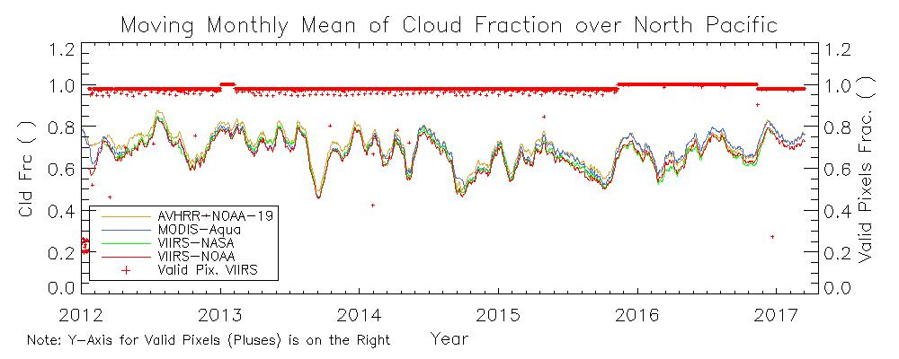
Comparison to VIIRS using Cloud Fraction
Time series of North Pacific Cloud fraction shows good agreement
Notes:
This image proves that cloud mask is okay even calibration is a bit different.

Slide 14
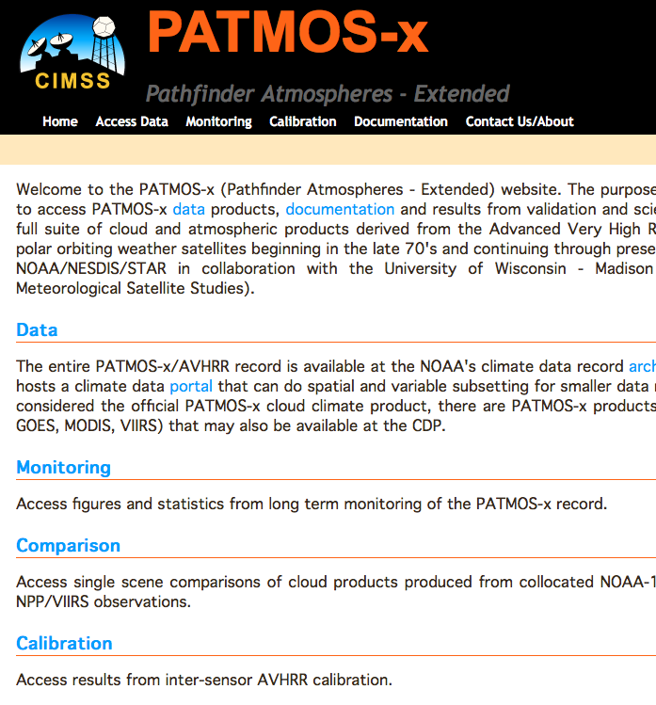
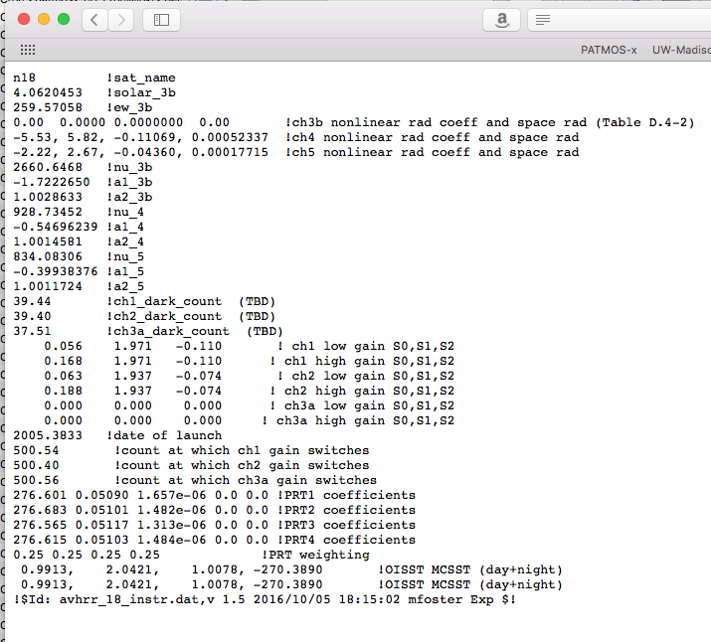
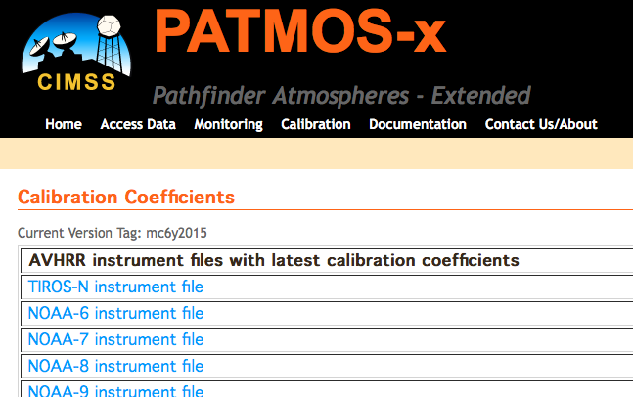
Access the latest AVHRR calibration coefficients at https://cimss.ssec.wisc.edu/patmosx/avhrr_cal.html

Slide 15
Conclusions
PATMOS-x AVHRR Solar Reflectance Calibration is continually being updated annually to support the NCEI PATMOS-x AVHRR Climate Data Records and GSICS.
We have expanded to the 1.6 μm channel and to METOP-B and plan for METOP-C.
We continue work with our EUMETSAT and ESA colleagues and users.
The potential 0.86 μm overestimation is a concern.
We need a better VIIRS 0.65 and 0.86 μm calibration. Our findings indicate VIIRS is 4-6% too high. These findings are confirmed by the NASA NPP Cloud Team.

