Slide 1
NOAA Agency Report 2017
Xiangqian Wu
NOAA

Slide 2
Presentation Overview
Agency’s GSICS Activities, Action & Achievements Summary
Agency’s support to GDWG Activities
Agency’s Instruments Updates & Planned launches – relevant to GSICS if any
Introduce/Confirm the Agency’s Personnel supporting GSICS
Agency’s GSICS activities to be discussed in this joint meeting.

Slide 3
Agency’s GSICS Activities, Actions & Achievements Summary
GRWG and Subgroup activities.
Ultraviolet, visible, infrared, and microwave: See respective reports.
Bi-lateral Cooperation:
With JMA through teleconference, side meeting, and visiting scientist.
With KMA through side meeting and NESDIS-KMA JWG-5
GSICS became part of the activities.
Discussed cooperation on MI & AMI
With EUMETSAT through IJPS-METOP and GOESR-MTG
METOP-C launch
GOESR – MTG cooperation, including GLM-LI and ABI-FCI
With CMA through visiting researchers.
Participated in RadCalNet
ABI pre-launch and post-launch activities.
Notes:
A maximum of 2 slides providing an overview of:
Current GSICS Activities
Agency’s Actions Statuses
Agency’s achievements

Slide 4
Agency’s GSICS Activities, Actions & Achievements Summary
GIR.2016.3n.1 – Fred to report at next meeting on cooperation with KMA on blackbody calibration correction.
Due: June 2017.
Status: On-going (delayed). Update in March 2017 (this meeting).
GWRG_14.25 – EUMETSAT/NOAA/NASA/JMA to perform analysis to evaluate the optimal temporal resolution for a DCC product. GPRCs are invited to report at the next web-meeting on the DCC method.
Due: 01 May 2015.
Status: On-going (delayed). Update in fall 2017 (ref. F. Yu & H. Yoo).
GRWG_15.12 – NOAA to report on plans to incorporate GOES-R/ABI in ICVS.
Due: 29 Feb 2016.
Status: On-going. Pending authorization for release. Can update after June 2017.
Notes:
A maximum of 2 slides providing an overview of:
Current GSICS Activities
Agency’s Actions Statuses
Agency’s achievements

Slide 5
Agency’s GSICS Activities, Actions & Achievements Summary
GRWG_15.13 – NOAA to provide their GEO-LEO IR algorithm code to IMD.
Due: 29 Feb 2016.
Status: Clarification. We have either delivered or the action now should fall on GCC.
GRWG_15.39 – NOAA to update the product user guide for GOES-IASI products to inform about the range of diurnal applicability.
Due: 29 Feb 2016.
Status: Request to close with the following statement: “Calibration of the infrared channels of the Imager instrument on GOES 8-15, MTSAT-2, and the Meteorological Imager on COMS may be unstable two hours before and four hours after the satellite midnight. This does not affect inter-calibration with IASI but may affect inter-calibration with AIRS and CrIS at night. The Midnight Blackbody Calibration Correction (ref.), implemented for all instruments after November 2003, alleviated the problem. Completion of GIR.2016.3N.1 may further improve the IR calibration for these instruments at satellite midnight.”
GRWG_15.55 – NOAA to investigate inter-channel calibration with IASI.
Due: 29 Feb 2016.
Status: Request to suspend. The scientist proposed this action has left.
Notes:
A maximum of 2 slides providing an overview of:
Current GSICS Activities
Agency’s Actions Statuses
Agency’s achievements

Slide 6
Support to GDWG Activities
NOAA supported GDWG in the following tasks:
Closed all seven actions.
Migrated the GSICS Wiki page to UMD.
Developed GSICS Action Tracker.
Maintained GSICS thredds server and GSICS Product Catalogue.
Meta data standard for Reference Record (5g & 5h)
Resources and time taken for this support.
Manik Bali and Jordan Yao
Issues:
NOAA security:
migrate the wiki.
Action tracker.
Need resources and plan to setup up instrument landing pages.
Jordan Yao will no longer be available.

Slide 7
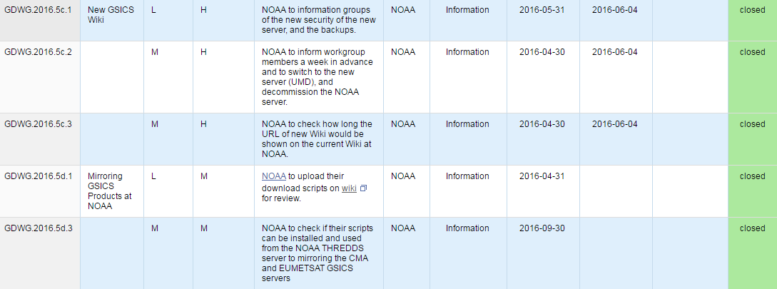
Support to GDWG Activities

Slide 8
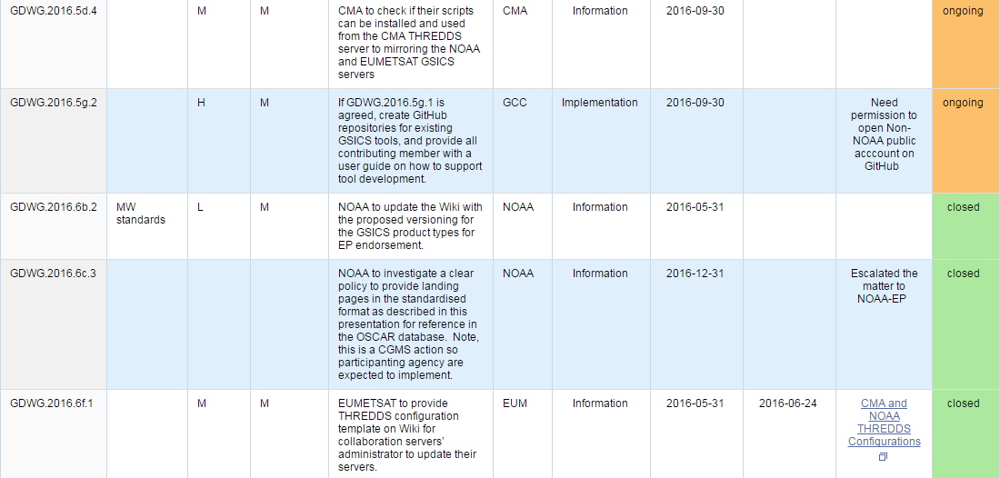
Support to GDWG Activities

Slide 9
Agency’s Instruments Updates & Planned launches
POES-PM
NOAA-19 is primary (S-NPP is also used primary).
NOAA-15/18 are backup. Have functioning instruments but on terminator orbits.
JPSS-1 will be launched in September 2017 (TBR).
POES-AM
METOP-B is primary.
METOP-A is healthy and active backup.
METOP-C will be launched in November 2017 (TBR).
GOES
GOES-13/15 are primary as GOES-EAST/WEST (75°W & 135°W)
May discuss technical issues, pending interest and authorization.
GOES-14 is on-orbit backup.
GOES-16 is being checked out at 89.5°W.
Notes:
A maximum of 1 slide summarising:
Summary of current and/or future instruments that is/are of interest to GSICS activities.
Introduction of new satellites/programmes than may be of interest to GSICS for side and/or future discussion with the partners.

Slide 10
Introduce/Confirm the Agency’s Personnel supporting GSICS
Executive Panel (EP):
Mitch Goldberg
GSICS Coordination Center (GCC):
Larry Flynn (Director) and Manik Bali (Deputy Director)
GSICS Data Management Working Group (GDWG):
Manik Bali (Jordan Yao is no longer supporting GDWG).
GSICS Processing and Research Center (GPRC):
Xiangqian (Fred) Wu
GSICS Research Working Group (GRWG):
Changyong Cao, Jason Choi, Ralph Ferraro, Larry Flynn, Andy Heidinger, Xingming Liang, Jeff Privette, Tony Reale, Dave Tobin (UW), Likun Wang, Xiangqian Wu, Fangfang Yu, Cheng-Zhi Zou, Members of GOES-R CWG.
Notes:
A maximum of 1 slide summarising:
GRWG members, summarise their expertise for support GSICS.
GDWG members, summarise their expertise for support GSICS.
Provide key agency personnel support GSICS activities in your organisation.

Slide 11
Agency’s GSICS activities to be discussed in this joint meeting.
Agenda items that are especially of interest to your agency.
Disclaimer – cannot speak for agency.
Others can speak for themselves. For me:
GSICS (Agencies and GSICS Organizations Reports).
CLARREO.
Limited interests to other topics at this crunch time for GOES-16.
Activities that may be of interest to the GSICS community.
FY-4 instrumentation, characteristics, and performance.
GSICS to complement bi-lateral cooperation.
Consider shifting technical topics to web meetings and allocate more annual meeting time for overview or review of relevant events:
In various agencies and GSICS bodies (EP/GCC/GRWG/GDWG);
At sister organizations such as CEOS, CGMS, WMO, etc.;
About programs such as MTG, CLARREO, FY-4 etc.;
For users such as FIDUCEO, GURAN etc.;
And tour the host, networking, side meetings, etc.
Notes:
A maximum of 1 slide summarising:
Summarise the GSICS agenda items in this joint meeting that are especially of interest to your agency.
Identify any agency’s activities that are not directly relevant to GSICS but may be of interest to the GSICS community.

Slide 12
Thank you for your attention
WMO GSICS Portal
http://gsics.wmo.int
GSICS Coordination Centre http://www.star.nesdis.noaa.gov/smcd/GCC/index.php
GSICS Product Catalog https://www.star.nesdis.noaa.gov/smcd/GCC/ProductCatalog.php
GSICS Wiki
http://gsics.atmos.umd.edu/wiki/Home

