Slide 1
EUMETSAT Agency Report 2017
Tim Hewison, Peter Miu, Rose Munro, Sebastien Wagner, Rob Roebeling, Igor Tomazic, …
EUMETSAT

Slide 2
Presentation Overview
Agency’s GSICS Activities, Action & Achievements Summary
Agency’s support to GDWG Activities
Agency’s support to GRWG Activities
Agency’s Instruments Updates & Planned launches – relevant to GSICS
Introduce/Confirm the Agency’s Personnel supporting GSICS
Agency’s GSICS activities to be discussed in this joint meeting.

Slide 3
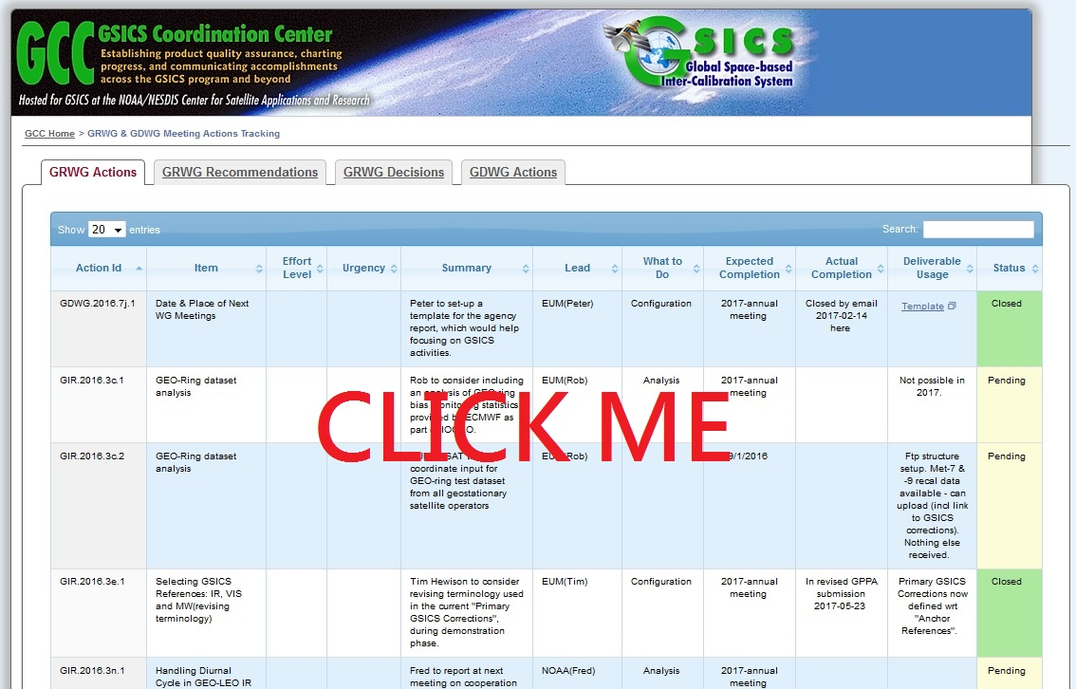
Update on EUMETSAT Actions from 2016 GRWG Meeting
Show entries
Search:

Slide 4
Other EUMETSAT GSICS Achievements during 2016
GSICS IR:
GEO-LEO IR products for SEVIRI-IASI in Operational Mode
Prime GSICS Correction officially entered Demonstration Mode
But will not develop further without feedback – or support from other GSICS partners / users
GSICS VNIR:
EUMETSAT GSICS VNIR products in demo phase (➔ See # 8l) for :
Meteosat-10 since March 2016
Meteosat-8 (IODC) since September 2016
Lunar calibration: GIRO updated to be license compliant + tested against ROLO
Development of an inter-calibration scheme using the Moon, in collaboration with JMA ➔ See # 8f

Slide 5
EUMETSAT GSICS Products
Monitored Instrument | Product Type / Band | Reference Instrument | GSICS NRT Correction | GSICS Re-Analysis Correction | GSICS Bias Monitoring
Meteosat-8-11 SEVIRI | GEO-LEO IR | Metop-A/IASI Metop-B/IASI | Operational | Operational | Plots RAC
Meteosat-7 MVIRI | GEO-LEO IR | Metop-A/IASI Metop-B/IASI | Demo | Demo | Plots RAC
Meteosat-8-11 SEVIRI | GEO-LEO IR Prime | IR Anchor |  | Demo | Plots RAC Need to plot Double Diffs
Meteosat-8/10 SEVIRI | GEO-LEO VIS | Aqua/MODIS | Demo | Demo | Need to plot RAC
Meteosat-8/10 SEVIRI | GEO-LEO VIS/NIR | Aqua/MODIS SNPP/VIIRS | In development | In development

Slide 6
Support to GDWG Activities
Collaboration Servers closer to realisation
For all collaboration servers, EUMETSAT has developed a tool to automate the generation of the configuration scripts and files to create GSICS product directories and configure THREDDS to detect and serve these products to the user community.
Support to the serving of KMA GEOLEOIR products from the EUMETSAT GSICS server.
Provided input to the distribution of the GIRO and GLOD to users.
Developing a software framework to simplify the generation of GSICS products; development has stalled due to lack of resources.

Slide 7
Support to GRWG Activities
GSICS VNIR:
Final presentation of the study “Validation of the SBAFs using hyper-spectral measurements”
GIRO implicitly covers SBAF + Consolidated dataset of Lunar Observations with SCIAMACHY .
Processing for the first time of GOME-2 Moon observations (Metop-A and B) ➔ Option K-O : 16.03.2017
Definition of a benchmark for the GIRO to support verification/validation against the ROLO + comparisons with alternative models/other implementations (see # 8i)
Preparation of the 2nd Joint GSICS/IVOS Lunar Calibration Workshop (see # 8h-j)

Slide 8
GSICS exchange format IASI data
Product: IASI GDS Level 1C - all spectral samples – Metop (-A and –B)
Format: netCDF (GSICS exchange format)
With effect from: 19 Jan 2017
Change: Corrected wavenumber definition of IASI spectral channels
Variable: wavenumber – now covers 64500.0 to 276000.0 m^-1
(was 64525.0 to 276025.0 m^-1)
Global attribute: format_version: 1.1 (was 1.0)
Impact: Small impact when convolved with spectral response of narrow sounding channels
For EUMETSAT, only Demo GSICS products are impacted
e.g. bias changes ~0.1K in SEVIRI/IR13.4
Recommendation: Change major version and reprocess products derived from these data
Will be implemented for EUMETSAT Demo GSICS products in summer 2017
Meanwhile, the impact of the change has been reverted in the processing to ensure consistency

Slide 9
EUMETSAT Satellite Updates & Planned launches
Satellite | Orbit | Status
Meteosat-7 | GEO 57°E | End of Life – Summer 2017 – incl Decontamination
Meteosat-8 | GEO 41.5°E | Moved in Summer 2016 – Operational full disc IODC
Meteosat-9 | GEO 9.5°E | RSS service
Meteosat-10 | GEO 0.0°E | Prime 0°E service
Meteosat-11 | GEO 3.4°W | In Orbit Storage
Metop-A | SSLEO 09:30 | End Of Life – Manouevres, Tests...
Metop-B | SSLEO 09:30 | Operational
Metop-C | SSLEO 09:30 | Launch scheduled 2018-10
Jason-2 | NSLEO | Operational
Jason-3 | NSLEO | Launched 2016-01-17 – Operational
Sentinel-3A | SSLEO 10:00 | Launched 2016-02-22
Sentinel-3B | SSLEO 10:00 | Launch „Nov 2017“

Slide 10
Metop-A EOL Test Acceptance Criteria
 | RISK_{ext} | COST
VERY HIGH (5) | Operations could affect EOL ops. Operation can pose a threat to spacecraft safety. | Complex Operation. Specific Orbital Constraints/ Requirements.
HIGH (4) | Operations can result in or contribute to a very serious mission capability loss. Operations can pose constraints on EOL operations. Risk of RRM and therefore extended de-orbiting time. | Instrument SW Patch to be developed. Ad-hoc tools required on ground. New ground processing methods/SW to be developed.
MEDIUM (3) | Operations can affect other instruments/ subsystems not related to the test. Potential PLSOL events. | As low, except operations are beyond the scope of what has been performed already in Routine, SIOV, Commissioning.
LOW (2) | Operations not done before or not nominal. Risk of EQSOL. | New procedures/ Datastore to be developed. More complex operation to be run via SOI. Within scope of Operations already performed during Routine, SIOV and Commissioning.
VERY LOW (1) | Not further risk than appropriate scheduling of the test into the timeline. | Operations can be done with the current FCP baseline. Short commanding operation.
How do we chose to accept/reject a test?
46 tests have been proposed by different parties.
Assign values to each test feature: cost (C), risk (R) and benefit (B).
The Acceptance criteria considers mainly the External Risk (on the system). The Internal instrument risks will mainly drive the position of the test in the test timeline.
IF:
R_{ext} = 1,2 & C = 1,2 → accepted
R_{ext} || C = 3 → assessed informally
R_{ext} = 4 || C = 4,5 → official review board
R_{ext} = 5 → rejected
R_{int} = 4,5 → official review board
B = 4,5 → test seriously considered
Expected OUTAGE duration will be used as well in the criteria.

Slide 11
Way forward – Metop-A EOL Tech Test Design & Planning
Activities for the EOL Tech tests:
Collecting all Test inputs from internal/external entities
Planning stage
Assessment of the inputs provided and selection of the first test baseline, based on:
Test feasibility;
Internal and external risks;
Test costs;
Produced benefits.
Early Test Specification Identification:
Test needs and requirements definition;
Constraints and inter-dependencies
Test timeline
Identify required operations
External parties & Instrument experts inputs and review
Pitch-Over manoeuvre detailed assessment
First draft of test Baseline and Timeline generation
Pitch-Over manoeuvre and other Tests Approval review boards
Baseline and Timeline finalization
Detailed planning stage
Test Specification Preparation:
Detailed Individual Test Specification
Overall schedule
Operational needs & required resources analysis
Procedures & other deliverables development and review
Test Validation for readiness
Final TRR for a compliant test packet
Execution stage
Test Execution
Analysis & Reporting stage
Test Execution Report
Q2 2017

Slide 12
Personnel supporting GSICS
Executive Panel
Ken Holmlund | EUMETSAT representative
Data Working Group
Peter Miu | Co-chair + Data management expert
Simon Elliott | Formats Expert
Research Working Group
Tim Hewison | Vice-chair GRWG + chair IR sub-group
Sebastien Wagner | VIS/NIR + Lunar calibration
Rob Roebeling | Climate records + SCOPE-CM + Event logging
Rosemary Munro | Chair UV sub-group
Joerg Ackermann | Microwave
Supported by
Viju John | Infrared (Meteosat - HIRS) + MW
Frank Ruetrich | Visible (Meteosat)
Igor Tomazic | Infrared (SLSTR & AVHRR - IASI
Rüdiger Lang | UV/VIS Spectrometers
Point of Contact for Operational Matters
Harald Rothfuss

Slide 13
Agency’s GSICS activities to be discussed in this joint meeting.
GIRO and GLOD:
License agreement finalised and sent out to USGS and JMA to roll-out the process.
All partners soon to be provided with the agreement to sign
GSICS IR:
Development of Sentinel-3/SLSTR inter-calibration monitoring (➔ See # 7c)
Coordinating Reference Traceability and Uncertainty Report (➔ See # 7d)
GSICS VNIR:
Inter-calibration using the Moon ➔ need to move from MODIS to VIIRS
Development of a strategy to blend DCC and Lunar Inter-calibration results

Slide 14
Thank you for your attention
WMO GSICS Portal
http://gsics.wmo.int
GSICS Coordination Centre http://www.star.nesdis.noaa.gov/smcd/GCC/index.php
GSICS Product Catalog https://www.star.nesdis.noaa.gov/smcd/GCC/ProductCatalog.php
GSICS Wiki
http://gsics.atmos.umd.edu/wiki/Home

Slide 15
Update on EUMETSAT Actions from 2016 GRWG Meeting
Show entries
Search:
Action Id | Summary | Lead | Expected Completion | Actual Completion | Deliverable Usage | Status
GIR.2016.3c.1 | Rob to consider including an analysis of GEO-ring bias monitoring statistics provided by ECMWF as part of IOGEO. | EUM(Rob) | 2017-annual meeting |  | Not possible in 2017. | Pending
GIR.2016.3c.2 | EUMETSAT to coordinate input for GEO-ring test dataset from all geostationary satellite operators | EUM(Rob) | 9/1/2016 |  | Ftp structure setup. Met-7 & -9 recal data available - can upload (incl link to GSICS corrections). Nothing else received. | Pending
GIR.2016.3e.1 | Tim Hewison to consider revising terminology used in the current "Primary GSICS Corrections", during demonstration phase. | EUM(Tim) | 2017-annual meeting | In revised GPPA submission 2017-05-23 | Primary GSICS Corrections now defined wrt "Anchor References". | Closed
GIR.2016.3p.1 | Rose to communicate the constraints for Metop-A end-of-life activities. Can we accommodate additional manoeuvres? | EUM(Rose) | 2017-annual meeting | 2017-annual meeting | Update on Metop-A End of Life included in Agency Report | Pending
GIR.2016.3p.3 | EUM + CNES (POC: Denis Jouglet (CNES) and Dorothee Coppens (EUM)) to work on the inter-comparison between CrIS and TANSO-FTS. | EUM(Dorothee), CNES(Denis) | 2017-annual meeting |  | Delayed at EUM until later in 2017 | Pending
GIR.2016.7b.2 | Tim Hewison to resolve use of GSICS products for Meteosat IR with FIDUCEO. | EUM(Tim) | 2017-annual meeting | FIDUCEO are using some GSICS methods to derive calibration coefficients for Meteosat. No further action reqrd. |  | Closed
GIR.2016.7i.3 | Tim to contact Sasha regarding the opportunities using NWP bias monitoring statistics. | EUM(Tim) | 2017-annual meeting | Closed by email 2017-01-17 | The MICROS team do not have the resources to support this at present. | Closed
GRWG.2016.2j.1 | Tim to share housekeeping link for IASI monitoring | EUM(Tim) | 2017-annual meeting | Closed by email 2017-02-16 | EPS Product Quality Monitoring Reports | Closed
GRWG.2016.7f.1 | Tim/Rob (EUM) to forward draft requirements for pre-launch characterisation to WMO. | EUM(Tim/Rob) | 2017-annual meeting | Closed by email 2016-03-09 |  | Closed
GVNIR.2016.4f.1 | Seb to verify that the policy reflects the needs of an Agency implementing a modification to the GIRO to ensure it is assessed against the benchmark. | EUM(Seb) | 2017-annual meeting | Closed at EP-16 on 2016-05-15 | Policy now states that modifications need to be traceable and new versions will be tested against benchmark. | Closed
GVNIR.2016.4h.2 | NOAA and EUMETSAT to liaise for comparison with time series of MSG full disk Moon irradiance measurements over same time period. NOAA to report back in one year time. | NOAA, EUM | 2017-annual meeting |  |  | Pending
GVNIR.2016.7h.1 | Seb to provide supporting slides to Dave Doelling as chair of the VIR/NIR sub-group to be presented at the Users' WS (upon availability of the feedback from Marine Application). | EUM(Seb) | 2017-annual meeting | Closed by email 2016-08-11 | Presented at User Workshop | Closed
GVNIR.2016.7i.2 | Seb to rescope the web meeting on lunar calibration. | EUM(Seb) | 2017-annual meeting | Closed by web meeting 2017-08-30 | Web meeting on next Lunar Calibration Workshop held 2017-12-06 | Closed

Slide 16
Update on EUMETSAT Actions from 2016 Web Meetings
Show entries
Search:
Action Id | Summary | Lead | Expected Completion | Actual Completion | Deliverable Usage | Status
GIR.20160908.2 | Dorothée Coppens (EUMETSAT) to look at impact of CrIS responsivity changes related to apodisation. | EUM(Dorothee) | 2017-annual meeting |  |  | Pending
GIR.20160908.4 | Tim Hewison (EUMETSAT) to regenerate comparison results in 10K bins and redo double-difference analysis, expressing results in BT, radiance and % radiance. | EUM(Tim) | 2017-annual meeting |  |  | Pending
GVNIR.20161206.2 | Sebastien Wagner (EUMETSAT) to set up a Doodle poll to establish whether the proposed location would introduce any difficulties to attendees. | EUM(Seb) | 2017-annual meeting | Closed by email 2016-12-22 |  | Closed
GVNIR.20161206.6 | Sebastien Wagner (EUMETSAT) to contact Jack Xiong (NASA) to discuss about the characterisation of cross-talk using lunar observations. | EUM(Seb) | 2017-annual meeting | Closed at bilateral meeting 2017-03-02 | Jack to give presentation at 2017 LCW | Closed
GVNIR.20161206.7 | Sebastien Wagner (EUMETSAT) to set up a Doodle poll to allow potential participants to indicate their interest in different topics. | EUM(Seb) | 2017-annual meeting |  |  | Pending
GVNIR.20161206.8 | Session chairs (Scott Hu, Tom Stone, Sebastien Wagner, Fred Wu) to coordinate speakers for each topic. | EUM(Seb), NOAA(Fred), USGS(Tom), CMA(Scott) | 2017-annual meeting |  |  | Pending

Slide 17
Update on EUMETSAT Actions from 2016 GDWG Meeting
Show entries
Search:
Action Id | Summary | Lead | Expected Completion | Actual Completion | Deliverable Usage | Status
GDWG.2016.7j.1 | Peter to set-up a template for the agency report, which would help focusing on GSICS activities. | EUM(Peter) | 2017-annual meeting | Closed by email 2017-02-14 | Template on 2017 meeting Wiki topic | Closed
GDWG.2016.5b.2 | EUMETSAT to specify when attribute or comments are to be used on the Wiki | EUM | 2016-05-31
GDWG.2016.5e.1 | GDWG chair (Peter) to present security constraints to EP meeting to get decision if we need GSICS product preservation. If yes, then they need to support their GDWG work based on the security constraints identified. | GDWG chair - Pete | 2016-06-30
GDWG.2016.5f.2 | EUMETSAT to define how to efficiently support the registration and distribution of the GIRO and GLOD deliverables. | EUM | 2016-09-30
GDWG.2016.5g.1 | GDWG chair (Peter) to update Wiki and seek EP endorsement if needed for using GitHub for collaboration. | GDWG chair - Pete | 2016-06-30
GDWG.2016.5i.1 | GDWG chair (Peter) to present the action tracking process to the working groups to come to a consensus and seek EP endorsement. | GDWG chair - Pete | 2016-06-30
GDWG.2016.6f.1 | EUMETSAT to provide THREDDS configuration template on Wiki for collaboration servers’ administrator to update their servers. | EUM(Pete) | 2016-05-31

