Slide 1
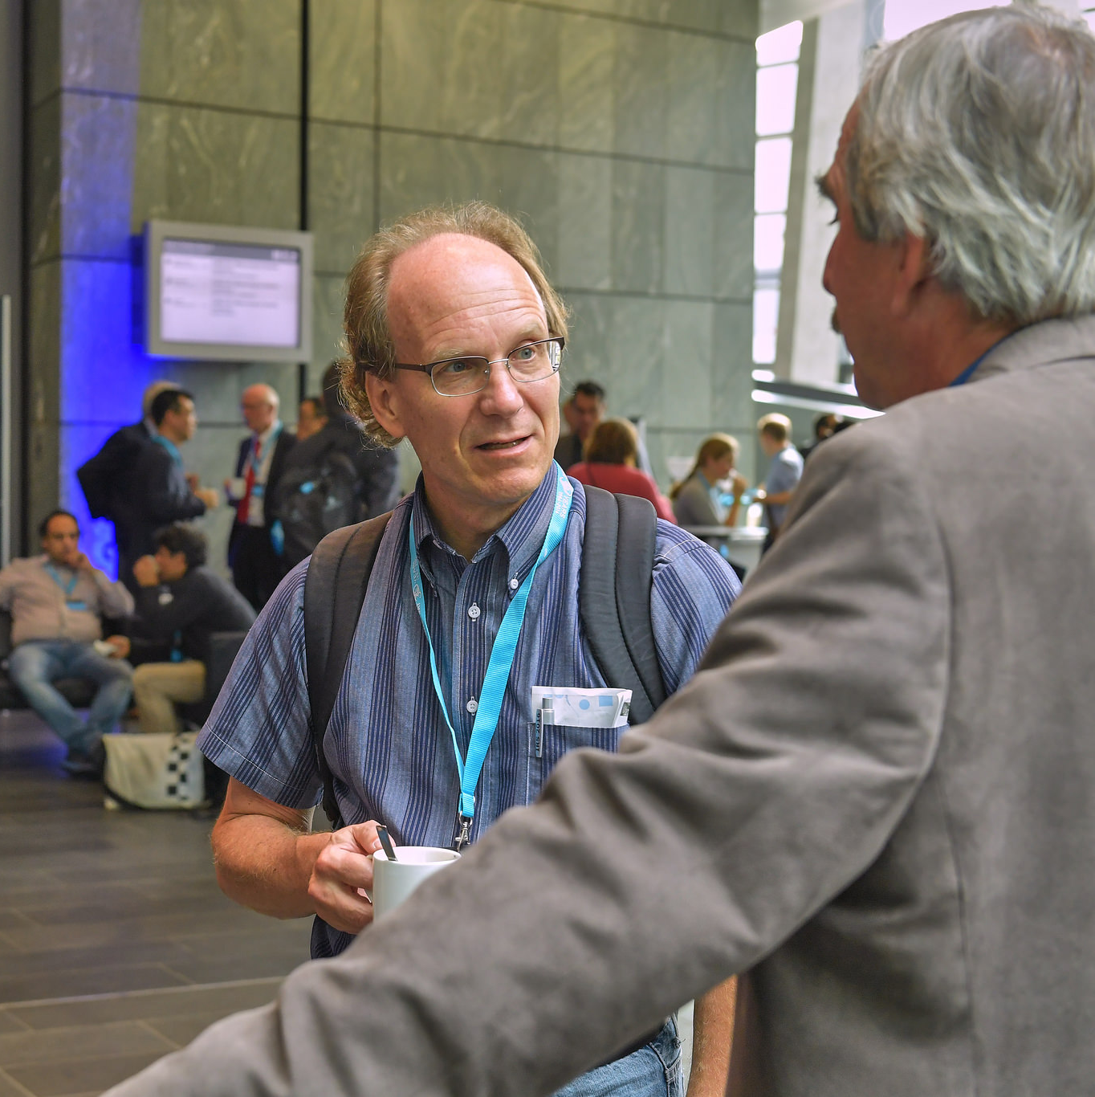
Alright, let me ask you something:
Is EUMETSAT going to move Meteosat-8 above the Indian Ocean????
’cause, you know, THAT would be a great thing to do!

Slide 2
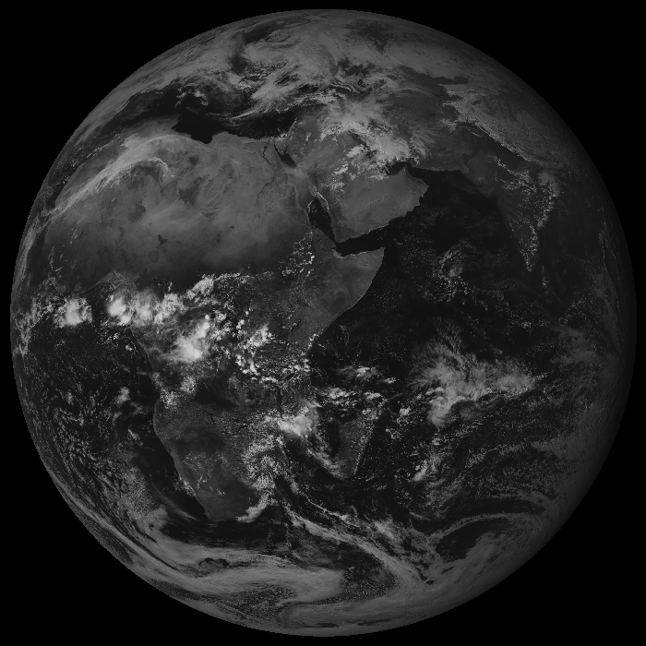
We made it!

Slide 3
Dave, you’ve got today a virtual gift…

