Slide 1
JAXA Agency Report 2017
Misako Kachi, Hiroshi Murakami, Takashi Maeda,
Takeshi Masaki, Yuki Kaneko, Kei Shiomi,
Takeo Tadono, Yukio Kurihara
JAXA

Slide 2
Presentation Overview
JAXA’s GSICS Activities, Action & Achievements Summary
Agency’s support to GRWG Activities
JAXA’s Instruments Updates & Planned launches
Introduce/Confirm the JAXA’s Personnel supporting GSICS

Slide 3
JAXA’s GSICS Activities, Action & Achievements Summary
Current GSICS Activities
Cross-calibration among passive microwave imagers (AMSR2, AMSR-E, GMI, TMI)
Cross-calibration between TRMM/PR and GPM/DPR
Development of new cross-calibration method for IR channels
Preparation of GCOM-C/SGLI lunar calibration using GIRO
Preparation of GOSAT-2/CAI-2 lunar calibration using GIRO (ongoing)
Action Status
Provide GOSAT TANSO-FTS ILS information through the web for hyperspectral IR satellite comparison, in response to A/I at the GSICS meeting in Mar. 2016.

Slide 4
New cross-calibration method for IR channels
In order to produce consistent SST datasets from various IR imagers (AHI, MODIS, VIIRS, SGLI), we have introduced a new physical SST algorithm applying to all IR imagers. Inconsistencies around about 0.3~0.4 K are still found due to calibration of each instrument.
GSICS correction was applied to Himawari-8/AHI, but improvement in SST retrieval was very small.
Currently, we are developing a new cross-calibration method focused on SST, by using SST and transmittance data which are physically retrieved from satellite IR data.
The method is expected to improve consistency in satellite SSTs effectively.
Satellite A
Satellite B
IR data
IR data
Calibration coefficients
Retrieve
IR data
F⁻¹
F
SST
SST
trans-mittance
trans-mittance
$$φ$$
Schematic view of new cross-calibration method for IR
Notes:
大気の情報がなくても、IRのみで放射伝達方程式を解くことで、SSTのほかに、透過率や大気の上向き放射、下向き放射の情報が出てくる。ので、これを使って、SSTからIRを逆算できる。

Slide 5
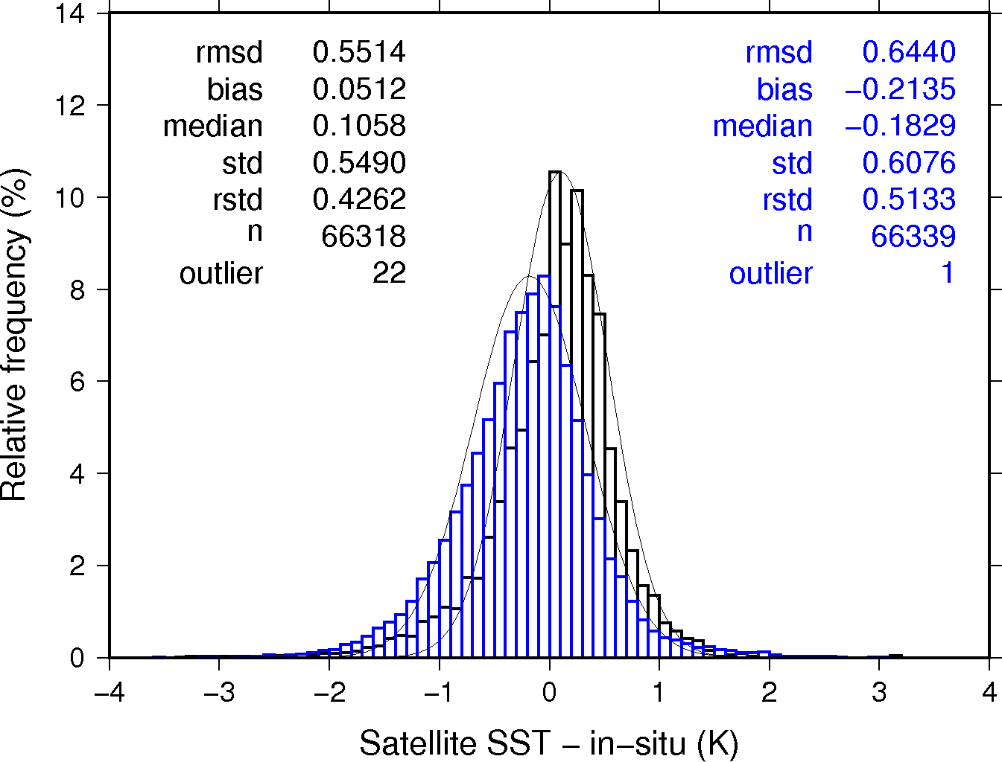
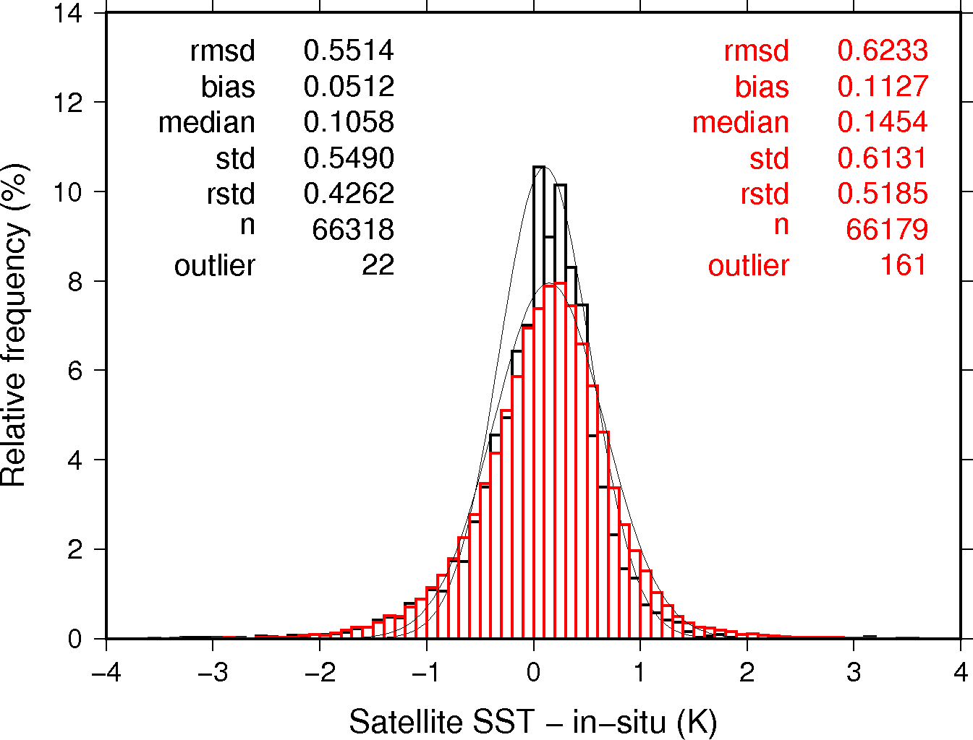
Preliminary results of new cross-calibration method for IR channels
Non calibrated
Calibrated
Histogram shows the relative frequency of the difference between satellite SST and buoy data (satellite minus buoy). Black shows Terra/MODIS, blue shows original Himwari-8 SST, and red shows Himawari-8 SST from calibrated data. The period of SST data is June 2016, and calibration coefficients were calculated by using data in May 2016.
Notes:
5月のデータで作った係数を6月のデータに適用した結果。季節変化があるかどうかは、これから調べる。校正係数をつくるためのデータの選別も今後、もう少し厳密にやるつもり。GSICSではチャネル毎に校正をしているが、このやり方だと、SSTで使うバンドを同時に校正可能。バンド間の相関関係が崩れないので、SST推定にはより効果的。

Slide 6
Major changes of calibrations for GPM/DPR and TRMM/PR
GPM/DPR’s calibration factors will be changed in V05 based on the new calibration results.
JAXA has re-examined Level 1 calibration carefully over 2yrs, and we determined new calibration factors in Dec. 2016.
In order to determine the calibration factors, DPR external calibration was conducted more than 50 times after GPM core observatory was launched.
There were many re-examined items for the calibration.
For example, recalibration of Active Radar Calibrator(ARC) itself, reconfirmation of radar parameters such as beam width, pulse width, and so on. We had re-checked all the items.
TRMM/PR’s calibration factors will also be changed in V05 (i.e. TRMM V8) based on the re-examination of PR’s calibration.
TRMM/PR is the first space-born precipitation radar which was completed the operation on 1st April 2015.
These new calibration factors would make the changes in Z-factor measured about +1dB for KuPR, KaPR and PR.
The continuity of the sigma-zero statistics between GPM/DPR and TRMM/PR will be realized in V05 with the new calibration factors.

Slide 7
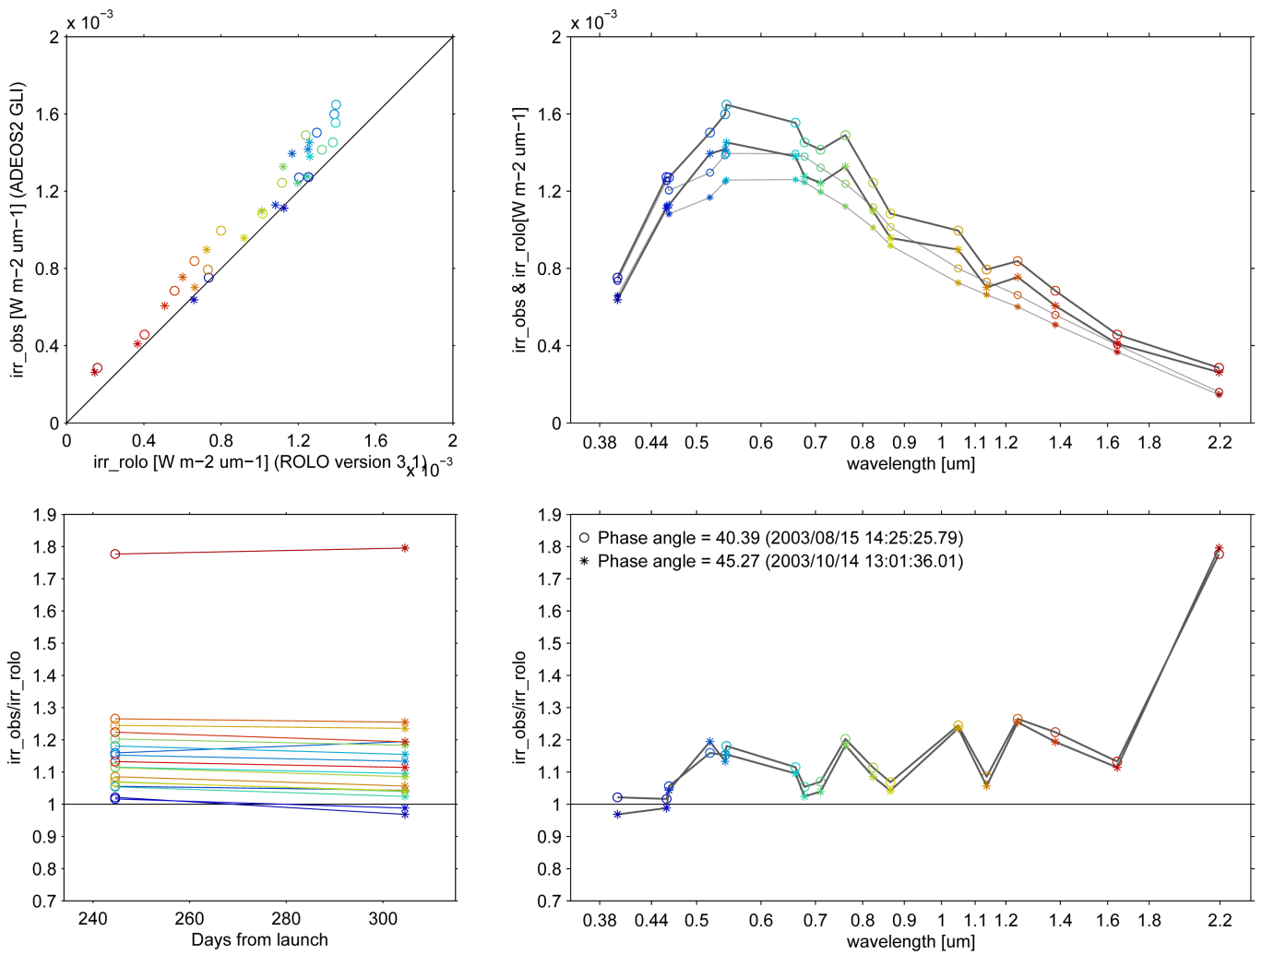
Preparation of SGLI Lunar-Cal by GIRO
GIRO: GSICS Implementation of the ROLO model
SGLI lunar observation images
(Monthly maneuver)
GLI lunar observation through deep space window
Formatting for GIRO
input (NetCDF4)
Colors shows GLI bands
GIRO simulation
GIRO
program
SGLI
response
function
provided by GIRO team
Aug. 2013
Oct. 2013
40.4deg
GIRO outputs
(NetCDF4)
45.3deg
I/O data will be shared within
the GSICS lunar-cal community
Consistent results for images in Aug and Oct 2013
Temporal change analysis
Comparison with other sensors
Lunar-cal exercise by using ADEOS-2 GLI lunar observations through deep-space window (supported by JMA/MSC)
JAXA’s work
7

Slide 8
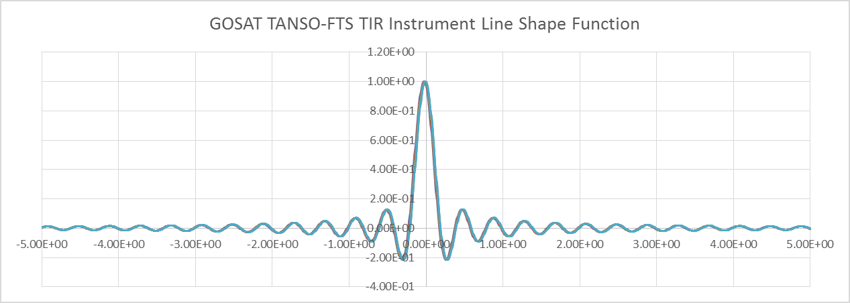
GSICS works of GOSAT
1. For hyperspectral IR satellite comparison,
GOSAT TANSO-FTS ILS information is available from the GOSAT user web site:
https://data2.gosat.nies.go.jp/doc/document.html#TechnicalInformation
Technical Information -> FTS -> Instrument line shape function
cm⁻¹
2. GOSAT lunar calibration data will be processed by GILO for preparation of GOSAT-2.

Slide 9
Support to GRWG Activities
Main contribution to GRWG actions
Provide GOSAT TANSO-FTS ILS information through the web for hyperspectral IR satellite comparison
Preparation of GCOM-C/SGLI lunar calibration using GIRO
Preparation of GOSAT-2/CAI-2 lunar calibration using GIRO (ongoing)

Slide 10
JAXA’s Instruments Updates & Planned launches
Current in operation
GPM: Launched in 2014. Latest version 4 was released in March 2015, and version up is scheduled in April, 2017
ALOS-2: Launched in 2014. Data release in November, 2014
GCOM-W: Launched in 2012. Latest version 3 was released in March 2017
GOSAT: Launched in 2009. Latest version 201.202 was released in 2016
Forthcoming launches
GCOM-C (JFY 2017)
GOSAT-2 (JFY 2018), EarthCARE (JFY 2018)
Advanced Optical (JFY 2020), Advanced SAR (JFY 2020)
Other major events
JAXA Himawari Monitor system (http://www.eorc.jaxa.jp/ptree) is updated in August 2016, and new geophysical products (ocean color, PAR & solar radiation, cloud properties, wild fire, photovoltaic power) are added.

Slide 11
Introduce/Confirm the JAXA’s Personnel supporting GSICS
GRWG Members
Hiroshi Murakami (optical & IR imager, GCOM-C/SGLI, Himawari-8)
Misako Kachi (MW imager, GCOM-W/AMSR2)
Takashi Maeda (MW imager, GCOM-W/AMSR2)
GDWG Members
None
Others who provide supports if needed
Takaeshi Masaki & Yuki Kaneko (precipitation radar, TRMM/PR, GPM/DPR)
Kei Shiomi (GOSAT, GOSAT-2)
Yukio Kurihara (IR imager, GCOM-C/SGLI, Himawari-8)
Takeo Tadono (high resolution optical imager & SAR, ALOS, ALOS-2, Advanced Optical)

Slide 12
Thank you for your attention
WMO GSICS Portal
http://gsics.wmo.int
GSICS Coordination Centre http://www.star.nesdis.noaa.gov/smcd/GCC/index.php
GSICS Product Catalog https://www.star.nesdis.noaa.gov/smcd/GCC/ProductCatalog.php
GSICS Wiki
http://gsics.atmos.umd.edu/wiki/Home

