Slide 1
GSICS Coordination Centre (GCC) 2016-2017
Larry Flynn and Manik Bali
2017 GSICS Annual Meeting
Madison, WI
21st March 2017

Slide 2
Outline
Introduction
GCC Activities
Global participation in GSICS activities
GSICS Quarterly Newsletter
Meeting Support
Updates to GPPA and Product Acceptance.
GSICS Product Status
GSICS outreach
Established Feedbacks Page
Template for Product Page
Near Term goals
Action Items
Summary

Slide 3
GCC Activities – Participation in GSICS Activities
Interest in GSICS activities continues to grow

Slide 4
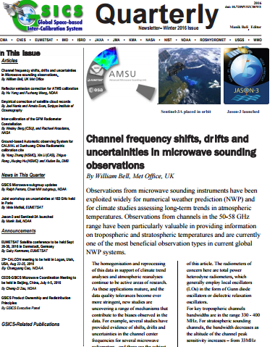
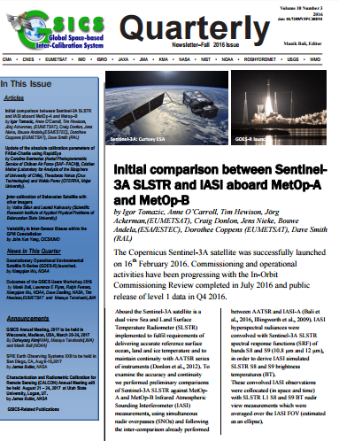
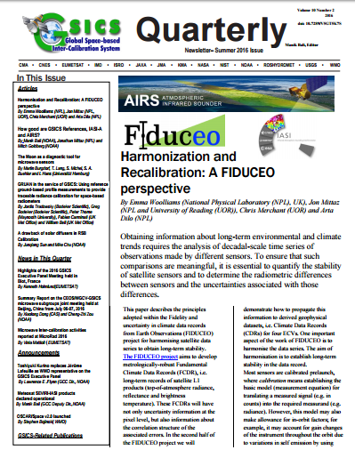
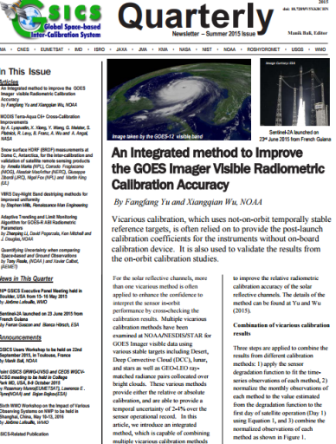
GSICS Activities-GSICS Newsletter https://www.star.nesdis.noaa.gov/smcd/GCC/newsletters.php
Over the last year, we published four New Issues of the GSICS Newsletter
Over 22 Research Articles, 15 Topics of News to which
Over 70 Scientists contributed as Authors & Co-Authors.
Reviewed contemporary journal policy on content sharing.
Contributions from non GSICS members has increased.
Replaced mailchimp with NOAA-Email for distribution.
News Letter included in SCOPUS and extensively cited by agencies and friends of GSICS (google scholar, twitter facebook).

Slide 5
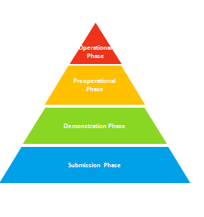
GSICS Activities-Meeting Support and Updates to GPPA
Meeting Support
12 Web-meetings
GSICS Users Workshop at NCWCP
First time for a full day GUW, over 60 attendees
New Clauses introduced in GPPA to enhance efficiency of review process and connect products with users
Impact report mandatory
Delegation clause accepted in GPPA
Instruments of same family directly enter Pre-Op **
For more info visit : http://gsics.atmos.umd.edu/bin/view/Development/GppaWorkflow

Slide 6
GSICS Products Status
Operational 4 product [4 EUMETSAT]
Preoperational 4 products [4 NOAA]
Demonstration 31 products [8 EUMETSAT, 13 NOAA, 6 JMA]
GCC initiated GPPA review process for these products
Review Process Status
EUMETSAT Prime Product → Accepted in Demo Phase
EUMETSAT DCC Product → Review Completed
ISRO INSAT IASI Product → Initial GPAT review sent to producer for implementation
KMA COMS- IASI Product → Initial GPAT review sent to producer for implementation
Notes:
Four demonstration products (NOAA) have ended production.
There are two prototype products.

Slide 7
Actions Webpage
A new actions page is online
Replaces the wiki actions page.
Actions will now be keyed in directly on google sheet instead of wiki.
These would be immediately visible on the Actions Webpage.
Features
Fast Search.
Chairs groups/subgroups and Co-Chairs can directly key in and update the actions.
Significant reduction in overhead on Chairs and GCC.
Actions webpage : https://www.star.nesdis.noaa.gov/smcd/GCC/MeetingActions.php

Slide 8
How good are GSICS References?
GCC work on ‘How good are IR references?‘ published in AMT and highlighted by the FIDUCEO and NASA-AIRS team and recommendations accepted. http://www.fiduceo.eu/sites/default/files/deliverables/D6.4_v1.pdf
Ref: Bali, M., Mittaz, J. P., Maturi, E., and Goldberg, M. D.: Comparisons of IASI-A and AATSR measurements of top-of-atmosphere radiance over an extended period, Atmos. Meas. Tech., 9, 3325-3336, doi:10.5194/amt-9-3325-2016, 2016.
In the Microwave, for the first time we are proposing an in-orbit L1B ‘Reference Record’ for monitoring Microwave instruments using GSICS SNO style method. This reference is a FCDR constructed by knitting together AMSU-A/MSU measurements of the last 40 Yrs.
Ref: http://gsics.atmos.umd.edu/pub/Development/20161025/MW_References_MW_Oct2016.pptx (Paper under preparation)

Slide 9
Outreach and Feedback
A prime responsibility of the GCC is to collect opinions of GSICS participants and feedback from potential users from time to time.
The idea is that gathered data would help our decision making and set goals that can help the users.
GCC has setup a wiki page to house feedback (here) .
Some of the latest Feedbacks are
IR: Reviewed FIDUCIO project report.
MW: User feedback from MW FCDR taken.
GPRC: Reviews received

Slide 10
Near-term 2017-2018 Goals
GSICS Procedure for Product Acceptance
Support inclusion of New Products
Coordination
Continue to coordinate efforts to establish the GSICS baseline algorithms, especially those for the GEO solar reflective channels,
Continue to provide communication between the developing group and users
GSICS Quarterly
Continue to create and distribute this important link to the GSICS community.
Support Review of GSICS Products, Deliverables and Resources
Meeting Support
Organization of GSICS 8rd Users Workshop at ROSHYDRO, Russia
Gather more user Requirements
Outreach to potential Users of GSICS Products

Slide 11
GCC Actions (1/3)
GWG.2016.2b.1 | web meeting | GCC to set up GRWG/GDWG web meeting on instrument performance monitoring. | GCC | 2017-annual meeting | Offered to make a presentation at the Annual Meeting | Closed
GWG.2016.2m.1 |  | GCC to contact IMD and coordinate interactions re: sharing and implementing GEO-LEO code. | GCC | 2017-annual meeting | IMD does not need | Closed
GWG.2016.2t.1 | Naming convention of GSICS products | GCC (Manik to coordinate) to develop a prototype template for product landing pages to be linked to the GSICS product catalog. | GCC (Manik) | 2017-annual meeting | Prototype pages template setup for VIS/NIR setup. This can be used by other groups too | Closed
GWG.2016.2u.1 | GSICS Procedure for Product Acceptance | GCC to coordinate input from product creators/developers to identify the family of monitored and reference instruments their product is applicable to. | GCC | 2017-annual meeting | Decision weather family or not could be made at the time of GPPA. Decision uploaded on GPPA page. EP to approve. | Closed
GWG.2016.7b.1 | Strawman User Requirements document | GCC to coordinate input from GPRCs to attempt to identify at least one user for NRT, RAC and climate applications and interact with users to establish draft user requirements. (note: this will provide input to Action EP_GRWG_16.10). | GCC | 2017-annual meeting | Agencies have indicated that not many users of GSICS Products | Closed

Slide 12
GCC Actions (2/3)
GWG.2016.7h.2 | Interaction & 2016 Users Workshop | Larry to coordinate with the JPSS meeting organizers to organize a dedicated time-slot for the GSICS Users' WS optimizing attendance and promote through meeting agenda. | GCC(Larry) |  |  | Closed
GWG.2016.7h.3 | Interaction & 2016 Users Workshop | GCC to check the possibility to have remote access through WebEx | GCC |  |  | Closed
GWG.2016.7i.4 | Topics & Chairing next Web Meetings | GCC to add a webex meeting for a user feedback (? probably not needed). Or organise one on changing reference and ensure traceability (to be organised by Dave) . | GCC | Configuration | 2017-annual meeting | Pending
GWG.2016.7j.2 | Date & Place of Next WG Meetings | GCC (Larry) to contact NIST to organise the next GRWG/GDWG annual meeting. | GCC (Larry) | Offer from CMISS to host meeting accepted. | 2017-annual meeting | Closed

Slide 13
GCC Actions (3/3)
GDWG.2016.5g.2 |  | H | M | If GDWG.2016.5g.1 is agreed, create GitHub repositories for existing GSICS tools, and provide all contributing member with a user guide on how to support tool development. | GCC | Implementation | 2016-09-30 |  | Need permission to open Non-NOAA public account on GitHub | Ongoing
GDWG.2016.6a.1 | Updating Action Tracking way | M | H | Based on user requirements from Tim’s presentation and GDWG members, GCC to investigate how to address these requirement using the Wiki and plug-ins. | GCC | Analysis | 2016-07-31 |  |  | Closed
GDWG.2016.6b.1 | Data versioning updates, Document Management System | L | M | GCC to update the Wiki with the proposed GSICS product types for EP endorsement. | GCC | Information | 2016-05-31 |  |  | Closed
GDWG.2016.6b.3 |  | L | M | GCC to discuss with MW sub group chair on the use of the proposed MW standards, if needed then seek GDWG agreements. | GCC | Information | 2016-05-31 |  |  | Closed

Slide 14
GSICS Users Workshop 2017 Discussion Topic 9.i. on Friday
The GSICS Users’ Workshop returns as a topical session as part of the 8th AOMSUC in Vladivostok, Russian Federation from 16-21 Oct 2017.
Official announcement would be made by ROSHYDRO

Slide 15
Summary
GSICS Coordination Center continues to support and coordinate exchanges of ideas within GSICS.
A new Actions page has been setup and is online.
The EUMETSAT Prime product accepted in Demo Phase.
GCC continues the work to publish the Newsletter, tune and implement the GPPA, support Meeting, and help to categorize products and documents.

Slide 16
Thank You

Slide 18
GSICS Coordination Centre (GCC) Annual Report to the Executive Panel 2015-2016 Document #3
Larry Flynn and Manik Bali
2016 GSICS Executive Panel Meeting
Biot, France
2 June 2016
Notes:
3 Report from the GSICS Coordination Centre (GCC) Doc 3: GCC Report (L. Flynn/M. Bali)
8 Promotion of Products to Pre-operational or Operational Stage Doc. 8.1: GSICS products recently promoted or proposed for promotion (GCC) Doc. 8.2: Review of the promotion process
9 GSICS User Requirements Doc. 9: Status of GSICS User Requirements (GCC)
10 GSICS deliverables : catalogue and definition Doc 10: GSICS catalogue and definition of GSICS products and services (GCC)
14 GSICS Reference Documentation Doc. 14.2: GSICS User Guide (GCC-WMO)

Slide 19
Disclaimer
“The scientific results and conclusions, as well as any views or opinions expressed herein, are those of the authors and do not necessarily reflect the views of NOAA or the Department of Commerce."

Slide 20
Outline
Introduction
GCC Activities
Registrations in GUMS
GSICS Quarterly Newsletter
Meeting Support
GPPA and Product Acceptance.
New GSICS Action Tracker Page
New GSICS Product Review Page
GSICS Product Status
GSICS Instrument performance Summary
GSICS Users’ Feedback
Near Term goals
Summary

Slide 21
GCC Activities - Registrations in GUMS
300+ members of GUMS

Slide 22
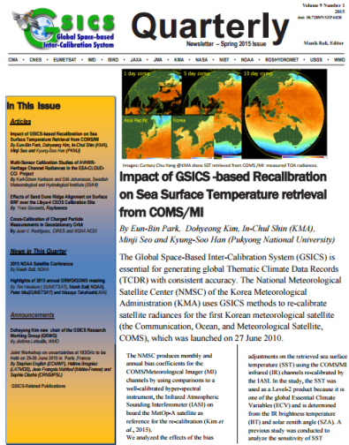
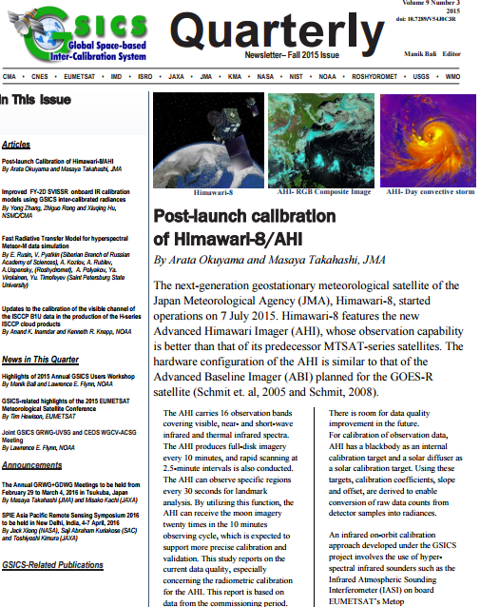
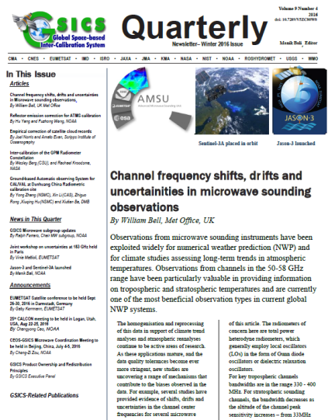
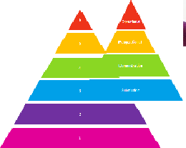
GSICS Activities (1)
Four new Issues of GSICS Newsletter were published
Over 25 Research Articles and 15 Topics of News contributed
by over 70 Scientists as Authors & Co-Authors.
Reviewed contemporary journal policy on content sharing
Meeting Support
10 Web-meetings + the 2015 GSICS Users Workshop
Supported CEOS WGCV-ACSG and GSICS UV Meeting at NCWCP
Supported GSICS GRWG + GDWG Annual Meeting, Tokyo
GPPA → Fine Tuned the GPPA and proposed review paths to producers ( Prime and DCC products).
MSG 2/3 –IASI-A Operational Product review completed in six months

Slide 23
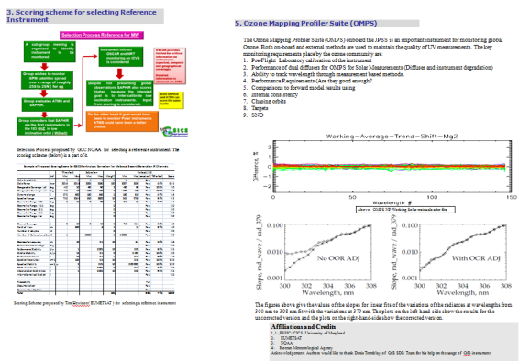
GSICS Activities (2)
Review the GSICS versioning paradigm.
Agencies encouraged to pick the versioning best suited for their needs provided the versioning is well documented and visible to the users.
Updated the Instrument Info Kiosk with the SRF netCDF files and Hyperlinks to the SRF data
Updated Instrument kiosk and SRF information available here .
Selection of Reference Instrument (discussion in 11)
GCC evaluated the criterion to select reference instruments
suggested by Tim Hewison and proposed a process of
selection. Presented ideas at the JPSS Science meeting.
(With contributions from JMA, KMA, EUMETSAT and NOAA)

Slide 24
GSICS Activities (3)
GCC reviewed FCDR inter-calibration requirements, in the framework of the GSICS User Product Guidance, to identify common inter-calibration types, which are not specialized to specific applications, and report to GRWG. These could be considered as potential future GSICS products.
IR – Reviewed FIDUCEO project report.
MW – User feedback on the MW FCDR received.

Slide 25
Proposed Entity Categorization
Core products
Subject to GPPA
Models and data sets
These should be reviewed by GSICS and recommended for use (or not).
Tools
These are made available because GRWG members find them useful.
GSICS Documents
GPRC and OSCAR Documents and Resources
Discussion of categories and proposed acceptance processes for each category in 8 & 10

Slide 26
GSICS Product status
Operational 4 products [4 EUMETSAT]
Preoperational 4 products [4 NOAA]
Demonstration 27 products [4 EUMETSAT, 17 NOAA, 6 JMA]
GCC initiated the GPPA review process for four new demonstration products
Review Process Status
ISRO INSAT IASI Product → Initial GPAT review sent to producer for implementation
KMA COMS IASI Product → Initial GPAT review sent to producer for implementation
EUMETSAT DCC Product → Proposed GPPA tuning, GCC Connected with Users
EUMETSAT Prime Product → Proposed GPPA tuning, received one review
In 2016, three GPRCs are preparing for their GEO-LEO IR GSICS products to enter new maturity levels:
EUMETSAT and NOAA → Operational
JMA → Pre-Operational
Notes:
Four demonstration products (NOAA) have ended production.
There are two prototype products.

Slide 27
GSICS GEO-LEO IR Product Status 2016-02 (IR)
GPRC | Monitored Instrument | Reference Instrument | GSICS NRT Correction | GSICS Re-Analysis Correction | GSICS Bias Monitoring
EUMETSAT | Meteosat-9, -10* Meteosat-7 | Metop-A/IASI* | Operational Demo | Operational Demo | Plots RAC*
JMA | MTSAT-1R } MTSAT-2 } | IASI (+ AIRS) | Demo | Demo | Plots RAC
NOAA | GOES-13 & -15 Imager GOES-11 & -12 Imager | IASI (+ AIRS) | Pre-op | Pre-op Demo | Prototype
 | GOES Sounder | IASI (+ AIRS) | Development | Development | In development
CMA | FY2C – E | IASI (+ AIRS) | Development | Development | Prototype
KMA | COMS-1 | IASI | Prototype | Prototype
ISRO | INSAT-3D | IASI | Prototype | Prototype
For the first time we will be able to inter-calibrate the geostationary ring to the same reference!

Slide 28
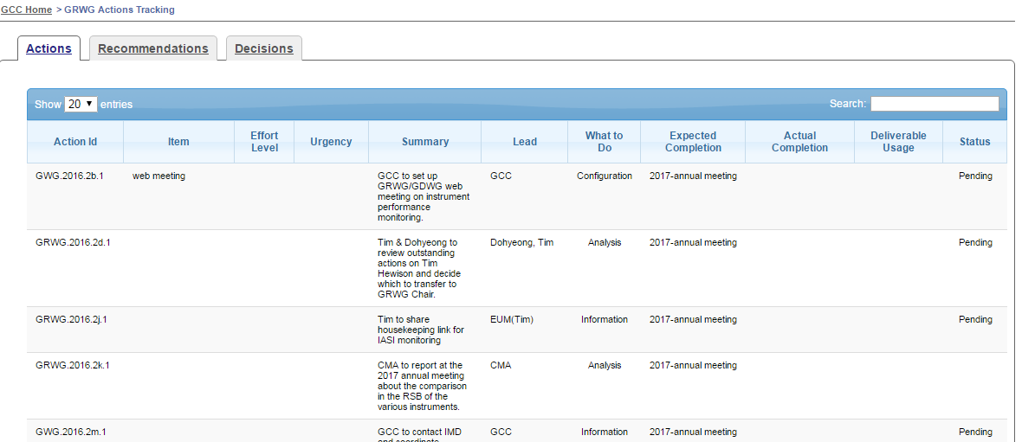
GSICS Action Tracker Page
New Action Tracking Page (link). Features include
Efficient and fast search
A decision tab
Records and display response

Slide 29
GSICS Product Review Pages
GCC established review pages for products submitted to GPPA
Each product has a dedicated review page. These main features are
The page gives the review status of the product
Comments from reviewer are posted on the page.
Response of producer are posted.
Proposed GPPA for the product is posted.
Review of Meteosat-2/3 Seviri - IASI product
Review SEVIRI MODI (DCC) Product
Review GSICS Prime Reference Product
Review of COMS IASI Product

Slide 30
GSICS Instrument Performance Summary
The aim is to provide a summary of in-orbit performance of monitored instrument, e.g., recent statistics compiled from GSICS products showing how well the products are performing.
We are extracting statistical performance metrics and will present them to characterize the measurements.
This is a work in progress and feedback is welcome.

Slide 31
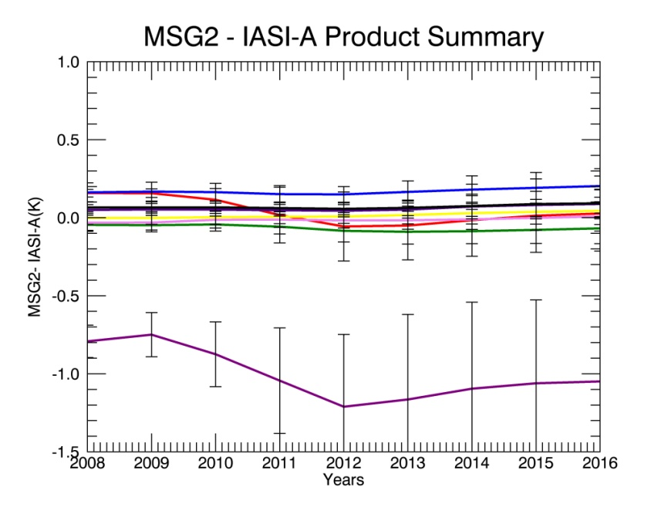
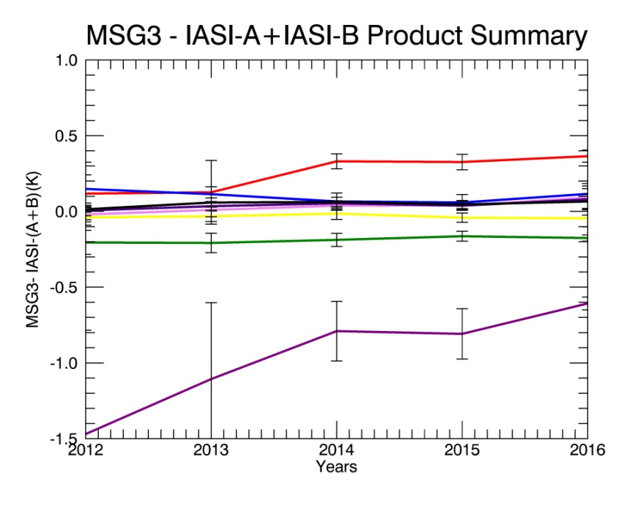
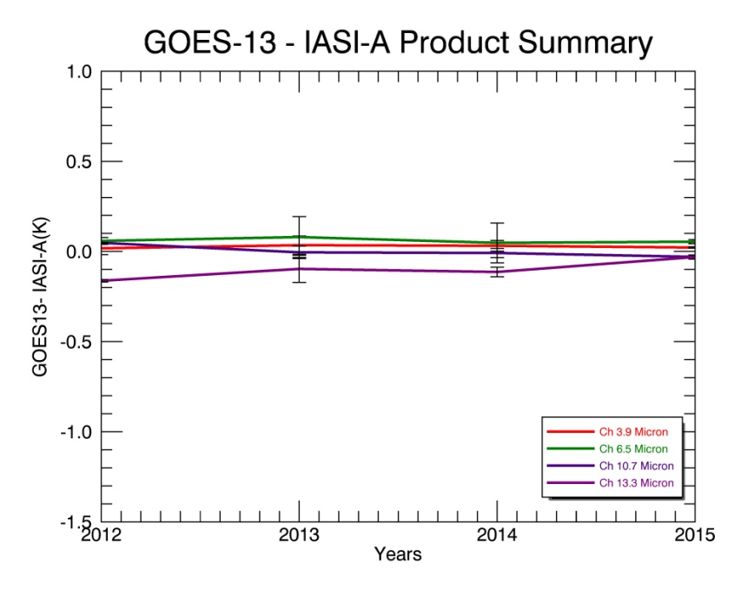
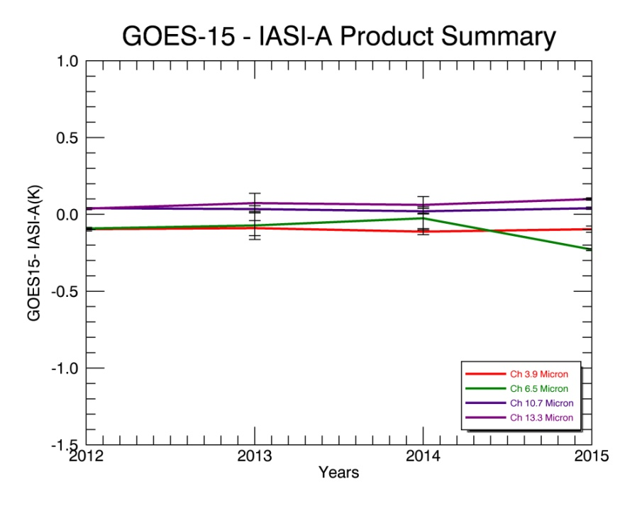
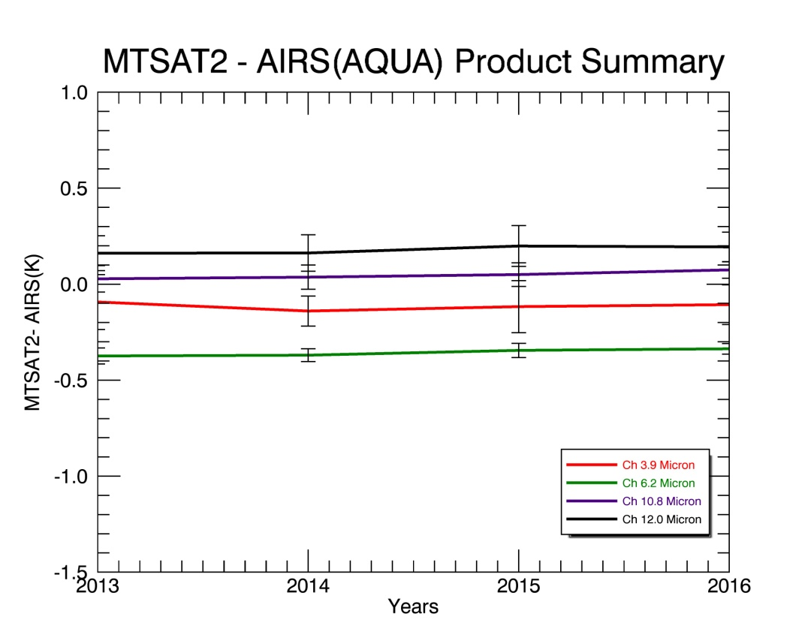
GSICS Instrument Performance Summary
GEO’s are stable over the years
Connect with health monitoring in the future

Slide 32
User Feedback (Discussion in 9)
Ep-16 assigned actions on GCC that were aimed at collecting Requirements and Expectations from Potential Users of GSICS Products → We want to make our products more useful to community.
GCC collected questions from each subgroup (IR, MW, UV and VIS, GRWG ,GDWG) which were put to potential users to understand their expectations (See here ).
GCC put an-online version of the questionnaire and opened it to the scientific community.

Slide 33
Near-term Goals for 2016-2017
Evolution of the GSICS Procedure for Product Acceptance
Support inclusion of New Products
Coordination
Continue to coordinate efforts to establish the GSICS baseline algorithms, especially those for the GEO solar reflective channels,
Continue to provide communication between the developing group and users
Publish the GSICS Quarterly Newsletter
Continue to create and distribute this important link to the GSICS community.
Support Reviews of GSICS Products, Deliverables and Resources
Meeting Support
Joint Meeting, GSICS Web Meetings and QA4EO telcons.
Organization of GSICS 7th Users Workshop at NCWCP, USA
Gather more user requirements

Slide 34
EP-15.01 GCC to register the GSICS catalogue as a service in the WMO Information System (WIS), to ensure it is discoverable in the WIS.
EP-15.02 Every GPRC to nominate at least one representative on the GDWG
EP-15.03 GCC and WMO Secretariat to coordinate with a view to send a letter of recognition from WMO to acknowledge significant personal contributions to GSICS.
EP-14.01 GCC, GDWG and GRWG to evaluate the relevance and implications of adding “calibration alert system” and “SNO and GEO-LEO collocation data” to the GSICS portfolio, and report to the Executive Panel.

Slide 35
2016 Users’ Workshop
Welcome to the GSICS Users’ Workshop 2016 on 11 Aug 2016 at
NOAA NCWCP, College Park, MD USA
as part of the JPSS Annual Science Team Meeting 8-12 Aug 2016
환영합니다
Bienvenue
Willkommen
Web site for last year’s meeting including the agenda and presentations
http://www.star.nesdis.noaa.gov/star/meeting_2015JPSSAnnual.php

Slide 36
2016 Users’ Workshop Areas (See Invitation Letter Draft)
Introduction to GSICS
Old, New and Future Products
Data Assimilation Users’ Needs and Contribuitons
Users’ Requirements
GSICS Resources
Notes:
Introduction to the Workshop
Logistics
Agenda
Participant Sign-Up Sheet
Introduction to GSICS
GCC
Resources and product catalog
Product Catgorization and evaluation/review
WIKI
Quarterly
GUM GDWG Directions and Participation GRWG Organization and Participation
Improvements
GPRCs
Instrument landing pages GIRO Products
DCC
Anchor Reference
GEO-Ring
ICVS beyond Core GSICS products
Alerts and monitoring.
User Requirements
How are products applied?
Where and by whom?
NRT versus CDR
Monitoring versus Corrections
Numerical Forecast users (NOAA and DOD) (Canada, etc.??)
Level 2 developers
Data Assimilation users
Climate Data Record developers and users
Level 1
CGMS Operators
Satellite Level 1 Processing Teams as users.
Who to invite to talk?
1. Product developers, NOAA GPRC contributors and ICVS developers, GSICS product developers.
NASA and USGS and ...
Jack, Jim, Tom, Dave
IR
Vis
MW
UV??
ICVS examples
3. Who are the users? What are their requirements?
3. Who do we invite as users? What are their requirements?
Numerical Forecast users (NOAA and DOD) (Canada, etc.??)
Level 2 developers
Data Assimilation users
Climate Data Record developers and users
Level 1
CGMS Operators?
Web participation
A major thrust would be to find overlaps between missions. ( For example, European S2 / US -VIIRS, European S3 SLSTR / JPSS, JAXA-AHI / GOES-R ABI , China FY-3 / US JPSS) and identify areas where JPSS mission can help with global monitoring.

Slide 37
Lawrence Flynn
Director, GSICS Coordination Center
NOAA NCWCP, College Park MD USA
Subject: Invitation to propose a talk or submit a poster for the GSICS 2016 Users’ Workshop
Dear Sir / Madam,
This year the GSICS Users’ Workshop will be organized as part of the JPSS Annual Science Team Meeting 8-12 August 2016. The venue is NOAA, NCWCP in College Park MD USA and the workshop will take place on Thursday 11 August 2016. We are inviting GSICS researchers, developers and product users to submit one-page abstracts for presentations on areas of interest to GSICS participants including the following topics:
GPRC resources (e.g., Calibration/Validation Systems, Long Term Monitoring, Instrument Landing Pages, and Monitoring notices, alerts and summaries),
Calibration advances (e.g., Lunar, Deep Convective Cloud, Reference Migration, Best Practices) ,
Practical experience in the use of JPSS Mission and other instruments as references for Monitoring GEO/LEO instrument measurements in Near Real Time and Climate Data Record applications,
Applications of current GSICS products,
Interactions between data assimilation groups and measurement calibration, characterization and monitoring teams, and
Introduction to upcoming GSICS products and research areas (e.g., GEO Ring, GOES-R on-orbit calibration).
Abstracts may be submitted by email to Manik Bali, GCC Deputy Directory, Manik.Bali@noaa.gov.
Please let us know whether you would prefer an oral or poster presentation for your submission and if there are constraints on the time of day when you can give your presentation.
Registration for the full meeting is free and is now open at
TBD
Sincerely,
Lawrence Flynn, GCC Director

Slide 38
Summary
GSICS Coordination Center continues to support and coordinate exchanges of ideas within GSICS.
Review of MSG2/3 – IASI-A products were completed and Products are in Operational Status.
Review of DCC and Prime product completed at GPPA.
List of GCC focused discussions at this meeting
8. Promotion of products to pre-operational or operational stage
9. Status of GSICS User Requirements and discussion
10. Catalogue and definition of GSICS deliverables
14. GSICS documentation and outreach

Slide 39
Thank You

Slide 40
GCC Action Status
EP-16.05 | GCC and WMO, in consultation with GRWG and GDWG, to complete a draft GSICS User Guide, for consideration by EP-17 | A draft user guide was provided to GCC for review by GRWG Chair . Following the review it was accepted and used in the GPPA of SEVIRI-IASI cross calibration product. The EP accepted the documents and declared the product operational.
EP-16.06 | (a) GCC to finalize the high-level categorization ofGSICS holdings and deliverables, ensuring that actual or planned products can be mapped to these categories, indicating a target audience, delivery or access mode; (b) GCC to propose appropriate review/acceptance mechanisms for each category of GSICS products (with a distinction between acceptance of the algorithms, and acceptance of the production of calibration coefficients or calibrated radiances). | EP-17 | Lawrence E Flynn presented a draft categorization to WMO and in Annual meeting Manik Bali presented a acceptance and review procedure at Annual Meeting
EP-16.11 | GCC and GRWG Chair to organize a discussion on user requirements in the context of the 2015 GSICS User Workshop (Toulouse, 22 September 2015) | 22 Sept 2015 | Completed
EP-16.12 | GCC to analyse, in consultation with GCOS/AOPC, the implications of GCOS observation needs on GSICS products. | January 2016

Slide 41
Do we have a process for accepting and then posting documents?
GCC manages the GSICS documentation plan.

