Slide 1
GDWG Report 2016 / 2017
Peter Miu / Masaya Takahashi
CMA, CNES, EUMETSAT, ISRO, IMD, JAXA, JMA, KMA, NASA, NIST, NOAA, ROSHYDROMET, USGS, WMO

Slide 2
Overview
Membership
GDWG Notable Activities Summary
GDWG Work Plan 2017 / 2018
Topics to be discussed at this meeting
GDWG Challenges
Questions

Slide 3
Membership
GPRCs: No updates
Current nomination to GDWG (13 members):
4 CMA, 2 EUMETSAT, 1 IMD, 1 JMA, 1 KMA, 2 NOAA, 1 ROSHYDROMET, and 1 WMO
Several GDWG/GRWG tasks cannot progress (e.g. Server products synchronisation, developments collaboration using GitHub, ...) due the low level of support from GDWG members. Please be reminded that GSICS is an international collaboration effort requiring commitment by all its members to contribute towards GDWG activities. Otherwise the tangible results and agreements may not reflect the views of all members and these will be presented to the international user community with your organisation’s “stamp of approval”.
WMO: Toshiyuki Kurino replaced Jerome Lafeuille in 2016
Please note, all GSICS member must be registered with the WMO to be involved in GSICS activities. GPRCs are kindly requested to provide their members’ information updates to the WMO as well as updates to their GSICS web presence accessible from the WMO GSICS Portal (http://gsics.wmo.int).

Slide 4
GDWG Notable Actions
Overview
Actions Summary 2017
29 actions proposed in 2016 joint meeting
21 actions have been completed.
6 actions have feedback provided, they are in progress.
Several actions will be discussed this week
2 actions have been pending due to the limited resources.
Old Actions
19 actions are still open; to be checked/discussed during this meeting.
Notes:
Collaboration Server service improvements; GSICS product mirror and new product notification and distribution.

Slide 5
GDWG Notable Actions
Migration of GSICS Wiki
Migration from NOAA to UMD Server on 12 June 2016.
The new Wiki URL is: http://gsicswiki.net/wiki
The complete GSICS Wiki was successfully migrated.
Main advantage of hosting the GSICS Wiki on the UMD server is this server is not constraint by NOAA security policies (i.e. no annual security test, hurray!).
Excellent work by NOAA (Thanks Yuanzheng “Jordan” Yao)!
The old Wiki URL http://gsicswiki.net is no longer available i.e. there is no redirection to the new URL.

Slide 6
GDWG Notable Actions
Collaboration Servers Status
CMA
Providing CMA GSICS products (the products are in-development)
Updated to the latest THREDDS configuration in summer 2016
EUMETSAT
Fully operational, providing EUMETSAT GSICS products
Ingesting products from KMA and JMA, and offering them to the GSICS user community
Ready to ingest ISRO GSICS products
Ingesting intermediate data (e.g. GEO-LEO collocation data) from JMA
Providing Source Dataset (e.g. IASI L1C netCDF) for GSICS products generation
NOAA
Providing NOAA GSICS products
Migrated to a new server
Notes:
Collaboration Server service improvements; GSICS product mirror and new product notification and distribution.

Slide 7
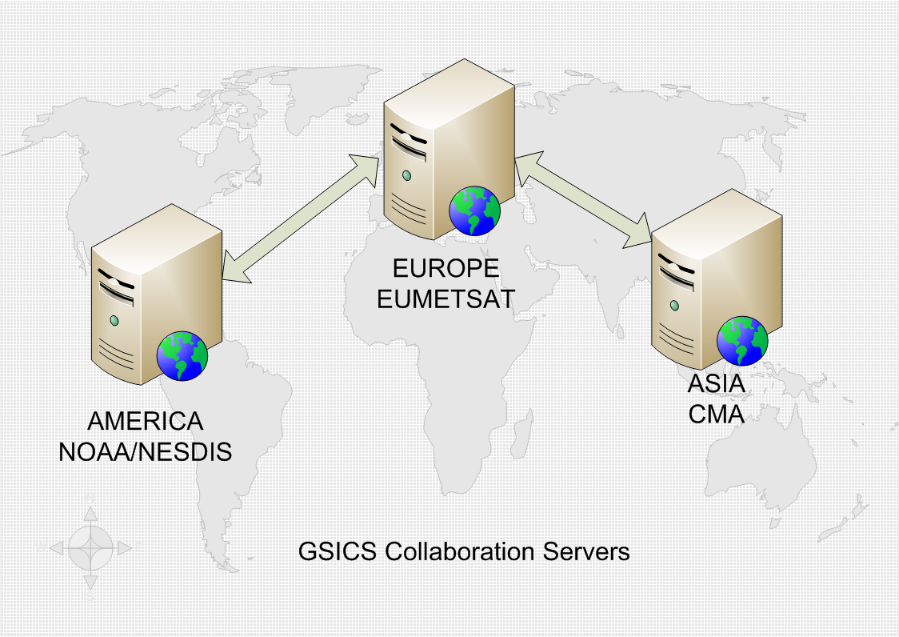
GDWG Notable Actions
Preservation of GSICS Products
Preservation of Re-Analysis Corrections (RAC) only was endorsed at GSICS-EP-16: 3 preservation approaches were accepted:
Product generation software is expected to be able to re-create the operational RAC.
Collaboration Servers are expected to be backed up by their system administrators.
Collaboration Servers are expected to replicate all RAC between themselves.
Replication of products between the collaboration servers proves challenging due to organisational security constraints.
A way to actively “get” products could be used to overcome security constraints and the GDWG is investigating the feasibility of its implementation.
To be discussed in agenda#5c
Notes:
Dave archiving vs. data preservation:
The former term includes the following additional services:
data discovery – services for users to detect the data (making the data explorable from multiple sources).
data identification – services for users to clearly understand what the data is (e.g. meta-data, landing pages, etc.).
data search – services for users to find the data.
data migration – obsolescence mitigation services to ensure the components of the archive maintain a reasonably level of integrity e.g. media change.

Slide 8
GDWG Notable Actions
Supporting GRWG Lunar Calibration
Considerations for the distribution to users of the GIRO (executable + source codes) + GLOD (lunar observation dataset) :
Intellectual Property Rights must be maintained i.e. users are required to registered and agree to the term of use by signing a license before they are authorised to access the GIRO/GLOD
The number of users expected to request GIRO/GLOD is anticipated to be less than 20
Based on these considerations, there is no need to establish a data management system to support the distribution of the GIRO/GLOD
An infrastructure for GIRO/GLOD on EUMETSAT website will be created
Notes:
Intellectual Property Rights cleared for ancillary data (solar and lunar spectra) + SPICE kernels:
Acknowledgement to the data and tool producers
Details about the composite lunar surface reflectance spectrum to be provided (ID numbers + weights in the composite)
IPRs cleared with Numerical Recipes routines:
Coded rewritten from scratch (GIRO v1.1.0)
Verified against version with Numerical Recipes (see following slides)
Next steps:
EUMETSAT’s internal procedure for Verification + Validation ➔by end September 2016
Code analysis to check license compliance ➔ by mid-October 2016
Preparation of a License Agreement to be agreed and signed by licensees = Condition for access to the GIRO + GLOD (following the policy presented at GSICS EP in May 2015) ➔ by end September 2016
Set-up of an infrastructure for GIRO + GLOD on EUMETSAT’s website (web page with relevant information/documents + helpdesk service + link to GIRO + GLOD repositories) ➔ by end 2016
To access the software and the data sets, users simply make a request to the EUMETSAT user service helpdesk, and the GIRO and GLOD administrators will provide the support needed to provide access

Slide 9
GDWG Work Plan 2017/2018

Slide 10
GDWG Work Plan 2017/2018
Revisiting GDWG ToR
CGMS-44 (2016) action: GSICS to review the GDWG Terms of Reference and associated indicated levels of effort of the members
Current GDWG ToR mainly focuses on developments like
Defining conventions of GSICS deliverables
Developing specifications for GSICS activities (e.g. data preserving system and plotting tool)
Substantial resources are needed for “operational” tasks such as operating and maintaining Collaboration Servers and Wiki admin
Associated resources will also be discussed at 6d (Thu. p.m.)
Long term commitment / effective collaboration is necessary not only for achieving GDWG purposes but also for supporting GRWG activities
Lack of resources for developing GSICS Data Management tasks mean GRWG deliverables will not be provided to the user community or in the most efficient manner

Slide 11
GDWG Work Plan 2017/2018
Chairing GDWG
By the end of 2017, current GDWG Co-chairs have completed their 3 years of leading and chairing the GDWG as specified in the GSICS ToR ref: GSICS-RD004-v1.0.
Chair & Vice Chair, or Co-chairs Election Possibilities
The ToR does not limit the renewal of the chairing if agreed amongst the GDWG members.
or
A Vice Chair is expected to offer to replace the Chair, and new Vice Chair(s) to be elected by the GDWG members.
a new Co-chair replaces one of the Co-chairs, staying in the Co-chairing leadership.
a new Co-chair replaces one of the Co-chairs, converting to the Chair and Vice-chair leadership.
A completely new Chair and vice Chair(s), or co-chair(s) are elected.
The EP will be informed of the above for discussion & inclusion in the ToR.
Nominations
To be discussed in the GDWG breakout session (6e).
GDWG members are kindly requested to considering themselves for the GDWG chairing nominations.
Notes:
For info (remove from slide to keep it simple):
JMA co-chair have also spent 2 years as a vice-chair.
EUMETSAT co-chair cannot commit to spend more time to work on GSICS in the next years due to organisation's commitments.

Slide 12
GDWG Work Plan 2017/2018
SRF file towards “GSICS Standard netCDF”
(3o, 5e)
NetCDF SRF files converted from official SRF file
A converter was developed by GDWG chair in 2013, in response to GRWG requirements
Initially generated for GSICS internal research activities (NOT meant for public use)
Adopted by GIRO (GSICS Implementation of the ROLO model) as one of input data
Requirements for defining “GSICS Standard SRF” Convention
EUMETSAT plans to provide their official SRF files in netCDF for future instruments (e.g. MTG/FCI)
Filenaming/Global Attributes/Variables need to be update
To be discussed at 3o (this afternoon) and 5e (GDWG tomorrow)

Slide 13
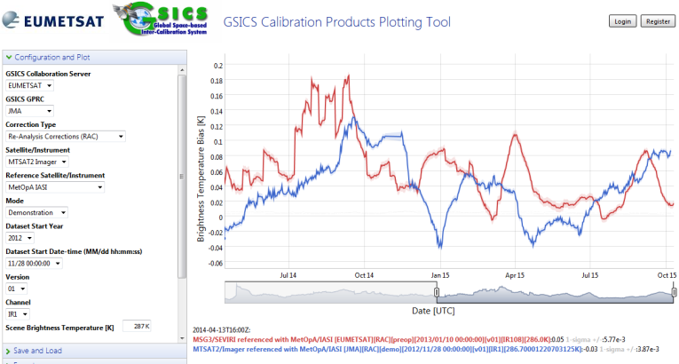
GDWG Work Plan 2017/2018
Plotting Tool: supporting new products (3m, 6c)
http://gsics.tools.eumetsat.int/plotter
Only GEO-LEO-IR is currently supported
Requirements for supporting GEO-LEO-VNIR
Have been discussed for past years, but the document is still in preparation (collaboration work with EUM/JMA)
Updating the tool needs GDWG resources
Requirements for other products?
Plotting “double difference” of GEO-LEO-IR Prime Correction?

Slide 14
GDWG Work Plan 2017/2018
Instrument Event Logging (6a)
Activity of CGMS Task Team on Calibration Events Logging, lead by Rob Roebeling (EUM)
Goal: to develop a uniform approach for presenting, logging, and monitoring calibration information across satellite operators
First step: to create/maintain stable landing pages
Hyperlinked from the WMO-OSCAR
CMA/EUM/JMA/KMA created, other agencies are also in progress
Second step: to adopt nomenclature and standards for instrument events
To identify a common set of parameters across space agencies
A white paper for CGMS-45 in June 2017 is under-reviewing by the task team members

Slide 15
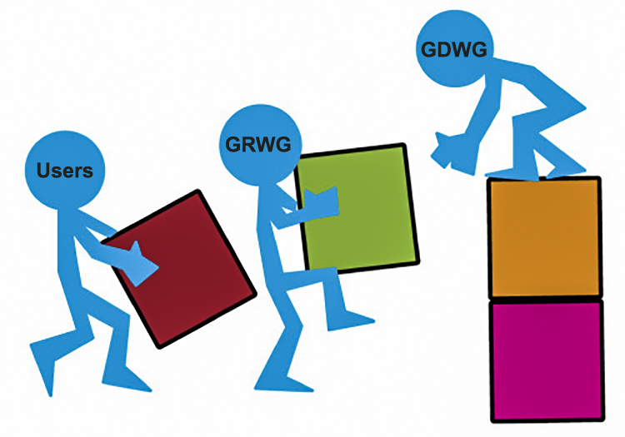
GDWG Work Plan 2017 / 2018
Specification of GSICS Data Management Guidelines, Conventions and Standards to address the users’ needs for new GSICS products
MW inter-calibration (5g), VNIR+IR combined products (3m, 6f), FCDR (5h)
GSICS Documentation Discussion on classification and storage (5b)
Use of GitHub for GSICS activities (5i)
Action tracking (lead by GCC, 6b)
Notes:
Guidelines, conventions and standards; using the netCDF as the format for data exchange, use of the WMO file naming convention for data and product identification, using CF conventions where possible to organise the netCDF array structures, and specifying meta-data.
GSICS collaboration servers are the platforms for data exchange and GSICS product distribution.
GSICS tools and utilities; GSICS products plotting tool, automate the GSICS products netCDF ncml validation, provide framework for the development of GSICS products in netCDF (in progress).
GSICS products generation framework simplifies and speeds up GSICS product development. This is needed as our partners are not all aware of how to develop the netCDF format. Framework provide a structure to create netCDF files through configuration, a ncml file defining the netCDF, and the implementation of mapping classes to populate the netCDF file from the native data.

Slide 16
GDWG Challenges
Use of netCDF-4 Enhanced Data Model for future GSICS products (6c)
Use of grouping function to contain multiple inter-calibration products (e.g. DCC/Moon, VNIR/IR)
GSICS product generation framework (5d)
Simplifies and speeds up GSICS product and relevant netCDFs development
Could be extended to generate other deliverables (e.g. GSICS Standard SRF)
Operations aspects
Getting GSICS products to the users in timely fashion (automated dissemination)
Collaboration automation
Developing tools for reminding reviewers in GPPA
Notes:
netCDF is currently using the classic data model; simply and works with all netCDF tools. Limitations with data types, lack of data structures and file size, enhance data mode provides these new features.
We need a easy way to do work together; documents and software developments – look for free tools to do this.
As part of data preservation for the GSICS products, we need to replicate all operational GSICS products across the GSICS servers.
Automated distribution of GSICS products would be very useful for users who are regularly using them for their operational systems.

Slide 17
End of Presentation: Thank you for your attention
Notes:
Questions?

Slide 18
Backup slides…maybe useful but not to be presented in their current form.

Slide 19
GSICS Data Preservation Strategy
(Reported at the EP-16 meeting in May 2015)
Data Archiving vs Data Preservation
“Data archiving” not only implies storage but additional services such as data discovery/identification/search/migration
“Data preservation” only implies reliable access to the data
For GSICS products, a data preservation strategy shall apply
The GSICS Executive Panel (EP) endorsed this Strategy
Objective should be the preservation of the “Re-analysis Corrections”, rather than the “Near Real-Time Corrections”
Additional Recommendation from the GSICS EP
Collocation data shall be preserved.
GSICS products generation software shall be able to regenerate all versions of their GSICS products.

Slide 20
Version controlling software for GSICS software development (lead by J. Kim, KMA)
Use of GitHub (online version controlling) will be discussed at 5g, lead by H. Oh (KMA)
Agency | Version controlling software | Comments by GDWG member
CMA | Subversion on a local server controlled by software engineers | GitHub will be possible
EUMETSAT | Subversion | Use of GitHub has been investigated
JMA | Subversion + Git (some developers) | GitHub is good for us.
KMA | Git on systems for real time operation/data processing, radiometric/geometric performance evaluation, space weather monitoring Subversion on systems for real time operation support and meteorological analysis | Like CMA status: the controlling established on a local server at each contract company. GitHub will be possible.
NOAA | Subversion | Git can give better performance. F. Yu has authored the GSICS product at NOAA.
Notes:
Members of the GDWG have produced some developments that are currently residing in their own software version controlling systems. While subversion fulfil our software version control needs at EUMETSAT, it cannot be used for collaboration developments. For example, the GSICS Calibration Products Plotting Tool. EUMETSAT has developed this tools for visualising the contents of the GEOLEOIR Calibration product. This tool needs to be updated for each new GSICS product types, and at present, only EUMETSAT can update this tool. We need a mechanism to provide all GDWG members with the ability to update this tool, and any other GSICS software. GitHub is a software version control system that supports collaboration developments across the internet. Not sure if Asia has access to GutHub and/or similar systems, and this is what we would like KMA to investigate and propose a way forward such that the GDWG can perform collaboration developments.

Slide 21
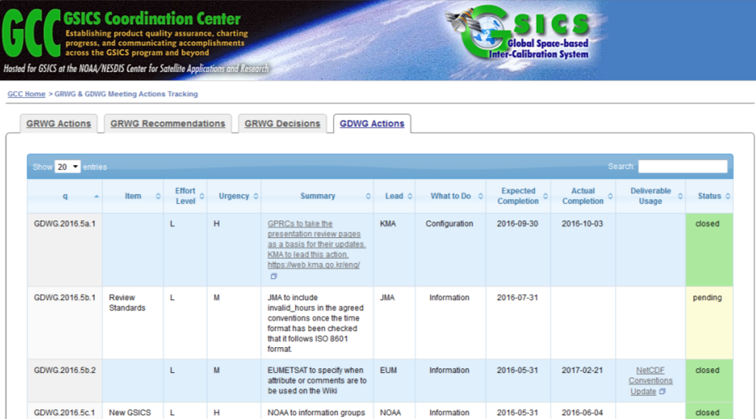
Action Tracking
GSICS actions have been tracked on the Wiki
2015/2016 GDWG actions are recorded in an online spreadsheet with new categorisations.
Improving the usability of the tracking page was discussed at 2016 Annual Meeting.
GCC (Manik Bali) took the lead of launching the new page!

Slide 22
Actions Identifier Format
GDWG Chairs were ask to provide a Format, the format is:
GsicsId.yyyy[ mmdd. | .agendaItemId. ]actionCount:
Valid GsicsId (update when needed):
[ GDWG | GRWG | GWG | GEP | GCC | GIR | GVNIR | GMW | GUV ]
agendaItemId is for annual meeting agenda item identification. 1a
mmdd is all other meetings indicates the month and day e.g. 0118
Examples:
GDWG.2016.5d.1 - GDWG annual joint meeting action 1
GIR.2016.2c.5 - GRWG IR sub group annual joint meeting action 5
GWG.20160118.3 - First GRWG & GDWG webex meeting in 2016, action 3
GEP.2016.1a.2 - GSICS EP annual meeting action 2
GCC.20161102.12 - GCC webex meeting in 2016 action 12
Please use this format for the actions in your group.

