Slide 1
Use of NWP+RTM as inter-calibration tool
Tim Hewison
EUMETSAT

Slide 2
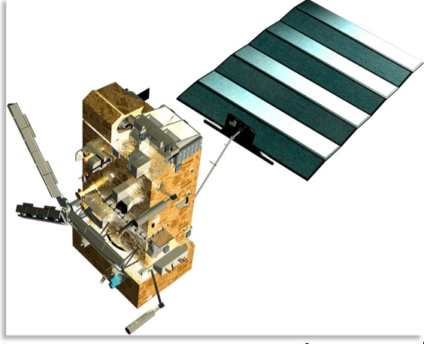
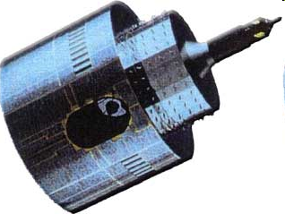
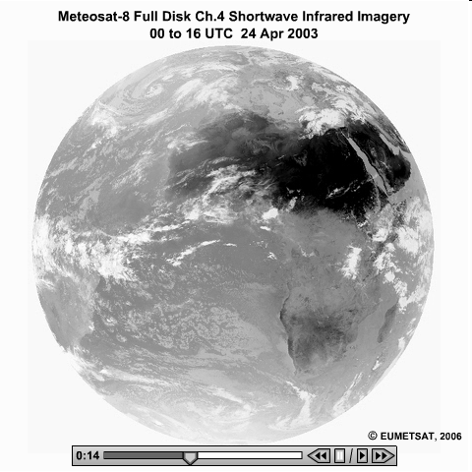
Direct Comparison of Collocated Radiances
Ob1-Ob2
Radiances
Relative differences
Limited coverage
Trends
Notes:
These direct comparisons have formed the bulk of the GSICS activities to date, and, therefore form the focus of this presentation.
However, these represent only 1 of the 3 basic methodologies we use to address the requirements of GSICS.

Slide 3
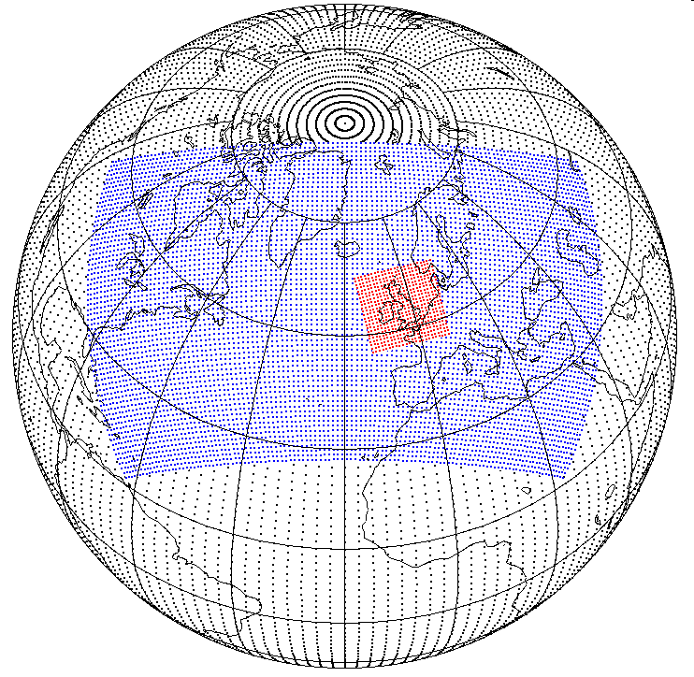
Indirect Comparison via NWP model
Ob1-Ob2
Ob1-Model
RTM
Ob2-Model
Radiances
Atmospheric Variables, p (z), T (z), q (z), l (z)
z
Ob-Model stats for ranges of:
Lat/Lon, angles, dates, radiances
Double differencing
Cancels model bias
Regional averages
Extended ranges
Trends/Sensitivities
Temp / Dew Pt
NWP Model
Notes:
Another method we are investigating in parallel with direct comparisons, is indirect comparisons, against a third party.

Slide 4
How to inter-cal with RTMs?
Numerical Weather Prediction (NWP) centres routinely
Process observations from multiple satellite instruments
Run RTM for each observation (or a subset)
Monitor relative differences to quality control satellite observations
Apply empirical bias correction to ensure consistency
Currently only for Microwave + IR channels
Calculate Double Differences
Assumption – NWP+RTM model biases cancel out
Limiting range of conditions to minimise variability of these biases
Also possible with other inputs – e.g. GRUAN profiles
Higher quality control
Higher absolute accuracy possible
Far fewer samples

Slide 5
Why inter-cal with RTMs?
Direct comparisons are not always possible
Incompatible orbits
Not simultaneous
To increase the sample size
NWP+RTM models can generate millions of „collocations“ per day
To increase diversity of comparison – allows investigation of
Diurnal variations
Scan-angle dependence, etc
Work with NWP + RTM communities to understand model biases

Slide 6
Previous GSICS work on NWP+RTM inter-cal
Had proposed a dedicated sub-group on the topic
Dropped in favour of following it up in sub-groups
Probably only IR and MW sub-groups at the moment
Microwave is certainly more developed than the IR in this regard
EUMETSAT commissioned external studies:
Can be used for tracking relative changes between instruments
But no absolute agreement with direct inter-calibration methods

Slide 7
Coordinating NWP+RTM method within GSICS
GSICS is about inter-calibration
We should not get “bogged down” in RTM details
RTMs are a tool to allow comparison of different sensors, based on double-differences.
Key for GSICS to understand models’ relative biases and how to constrain them
Coordinate with NWP + RTM experts to understand relative biases
Commonalities that would benefit from coordination
Follow up in Microwave Sub-Group session – Item 6g
Web meeting for IR Sub-Group? Guest chair?

Slide 8
Thank you for your attention
Your thoughts?

