Slide 1
UV Instrument and Project Leads
Instrument | Main Contact Web Site | Reflectivity/ Aerosols | Solar Spectra | Ozone Profiles | Calibration
ACE/MAESTRO
EPIC |  |  |  |  | K. Yang
GEMS
GOME | D. Loyola |  | M. Coldewey-Egbers, S. Slijkhuis
GOME-2 | R. Munro |  | M. Krijger |  | R. Lange
GOMOS
OMI | G. Jaross | O. Torres | S. Marchenko, M. DeLand, K. Yang
OMPS Nadir | L. Flynn | L. Flynn | M. Bali, J. Niu | L. Flynn | C. Pan,
OMPS Limb | G. Jaross |  |  |  | G. Jaross
OMS
OSIRIS
SAGE III | D. Flittner |  |  | S. Buckner
SBUS | F-X. Huang |  |  | F-X. Huang
SBUV/2 | L. Flynn |  | L-K Huang | L. Flynn | L-K Huang
SCIAMACHY | M. Weber |  | K. Bramstedt, T. Hilbig, M. Krijger
SOURCE (SOLSTICE/SIM) | M. Snow, T. Woods |  | J. Harder, E. Richard
TEMPO | K. Chance
TOMS
TOU | W-H. Wang | W-H. Wang | Y. Li
TropOMI | C. Zehner
UVN |  |  |  |  | B. Ahlers, M. Dobber

Slide 2
4.a. Using Version 8 Ozone Profile algorithm initial and final residuals to track calibration drift and estimate biases between instruments.
By L. Flynn, Z. Zhang & C.T. Beck
www.star.nesdis.noaa.gov/smcd/spb/OMPSDemo/

Slide 3
Outline
Project Overview
SBUV/2 CDR Example
Drifting Orbit (SZA) Examples
Operational Examples
Radiance Comparison Ideas
Contribution Function Equivalences

Slide 4
Initial Measurement Residual Project
The purpose of this project is to use initial measurement residuals from the Version 8 ozone profile retrieval algorithm to compare channels from 240 nm to 290 nm. (Note, this will require modification of the first guess creation to use consistent total ozone starting values as inputs.)
Ascending/descending equivalent channel ideas will be used with hyperspectral measurements.
Zonal mean and other matchup criteria will be used both to establish offsets and track relative drifts.
Expand SBUV(/2) results to other sensors (OMPS, SBUS, OMI, GOME-2)
Monitor time dependence for multiple instruments.
http://www.star.nesdis.noaa.gov/smcd/spb/OMPSDemo/proSBUV2released-2.php
http://www.star.nesdis.noaa.gov/smcd/spb/OMPSDemo/proOMPSbeta.O3PRO_V8.php
Goals
  Agreement at 2% for Profile channels by using the Version 8 A Priori Profiles with TOMRad Tables and single scattering.

Slide 5
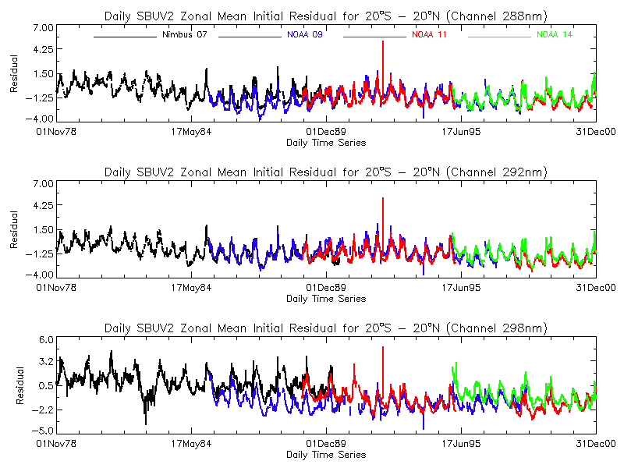
Long-term Inter-calibrated Initial Residuals for SBUV/2

Slide 6
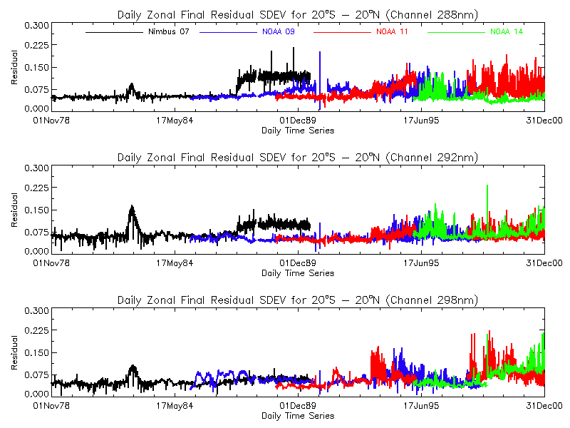
Long-term Inter-calibrated Final Residuals for SBUV/2

Slide 7
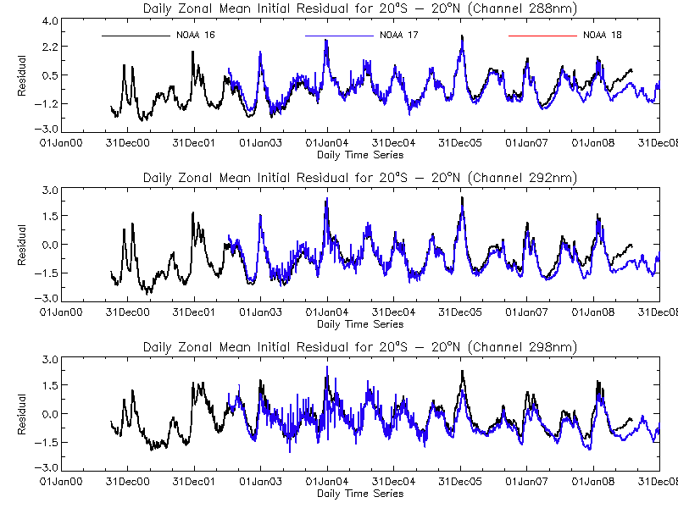
Inter-calibrated Initial Residuals for SBUV/2 with SZA Drift

Slide 8
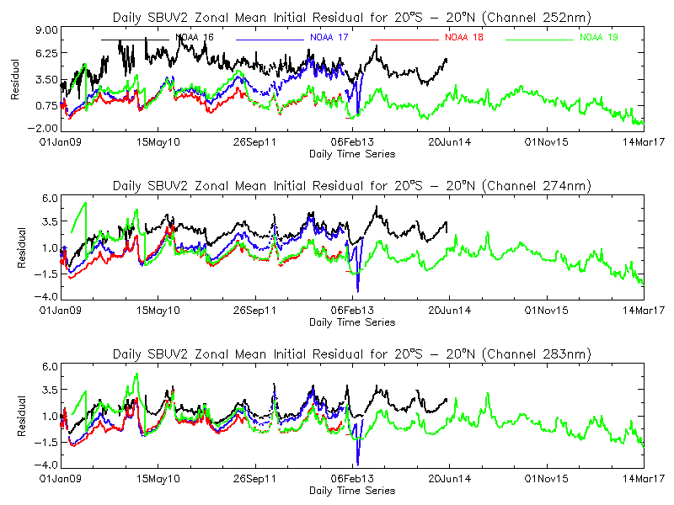
Operational Initial Residuals for SBUV/2 with SZA Drift and Calibration Adjustments

Slide 9
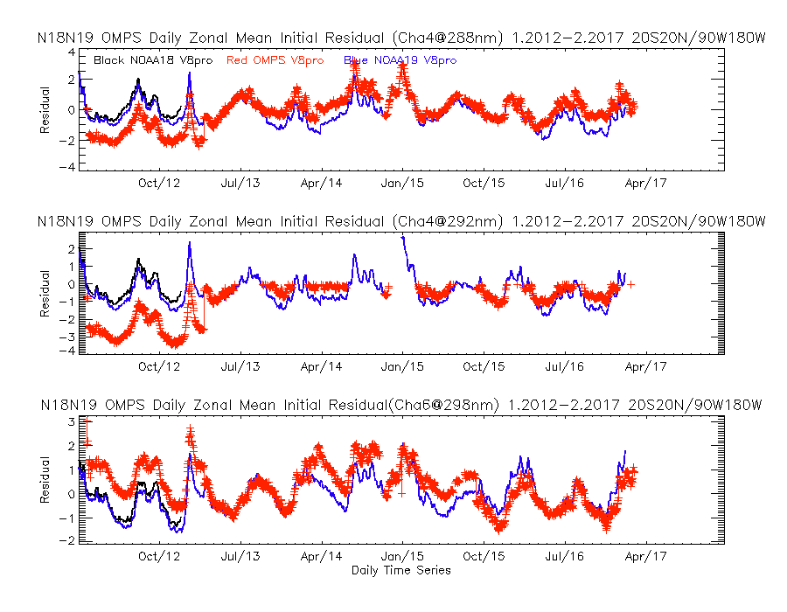
Operational Initial Residuals for SBUV/2 & OMPS with Operational Adjustments

Slide 10
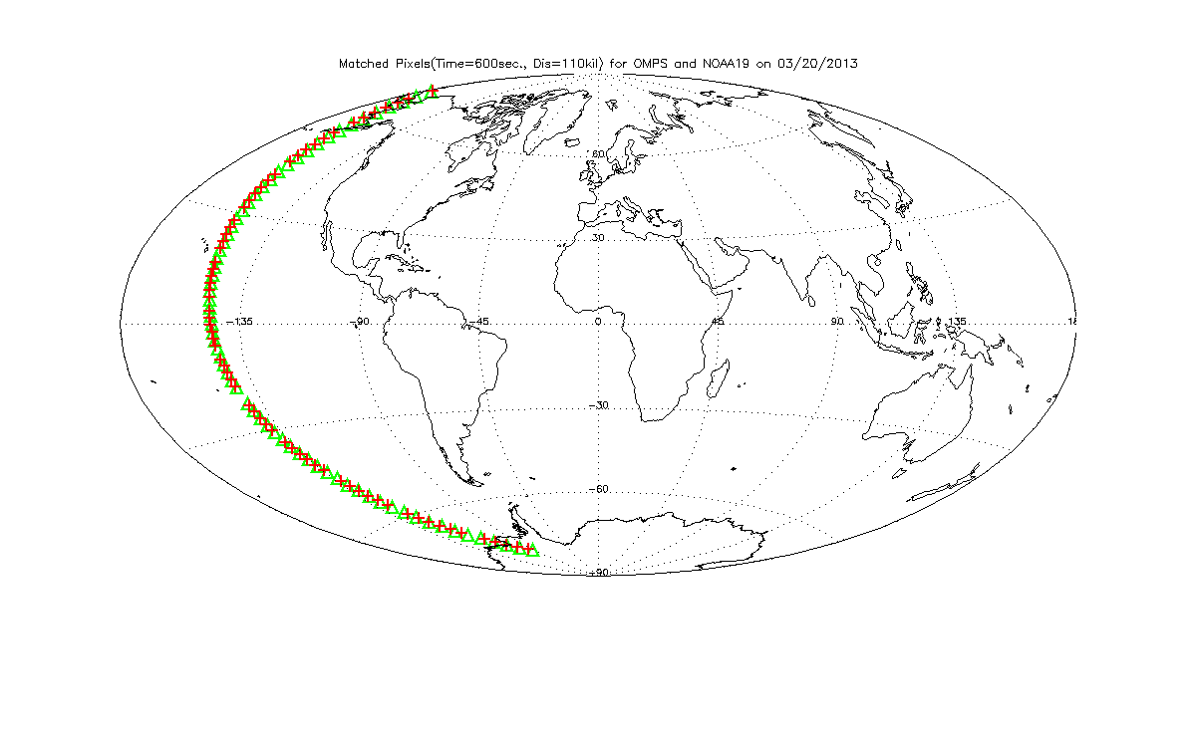
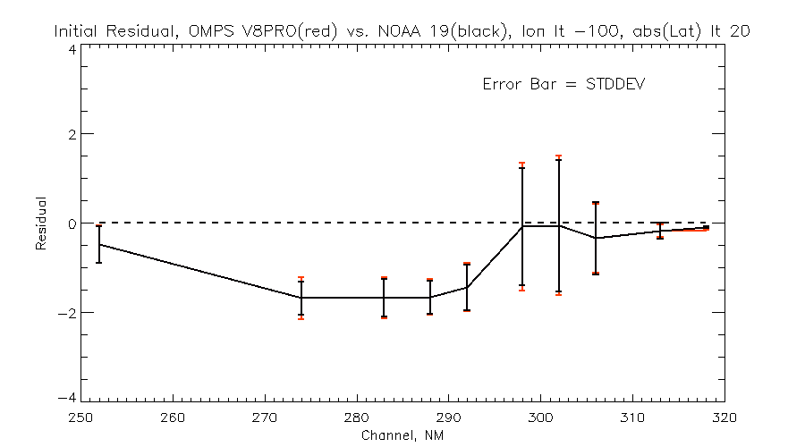
Matching orbit on 3/20/2013 for S-NPP OMPS and NOAA-19 SBUV/2

Slide 11
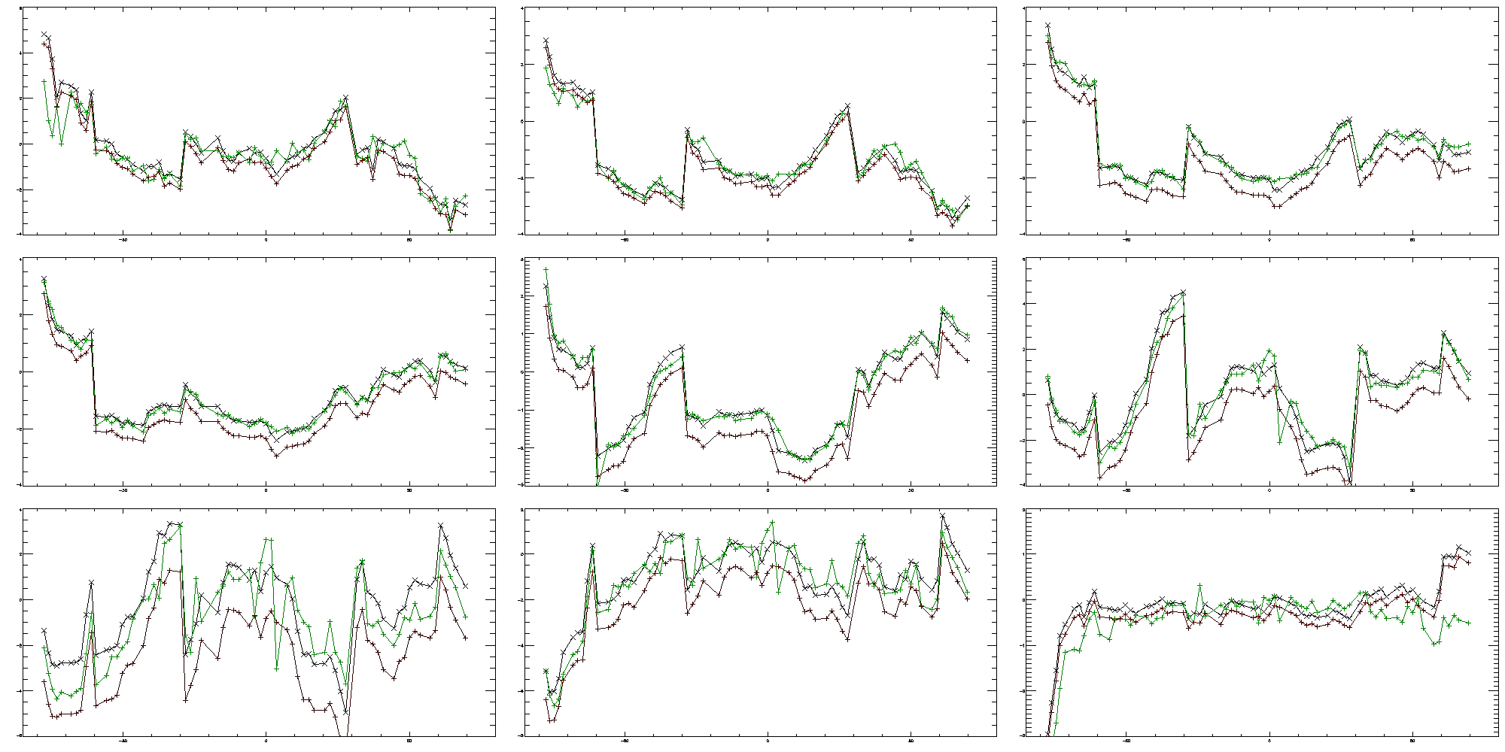
V8Pro Initial Residuals along Chasing Orbit
Red and Black OMPS (Before and After), Green SBUV/2.
Jumps at 30N/S and 60 N/S where climatologies switch latitude bins.
Adjustments: 254 0.4; 274 0.3; 283 0.6; 288 0.5; 292 0.5; 298 1.1; 302 2.3; 306 1.3; 312 0.3
3%
254 nm
3%
274 nm
3%
283 nm
3%
288 nm
3%
292 nm
3%
298 nm
3%
3%
3%
306 nm
312 nm
302 nm
Notes:
Changes at 30N/S and 60N/S are changes in profile climatologies.
The adjustments for OMPS V8PRO
253.510 1.0 0 0.432306
273.680 1.0 1 0.278885
283.010 1.0 1 0.594589
287.700 1.0 1 0.533733
292.410 1.0 1 0.546053
297.550 1.0 1 1.10301
301.850 1.0 1 2.2710
305.730 1.0 1 1.26444
312.478 1.0 1 0.289876
317.497 1.0 1 0.051534
331.279 1.0 1 -0.512017
339.622 1.0 1 0.0
378.438 1.0 1 0.451
Statistics NOAA19 Vs OMPS V8PRO over Pacific box after adjustment
the average NOAA19 reflectivity is: 0.209939
the average OMPS reflectivity is: 0.209933
the average NOAA19 stp1oz is: 256.821
the average OMPS stp1oz is: 256.796
the average NOAA19 stp2oz is: 254.914
the average OMPS stp2oz is: 255.348
the average NOAA19 aerosol is: 0.415739
the average OMPS aerosol is: 0.420372
the average NOAA19 stp3oz(bsttoz) is: 253.768
the average OMPS stp3oz(bsttoz) is: 254.164

Slide 12
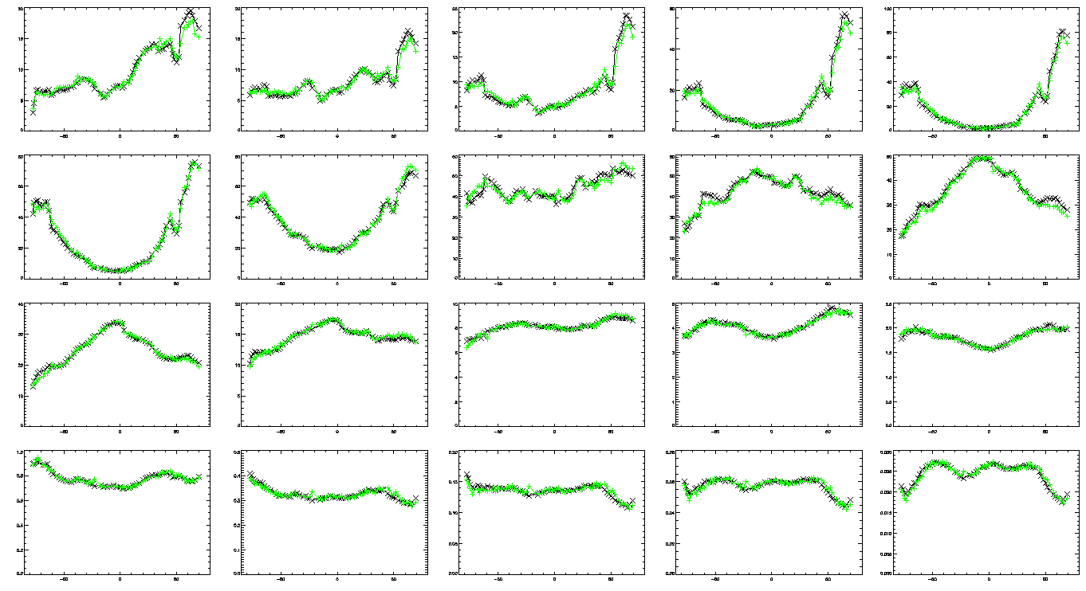
V8Pro Layer Ozone, Bottom to Top
Bottom to top, Black OMPS (After) and Green SBUV/2.
Notes:
Jumps at 60S and 60N are changes in profile climatologies.

Slide 13
Outline of an Approach for Comparisons of radiance/irradiance ratios from 240 nm to 300 nm
Double Difference using Climatology:
Compute the measurement residuals using a forward model with the effective scene reflectivity of the clouds and surface determined from longer channel measurements, and the ozone profile prescribed by the Version 8 a priori climatology. Use viewing geometries and bandpasses are as reported for each instrument.
Compare residuals for channels λ1 and λ2 where S1*α1 = S2* α2, where S values give the path lengths and α values give the ozone absorption cross sections. That is, works with pairs of wavelengths where the measurement contribution functions are similar.
Perform comparisons (statistical trade off in quantity of matchups vs. quality)
  Simultaneous nadir overpass matchups
  Zonal means (and No-local-time-difference zonal means)
  Opportunistic formation flying / Chasing orbits
  Benign geographic regions (e.g., Equatorial Pacific Box)
  Ascending/descending zonal means (In the Summer hemisphere, the same latitude is observed twice so one can obtain a set of internal comparisons.)
Forward model and measurements
  V8 SBUV/2 forward model and A Priori as transfer for Viewing conditions
  Complications from real diurnal variations in the ozone profiles
  Complications if best ozone product values differ and initial residuals are used
  Measurement residuals’ correlation with scene reflectivity for longer wavelengths can disclose stray light contamination.
Notes:
I believe a similar method was used to check the GOME long-term calibration by assuming stable equatorial ozone profiles.

Slide 14
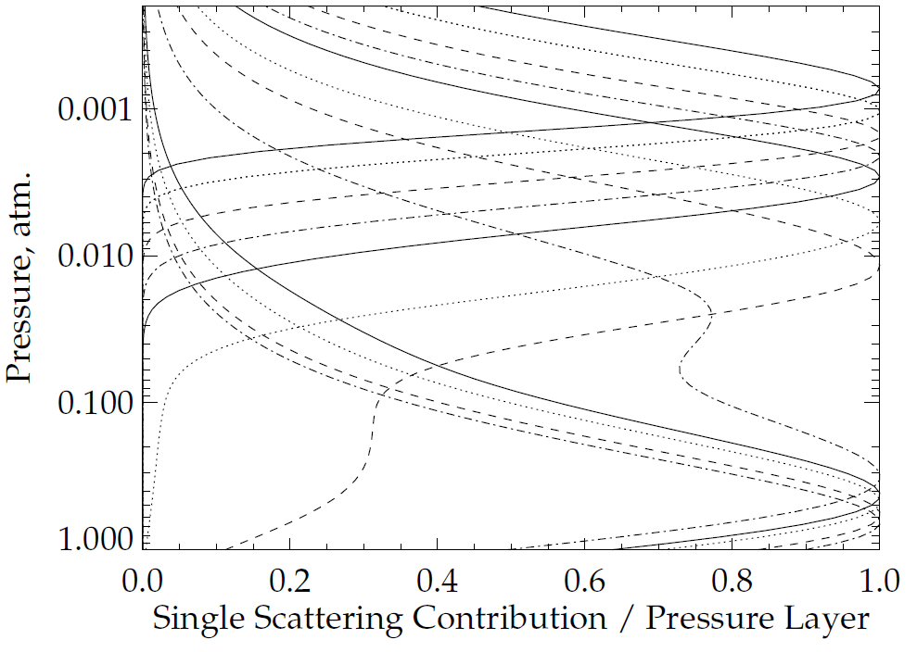
273 nm
253 nm
318 nm
340 nm
Figure 6.a. Normalized Single Scattering Contribution Functions for 12 wavelengths at [253,273,283,288,292,297,302,306,313,318,331,340] nm for a 325 DU total column ozone profile for Solar Zenith Angle θ₀ = 30°.

Slide 15
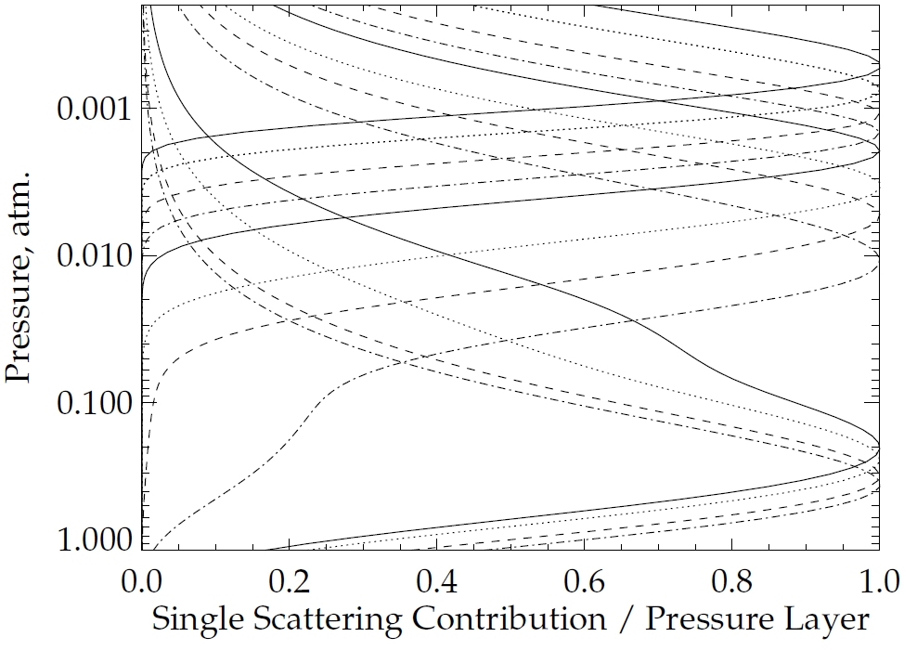
273 nm
318 nm
340 nm
Figure 6.b. Normalized Single Scattering Contribution Functions for 12 wavelengths at [253,273,283,288,292,297,302,306,313,318,331,340] nm for a 325 DU total column ozone profile for Solar Zenith Angle θ₀ = 70°.

Slide 16
Pseudo-Channels in the UV from 250 nm to 300 nm
As the SZA or SVA increases, the contribution functions shift up. One can find combinations (linear?) of radiances for longer channels that can represent (capture the response to ozone changes) a measurement at a shorter channel at SZA=0 and SVA=0. (MW Pseudo-Channel Ideas)
We can compare instruments measuring at different viewing geometries or times of day.
This can help to determine both internal and external biases.
Diurnal ozone variations will present an involved complication.
Changing channel emphasis can introduce wavelength-dependent biases.

Slide 17
Summary, Questions and Future
Initial measurement residuals can identify calibration biases between instruments.
Provide tools to create initial residuals for other instruments.
Expand and formalize matchup techniques.
Reprocess and Homogenize NOAA-16 through NOAA-19 SBUV/2 and OMPS NP for a post-2000 Ozone Profile CDR.
Create invariant channel combinations under SZA & SVA changes.
Notes:
For the Comparisons of Initial Measurement Residuals for Ozone Profile Channels project, we have used this method to generate soft calibration adjustments to remove measurement bias between the NOAA-19 SBUV/2 and S-NPP OMPS NP. We will reprocess the first five years of OMPS NP measurements and compare the two records. Talk 4.a in this meeting will cover some of these results.

Slide 18
Backup Slides

Slide 19
The figures show the initial measurement residuals for three profile wavelengths (Top 288 nm, Middle 292 nm, and Bottom 298 nm) for the V8PRO product for the equatorial daily zonal means (20N to 20S). The two sets of data are for the NOAA-16 SBUV/2 and the NOAA-17 SBUV/2. The units are N-values (~2.3%). The Version 8 algorithm a priori ozone profiles and forward model have been used to allow direct comparison of the radiance/irradiance ratios for the two instruments. NOAA-16 was an afternoon satellite and NOAA-17 was a morning satellite during this period. By the end of the record, the NOAA-16 satellite was in a late afternoon orbit.
Notes:
http://www.star.nesdis.noaa.gov/icvs/prodDemos/index.php

Slide 20
Adjustments using A, K, and Dy
The Averaging Kernel, A, is the product of the Jacobian of partial derivatives of the measurements with respect to the ozone profile layers, K, and the measurement retrieval contribution function, Dy:
A = Dy # K
For a linear problem, the retrieved profile, Xr, is the sum of the A Priori Profile, Xa, plus the product of the Averaging Kernel, A, times the difference between the Truth Profile, Xt, and Xa:
Xr = Xa + A # [Xt – Xa]
The measurement change, ΔM, is the Jacobian times a profile change, ΔX:
ΔM = K # ΔX
The retrieval change, ΔXr, is the contribution function times a measurement change, ΔM:
ΔXr = Dy # ΔM
D_{y} = S_{a}K_{a}^{T} [K_{a}S_{a}K_{a}^{T} + S_{M}]⁻¹

Slide 21
+ ΔXr
* Dy # ΔM
Comparison of actual differences in annual tropical zonal mean profiles retrieved by NOAA-16 and NOAA-17 SBUV/2 for 2003 with those predicted by the differences in their initial residuals. The “+” symbols are ΔXr computed directly and the * symbols are Dy ΔM.
Notes:
Dy, measurement contribution function; deltaM, difference in annual tropical zonal mean initial measurement residuals.

Slide 22
Comparison Considerations
Different spectral and spatial resolution
  Forward models can remove these dependencies
Chasing orbits
  If orbital periods are slightly off, then beat frequency matchups are better.
SNO for AM with PM (+product comparisons?)
  No-local-time difference zonal means
Asc/Desc Langley –> S1*alpha1 = S2*alpha2

Slide 23
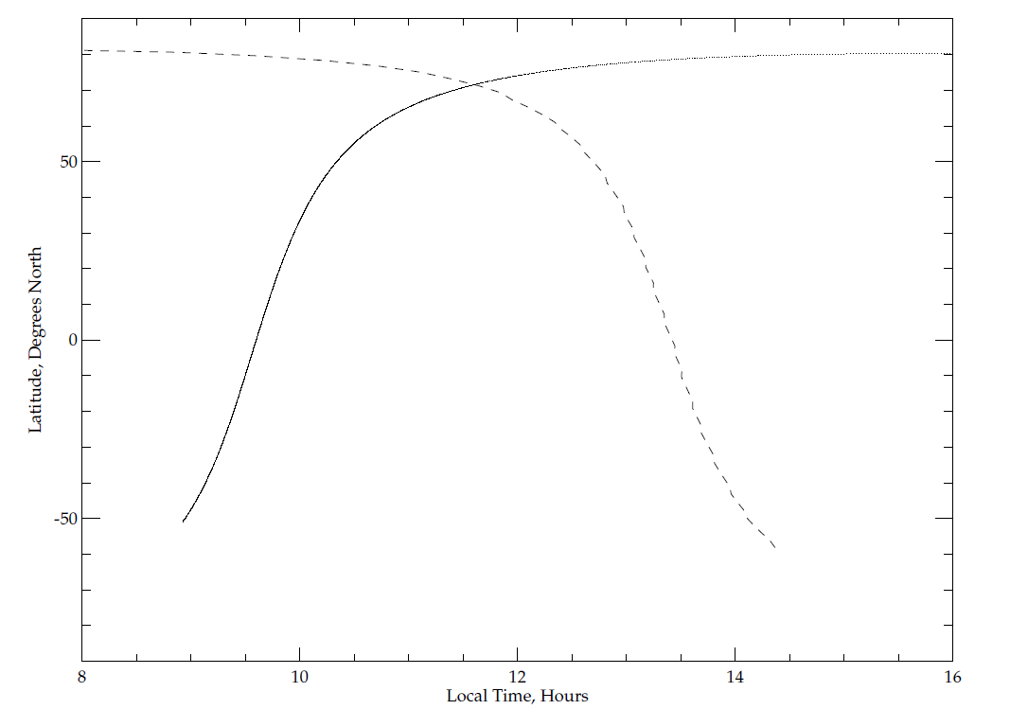
Simultaneous Nadir Overpass and
No Local Time Difference Comparisons
Latitude range
for zonal mean
Latitude, Degrees North
---- GOME-2
- - - OMPS
Local Time, Hours

Slide 24
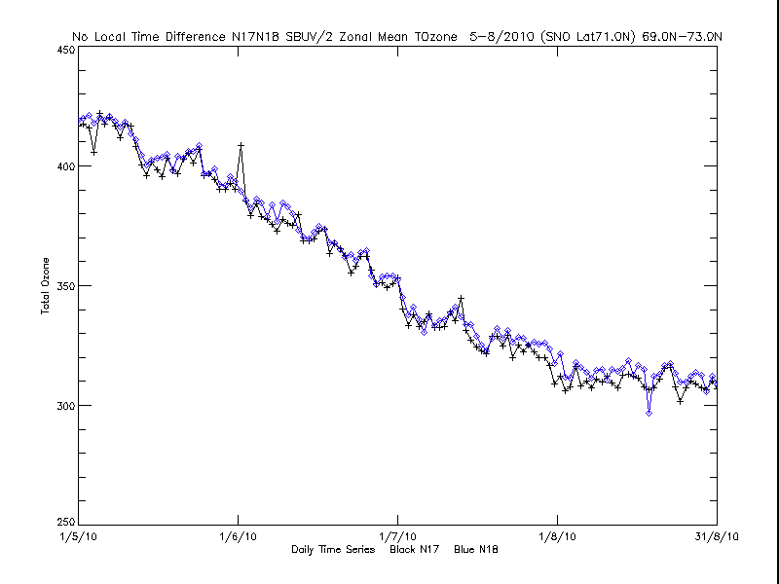
No Local Time Difference Comparisons, NOAA-17 SBUV/2 & NOAA-18 SBUV/2
May-August 2010, 69 N to 73 N, Daily Zonal Mean
Total Ozone, DU
+----+ NOAA-18 SBUV/2
--<>-- NOAA-17 SBUV/2
Daily Time Series

Slide 25
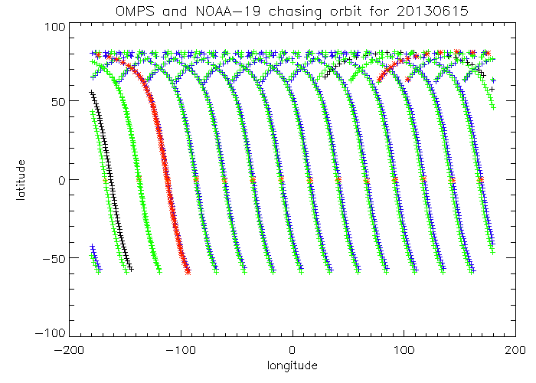
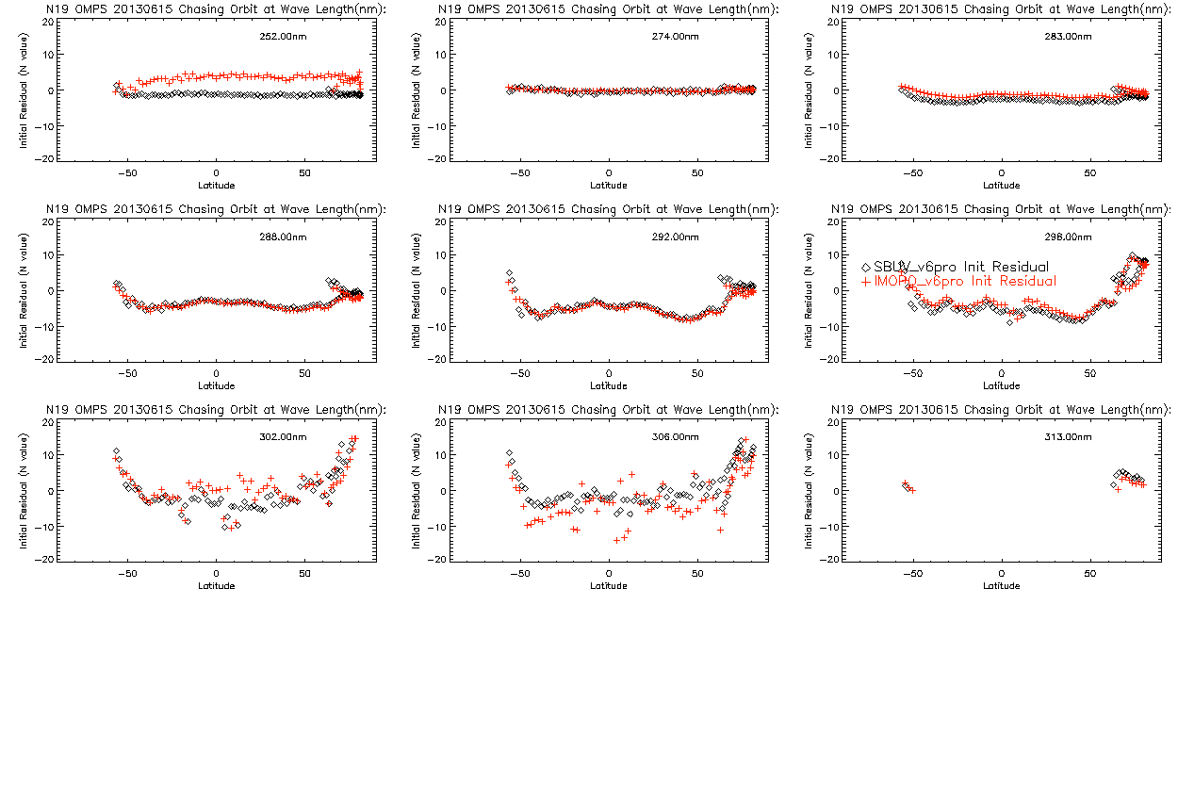
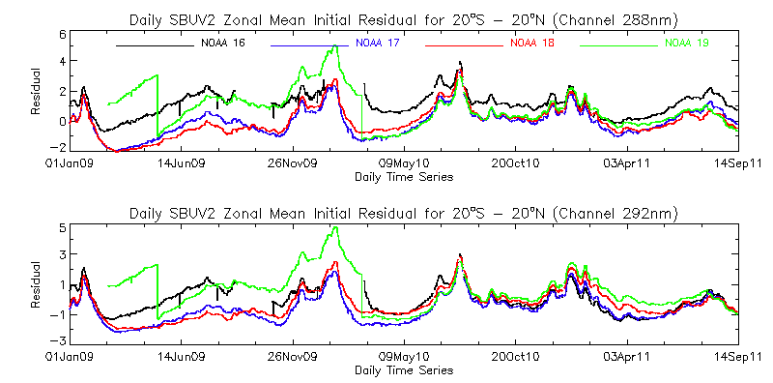
Well-matched Orbits for 6/15/2013
Comparison of Initial V6 Measurement Residuals
for S-NPP OMPS NP and NOAA-19 SBUV/2
Latitude, Degrees North
Longitude, Degrees East
Operational Initial Residuals for SBUV/2
Daily Means
Equatorial Pacific Box
20S – 20N Latitude
100W to 180W Longitude

Slide 26
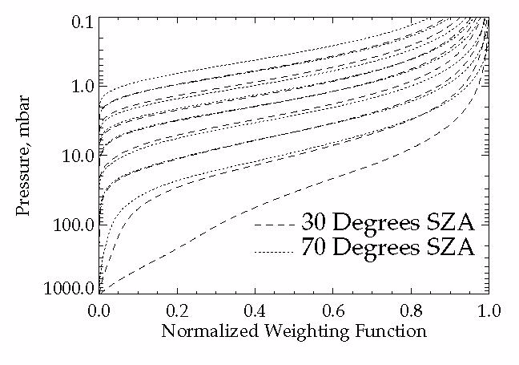
252 nm
273 nm
302 nm
306 nm
S1*α1 = S2* α2, Si = 1 + sec(SZAi) for nadir viewing
Notes:
Figure 2. Normalized weighting functions for SBUV/2 measurements for a standard 325 DU (0.325 atm.-cm.) ozone profile for two SZAs (Eight wavelengths from 252, 273, 283, 288, 292, 298, 302 to 306 nm)
The normalized single-scattering weighting functions, which show how sensitive the measurements are to ozone changes as functions of pressure, are given for eight wavelengths (252, 273, 283, 288, 292, 298, 302, and 306 nm) in Figure 2. The two sets of curves from top to bottom are for the wavelengths from short to long. This shows, for example, that the measurement by a space-based instrument looking down on a sunlit atmosphere of the radiance at 252 nm is primarily affected by changes in the ozone above 2.0 mbar while the measurement at 306 nm is affected by changes in ozone throughout the stratosphere. Ozone profile retrieval algorithms make use of this physical difference in the spectral measurements to obtain estimates of vertical ozone profiles.
The information at wavelengths measured by a BUV instrument shifts upward as the Solar Zenith Angle (SZA) or the Satellite Viewing Angle (SVA) increases and the path length of photons through the atmosphere increases. For the example in Figure 2, at 70° SZA, the 273 nm measurements responds to changes in the ozone vertical profile in almost the same manner as the 252 nm measurements do at 30° SZA. Notice that the second highest dotted curve and the highest dashed curve almost coincide.
The eight wavelengths in Figure 2 are the standard profiling wavelengths for normal SBUV/2 observations. They provide good coverage of the stratosphere. The gradual decrease in the weighting function (the lack of sharp cutoffs) limits the resolution of the vertical profile information. Even these eight wavelengths have some redundancy in their information and it remains to be seen how much new information will be obtained by denser spectral coverage.
Hyperspectral algorithms for profile retrievals are under development. The duplication of measurement information both spectral and spatial, should help to provide internal consistency and calibration checks. It will also help with methods for radiance comparisons between measurements for Cal/Val work.
Limb viewing produces a geometric magnification of layer response compared to nadir viewing, but with at the cost of a large increase in the optical path.

Slide 27
Possible Goals/Topics for the UV Subgroup
1. Exchanges and traceability of standards
  NIST and SIRCUS
  Integrating Spheres, diffusers, lamps, lasers, etc.
2. Establish a library of solar measurements
  Reference high resolution solar (SOLSTICE, SIM, Kitt Peak, etc.)
  Mg II Index time series, Scale factors at resolution (new OMI)
3. Establish a library of instrument data bases
  Bandpasses, calibration constants, wavelength scales
  Day 1 solar, time series with error bars
  Mg II Indices and scale factors
  FOVs, Polarization sensitivity,
  Reference papers, ATBDs, validation, Shift & Squeeze,
4. Establish a library Absorption data bases
  O3 in the UV with wavelength and temperature dependence
    at instrument resolution – from DOAS?
  UV compared to Visible and IR
  other species -- SO2, NO2, etc.
5. Standard climatologies; vicarious calibration & residual studies
  Ozone and temperature profiles, covariances
  Neural net, with tropopause information
  Averaging kernels or efficiency factors, measurement contribution functions, and Jacobians
6. Analysis of on-board systems
  Diffusers, stable orbits
  White lights, spectral lamps, LEDs
  Moon views
Stray light, linearity, gains, offsets, mirrors, polarisation, λ-scale, bandpass
7. Considerations for comparisons
  Complications from diurnal variations, SZA, SVA, RAA
  Zonal means
  Simultaneous nadir overpass (Rad/Irrad or products)
  Formation flying / Chasing orbits
  No-local-time differences
  Ice, desert and open ocean targets
  Pacific Box
  LEO to GEO to L1
8. Internal consistency techniques
  Ascending/descending -- Langley methods
  Pair justification
  DOAS (and EOF analysis) (Closure polynomials)
  Stray light correlation
  Wavelength scale, shift and squeeze, etc.
  Measurement Residuals, reflectivity range/distribution
9. Forward model and measurements
  Rayleigh
  Absorption
  Spherical geometry
  Inelastic scattering (Ring Effect), Stray light, solar activity
  Aerosols
  Polarization
  TOMRAD, VLIDORT, SCIATrans, CRTM, etc.
  V8 SBUV/2 and A Priori as transfer for Viewing conditions…
10. Reflectivity
  Surface (database and snow/ice forecasts), Variations in surface reflectivity with season, sza and sva.
  Surface pressure
  Clouds (Cloud top pressure)
  Cloud-optical-centroids (Ring Effect, 02-02, O2 A band)
11. Aerosols
  Climatology/Type, height
  Wavelength or polarization dependence (Aerosol Indices)
12. Nadir Instruments LEO
TropOMI, GOME(-2), OMPS, TOU/SBUS, OMS,
SCIAMACHY, OMI, TOMS, SBUV(/2)
12. Nadir Instruments GEO or L1
TEMPO, GEMS, UVN and EPIC
13. Limb instruments
SAGE III, ACE/MAESTRO, OSIRIS, MLS,
GOMOS, SCIAMACHY, OMPS-LP
14. Ground-based
WOUDC, Dobson, Brewer, Lidar, MW and Ozonesondes
Notes:
http://www.nesdis.noaa.gov/news_archives/dscovr.html
http://science.nasa.gov/media/medialibrary/2012/03/01/Nguyen-DSCOVR-Mission-Briefing-HPS-v01b.pdf

