Slide 1
Proposal for (on-ground) calibration
white paper
for UVNS hyper-spectral sensors
Ruediger Lang, Marcel Dobber and Rose Munro

Slide 2
UVNS hyper-spectral Instrument On-Ground Calibration
GSICS White Paper - TOC
Accuracy, sensitivity and repeatability
Sources / commissioning
Thermal and pressure environment / stability and characterization
Instrument components
Detector level (CCD/linear diode arrays)
  Noise
  PRNU/PPG/RTS
  SMEAR
  Etaloning
  Linearity
Stray-light
Grating and alignment (ISRF)
  Spectral assignment
  Spectral stability
  Slit Irregularity
Pointing and Spatial stability (ISRF/PSF)
  Spatial and spectral aliasing
  Radiometric and spectral scene in-homogeneity errors.
  Detector co-registration (overlap)
Polarisation sensitivity
Radiometric response
  Sources
  Geometry
Diffuser characterisation
Degradation and contamination
..........?
Editor: Ruediger Lang,
Co-Editors: Marcel Dobber, Rose Munro

Slide 3
UVNS hyper-spectral Instrument On-Ground Calibration
Some Examples
Some selected examples

Slide 4
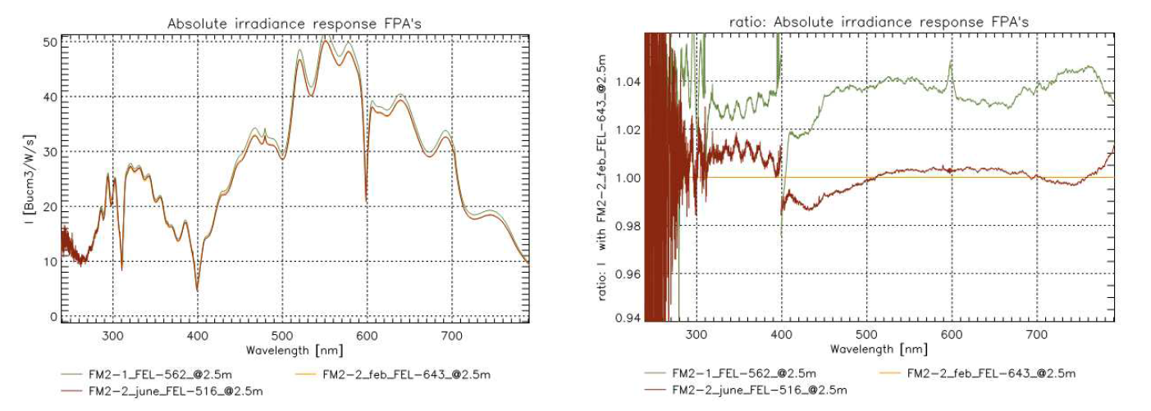
On-ground calibration GOME-2 / Metop
Accuracy, sensitivity and repeatbility
GOME-2 FM2 Metop-B
Example: Radiometric response of the solar (irradiance) measurement port
FM2: Campaigns 2004 / 2011
2004
2012 (Feb)
2012 (June)
2004
σ≈1%
2012
σ≈1%
w.r.t. 2012 (Feb)

Slide 5
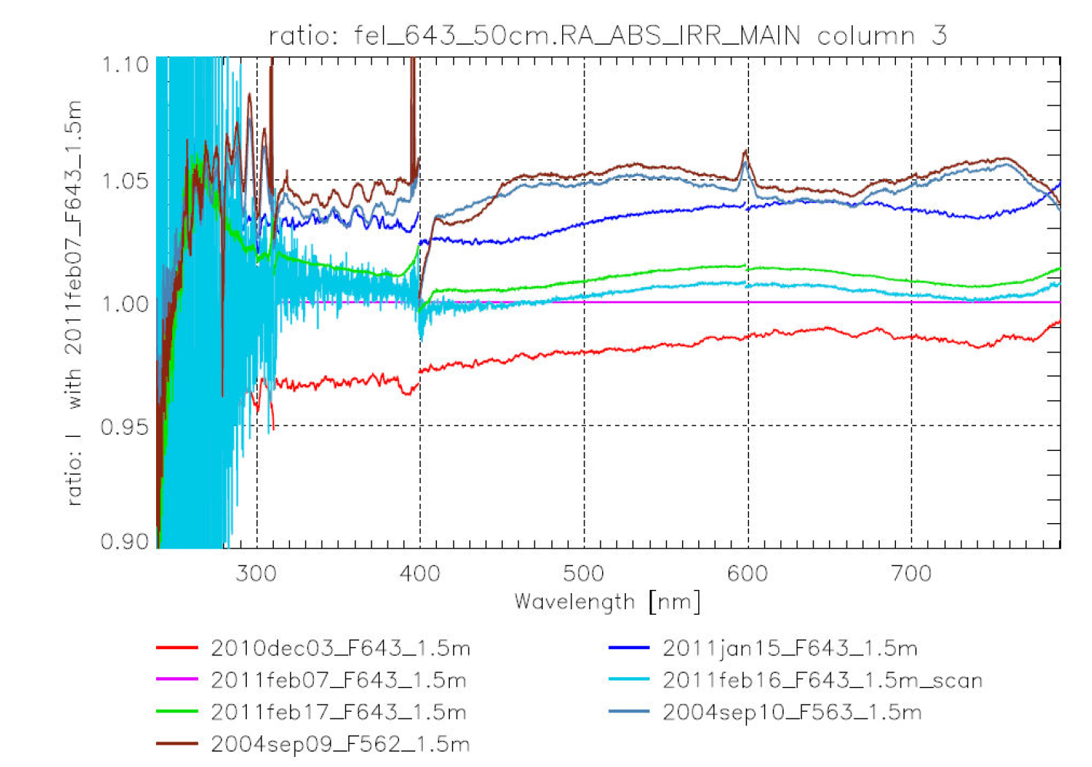
On-ground calibration GOME-2 / Metop
Accuracy, sensitivity and repreatbility
GOME-2 FM2 Metop-B

Slide 6
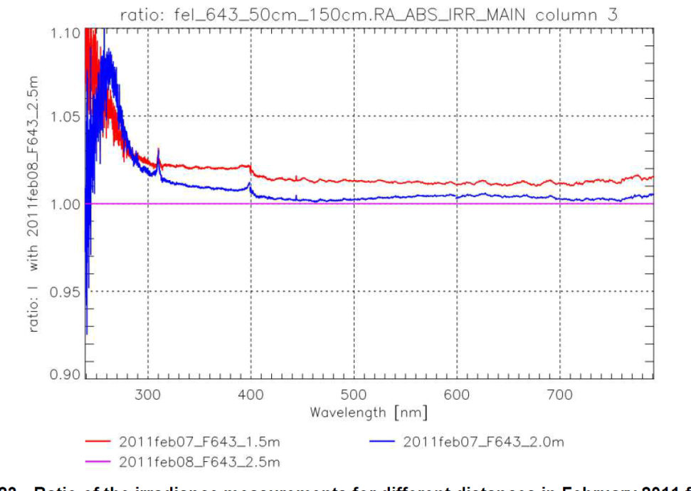
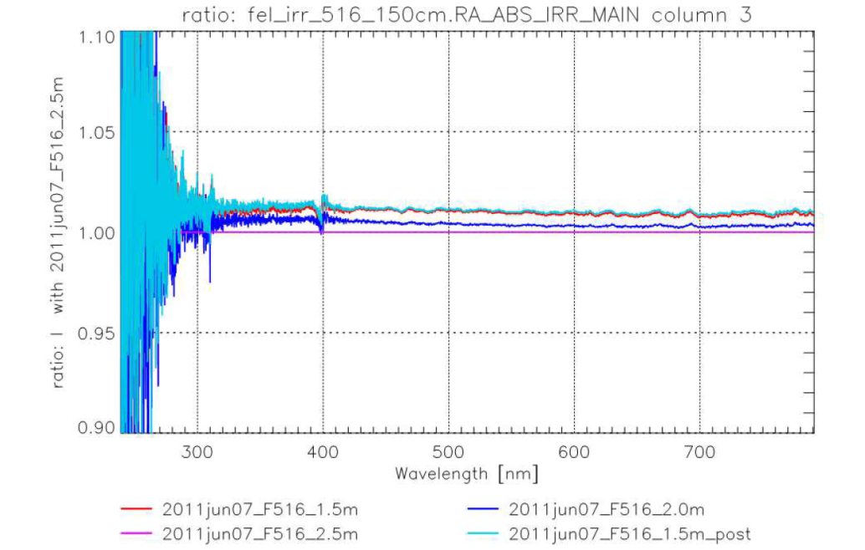
On-ground calibration GOME-2 / Metop
Accuracy, sensitivity and repreatbility
GOME-2 FM2 Metop-B
Multiple source / instrument distance
measurements
Final setup and alignement procedures
1.5 m
2 m
σ≈1%
w.r.t. 2.5 m
Example: Identification of alignement problems from multiple source/instrument distance measurements

Slide 7
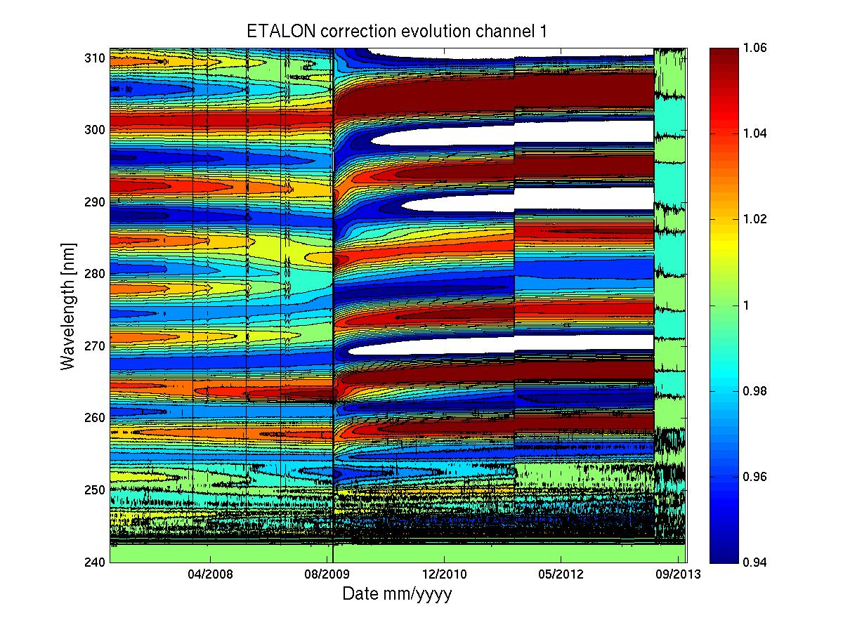
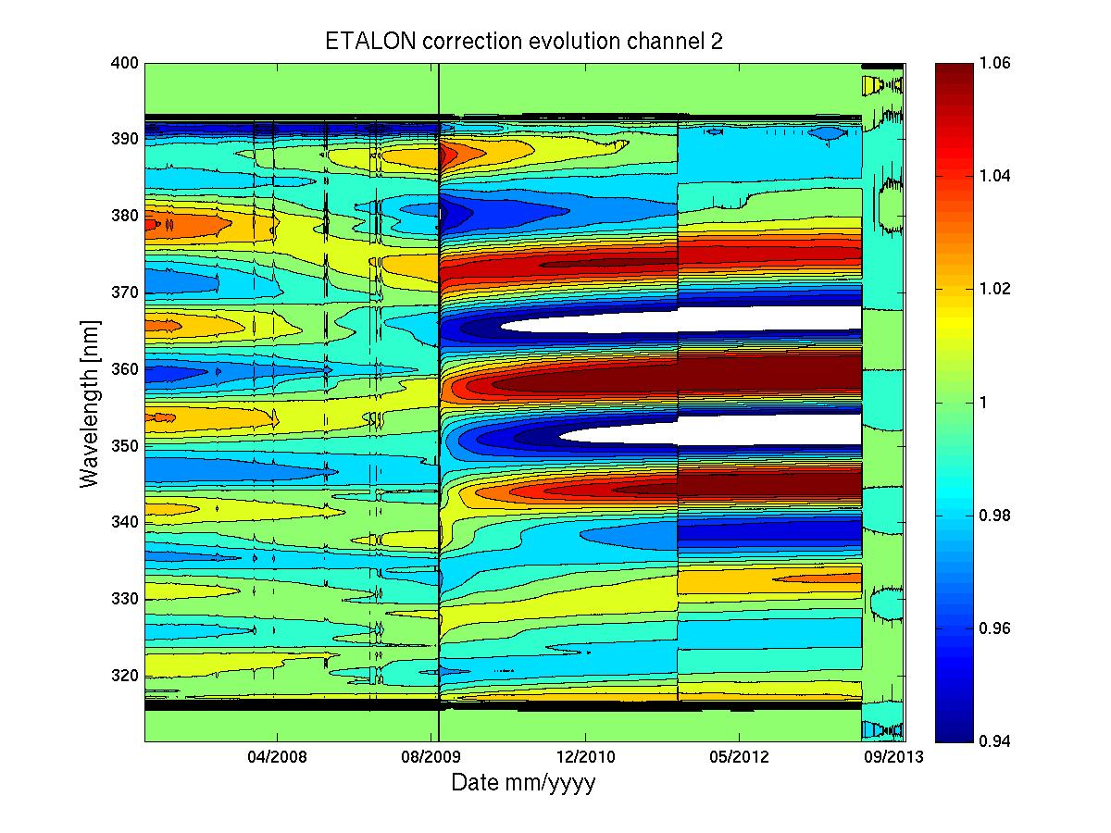
GOME-2 Metop-A Long-term throughput changes
On-board calibration ETALON (FPA)
GOME-2 FM3 Metop-A
Modification of on-ground radiometric response functions to include in-orbit etalon
Reduction of magnitude of in-orbit etalon correction ... plus

Slide 8
GOME-2 Metop-A Long-term throughput changes
On-board calibration ETALON (FPA)
GOME-2 FM3 Metop-A
Modification of on-ground radiometric response functions to include in-orbit etalon
extension of region spectral region corrected

Slide 9
GOME-2 level-1/level-2 products
Online Stokes fraction correction – PPF 4.3 and higher
GOME-2 FM3 Metop-A
GOME-2 FM2 Metop-B
Online in-orbit correction of GOME-2 measured Stokes fractions using special geometries for which q=!0
Correction surface automatically updated 2 to 4 times per month
Used for aerosol retrieval (PMAp)
and for correction of polarisation sensitivity of the instrument
Metop-B / FM2
Metop-A / FM3
Viewing angle
Wavelength
Viewing angle
Wavelength

Slide 10
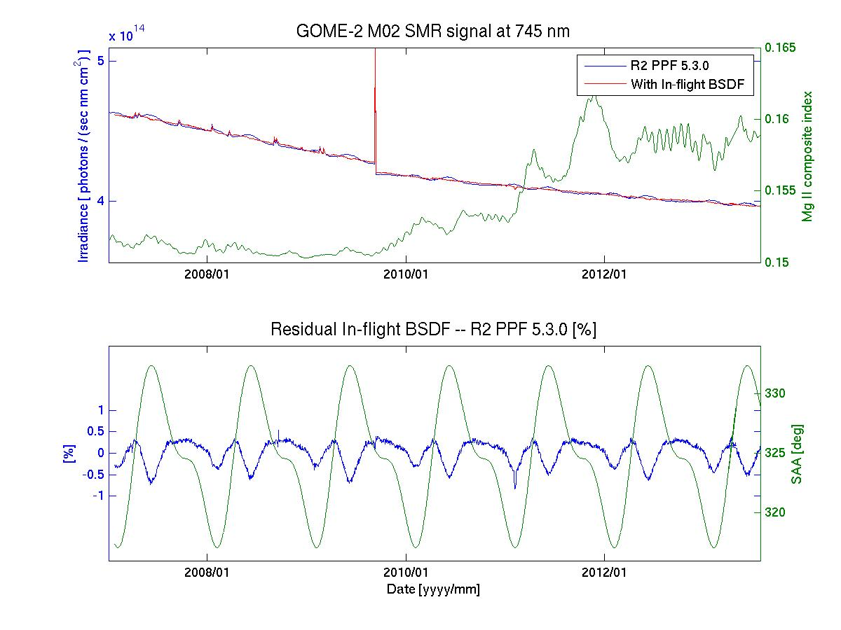
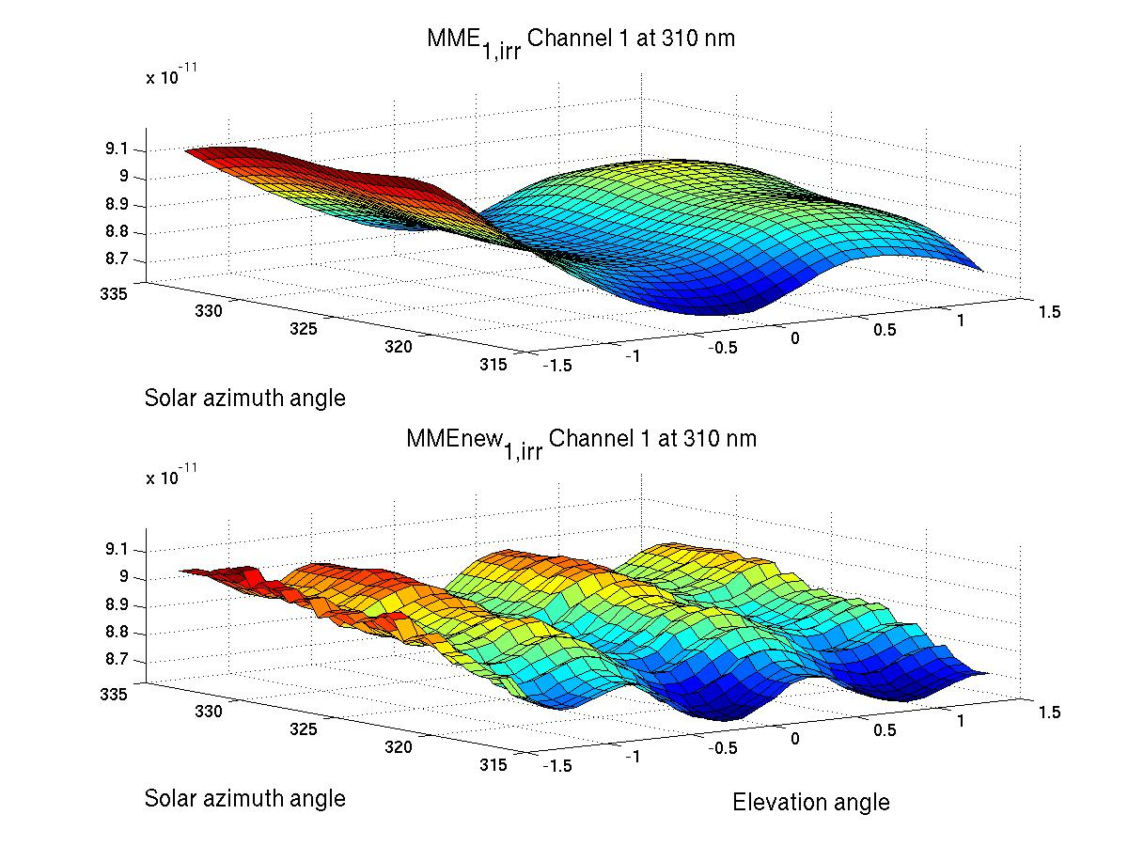
On-ground calibration GOME-2 / Metop
Diffuser degradation
On-ground
In-flight
In-flight--On Ground
On-ground vs. In-flight

Slide 11
UVNS hyper-spectral Instrument On-Ground Calibration
GSICS White Paper – In-orbit or on-ground?
Accuracy, sensitivity and repeatability
Sources / commissioning (in-orbit/on-ground/both)
Thermal and pressure environment / stability and characterization (in-orbit/on-ground/both)
Instrument components
Detector level
  Noise (in-orbit/on-ground/both)
  PRNU/PPG/RTS (in-orbit/on-ground/both)
  SMEAR (in-orbit/on-ground/both)
  Etaloning (in-orbit/on-ground/both)
  Linearity
Stray-light (in-orbit/on-ground/both)....
Grating and alignment (ISRF)
  Spectral assignment
  Spectral stability
  Slit irregularity
Pointing and Spatial stability (ISRF/PSF)
  Spatial and spectral aliasing
  Radiometric and spectral scene in-homogeneity errors.
  Detector co-registration (overlap)
Polarisation sensitivity
Radiometric response
  Sources
  Geometry
Diffuser characterisation
Degradation and contamination
..........?

Slide 12
UVNS hyper-spectral Instrument On-Ground Calibration
GSICS White Paper – criticality / complexity / schedule impact
Accuracy, sensitivity and repeatability
Sources / commissioning (criticality / complexity / schedule)
Thermal and pressure environment / stability and characterization (criticality / complexity / schedule)
Instrument components
Detector level
  Noise (criticality / complexity / schedule)
  PRNU/PPG/RTS (criticality / complexity / schedule)
  SMEAR (criticality / complexity / schedule)
  Etaloning (criticality / complexity / schedule)
  Linearity (criticality / complexity / schedule)
Stray-light (criticality / complexity / schedule)....
Grating and alignment (ISRF)
  Spectral assignment
  Spectral stability
  Slit irregularity
Pointing and Spatial stability (ISRF/PSF)
  Spatial and spectral aliasing
  Radiometric and spectral scene in-homogeneity errors.
  Detector co-registration (overlap)
Polarisation sensitivity
Radiometric response
  Sources
  Geometry
Diffuser characterisation
Degradation and contamination
..........?

Slide 13
UVNS hyper-spectral Instrument On-Ground Calibration
GSICS White Paper - TOC
Accuracy, sensitivity and repeatability
Sources / commissioning (Author: ..... It could be you!!!)
Thermal and pressure environment / stability and characterization (Author: ..... It could be you!!!)
Instrument components
Detector level (Author: ..... It could be you!!!)
  Noise (Author: ..... It could be you!!!)
  PRNU/PPG/RTS (Author: ..... It could be you!!!)
  SMEAR (Author: ..... It could be you!!!)
  Etaloning (Author: ..... It could be you!!!)
  Linearity (...)
Stray-light
Grating and alignment (ISRF)
  Spectral assignment
  Spectral stability
  Slit irregularity
Pointing and Spatial stability (ISRF/PSF)
  Spatial and spectral aliasing
  Radiometric and spectral scene in-homogeneity errors.
  Detector co-registration (overlap)
Polarisation sensitivity
Radiometric response
  Sources
  Geometry
Diffuser characterisation
Degradation and contamination
..........?
Call for contributors

Slide 14
UVNS hyper-spectral Instrument On-Ground Calibration
GSICS White Paper - Conclusions
Call for contributions to a white-paper on (on-ground) hyper-spectral instrument calibration.
Contributors can take responsibility for a particular sub-section of the paper per interest and experience.
Reviewing by GSICS community (and potentially “external” reviewers / Industry?)
For discussion:
What are we missing in the TOC?
Do we want/need to have an “in-orbit” section?
Do we want to include vicarious calibration?
Do we need more fundamental/philosophical sections like:
  Calibration campaign organisation,
  Campaign schedules,
  Campaign planning, etc...?
In-situ (“open-roof”) measurements?
Novel sources (for hyper-spectral calibrations / stray-light)?

Slide 15
The end

