Slide 1
UVN solar reference and model quality
w.r.t. GOME-2/Metop
Ruediger Lang, Gabriele Poli,
Roger Huckle and Rose Munro

Slide 2
GOME-2 Solar reference comparisons First GOME-2 solar spectrum MetopB
GOME-2 /Metop- B Solar spectrum
taken at 29th October 2012 (41 days in-orbit)
Wavelength [nm]
Spectral resolution:
0.12 nm (240 to 400 nm)
0.24 nm (400 to 780 nm)

Slide 3
GOME-2 Solar reference comparisons Solar Reference Spectra I
1) KPNO / AFGL
Kitt Peak National Observatory (KPNO) spectrum
combined with Halland Anderson AFGL spectrum worked on by
Kurucz RL,Furenlid I,Brault J,Testerman L.Solar flux atlas from 296 to 1300nm National Solar Observatory, Sunspot, NewMexico,1984.
And Chance K, Spurr RJD. Ring effect studies: Rayleigh scattering, including molecular parameters for rotational Raman scattering, and the Fraunhofer spectrum. Appl. Opt. 1997; 36:5224–30.
2) Wehrli 1985
The WMO/WRDC Wehrli Air Mass Zero (AM 0) solar spectral irradiance,1985
Wehrli, C. "Extraterrestrial Solar Spectrum", Publication no. 615,
Physikalisch-Meteorologisches Observatorium + World Radiation Center
(PMO/WRC) Davos Dorf, Switzerland, July 1985. Neckel, H. and D. Labs "Improved Data of Solar Spectral Irradiance from 0.33 to 1.25 um", Solar Physics, Vol 74, 1981.
http://rredc.nrel.gov/solar/spectra/am0
3) Dobber 2008 (<590 nm) and kpno/afgl (>=590 nm)
Dobber M, Voors R, Dirksen R, Kleipool Q, Levelt P. The high-resolution solar reference spectrum between 250 and 550nm and its application to measurements with the Ozone Monitoring
Instrument. Sol Phys 2008; 249:281–91,doi:10.1007/s11207-008-9187-7.
Above 590 nm see 1).

Slide 4
GOME-2 Solar reference comparisons Solar Reference Spectra II
4) Chance and Kurucz 2010
K. Chance, R.L. Kurucz Journal of Quantitative Spectroscopy & Radiative Transfer 111(2010), 1289–1295.
5) Thullier 2013
G. Thuillier; M. Hersé; D. Labs; T. Foujols; W. Peetermans; D.Gillotay; P.C. Simon; H. Mandel Solar Physics 214(1): 1-22 (2003)
http://www.springerlink.com/content/qk6574304g27m272/

Slide 5
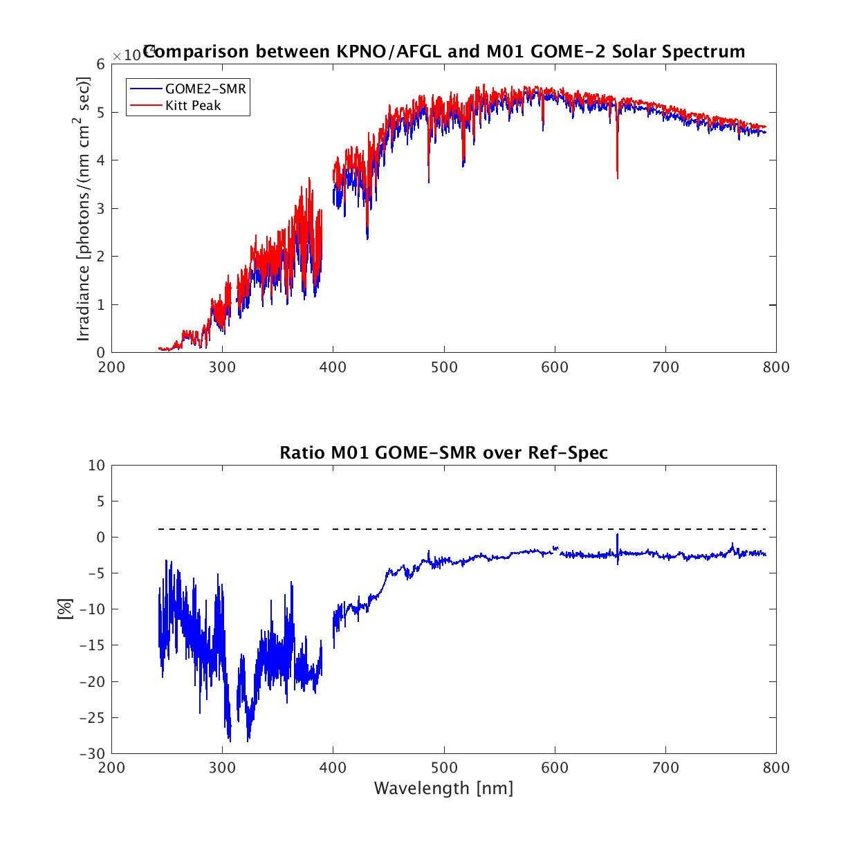
GOME-2 Solar reference comparisons First GOME-2 solar spectrum MetopB – KPNO.

Slide 6
GOME-2 Solar reference comparisons First GOME-2 solar spectrum MetopB – vs Dobber et al.

Slide 7
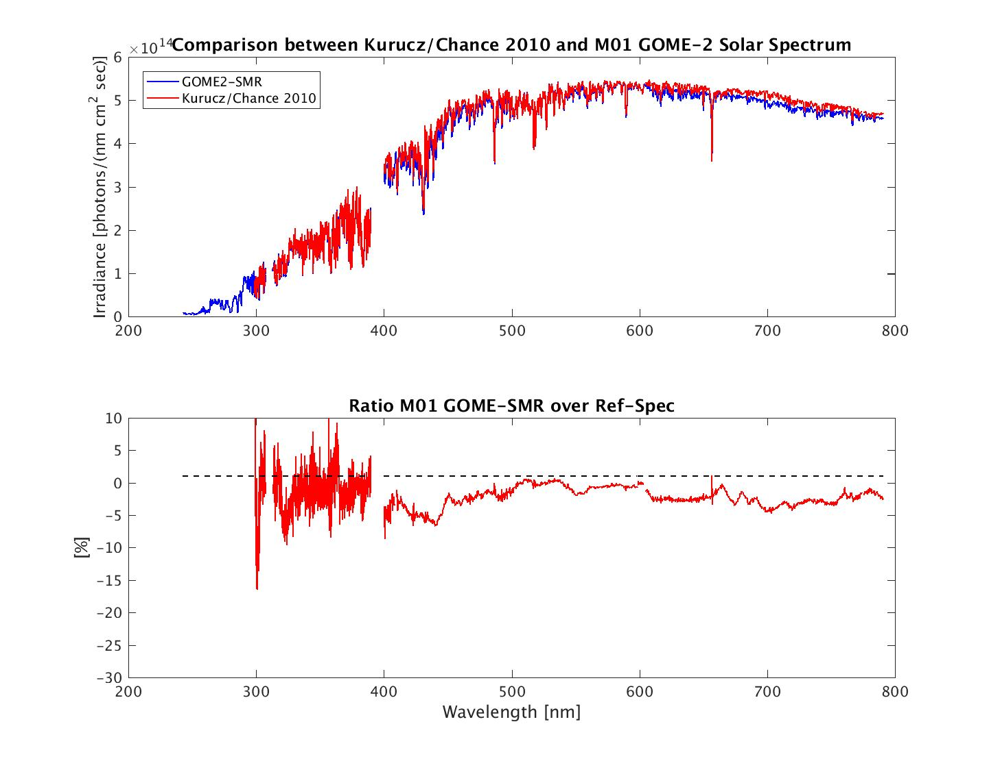
GOME-2 Solar reference comparisons First GOME-2 solar spectrum MetopB – vs Kuruscz/Chance 2010

Slide 8
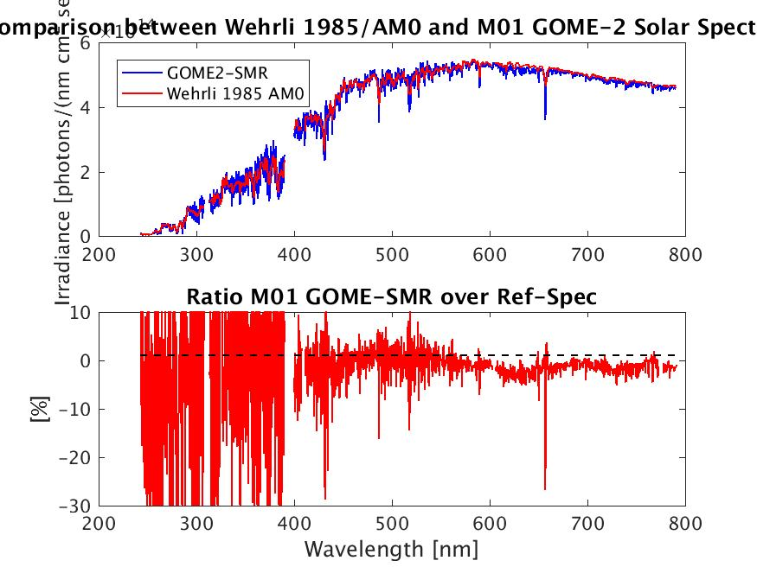
GOME-2 Solar reference comparisons First GOME-2 solar spectrum MetopB – vs Wehrli 1985/AM0

Slide 9
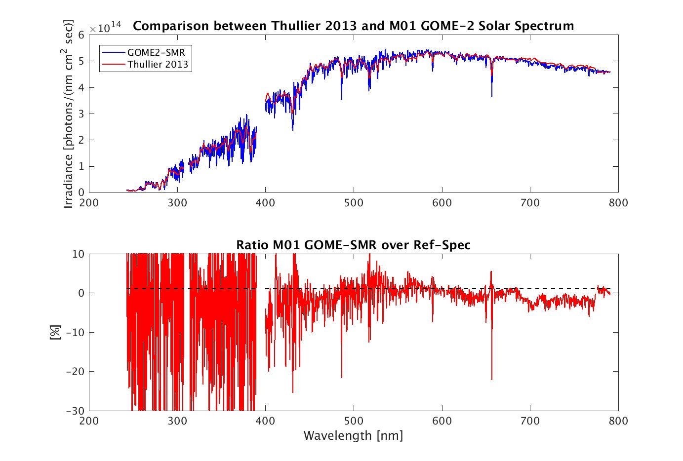
GOME-2 Solar reference comparisons First GOME-2 solar spectrum MetopB – vs Thullier 2013

Slide 10
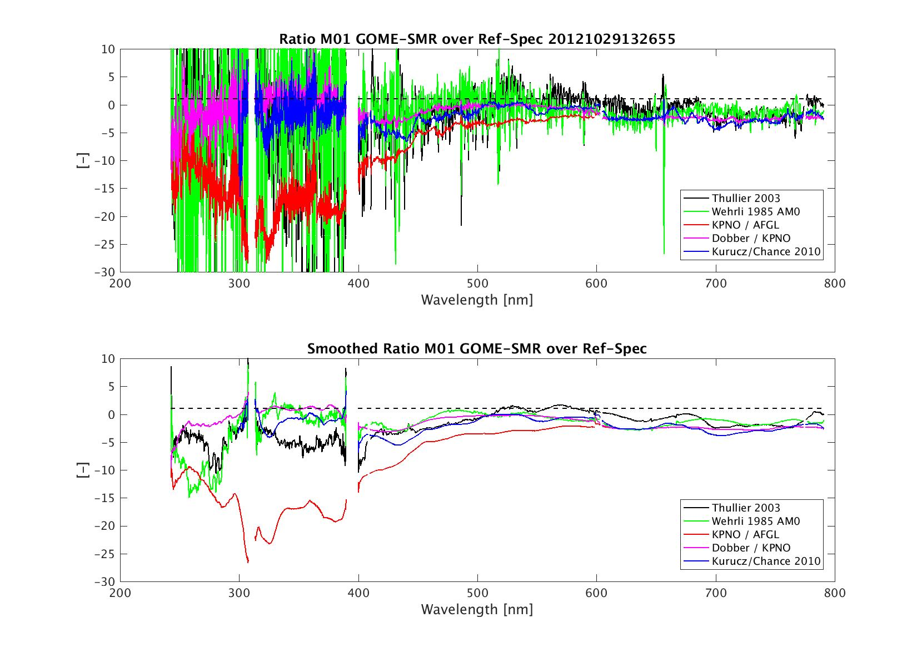
GOME-2 Solar reference comparisons All residuals

Slide 11
GOME-2 / Metop-A - Loss of solar visibility
LTAN evolution and gap analysis based on FOV 8.05 – after OOP in Aug 2016
GOME-2 FM3 Metop-A
Gap(days) From To .
2017 0.0 N/A N/A
2018 24.4 2018/01/26 2018/02/19
2019 82.8 2018/12/28 2019/03/20

Slide 12
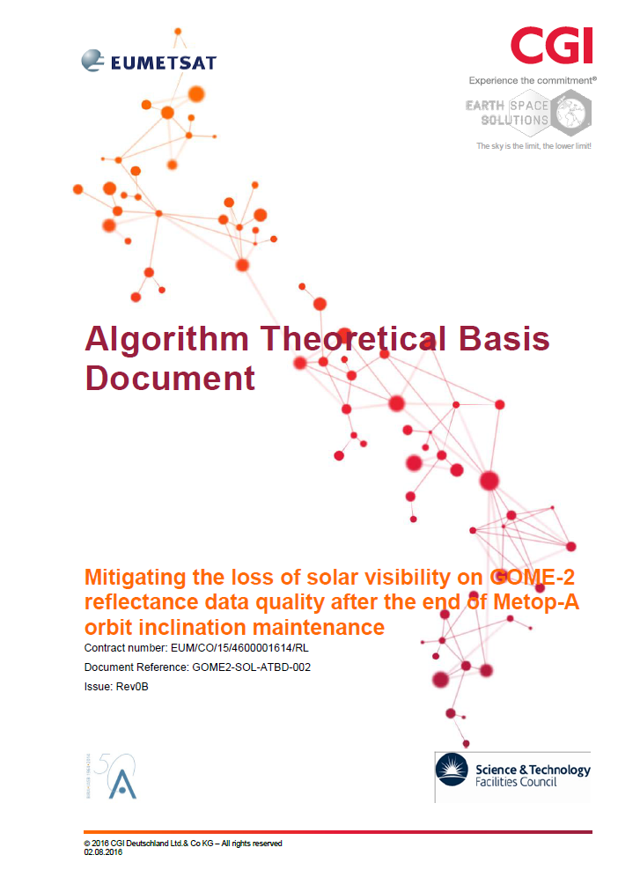
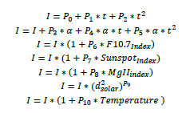
GOME-2 Solar Model
CGI/ESS-Study on mitigating the loss during gaps of solar visibility for Metop-A
GOME-2 FM3 Metop-A
Earth Space Solutions, Krijger et al.
Coefficients P₁ to P₁₀ together with the external parameters are fully describing the information content and evolution of the GOME-2 Metop-A solar main channel measurement

Slide 13
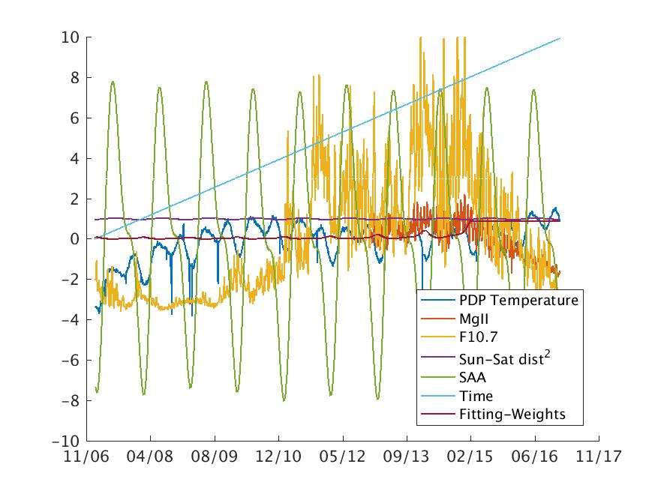
GOME-2 Solar Model
CGI/ESS-Study: Solar model contributors

Slide 14
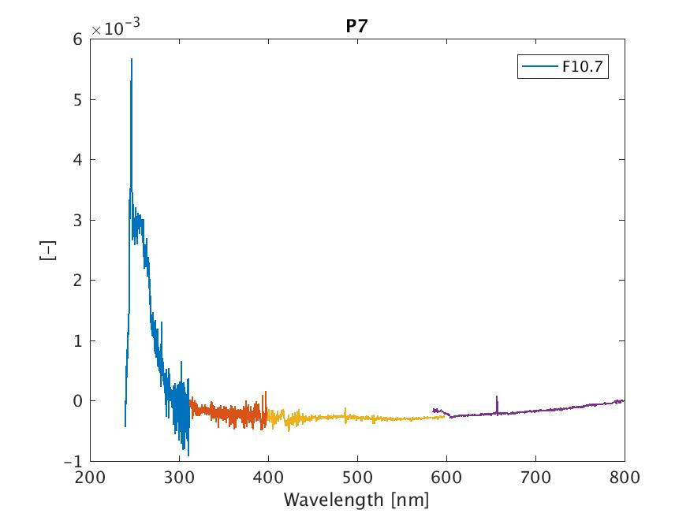
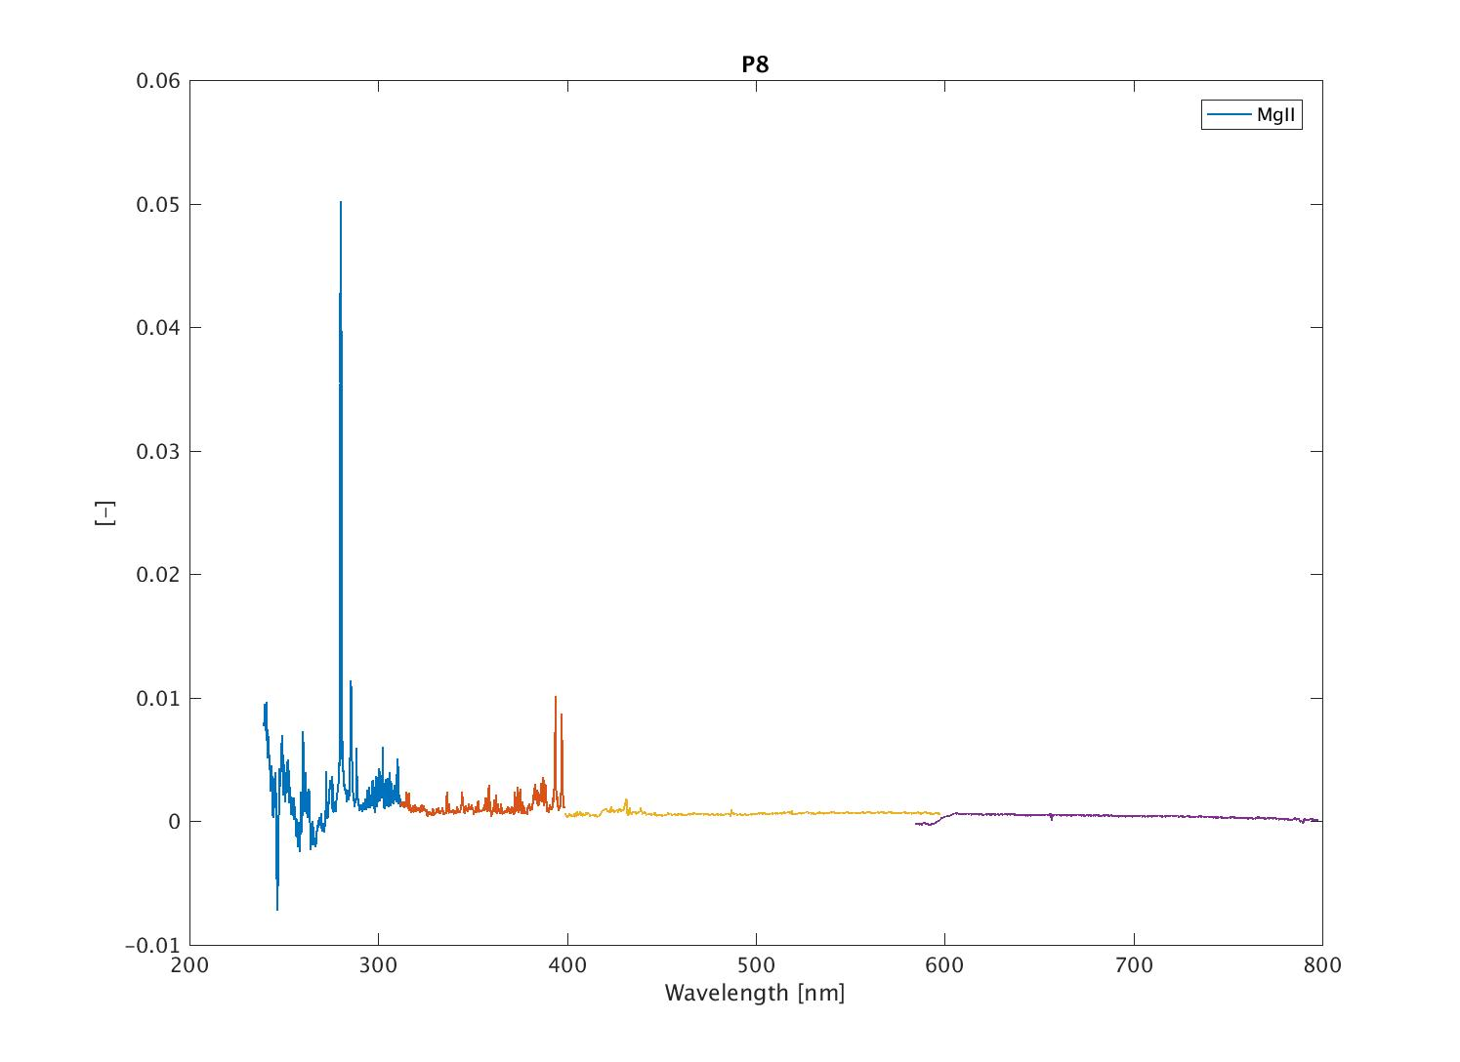
GOME-2 Solar Model
CGI/ESS-Study: F10 and MgII spectral contribution.
F10
MgII

Slide 15
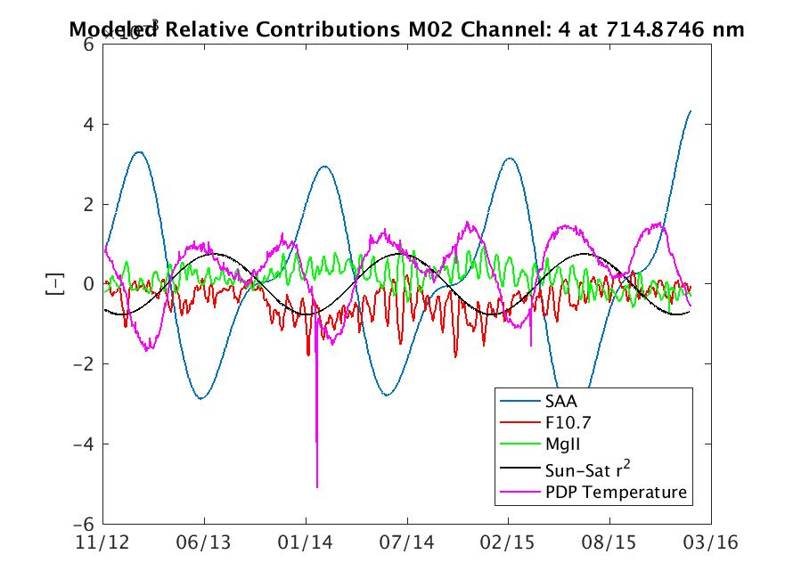
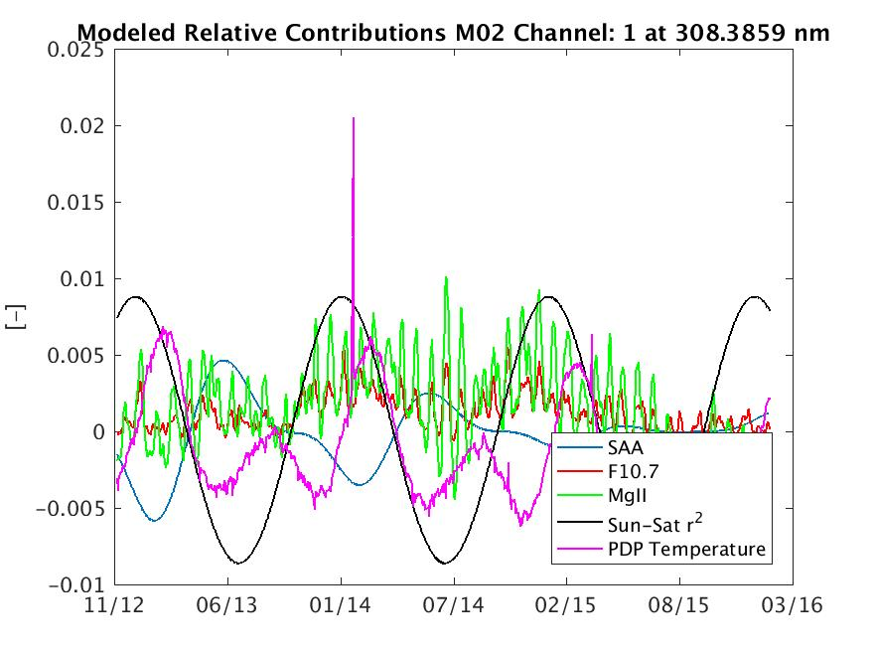
GOME-2 Solar Model
CGI/ESS-Study: Time series.

Slide 16
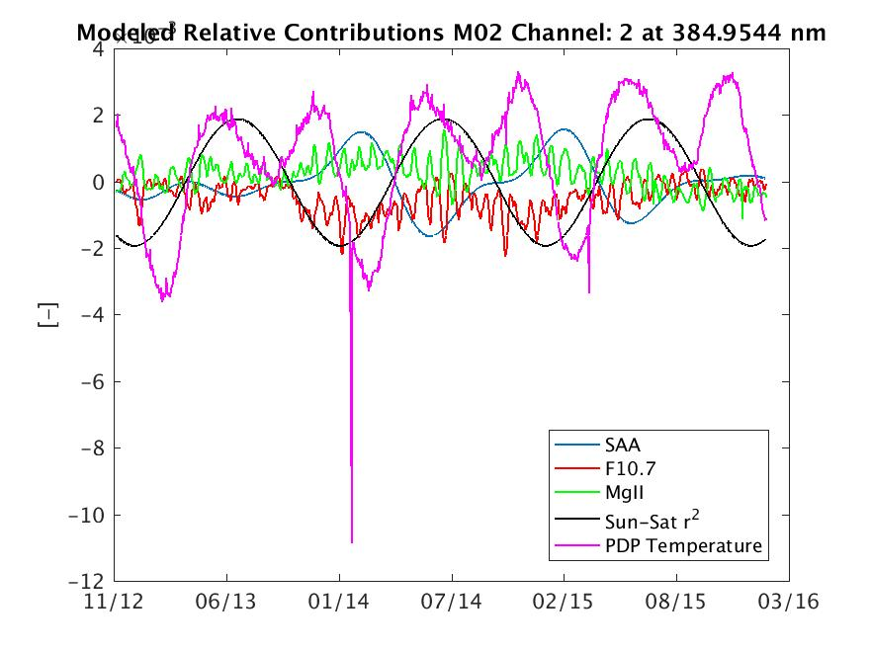
GOME-2 Solar Model
CGI/ESS-Study: Time series.

Slide 17
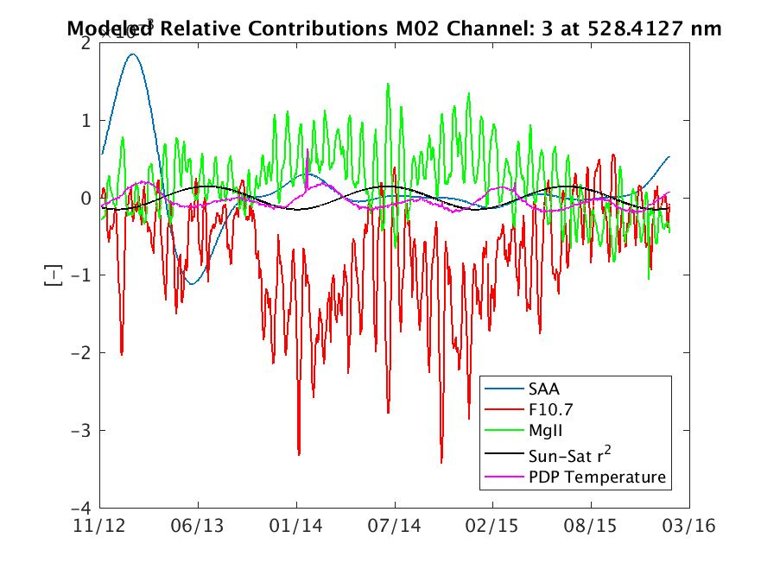
GOME-2 Solar Model
CGI/ESS-Study: Time series.

Slide 18
GOME-2 Solar Model
CGI/ESS-Study: Time series.

Slide 19
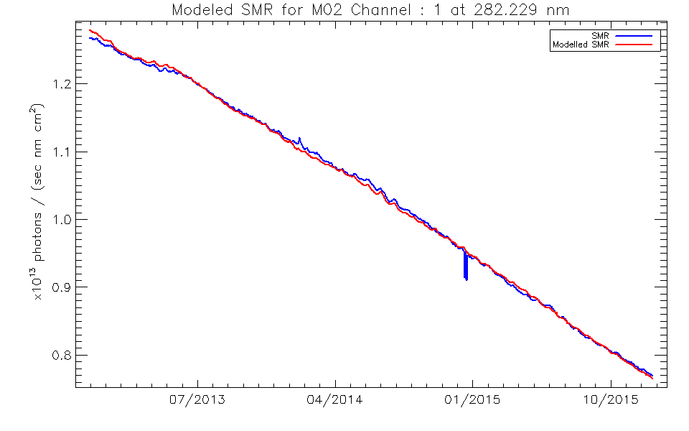
GOME-2 Solar Model
CGI/ESS-Study: Time series.

Slide 20
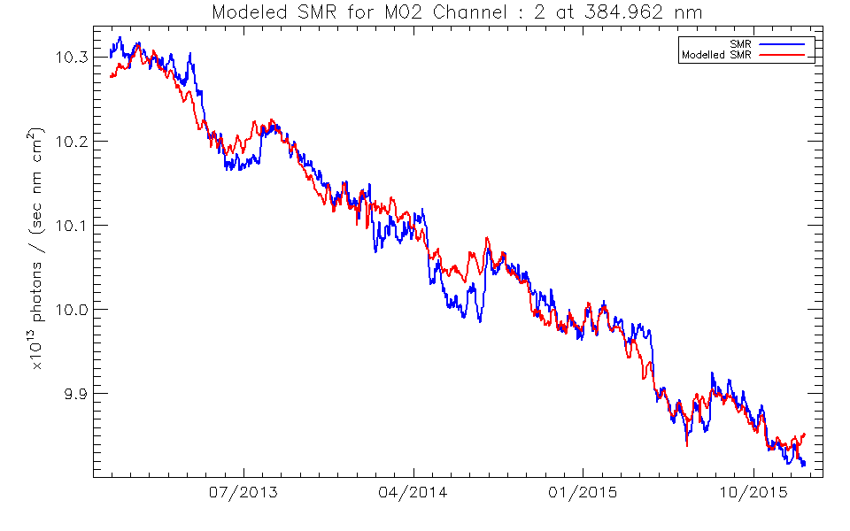
GOME-2 Solar Model
CGI/ESS-Study: Time series.

Slide 21
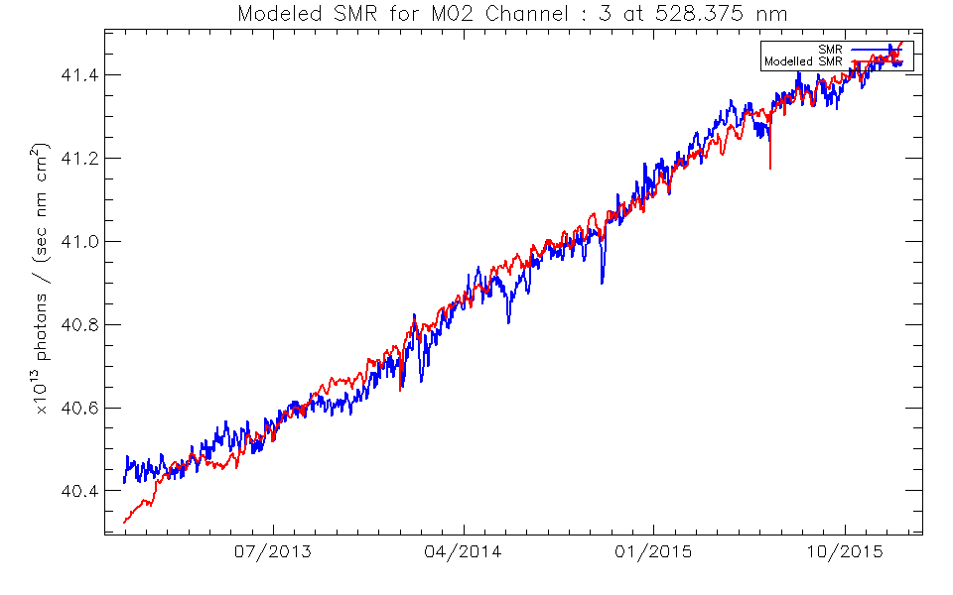
GOME-2 Solar Model
CGI/ESS-Study: Time series.

Slide 22
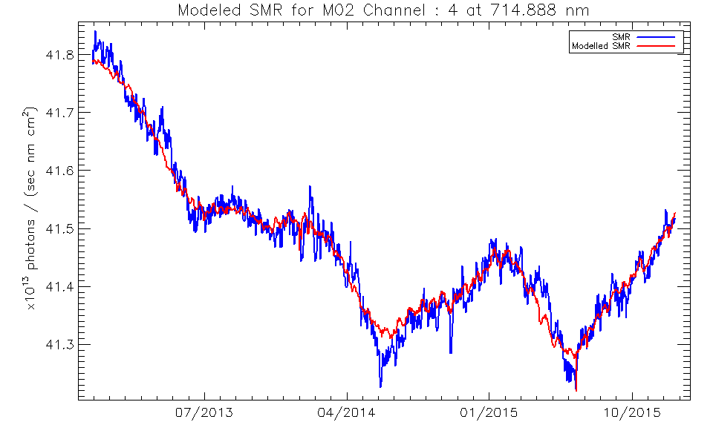
GOME-2 Solar Model
CGI/ESS-Study: Time series.

Slide 23
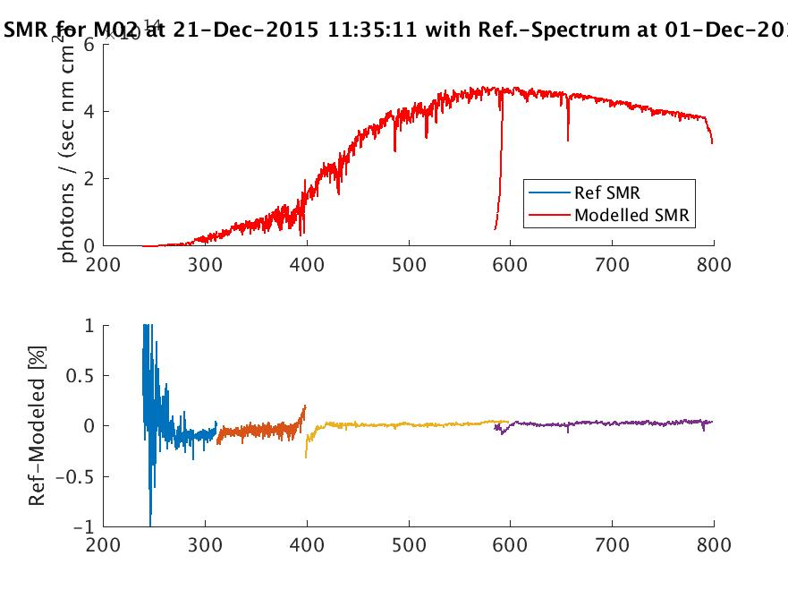
GOME-2 Solar Model
CGI/ESS-Study: Model performance - Residual
Preliminary!
We should get even better in the UV according to study results by ESS.

Slide 24
UVN hyper spectral solar reference and modelling Summary
Comparisons between solar reference spectra used in this study show generally good to very good performance above 400 nm (up to 780 nm) in the over all irradiance levels, when compared to a solar spectrum from GOME-2 taken at the very beginning of the mission (42 days in-orbit).
Below 400 nm there can be substantial differences in the baseline performance.
However, solar variability is not yet accounted for in this performance.
Not all of the evaluated spectra posses the required spectral resolution required to serve as a UVN hyper-spectral reference. They may however be used for adjusting the baseline, if needed.
EUM is currently in the process of implementing a solar- and instrument/platform-variability model for GOME-2 on Metop A developed by Krijger et al. (ESS) in a study with CGI.
Initial and preliminary results show the capability of the model to forecast the solar variability for most of the 4096 spectral points of the GOME-2 solar spectrum.
There is still some under-performance of the EUM proto-type implementation of the model in the UV.
Future work:
To apply the model to the solar reference spectra, in case their solar activity levels and time of measurement are known.

Slide 25
The end

Slide 26
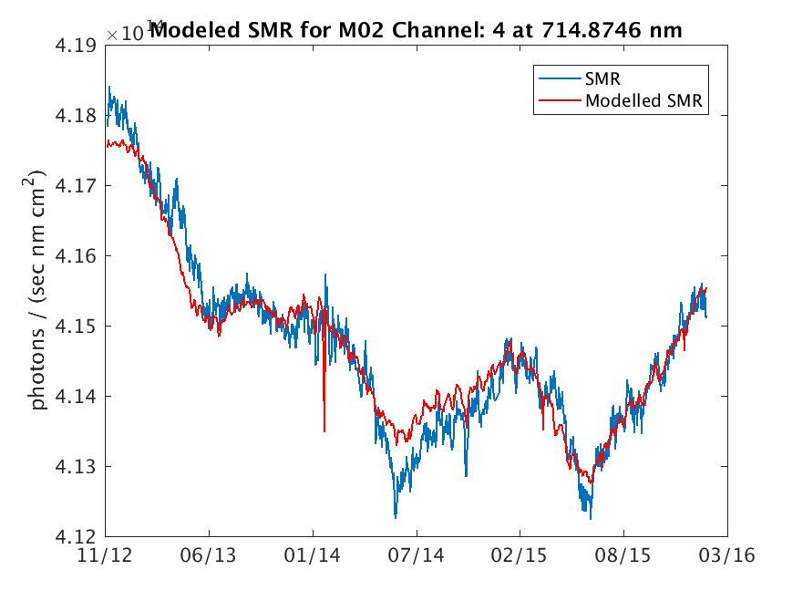
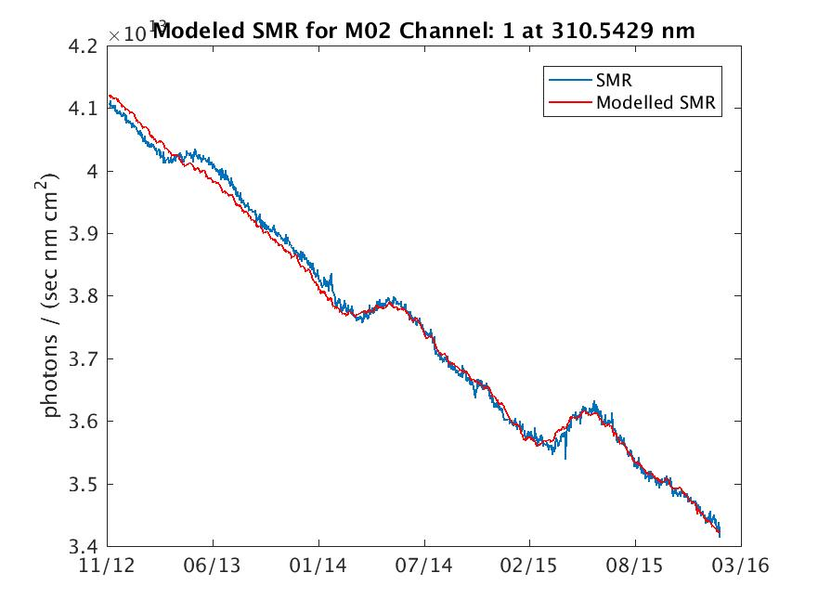
GOME-2 Solar Model
CGI/ESS-Study: Time series.

Slide 27
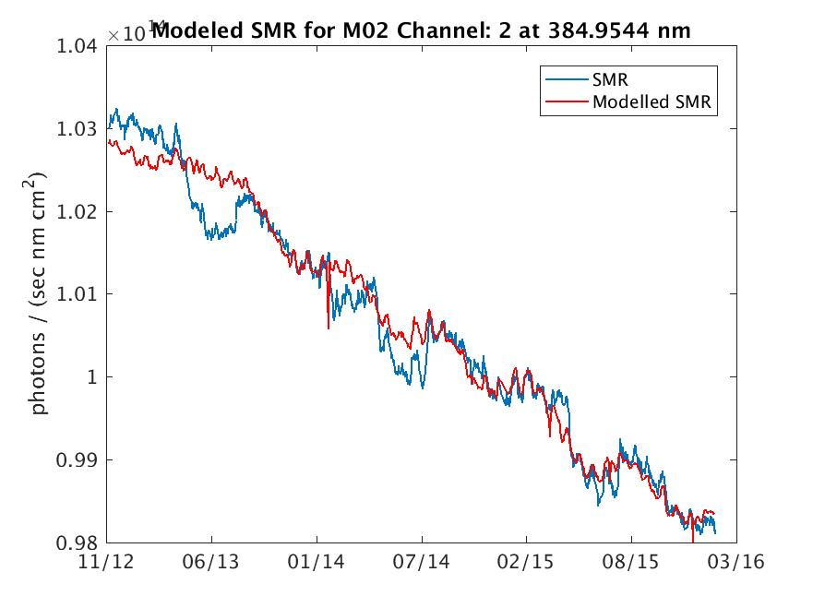
GOME-2 Solar Model
CGI/ESS-Study: Time series.

Slide 28
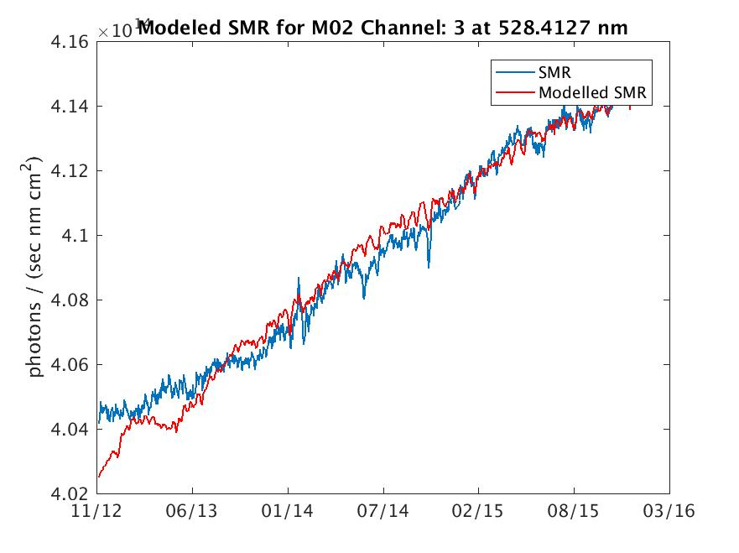
GOME-2 Solar Model
CGI/ESS-Study: Time series.

Slide 29
GOME-2 Solar Model
CGI/ESS-Study: Time series.

