Slide 1
GSICS Collaboration Servers Statuses and Updates
Peter Miu EUMETSAT
CMA, CNES, EUMETSAT, ISRO, IMD, JMA, KMA, NASA, NIST, NOAA, ROSHYDROMET, USGS, WMO

Slide 2
Collaboration Servers – What are these?
Status
Operations
Discussions

Slide 3
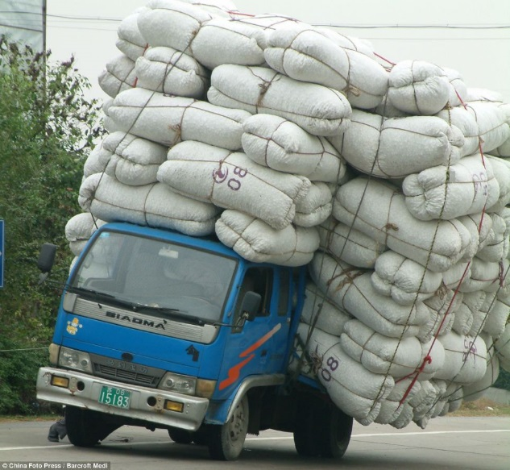
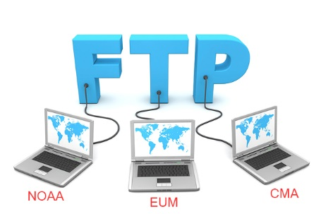
Collaboration Servers
A Vehicle for Receiving and Distribution GSICS source Data Sets and Products
3 Collaboration Servers
CMA
EUMETSAT
NOAA
GPRC upload their comparable source Data Sets to these Servers
Scientist develop GSICS Products, upload these and supporting data sets back to the servers.
Users download these products for calibrating data needed for the work / research.

Slide 4
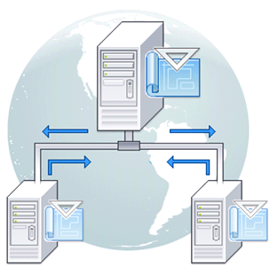
Collaboration Servers
Implementation Details - EUMETSAT
SUN OS Server connected to the Internet
Unidata THREDDS Cataloguing Application
EUMETSAT Proprietary Pre-processing application
EUMETSAT Unix Shell script – move files from directory X to Y
Operational Support Required
System Administration of the Server, network and Internet Security, and backup/restore
THREDDS configuration; catalogue structures specification, scan directories, products’ meta-data specification and access
Pre-processing application configuration; scan directories links to executables when expected files are received.
Shell script maintenance; bug fixes and enhancements.
Improvements
THREDDS GSICS Products configurations can now been automatically generated (completed, see next slide).
Automated collaboration servers products replication, to be implemented.

Slide 5
THREDDS Configuration Automation
XML file specifying the monitor and reference instrument combo.
Run Perl Script1 on XML file to generate:
Shell script to create the products’ directories: gprc, nrtc/rac, monInstr, refInstr, demo/preop/op.
XML file holding information on how to create the THREDDS configuration file for each product.
Run shell script to generate the product directories.
To generate a product’s THREDDS configuration file:
a GSICS product template is required e.g. a GEOLEOIR product.
The template contain variables that can be replaced by actual values e.g. XX_GPRC_XX is replace by CMA for a CMA GEOLEOIR, by JMA for a JMA GEOLEOIR product, etc.
A lookup file specified using XML to provide values for these variables.
Run Perl Script2 on the XML file with the template and the lookup file to generate all THREDDS configurations for the GSICS products.
These scripts can generate specific GSICS products’ configuration files for each collaboration server, and the generation takes less around 20 seconds.
Manual configuration of one product use to take at least an hour and was prone to human error.

Slide 6
Status
From the automation, the servers can be configured with the same Product Directory Structures
At present EUMETSAT Server is operational, it serves:
EUMETSAT GSICS Products
JMA GSICS Products
KMA GSICS Products
This server is compatible with the GSICS Product Plotting tool
NOAA and CMA servers require attention
Product Replication is to be Implemented (Prototype Available?)

Slide 7
Operations
For the EUMETSAT Collaboration Server:
Best Effort Basis for admin and support.
Coordination and support is provided by Pete when he makes time.
Monitoring of the system is planned
User support is provided by EUMETSAT’s HelpDesk
No resources are planned for Operational support.
Collaboration between the servers is limited.

Slide 8
Discussions
Review the servers’ Structures.
Finding Resources to Support Enhancements and Operations
Finding Resource to Upgrade the Product Plotting Tool to visualise new GSICS products.
Replication of the GSICS Products (Prototype Available?)

Slide 9
Info to EP
ToR need to reflect operations support (see 6d); admin and developments.
Resources are needed to admin GitHub.
Resources are need to plotting tools developments.

Slide 10
End of Presentation: Thank you for your attention

