Slide 1
The GSICS Actions Page
Manik Bali and Lori Brown
Annual Meeting Madison, Wisconsin

Slide 2
Outline
Introduction
Requirements from GSICS Members
Approach – Migrate to Google Cloud + interface with webserver
How to use the actions Page.
Conclusions

Slide 3
Introduction
Each year actions are generated in GSICS community.
These actions were previously monitored on the GSICS Wiki Page (See here ).
Over the years activity in GSICS has increased and number of Actions are generated in each GSICS Annual meeting, GSICS EP meeting GUW and subgroup meeting.
GRWG placed a request to GCC-NOAA-GDWG to provide an alternative to the wiki actions page. Features that were requested.
Fast search.
Easy Actions writing.
Easy updation.
Easy to understand layout.
New Category of actions ( For eg Lunar, Recommendation Decision)
Some level of Automation.

Slide 4
Challenges with Wiki implementation
Implementing changes to wiki requires testing with plugins. With very little available leads to additional resource overheads.
Wiki not as fast as http pages and not a very efficient search engine.
Addition of extra features needs resources overhead.

Slide 5
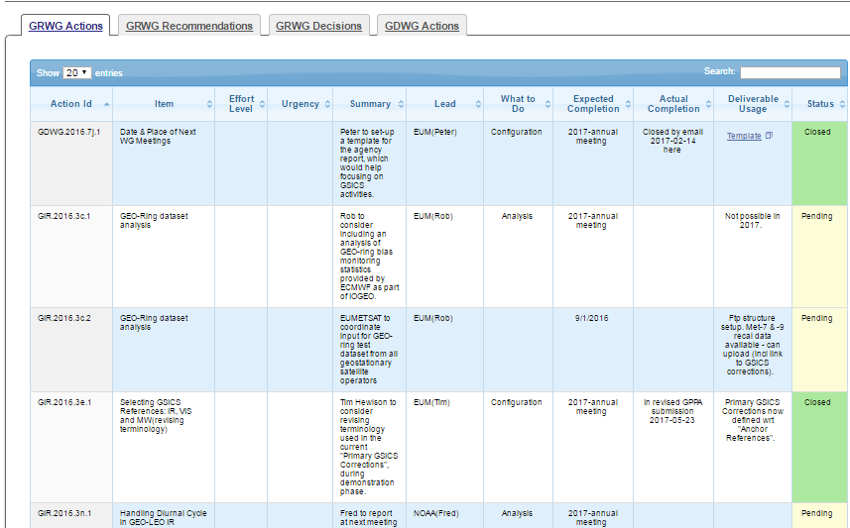
Approach - Google Cloud + Web
Actions are input into GOOGLE Sheet
API communicates with Sheet. Fetches a CSV format file
Start
Finish

Slide 6
How to Use the Action Tracker
GCC creates a google Sheet for each type of action being tracked. The Sheet link is shared among GSICS members.
The actions are grouped into pages by year, each different type viewable on a separate tab. The content of the tables on the tabs are sortable and searchable.
If users need to add hyperlinks to any action sheet, users should use the ‘Activate Hyperlink’ button to activate it on the GCC Action Tracker website.
When users’ changes are saved, they are dynamically updated onto the correct Action Tracker page.

Slide 7
Upcoming Features
Automate the Activate Hyperlink
Facility to insert hyperlinks on pieces of texts within the cell.

Slide 8
Conclusion
A new Google based Action Tracker has been setup at NOAA.
The action tracker utilizes key features of the google sheets ( versioning, projects)
Tracker is fast and efficient
Utilizes the new Action naming convention.
New categories of actions have been created ( such as lunar, EP, Recommendation, Decisions)

