Slide 1
Chairing of the GDWG
Peter Miu
CMA, CNES, EUMETSAT, ISRO, IMD, JMA, KMA, NASA, NIST, NOAA, ROSHYDROMET, USGS, WMO

Slide 2
Presentation Overview
ToR for Chair / Vice Chair / Co-Chair
What does a Chair Actually do?
GDWG Charing Status
Candidates
Group Decision to EP

Slide 3
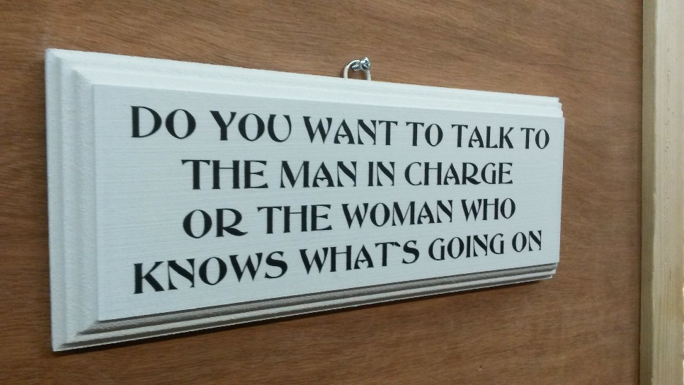
GSICS ToR
Chair / Co-Chair:
Lead the GSICS Data Management Activities
Plan & Organise
Coordinate
Report
Vice Chair / Co-Chair:
Support the Chair
Take over the role of the Chair after 3 years if needed.

Slide 4
What does a Chair actually do?
Coordinate
Report
Data Management Developments
Checking Actions
GPPA
Web Meetings

Slide 5
GDWG Chairing Status
By the end of 2017, current GDWG Co-chairs have completed their 3 years of leading and chairing the GDWG as specified in the GSICS ToR ref: GSICS-RD004-v1.0.
Chair & Vice Chair, or Co-chairs Election Possibilities
The ToR does not limit the renewal of the chairing roles if agreed amongst the GDWG members.
or
A Vice Chair is expected to offer to replace the Chair, and new Vice Chair(s) to be elected by the GDWG members.
a new Co-chair replaces one of the Co-chairs, staying in the Co-chairing leadership.
a new Co-chair replaces one of the Co-chairs, converting to the Chair and Vice-chair leadership.
A completely new Chair and vice Chair(s), or co-chair(s) are elected.
The EP will be informed of the above for discussion & inclusion in the ToR.
Nominations
Peter Miu (EUMETSAT) – Chair or Co-Chair
Masaya Takahashi (JMA) – Vice Chair or Co-Chair
Xu Zhe (CMA) – Vice Chair
Notes:
For info (remove from slide to keep it simple):
JMA co-chair have also spent 2 years as a vice-chair.
EUMETSAT co-chair cannot commit to spend more time to work on GSICS in the next years due to organisation's commitments.

Slide 6
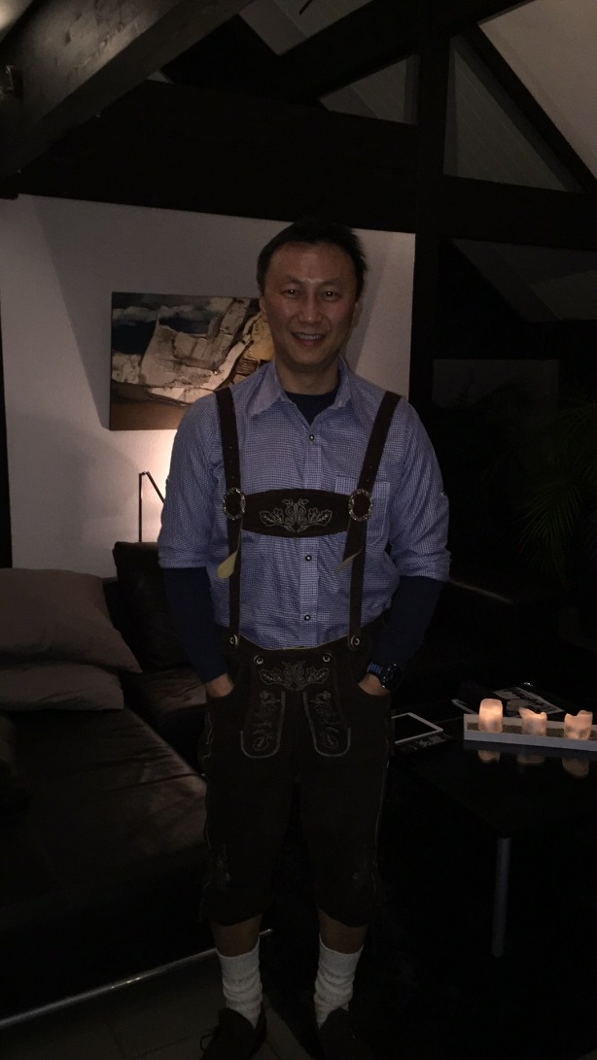
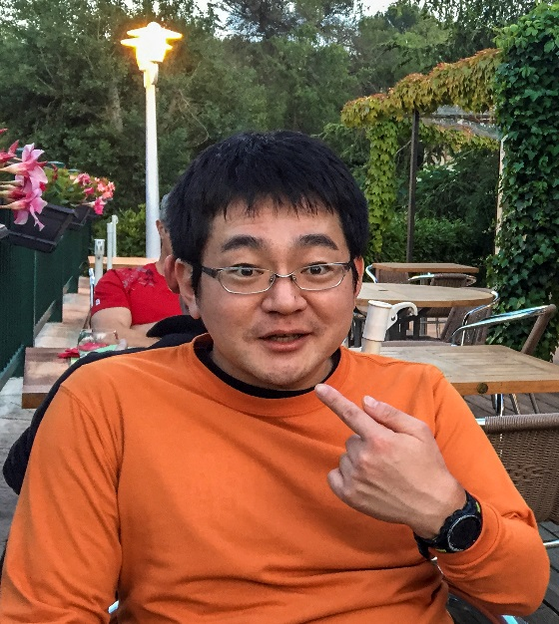
Candidates
Peter Miu - EUMETSAT
Member of GDWG since 2006
Software Engineer – Degree in Computer Science
Formats and Meta-Data Expert
Data Centre Operations Team Leader
Co-Chair of the GDWG since 2014
Masaya Takahashi - JMA
Member of GRWG/GDWG since 2013
System Engineering & Data Processing Expert
Co-Chair of the GDWG since 2014

Slide 7
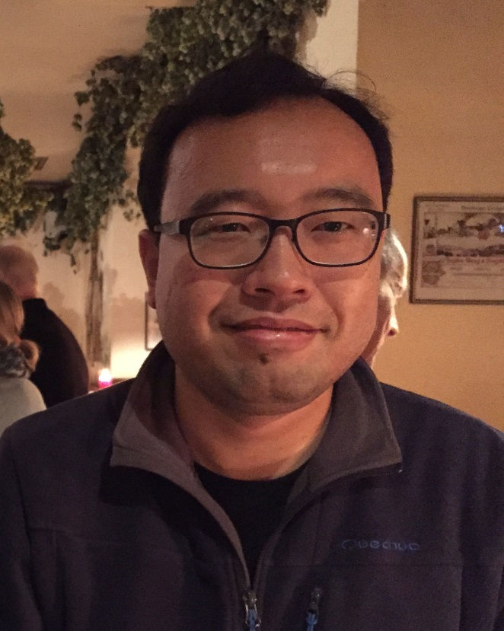
Candidates
Zu Xhe (Thomas) - CMA
Member of GDWG since 2015
Software Engineer – Degree in Computer Science
XXX
Member of GRWG/GDWG since 2013

Slide 8
Group Decision to EP

Slide 9
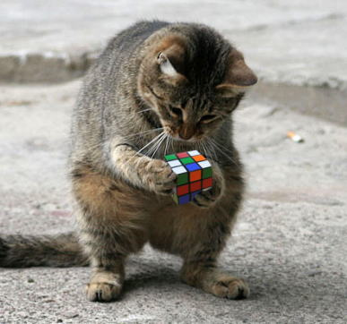
Thank you for your attention

