Slide 1
Developing GSICS products for IR channels of GEO imagers Tim Hewison
Special Issue of the IEEE TGRS on “Inter-Calibration of Satellite Instruments”:
Special Issue of the IEEE TGRS on “Inter-Calibration of Satellite Instruments”:

Slide 2
GSICS GEO-LEO IR Product Status 2017-02
GPRC | Monitored Instrument | Reference Instrument | GSICS NRT Correction | GSICS Re-Analysis Correction | GSICS Bias Monitoring
EUMETSAT | Meteosat-8-11/SEVIRI Meteosat-7/MVIRI | Metop-A/IASI | Operational Demo | Operational Demo | Plots RAC
JMA | MTSAT-2 Imager | IASI (+ AIRS) | Demo | Demo | Plots RAC
NOAA | GOES-13 & -15 Imager GOES-11 & -12 Imager | IASI (+ AIRS) | Pre-op | Pre-op Demo | Prototype
 | GOES Sounder | IASI (+ AIRS) | Development | Development | In development
CMA | FY2C – E | IASI (+ AIRS) | Development | Development | Prototype
KMA | COMS-1 | IASI | Prototype | Prototype
ISRO | INSAT-3D | IASI | Prototype | Prototype
Full GSICS Product Catalog available at http://www.star.nesdis.noaa.gov/smcd/GCC/ProductCatalog.php

Slide 3
GEO-LEO IR Issues - Prime
Combining and Transitioning Reference Sensors
Prime GSICS Correction concept
Based on series of double-differences
Also good for monitoring reference sensors‘ relative calibration
Need to include double-differences in the netCDF files!
Need to enhance plotting tool to visualise double differences!

Slide 4
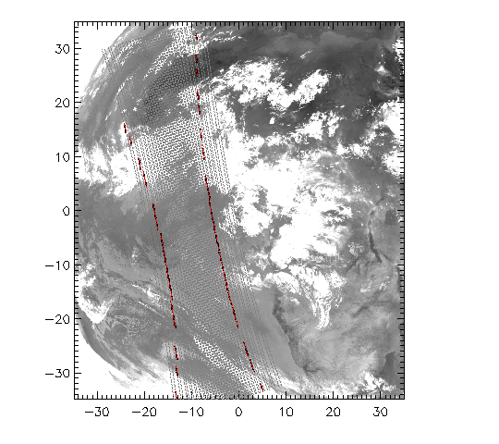
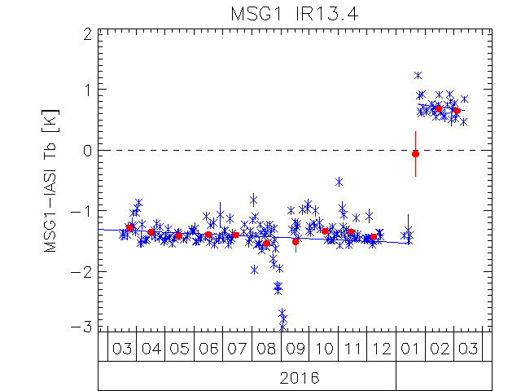
GEO-LEO IR Issues – Incidence Angle
Meteosat-8 moved to 41.5°E
During summer 2016
Kept fixed 21:30Z IASI overpass
Used for 0°E SEVIRI images
In prototype processor
Until 2016-09-11
Fewer collocations
More variable results
Increased incidence angle
Changed sounding channels´ bias
Further investigation of sensitivity?
Decontamination in Jan 2017

Slide 5
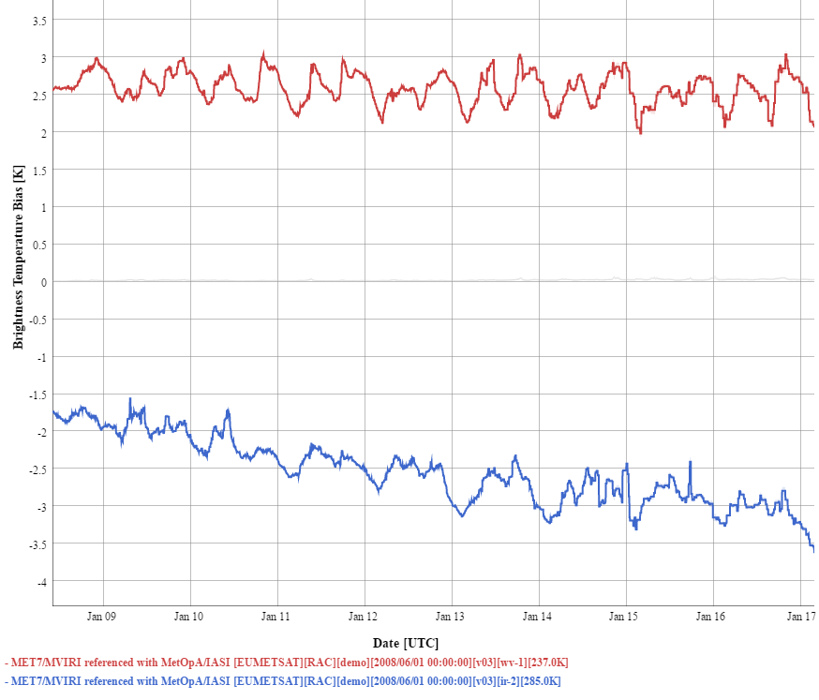
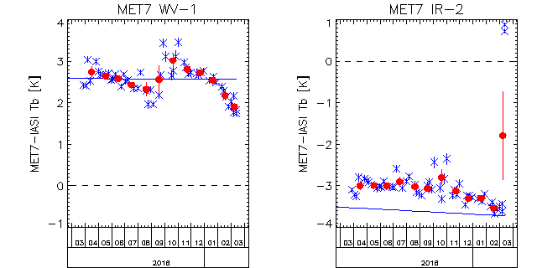
Meteosat-7
Meteosat-7 End of Life
Long-term drift in IR channel bias
-1.75K in 2008-06
-3.5K in 2017-02
Prime suspect: ice contamination
Build-up of ice layer on optics
Absorption band ~12µm
Modifies SRF
Apparent bias in IR
Decontamination 2016-03
1st since move to IODC
Sudden change in bias
Need to reprocess!

Slide 6
GEO-LEO IR Issues – Diurnal/Seasonal
Account for diurnal variations in GEO imagers‘ calibration
Important issue for 3-axis stabilised platforms
Thermal + Straylight factors
Especially in eclipse season?
Inadequate Midnight Black Body Correction
Combine results from multiple reference sensors (on platforms with different equator crossing times)
Assign different uncertainties to different times of day/season?
Are seasonal variations sufficiently accounted for in current products?
Recommendation: KMA to assess uncertainties in double differences between COMS-1/MI and IASI-A and -B (e.g. as standard error)

Slide 7
GEO-LEO IR Issues – Cold End
Current ATBD uses linear weighted regression of collocated radiances
Concentrate on warm end (more clear sky pixels near equator)
Reliability of results at cold end needs further validation
Conversion to brightness temperature amplifies errors
Could use alternative algorithm
E.g. Convert collocated radiance to Tb, bin, then do regression?
GIR.2016.3o.1
Arata to check how the cold end corrections are behaving using AIRS.
GIR.2016.3o.2
Arata to use the various regression methods for both radiance and brightness temperatures and process the corrections as derived from AIRS and report back.
How to follow up these activities?

Slide 8
GEO-LEO IR Issues – New GEO imagers
New GEO imagers have new channels
Spectral coverage of reference instruments?
Extension of gap-filling method?
Development of GSICS products?

Slide 9
GEO Imagers Spectral Coverage
 | Meteosat/FCI |  |  | GOES-R/ABI |  |  | Himawari-8/AHI |  |  | FY-4A/AGRI |  |  | KOMPSAT-2A/AMI |  |  | INSAT-3DR/Imager
 | λmin | λnom | λmax | λmin | λnom | λmax | λmin | λnom | λmax | λmin | λnom | λmax | λmin | λnom | λmax | λmin | λnom | λmax
SWIR | 3.60 | 3.80 | 4.00 | 3.80 | 3.90 | 4.00 | 3.74 | 3.85 | 3.96 | 3.50 | 3.75 | 4.00 | 3.60 | 3.85 | 4.10 | 3.80 | 3.90 | 4.00
MWIR | 5.80 | 6.30 | 6.80 | 5.70 | 6.15 | 6.60 | 6.07 | 6.25 | 6.44 | 5.80 | 6.25 | 6.70 | 5.72 | 6.24 | 6.76
 | 7.10 | 7.35 | 7.60 | 6.80 | 7.00 | 7.20 | 6.89 | 6.95 | 7.01 | 6.90 | 7.10 | 7.30 | 6.70 | 6.95 | 7.20 | 6.50 | 6.80 | 7.10
 |  |  |  | 7.30 | 7.40 | 7.50 | 7.27 | 7.35 | 7.44 |  |  |  | 7.01 | 7.35 | 7.70
LWIR | 8.50 | 8.70 | 8.90 | 8.30 | 8.50 | 8.70 | 8.44 | 8.60 | 8.76 | 8.00 | 8.50 | 9.00 | 8.35 | 8.60 | 8.85
 | 9.51 | 9.66 | 9.81 | 9.60 | 9.70 | 9.80 | 9.54 | 9.63 | 9.72 |  |  |  | 9.39 | 9.63 | 9.87
 | 10.15 | 10.50 | 10.85 | 10.05 | 10.30 | 10.55 | 10.30 | 10.45 | 10.60 | 10.30 | 10.70 | 11.10 | 9.99 | 10.43 | 10.87 | 10.30 | 10.80 | 11.30
 | 12.55 | 12.30 | 12.55 | 10.80 | 11.20 | 11.60 | 11.10 | 11.20 | 11.30 | 11.50 | 11.00 | 12.50 | 10.70 | 11.20 | 11.70 | 11.50 | 12.00 | 12.50
 | 13.00 | 13.30 | 13.60 | 11.80 | 12.30 | 12.80 | 12.20 | 12.35 | 12.50 | 13.20 | 13.50 | 13.80 | 11.69 | 12.30 | 12.92
 |  |  |  | 13.00 | 13.30 | 13.60 | 13.20 | 13.30 | 13.40 |  |  |  | 12.93 | 13.30 | 13.68

Slide 10
Actions on IR Sub-Group
Show entries
Search:
Action Id | Item | Effort Level | Urgency | Summary | Lead | What to Do | Expected Completion | Actual Completion | Deliverable Usage | Status
GIR.2016.3n.1 | Handling Diurnal Cycle in GEO-LEO IR |  |  | Fred to report at next meeting on cooperation with KMA on black body calibration correction. | NOAA(Fred) | Analysis | 2017-annual meeting |  |  | Pending
GIR.2016.3o.1 | v2 of GEO-LEO IR - alternative ATBDs(cold end corrections effect) |  |  | Arata to check how the cold end corrections are behaving using AIRS. | JMA(Arata) | Analysis | 2017-annual meeting |  |  | Pending
GIR.2016.3o.2 | v2 of GEO-LEO IR - alternative ATBDs (regression model and correction) |  |  | Arata to use the various regression methods for both radiance and brightness temperatures and process the corrections as derived from AIRS and report back. | JMA(Arata) | Analysis | 2017-annual meeting |  |  | Pending

Slide 11
IR Sub-Group Activities
GEO-LEO IR
GEO-ring test data to support SCOPE-CM IOGEO
Promotion of products through GPPA
Handling GEO diurnal calibration variations
New inter-calibration algorithms
Wed pm | GRWG: IR Sub-Group
 | Chair: Tim Hewison
13:00 | Tim Hewison | Developing GSICS products for GEO imagers
 | Fred Wu | – including diurnal cycles
 | Dohyeong Kim | – accounting for seasonal variations
 | All (incl Na Xu) | – Review Plans for GEO-LEO IR products
 | All | – new algorithms

Slide 12
Thank You for your contributions!

