Slide 1
NOAA-KMA Collaboration on Imager Midnight IR Calibration Anomaly
Xiangqian Wu
2017-03-22, GSICS WG Meeting, Madison, WI

Slide 2
Problem
Calibration of Imager infrared channels is unstable around satellite midnight.
Thermal stress plays a major role.

Slide 3
GOES Blackbody Contamination
One Week
One Month
~60ºK some other days
~40ºK “now”
Complicated seasonal variations of diurnal heating
Long term trend
D. Han
One Year
One Satellite
Goes-12 Scan Mirror Temperature

Slide 4
Motivation
As similar instruments have been in operation at KMA (2010-2018) and NOAA (1994-2024), this collaboration may lead to mutual benefits to both agencies including:
Immediate benefits for ongoing operations;
Potential benefits in re-calibration for climate applications;
Directly applicable to JMA’s MTSAT-2 (2010 – 2015) – contributions to international community;
Risk reduction for Advanced Imager (ABI/AMI/AHI) – benefit to future satellite programs.

Slide 5
Goal
Quantitative characterization of midnight IR calibration anomaly (MICA or MIRCA)
A name different from MBCC, an existing algorithm and product.
Need more attention on this.
Identification of the root cause.
Mitigation
Implementation

Slide 6
Assets
MBCC, when formulated in late 1990’s, was based on very limited understanding of impacts on products.
The advent of GSICS since 2007 would be a tremendous help.
But NOAA no longer has the raw data after the MBCC implementation in 2004.
KMA possesses the ability of parallel processing, thus the untinted data.
NOAA has related technical expertise.

Slide 7
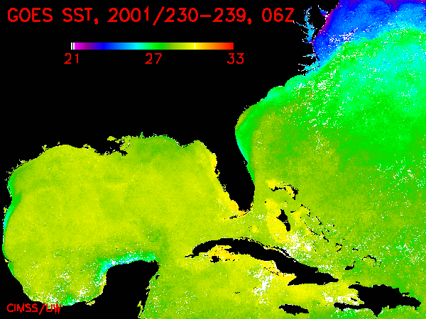
GOES Blackbody Contamination
GOES-8 Midnight. While the cool down before midnight may be attributed to SST diurnal variation, the warm up after midnight but before sunrise is puzzling.

Slide 8
GOES Blackbody Contamination

Slide 9
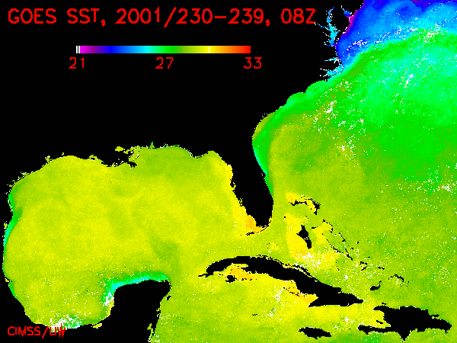
GOES Blackbody Contamination

Slide 10
GOES Blackbody Contamination

Slide 11
GOES Blackbody Contamination

Slide 12
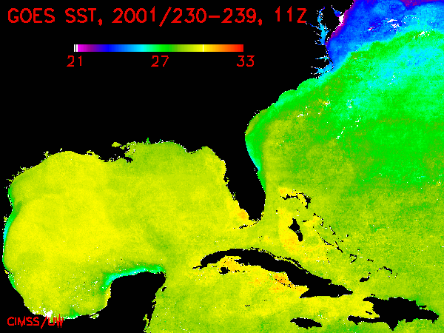
GOES Blackbody Contamination

Slide 13
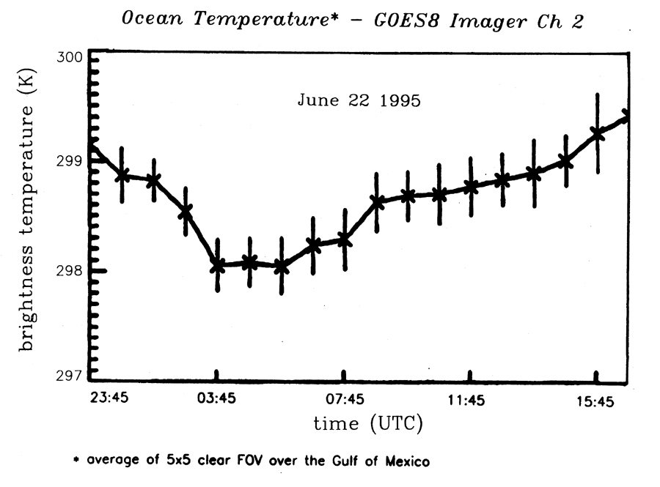
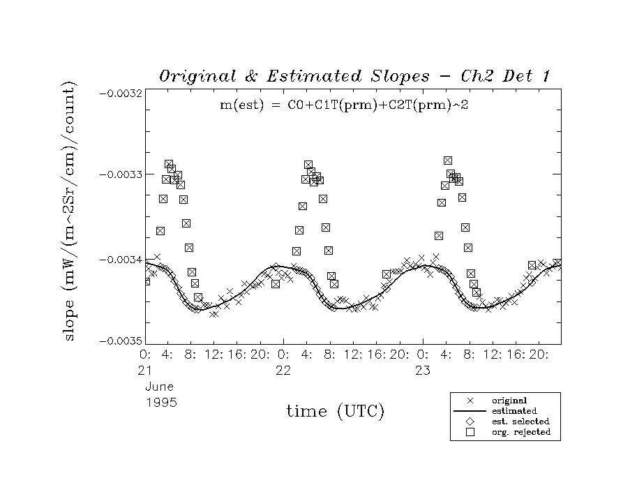
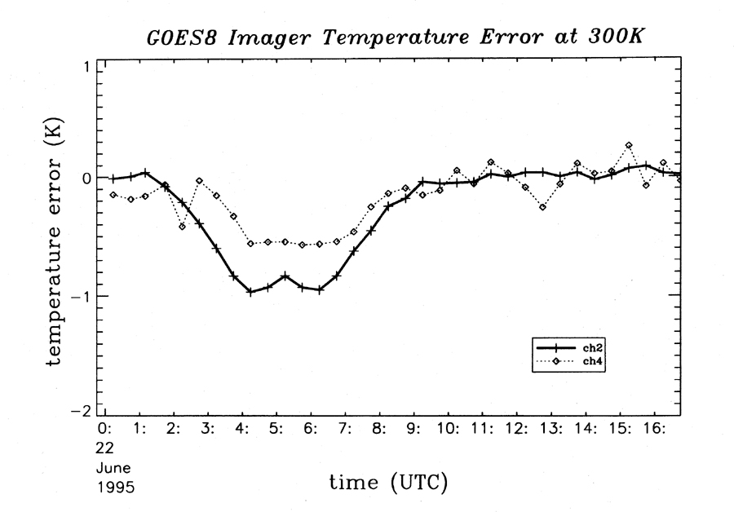
GOES Blackbody Contamination

Slide 14
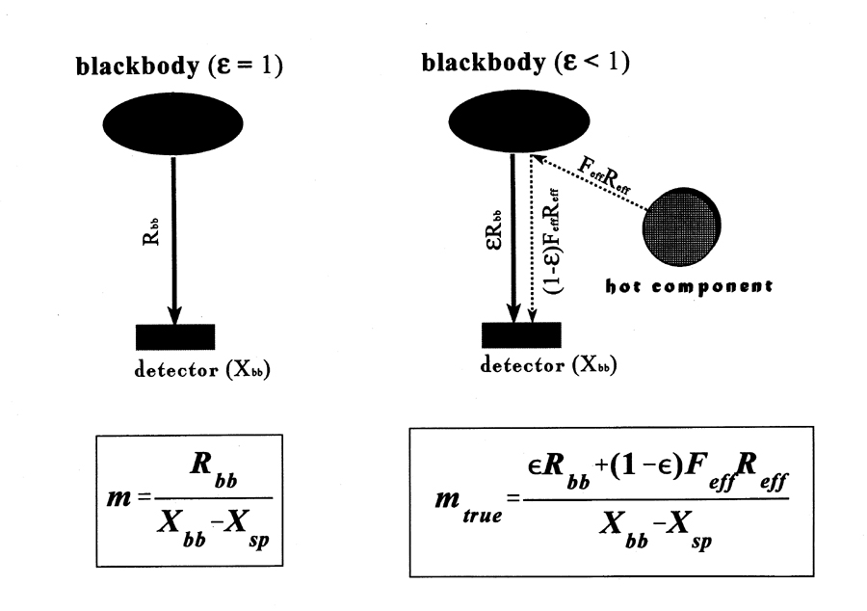
GOES Blackbody Contamination
T_{BB}
Not a problem without this varying radiator

Slide 15
GOES Blackbody Contamination
T_{BB}
T_{BB}
OK if ε=1 or T_{env}=T_{BB}
Less true for GOES
T_{env}

Slide 16
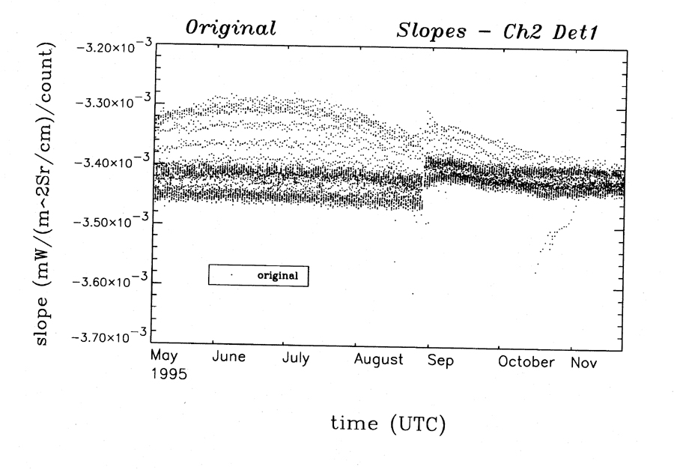
GOES Blackbody Contamination

Slide 17
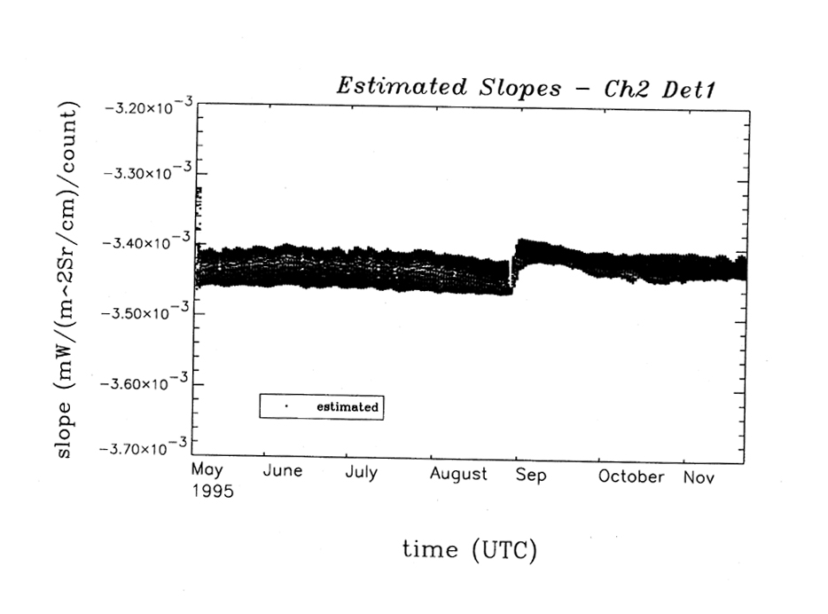
GOES Blackbody Contamination

Slide 18
Existing MBCC
When not under thermal stress:
Derive m from space counts and blackbody counts and radiance;
Relate m_{MBCC} with m and T_{mirror} by regression;
When under thermal stress:
Derive m from space counts and blackbody counts and radiance;
Compute m_{MBCC} from T_{mirror};
Decide whether to use m or m_{MBCC}.

Slide 19
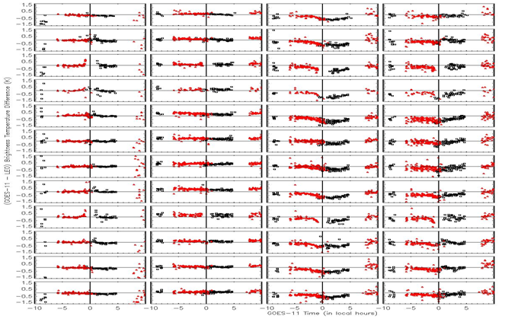
MBCC Performance Evaluation – GOES-11 Imager IR Channels
Ch2 Ch3 Ch4 Ch5
Jan
Feb
Mar
Apr
May
Jun
Jul
Aug
Sep
Oct
Nov
Dec
Jan
Feb
Mar
Apr
May
Jun
Jul
Aug
Sep
Oct
Nov
Dec
Diurnal variation varies at different channel and different season

Slide 20
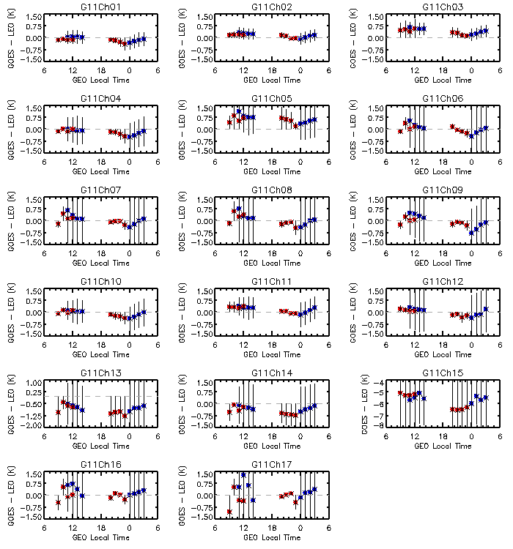
No MBCC applied to the Sounder IR channels
Impact of the midnight calibration anomaly for GOES-11 Sounder IR channel 1 through Ch17. ΔTb_{4:00am,0:00am} = ΔTb_{4:00am} - ΔTb_{0:00am}
Channel | ΔTb_{4:00am,0:00am} (K) | Channel | ΔTb_{4:00am,0:00am} (K) | Channel | ΔTb_{4:00am,0:00am} (K)
Ch1 | +0.25 | Ch7 | +0.54 | Ch13 | +0.33
Ch2 | +0.22 | Ch8 | +0.49 | Ch14 | +0.38
Ch3 | +0.25 | Ch9 | +0.67 | Ch15 | +0.61
Ch4 | +0.37 | Ch10 | +0.39 | Ch16 | +0.28
Ch5 | +0.24 | Ch11 | +0.44 | Ch17 | +0.51
Ch6 | +0.51 | Ch12 | +0.53
Yu and Wu, 2013 TGRS

Slide 21
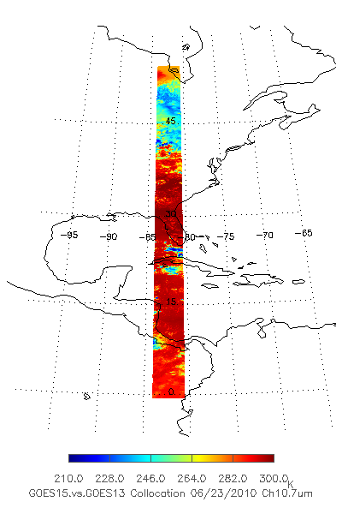
GEO-GEO Comparison During GOES-15 PLT Period
GEO-GEO collocation
Spatial collocation
Temporal difference: < 5 minutes
Geometric alignment: viewing zenith angle difference < 1%
GOES 13: -75º
GOES-15: -89.5º

Slide 22
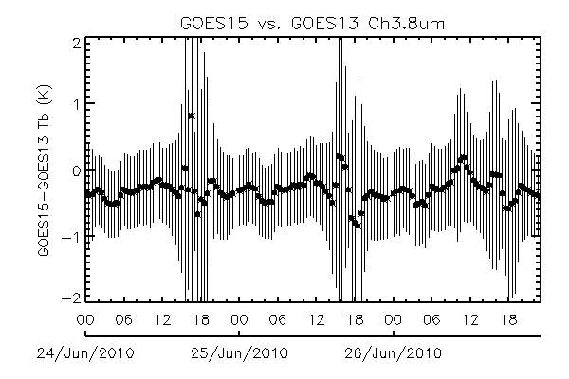
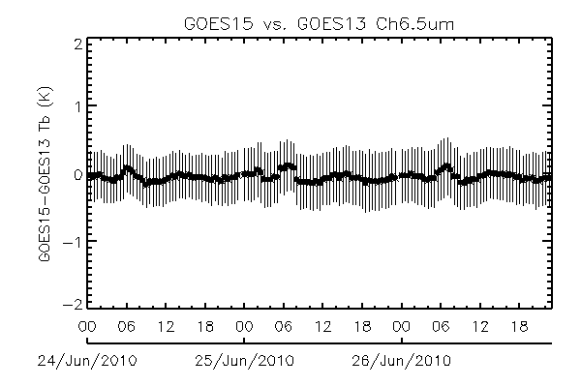
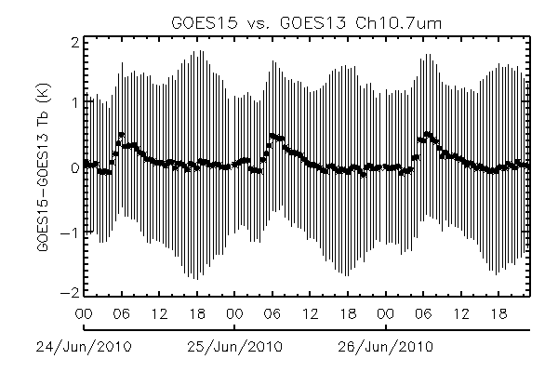
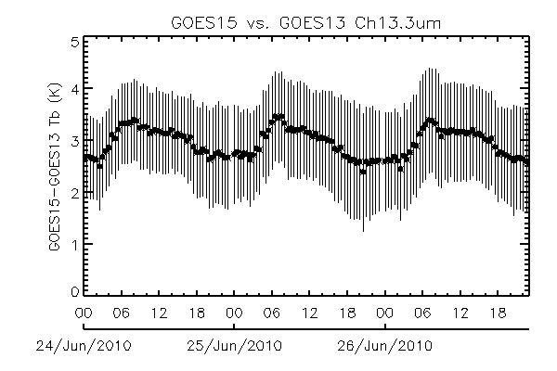
GEO-GEO Comparison
No correction was made for SRF difference
Midnight
Midnight
BRDF
Midnight
Midnight
Yu
Note: the GEO-GEO inter-comparison was conducted before the SRF shifts for G15 Ch3 and Ch6

Slide 23
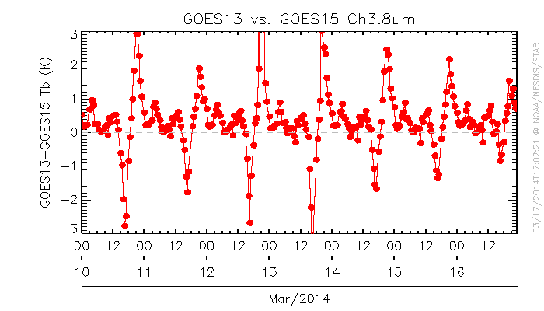
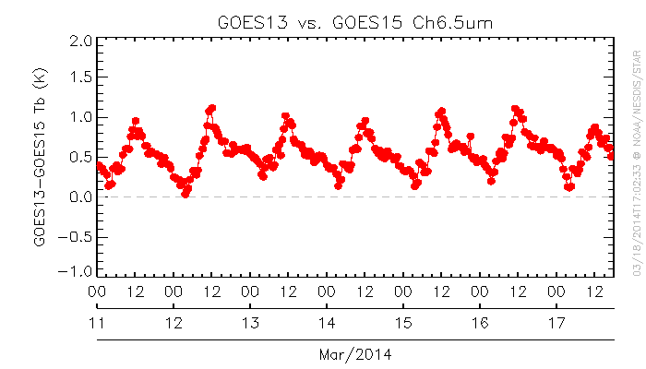
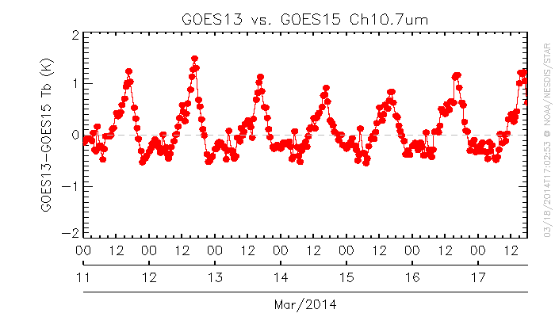
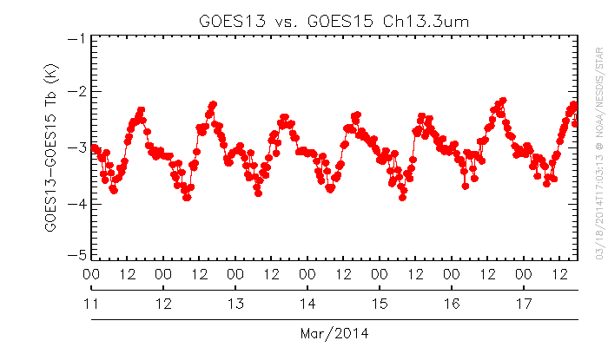
GEO-GEO Radiance Comparison
Yu

Slide 24
Scan Mirror Emissivity
Full-System
Full-Aperture

Slide 25
Nominal

Slide 26
Actual
Radiative Equilibrium

Slide 27
It boils down to …

Slide 28
Plan and Schedule
Characterization
Data collection (temperature, count, …)
Data analysis
Identification / Confirmation

