Slide 1
Diurnal and Seasonal variations of COMS IR inter-calibration
Dohyeong Kim, and Minju Gu

Slide 2
Diurnal Variations (COMS IR)

Slide 3
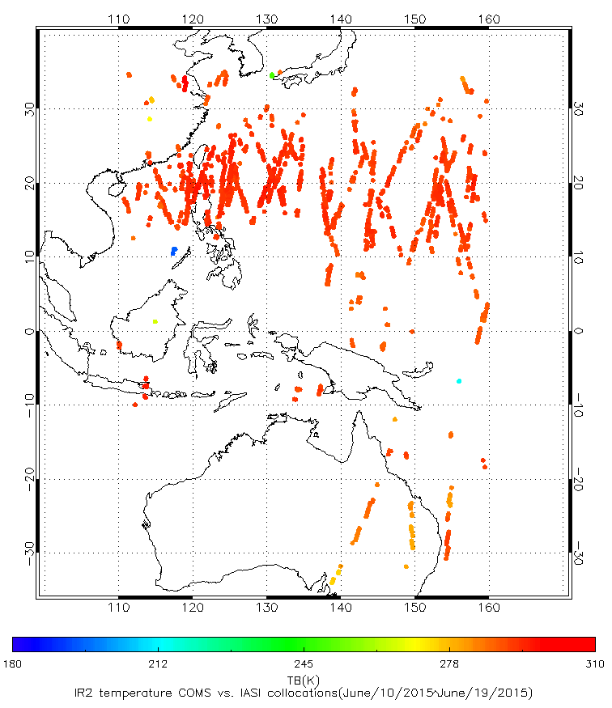
Spatial and temperature distributions of collocation
Example of spatial and temperature distributions of COMS vs. LEO collocations on June/10/2015~June/19/2015, for COMS IR2 vs. IASI

Slide 4
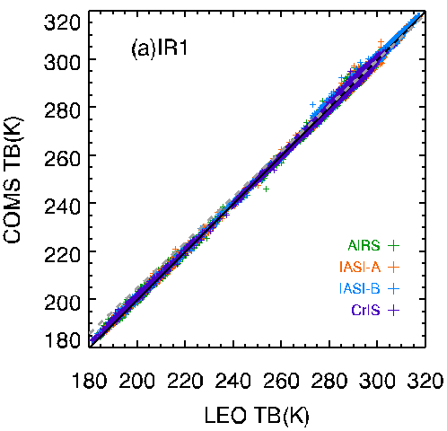
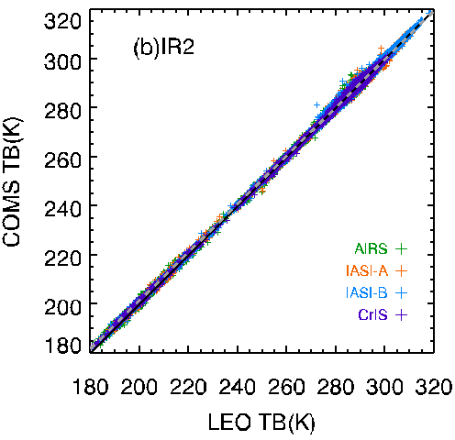
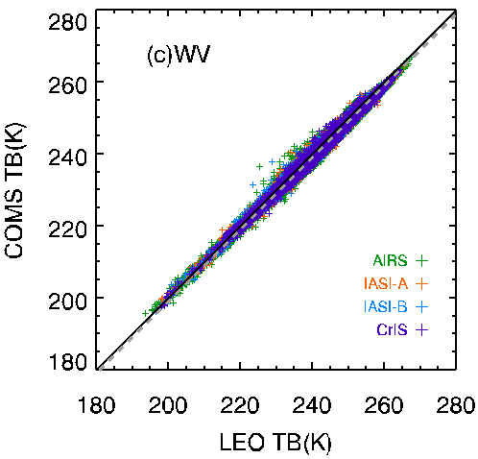
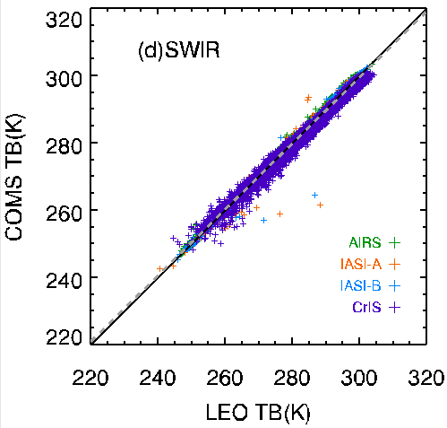
TB bias(GEO-LEO) using IASI-A,-B, AIRS & CrIS
Check the TB bias from COMS/MI and LEOs(MetOp-A,B/IASI, Aqua/AIRS and SNPP/CrIS) for four IR Channels.
 |  | IASI-A | IASI-B | AIRS | CrIS
IR1 | Number | 137840 | 109334 | 566782 | 241119
 | Bias | 0.1072 | 0.1260 | 0.0437 | 0.0266
 | RMSE | 0.3517 | 0.3489 | 0.4277 | 0.3981
 | Slope | 0.9938 | 0.9967 | 1.0032 | 1.0004
 | Intercept | 1.9238 | 1.0903 | -0.8982 | -0.0973
IR2 | Number | 151320 | 121346 | 612961 | 263226
 | Bias | -0.0073 | 0.0224 | 0.0233 | -0.0008
 | RMSE | 0.3352 | 0.3364 | 0.3346 | 0.2887
 | Slope | 0.9931 | 0.9931 | 0.9999 | 0.9987
 | Intercept | 1.9972 | 2.0201 | 0.0518 | 0.3900
IR3 (WV) | Number | 178297 | 140999 | 741373 | 325975
 | Bias | -0.8373 | -0.8544 | -1.0767 | -0.9880
 | RMSE | 0.4211 | 0.4170 | 0.4705 | 0.4369
 | Slope | 0.9828 | 0.9851 | 0.9859 | 0.9886
 | Intercept | 3.3749 | 2.7865 | 2.3656 | 1.7984
IR4 (SWIR) | Number | 43437 | 35031 | 112060 | 36243
 | Bias | 0.1508 | 0.1421 | -0.1746 | -1.4627
 | RMSE | 0.2651 | 0.2381 | 0.3380 | 0.8662
 | Slope | 0.9959 | 0.9953 | 0.9885 | 0.9450
 | Intercept | 1.3592 | 1.5193 | 3.1955 | 14.8188

Slide 5
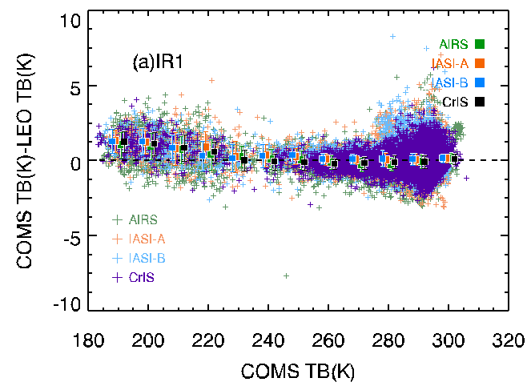
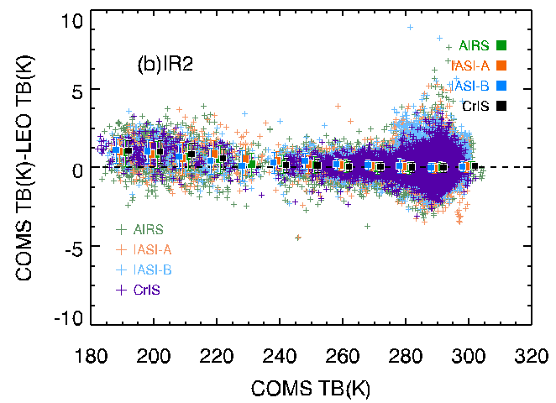
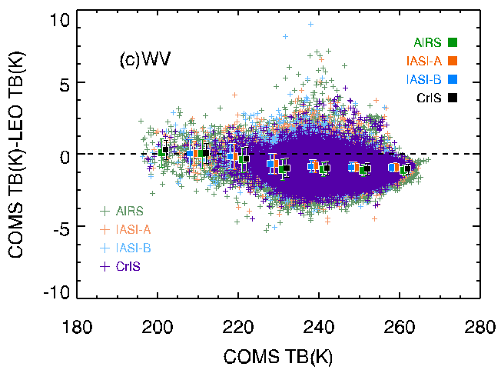
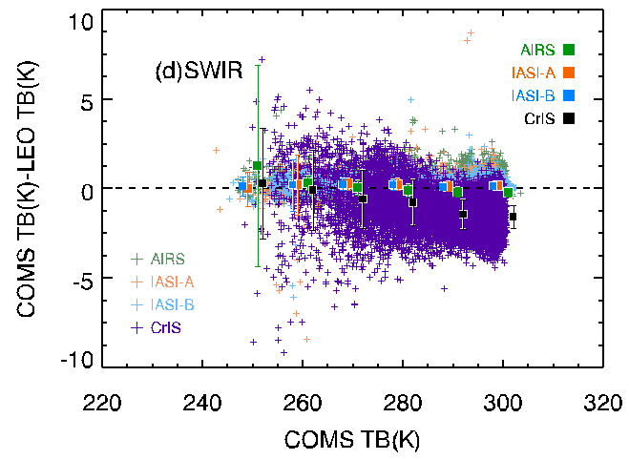
Trend of TB bias
The TB difference between MI and LEOs(IASI-A, -B, AIRS & CrIS) as a function of the MI TB
IR1
IR2
WV
SWIR

Slide 6
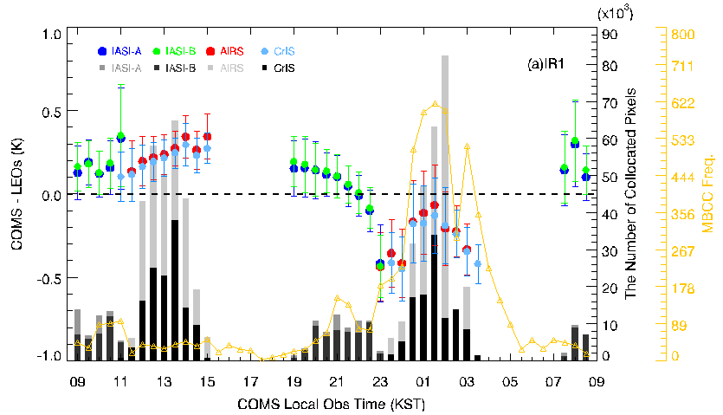
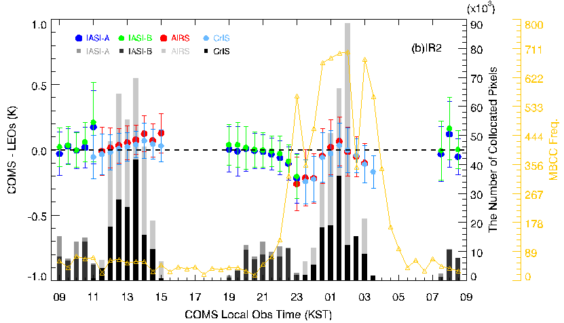
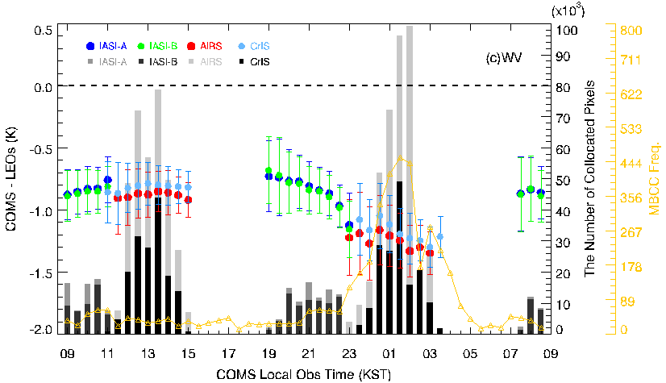
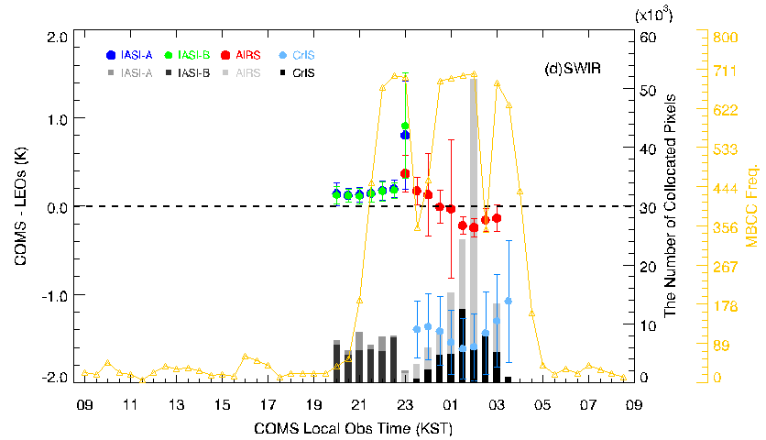
Diurnal variation for Four Seasons (TB biases)
Diurnal variation for TB bias of IASI-A, -B, AIRS and CrIS, and for Frequency of MBCC application
IR1
IR2
WV
SWIR

Slide 7
Diurnal Tb variation vs. MBCC performance
period: AIRS(April 2011 - Dec. 2015)
$Diurnal Tb variation=\max\left(∆{Tb}_{GEO−AIRS,i}\right)−\min\left(∆{Tb}_{GEO−AIRS,j}\right)$ $i=12:00\sim 15:00(daytime)$, $j=00:00\sim 03:00\left(nighttime\right)$ LST
$MBCC performance=\operatorname{mean}\left(∆{Tb}_{GEO−AIRS,j}\right)−\operatorname{mean}\left(∆{Tb}_{GEO−AIRS,i}\right)$ $i=13:00\sim 14:00(daytime)$, $j=01:00\sim 02:00(nighttime)$ LST
COMS-AIRS Diurnal Tb variation
 | Winter | Spring | Summer | Autumn | Total
IR1 | 0.9445 | 0.7586 | 0.7103 | 0.6082 | 0.7497
IR2 | 0.4856 | 0.4537 | 0.4817 | 0.2943 | 0.3808
WV | 0.6681 | 0.5893 | 0.5817 | 0.5677 | 0.5595
COMS-CrIS Diurnal Tb variation
 | Winter | Spring | Summer | Autumn | Total
IR1 | 0.8201 | 0.6734 | 0.7468 | 0.7063 | 0.6640
IR2 | 0.3875 | 0.2467 | 0.3670 | 0.2835 | 0.2456
WV | 0.7099 | 0.5294 | 0.5494 | 0.5519 | 0.5395
COMS-AIRS MBCC performance
 | Winter | Spring | Summer | Autumn | Total
IR1 | -0.3775 | -0.2784 | -0.5283 | -0.0873 | -0.3133
IR2 | -0.0130 | -0.0238 | -0.1772 | 0.1450 | -0.0142
WV | -0.4844 | -0.3706 | -0.4706 | -0.2675 | -0.3841
COMS-CrIS MBCC performance
 | Winter | Spring | Summer | Autumn | Total
IR1 | -0.3907 | -0.2711 | -0.5455 | -0.1575 | -0.3321
IR2 | -0.0611 | 0.0166 | -0.1601 | 0.1079 | -0.0179
WV | -0.4621 | -0.2801 | -0.4723 | -0.2655 | -0.3662
*Reference: Fangfang Yu et. al(2013), Diurnal and Scan Angle Variations in the Calibration of GOES Imager Infrared Channels

Slide 8
Slope retrievals (m_{org} vs. m_{est}(MBCC) vs. m_{GSICS})
GSICS Corrected slope(?)
m_{GSICS}
Original slope :
m_{org}
$I_{GEO}=a_{c}+b_{c}C_{GEO}$
($R = b + m∗X+q∗X^{2}$)
$${\hat{I}}_{LEO}=a_{g}+b_{g}C_{GEO}$$
$a_{c}$,$b_{c}$ : original calibration coeff.
$$R=q∗X^{2}+m∗X+b$$
$BB$: true reference
$m$: true value
$$r_{BB}=q∗{{\overline{X}}_{BB}}^{2}+m∗{{\overline{X}}_{BB}}^{}+b$$
$$r_{SP−BB}=q∗{{\overline{X}}_{SP−BB}}^{2}+m∗{{\overline{X}}_{SP−BB}}^{}+b$$
$$C_{GEO}\text{: }\text{GEO} \text{count}$$
$I_{GEO}=a_{r}+b_{r}I_{LEO}$ (regression coeff.)
$${\hat{I}}_{LEO}=−\frac{a_{r}}{b_{r}}+\frac{1}{b_{r}}I_{GEO}$$
$I_{GEO}=a_{c}+b_{c}C_{GEO}$
$${\hat{I}}_{LEO}=a_{g}+b_{g}C_{GEO}$$
$a_{g}=\frac{a_{c}−a_{r}}{b_{r}}$, $b_{g}=\frac{b_{c}}{b_{r}}$
$m=\frac{r_{BB}−q×({{\overline{X}}_{BB}}^{2}−{{\overline{X}}_{SP−BB}}^{2})}{{\overline{X}}_{BB}−{\overline{X}}_{SP−BB}}$
m_{est}(MBCC)
Estimated slope (MBCC) :
$\hat{m}=C_{0}+C_{1}×T_{optics}+C_{2}×{T_{optics}}^{2}$ ,
where $T_{optics}$ : “predicting” temperature
(primary mirror temperature)
Collaboration with NOAA (Fred and Fangfang)

Slide 9
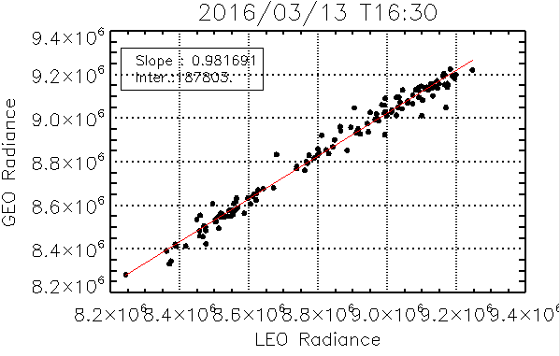
Slope retrievals (m_{GSICS})
$I_{LEO}=b+m_{GSICS}∗C_{GEO}$ $I_{GEO}$ [Wm⁻²str⁻¹m⁻¹], $I_{LEO}$ [mWm⁻²str⁻¹cm⁻¹]
To retrieval $m_{GSICS}$
$I_{GEO}=a_{r}+b_{r}I_{LEO}$ [Wm⁻²str⁻¹m⁻¹]
${\hat{I}}_{LEO}=−\frac{a_{r}}{b_{r}}+\frac{1}{b_{r}}I_{GEO}$
$I_{GEO}=a_{c}+b_{c}C_{GEO}$ ($a_{c}, b_{c}$: given value)
${\hat{I}}_{LEO}=a_{g}+b_{g}C_{GEO} (a_{g}=\frac{a_{c}−a_{r}}{b_{r}}$, $b_{g}=\frac{b_{c}}{b_{r}}$)
⇒ $m_{GSICS}$ = $b_{g}=\frac{b_{c}}{b_{r}}$
$I_{GEO}=a_{r}+b_{r}I_{LEO}$ [Wm⁻²str⁻¹m⁻¹]
Least square fitting method is applied to every scene
If there are more than 50 of matching, $a_{r}$and $b_{r}$are obtained through linear fit
The following figure is an example of scene for 16: 30 on March/13/2016
Linear Regression (red line)
Slope: $b_{r}$
Intercept : $a_{r}$

Slide 10
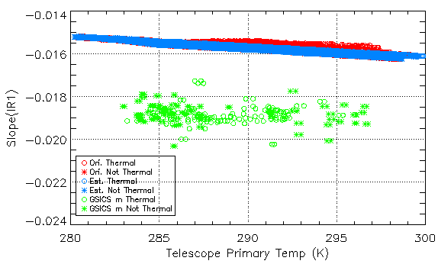
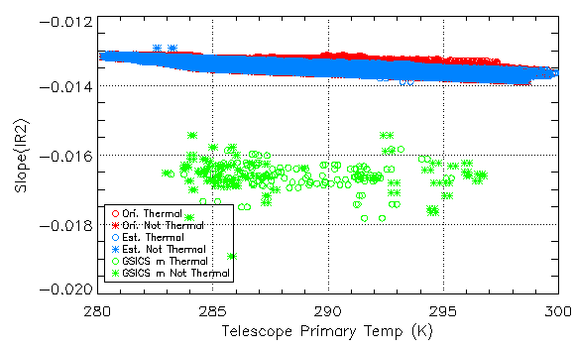
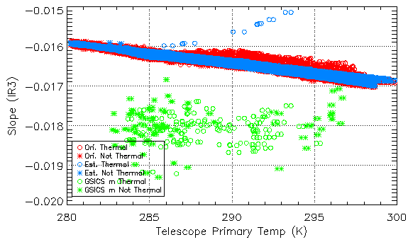
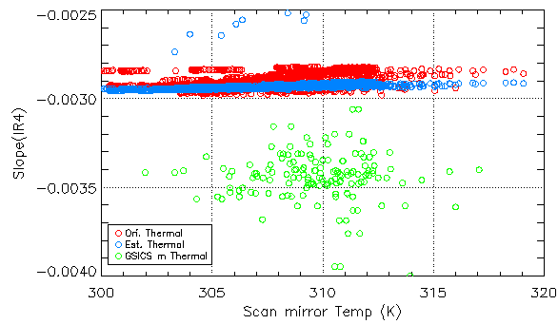
Slope Comparison (m_{org} vs. m_{est}(MBCC) vs. m_{GSICS})
Period : March/12/2016~April/10/2016, June/07/2016/~July/05/2016, Sep./10/2016~Oct./11/2016, Dec./10/2016~Jan./11/2017
under thermal stress(22:00~03:00 LST) [Wm⁻²str⁻¹μm⁻¹/count]
IR1
m_{org}
IR2
m_{est}(MBCC)
m_{GSICS}
WV
SWIR

Slide 11
Time series for Slope
Mar-Apr
Jun-Jul
Sep-Oct
Dec-Jan
m_{org}
m_{est}(MBCC)
m_{GSICS}
IR1 | March/12 -April/10 | June/7 -July/5 | Sep/10 -Oct11 | Dec/10 -Jan/11
Ori.mean | -1.55029e-2 | -1.58900e-2 | -1.55087e-2 | -1.54963e-2
Ori.stdv | 0.0905e-3 | 0.1814e-3 | 0.1977e-3 | 0.1134e-3
Est.mean | -1.55551e-2 | -1.59138e-2 | -1.55311e-2 | -1.54904e-2
Est.stdv | 0.1305e-3 | 0.1574e-3 | 0.204e-3 | 0.1079e-3
GSICS mean | -1.88392e-2 | -1.89185e-2 | -1.87313e-2 | -1.87766e-2
GSICS stdv | 0.3723e-3 | 0.5406e-3 | 0.4871e-3 | 0.4167e-3
IR2 | March/12 -April/10 | June/7 -July/5 | Sep/10 -Oct11 | Dec/10 -Jan/11
Ori.mean | -1.32695e-2 | -1.36696e-2 | -1.32526e-2 | -0.29184e-2
Ori.stdv | 0.0761e-3 | 0.1150e-3 | 0.1020e-3 | 0.0081e-3
Est.mean | -1.33140e-2 | -1.37036e-2 | -1.32597e-2 | -0.29327e-2
Est.stdv | 0.0819e-3 | 0.0827e-3 | 0.0991e-3 | 0.0059e-3
GSICS mean | -1.66532e-2 | -1.66500e-2 | -1.64663e-2 | -0.35651e-2
GSICS stdv | 0.5170e-3 | 0.5072e-3 | 0.3240e-3 | 0.2424e-3

Slide 12
Time series for Slope
Mar-Apr
Jun-Jul
Sep-Oct
Dec-Jan
WV | March/12 -April/10 | June/7 -July/5 | Sep/10 -Oct11 | Dec/10 -Jan/11
Ori.mean | -1.62584e-2 | -1.65747e-2 | -1.62387e-2 | -1.62236e-2
Ori.stdv | 0.1056e-3 | 0.2154e-3 | 0.2196e-3 | 0.1430e-3
Est.mean | -1.62900e-2 | -1.66039e-2 | -1.62412e-2 | -1.61902e-2
Est.stdv | 0.1383e-3 | 0.1851e-3 | 0.2187e-3 | 0.1098e-3
GSICS mean | -1.81364e-2 | -1.80508e-2 | -1.80778e-2 | -1.80601e-2
GSICS stdv | 0.5543e-3 | 0.5956e-3 | 0.4137e-3 | 0.3193e-3
SWIR | March/12 -April/10 | June/7 -July/5 | Sep/10 -Oct11 | Dec/10 -Jan/11
Ori.mean | -0.28924e-2 | -0.28331e-2 | -0.29511e-2 | -0.29184e-2
Ori.stdv | 0.0528e-3 | 0.0082e-3 | 0.0322e-3 | 0.0081e-3
Est.mean | -0.29240e-2 | -0.29132e-2 | -0.29604e-2 | -0.29327e-2
Est.stdv | 0.0075e-3 | 0.0075e-3 | 0.0136e-3 | 0.0059e-3
GSICS mean | -0.34766e-2 | -0.34605e-2 | -0.34613e-2 | -0.35651e-2
GSICS stdv | 0.1510e-3 | 0.1380e-3 | 0.1712e-3 | 0.2424e-3

Slide 13
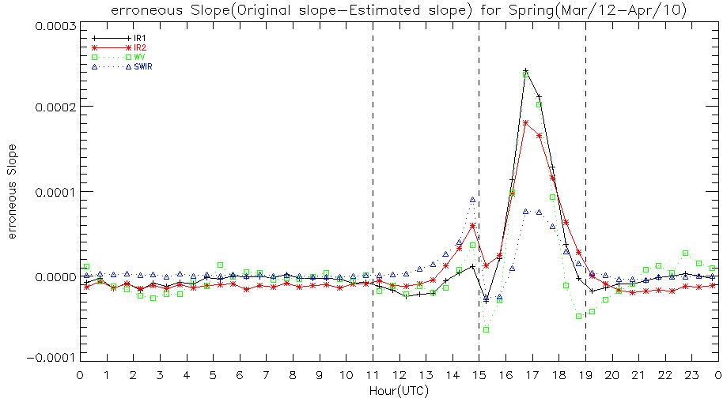
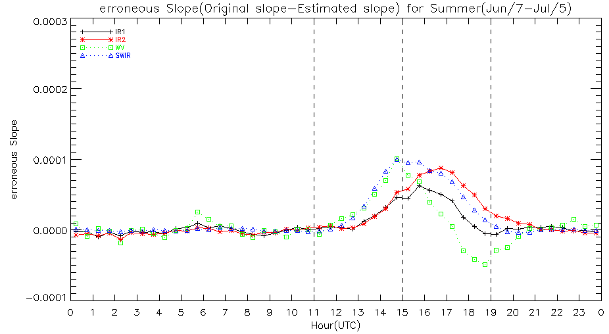
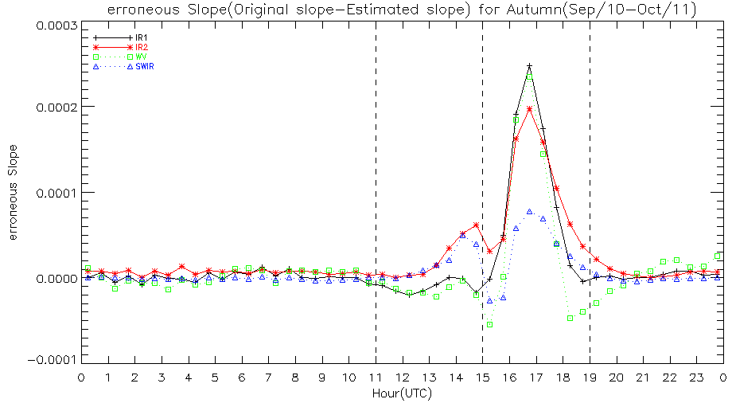
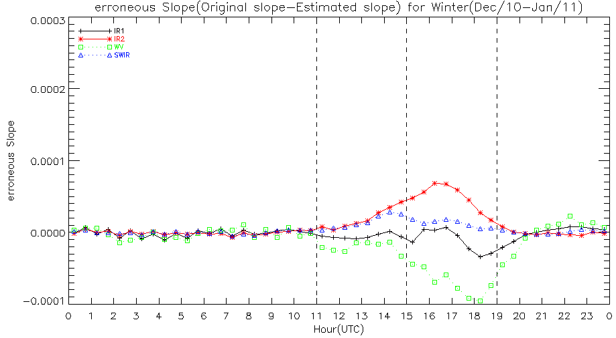
Erroneous Slope (m_{org} – m_{est}(MBCC))
Spring
Summer
Autumn
Winter

Slide 14
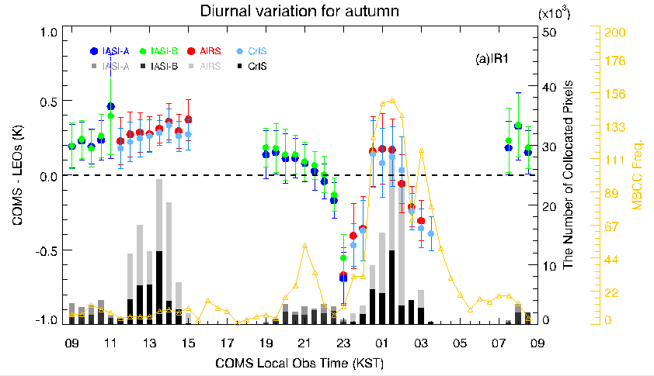
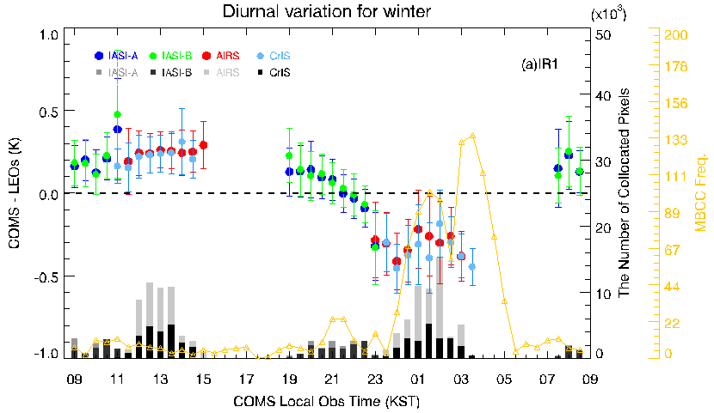
Erroneous Slope (Autumn and Winter)
Autumn
Winter

Slide 15
Seasonal Variations (COMS IR)

Slide 16
Time series (TB biases and RMSE)
IR1
IR2
WV
SWIR

Slide 17
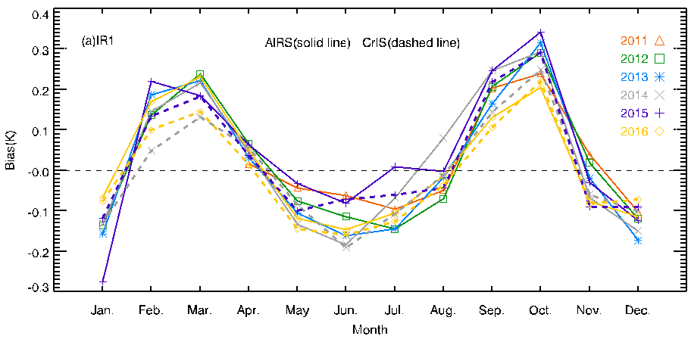
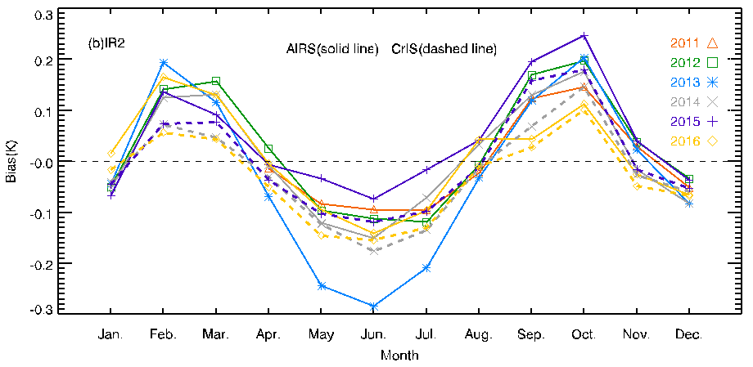
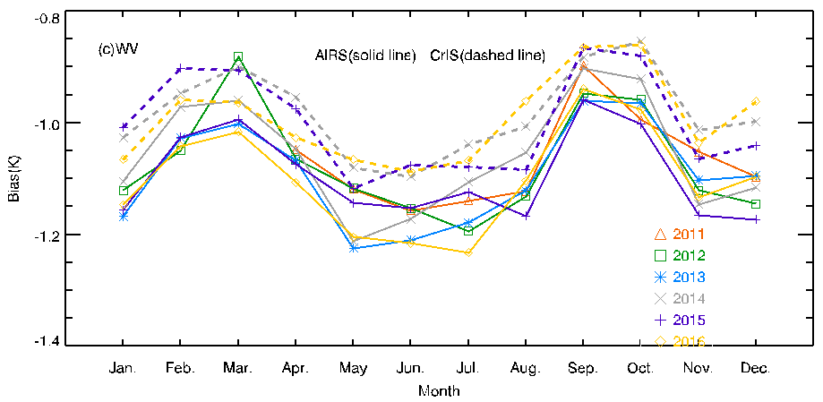
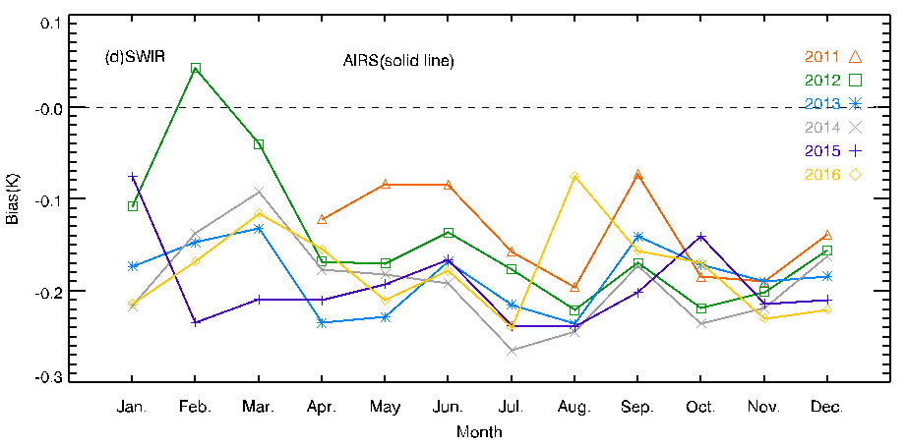
Seasonal variation (AIRS and CrIS)
IR1
IR2
WV
SWIR

Slide 18
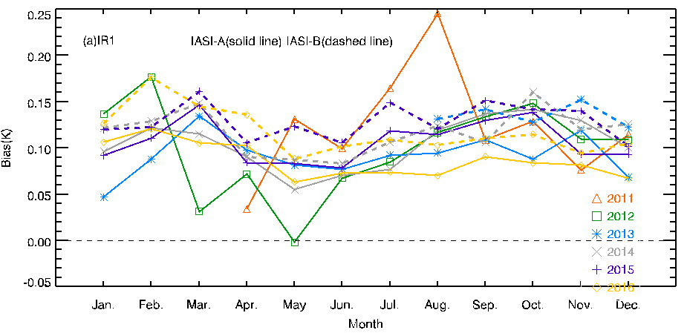
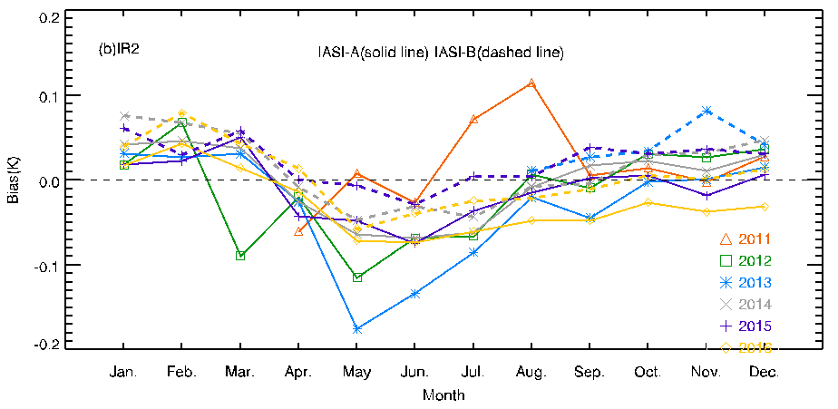
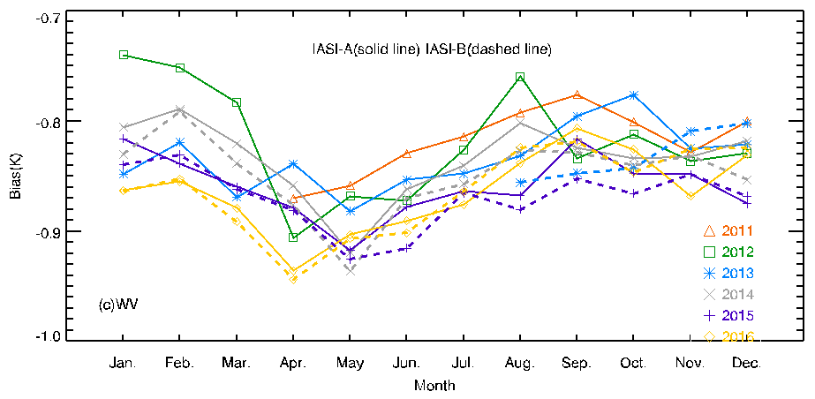
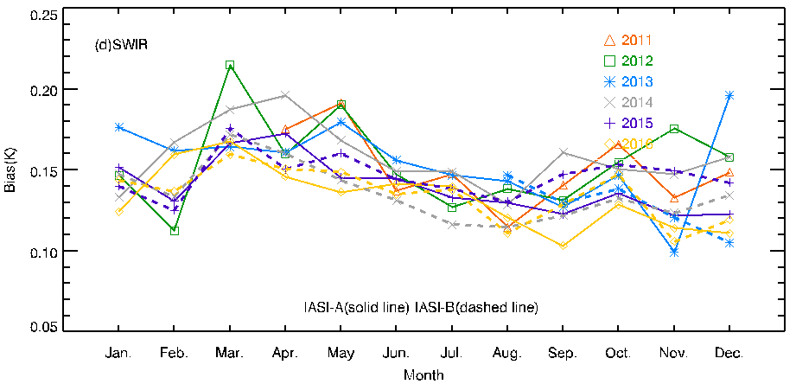
Seasonal variation (IASI)
IR1
IR2
WV
SWIR

Slide 19
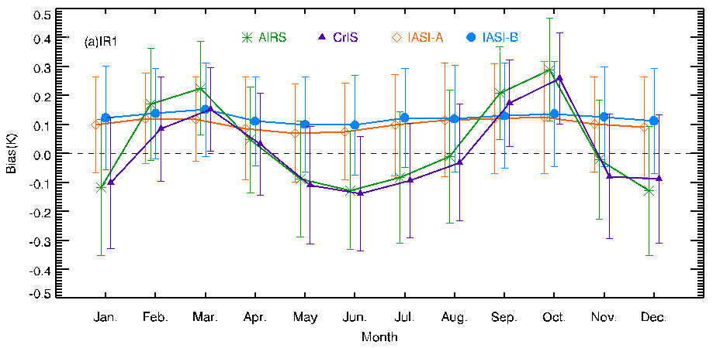
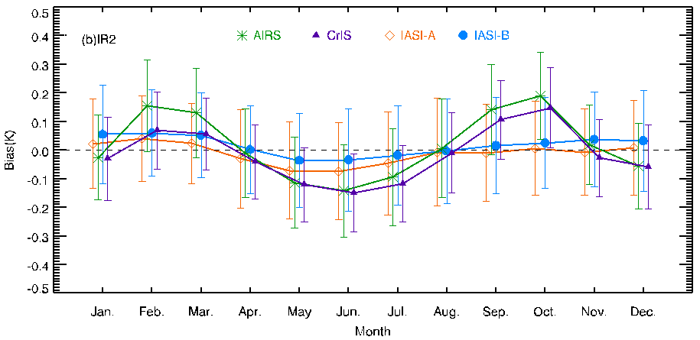
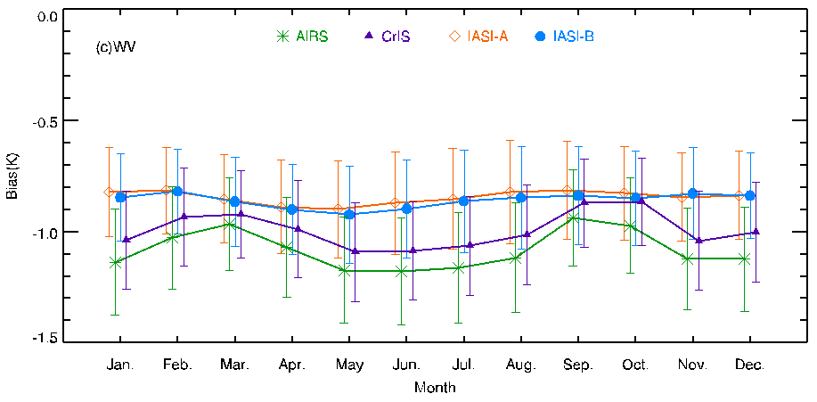
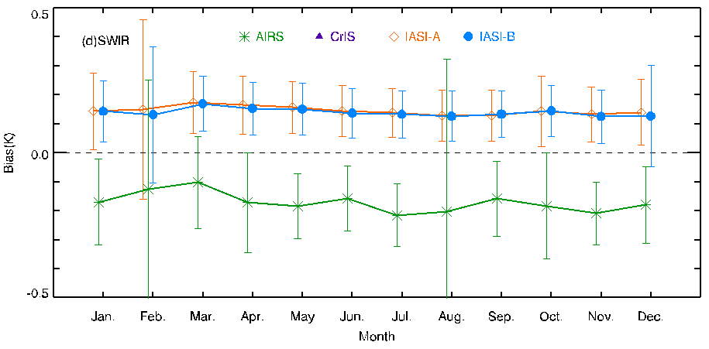
Seasonal variation (AIRS/CrIS and IASI)
IR1
IR2
WV
SWIR

Slide 20
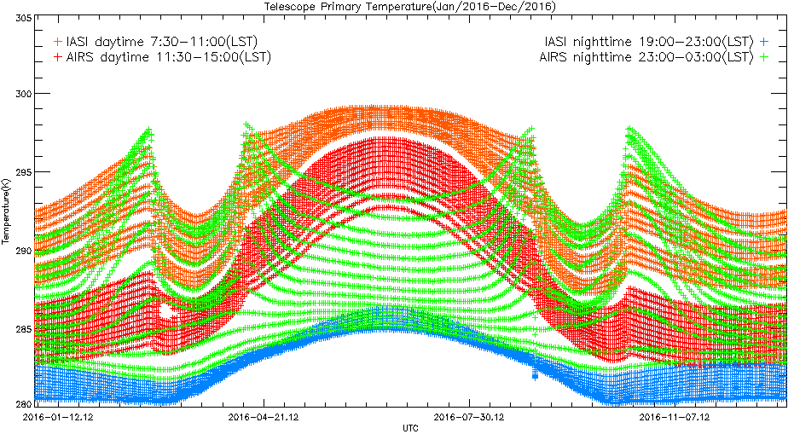
Telescope Primary Temperature(day+night)
IASI and AIRS collocation time (daytime vs. nighttime) during 2016

Slide 21
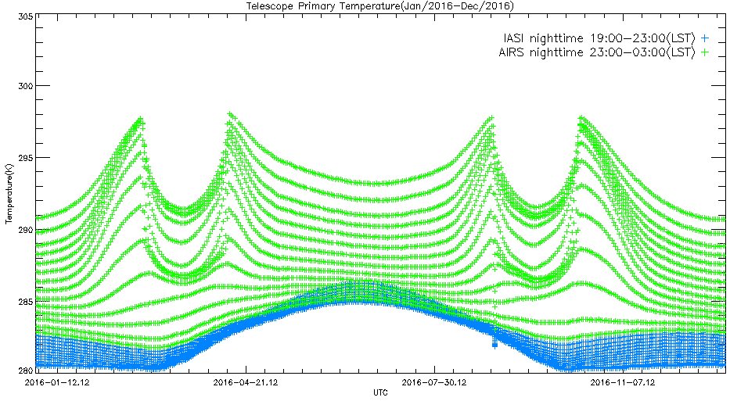
Telescope Primary Temperature(night)
For IR1, IR2 and WV, IASI and AIRS collocation time (nighttime, MBCC) during 2016
AIRS
IASI

Slide 22
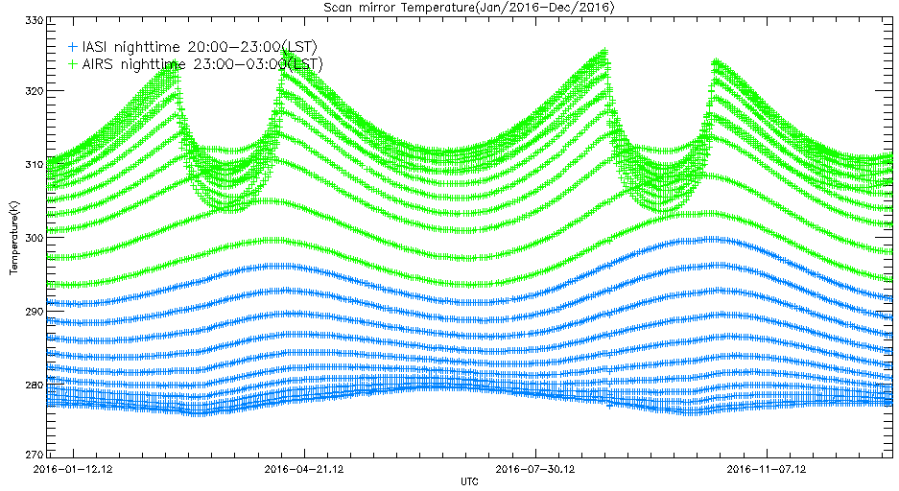
Scan Mirror Temperature(night)
For SWIR, IASI and AIRS collocation time (nighttime, MBCC) during 2016
AIRS
IASI
1 : This correction algorithm is especially pertinent for the shortwave IR channels around satellite midnight and during eclipse seasons.(GOES-8 imager midnight effects and slope correction, Weinreb)
2 : While it is usually applied with high frequency for about 8h around satellite midnight for the short-wave channels, it may only be intensively used right after satellite midnight or even barely used for the other IR channels.(Diurnal and Scan Angle Variations in the Calibration of GOES Imager Infrared Channels, Yu)

Slide 23
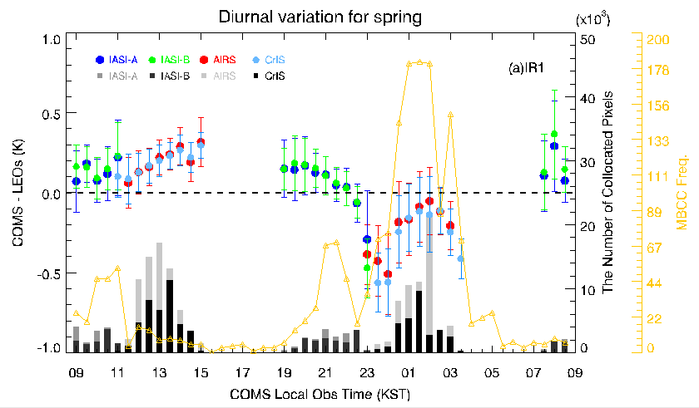
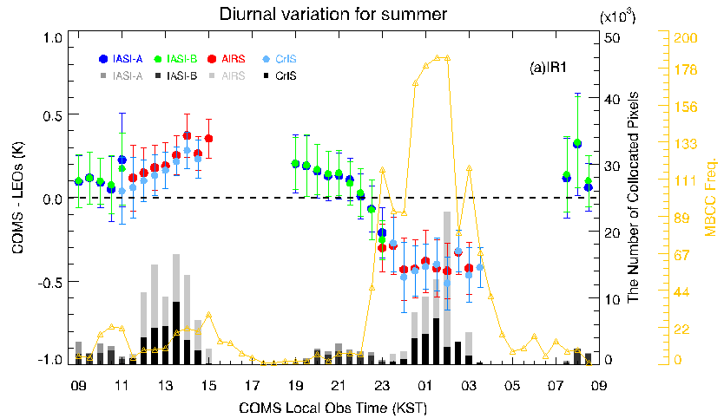
Erroneous Slope (Spring and Summer)
Spring
Summer

Slide 24
Erroneous Slope (Autumn and Winter)
Autumn
Winter

Slide 25
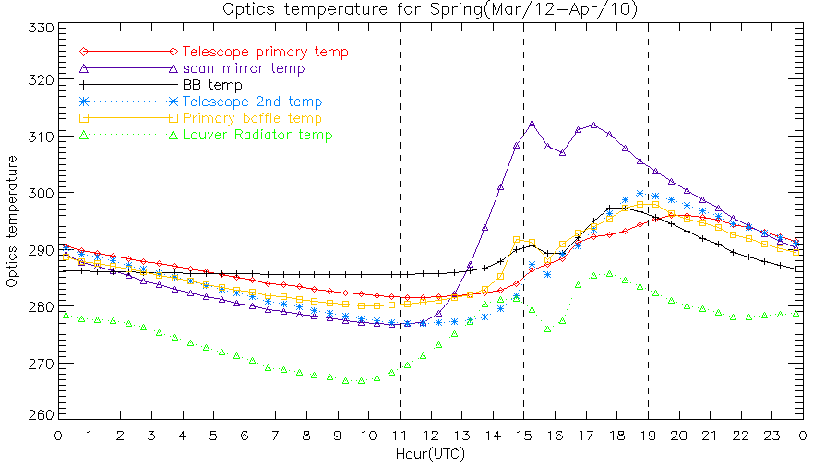
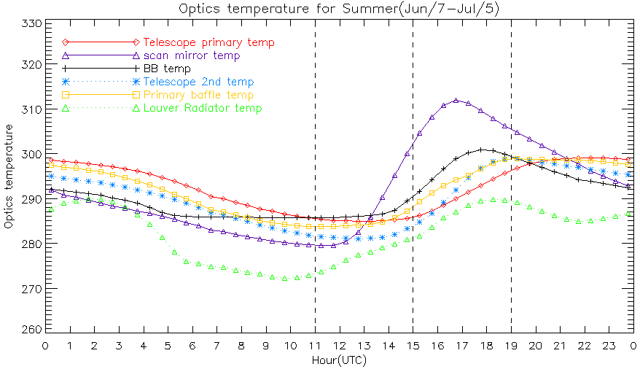
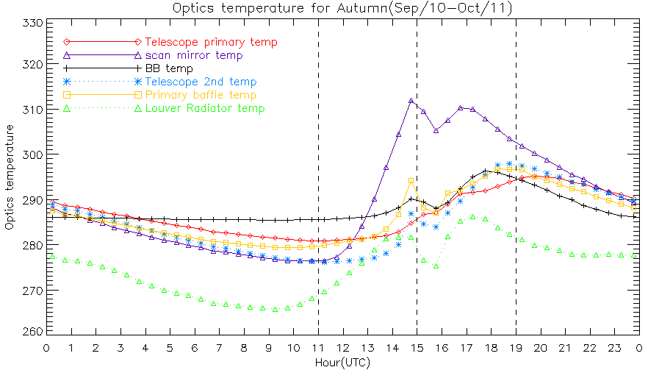
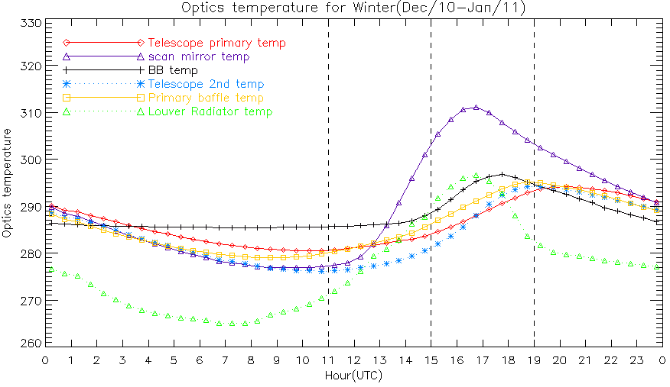
Optics temperature (diurnal variation)
Spring
Summer
Autumn
Winter

Slide 26
Summary and discussion
Diurnal and seasonal variations are not ignorable in 3 axis stabilized satellite
MBCC corrections (COMS) showed seasonal characteristics
Spring/Autumn shows strong correction while summer/winter weak correction
Requirements from SST community
To provide the each band(IR1), interband(IR1-IR2), and their combination correction coefficients
To provide the diurnal variation of GSICS correction
Need to update the corrected TB not retrieval coefficients

Slide 27
GEO-GEO intercomparison (COMS vs MTSAT-2 COMS vs Himawari-8)

Slide 28
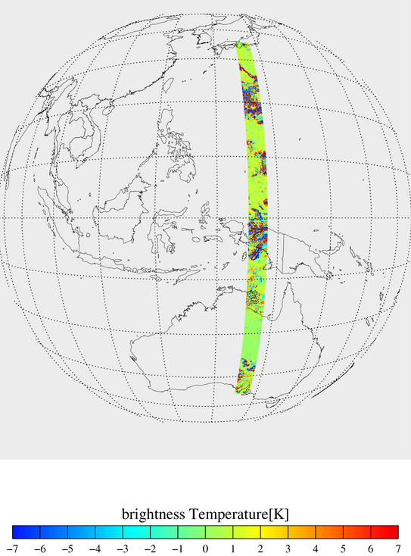
COMS vs MTSAT-2
Collocation
1) Time
- 8 times/day(COMS: 15min, MTSAT-2: 33min)
* SWIR: night time(11~20UTC)
2) Optical path
- Δsec(satellite zenith angle) < 1%
- lon,lat≤each satellite center lonlat±35º
→△lon: 135.21~137.97º, △lat: -35~35º
Uniformity Test
- 9x9(L_{E}) pixels : TB STDV(L_{E}) < 1K
IR1 TB[K] difference in collocaion region
(1 Jun. 2014 02:15/02:30UTC)

Slide 29
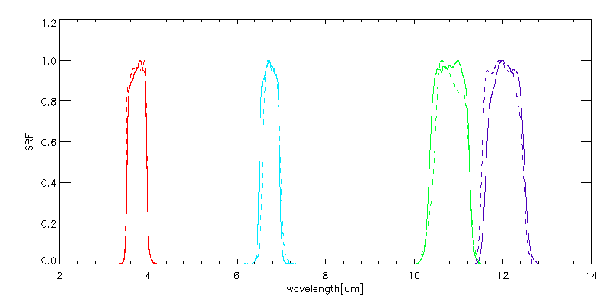
COMS vs MTSAT-2
COMS SRF(solid), MTSAT-2 SRF(dashed)

Slide 30
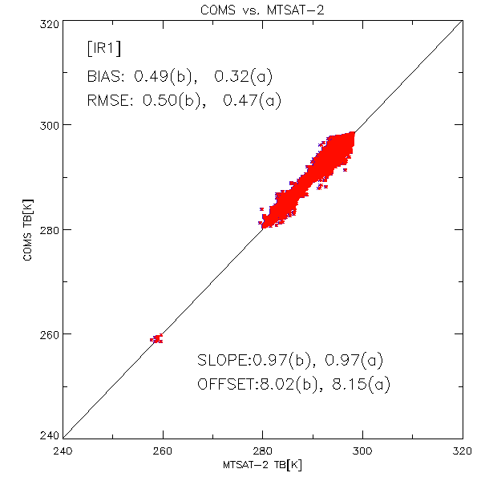
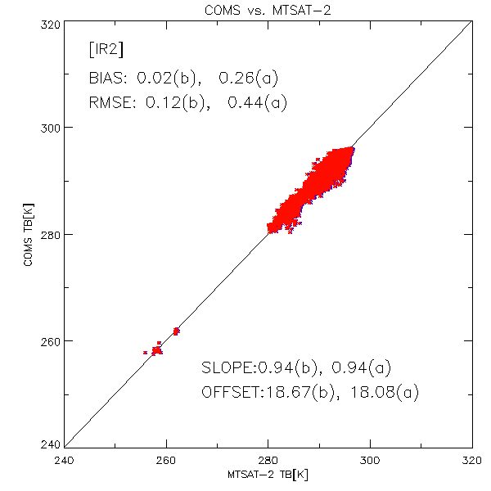
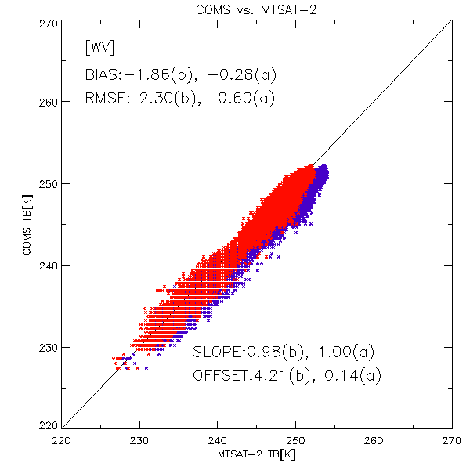
COMS vs MTSAT-2
11:15UTC(COMS) 11:33UTC(MTSAT-2)
‘a’ with SBAF, ‘b’ without SBAF application
* SBAF is important
* SBAFs obtained
via http://cloudsgate2.larc.nasa.gov/

Slide 31
COMS vs MTSAT-2
TB bias over TB(GSICS Corrected)
- SBAFs applied
- 3 months(Jun., Sep. Dec.) mean
- part of shading: Uncertainty(k=1)

Slide 32
COMS vs Himawari-8
Methods
COMS Lv1b
HIMAWARI-8 Lv1b
Collocation
1. Time: 8 times/day (COMS 15min, H-8 20min)
* SWIR: only night time(11~20UTC)
2. Optical path: Δsec(satellite zenith angle) < 1%, lon,lat≤±35º
- △Lat: -35~35º
- △Lon: 132.5~136.45º(about △3.94)
3. Channel(central wavelength) match
1) COMS IR1(10.79㎛) - H8 Ch13(10.41㎛)
2) COMS IR2(12.06㎛) - H8 Ch15(12.38㎛)
3) COMS WV(6.74㎛) - H8 Ch08(6.24㎛)
4) COMS IR1(3.75㎛) - H8 Ch07(3.89㎛)
Uniformity test
To minimize the difference of observation conditions, only use the pixel passed the Uniformity test
: when 50 of 81(9x9(L_{E}))pixels exist, STDV(L_{E}) < 1K
COMS IR1 TB[K] in collocaion region
(1 Feb. 2017 08:15UTC)

Slide 33
COMS vs Himawari-8
COMS SRF(solid), HIMAWARI-8 SRF(dashed)

Slide 34
COMS vs Himawari-8
11:15UTC(COMS) 11:20UTC(H-8)
‘a’ with SBAF, ‘b’ without SBAF application

Slide 35
Diurnal variation (with MTSAT-2)
To select clear pixel during the day (00-23UTC)
IR1(10.8um), IR1-IR2(12um)
Case 1: 31 Jan. 2015 / 35.09ºN, 129.32ºE
Case 2: 31 Jan. 2015 / 39.02ºN, 122.0ºE
Case 3: 1 Feb. 2015 / 42.99ºN, 136.03ºE
Case 3
Case 2
Case 1
COMS IR1 image (16:00UTC 31 Jan. 2015)
Notes:
Case1: 2015년 1월 31일 35.09ºN, 129.32ºE COMS(992,384), MTSAT-2(1035,499)
Case2: 2015년 1월 31일 39.02ºN, 122.0ºE COMS(1118, 238), MT-2(1200, 348)
Case3: 2015년 2월 1일 42.99ºN, 136.03ºE COMS(840,308), MTSAT-2(915,428)

Slide 36
Diurnal variation (with MTSAT-2)
[Case 1] 31 Jan. 2015/35.09ºN,129.32ºE
[Case 1] 31 Jan. 2015/35.09ºN,129.32ºE
IR1(10.8μm) TB bias
Apply SBAF
Bias < 1K
Warm bais is shown except for midnight
Around midnight, cold bias increase due to Midnight effect
MBCC(Midnight blackbody calibration correction) is implemented for four hours around midnight
Red: 1x1 pixel
Blue: 2x2 pixel
Black: 3x3 pixel
[Case 2] 31 Jan. 2015/39.02ºN,122.0ºE
[Case 2] 31 Jan. 2015/39.02ºN,122.0ºE
[Case 3] 1 Feb. 2015/42.99ºN, 136.03ºE
[Case 3] 1 Feb. 2015/42.99ºN, 136.03ºE
Red: 1x1 pixel
Blue: 2x2 pixel
Black: 3x3 pixel
Application of MBCC
IR1(10.8μm) TB bias
IR1-IR2 TB bias

Slide 37
Thank you

