Slide 1
Developing GSICS products for IR channels of LEO imagers Tim Hewison
Special Issue of the IEEE TGRS on “Inter-Calibration of Satellite Instruments”:
Special Issue of the IEEE TGRS on “Inter-Calibration of Satellite Instruments”:

Slide 2
GSICS LEO-LEO IR Product Status 2017-02
GPRC | Monitored Instrument | Reference Instrument | GSICS NRT Correction | GSICS Re-Analysis Correction | GSICS Bias Monitoring
Full GSICS Product Catalog available at http://www.star.nesdis.noaa.gov/smcd/GCC/ProductCatalog.php

Slide 3
GSICS LEO-LEO IR Product Status 2017-02
GPRC | Monitored Instrument | Reference Instrument | GSICS NRT Correction | GSICS Re-Analysis Correction | GSICS Bias Monitoring
EUMETSAT | Metop-A/HIRS, Metop-B/HIRS | Metop-A/IASI, Metop-B/IASI | Prototype | Prototype | Plots RAC
Full GSICS Product Catalog available at http://www.star.nesdis.noaa.gov/smcd/GCC/ProductCatalog.php

Slide 4
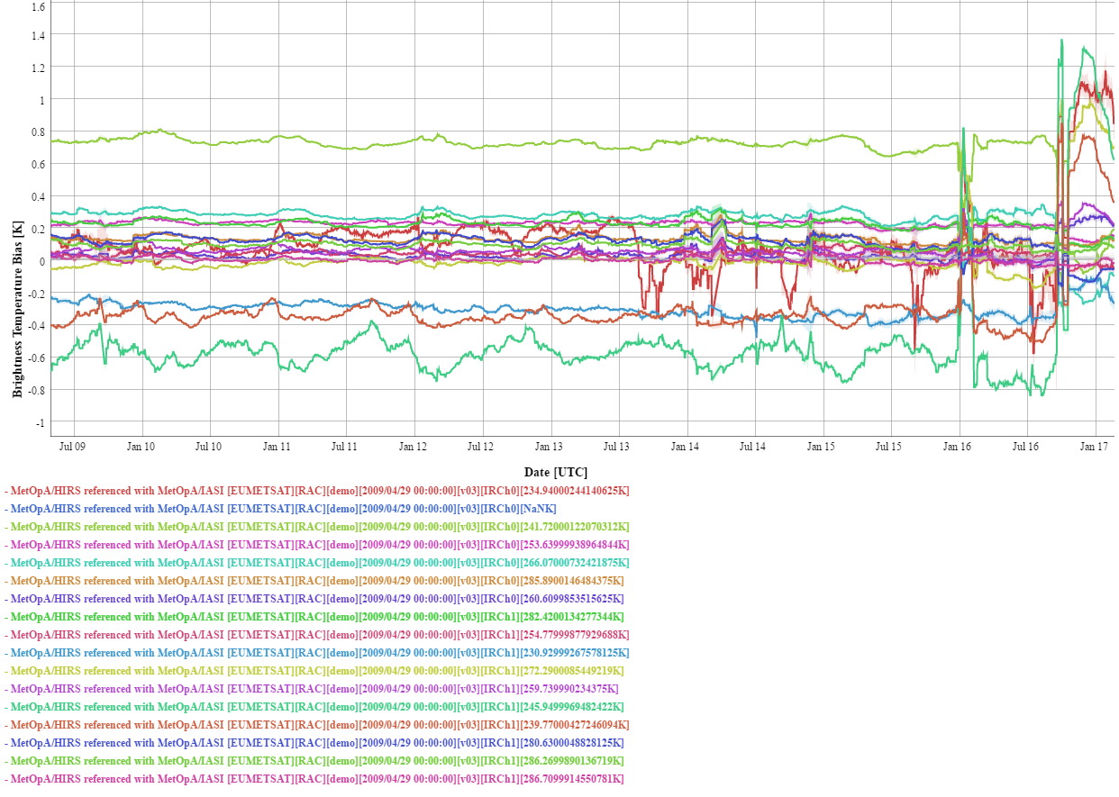

Slide 5
LEO-LEO IR Issues – Collocation Method
GEO-LEO IR ATBD uses linear weighted regression of collocated radiances
Easy for LEO imagers on same platform as reference instruments!
Others: Time difference <5min limits LEO-LEO collocations to polar SNOs
Few collocations – less robust statistics
Few collocations for warm radiances – limit application for SST, etc
Quasi SNOs
Relax time threshold
But limit collocations to scenes with low temporal variability
E.g. Clear Sky? Over the sea? At night?
Aim for unifrom distributions over dynamic range? – in Tb?
Need to complement QSNO coverage with polar SNOs
Other methods?
NWP+RTM, ...

Slide 6
LEO-LEO IR Issues – Product Development
Spectral coverage of reference instruments?
Extension of gap-filling method?
Development of GSICS products?
Recommendation: NASA is encouraged to follow the approach adopted for the GEO-LEO IR to derive GSICS products.
Recommendation: NASA to investigate the relative calibration of MODIS and VIIRS cold-end.

Slide 7
Discussion on LEO-LEO IR Products
Share your thoughts on developing GSICS products for LEO imagers
(at least for the IR channels)
a) Would it be useful to have GSICS corrections to inter-calibrate LEO imagers to a common reference?
b) If so, do they need regularly updating or could they be static?
c) What form would such corrections need to take to meet user expectations?
d) Anything else on this theme?

Slide 8
IR Sub-Group Activities
LEO-LEO IR
Inter-calibration algorithms
Hyperspectral gap-filling methods
Establishing user requirements
Developing first demonstration products?
Wed pm | GRWG: IR Sub-Group
 | Chair: Tim Hewison
14:20 | CMA? | Developing GSICS products for LEO imagers
 | Aisheng Wu (Remote) | – including VIIRS/MODIS
 |  | – extending coverage below 3.6µm
 | Tim + Igor | – including SLSTR
14:20 | CMA? | Developing GSICS products for LEO imagers
 | Aisheng Wu (Remote) | – including VIIRS/MODIS

Slide 9
Thank You for your contributions!

Slide 10
LEO-LEO IR Products for SLSTR
Share your thoughts on developing GSICS products for LEO imagers
(at least for the IR channels)
a) Would it be useful to have GSICS corrections to inter-calibrate LEO imagers to a common reference?
b) If so, do they need regularly updating or could they be static?
c) What form would such corrections need to take to meet user expectations?
d) Anything else on this theme?
We have started thinking about these questions for SLSTR. So far:
a) Yes.
b) Static, but calibration routinely monitored to check validity
c) TBD, but maybe quadratic in radiance
d) Need to deal with IASI spectrum missing from the 3.7µm channel (- Possible topic for Visiting Scientist at EUMETSAT?)
e) Already need to think about how to integrate with VIS/NIR channels

Slide 11
SLSTR/IASI L1 intercomparison
Igor Tomazic, Anne O’Carroll, Tim Hewison, Jorg Ackermann, Craig Donlon, Jens Nieke, Bouwe Andela, Dorothee Coppens, Jean-Francois Piolle

Slide 12
Outline
Introduction
Data
SLSTR, IASI A/(B)
Methodology
Crossovers, collocations, spectral convolution
Results
SNO: IASI A; per detector; outlier removal; IASI B (double difference)
Summary
Future work

Slide 13
Introduction
Important task in both E1 and E2 phases of Sentinel
Defined in joint ESA/EUM S3 Cal/Val plan and EUM S3 Mission Performance Implementation Plan
Following Global Space-based Inter-Calibration System (GSICS) methodology (Hewison, 2013)
EUMETSAT study by University of Leicester: Radiometric intercomparisons of AATSR and IASI, 2013, C. Whyte, D. Moore, J. Remedios

Slide 14
Introduction
IASI – GSICS referent sensor - due to the stability and characterisation
GSICS Traceability statement for IASI and AIRS → “Both AIRS and IASI are high spectral-resolution instruments, which have been characterised in a well-documented way pre-launch, which suggest their calibrations had uncertainties of the order of 0.1K.”
CrIS and IASI Polar SNOs <0.2 K at 900 cm-1 (for 200K < TB < 300 K) (Wang, 2015)
CrIS (Suomi-NPP) ~0.1 K – 0.2 K (k=3) TIR

Slide 15
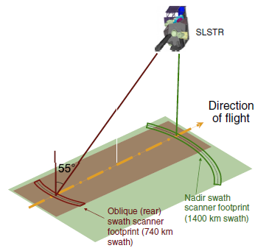
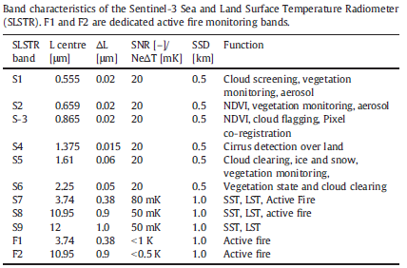
Copernicus Sentinel-3 SLSTR
Sea and Land Surface Temperature
Radiometer
S3A launched 16th February 2016.
SLSTR L1b data to S3VT 14/6.
Operational SLSTR L1b 17/11.

Slide 16
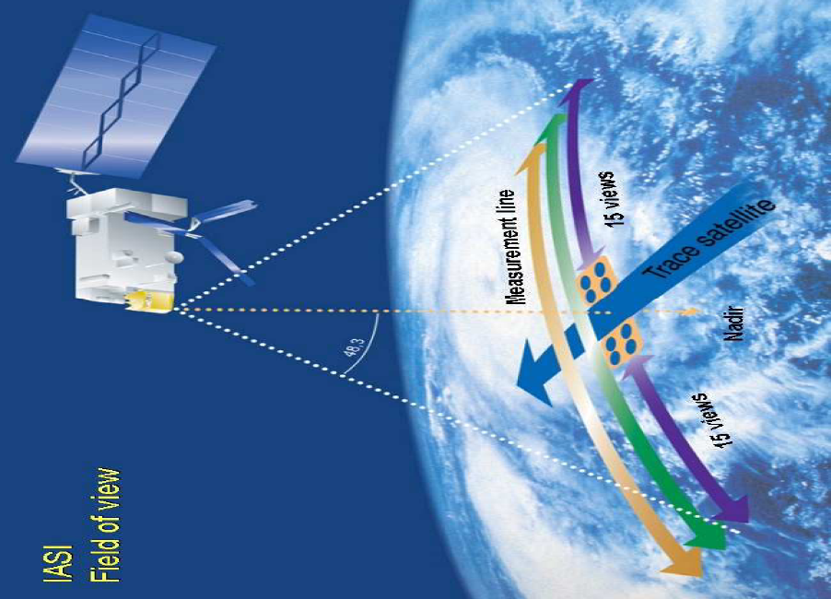
IASI: The Infrared Atmospheric Sounding Interferometer
Nadir Fourier Transform Interferometer
For atmospheric sounding
Spectral range: 645 to 2760 cm⁻¹ (3.62 to 15.5 microns)
Maximum Optical Path Difference (OPD) : +/- 2 cm
Spatial resolution : pixel diameter of 12 km
Spectral resolution : 0.5 cm⁻¹
Radiometric resolution : 0.2 to 0.4 K
Number of channels: 8700
Characteristics | Value | Unit
Scan type | step and stare | –
Scan rate | 8 | s
Stare interval | 151 | ms
Step interval | 8/37 | s
Number of Earth scans / line - EFOV | 30 | –
Swath | ±48.333 | deg
Swath width | ±1100 | km
IFOV - shape at nadir | Circular | –
IFOV - size at nadir | 12 | km
IFOV - size at edge of scan line across track | 39 | km
IFOV - size at edge of scan line along track | 20 | km

Slide 17
SLSTR: IR requirement
The absolute radiometric accuracy of the data acquired in the IR channels shall be smaller than 0.2 K (0.1 K goal) traceable to the ITS-90.
As a minimum, this requirement shall be met in the blackbody temperature range (~250 K - ~300 K), provided that the on-ground characterization covers the complete temperature range specified.

Slide 18
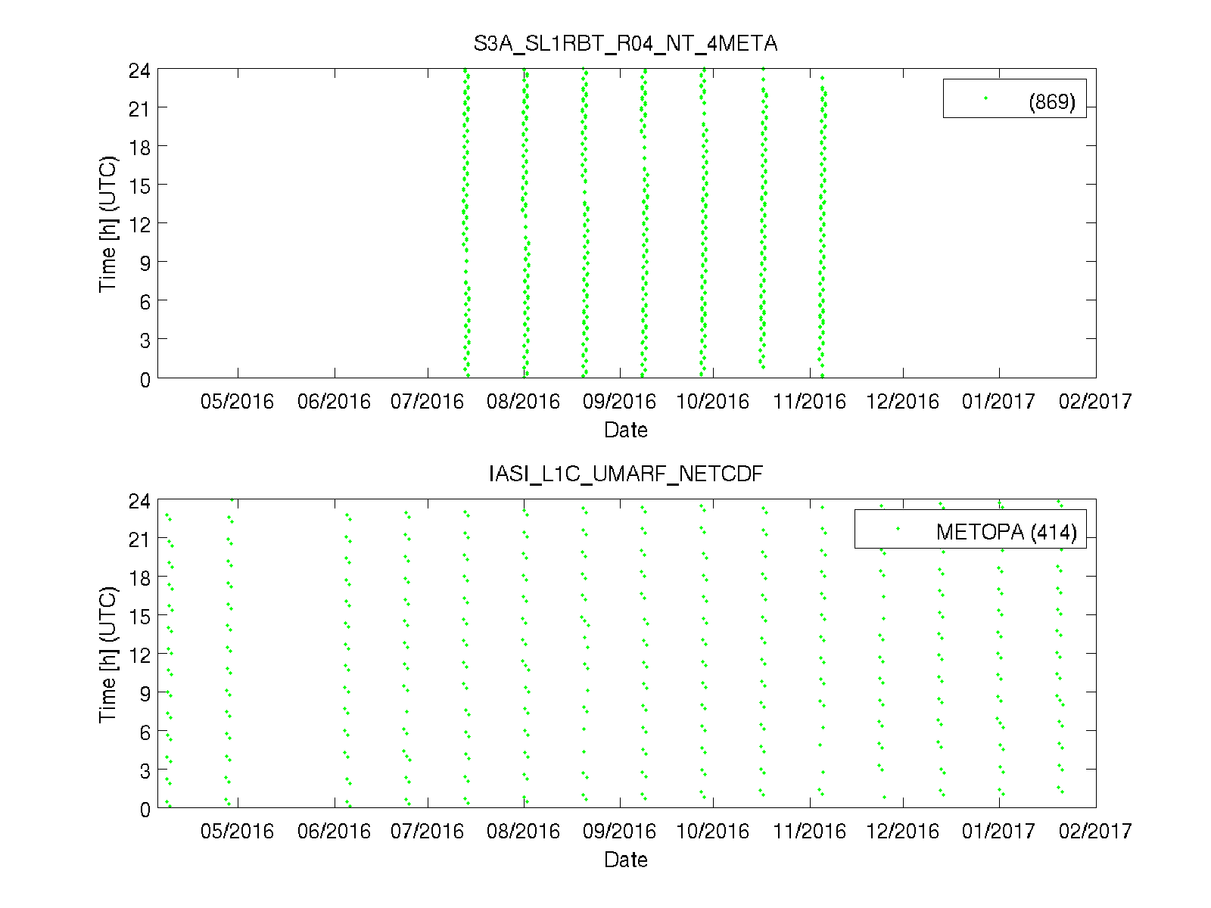
Data
S3A SLSTR: SL_1_RBT___ (L1B)
Reprocessed: Jul-Nov 2016 (IASI A – main analyses)
IPFP (prototype): Apr-Aug 2016 (for IASI A/B)
IPF (operational): Nov 2016-
IASI A (B)
Level 1C
SNOs time range

Slide 19
Methodology
Crossovers (SNO/QSNO)
(Q)SNO=(quasi) simultaneous nadir overpasses
Collocations (matchups)
spatio/temporal/geometry
Spectral convolution
Convolve IASI radiance spectra with SLSTR SRF
Aggregate (average)
SLSTR pixels in IASI FoV

Slide 20
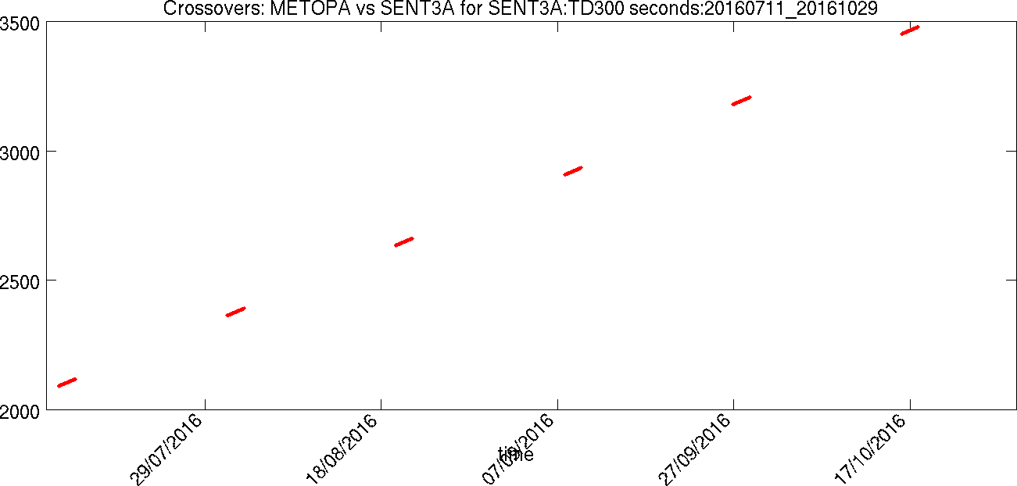
Methodology – Crossovers: SNO
SNOs – based on orbital model prediction
Estimated for the period: Apr16-Jan17
Max time difference: 5 min
Max spatial distance:10 km
Analysed 7 SNO (REP) events for IASI-A
Each event last ~2 days with ~50 crossovers per SNO
MetopA: 27-28/04; 04-06/06; 23-25/06; 12-14/07; 31/07-02/08; 19-21/08; 07-09/09; 26-28/09; 16-17/10;04-05/11; ...

Slide 21
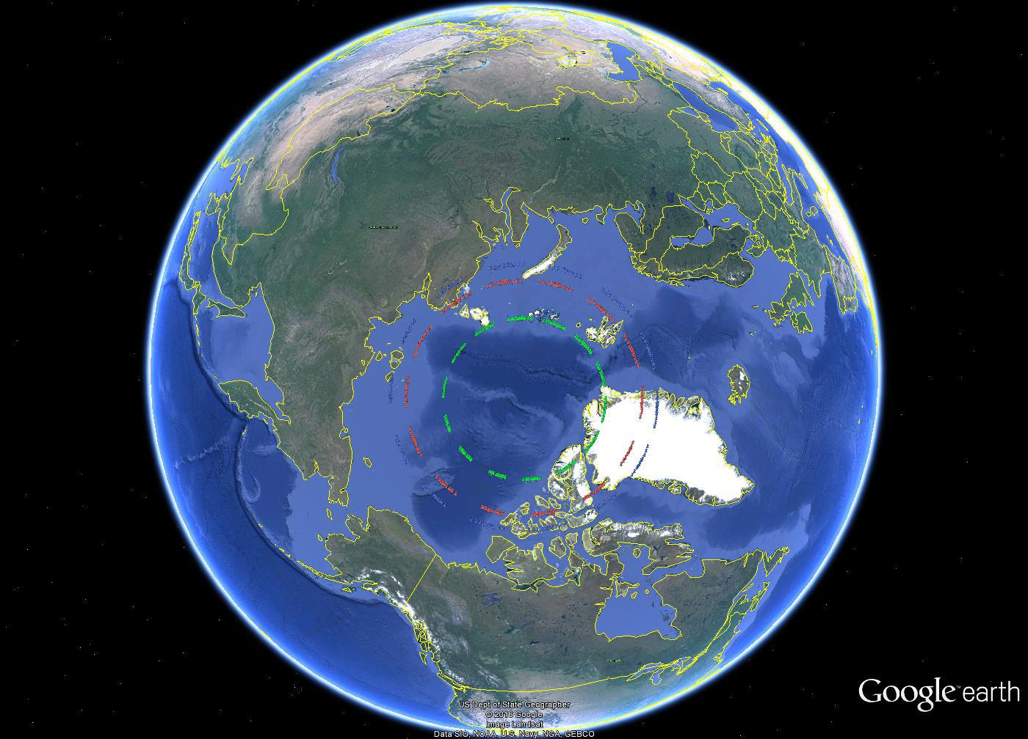
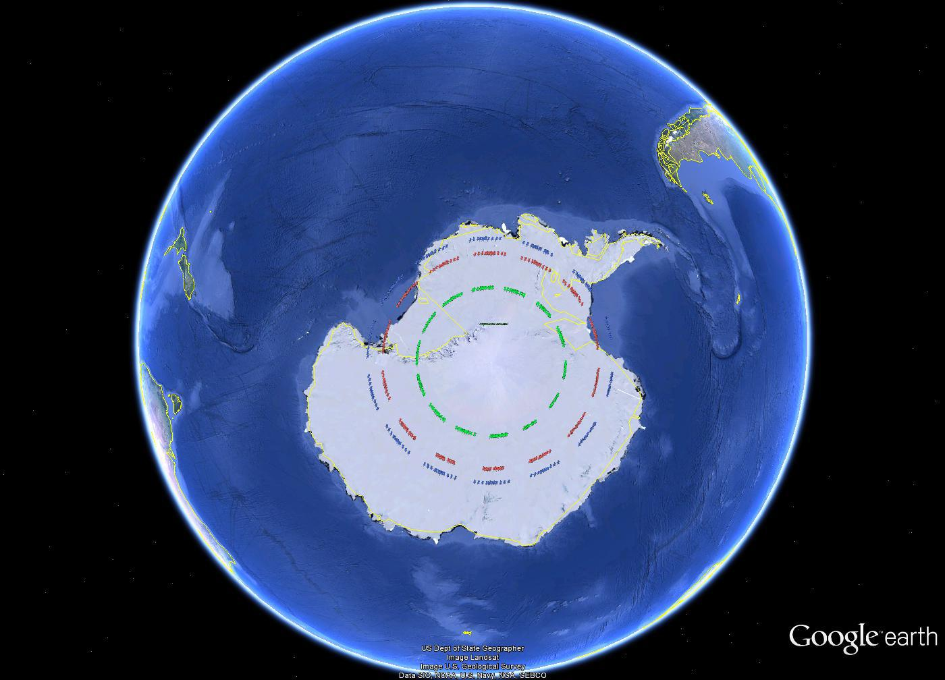
Methodology – Crossovers: SNO
Location of SNO crossovers (South&North Pole)
Green – true collocation; blue – time of collocation + 3 min; red – time of collocation – 3 min
Limited to pole regions → temperature range ~200 K - 280 K

Slide 22
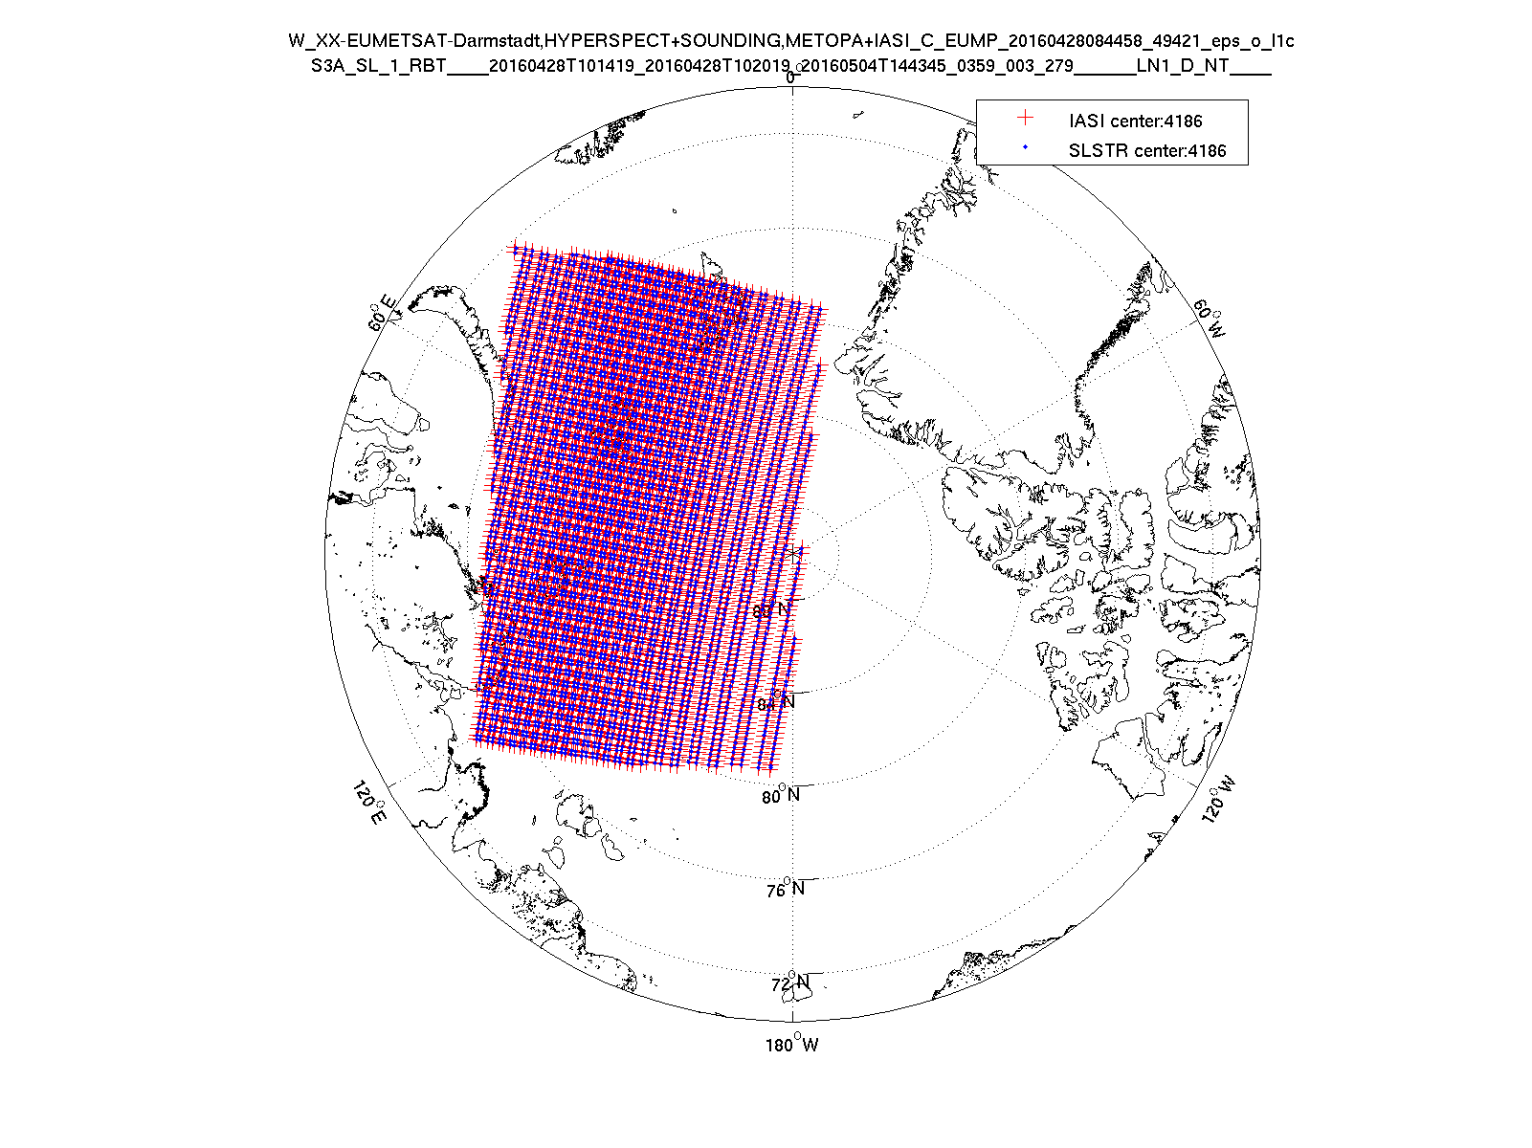
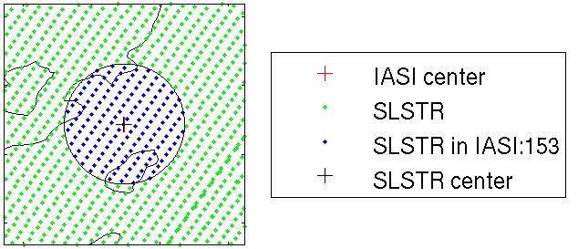
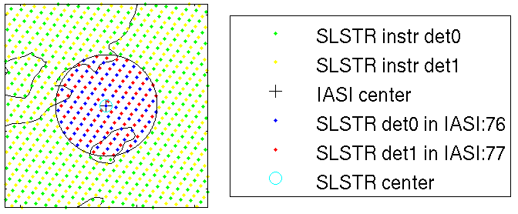
SNO crossover and collocations
Example of collocation between SLSTR and IASI

Slide 23
Collocation criteria (pixel matchup)
Time difference (pixel time):
5 min (SNO)
Spatial difference
within pixel (central)
Viewing angle:
|Δsec(ϑ)/sec(ϑ)|<1% or
|IASI SZA| < 20° (relaxed to preserve more matchups)
Included all matchups (before only 3% per crossover)
IASI IFOV estimated as ellipse f(ϑ)

Slide 24
Spectral convolution
Convolution of SLSTR SRF over IASI radiances → synthetic SLSTR S8 and S9 bands
SLSTR SRF v2014
TODO: Assesing band 7 (3.7 µm) requires gap filling approach due to the incomplete spectral coverage by IASI (tbd)

Slide 25
Results: SNO
Pixel time difference: 5 min (IASI-SLSTR)
100% pixels per crossover
# matchups (abs(IASI satza)<20 deg):
~370000/ ~50000 per crossover
Statistics:
Pixel time difference
# SLSTR pixels inside IFOV
Weighted regression (1/σ)
Detector 0/1
Homogenous IASI IFOV (σ<0.4 K) vs. all

Slide 26
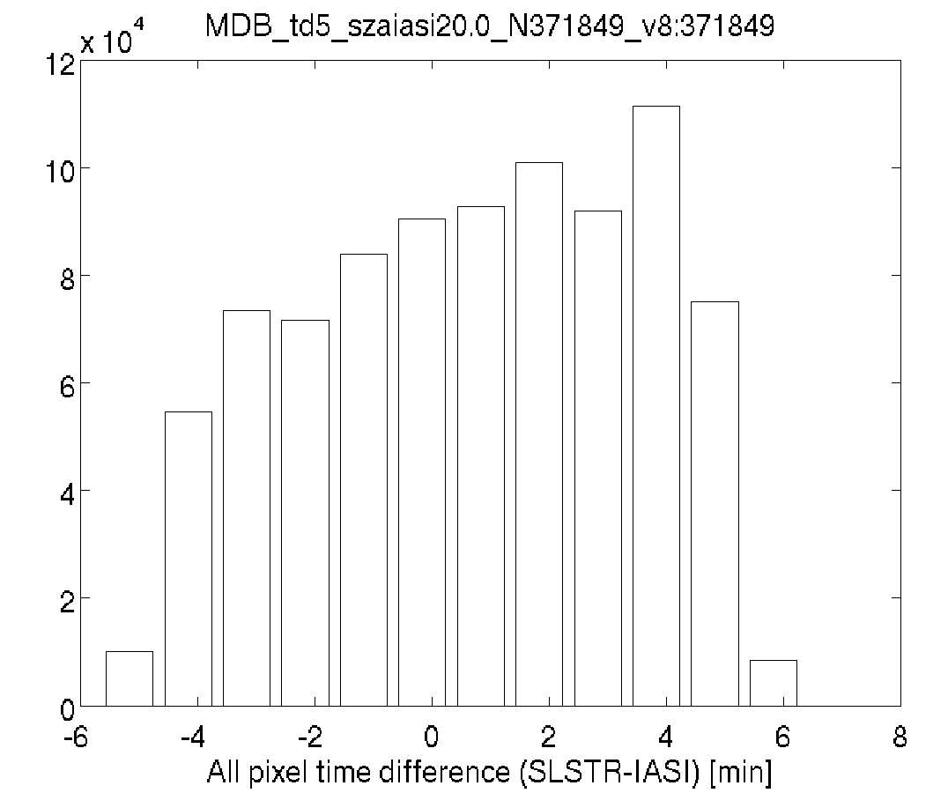
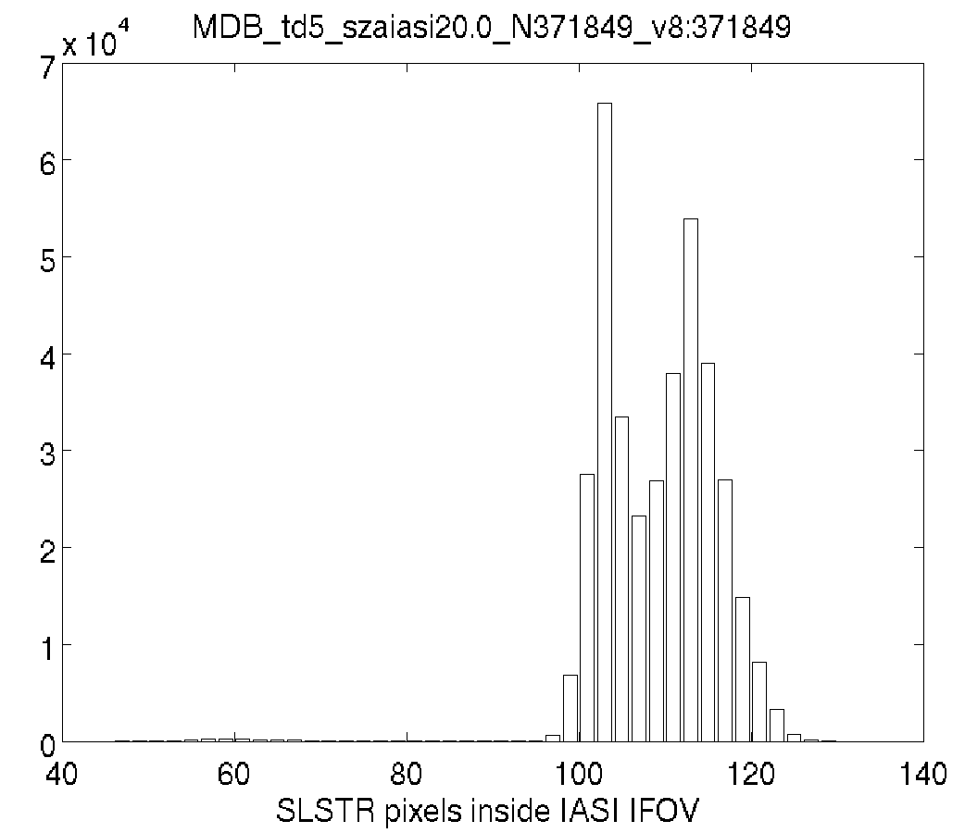
MDB info; time difference < 5 min; |IASI satza|<20 deg
Pixel time difference between IASI and SLSTR
Number of SLSTR pixels inside IASI IFOV

Slide 27
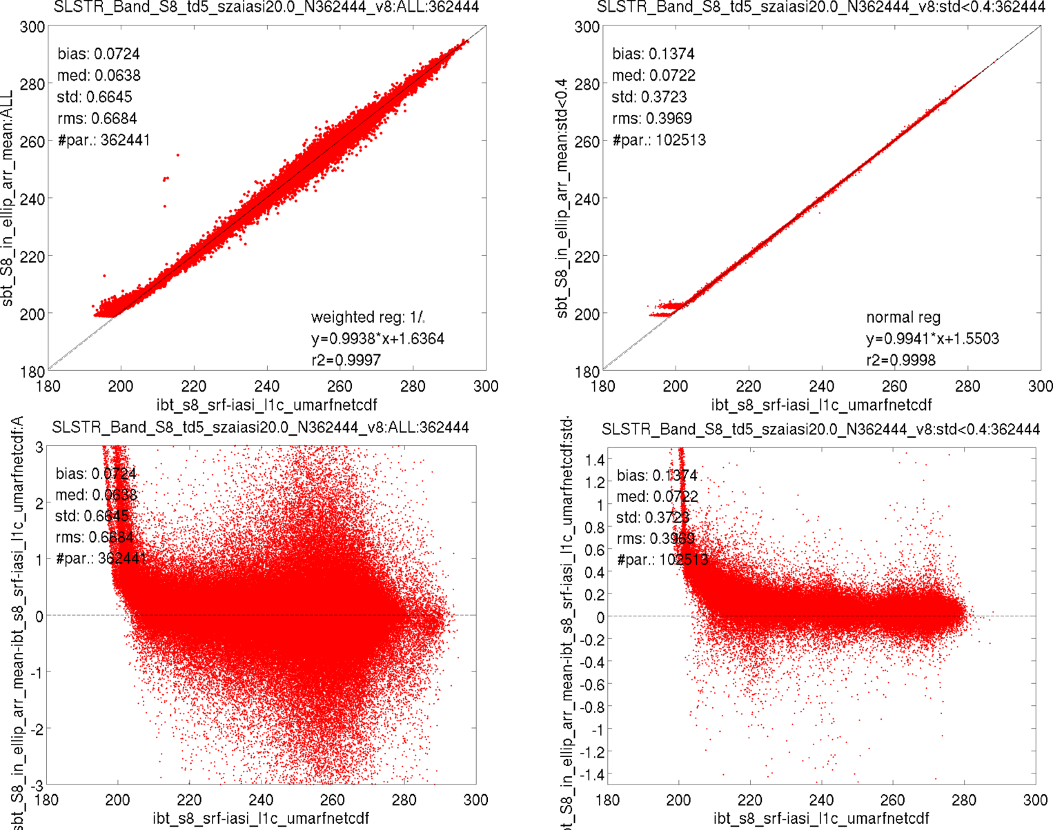
S8: td5 min; |IASI satza|<20deg
ALL
Homogenous: (std<0.4 K)

Slide 28
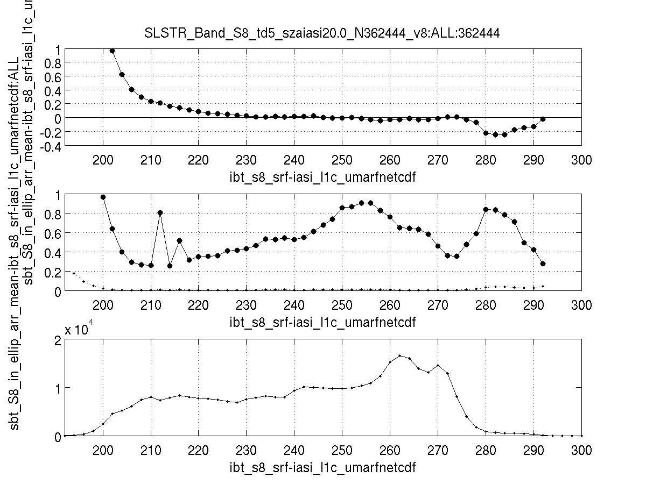
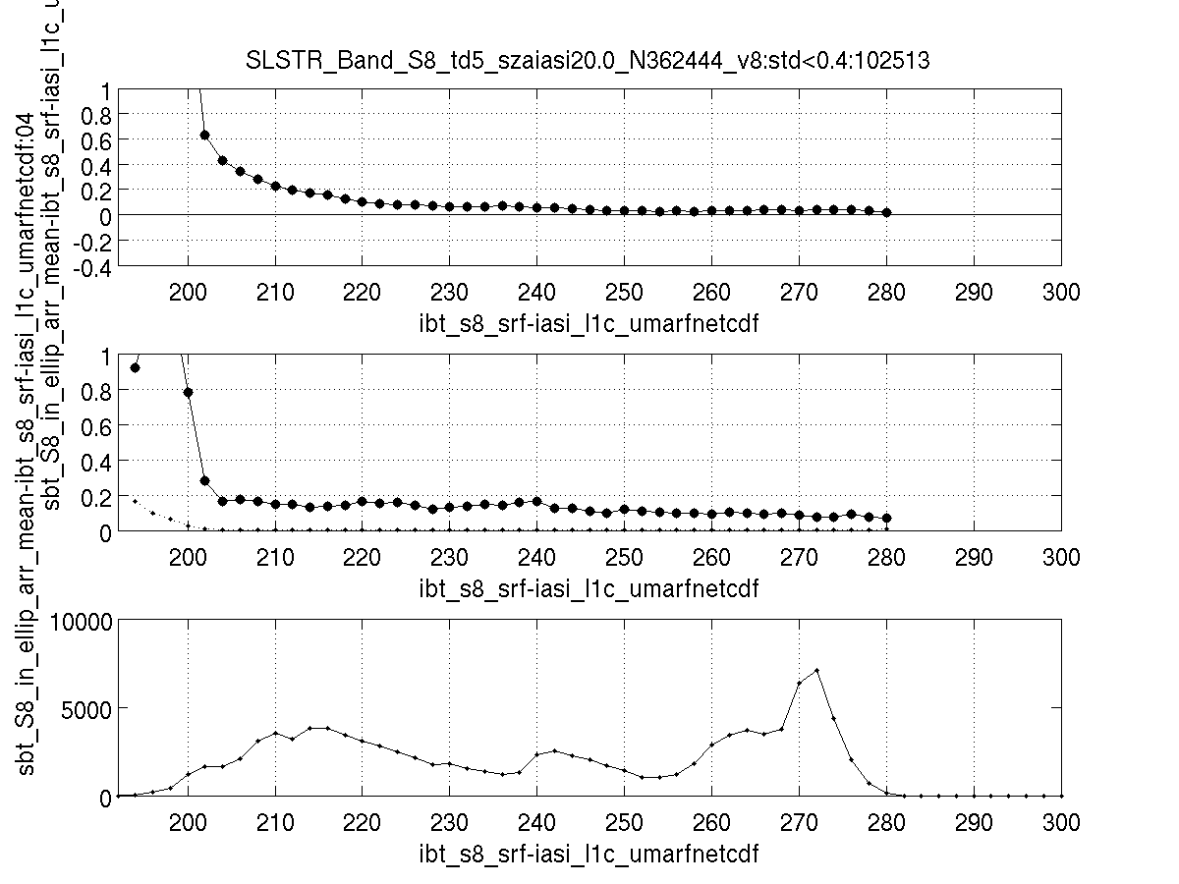
S8: td5 min; |IASI satza |<20deg
ALL
Homogenous: (std<0.4 K)
Theoretical uncertainty After Smith et al., 2014

Slide 29
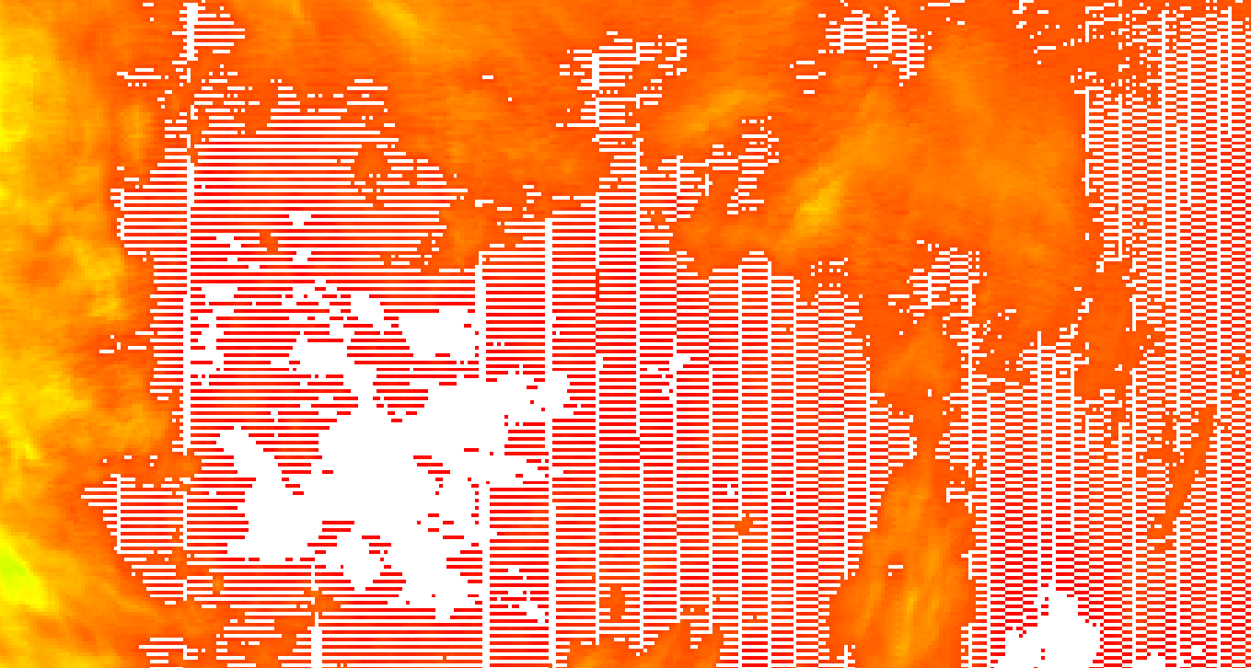
S8: td5 min; |IASI satza|<20 deg: no_signal filtered
Removed all collocations containing SLSTR pixels flagged with “no_signal”
Checkerboard pattern around ~200 K related to different response of det0 and det1

Slide 30
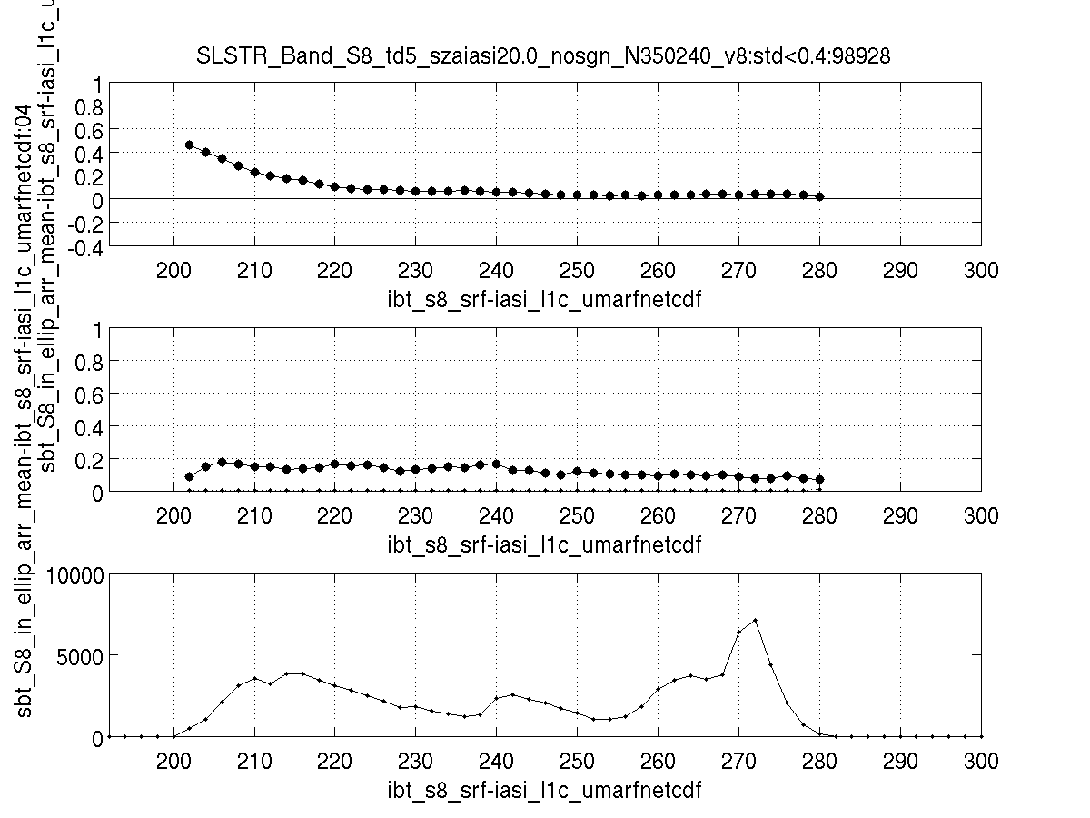
S8: td5 min; |IASI sza|<20 deg: binned: homo: no_signal filtered
homo
Homo: “no_signal” filtered

Slide 31
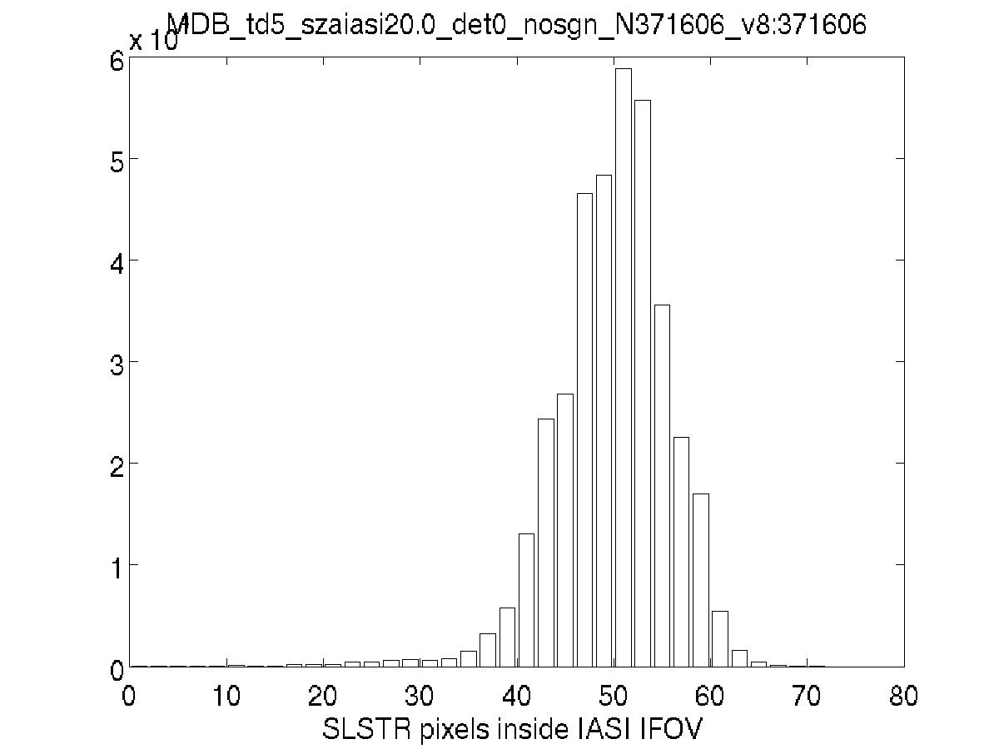
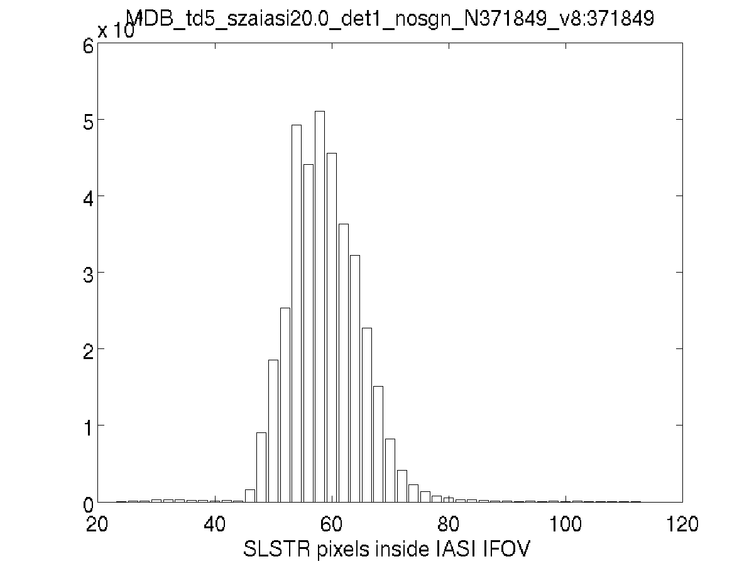
Detector 0 vs 1: S8: td5 min; |IASI sza|<20deg:binned: homo: no_signal filtered
Number of SLSTR pixels within IASI IFOV
det0
det1

Slide 32
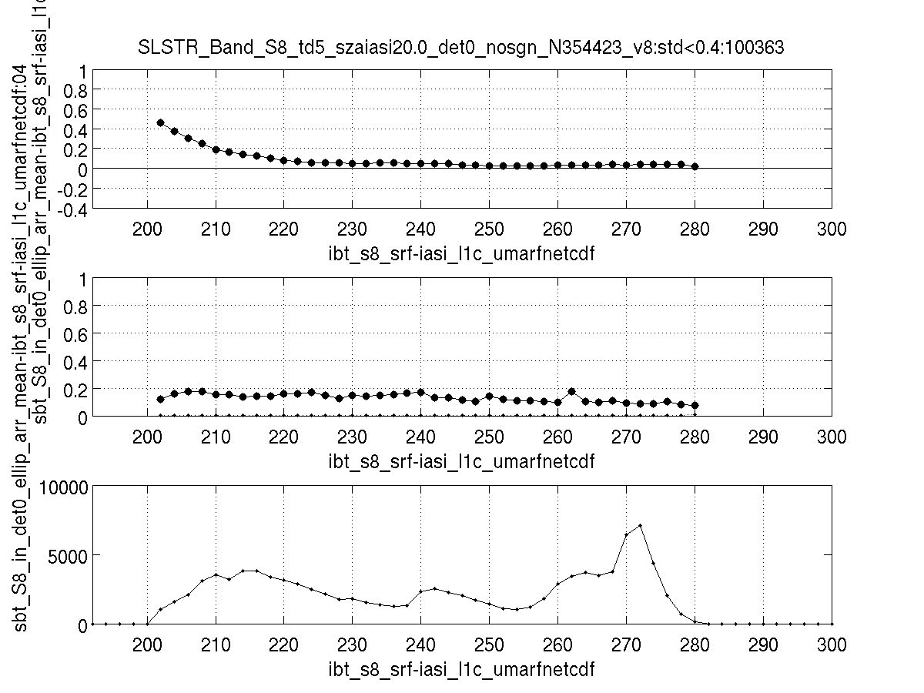
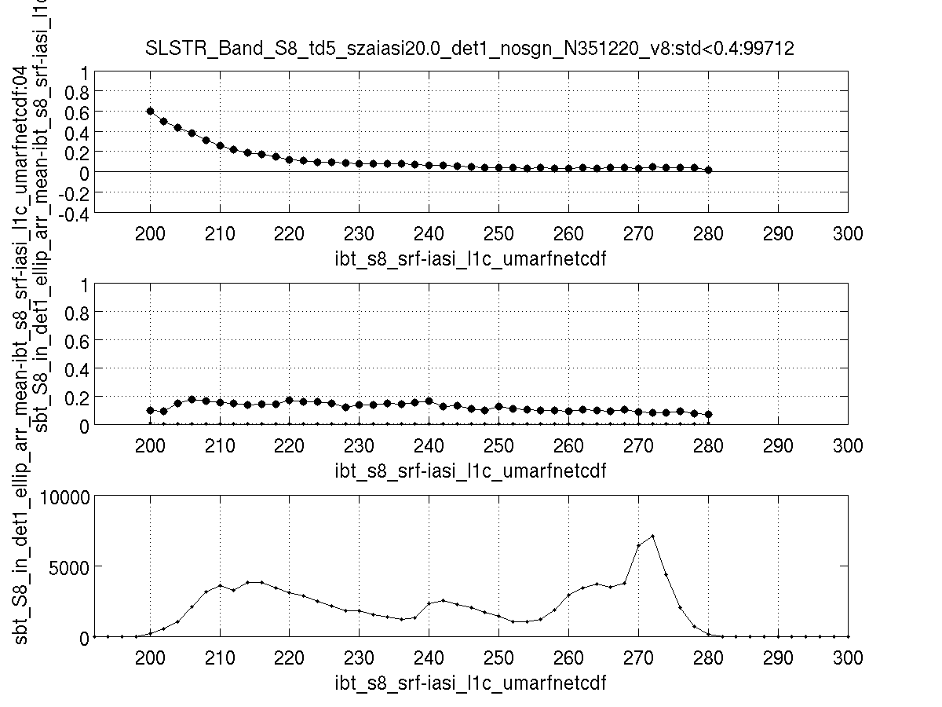
S8: td5 min; |IASI sza|<20deg:binned: homo: no_signal filtered: det0/1
S8: detector 1
S8: detector 0
Small difference in det0 and det1 responses → radiometers not single radiometer

Slide 33
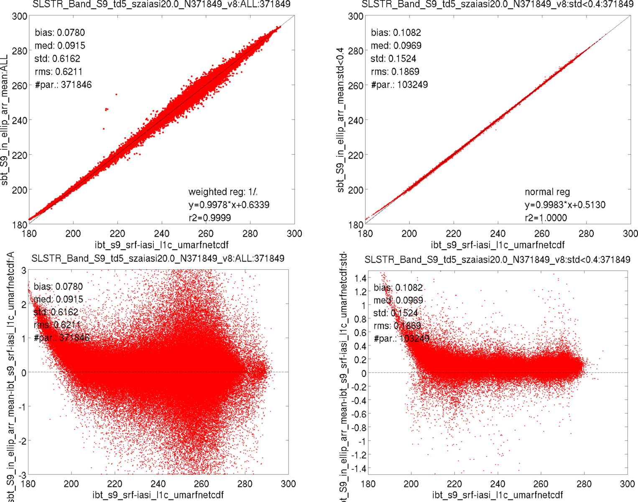
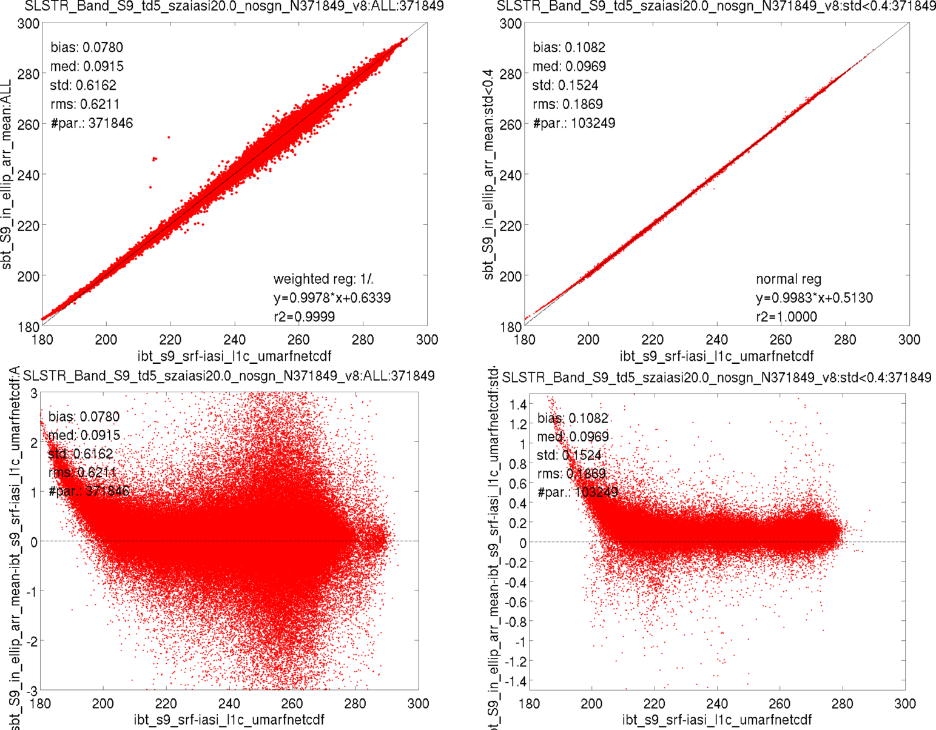
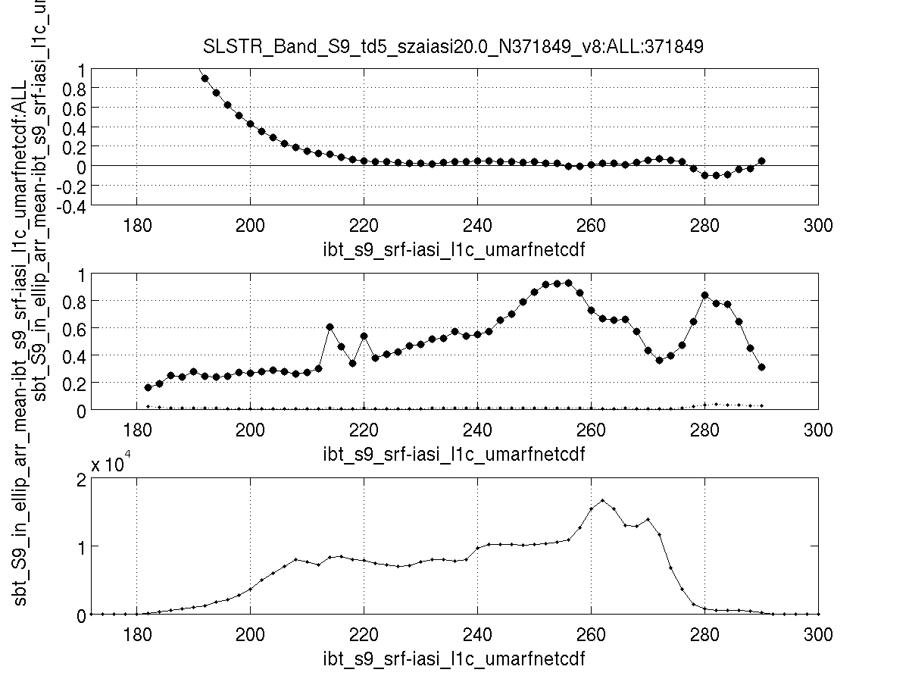
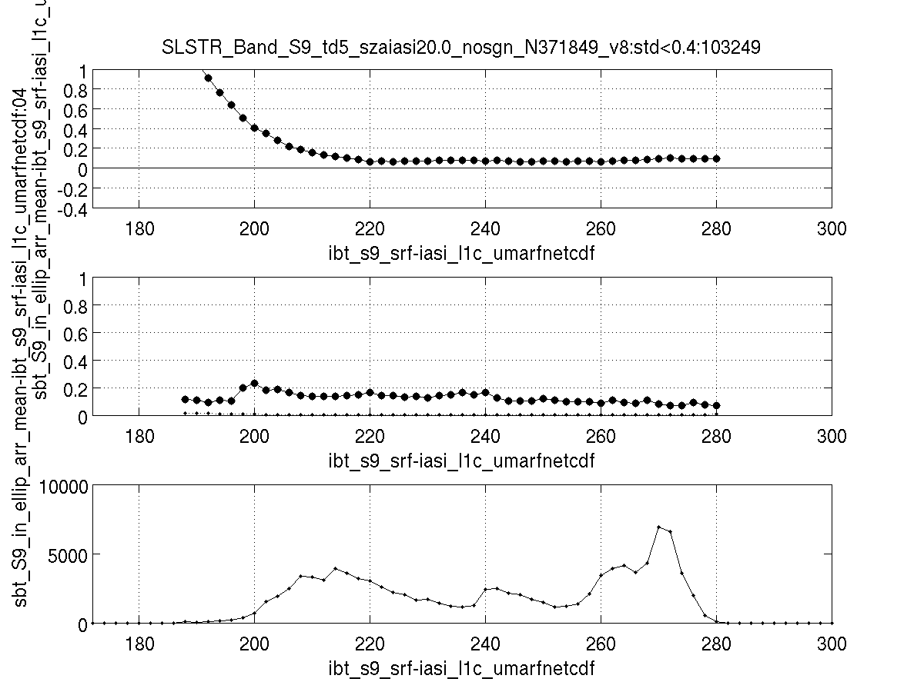
S9: td5 min; |IASI sza|<20deg:binned: homo: no_signal filtered
S9

Slide 34
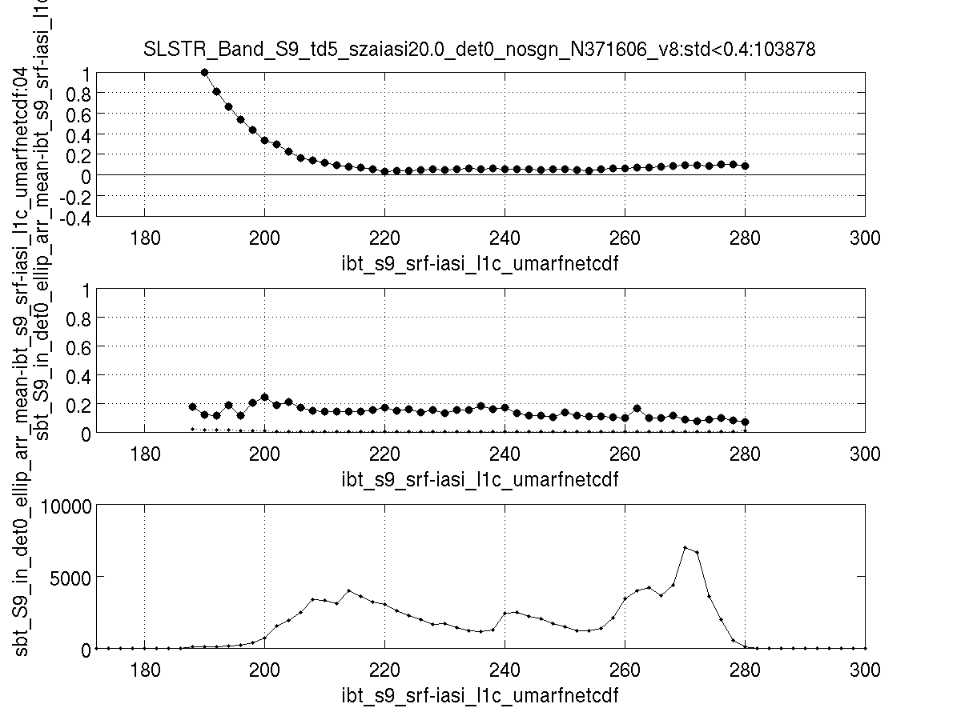
S9: td5 min; |IASI sza|<20deg:binned: homo: no_signal filtered: detector0&1
S9: detector 1
S9: detector 0
S9: more pronounced difference between det0 and det1

Slide 35
Overall statistics for BT>220 K
 | All/det0/ det1 | homo | ALL
S8 | all | 0.05+-0.11 (72863) | 0.00+-0.64 (291396)
 | det0 | 0.04+-0.12 (73128) | -0.01+-0.66 (291155)
 | det1 | 0.05+-0.12 (73291) | 0.00+-0.65 (291488)
S9 | all | 0.08+-0.11 (73606) | 0.03+-0.66 (287830)
 | det0 | 0.07+-0.12 (73963) | 0.02+-0.67 (287570)
 | det1 | 0.09+-0.11 (74056) | 0.04+-0.67 (287900)

Slide 36
SLSTR A vs IASI A/B
Double differences (SLSTRA – IASIA) – (SLSTRA-IASIB)
(IASIB-IASIA)
|IASI SZA|<20°
5 min time difference
SNOs: Apr – Aug 2016

Slide 37
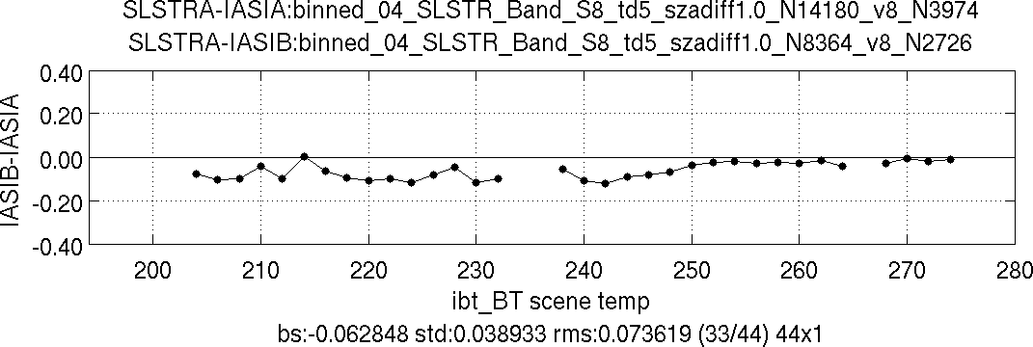
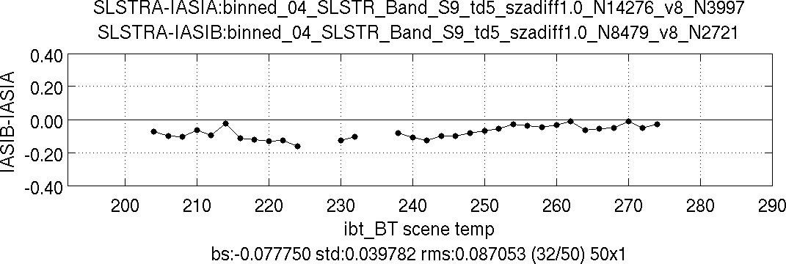
IASI B – IASI A (over SLSTR A)

Slide 38
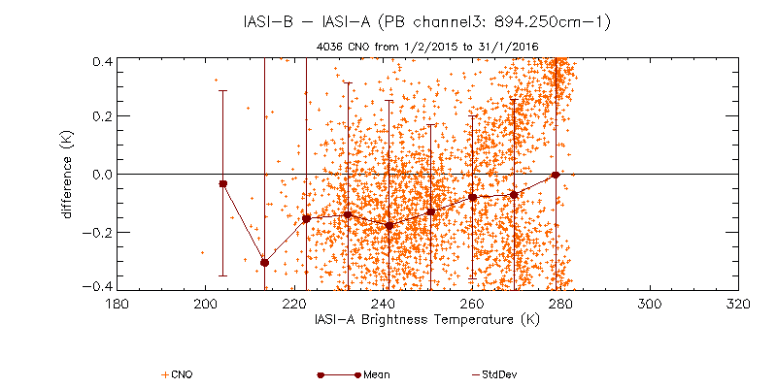
IASI A/B: Statistics of Double difference Time Series – MSG3
(MSG3-IASIA)-(MSG3-IASIB) Demo RAC Standard Bias over 2013-03/2016-02:
Channel | Double Difference Trend [K/yr] |  |  |  | Mean Double Difference [K]
IR3.9 | -0.016 | + | 0.008 |  | 0.001 | + | 0.005
IR10.8 | 0.004 | + | 0.009 |  | -0.016 | + | 0.006
IR12.0 | -0.009 | + | 0.009 |  | -0.018 | + | 0.006
No statistically significant trend
in any channel
Within standard uncertainty of 10mK/yr
Consistent results from other Meteosats
But larger uncertainties
No statistically significant difference
between IASI-A and -B
in Short- and Mid-bands
in any channel
Small, but significant difference
in long-wave band
Larger for colder scenes
After Hewison, 2016 (IASI WG 2106)

Slide 39
Summary
Stable SLSTR IR S8/S9 calibration
Near zero bias (<0.1 K) in S8 and S9 nadir (220 K – 280 K)
Cold temperature bias (~>0.2 K): nonlinearity (BB 250-300)
“no_signal” flagging issues ~200 K for S8 (change of the dynamic range for S8 channel)
Negative bias in >280 K → QSNO for detail analyses
Detectors response: S8 – OK, S9 small offset (~0.08 K)
SLSTR → 2 radiometers
IASI double differences:
Very small bias ~ 0.05 K – F(SNO event/season) → similar results as for MSG/SEVI

Slide 40
Future work
Operational SNOs
Oblique view
QUASI SNOs (in progress)
AVHRR A/B
3.7 µm gap filling for Band 7
S3B (end 2017)

Slide 41
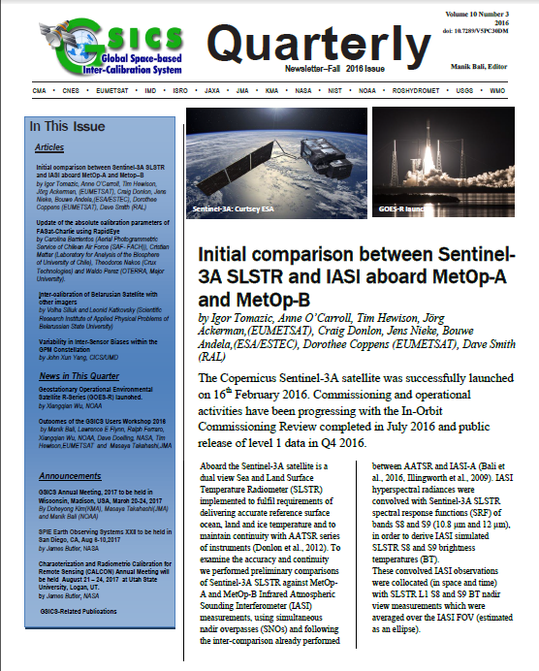
GSICS querterly
Fall 2016 Issue of the GSICS Quarterly Newsletter [DOI: 10.7289/V5PC30DM]
https://docs.lib.noaa.gov/noaa_documents/NESDIS/GSICS_quarterly/v10_no3_2016.pdf
http://dx.doi.org/10.7289/V5PC30DM

Slide 42
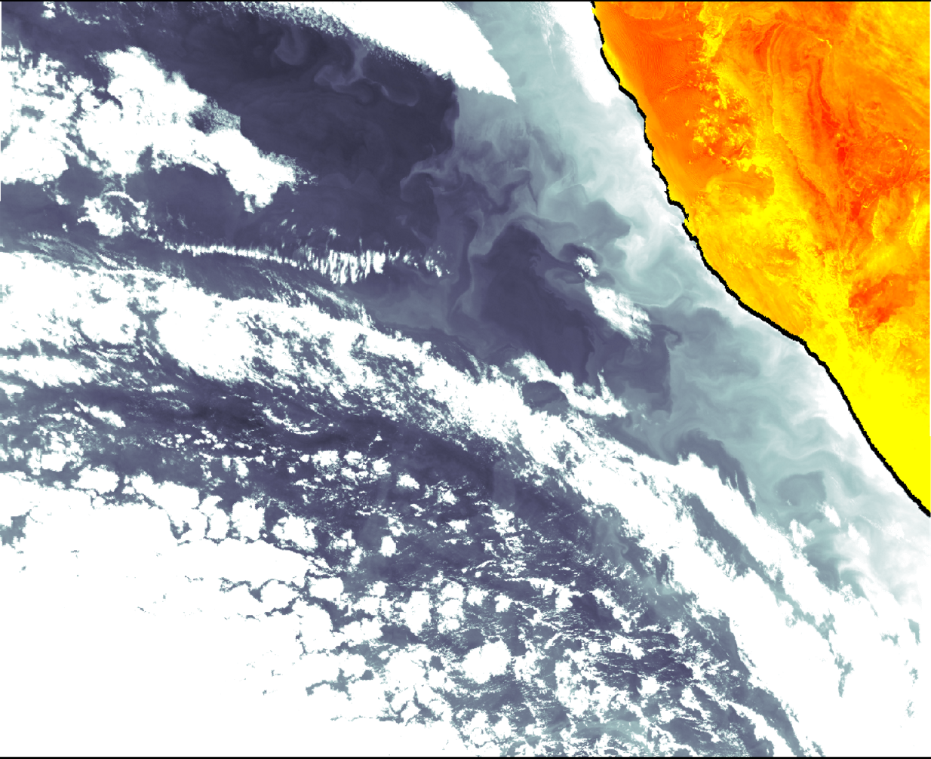
Thank you!

