Slide 1
Comparisons with GRUAN Sondes
Tony Reale, Xavier Calbet, Bomin Sun
NOAA/NESDIS
Center for Satellite Applications and Research (STAR}
College Park, Md
GSICS Annual Meeting
IR GRWG
March 22, 2017
Madison, Wisconsin

Slide 2
Outline
GRUAN and NPROVS+ …
GRUAN Uncertainty and Analytical Integration (IR)
EDR cal/val …Geophysical space
SDR cal/val …Radiance (IR, MW) space, RTM
Calbet paper examples
Path Forward

Slide 3
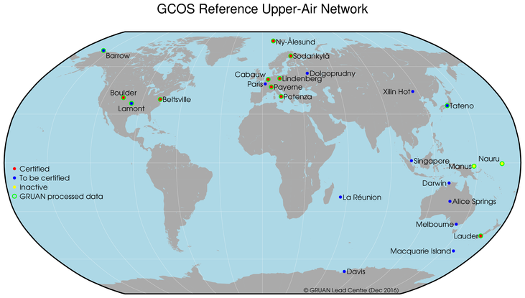
Global Climate Observing System (GCOS) Reference Upper Air Network (GRUAN)
www.GRUAN.org …. GRUAN Movie !!

Slide 4
GRUAN reference observations are calibrated through an unbroken traceability chain to SI or community standards with the uncertainty interval in each step in the chain fully characterized, meaning the resulting estimates can be used with high confidence that the true measurement is within
the interval.
Among the primary objectives of GRUAN is the constraining and inter-calibration of data from other more spatially extensive observing systems such as satellites and the current radiosonde network.

Slide 5
GRUAN Data Streams
Radiosonde (T, RH)
Vaisala RS92 (v2, v3)
Vaisala RS41
CFH
GNSS-TPW
Lidar
MWR
AERI … (IR)

Slide 6
connect between GRUAN and GSICS could be:
"GSICS could provide travelling reference (in space, eg CrIS, ATMS…) standards for GRUAN stations, while GRUAN with Radiative Transfer Models (RTM) could provide references (calculated radiance …) for MW, IR calibration”…
highlighted by Mitch Goldberg in GSICS Executive Panel meeting … 2016

Slide 7
NPROVS/NPROVS+ Data Management Schematic
INPUTS
NUCAPS:
S-NPP
MetOp-A
MetOp-B
NOAA
MIRS:
S-NPP
NOAA-18,19
MetOP-A,B
DMSP F16,18
NOAA
AIRS v.6
Aqua-EOS
NASA
IASI:
MetOp-A,
MetOp-B
EUMETSAT
Conv
Radiosondes
GFS 6-hr NWP
GRUAN
JPSS
DOE/ARM
etc
Radiosondes
ATOVS
NOAA-18,19
MetOp-A,B
NOAA
GOES
NOAA
GRAS
MetOp-A,B
EUMETSAT
COSMIC
UCAR
NWP ANAL
ECMWF
PROCESSING
Visualization Tools:
ODS
PDISP
NARCS
3 day delay
NPROVS
NPROVS+
14 day delay
NPROVS
Collocation
Archive
NPROVS+
Collocation
Archive
Algorithm
Development
VALAR
FTP
OUTPUTS
FTP

Slide 8
Overview of EDR Data Products
Sounding is performed on 50 km field of regard (FOR).
FOR is currently defined by the size of the microwave sounder footprint.
IASI/AMSU has 4 IR FOV’s per FOR
AIRS/AMSU & CrIS/ATMS have 9 IR FOV’s per FOR.
ATMS is spatially over-sampled and can emulate an AMSU FOV.
Barnet, Prov

Slide 9
GRUAN Uncertainty Principle
Given two measurement (m1, m2), their uncertainty (u₁, u₂) and
variability (σ), then two observations are consistent if
“k” .le. 2
Immler, F. J., Dykema, J., Gardiner, T., Whiteman, D. N., Thorne, P. W., and Vömel, H.: Reference Quality Upper-Air Measurements: guidance for developing GRUAN data products, Atmos. Meas. Tech., 3, 1217-1231, doi:10.5194/amt-3-1217-2010, 2010.
Notes:
K profiles essentially re-define sat-RAOB differences in units of GRUAN uncertainty
GATNDOR is working group in GRUAN to herpl us define sigma, which for results shown in next slides is assumed 0
U2 which would be the uncertainty in sat product is also assumed 0 but we are hopeful in future to provide such estimates with sat sounding (NUCAPS)

Slide 10
1) ABS (m1 – m2) < k (σ² + u1² + u2²)^{1/2}
2) “k” = ABS (m1 – m2) / u2
3) σ² + u1² = ((“k”/2)² –1) (u2)² ; u1= a (u2)
σ²
= ((“k”/2)² –1 – a²) (u2)²
or, assuming sigma small
4) u1 = ((“k”/2)² –1)^{1/2} (u2)
… can transfer to the radiance space given GRUAN uncertainty, RT model (+ uncertainty), but …

Slide 11
GEWEX-GVAP
H20 MR Uncertainty (g/kg) for IR soundings (pass QC) and ECMWF Analysis
(tropic sea)
Tropical, Sea | HIRS | IASI / HIRS | AIRS / HIRS / ECMWF
300 hPa | 0.061 0.175 0.014 9.0 | 0.051 / 0.061 0.172 0.013 8.1 / 9.6 | 0.025 / 0.052 / 0.028 0.166 0.013 4.4 / 8.3 / 4.8
500 hpa | 0.23 1.87 0.115 4.5 | 0.18 / 0.23 1.68 0.113 3.8 / 4.5 | 0.18 / 0.20 / 0.09 1.59 0.107 3.9 / 4.4 / 2.3
700 hpa | 0.59 5.51 0.272 4.8 | 0.46 / 0.56 5.52 0.268 4.0 / 4.6 | 0.46 / 0.53 / 0.16 5.63 0.273 3.9 / 4.4 / 2.3
1000 hPa | --- 16.6 0.651 1.9 | --- / 0.49 12.9 0.537 1.6 / 2.7 | 0.20 / --- / --- 16.0 0.626 2.1 / 1.7 / 1.0
Table 1: Each element (box) includes four sets of mean values for:
Satellite (and ECMWF) MR uncertainties
GRUAN MR (g/kg),
GRUAN MR uncertainty
“k” value

Slide 12
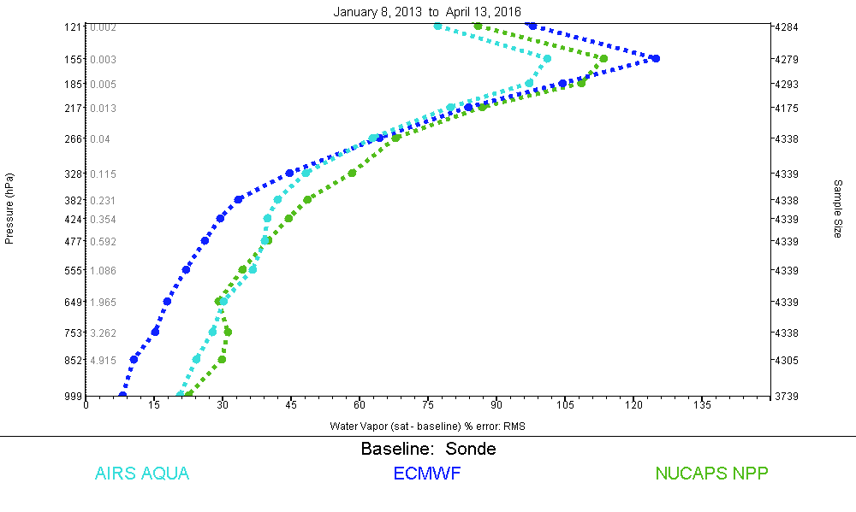
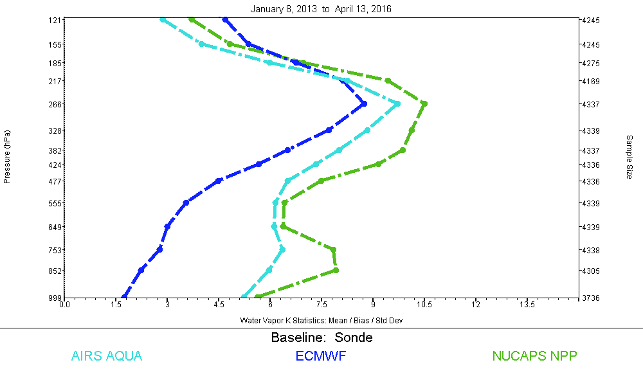
“Spec”
RMS
2
“k”
4.9u2
4.7u2
4.1u2

Slide 13
“3G” / STAR Coordination
Append SDR’s to EDRs collocated in NPROVS+ …
Special GRUAN, IR/MW, RO collocation dataset for uncertainty characterization studies (Calbet …)
Radiance propagation problem …

Slide 14
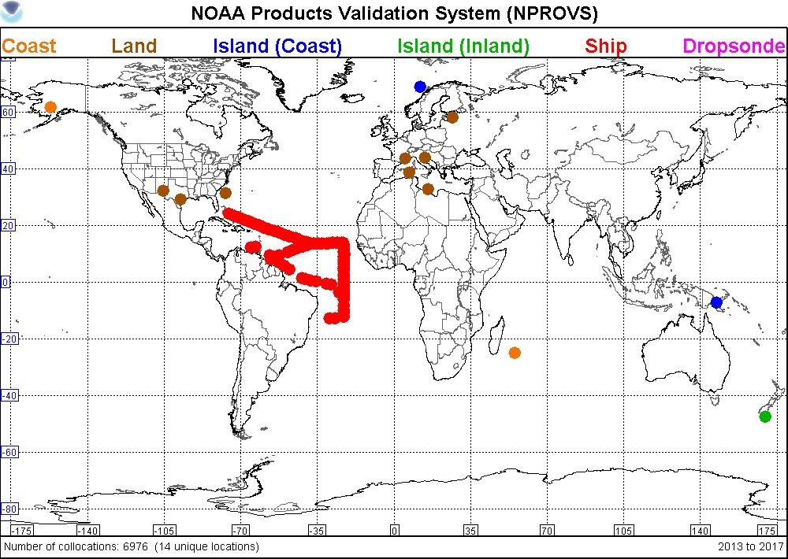
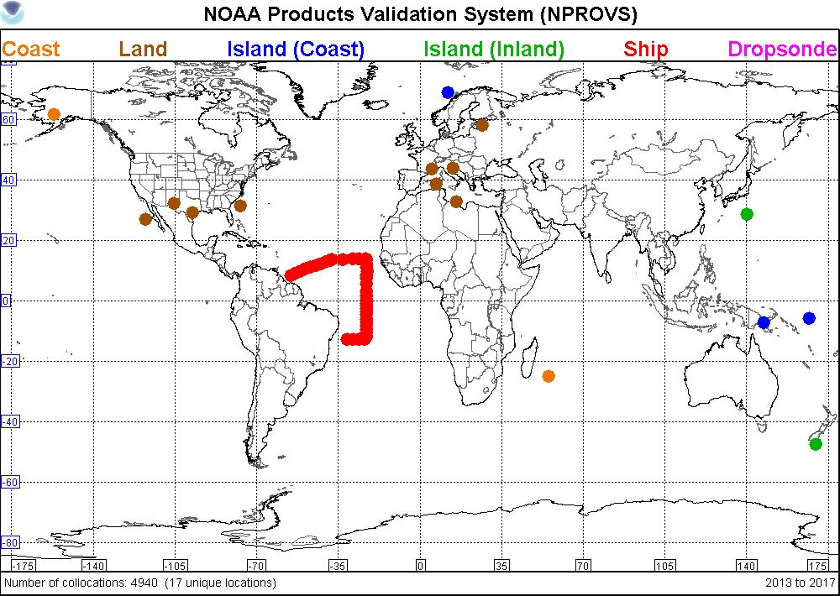
N P R O V S + at STAR
7000
S-NPP
+/- 1hr, 50km
4000 IR pass QC
5000
MetOp
+/- 1hr, 50km
2500 IR pass QC

Slide 15
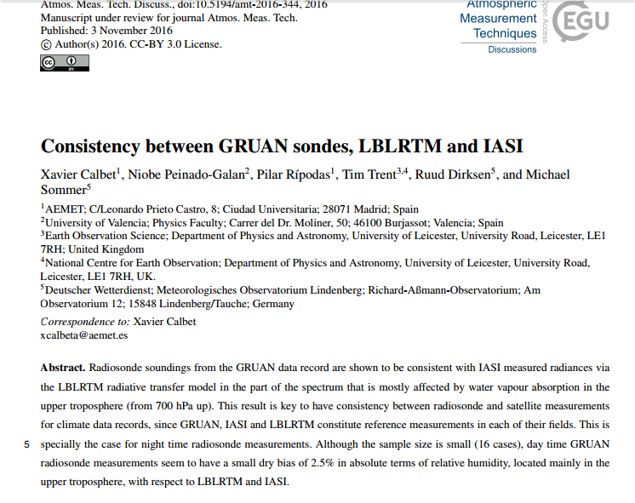

Slide 16
A conclusion from this work that might relate most to you is that GRUAN uncertainties of temperature and humidity are given at a pressure level individually, more or less with all levels uncorrelated.
To properly propagate these uncertainties into radiance space the complete uncertainty covariance matrix for T and humidity from GRUAN is needed. This has been summarized in Fig. 5 of the above mentioned paper (green line, totally correlated uncertainties between levels, and orange line, totally uncorrelated uncertainties between levels).
So basically, there is a need to estimate these uncertainty covariances for GRUAN. This, I believe, has been recognized by the GRUAN community.
Xavier Calbet

Slide 17
The channels used range from 1400 to 1900 cm−1 , covering practically all atmospheric levels from around 700 hPa and above.
Its spectral resolution for this particular LBLRTM lies bewteen 0.00025 and 0.0005 cm−1 is considered as a standard by the IR RTM community.
IASI, is a Fourier transform spectrometer currently on board Metop-A and B with spectral range from 645 to 2760 cm−1 with a spectral sampling of 0.25 cm−1 , an apodized effective resolution of 0.5 cm−1 and with a spatial resolution of about 12 km at nadir
GSICS community has declared IASI as a standard to which all other IR satellite sensors 25 can reference to (Hewison et al., 2013).
GRUAN radiosonde (and uncertainty) profiles are smoothed with a mean filter of 100 points in the vertical as IASI measured radiances not sensitive to particular small scales in the vertical.
Manus only

Slide 18
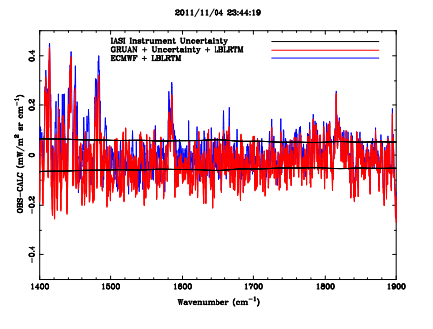

Slide 19
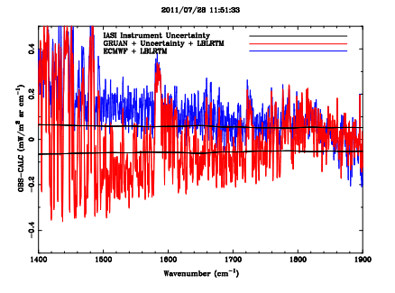

Slide 20
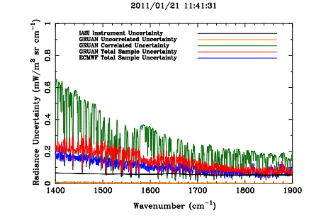

Slide 21
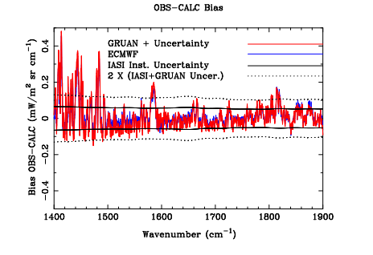

Slide 22
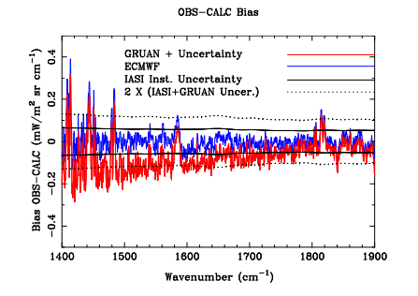

Slide 23
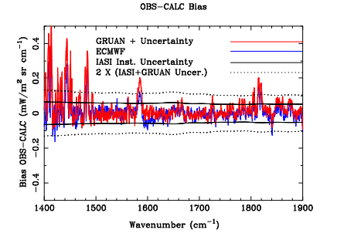

Slide 24
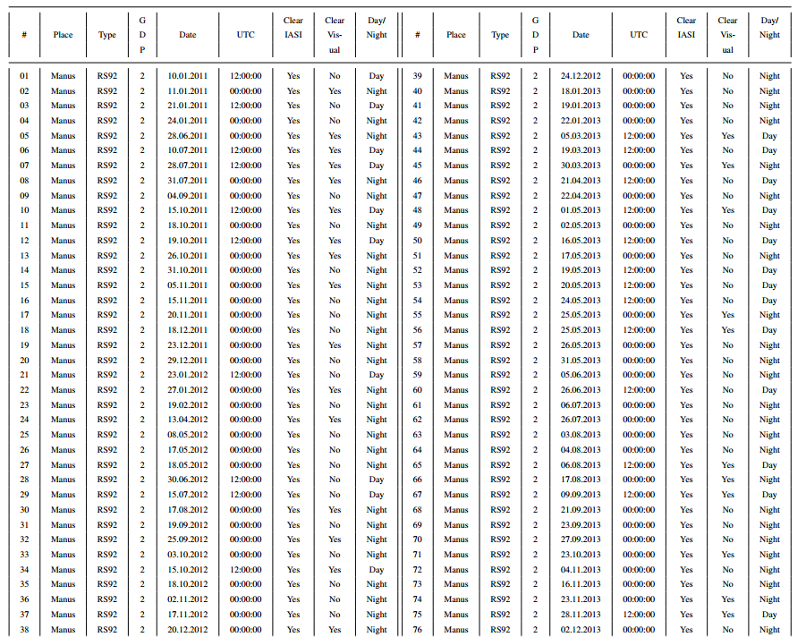
Final visual inspection to determine clear …

Slide 25
Preliminary Experiment Straw-man
GSICS Calibrated Sensor Data
(IR, MW)
ICVS … Calibrated Sensor Data
(IR, MW)
(?)
GRUAN (NPROVS+)
Radiosonde
(Ancillary, SASBE…)
Sampling Constraints
Propagate to Radiance (Uncertainty)
Consistency Testing (Immler)
Sigma
Double Difference
Collocations for radiance propagation studies
GSICS
(IR, MW)
Collocations for radiance propagation
studies
ICVS …
(IR, MW)
Objective: Can GRUAN help verify the “accuracy” of GSICS adjustments

Slide 26
Summary
GRUAN provides global “reference “observations of atmospheric ECV
These routinely collocated with multiple satellites (NPROVS+, GAIA- CLIM…)
Satellites and GRUAN are synergistic; better targeting needed
3G Workshop provides some initial studies wrt radiance propagation problem (Calbet et.al …)
Need for uncertainty vertical correlation …
Sigma and SASBE
Action(s): GSICS Task Team (IR and MW) to design experiment using GRUAN observations … (ICM-9, Helsinki, June, 2017)

