Slide 1
FY-3D HIRAS
Pre-launch Characteristics and Calibration
Chengli Qi(Lilly), Xiuqing Hu, Mingjian Gu,
Chunqiang Wu
National Satellite Meteorological Center,
China Meteorological Administration
UW-Madison, 20-24 Mar 2017

Slide 2
Outline
Introduction
Pre-launch instrument characteristics
Radiometric calibration method
Calibration Results
Summary

Slide 3
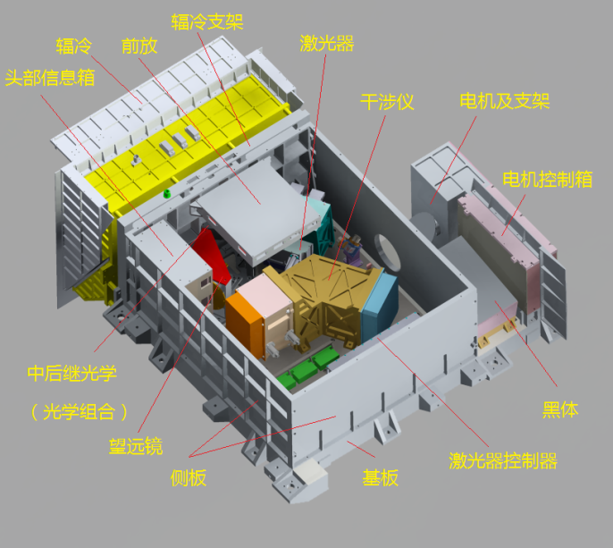
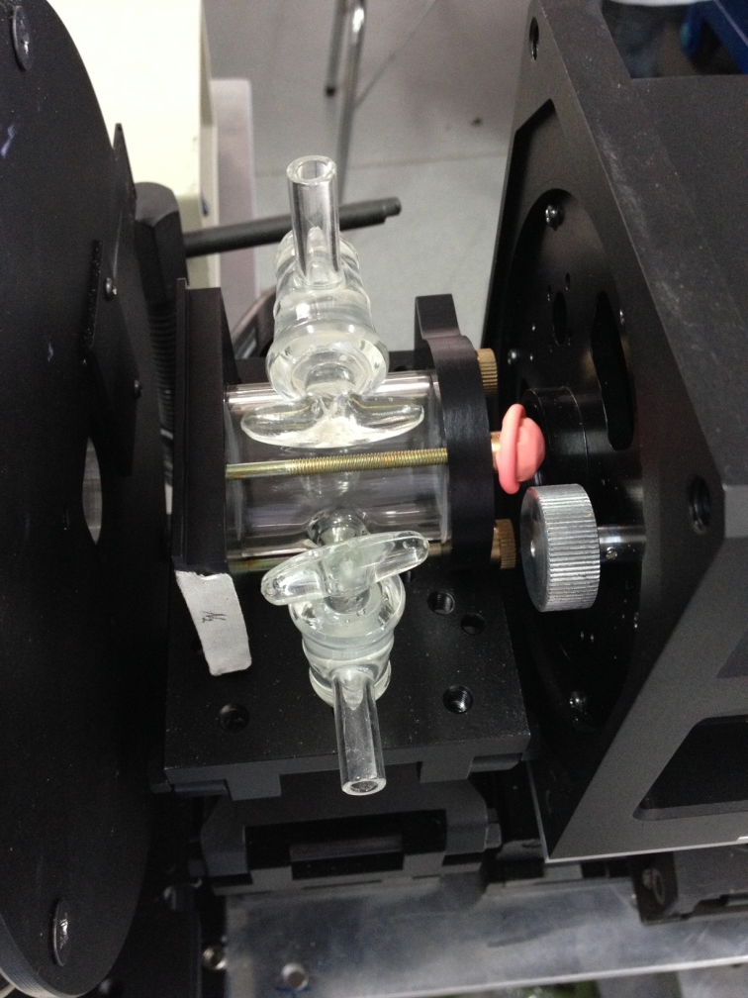
1. Introduction
HIRAS--High Spectral Infrared Atmospheric Sounder will be carried on-board FY-3D satellite.
Designed and manufactured completely by Shanghai Institute of Technical Physics (SITP), Chinese Academy of Sciences (CAS) .
Instrument structure
Instrument header

Slide 4
Introduction
HIRAS is a Fourier interferometer which posses of high spectral resolution, low radiometric noise and high spectral and radiometric accuracy.
HIRAS instrument characteristics
Parameters | Specification
Scan Period | 10s
View angle | 1.1°
Pixels per scan line | 58
Scan angle | ± 50.4°
Radiative calibration accuracy | 0.7K
Spectral calibration accuracy | 7ppm
Direction pointing bias | ＜±0.25°

Slide 5
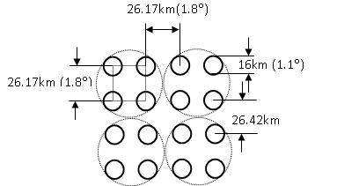
FY-3D/ HIRAS Specifications
HIRAS scan, field-of-regard (FOR), field-of-view (FOV)
Nadir spatial resolution is 16km
Band | Spectral Range (cm⁻¹) | Spectral Resolution (cm⁻¹) | Sensitivity (NEΔT@250K) | No of Channels
LWIR | 650*～1136 （15.38μm～8.8 μm） | 0.625 | 0.15～0.4K | 778
MWIR1 | 1210～1750 （8.26μm～5.71 μm） | 1.25 | 0.1～0.7K | 433
MWIR2 | 2155～2550 （4.64μm～3.92 μm） | 2.5 | 0.3～1.2K | 159

Slide 6
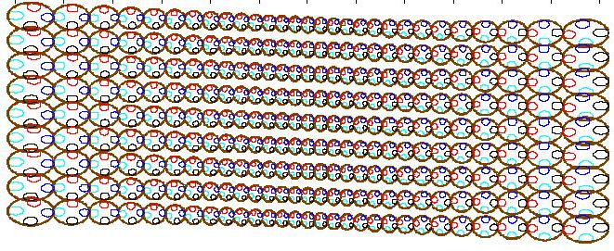
Four detectors on each focal planes are arranged into a 2×2 grid which define the field of regard (FOR)
One complete scan consists of 33 interferogram sweeps, including 29 Earth View (ES), 2 Deep Space (DS), 2 Internal Calibration Target (ICT) measurements
FOR
FOV
10s scan model earth view projection sketch map

Slide 7
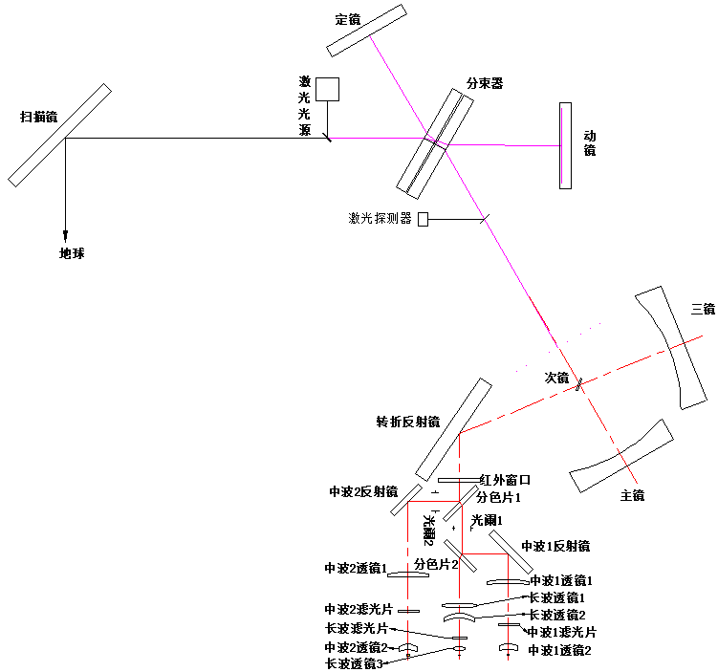
HIRAS Infrared interference main optical path
Stationary mirror
Scan mirror
Moving mirror
Laser source
Beam splitter
Laser detector
Aft optics

Slide 8
Introduction
HIRAS object:
1) atmospheric temperature and humidity profiles retrieval
2) numerical weather prediction (NWP)
3) climate change study
4) trace gas measurement
5) Another GSICS infrared radiation measurement reference

Slide 9
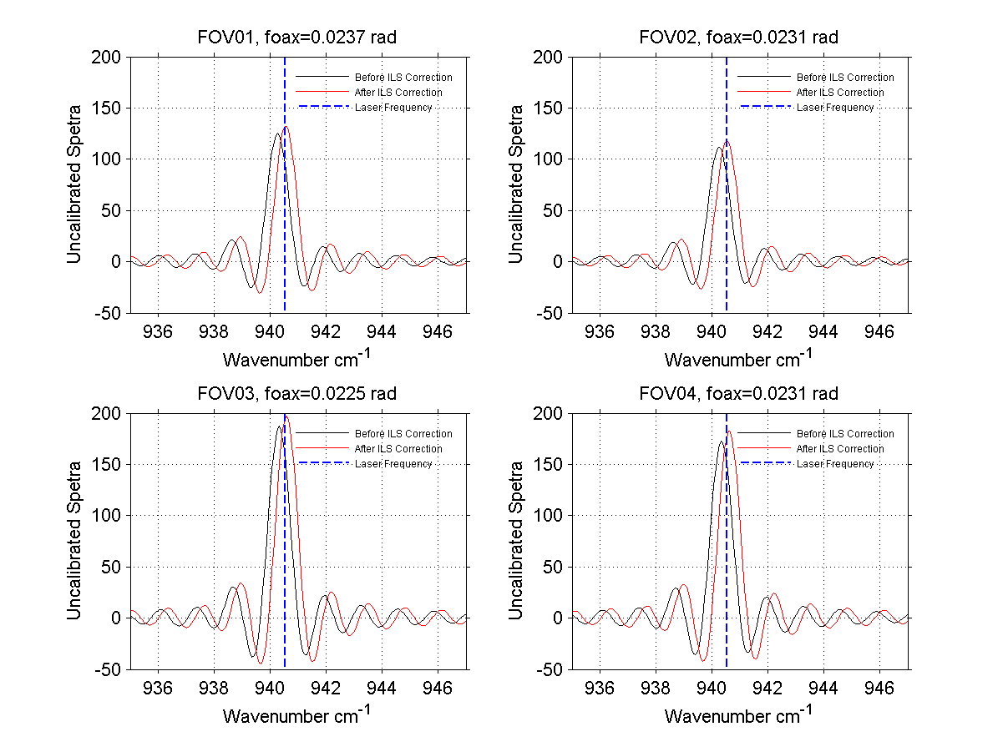
2. Pre-launch instrument characteristics
Before ILS Correction：-28.16ppm
After ILS Correction ：-0.44ppm
Before ILS Correction ：-27.64ppm
After ILS Correction ：-0.47ppm
Before ILS Correction ：-21.23ppm
After ILS Correction ： 6.48ppm
Before ILS Correction ：-21.52ppm
After ILS Correction ： 6.32ppm
Spectral position bias of LWIR band laser measurement

Slide 10
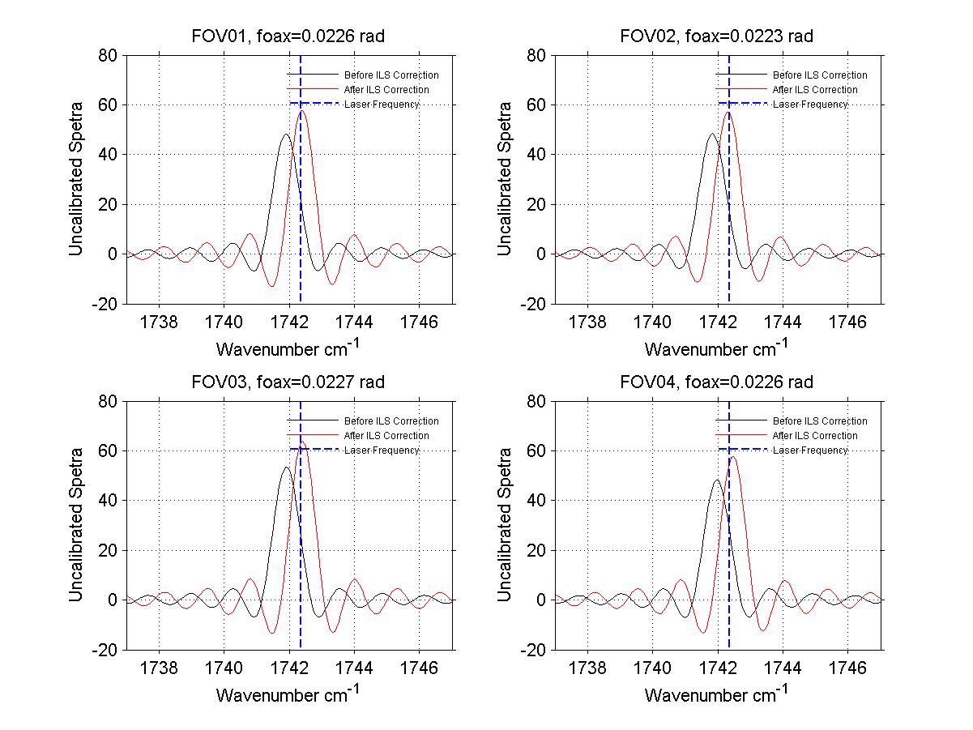
2. Pre-launch instrument characteristics
Before ILS Correction ：-49.51ppm
After ILS Correction ：5.92ppm
Before ILS Correction ：-56.44ppm
After ILS Correction ：-7.93ppm
Before ILS Correction ：-49.51ppm
After ILS Correction ：5.92ppm
Before ILS Correction ：-42.58ppm
After ILS Correction ：12.85ppm
Spectral position bias of LWIR band laser measurement

Slide 11
FOV1
NEdT of LWIR
FOV2
FOV3
FOV4

Slide 12
FOV1
FOV2
NEdT of MWIR1
FOV3
FOV4

Slide 13
FOV1
NEdT of MWIR2
FOV2
FOV3
FOV4

Slide 14
3. Radiotric calibration method
Radiometric calibration is the process of assigning absolute radiance to the spectral axis
complex calibration: Interferogram is not mirror-symmetrical about the ZPD point which will getting a non-zero imaginary component out of the fourier transfer

Slide 15
The asymmetry originates from two different sources, either extrinsic or intrinsic.
Extrinsic:
ZPD (Zero Path Difference) sampling positions error;
Fringe counts are lost during the sweep;
Feference metrology interferogram sampling may be different from infrared signal;
Sampling fluctuations between each digitized point;
Shift between the up zero crossing and the down zero crossing of the metrology laser analog signal;
Intrinsic:
Optical dispersion in the beamsplitter-compensator subassembly;
Misalignments (Systematic IR misalignment, Interferometer divergence, Systematic OPD measuring Laser misalignment);

Slide 16
two radiation calibration sources :
Internal Calibration Target (ICT) & Deep Space (DS)
ICT view interferogram of LWIR FOV1
DS view interferogram of LWIR FOV1

Slide 17
IGMs of 12 FOVs for cold space view
FOV1
FOV2
FOV3
FOV4
FOV5
FOV6
FOV7
FOV8
FOV9
FOV10
FOV11
FOV12

Slide 18
Thermal vacumm (TVAC) test
HIRAS engineering model was manufactured and integrated during 2015 and performed thermal vacumm (TVAC) testing in Jan 2016.
the primary objective:
establish transfer relation of detected counts and radiance;
characterize key performance parameters of instrument
identify any shortcomings or issues in the design.
develop and check out the test support equipment needed to test the HIRAS flight unit.
Ground pre-processing scheme and algorithm development.

Slide 19
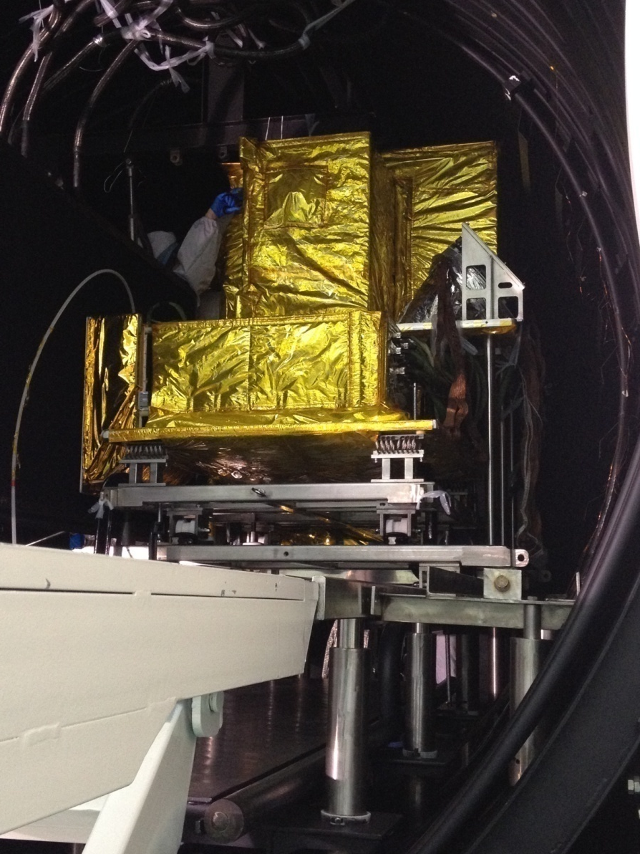
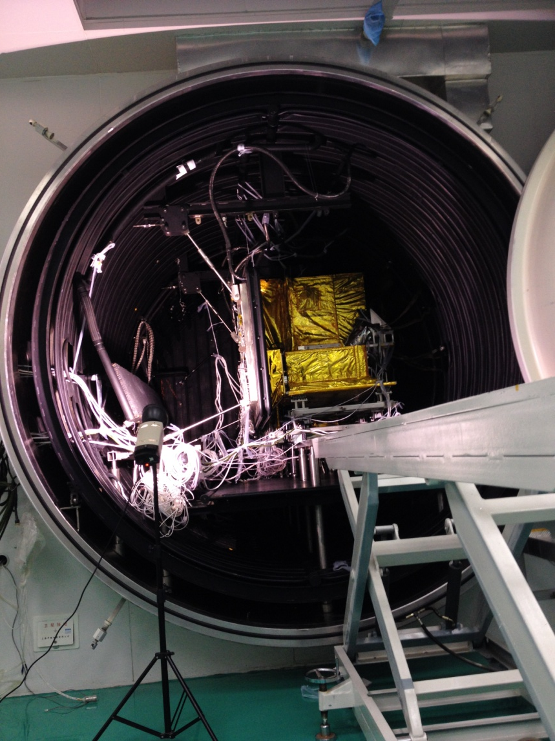
Thermal vacumm (TVAC) test

Slide 20
Vacumm testing data
External Calibration Target (ECT) temperature changed from 190K to 340K.
HIRAS operated in two models: focus and scan
Laser test : assess spectral resolution
Absorbing gas cell: assess spectral accuracy, ILS retrieval
Only LWIR band interferogram was used during large noise in MWIR1 and MWIR2 bands.

Slide 21

Calibration method
FFT
IGM Complex Spectra
Uncalibrated spectra
Earth view calibrated radiance

Slide 22
Quality control:
Alignment of multiple sampled IGMs of the same object
Alignment of IGMs of the different object(BB,ICT,CS)
same object:
Before Alignment
same object:
After Alignment
Imaginary contribution part

Slide 23
Alignment of IGMs of the different object(BB,ICT,CS)

Slide 24
CALIBRATION RESULTS- calibration bias of LWIR
FOV 3 position bias

Slide 25
CALIBRATION RESULTS- calibration bias of MWIR1

Slide 26
CALIBRATION RESULTS- calibration bias of MWIR2
FOV1
FOV2
FOV3
FOV4

Slide 27
SUMMARY
HIRAS vacumm test data was used to characterize key performance parameters of instrument and to check out the test support equipment needed to test the HIRAS flight unit.
radiometric calibration results revealed some interferogram quality and spectra absorbing peak appearance, validated the feasibility of complex calibration method and test data.
Ground pre-processing scheme and method was tested based on the measurements of test data.
Future vacumm tests will solve remaining bias and improve measurement precision. Non-linearity correction and ILS correction will be optimized in following work.

Slide 28
Thanks!

