Slide 1
Update on Lunar Calibration Development
Thomas C. Stone
U.S. Geological Survey, Flagstaff, AZ USA
GSICS Joint Working Groups Meeting
Madison, Wisconsin
23 March 2017

Slide 2
Outline
Overview of lunar calibration
Requirements for absolute lunar calibration
the need: capabilities enabled by an absolute lunar reference
considerations for achieving high accuracy
Recent efforts
new measurements
assimilating current observational datasets
Way forward

Slide 3
Background — Overview of Lunar Calibration
At reflected solar wavelengths, the Moon can be regarded as a solar diffuser, which has exceptionally stable reflectance.
To use the Moon as a calibration reference requires an analytic model
to predict the lunar brightness for any Moon observations made an instrument (i.e. the Sun-Moon-Observer geometry)
the model comprises the lunar calibration reference
To build a lunar photometric model requires a large set of characterization measurements of the Moon, spanning several years
to capture the periodic brightness variations sufficiently for modeling
the range of available Moon views is constrained by orbital mechanics
Development of the lunar calibration system at USGS found the most useful radiometric quantity is the spatially integrated lunar irradiance.

Slide 4
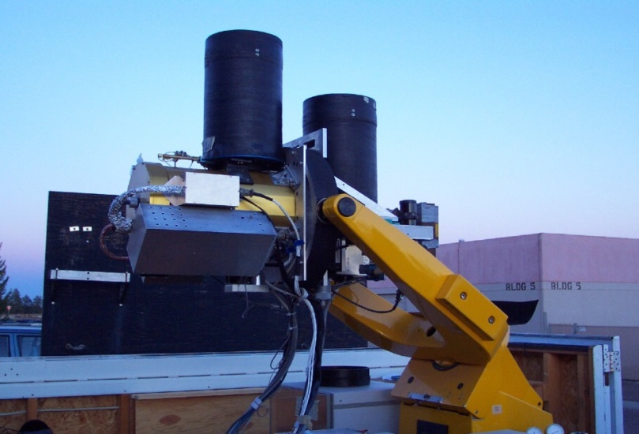
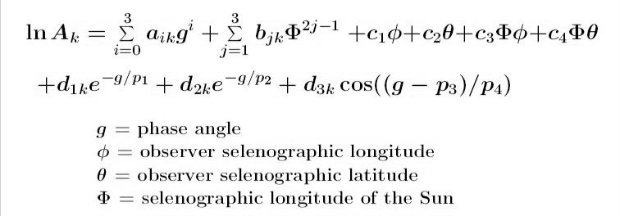
Lunar Model Development at USGS — ROLO
A dedicated ground-based telescope facility — the Robotic Lunar Observatory (ROLO):
Lunar disk reflectance model
• empirically derived formulation
• a function of only the geometric variables of phase and the lunar librations:
• located at Flagstaff, AZ 2143 m altitude
• acquired >110 000 Moon images in
32 multispectral bands
• in operation more than 8 years

Slide 5
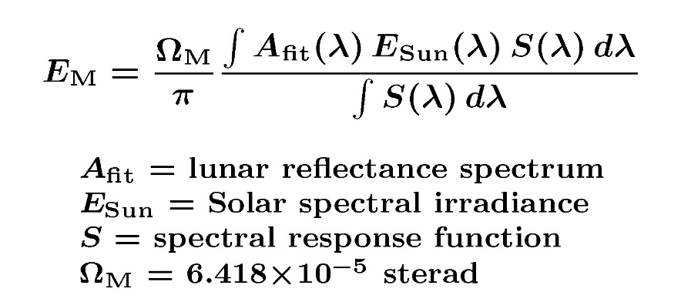
Lunar Irradiance Model — Operation
The fundamental model outputs (A_{k}) at 32 ROLO bands are fitted with a lunar reflectance spectrum, which is convolved with the instrument band spectral response functions and the solar spectrum to give the lunar irradiance (E_{M}):
The model computations (A_{fit}) and Ω_{M} are for standard Sun–Moon and Moon–Observer distances of 1 AU and 384400 km
Apply distance corrections:
The final output E′_{M} is the lunar irradiance present at the instrument location at the time of the observation, in each sensor spectral band.

Slide 6
Requirements for Absolute Lunar Calibration
Although the ROLO/GIRO model is the most precise and reliable lunar radiometric reference available, it typically is not used for absolute calibration. Why not?
uncertainty in the model absolute scale is ~5-10%
originates with the ROLO telescope dataset
the main source of error is the atmospheric correction
derived nightly from star observations, but airmass range is limited to ≤2
applies also to Vega, which is the calibration reference for ROLO
The current absolute accuracy limitation is solely with the lunar model.
the Moon potentially can provide an absolute calibration reference with total uncertainty under 1% (k=2)
To achieve a high-accuracy, SI-traceable absolute lunar calibration reference requires acquisition of a new measurement database.

Slide 7
Requirements for Absolute Lunar Calibration
Described in a CGMS Working Paper (2016)
prepared by USGS on behalf of GSICS, in response to CGMS action A43.01
provided:
requirements for ground-based measurements
to sample phase and libration parameters sufficiently for modeling
requirements for above-atmosphere measurements
to anchor the absolute scale
formulation of the model-based lunar reference
impacts on space-based sensor calibration
recommendations to the CGMS
http://cgms.eumetsat.int/views/agendas.xhtml → CGMS-44 → WG II → WG II/8 → CGMS-44-GSICS-WP-01

Slide 8
Capabilities Enabled by a High-Accuracy Lunar Reference
calibration to the same reference standard for all sensors that have viewed the Moon
removes cross-sensor biases; facilitates inter-operability of datasets
back-calibration of data archives that contain lunar images
Moon observations acquired in the past are valid forever. An updated lunar model can be applied to irradiance measurements for any time.
example: geostationary meteorological imagers
the Moon is captured in the off-Earth regions of a rectangular FOR
potential consistent EO records extending back decades in time
ability to bridge a gap in continuous Earth observation records
with views of the invariant Moon by instruments operating before and after the gap, the sensors can be inter-calibrated
the accuracy of the bridge calibration depends on the accuracy of the lunar reference
transfer of pre-launch calibration to on-orbit operations

Slide 9
Considerations for a High-Accuracy Lunar Reference
Requirements for new measurements of the Moon to use as a basis dataset for a revised lunar reference model:
Primary consideration: absolute accuracy ≤1% with SI traceability
the potential achievable accuracy is limited only by capabilities for making calibrated measurements in the field
some absolute measurements above the atmosphere are required
Radiometric and geometric specification of the lunar irradiance
requires a multi-year measurement campaign, to sufficiently sample the parameter space of phase angles and lunar librations
the availability of different Moon views is governed by celestial mechanics
Spectral specification
the lunar reflectance spectrum is dependent on phase and on terrain type
requires spectrally resolved measurements
SCIAMACHY lunar observation data may be immediately useful

Slide 10
Considerations for a High-Accuracy Lunar Reference
Polarization specification
moonlight is polarized up to ~13%, varying widely with phase angle
also dependent on wavelength and lunar terrain type (thus librations)
accounting for polarization effects is essential for achieving high accuracy
an inherent property of the Moon, thus must be part of the reference
effects are instrument-dependent — tied to the sensor’s sensitivity
a polarization model is needed, separate from the radiometric one
requires collecting disk polarization measurements (basis dataset)

Slide 11
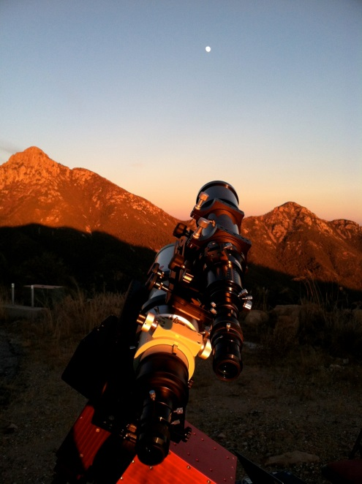
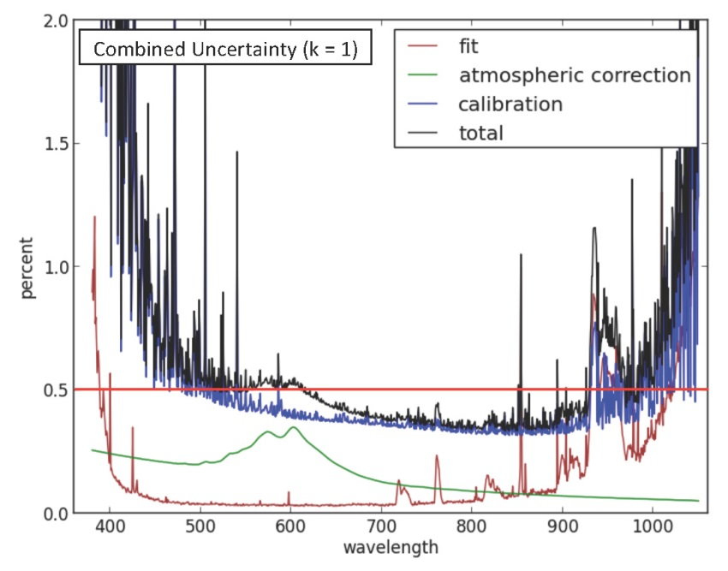
Recent Efforts — New Lunar Measurements
NIST ground-based Lunar Spectral Irradiance (LUSI) project
non-imaging optical system, COTS spectrometer: 390−1040 nm
on-site calibration reference: 30 cm integrating sphere “artificial Moon”
Mt. Hopkins, AZ: two nights in Nov. 2012 with good viewing conditions
atmospheric correction by Langley analysis of the lunar data
combined total uncertainty under 1% (k=1) from 400 nm to 1000 nm
current status: NIST staff is budgeted for setup at Mauna Loa, Hawaii (3397 m alt); airborne project is funded by NASA (ER-2, 20 km alt)
C. Cramer — NIST

Slide 12
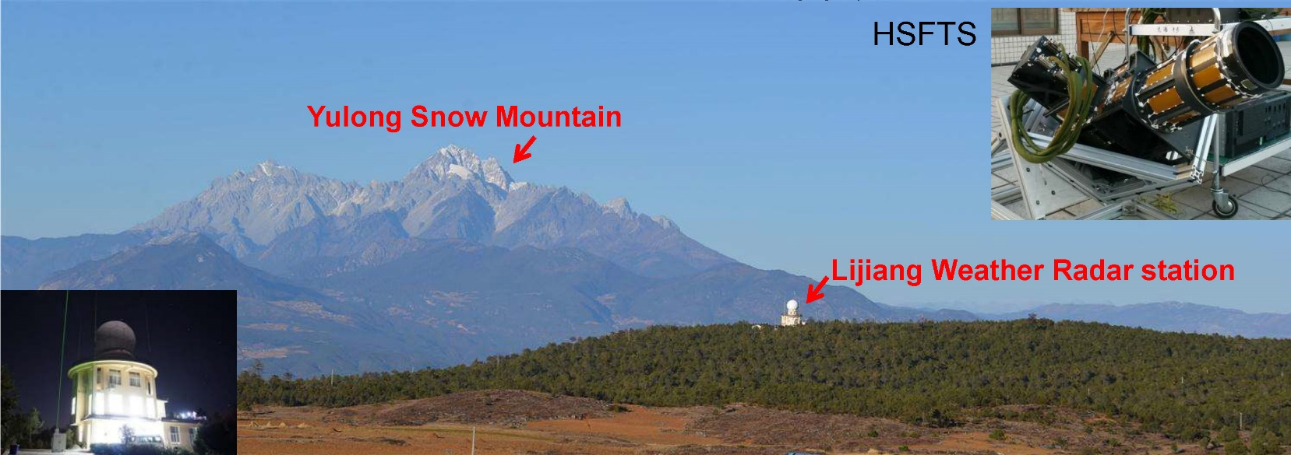
Recent Efforts — New Lunar Measurements
China Meteorological Administration (CMA) ground-based campaign
multiple lunar imaging and spectral instruments, 350−2500 nm
ancillary atmospheric measurements: lidar, aerosol photometer, sounder
3 months of dedicated acquisitions from Lijiang, Yunnan (3193 m alt)
December 2015 to March 2016
report from CMA: presentation 8g
China Meteorological Administration

Slide 13
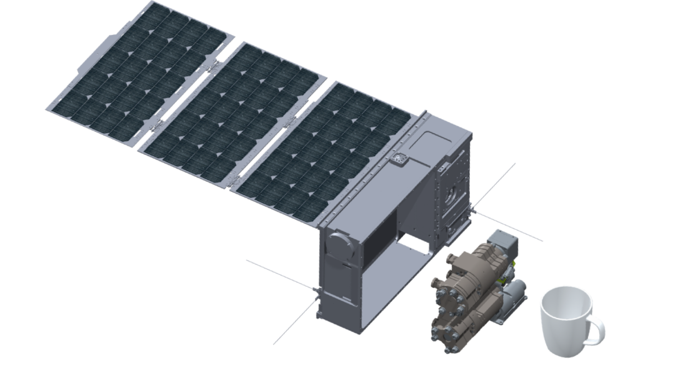
Recent Efforts — New Lunar Measurements
ARCSTONE: lunar reflectance measurements from a 6U cubesat
project led by NASA Langley Research Center, PI: C. Lukashin
2 non-imaging spectrometers: VNIR 350−950 nm, SWIR 900−2300 nm
lunar disk reflectance measurements by alternating observations of the Sun and the Moon, with absolute accuracy ≤0.5% (k=1)
using the same optics for both measurements, accommodating the ~10⁵ intensity difference with spatial dispersion and integration times
current status : breadboard spectrometers built, tested at NIST; March 2017 — EDU instrument development funding approved by NASA ESTO
Blue Canyon Technologies

Slide 14
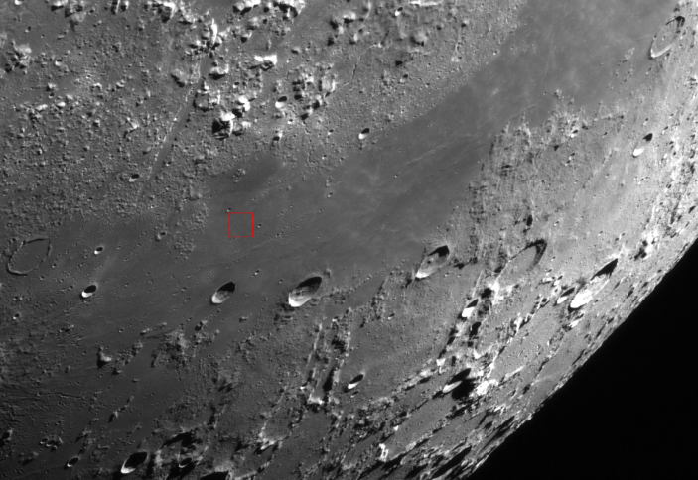
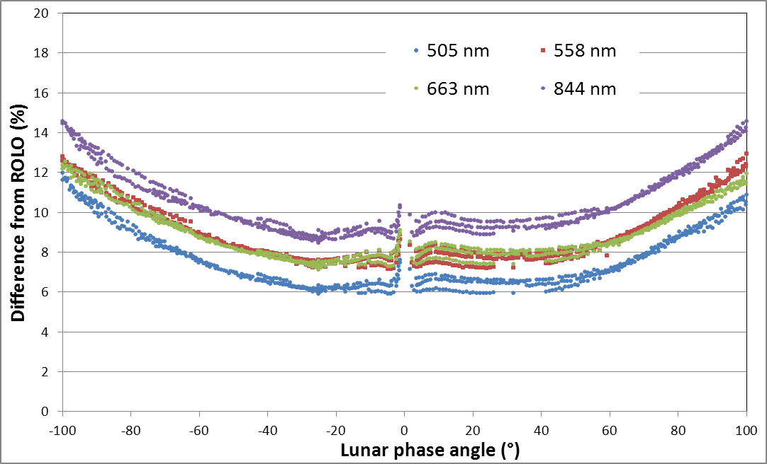
Recent Efforts — Measurements from Spacecraft
GSICS Lunar Observation Database (GLOD)
established as part of the GIRO, with users’ agreement to contribute data
potential to set the lunar irradiance scale with well-calibrated instruments in orbit, e.g. Aqua-MODIS, NPP-VIIRS, Landsat-8 OLI, PLEIADES
instruments’ lunar measurements must first be validated
example: PLEIADES (CNES)
several intensive data collects, some with Moon views every orbit
S. Lachérade — CNES

Slide 15
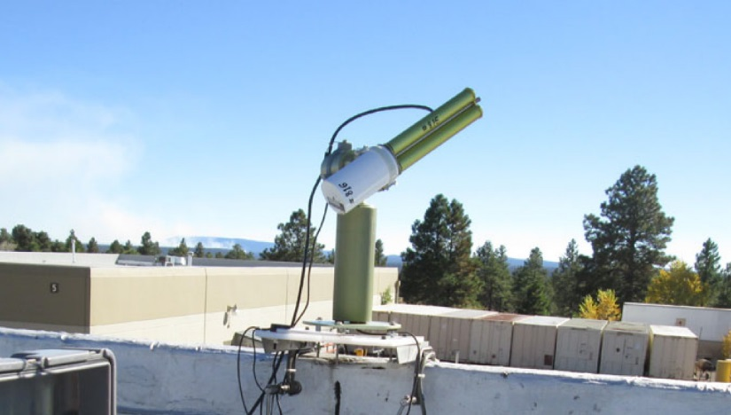
Recent Efforts — Nighttime Aerosol Photometry
aerosol Sunphotometers adapted to measure moonlight
various instruments deployed around the world, several active research groups: AEMET (Spain), AERONET (USA), DWD (Germany), ISAC (Italy), NILU (Norway), PMOD (Switzerland), and recently ESA
with reliable calibration of the photometers, this represents a potential extensive set of lunar irradiance measurements
ground-based measurement, thus requires atmospheric correction
Cimel Sun/Moon photometer at ROLO site in Flagstaff (AERONET)

Slide 16
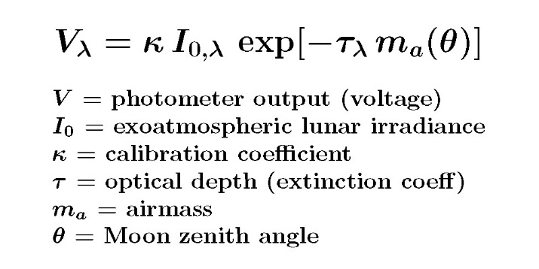
Recent Efforts — Nighttime Aerosol Photometry
atmospheric transmission (optical depth) follows extinction law :
linear form for Langley analysis, to get cal coefficient κ and optical depth τ
requires the exoatmospheric lunar irradiance, i.e. the ROLO reference
varies with time ‒ phase angle and distance change with Earth rotation
errors in V and I₀ are indistinguishable in the ratio
nighttime aerosol analysis reveals uncertainties in both quantities

Slide 17
Way Forward
The goal is a reformulated lunar reference (model) with high accuracy and SI traceability (≤1.0% (k=2) is feasible).
near term — reprocessing the ROLO dataset
to address observed residual geometry dependencies in the lunar model
work in progress; subject to funding and staffing constraints
assimilating existing and current/ongoing Moon observations
requires validating the instruments’ lunar irradiance measurements
utilize the GLOD holdings, operational views of the Moon
collecting a new lunar measurement database
requirements outlined in CGMS Working Paper: CGMS-44 GSICS-WP-01
includes an above-atmosphere component
to achieve the full potential for accuracy, must consider polarization aspects
increasing the cognizance of stakeholders to the value of a high-accuracy reference for reflective solar bands
e.g. motivate a change in traditional thinking for algorithm development

Slide 18
Thank You!

