Slide 1
Sensitivity of BRDF model in RTM DCC calculation
Special Issue of the IEEE TGRS on “Inter-Calibration of Satellite Instruments”:
Special Issue of the IEEE TGRS on “Inter-Calibration of Satellite Instruments”:

Slide 2
Contents
DCC(RTM) reflectance sensitivity test
With different BRDF (Baum and MIE)
With different SRF (COMS and AHI)

Slide 3
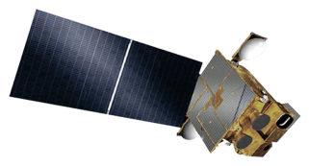
DCC(RTM) Calculation
Observation
Model
Simulation accuracy (COT = 200, Re = 20 μm) < 5% uncertainty
*applying MODIS visible sensor(Sohn et al, 2009)
RTM(SBDART)
Ocean BRDF
Tropical profile
RTM Inputs
Surface – Ocean BRDF
Atmosphere – Tropical profile
Cloud properties
- COT = 200, particle size (r_{e}) = 20 μm
Baum scattering model
With different BRDF (Baum and MIE)
Thresholds of DCCs
(1) Cold cloud condition to select clouds overshooting tropopause layer
- TB_{10.8} ≤ 190K where TB_{10.8}: Brightness Temp. at 10.8-µm band
(2) Homogeneity checks
- STD(TB_{10.8}) ≤ 1K
- STD(R_{0.6})/Mean(R_{0.6}) ≤ 0.03 where R_{0.6}: Visible reflectance
COMS 0.675-μm Reflectance
COMS 10.8-μm Brightness Temperature
MODIS Products
MODIS data
MOD021KM
Sohn, B-J., Seung-Hee Ham, Ping Yang, 2009: Possibility of the Visible-Channel Calibration Using Deep Convective Clouds Overshooting the TTL. J. Appl. Meteor. Climatol., 48, 2271~2283.

Slide 4
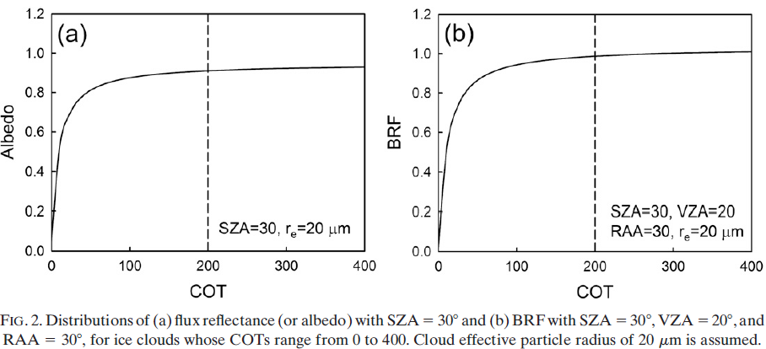
Sensitivity of reflectivity(BRF)
Albedo and BRF increase rapidly with the increase of COT ~30
The further increase in COT, BUT the slope decreases.
Sohn, B-J., Seung-Hee Ham, Ping Yang, 2009: Possibility of the Visible Channel Calibration Using Deep Convective Clouds Overshooting the TTL.
J. Appl. Meteor. Climatol., 48, 2271-2283.

Slide 5
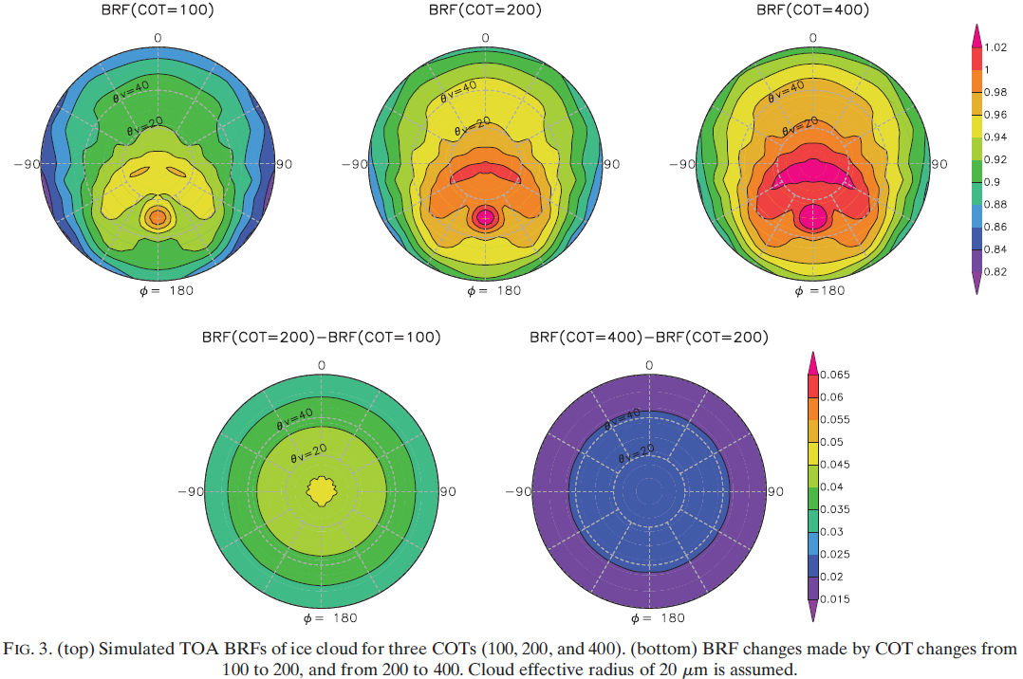
Sensitivity of reflectivity in COT
BRF increase with the increase of VZA
The maximum difference of BRFs up to 0.05 (COT from 100 to 200)
BRF : Bidirectional Reflectance Function
(Sohn et al., 2009)
Notes:
반사도는 VZA가 증가함에 따라 감소함.
COT 100에서 VZA의 변화(0~60도)에 따라 BRF는 0.82~1까지 변화함.

Slide 6
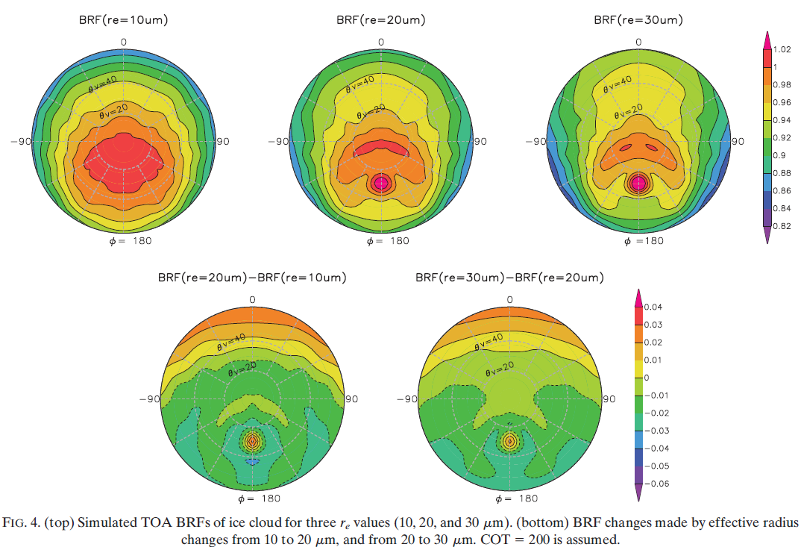
Sensitivity Test($r_{e}$)
Forward scattering tend to be increased while backward scattering is decreased with respect to particle size.
Fixed cloud parameters(COT=200, $r_{e}$=20$μm$)
RTM 민감도 테스트 결과 그림 3, 4
(Sohn et al., 2009)

Slide 7
Baum BRDF vs MIE BRDF
Baum BRDF
MIE BRDF

Slide 8
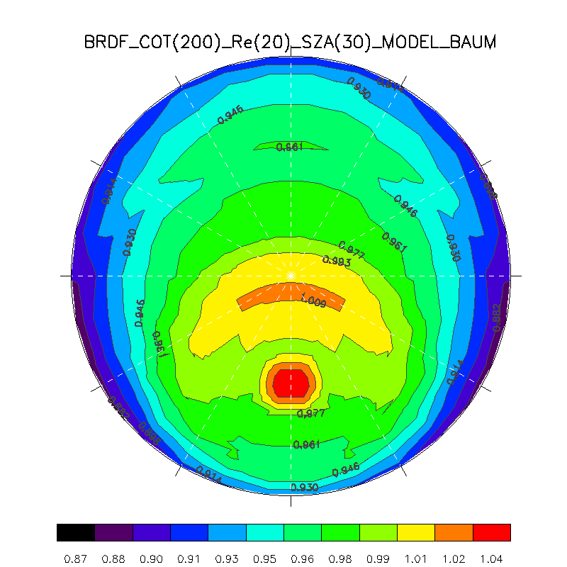
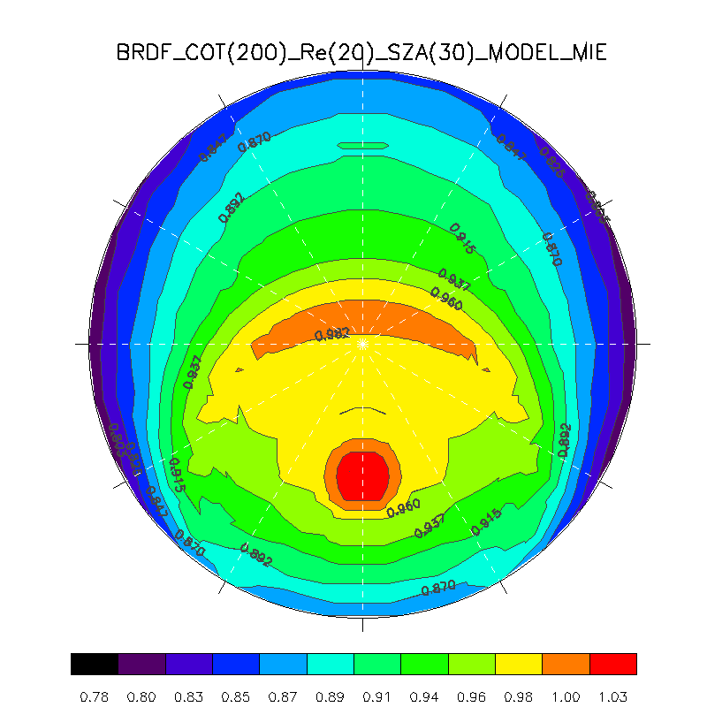
BRDF comparison (Baum vs MIE)
Comparison reflectance of between Baum and Mie BRDF
COT=200, $r_{e}$=20$μm\text{, }\text{SZA}$=30deg
Baum BRDF
COT(200), Re(20), SZA(30)
MIE BRDF
COT(200), Re(20), SZA(30)
Mean = 0.967
Mean = 0.931

Slide 9
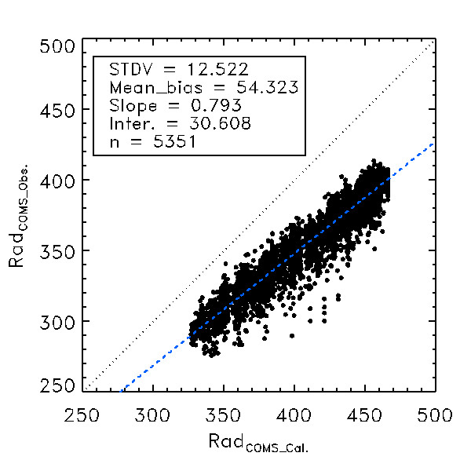
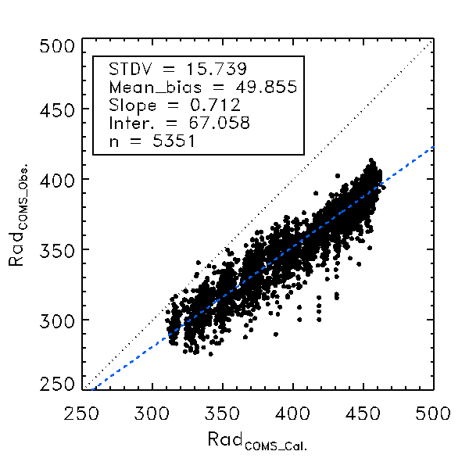
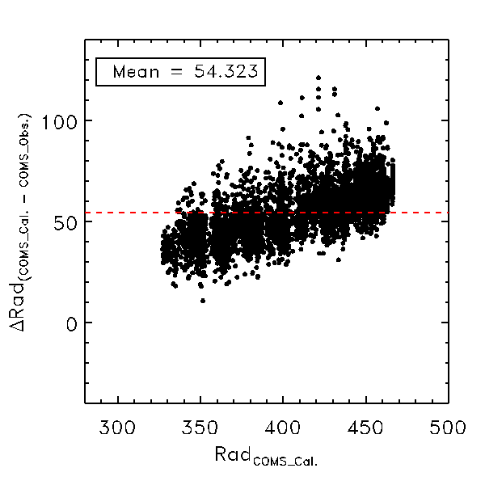
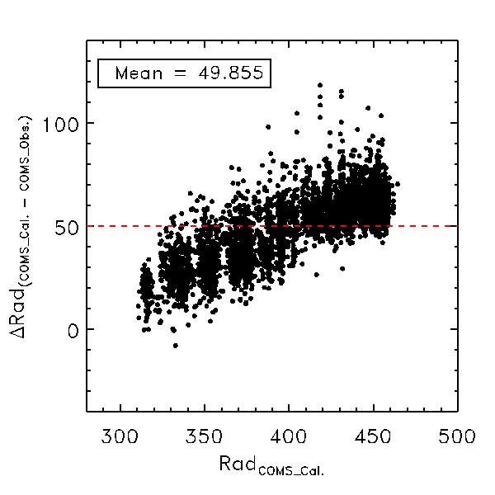
Radiance comparison (Baum vs MIE)
2016.08
Baum BRDF
MIE BRDF

Slide 10
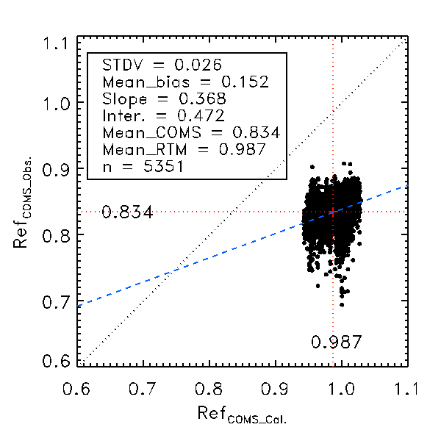
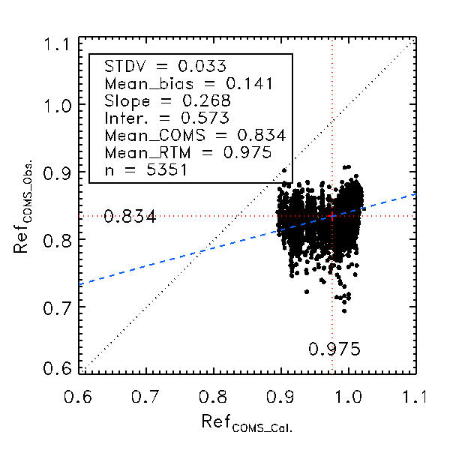
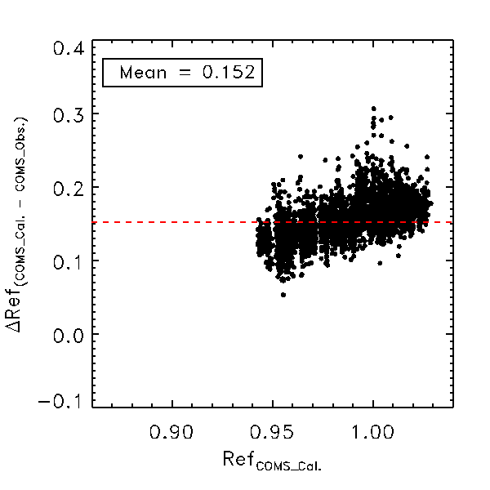
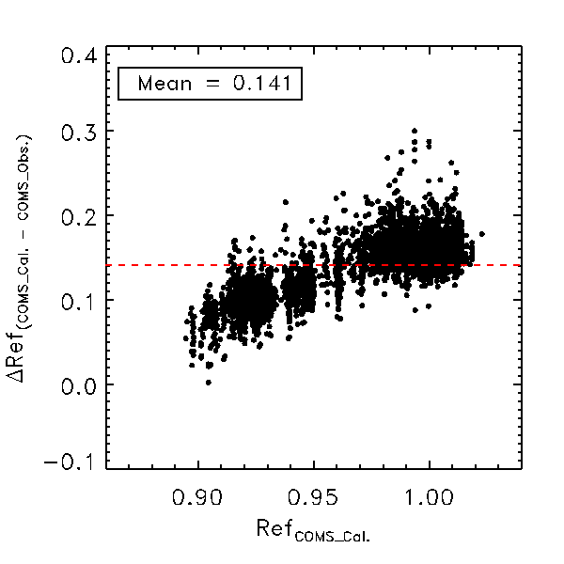
Reflectance comparison (Baum vs MIE)
2016.08
Baum BRDF
MIE BRDF

Slide 11
BRDF comp (Baum vs MIE)
2016.08
DCC calibration results
COMS_cal. vs COMS_Obs. |  | BAUM | MIE | n
Radiance | STDV | 12.522 | 15.739 | 5351
 | Mean_bias | 54.323 | 49.855
Reflectance | STDV | 0.026 | 0.033
 | Mean_bias | 0.152 | 0.141
 |  | BAUM | MIE | Difference
Reflectance | Mean_Cal. | 0.987 | 0.975 | 0.012
 | Mean_Obs. | 0.834 | 0.834 | 0

Slide 12
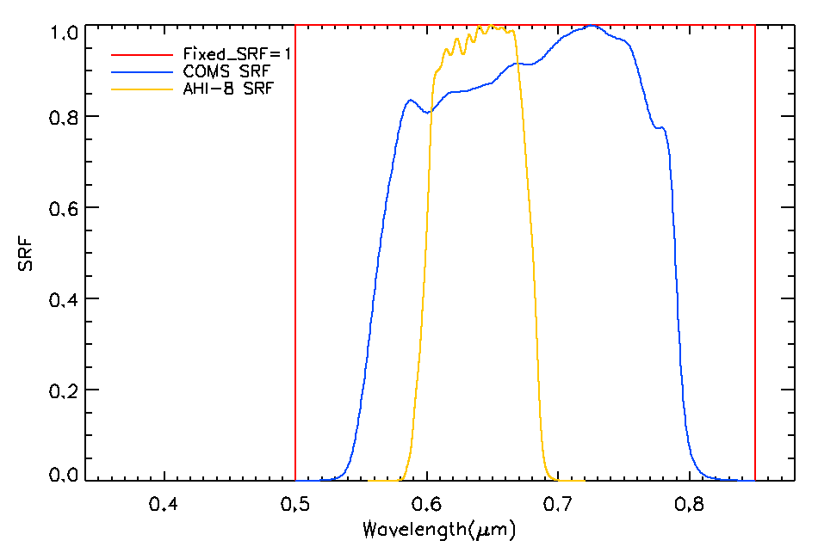
BRDF sensitivity (Three SRFs)
3 types of RTM SRF with BRDF model (Baum)
Type | Wavelength
Fixed SRF = 1 | 0.5 – 0.85
COMS SRF | 0.5 – 0.85
AHI SRF | 0.582 – 0.694
SRF : Spectral Response Function

Slide 13
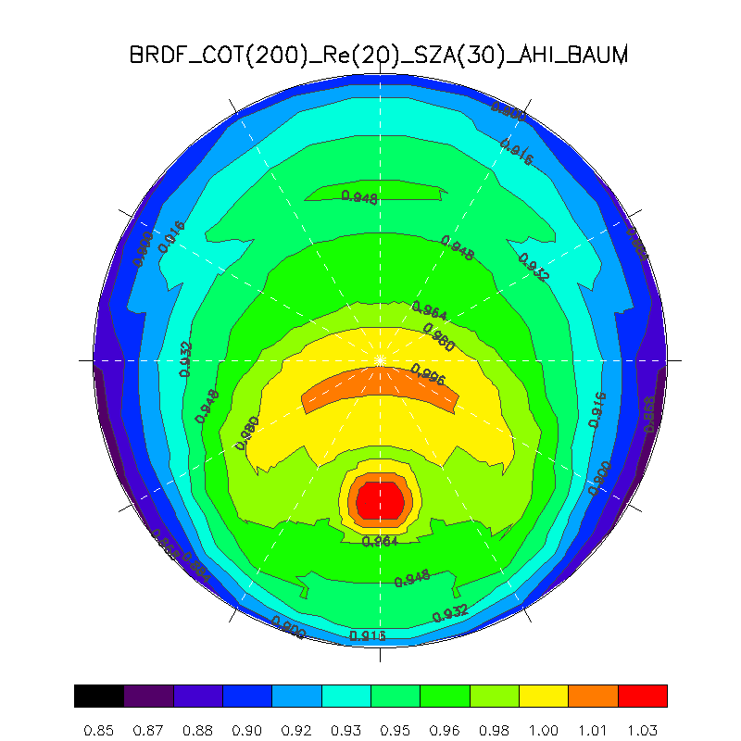
BRDF comparison (COMS vs AHI SRF)
COMS BRDF
COT(200), Re(20), SZA(30)
AHI BRDF
COT(200), Re(20), SZA(30)
Mean = 0.967
Mean = 0.955

Slide 14
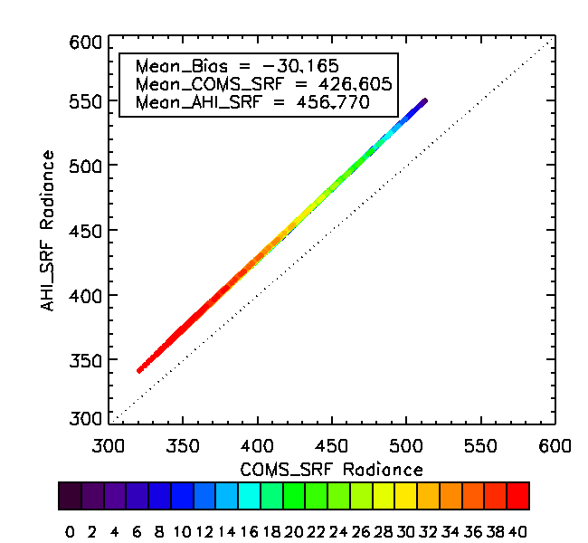
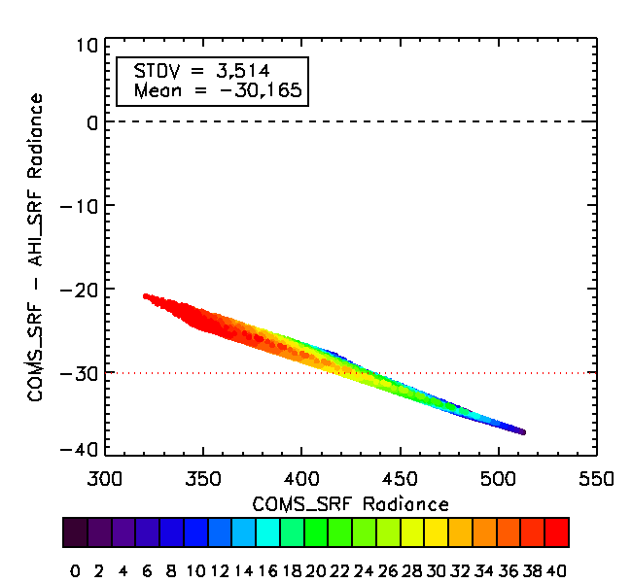
Radiance (AHI vs COMS SRF)
Comparison radiance of between AHI SRF and COMS SRF.
Fixed COT=200, $r_{e}$=20$μm$.
SZA
SZA

Slide 15
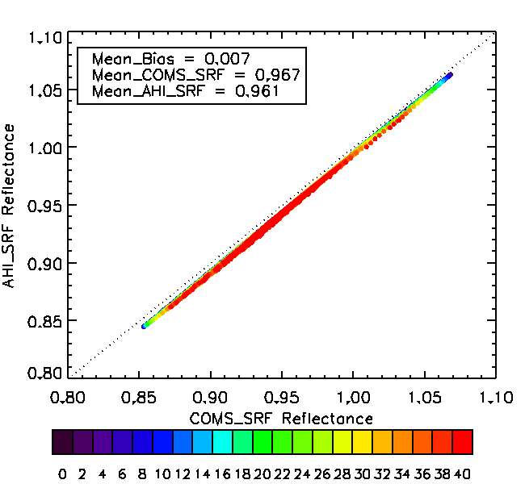
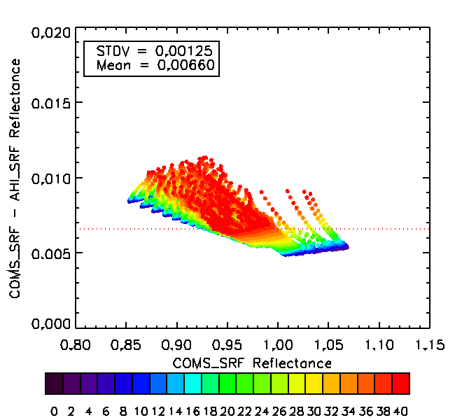
Reflectance (AHI vs COMS SRF)
Comparison reflectance of between AHI SRF and COMS SRF
Fixed COT=200, $r_{e}$=20$μm$.
SZA
SZA

Slide 16
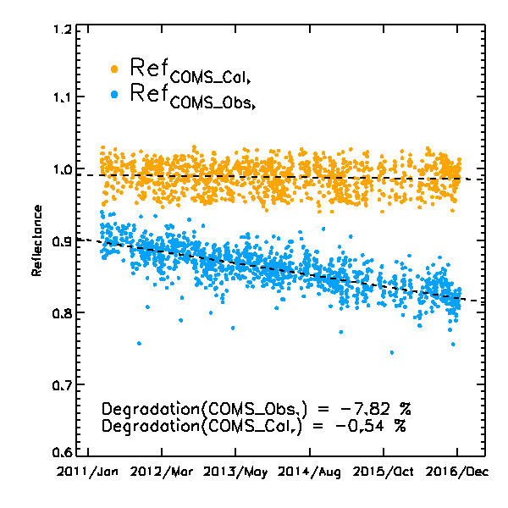
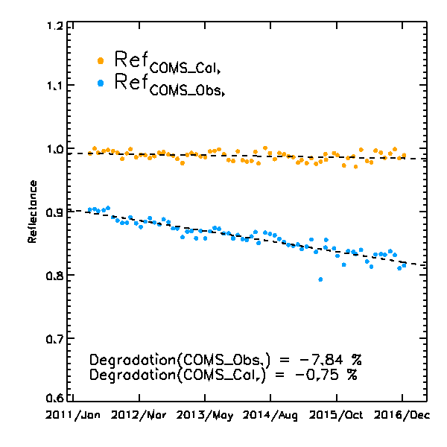
COMS VIS Degradation Trend
COMS VIS degradation trend during April 1, 2011 to December 31, 2016
Daily mean
Monthly mean

Slide 17
Thank you

