Slide 1
Update on the NASA Langley Satellite Calibration SBAF Tools
Benjamin Scarino¹, David R. Doelling², Arun Gopalan¹, Thad Chee¹, Rajendra Bhatt¹, and Conor Haney¹
¹SSAI, One Enterprise Pkwy Ste 200, Hampton, VA 23666 USA
²NASA Langley Research Center, 21 Langley Blvd MS 420, Hampton, VA 23681-2199 USA
2017 GRWG/GDWG Annual Meeting
20 - 24 March 2017 Madison, WI
GRWG: VIS/NIR Sub-group
Thursday, March 23rd, 14:40

Slide 2
Outline
Purpose
Spectral Band Adjustment Factor (SBAF) [brief] review
Calibration webpage
Highlighting the Solar Constant Comparison Tool
Tool updates
IASI
SCIAMACHY and introducing GOME-2
Consistency
Showcasing SRF and Spectra Tool
Revisiting Hyperion
Summary and conclusions

Slide 3
Purpose
Provided tools for use by inter-calibration developers
GSICS deliverable
Open sharing to benefit calibration community
Support proposed effort to provide open access SBAFs for consistent inter-satellite calibration and retrievals
Need users | Will take suggestions and adapt Spectral domains Tool features New sub-setting options Different buttons Plotting controls Uncertainty Range
Need input from instrument teams New/updated/recommended SRFs New calibration Version updates E.g., next SCIAMACHY release this year

Slide 4
SBAF Review
(a) The Wherli 1985 solar irradiance spectra. (b) The SCIAMACHY reflectance spectra over DCC, clear-sky ocean, and vegetation overlaid with GOES-12 Ch1 (G12) and MODIS Band 1
Derivation of reference- and target-sensor pseudo radiance (L_{p})

Slide 5
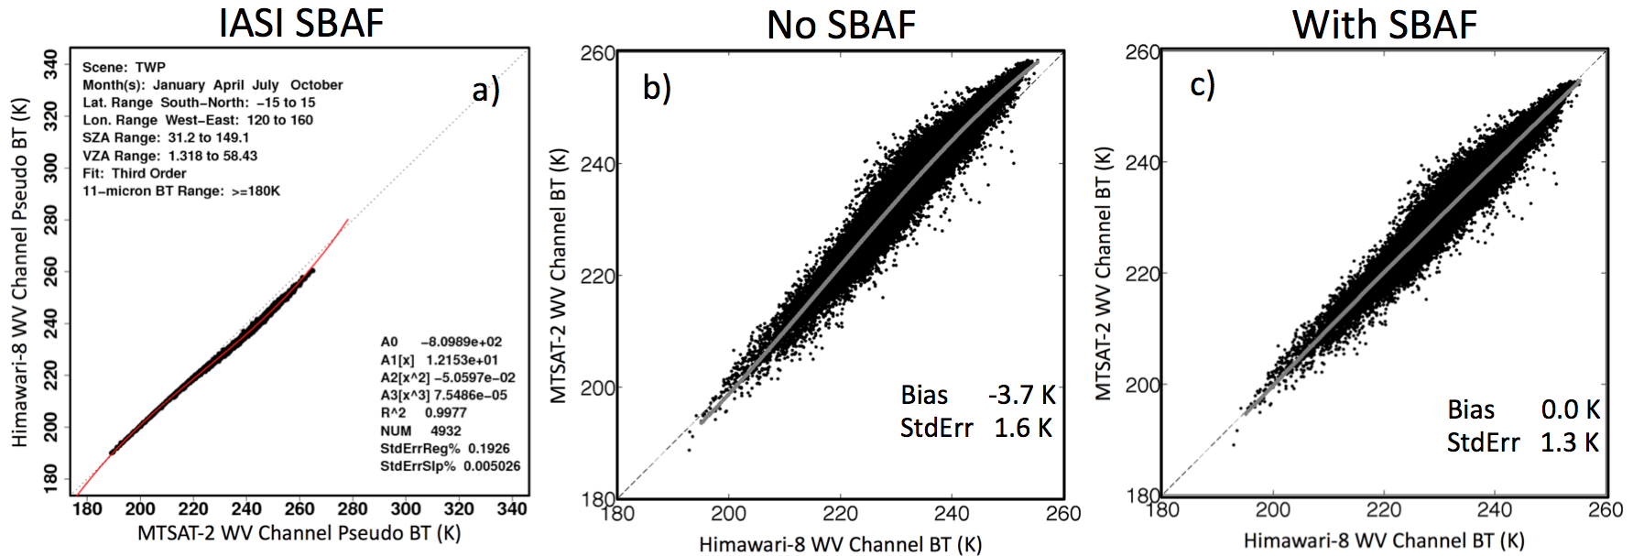
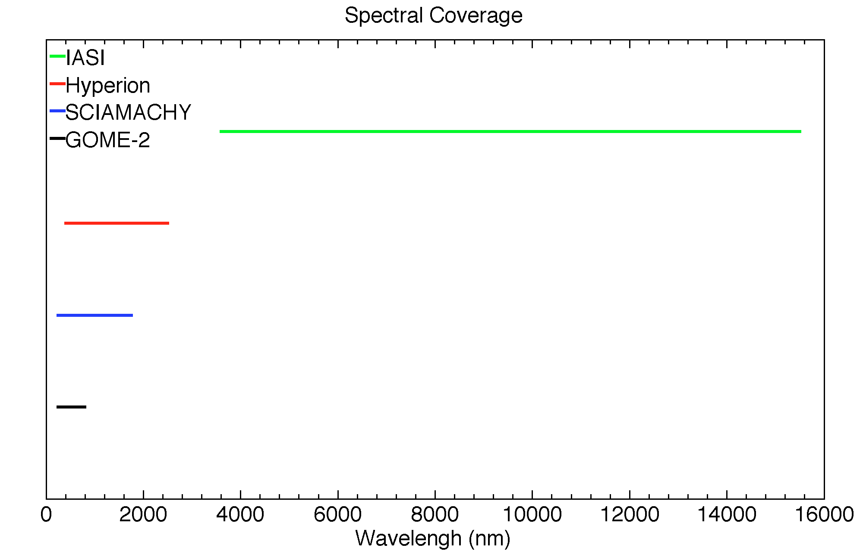
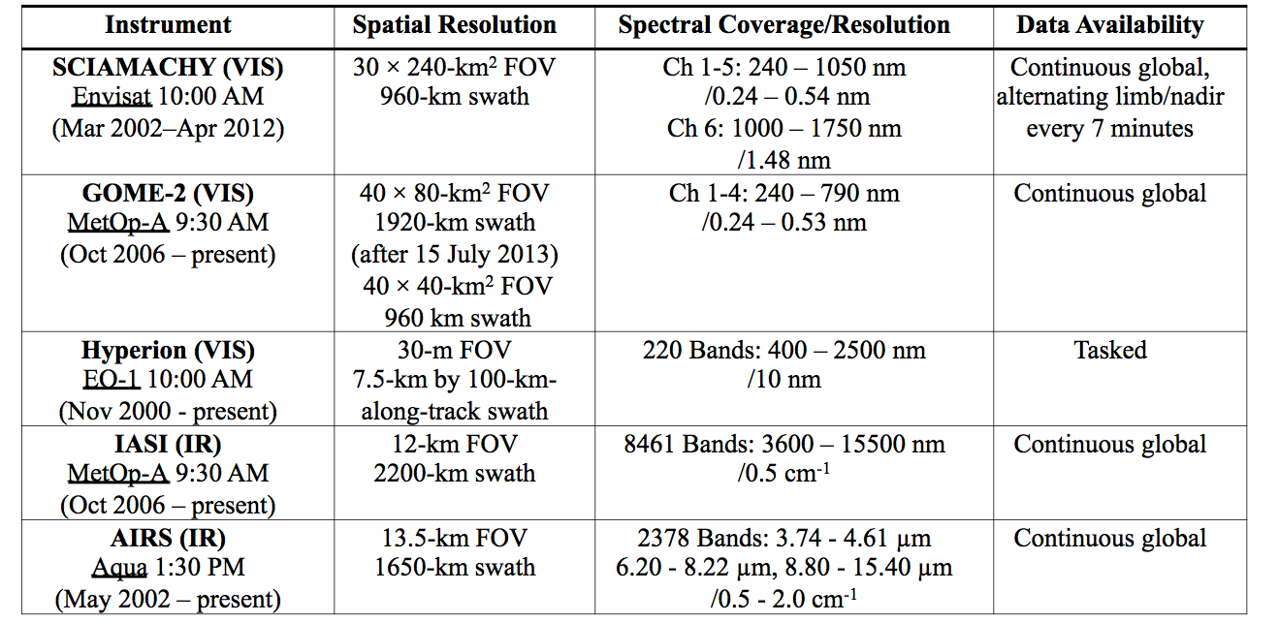
SBAF Review
3rd-order relationship of WV channels resoled by 3rd-order SBAF application
SBAF reduces relative gain difference of multiple independent calibration methods
SBAF applicable for 0.24-2.50 μm via SCIAMACHY, Hyperion, and GOME-2
GOME-2 affords smaller footprint from narrower spectral range
IASI covers 3.60-15.5 μm
Will also support AIRS starting this year
3600 – 15500 nm
400 – 2500 nm
240 – 1750 nm
240 – 790 nm

Slide 6
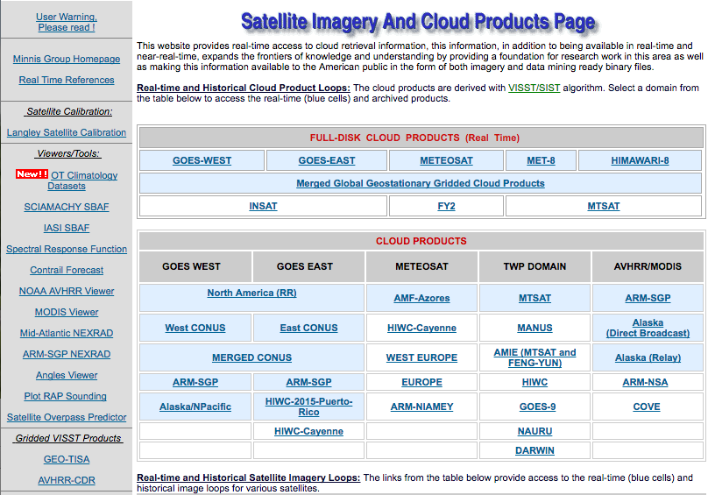
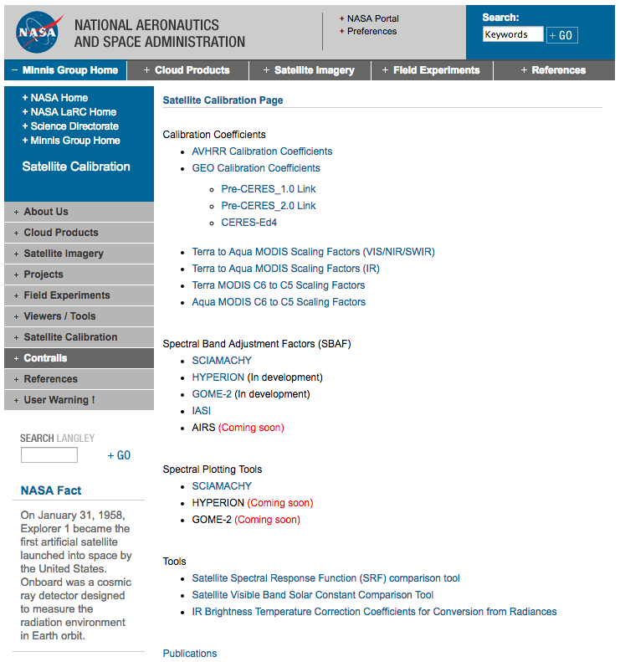
NASA Langley Satellite Calibration Webpage
https://satcorps.larc.nasa.gov
https://satcorps.larc.nasa.gov/cgi-bin/site/showdoc?mnemonic=SAT_CALIB_USER

Slide 7
Solar Constant Tool
Select any instrument visible-band SRF for convolution
Select up to 4 solar spectra from 6 options
Plot provides image of SRF relative response and solar irradiance relative to wavelength
Table reveals the SRF convolution of flux, irradiance, and radiance for the chosen solar spectra(s)

Slide 8
NASA Langley Satellite Calibration Webpage
https://satcorps.larc.nasa.gov
https://satcorps.larc.nasa.gov/cgi-bin/site/showdoc?mnemonic=SAT_CALIB_USER

Slide 9
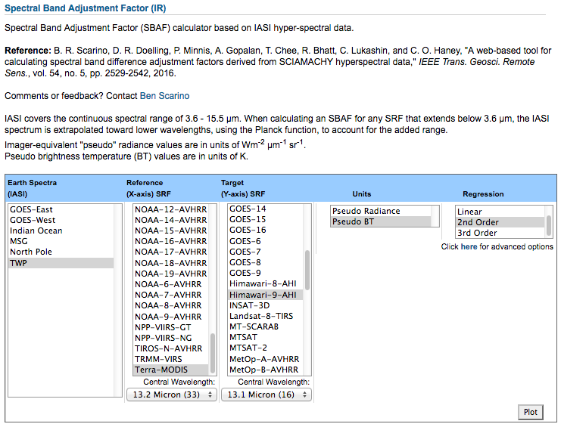
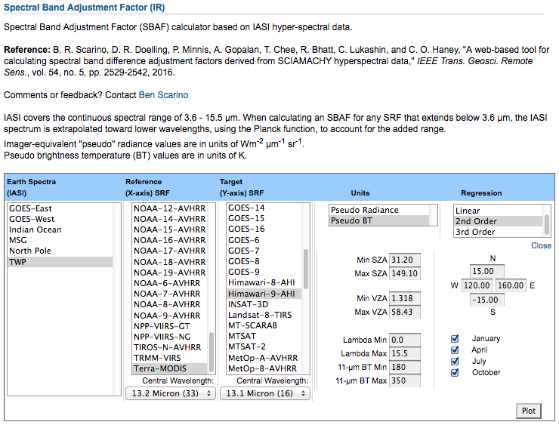
IASI-based IR SBAF Tool Update
Available spectral domains and selection features as shown
Current user request for land/water mask
Recently implemented user requests for 11-μm BT subsetting, and wavelength cutoff for spectral convolution

Slide 10
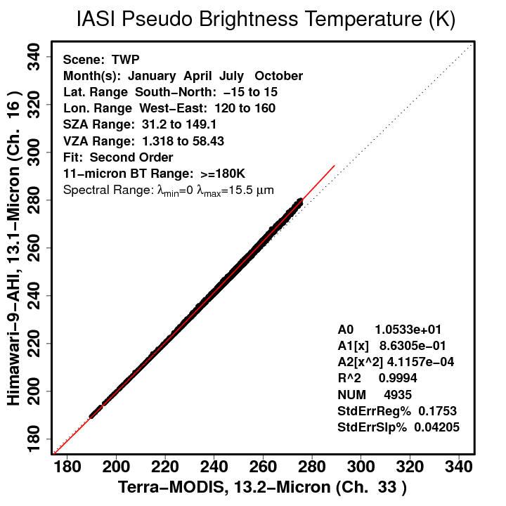
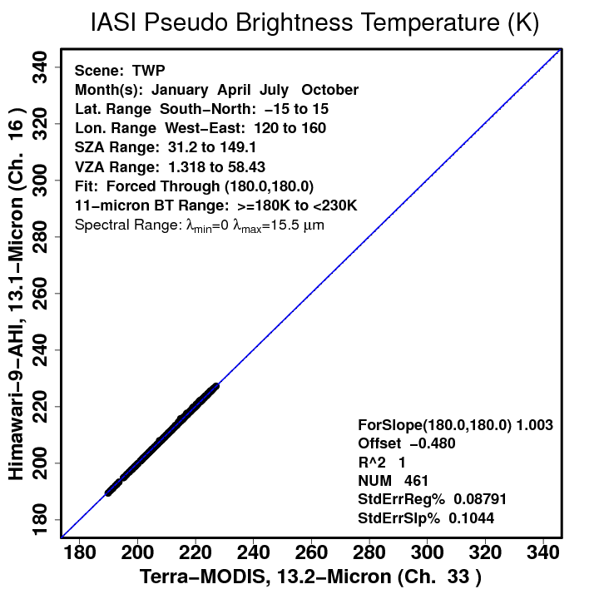
IASI-based IR SBAF Tool Update
Users conducting Overshooting Convective Top studies found it helpful to construct piece-wise SBAFs using limited ranges of 11-μm BT
Works for any channel SBAF, not just 11-μm

Slide 11
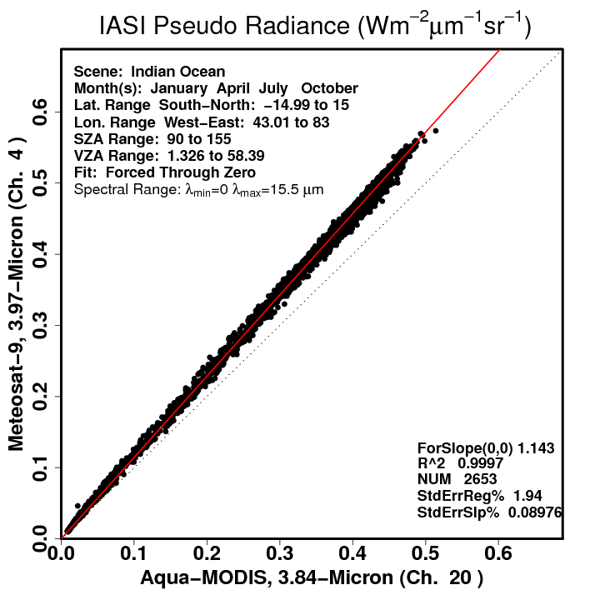
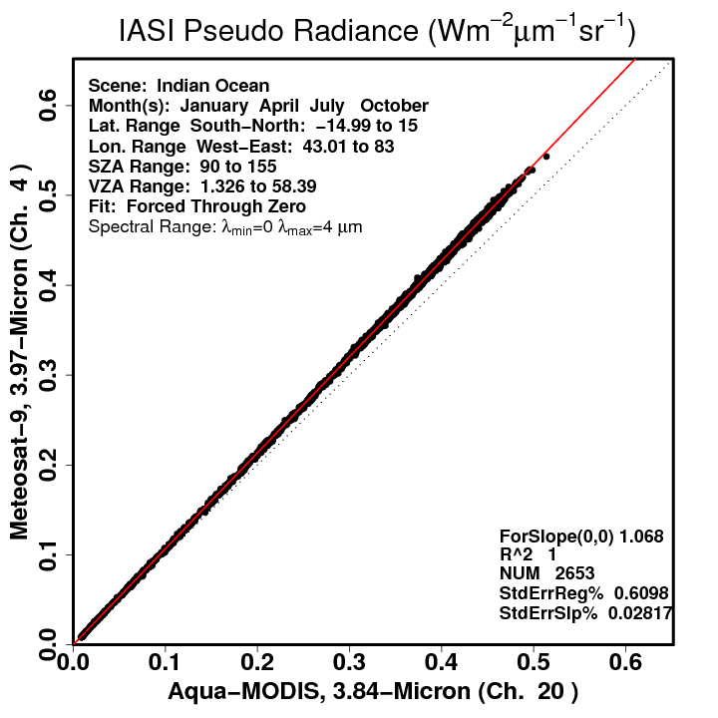
IASI-based IR SBAF Tool Update
A user suspected SBAF uncertainty was caused by CO₂ absorption band just beyond 4.0 μm
Intend to enable means simple spectral absorption band analysis

Slide 12
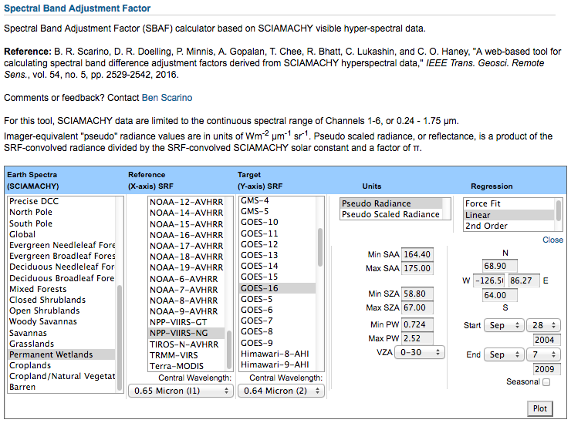
SCIAMACHY-based Visible SBAF Tool Update
Available spectral domains and selection features as shown
A current request for enhanced interfacing capabilities, i.e., run-time/real-time automation, script-driven production
Security considerations
Land-use community user recently requested clear-sky IGBP-specific subsetting
Probably better served by GOME-2
User-controlled outlier filtering

Slide 13
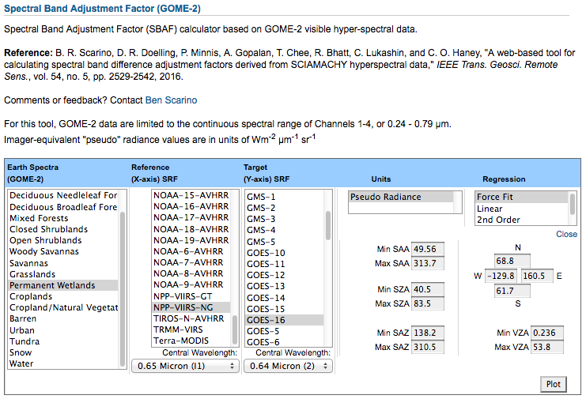
GOME-2-based Visible SBAF Tool Introduction [In Development]
Currently based on 1 month of data (July 2008)
Will support full record as year continues
Live for 18 IGBP Land Classification types (clear sky)
Better sampled than can be accomplished with SCIAMACHY footprints

Slide 14
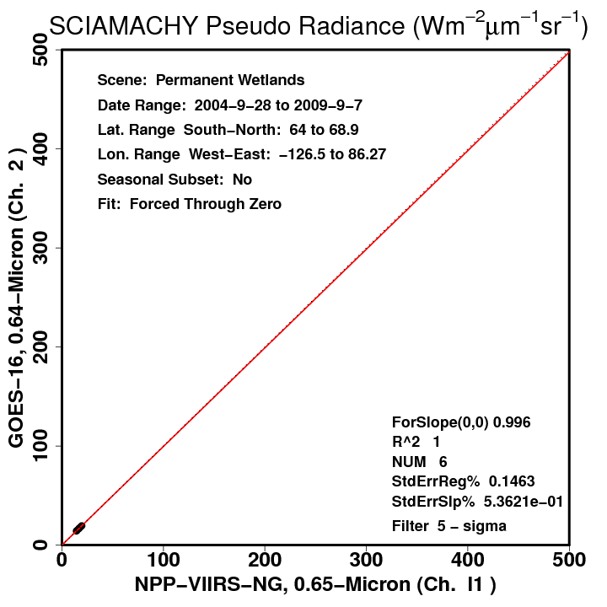
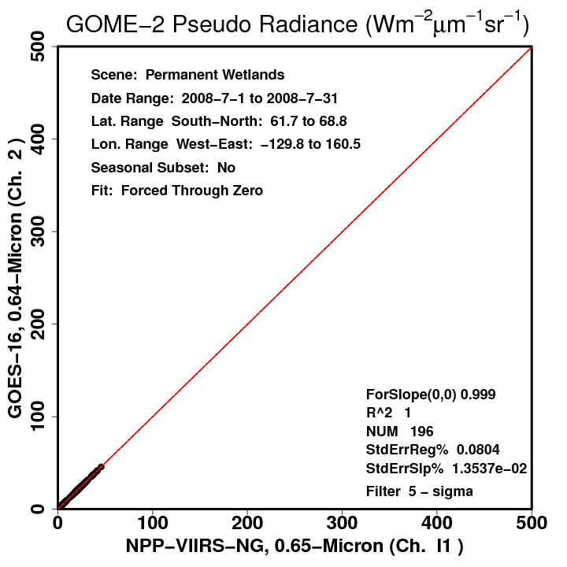
SCIAMACHY and GOME-2 Clear-sky IGBP Scene Spectra
8 years of SCIAMACHY vs. 1 month of GOME-2, and the ability to sample a properly-represented Wetlands scene ID

Slide 15
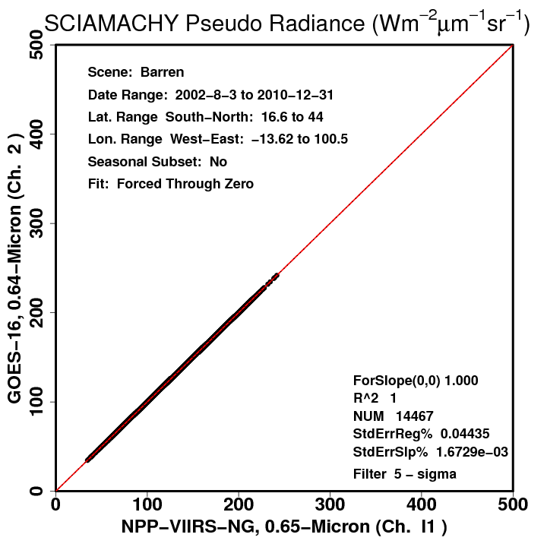
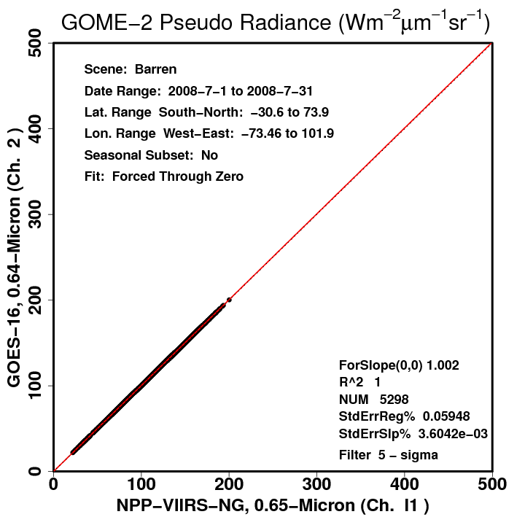
SCIAMACHY and GOME-2 Clear-sky IGBP Scene Spectra
GOME-2-based SBAFs over Barren land (IGBP=16) suggest a 0.2% spectral disparity between the above SRFs
SCIAMACHY-based SBAFs suggest no spectral correction necessary

Slide 16
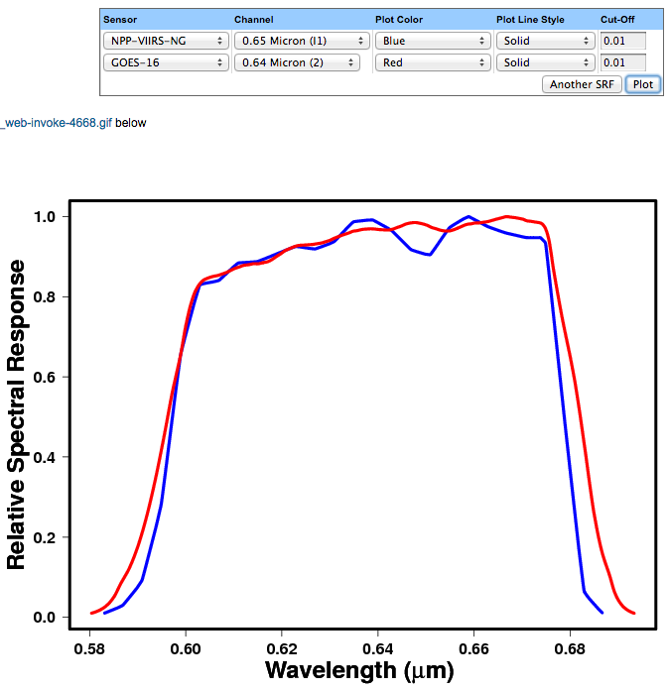
Spectral Response Function Comparison Tool
A fair SBAF comparison should have have adequate sampling from each instrument, with comparable viewing/solar geometry
Preferable to use a PICS
Otherwise can get significant SBAF difference for a more disparate SRF pairing
https://satcorps.larc.nasa.gov/cgi-bin/site/showdoc?mnemonic=SAT_CALIB_USER

Slide 17
SCIAMACHY and GOME-2 Clear-sky IGBP Scene Spectra
A fair SBAF comparison should have have adequate sampling from each instrument, with comparable viewing/solar geometry
Preferable to use a PICS
Otherwise can get significant SBAF difference for a more disparate SRF pairing

Slide 18
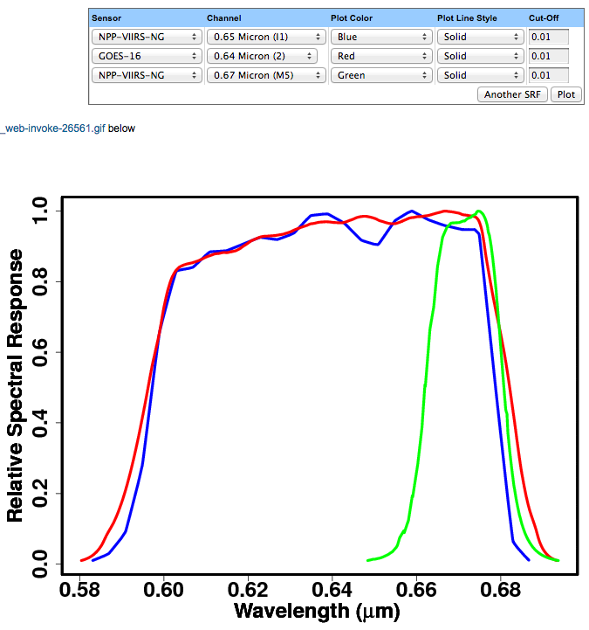
Spectral Response Function Comparison Tool
For example, VIIRS I1 vs. M5 Band
https://satcorps.larc.nasa.gov/cgi-bin/site/showdoc?mnemonic=SAT_CALIB_USER

Slide 19
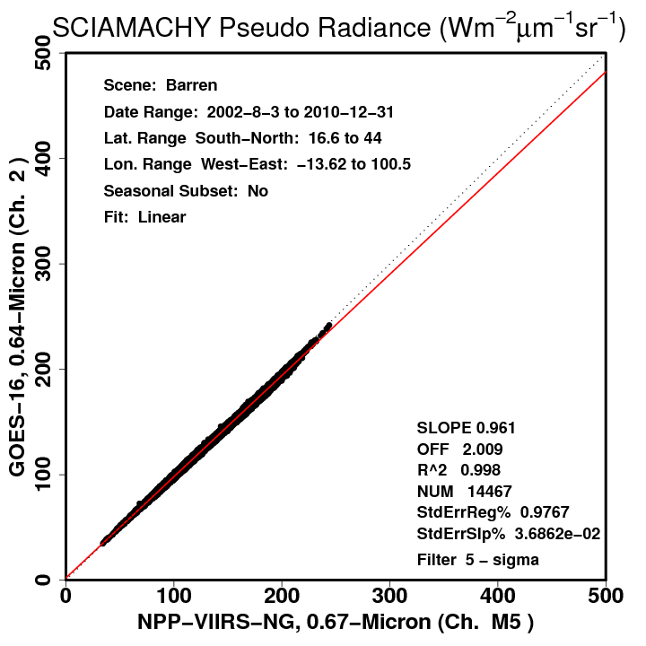
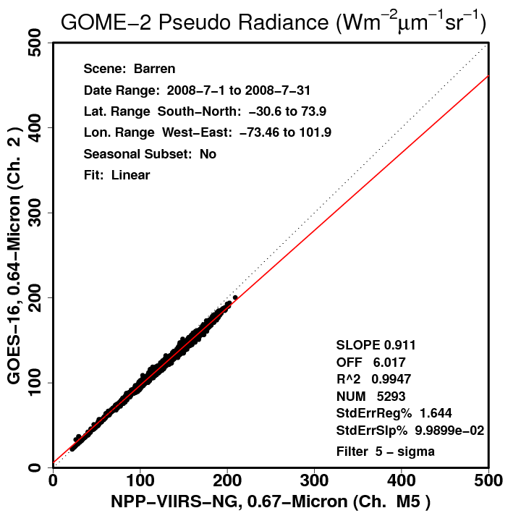
SCIAMACHY and GOME-2 Clear-sky IGBP Scene Spectra
SBAFs inconsistent for disparate bands
Some difference could be owed to seasonal/regional/anisotropic effects

Slide 20
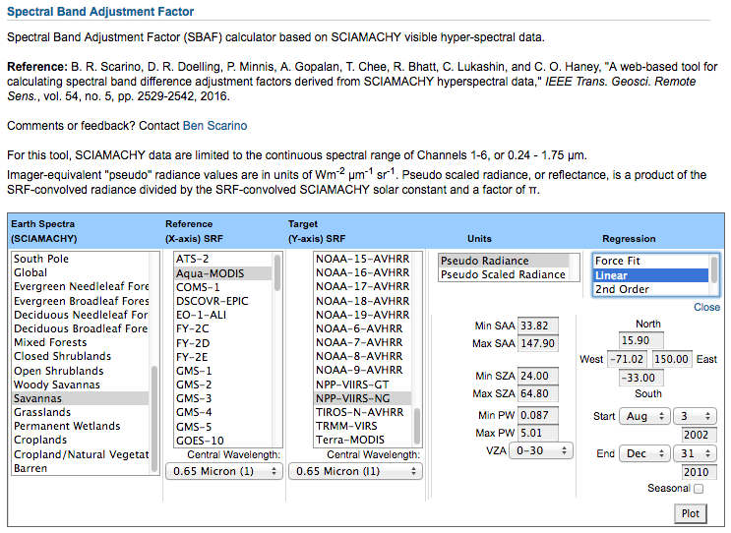
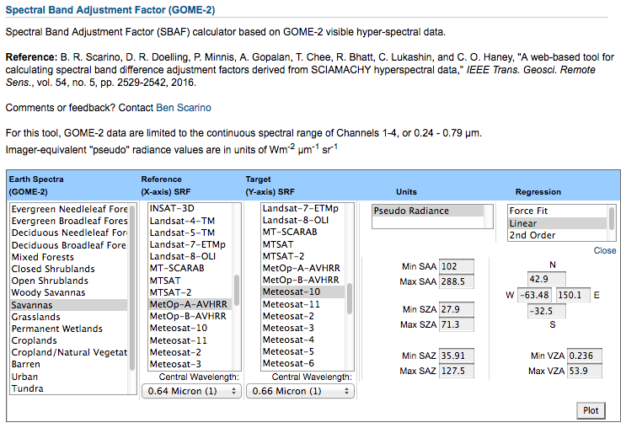
SCIAMACHY and GOME-2 Clear-sky IGBP Scene Spectra
Best effort can be made to pick similar view/illumination angle allowances, season, and domain
Won’t account for specific SZA difference
Note: Will not be an adequate imitation of a simultaneous, co-located comparison

Slide 21
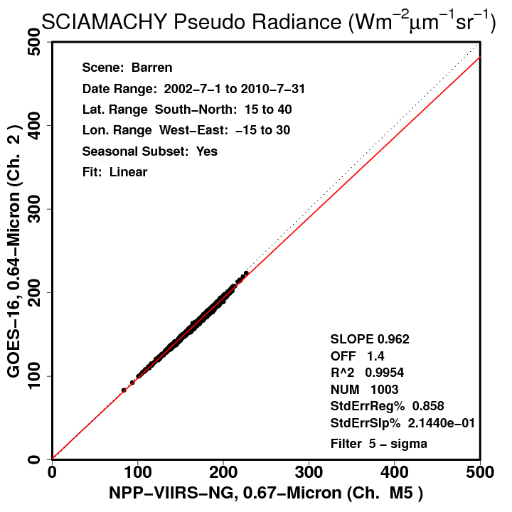
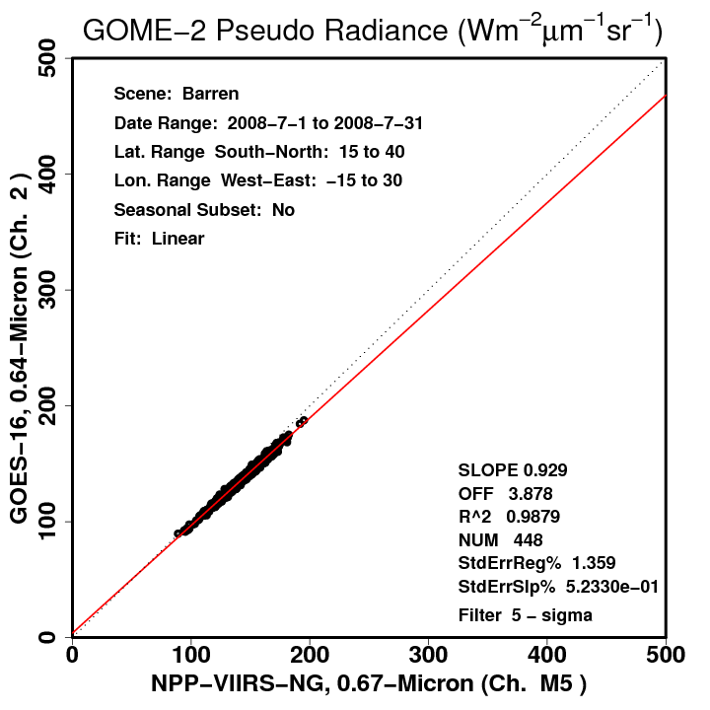
SCIAMACHY and GOME-2 Clear-sky IGBP Scene Spectra
Likely that agreement is highly dependent on scene homogeneity
SCIAMACHY may miss small clouds
GOME-2 perhaps more accurately distinguishing spectra of bare rock vs. soil vs. sand, whereas SCIAMACHY may represent more of an average

Slide 22
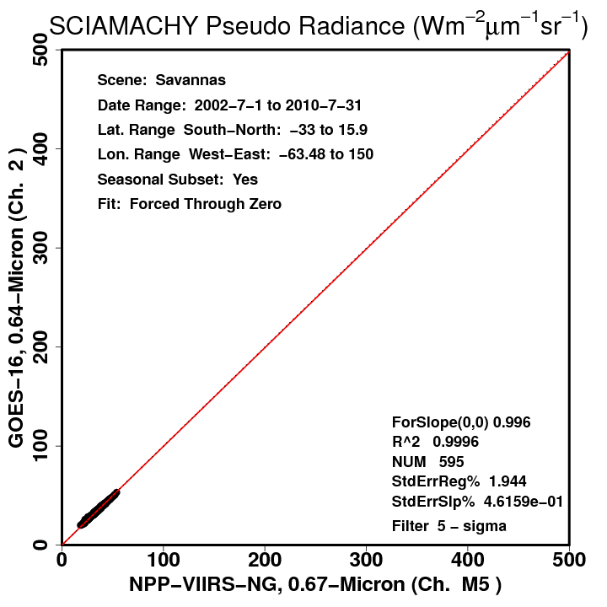
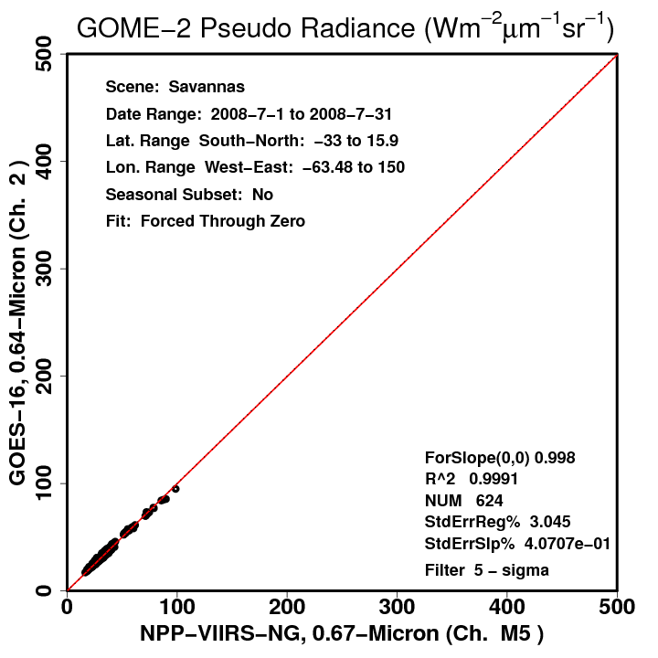
SCIAMACHY and GOME-2 Clear-sky IGBP Scene Spectra
Other scene types suggest better consistency for same disparate SRFs
Again, conclusions about consistency are best afforded from formal PICS study
Bottom line: Attempt to best match scene conditions of one’s calibration approach

Slide 23
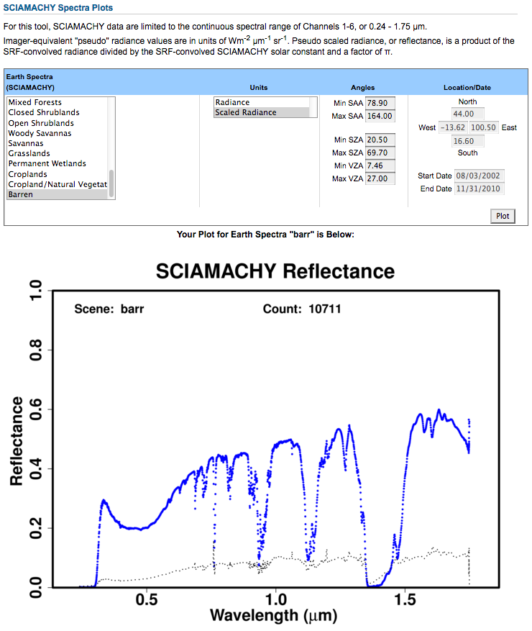
SCIAMACHY Spectra Plotting Tool
Mean radiance/reflectance spectra and standard deviation available for all SCIAMACHY Earth targets.
https://satcorps.larc.nasa.gov/cgi-bin/site/showdoc?mnemonic=SAT_CALIB_USER

Slide 24
Hyperion-based Visible SBAF Tool Update
Map displays entire record of Hyperion ground measurements

Slide 25
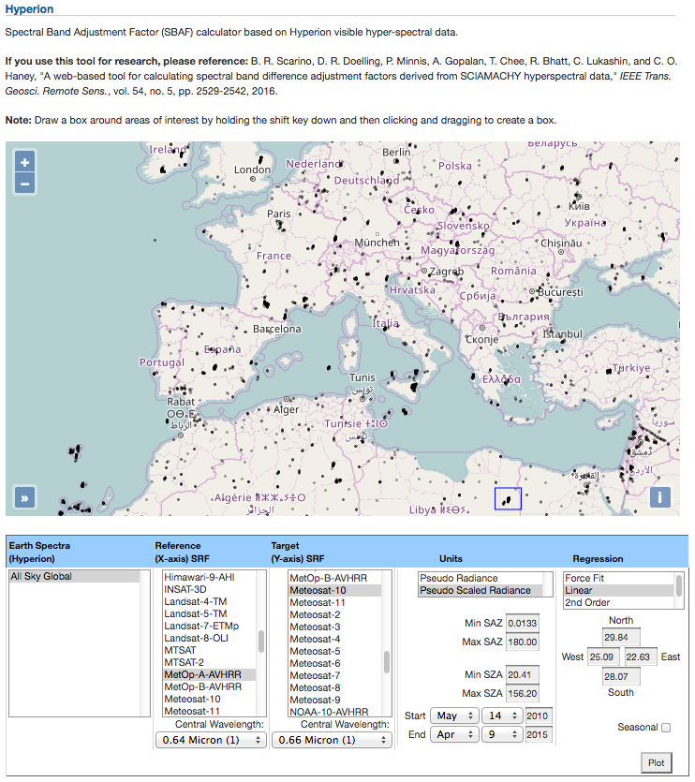
Hyperion-based Visible SBAF Tool Update
Map displays entire record of Hyperion ground measurements
Grey → black = low → high density
Irregular distribution due to nature of tasked retrieval

Slide 26
Hyperion-based Visible SBAF Tool Update
Map displays entire record of Hyperion ground measurements
Grey → black = low → high density
Irregular distribution due to nature of tasked retrieval
Enter coordinates for area of interest, or simply ‘shift+click+drag’

Slide 27
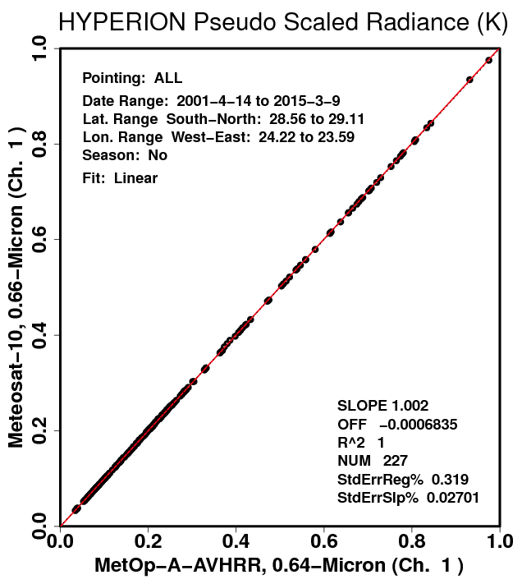
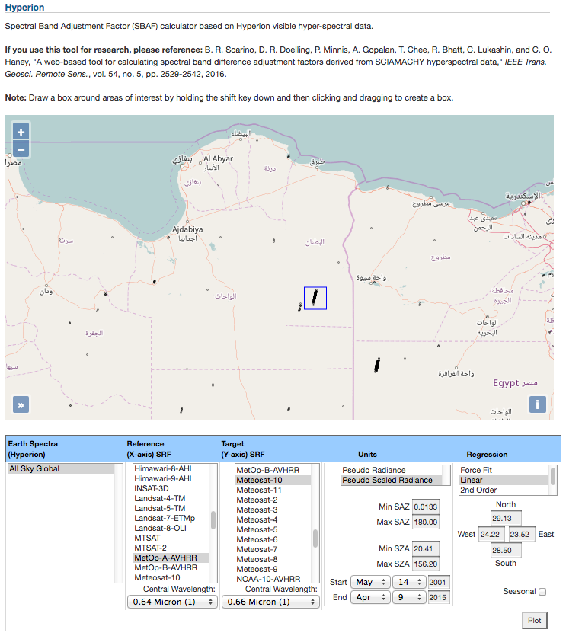
Hyperion-based Visible SBAF Tool Update
Map displays entire record of Hyperion ground measurements
Grey → black = low → high density
Irregular distribution due to nature of tasked retrieval
Enter coordinates for area of interest, or simply ‘shift+click+drag’

Slide 28
Summary and Conclusions
Providing support for calibration community and developers with open access SBAFs for consistent inter-satellite calibration and retrievals
Want to work with instrument teams to showcase highest-quality data and latest SRFs
Feedback, suggestions, and requests
Will integrate full record of GOME-2, introduce AIRS
Update on the NASA Langley Satellite Calibration SBAF Tools
Benjamin Scarino
benjamin.r.scarino@nasa.gov

