Slide 1
Characterizing DCC as invariant calibration target
David Doelling, Rajendra Bhatt, Ben Scarino, Conor Haney, Arun Gopalan, Jack Xiong
GSICS annual meeting, Madison, WI, USA, March 20-24, 2017

Slide 2
DCC Invariant target methodology (relative or stability calibration)
Identify monthly all DCC pixels over the domain
The GEO and MODIS window channel IR temperatures are stable
Convert the DCC radiance to an overhead sun radiance using the Hu BRDF model
Apply an spectral band adjustment factor to the Aqua-MODIS sensor radiance to convert the radiance to an equivalent GEO sensor radiance using SCIAMACHY hyper-spectral radiances.
very small factor for DCC <1µm
Histogram all of the pixel level DCC overhead sun radiances and determine the PDF mode radiance.
Compute the GEO calibration coefficients by monitoring the drift of the monthly GEO PDF mode radiances, which represents the visible degradation of the sensor

Slide 3
DCC Invariant target methodology (absolute calibration)
Assume that each GEO domain has an invariant reflectance, which is dependent on the local time
Assume that the GEO (monitored) sensor and Aqua-MODIS (reference calibration) sensor capture the same DCC over the GEO domain at the time of the Aqua-MODIS overpass
Each domain has a distinct diurnal and seasonal cycle
Assume the inter-annual variability of the diurnal and seasonal cycle is very small
This method makes it possible to calibrate historical as well as future GEOs
Does not need any contemporary reference Aqua-MODIS or NPP-VIIRS radiance observations
Able to tie historical, current and future reflected solar band calibration references

Slide 4
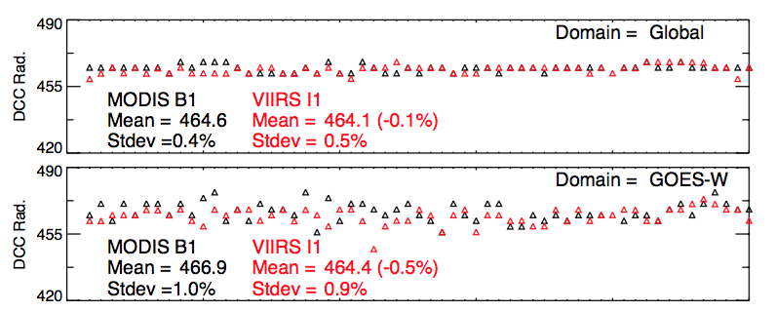
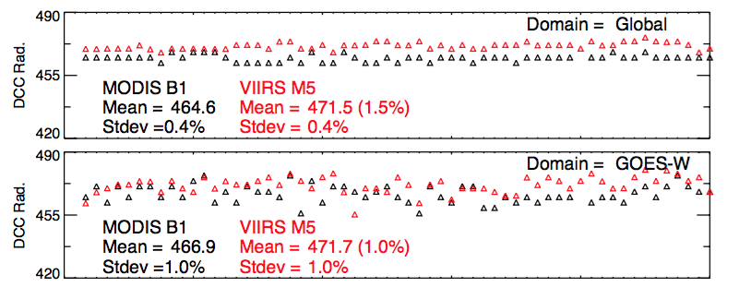
Transferring the reference calibration using DCC targets
• Find the DCC mode radiance reference based on Aqua-MODIS (C6) B1, NPP-VIIRS (V001) I1 and M5
• Compare the GEO domain mode radiance with respect to the global mode radiance
• Compare the reference ratio over each of the GEO domains
DCC mode radiances for MODIS B1, VIIRS I1 and M5 for global and GOES-W domain
GEO domain standard deviations
Satellite | Position | B1 | I1 | M5
Global |  | 0.4 | 0.5 | 0.4
GOES-W | 135°W | 1.0 | 0.9 | 1.0
GOES-E | 75°W | 0.5 | 0.4 | 0.5
Met-10 | 0°E | 0.7 | 0.7 | 0.7
Met-7 | 60°E | 0.9 | 1.0 | 1.1
FY2E | 86° | 0.8 | 0.7 | 0.7
MTSAT-2 | 140° | 0.8 | 0.7 | 0.7

Slide 5
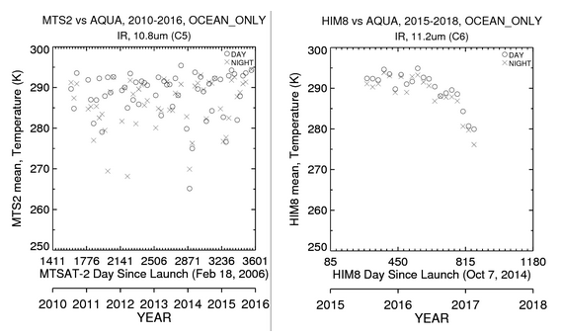
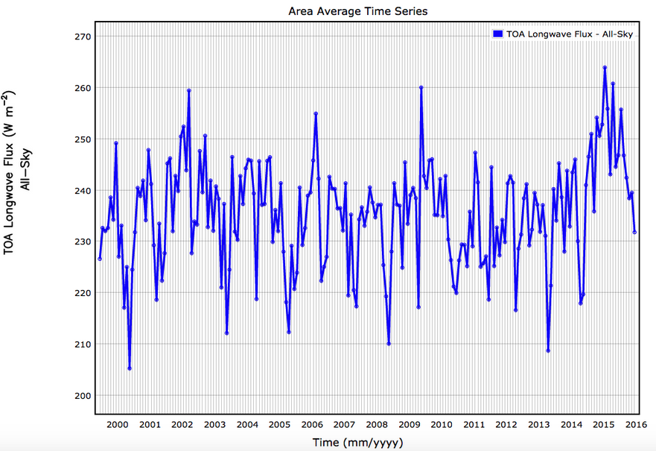
TWP DCC inter-annual variability
270
250
CERES LW flux (Wm⁻²)
230
210
2000
2017
• The TWP DCC mode reflectance inter-annual (ENSO) stability is within 0.8% over the TWP

Slide 6
Compare the GEO domain with the global DCC mode radiance
Domain |  | B1 | I1 | M5
 |  | GEO/global (%) | GEO/global (%) | GEO/global (%) | range
Global |  | 464.6 | 464.1 | 471.7
GOES-W | 135°W | +0.5 | +0.1 | +0.0 | 0.5
GOES-E | 75°W | +0.3 | +0.2 | +0.3 | 0.1
Met-10 | 0°E | +0.5 | +0.6 | +0.6 | 0.1
Met-7 | 60°E | +0.1 | -0.2 | -0.1 | 0.3
FY2E | 86° | -0.6 | +0.3 | +0.4 | 1.0
MTSAT-2 | 140° | -0.5 | -0.5 | -0.4 | 0.1
• Each GEO domain has a unique invariant DCC mode radiance
• The GOES-W, GOES-E, Met-10 locations have greater mode radiances
• The MTSAT-2 domain has a smaller mode radiance and has the greatest DCC frequency
• GOES-E, Met-10 and MTSAT-2 domain mode radiance is very well tied to the global

Slide 7
Compare the reference radiances in each GEO domain
Satellite | Longitude Position | I1-B1 | M5-B1 | M5-I1
Global |  | -0.1 | 1.5 | 1.6
GOES-W | 135°W | -0.5 (-0.4) | 1.0 (-0.5) | 1.5 (-0.1)
GOES-E | 75°W | -0.3 (-0.2) | 1.4 (-0.1) | 1.7 (+0.1)
Met-10 | 0°E | -0.1 (0.0) | 1.6 (+0.1) | 1.7 (+0.1)
Met-7 | 60°E | -0.3 (-0.2) | 1.3 (-0.2) | 1.6 (+0.0)
FY2E | 86° | +0.8 (+0.9) | 2.5 (+1.0) | 1.7 (+0.1)
MTSAT-2 | 140° | -0.1 (0.0) | 1.6 (+0.1) | 1.7 (+0.1)
() Relative ratio with respect to the global
• The GEO domain reference band ratios are similar to the global for most domains except for GOES-W, and FY-2E, but mostly within the GEO domain DCC mode sigma
• Next compare the DCC mode radiance to the ray-matched calibration

Slide 8
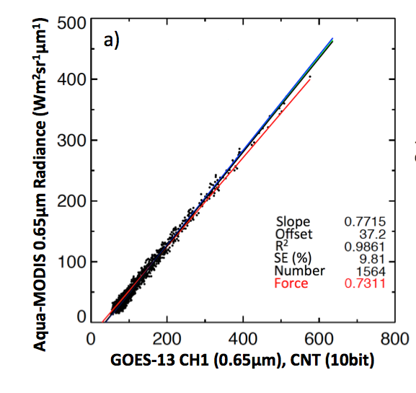
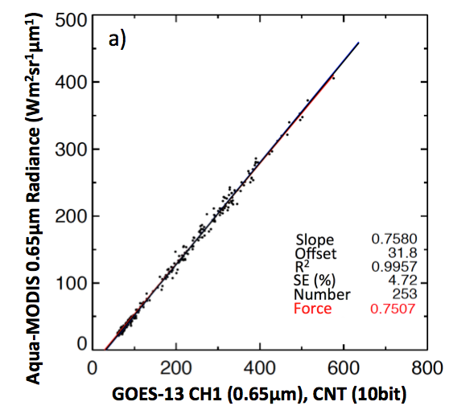
All-sky Tropical Ocean Ray-match calibration
Doelling et al. 2016
GOES-13/Aqua-MODIS for April 2011
Ed 3
Ed 4
Decrease angle tolerance for clear-sky radiances
Red line = linear regression through the space clamp offset (force fit)
Black line = linear regression
Under perfect ray-matching conditions the force fit and the linear regression should be equal
• The lax angular matching, not accounting for spectral band differences, biased Ed3

Slide 9
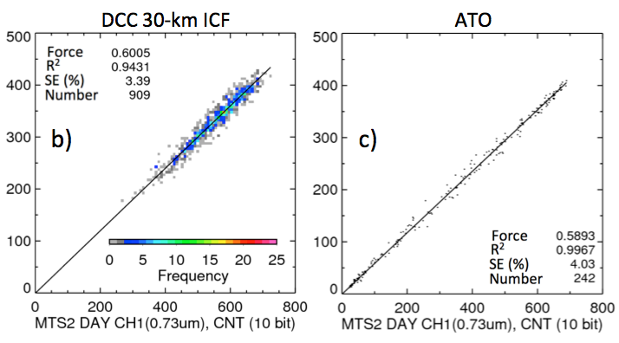
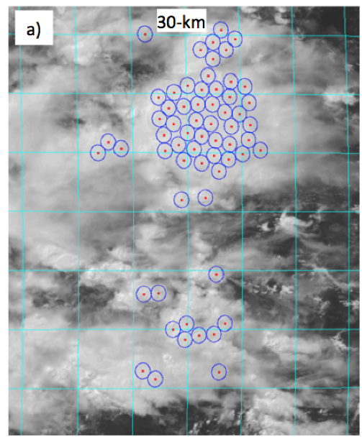
DCC ray-matched calibration
Doelling et al. 2016
MTSAT-2/Aqua-MODIS Jan 2013
All-sky Tropical Ocean
• Find 30-km diameter cores in MODIS image with the T<220K
• Match coincident MODIS and GEO DCC pairs within a scattering angle of 15°
• Apply SBAF, and follow ATO algorithm
DCC are more Lambertian and a smaller SBAF correction and uncertainty than ATO

Slide 10
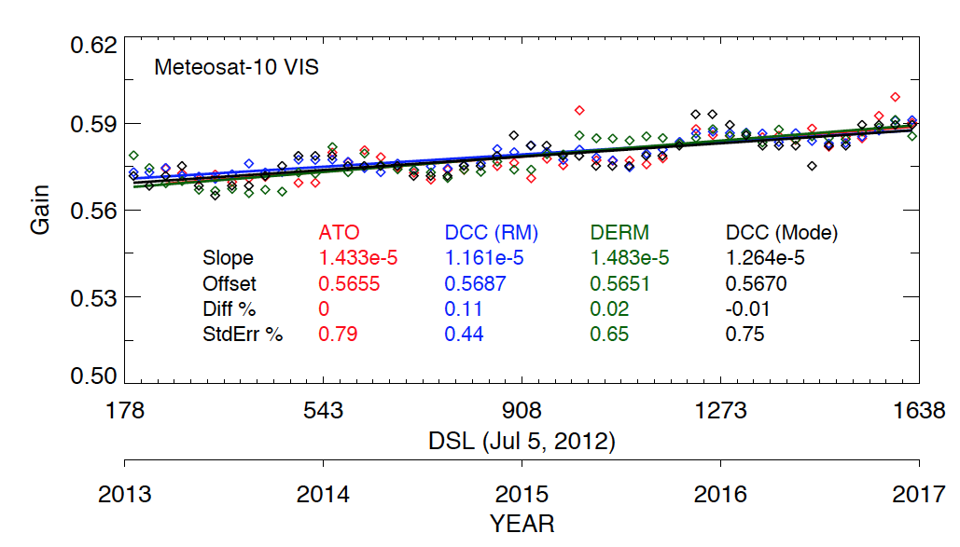
Meteosat-10 calibration gains
desert
• All calibration methods give consistent gains

Slide 11
Comparison of GEO calibration gains referenced to Aqua-MODIS
Satellite | Longitude | DCC-ATO (ray) | DCCmode- ATOray | DCCmode-DCCray
GOES-15 | 135°W | -0.02 | -0.37 | -0.35
GOES-13 | 75°W | -0.11 | +0.53 | +0.64
Met-10 | 0°E | 0.11 | -0.1 | -0.12
Met-7 | 60°E | 0.31 | 0.33 | +0.02
Him-8 | 86° | -0.13 | 0.47 | +0.60
MTSAT-2 | 140° | 1.02 | 0.52 | -0.51
• The DCC mode calibration is within 0.7% of either ATO and DCC ray-matching, again within the GEO domain DCC mode radiance standard deviation
• The DCC and ATO ray-matching is mostly within 0.3%

Slide 12
Comparison of ATO and DCC ray-matched gains for Himawari-8
Him-8 band | VIIRS band | µm | Gain DCC | Stderr (%) | Gain ATO | Stderr (%) | DCC-ATO (%)
Ch1 | M3 | 0.47 | 0.3935 | 0.21 | 0.3911 | 0.31 | 0.61
Ch2 | M4 | 0.51 | 0.3676 | 0.26 | 0.3659 | 0.29 | 0.46
Ch3 | I1 | 0.64 | 0.3021 | 0.27 | 0.3013 | 0.31 | 0.27
Ch3 | M5 | 0.64 | 0.3060 | 0.25 | 0.3047 | 0.28 | 0.43
Ch4 | M7 | 0.86 | 0.1815 | 0.21 | 0.1810 | 0.27 | 0.28
Ch5 | I3 | 1.6 | 0.04420 | 0.53 | 0.04404 | 0.50 | 0.36
Ch5 | M10 | 1.6 | 0.04340 | 0.54 | 0.4331 | 0.46 | 0.21
Ch6 | M11 | 2.3 | 0.01460 | 0.39 | 0.1488 | 0.39 | -1.88
• Most Himawari-8 bands ATO and DCC ray-matched gain differences are within 0.6%

Slide 13
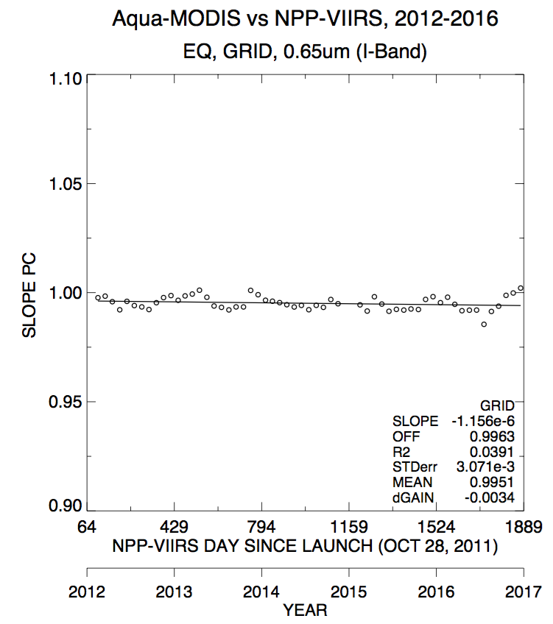
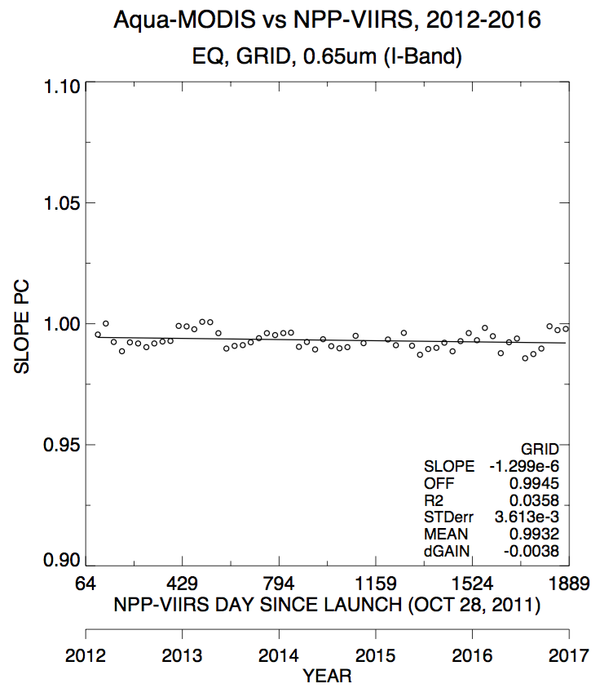
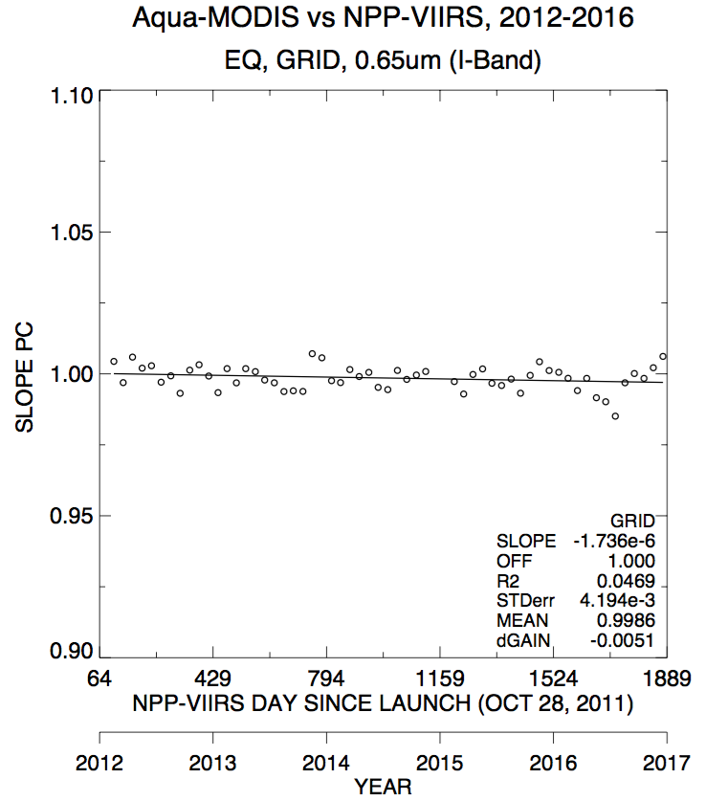
Compare Aqua-MODIS B1 and NPP-VIIRS I1 over the tropics using ATO ray-matching
AZ>90°
Ocean only
All AZ
Gain=0.9951
AZ<90°
Gain=0.9932
AZ>90°
Gain=0.9986
• The global DCC mode B1-I1 is -0.1%, while the global ATO ray-matched is 0.5%
• We know that MODIS has scan angle biases, separate by azimuthal angle
• The azimuthal scan angle dependency between left and right of nadir is 0.5%

Slide 14
MODIS scan angle dependence ray-matching impact
Most stderrs <0.5%
Pair | Ray-match | All AZ | AZ<90 | AZ>90 | AZ ratio
B1/I1 | ATO | 0.9954 | 0.9926 | 0.9993 | 0.67
 | DCC | 0.9917 | 0.9867 | 0.9959 | 0.92
B1/M5 | ATO | 0.9795 | 0.9773 | 0.9828 | 0.56
 | DCC | 0.9788 | 0.9746 | 0.9822 | 0.77
• The azimuthal scan angle dependency between left and right of nadir is 0.5 to 1.0% based on ray-matching

Slide 15
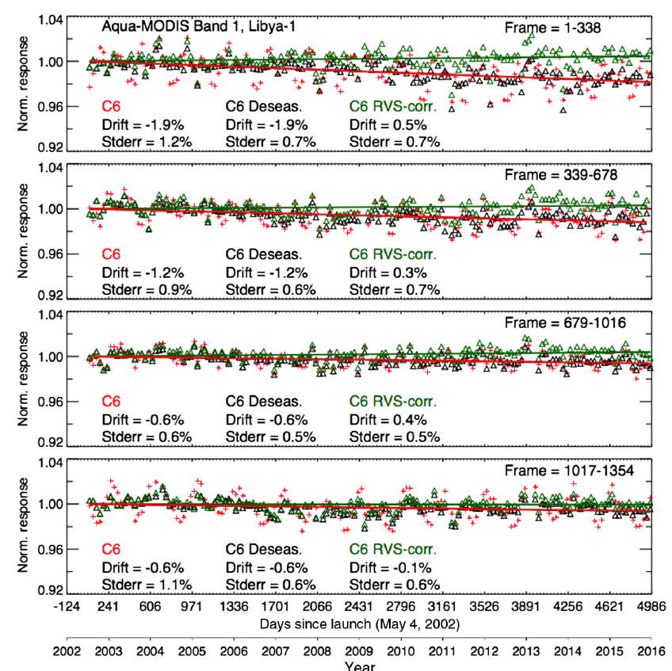
MODIS B1 scan angle dependencies over Libya-4
Bhatt et al. 2017
• The azimuthal scan angle dependency between left and right of nadir is 0.5 to 1.0% based on ray-matching
• This is confirmed using the Libya-4 invariant target, C6 • RVS corrections were based on the DCC mode method

Slide 16
Conclusions
The space agencies intend to maintain operational satellite VIS/NIR imagers in the 1:30 PM and 9:30 AM orbits for many decades
The satellites will be placed 45 minutes apart in the same orbit allowing for no SNO opportunities
Possible to inter-calibrate concurrent 1:30 and 9:30 orbits over the poles
DCC invariant target calibration can be used to transfer the calibration of one satellite with another and they need not be concurrent
Each GEO domain DCC mode radiance is unique but stable over time within 1% inter-annual variability
The GEO calibration is verified with ray-matching and found to be within 0.7%
The uncertainty maybe overestimated due to MODIS scan angle dependencies
This allows historical and future GEO satellites with similar channels to be calibrated with multiple references
As the DCC invariant target is more accurately characterized by wavelength, diurnally, seasonally, and regionally the 1% uncertainty can be reduced

