Slide 1

A Sustainable Maintenance/Validation Scheme for OSCAR/Space Database
Toshiyuki Kurino, WMO Space Programme
2017 GRWG/GDWG Annual Meeting
SSEC, Madison, WI, 2017-03-20/24

Slide 2
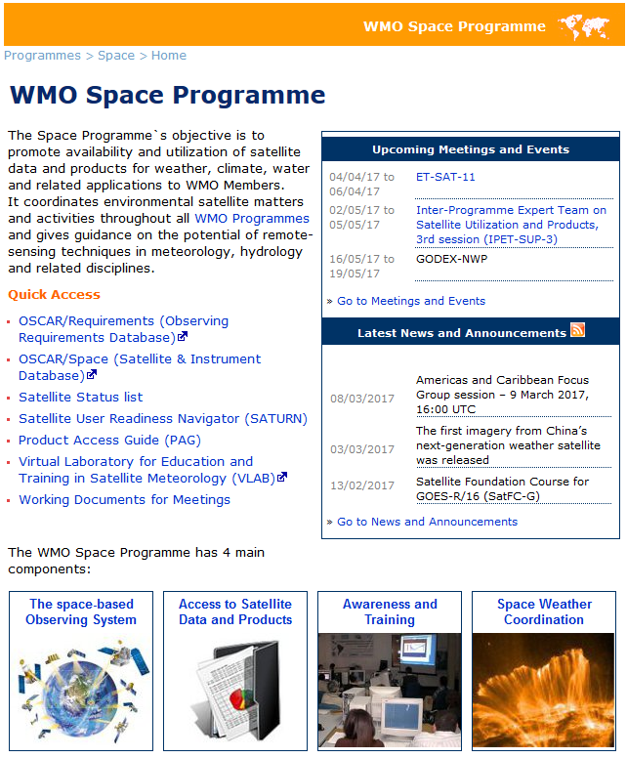

What is OSCAR
(http://www.wmo.int/pages/prog/sat/index_en.php)

Slide 3
WMO Observing System Capability Analysis and Review tool (OSCAR)
WMO-maintained online resource with 3 components:
  OSCAR/Space: satellite programmes, instruments, and the variables they can observe
  OSCAR/Surface: surface-based stations/platforms under WIGOS
  OSCAR/Requirements: observation requirements for 14 “application areas” and for all relevant variables
Variables
Variables
OSCAR/
Space
OSCAR/
Requirements
OSCAR/
Surface
WIGOS Information Resource
Basis for WMO Rolling Review of Requirements

Slide 4
‘OSCAR/Space’ is a tool for ‘Gap Analysis’
Long-term WIGOS Vision
2025 / 2040
Requirements
Requirements
Requirements
“Statement of Guidance”
Implementation Plan (Actions,Recom)
Gap Analysis
Requirements
OSCAR/ Requirements
Database on the Global Observing System
OSCAR/ Surface
Members agencies and programmes
OSCAR/
Space
Notes:
4
Example GCOS IP

Slide 5
OSCAR/ Requirements
‘OSCAR/Requirements’ provides…..
14 WMO Application Areas:
- Global Numerical Weather Prediction
- High-resolution Numerical Weather Prediction
- Nowcasting
- Sub-seasonal to Longer-range Forecasting
- Forecasting Atmospheric Composition
- Monitoring Atmospheric Composition
- Atmospheric Composition info → services in urban and populated areas
- Ocean Applications
- Aeronautical Meteorology
- Agricultural Meteorology
- Hydrology
- Climate Monitoring (GCOS) [now including GFCS requirements]
- Climate Applications
- Space Weather
https://www.wmo-sat.info/oscar/requirements

Slide 6
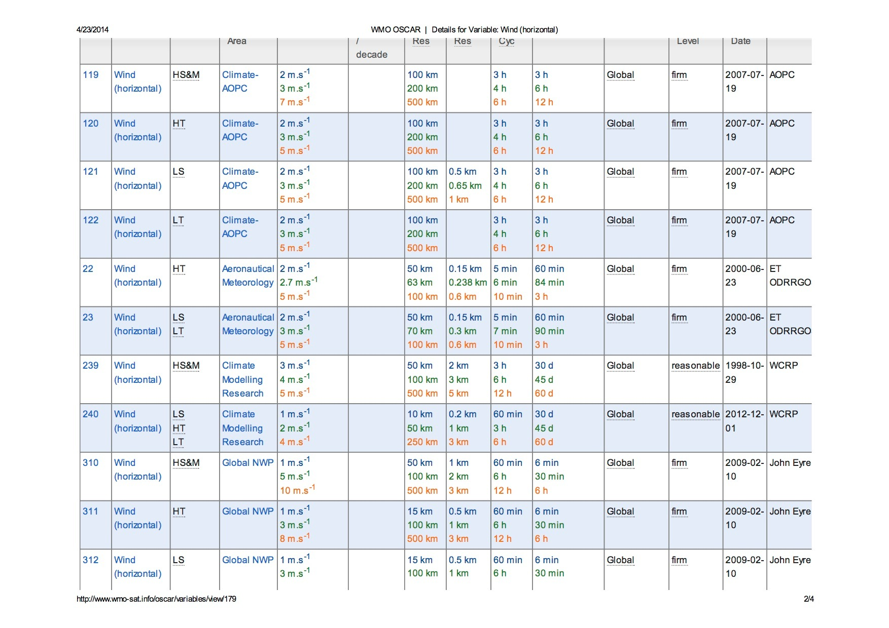
Layer
Application Area
Uncertainty
Looking-up variable: Wind
  Spatial (horizontal and vertical) and temporal resolution, uncertainty, data latency, required coverage area, source, and level of confidence

Slide 7
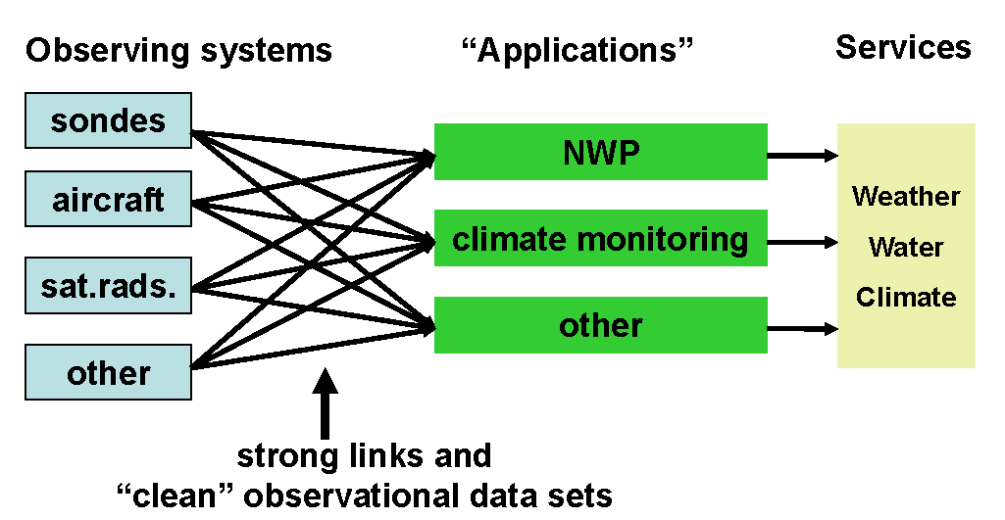
Requirements & Integration

Slide 8
OSCAR/Space
OSCAR/
Space
    Factual information on satellites and instruments
    (“capabilities”)
      81 agencies
      673 satellites
      927 instruments
Assessment of instruments, and gap analyses
(“analysis and review”)
  - Mapping instruments to measured variables
  - “Gap analysis” by measured variable, or by type of mission
Notes:
Inventory of factual information ,
The responsibilty for Maintenance of this part is with the WMO Space Programme
«Expert»: Decision-tree, rule-based; to be reviewed and maintained by expert groups

Slide 9
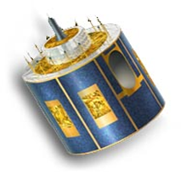
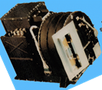
(Part 1) Looking-up information
Name, purpose
Mass, power
Orbit (type, alt, ECT, longitude)
Launch date, end date, status
Data access, telecom frequencies
Agency
Programme
Satellite
Instrument status, dates
Link to calibration events
Payload status
Instruments
Name, purpose
Mass, power
Type, description, scan mode
Resolution, FOV, coverage
Status
Spectral characteristics

Slide 10
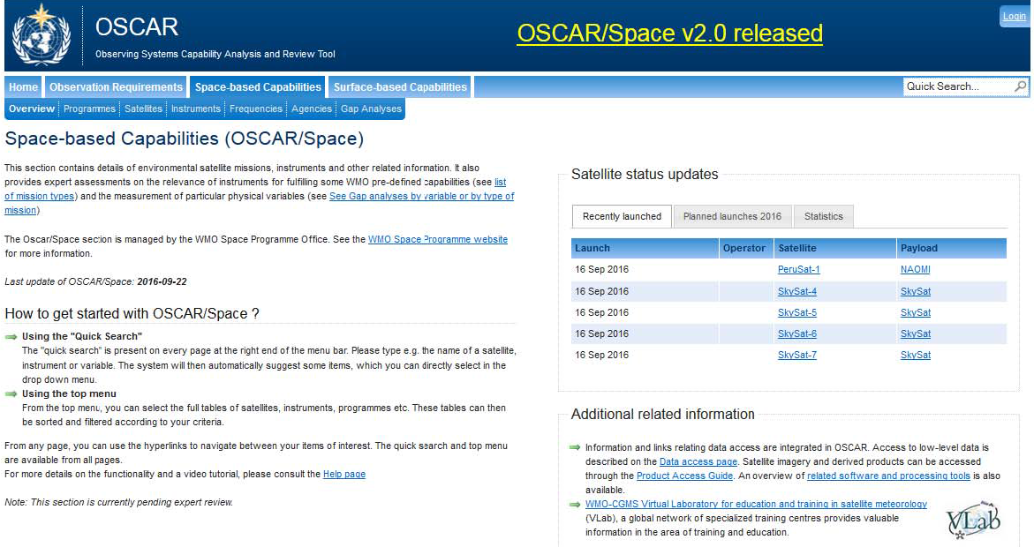
OSCAR/Space: Home

Slide 11
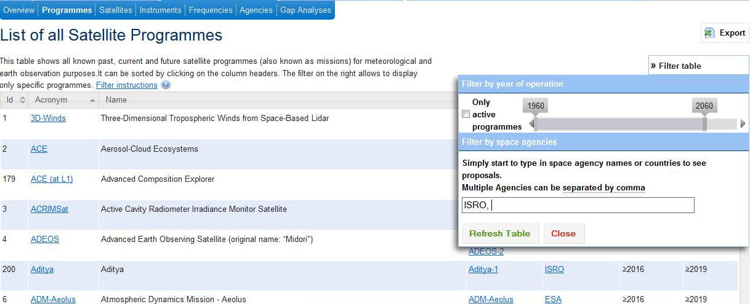
Satellite Programmes
Total: 236
Example Filter: ISRO, currently active programmes

Slide 12
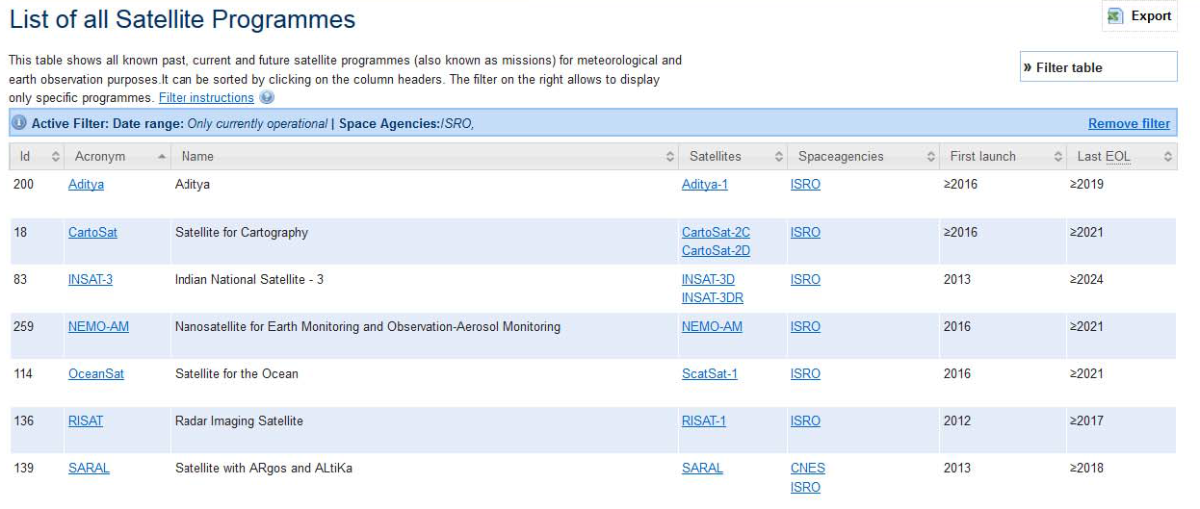
Satellite Programmes:
ISRO, active programmes
Example Satellites: INSAT-3DR

Slide 13
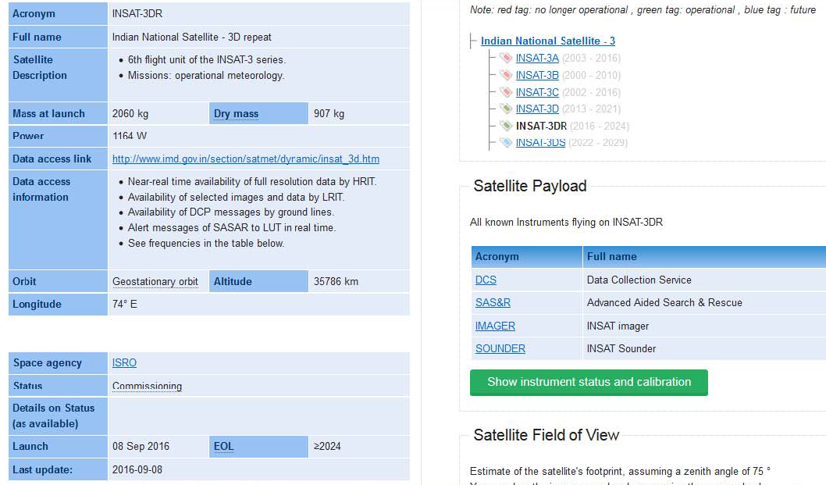
Satellite: INSAT-3DR

Slide 14
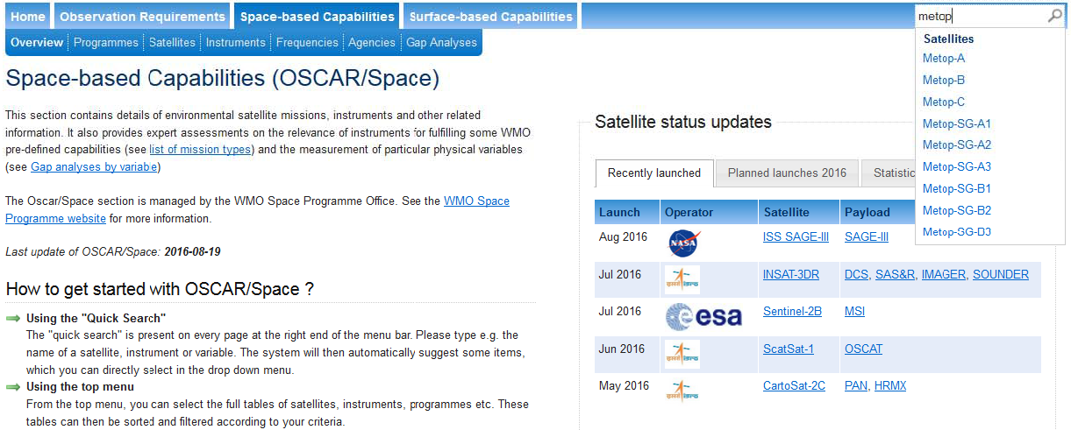
Payload status, Calibration events
Example: Metop-A
Search: Metop
(automatic dropdown menu after 2 typed letters)
Notes:
The search is ajax-powered and is triggered as soon as at least 2 characters have been entered in the search field. In an attempt to implement a more intelligent search, it uses a weighing system to sort results by importance
• If the exact acronym is found => 20 points
• If the acronym is similar => 10 points
• If the name is similar => 8 points

Slide 15
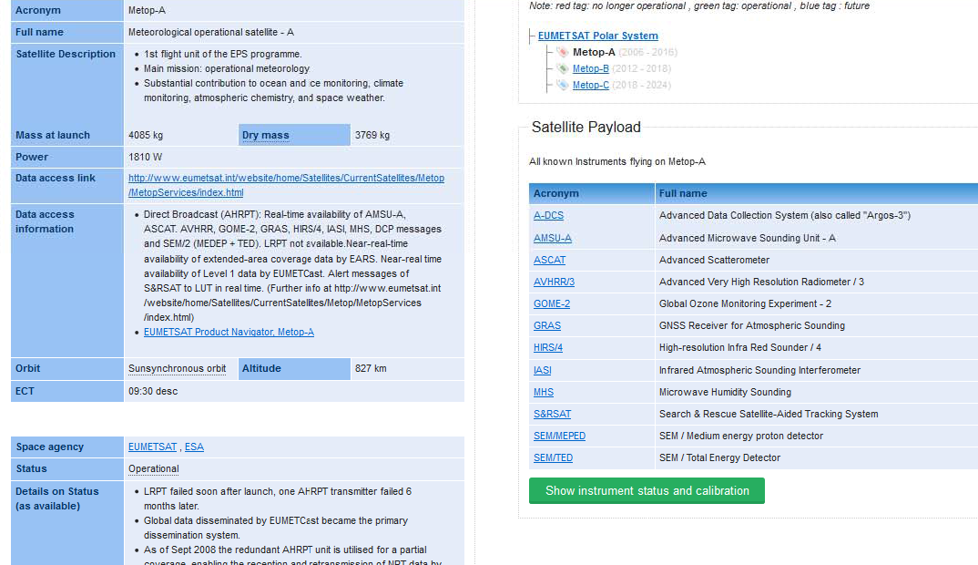
Payload status, Calibration events
Example: Metop-A

Slide 16
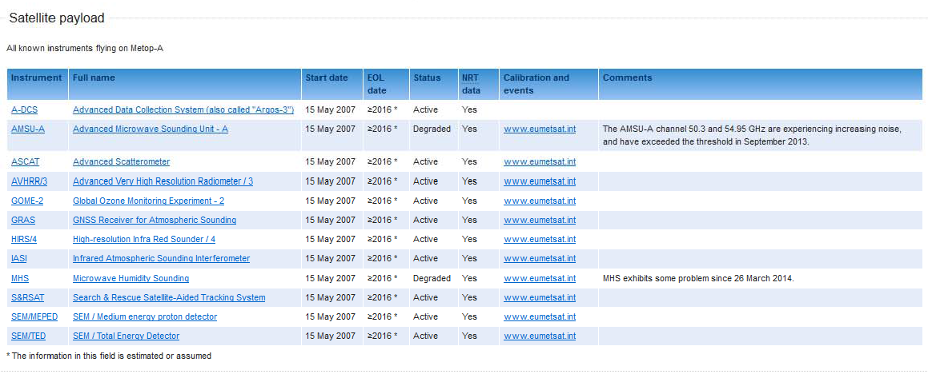
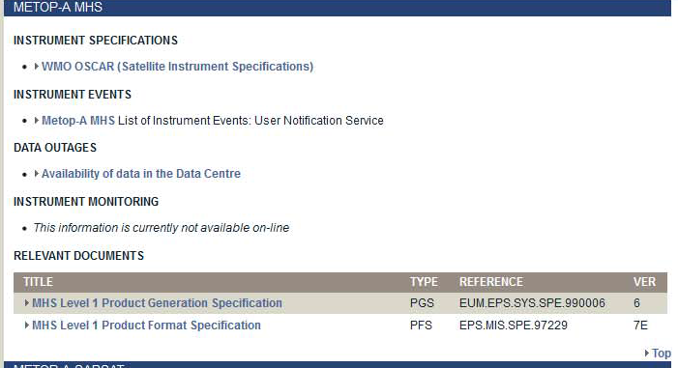
Payload status, Calibration events
Example: Metop-A
eumetsat.int
Landing page
GSICS
MHS degradation
http://www.eumetsat.int/website/home/Data/Products/Calibration/Instrumentstatusandcalibration/index.html#metopamhs

Slide 17
for Frequency management
“What is the potential impact on Jason missions of proposals for sharing 5350-5470 MHz (C band) with commercial broadband providers?”
“Give me all satellites that use C band, for sensing or for telecommunication”
Notes:
US proposals for sharing 5350-5470 MHz (C band) with commercial can impact JASON missions.

Slide 18
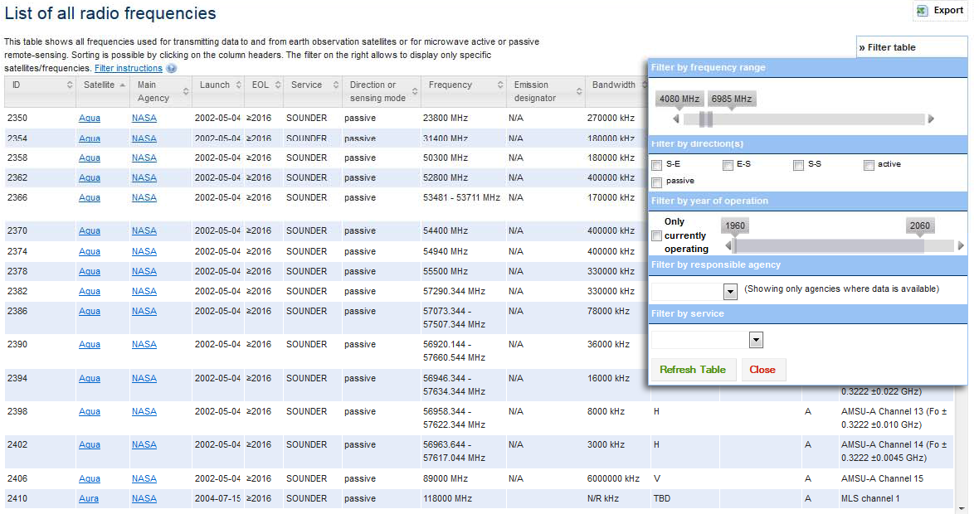
Information for frequency management
Filter C band range
Notes:
US proposals for sharing 5350-5470 MHz (C band) with commercial can impact JASON missions.

Slide 19
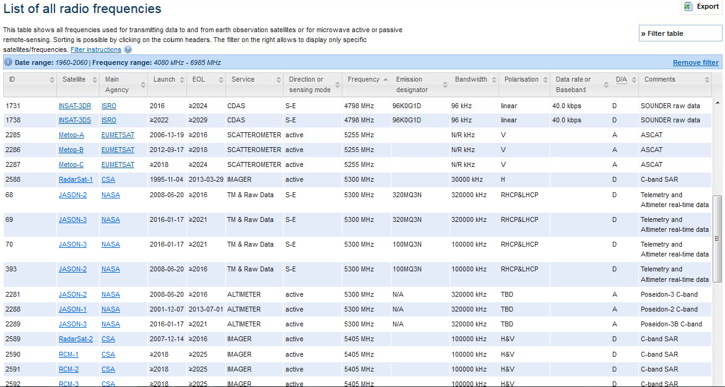
Information for frequency management:
Sensing and telecom frequencies
Total: 49

Slide 20
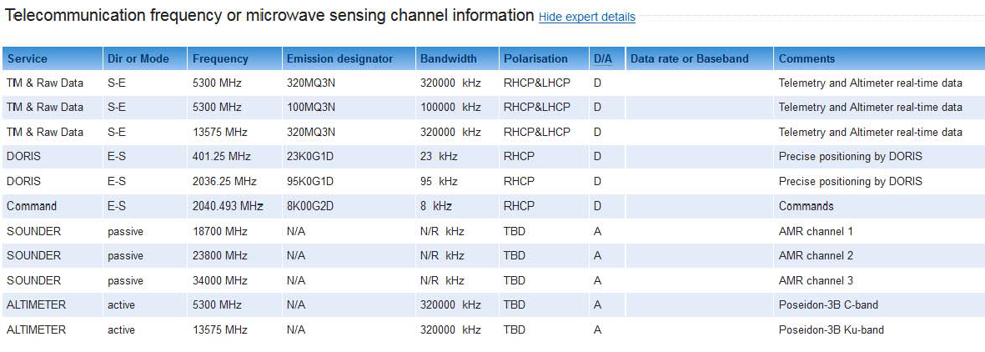
Frequency information: Jason-3
Notes:
US proposals for sharing 5350-5470 MHz (C band) with commercial can impact JASON missions.
Discussed in Space Frequency Coordination Group

Slide 21
(Part 2) Assessments: Gap Analyses
Two sides of the same relationship:
Which variables can be measured with a given instrument? Which capability does the instrument contribute to?
Which instruments can measure a given variable? Which instruments are responding to the WMO Vision?…and during which period of time ?
Notes:
Instrument types:
MW conical scanner; cross-track scanner
MW imager / XXX?

Slide 22
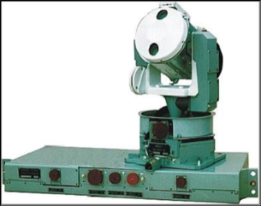
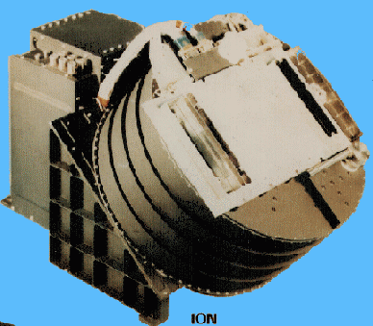
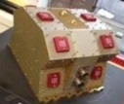


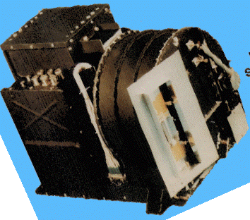
Instrument-variable mapping principle
Variable 1
Variable 2
Compliance analysis
Variable 3
Science-based rules
Variable 4
Variable x
Required instrument specifications:
Spectral bands
Bandwidth
No of channels
Polarization
Scanning mode
Etc..
Variable y
XX
X
X
X
XX
X
X
X
X
XX
X
X
X
X
XX
X
X
X
X
X
XX
X
X
X
XX
X

Slide 23
‘OSCAR/Space’ is a tool for ‘Gap Analysis’
Long-term WIGOS Vision
2025 / 2040
Requirements
Requirements
Requirements
“Statement of Guidance”
Implementation Plan (Actions,Recom)
Gap Analysis
Requirements
OSCAR/ Requirements
Database on the Global Observing System
OSCAR/ Surface
Members agencies and programmes
OSCAR/
Space
Notes:
23
Example GCOS IP

Slide 24
About the Gap Analysis
Long-term WIGOS Vision
Requirements
Requirements
Reference Observing
System
Requirements
Gap Analysis
instruments
Requirements
“Statement of Guidance”
Implementation Plan (Actions,Recom)
Gap Analysis
measurements
Measured variables
Members’ Space Agencies and programmes
Notes:
24

Slide 25
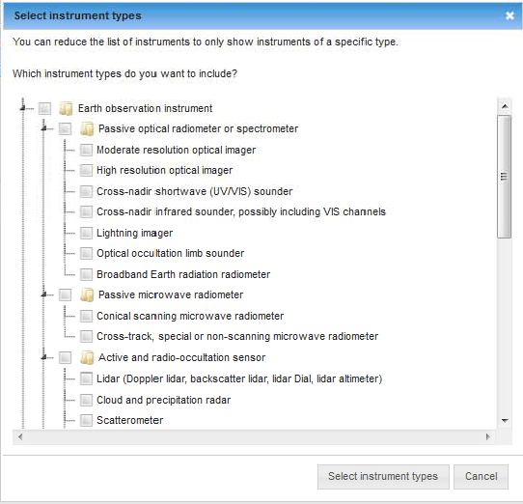
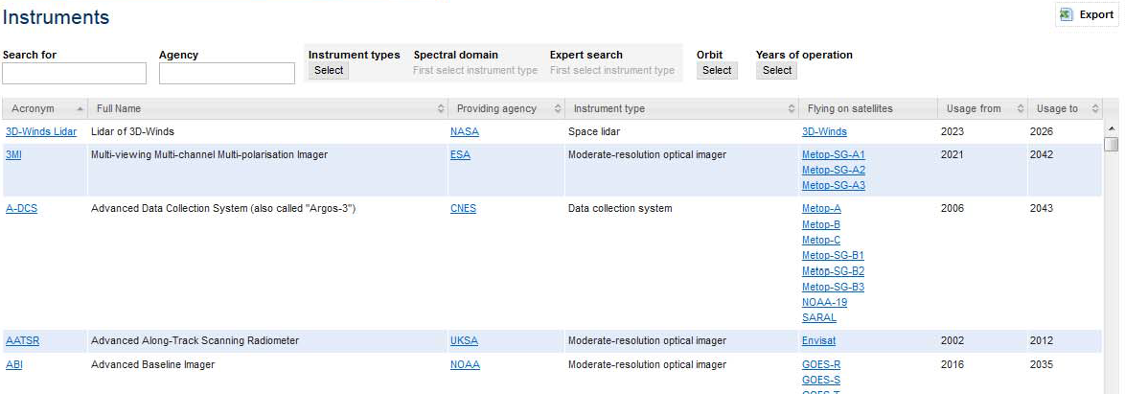
Instrument menu: Filters
Total: 927

Slide 26
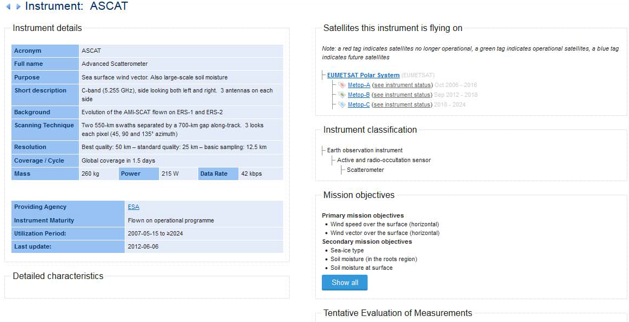
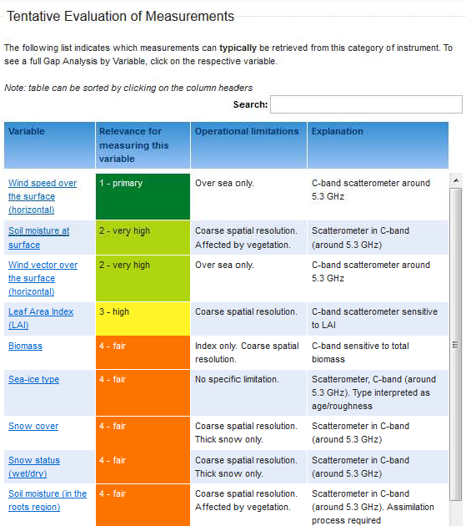
Instrument: ASCAT
Notes:
Check v2.0 for this content
Learn more about ASCAT

Slide 27
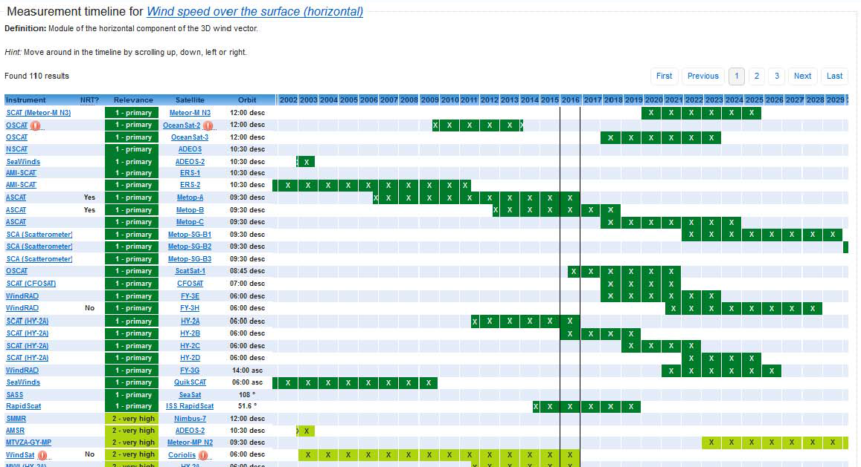
Gap analysis
Relevance

Slide 28
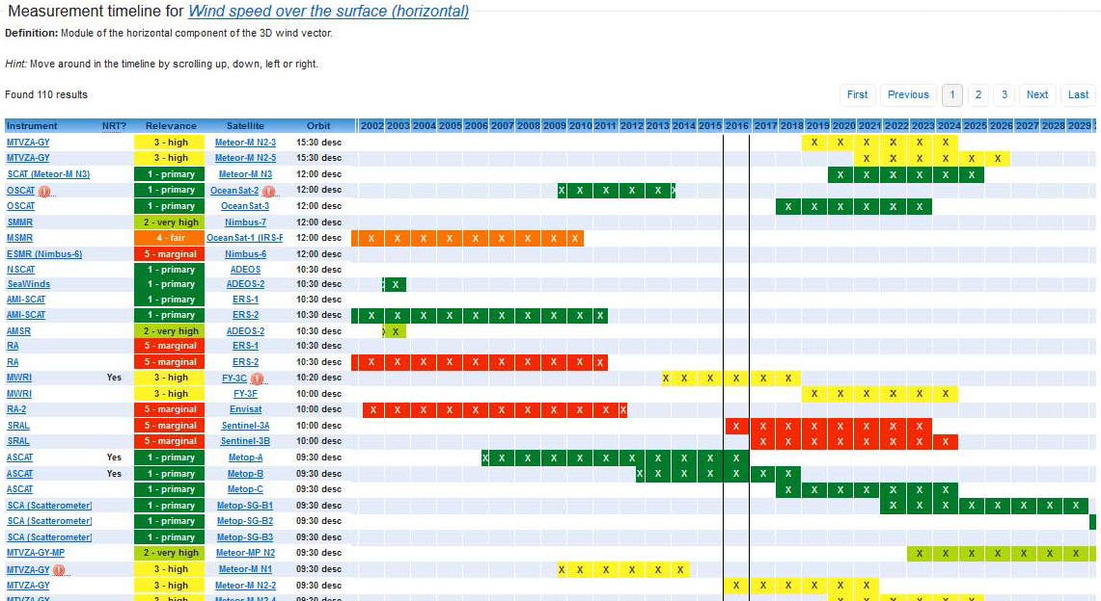
Gap analysis
Flag instrument issue
indicates “degradion”
Orbit

Slide 29
Maintenance and Support: Outlook
Two main tasks for OSCAR/Space:
(1) Updating facts
(2) Keep under review assessments, functions, rules, interfaces
Under supervision of WMO CBS expert teams,
and consistent with overall OSCAR development,
WMO Space Programme office plans to establish:
- OSCAR/Space Support Team (for task 1)
- OSCAR/Space Science and Technical Advisory Team (task 2)
Notes:
Seven functions

Slide 30
Maintenance and Support Concept for OSCAR/Space v2.0
ET-SAT
IPET-SUP
IPT-SeWISS
CBS
OSCAR
Project
Board
WMO SP Office
Support Team
(maintenance)
- Space agency, Satellite operator focal
points (CGMS, …)
- Key users
- Other partners
Science and Technical Advisory Team (validation)
- Space agency, satellite operator focal points (CGMS, ..)
- Instrument experts
- International Science Working Groups FPs (ITWG –
Sounding, IWWG – Winds, IPWG – Precipitation,
IROWG – Radio Occultation, ICWG – Clouds)
- Oceans FPs: JCOMM, GHRSST, IOCCG, OSVW, …
- Atmospheric chemistry FPs: GAW, ACC
- Other EO science groups FPs, Space weather FPs
- CBS expert team focal points

Slide 31

Concluding Remarks
OSCAR/Space is a reference community resource on satellite programmes, instruments, and the variables they can observe
New version 2.0 is now available
Encompassing satellites for weather, climate, ocean, EO
Space weather part under development
Transparent gap analyses and assessments (rules to be kept under review)
WMO welcomes user feedback, for further improvements
Implementation of sustainable maintenance scheme:
WMO will need communitie engagement for supporting and advising on OSCAR/Space
Establishment of the maintenance and support
structure underway

Slide 32
Contact details
OSCAR/Space :
http://oscar.wmo.int/space
User feedback
sat-help-desk@wmo.int
For your engagement , please contact WMO:
Toshiyuki Kurino
Stephan Bojinski

Slide 33
References
OSCAR/Surface: http://oscar.wmo.int/surface
OSCAR/Requirements: https://www.wmo-sat.info/oscar/observingrequirements
WMO Space Programme: http://www.wmo.int/sat
WMO Vision for the Global Observing System in 2025

Slide 34

Thank you
7L30
Questions:
tkurino@wmo.int

