Slide 1
The GSICS Actions Page
Manik Bali and Lori Brown
Annual Meeting Madison, Wisconsin

Slide 2
Introduction
Each year actions are generated in GSICS community.
These actions were previously monitored on the GSICS Wiki Page
Over the years activity in GSICS has increased as has the number of Actions generated in GSICS Annual, EP, UW and group and subgroup meetings.
GRWG placed a request to GCC-NOAA-GDWG to provide an alternative to the wiki actions page. Features that were requested.
Fast search.
Easy Action writing.
Easy updating.
Easy to understand layout.
New Category of actions ( For example, Lunar, Recommendation, Decision)
Some level of automation.

Slide 3
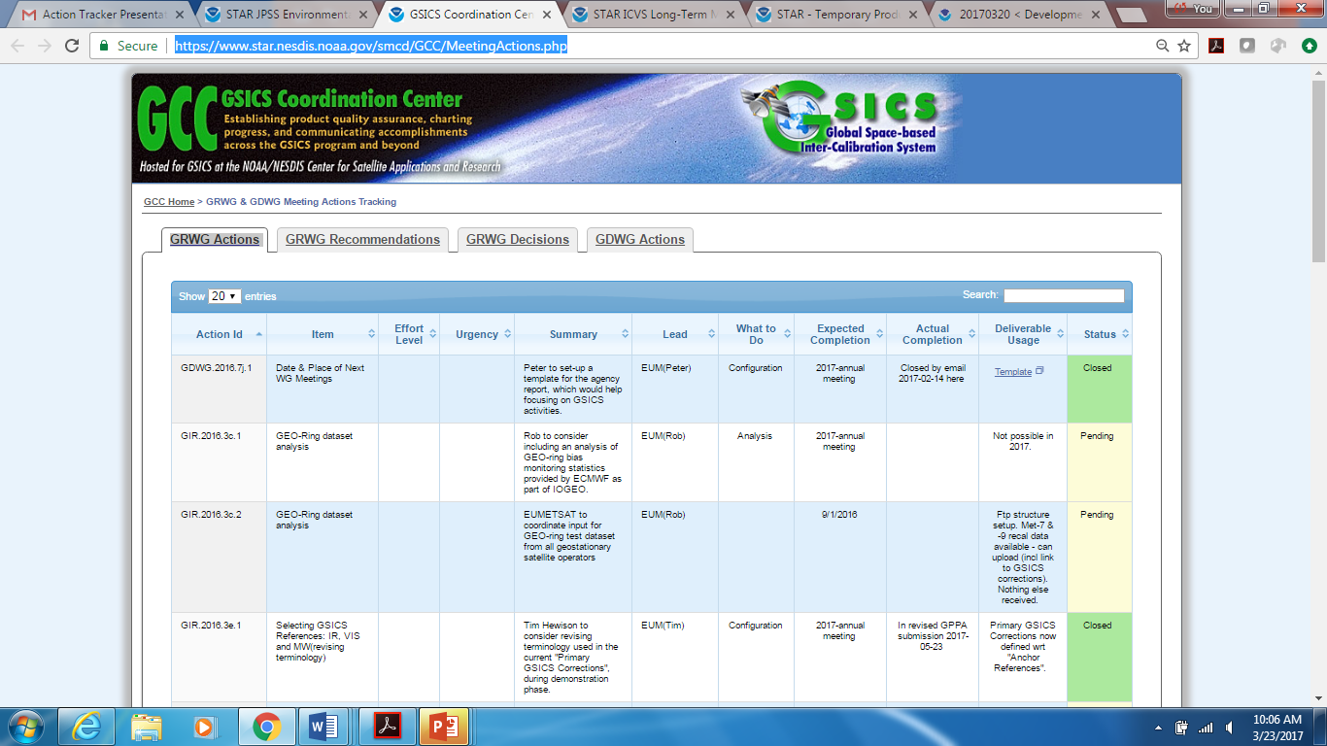
After a few iterations,
we now have a new page

Slide 4
Sample of GRWG Actions
Action Id | Item | Effort Level | Urgency | Summary | Lead | What to Do | Expected Completion | Actual Completion | Deliverable Usage | Status
GDWG.2016.7j.1 | Date & Place of Next WG Meetings |  |  | Peter to set-up a template for the agency report, which would help focusing on GSICS activities. | EUM(Peter) | Configuration | 2017-annual meeting | Closed by email 2017-02-14 here | Template | Closed
GIR.2016.3c.1 | GEO-Ring dataset analysis |  |  | Rob to consider including an analysis of GEO-ring bias monitoring statistics provided by ECMWF as part of IOGEO. | EUM(Rob) | Analysis | 2017-annual meeting |  | Not possible in 2017. | Pending
GIR.2016.3c.2 | GEO-Ring dataset analysis |  |  | EUMETSAT to coordinate input for GEO-ring test dataset from all geostationary satellite operators | EUM(Rob) |  | 9/1/2016 |  | Ftp structure setup. Met-7 & -9 recal data available - can upload (incl link to GSICS corrections). Nothing else received. | Pending
https://www.star.nesdis.noaa.gov/smcd/GCC/MeetingActions.php
Column Sorting and Page Searching capabilities are present

Slide 5
How to Use the Action Tracker
GCC creates a google Sheet for each type of action being tracked. The Sheet link is shared among GSICS members.
The actions are grouped into pages by year, each different type viewable on a separate tab. The content of the tables on the tabs are sortable and searchable.
If users need to add hyperlinks to any action sheet, they should use the ‘Activate Hyperlink’ button to activate it on the GCC Action Tracker website.
When users’ changes are saved, they are dynamically updated onto the correct Action Tracker page.

Slide 6
Conclusion and Future Work
A new Google based Action Tracker has been setup at NOAA.
The action tracker utilizes key features of the google sheets (versioning, projects)
The tracker is fast and efficient
Utilizes the new Action naming convention.
New categories of actions have been created including EP, Recommendations and Decisions
Future refinements
Automate the Activate Hyperlink
Facility to insert hyperlinks to texts within the cell.

Slide 7
Presentation 6b from GDWG

Slide 8
Outline
Introduction
Requirements from GSICS Members
Approach – Migrate to Google Cloud + interface with webserver
How to use the actions Page.
Conclusions

Slide 9
Introduction
Each year actions are generated in GSICS community.
These actions were previously monitored on the GSICS Wiki Page (See here ).
Over the years activity in GSICS has increased and number of Actions are generated in each GSICS Annual meeting, GSICS EP meeting GUW and subgroup meeting.
GRWG placed a request to GCC-NOAA-GDWG to provide an alternative to the wiki actions page. Features that were requested.
Fast search.
Easy Actions writing.
Easy updation.
Easy to understand layout.
New Category of actions ( For eg Lunar, Recommendation Decision)
Some level of Automation.

Slide 10
Challenges with Wiki implementation
Implementing changes to wiki requires testing with plugins. With very little available leads to additional resource overheads.
Wiki not as fast as http pages and not a very efficient search engine.
Addition of extra features needs resources overhead.

Slide 11
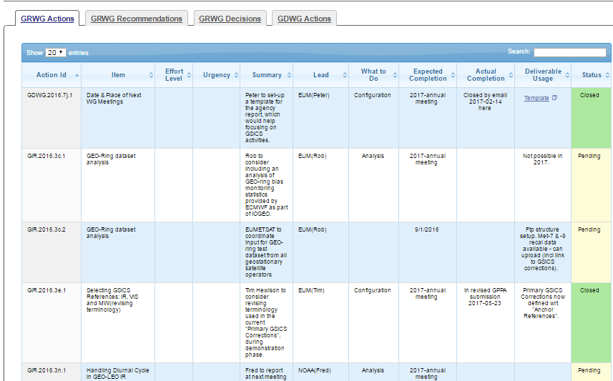
Approach - Google Cloud + Web
Actions are input into GOOGLE Sheet
API communicates with Sheet. Fetches a CSV format file
Start
Finish

Slide 12
How to Use the Action Tracker
GCC creates a google Sheet for each type of action being tracked. The Sheet link is shared among GSICS members.
The actions are grouped into pages by year, each different type viewable on a separate tab. The content of the tables on the tabs are sortable and searchable.
If users need to add hyperlinks to any action sheet, users should use the ‘Activate Hyperlink’ button to activate it on the GCC Action Tracker website.
When users’ changes are saved, they are dynamically updated onto the correct Action Tracker page.

Slide 13
Upcoming Features
Automate the Activate Hyperlink
Facility to insert hyperlinks on pieces of texts within the cell.

Slide 14
Conclusion
A new Google based Action Tracker has been setup at NOAA.
The action tracker utilizes key features of the google sheets ( versioning, projects)
Tracker is fast and efficient
Utilizes the new Action naming convention.
New categories of actions have been created ( such as lunar, EP, Recommendation, Decisions)

