Slide 1
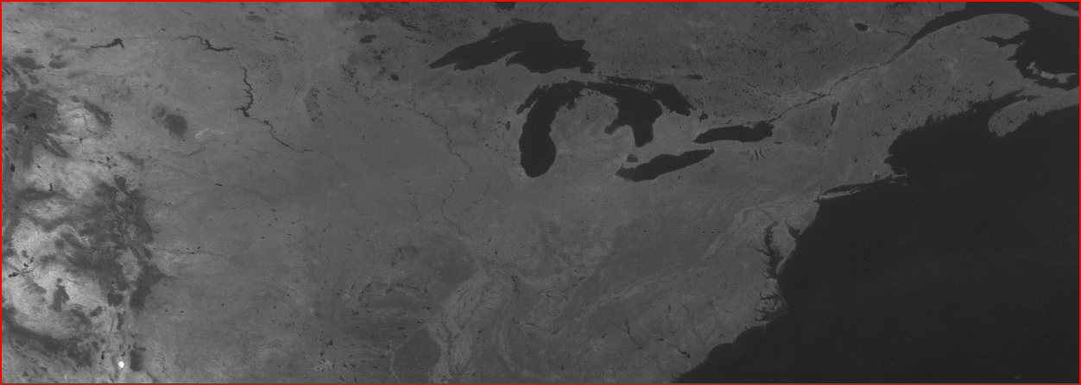
ISCCP and GSICS
Future collaborations between GSICS and the ISCCP project
NOAA/NCEI
Ken Knapp (& ISCCP Team)
Meteorologist, NOAA National Centers for Environmental Information
March 2017
National Oceanic and Atmospheric Administration | National Centers for Environmental Information

Slide 2
Overview
ISCCP Reprocessing
Plans, Status,
ISCCP Calibration
Visible, IR Window
ISCCP Future
Discussion

Slide 3
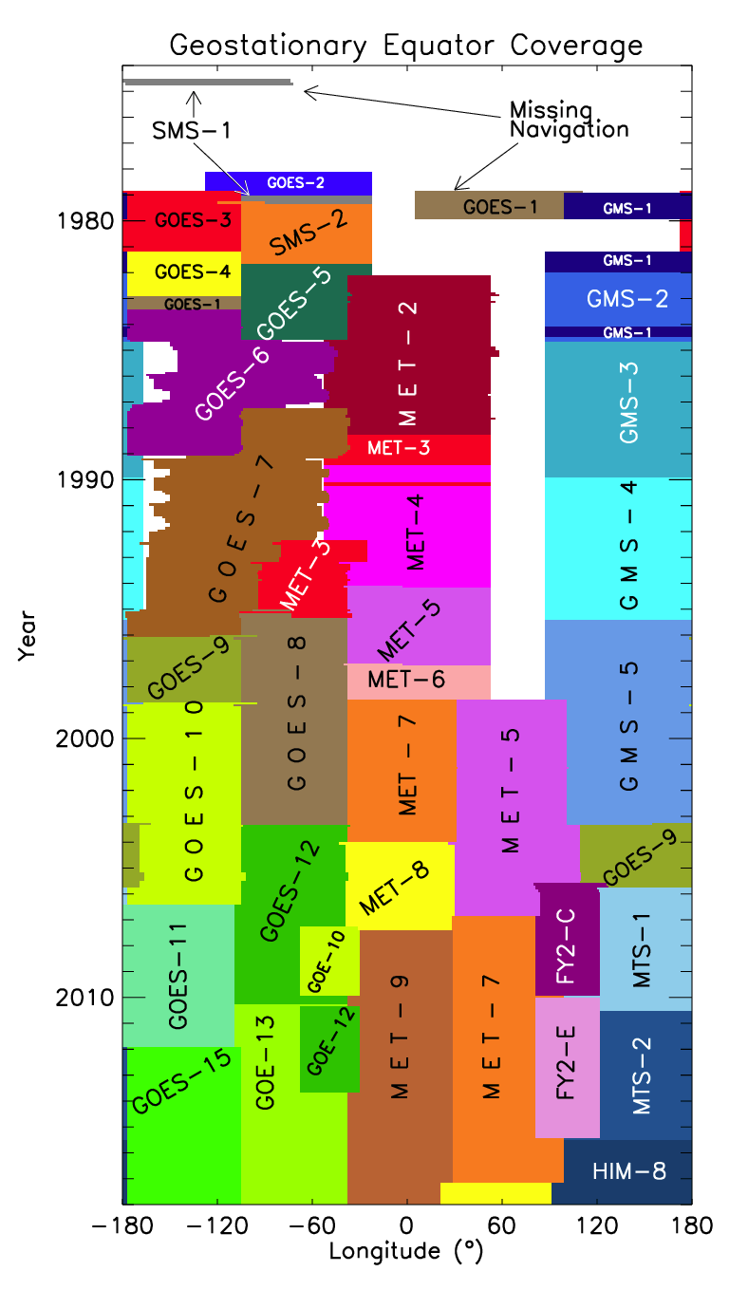
ISCCP History
Data collection for 5-year project begins
Release of first set of cloud products (C)
Pinatubo causes a pause
New cloud products developed (D)
B1 data rescue began
Last year processed for ISCCP

Slide 4
ISCCP Processing

Slide 5
History is repeating: 1982 and 2017
ISCCP designated SPCs to produce B1/B2
SPCs could develop products for B1/B2
Full resolution was too much for most users
ISCCP GPC
Merged B2 data globally
Created merged global products
Similar problems being discussed here...
Provide adjustments or Level 1B
What do Agencies provide vs. GSICS/IOGEO?

Slide 6
ISCCP Reprocessing: Improvements
New satellite data inputs
Using full resolution AVHRR GAC data (moved to 4 km data from 32 km)
Using ISCCP B1 data (moved to 10 km data from 30 km).
New resolution
Higher resolution inputs allow 1 deg products (previously, 2½ degree)
New products
ISCCP HXG - 10 km global merged product (radiances, cloud flag, cloud parameters)

Slide 7
ISCCP Reprocessing: New Types
DX HXS Hi-res, piXel, Single-sat
HXG Hi-res, piXel, Global (new product)
DS HGS Hi-res, Gridded, Single-sat
D1 HGG Hi-res, Gridded, Global
D2 HGH Hi-res, Gridded, Hourly-monthly mean
D3 HGM Hi-res, Gridded, Monthly mean
GridSat-like

Slide 8
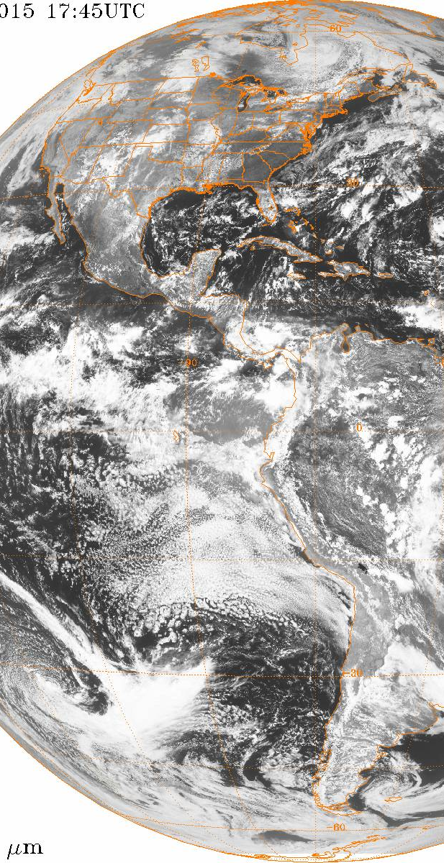
ISCCP Reprocessing: New Types
HXS
HXG
HGS
HGG
(240x monthly)
HGH (8x monthly)
HGM

Slide 9
ISCCP Reprocessing: Schedule
Phase I
Base Period [7/1983 - 12/2009]
May 2017
Phase II
Extended Period [1/1982-6/1983 and 1/2010-6/2015]
Aug 2017
Phase III
Routine Updates [ 6/2015 - ’present’]
2018?

Slide 10
ISCCP Calibration

Slide 11
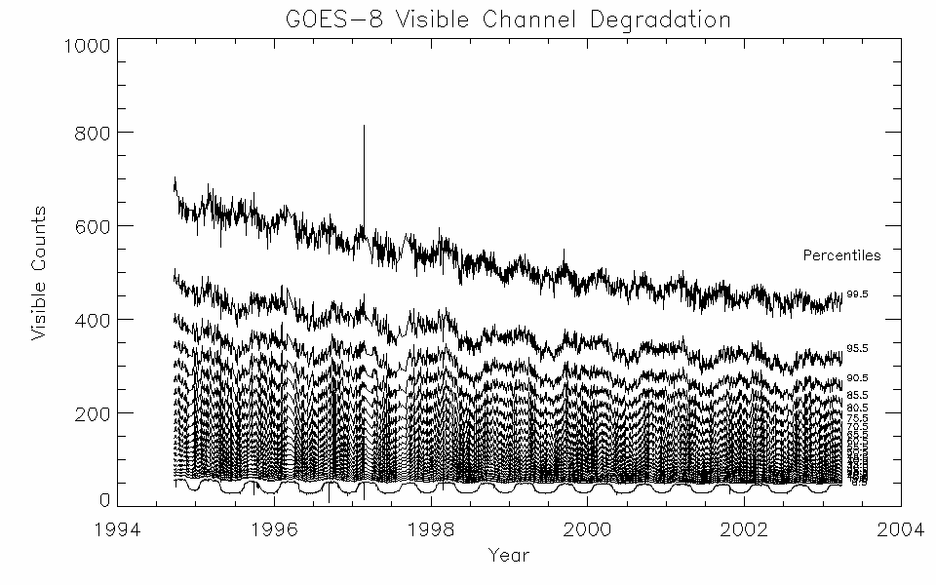
ISCCP Calibration: Use the Earth
ISCCP uses the Earth as its calibration reference.

Slide 12
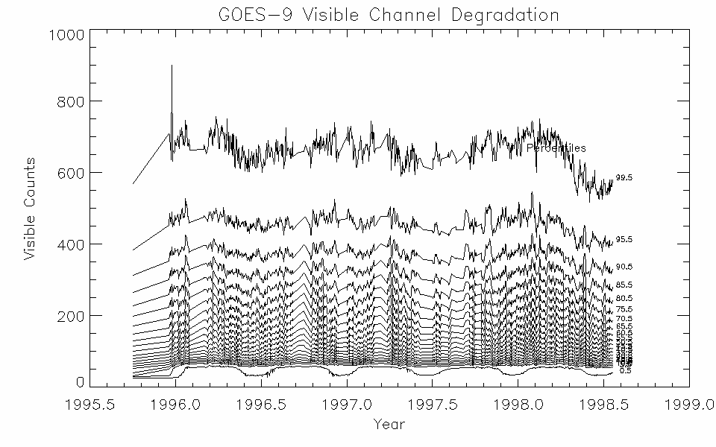
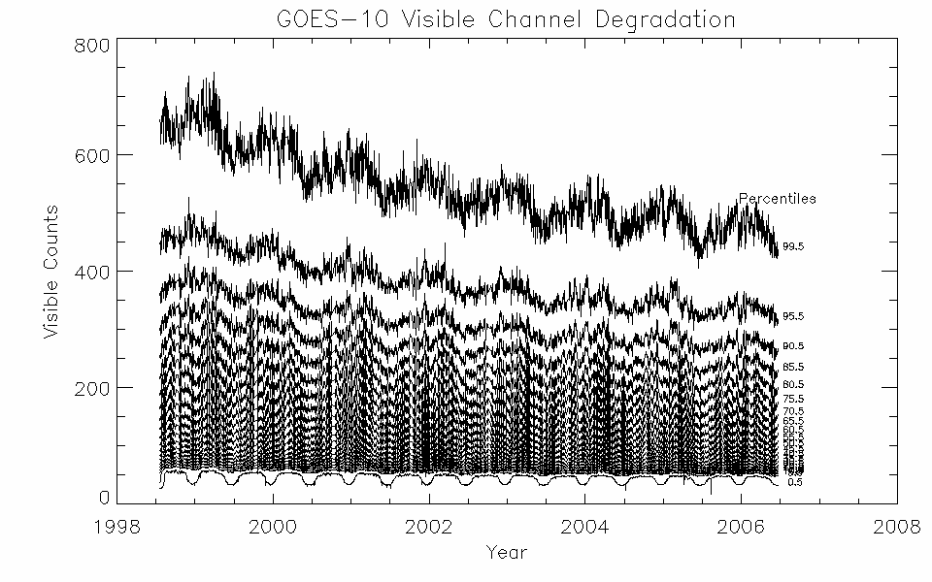
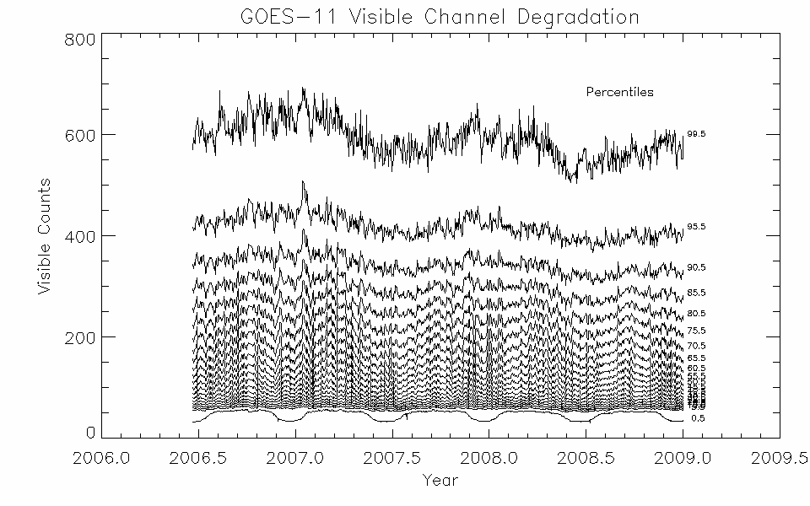
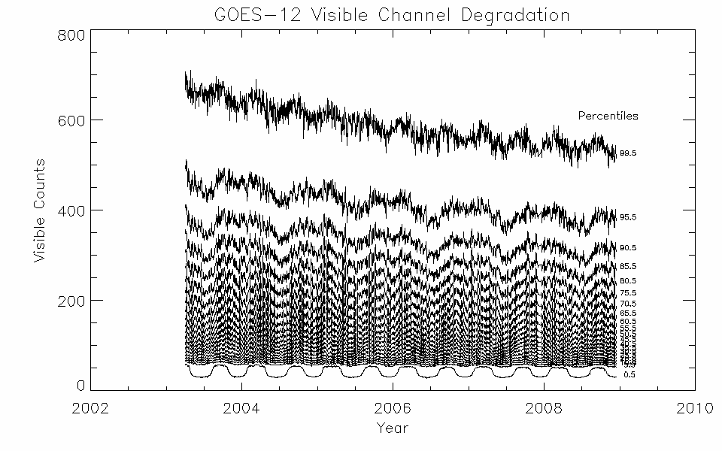
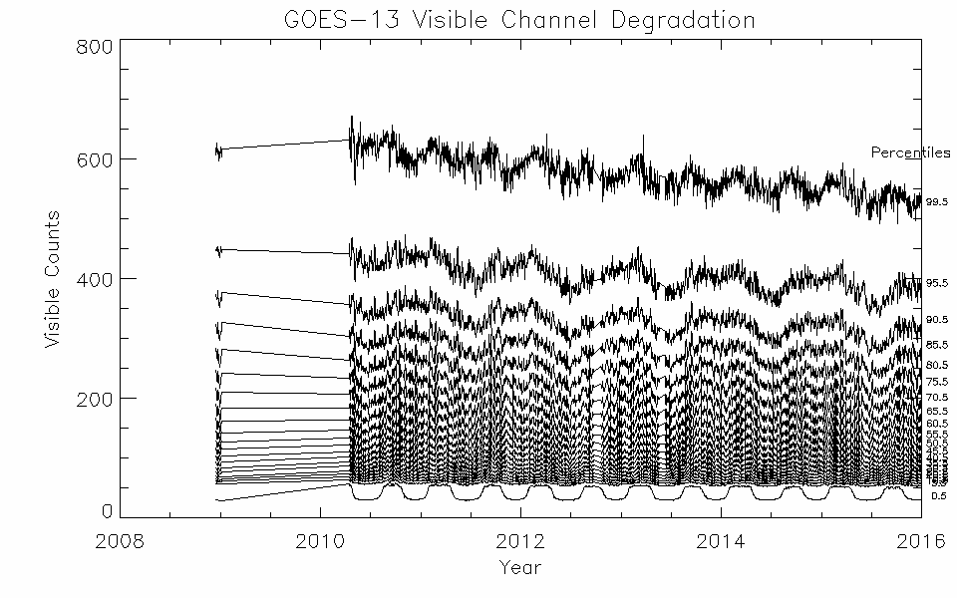
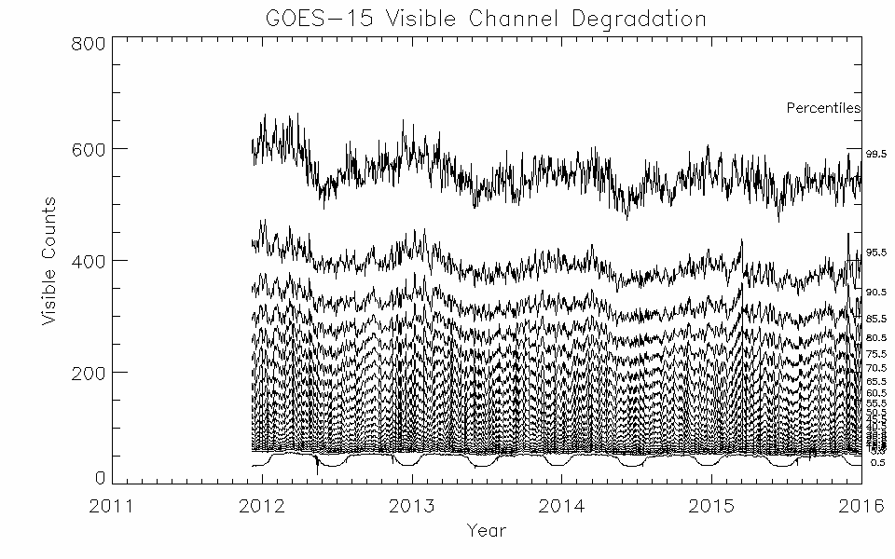
ISCCP Calibration:
Use the Earth

Slide 13
ISCCP Calibration: Current capability
Replicate original ISCCP
Use heritage process to calibrate

Slide 14
ISCCP Calibration
Nominal (NOM)
Calibration from the satellite provider
Pre-launch calibration
Normal (NORM)
Inter-satellite normalization
Absolute (ABS)
Temporally stable

Slide 15
What are we calibrating?
POES
AVHRR GAC
GEO - B1U data
All meteorological GEO satellites
GOES 4-15
GMS 1-5, MTS 1R-2, HIM-8
MET 2-10
FY2
30 GEOs in all

Slide 16
ISCCP Calibration:Process
AVHRR/GAC
Monitor VIS
Monitor IR
Absolute calibration tied back to NOAA-9
IR - 10th and 90th percentiles
VIS - 28 Earth targets (various surface types)
LEO/GEO normalization
Collocation comparisons - IR & VIS
Comparison of retrieved properties:
IR: Sfc. Temp & Cloud Temp.
VIS: Sfc. Reflectance & Cloud Opt. Depth
Adjust calibration if necessary

Slide 17
ISCCP Future

Slide 18
ISCCP Future
GOES 16, Himawari-8, others?
JPSS/VIIRS
Indian Ocean GEO replacement?
How and what to incorporate from GSICS

Slide 19
ISCCP Discussion
ISCCP and GSICS Calibration(s)?
ISCCP and the GEO Ring?
Can calibration be divorced from algorithms?
ISCCP’s final check is on retrieval
Know your users/uses
Start with the end in mind.

