Slide 1
Workshop on best practices on pre-flight and onboard calibration
Dohyeong Kim

Slide 2
Overview
Outcome from 2016 annual meeting
Interaction/cooperation of GSICS with CEOS/WGCV
Partnership with CEOS/WGCV
Cooperative activities

Slide 3
Outcome from 2016 annual meeting
Action(web meeting 20151203)
Rob Roebeling to draft a proposal for which instrument characteristics should be published 2-3 years before launch, and at what level of detail, for presentation at 2016 GRWG/GDWG meeting. These could be specified both as a minimum recommended level, and full, detailed level. It should suggested that these include radiometric noise, SRFs, and some geometric aspects, such as iFoV (if not full PSFs/MTFs)
Can we provide a quick DRAFT list of parameters,
from the top of your heads,
based on list of input data used in ATBD of GSICS IR correction and VIS correction
Including parameters identified so far for instrument monitoring and event log
We would circulate this DRAFT to key users (e.g. ECMWF) and use it to start with.
Later (2017) we could refine the list with the outcome of the WGCV workshop.
GRWG.2016.7f.1 | Tim/Rob (EUM) to forward draft requirements for pre-launch characterization to WMO | EUM(Tim/Rob) | Closed by email 2016-04-19 GSICS Tech Note

Slide 4
Outcome from 2016 annual meeting
Item to put on the list of parameters to be provided :
channel names/purpose
SRF (and inter-detector variability), or at least channel central frequency/wavelength and bandwidth
FOV-pixel size or full PSF/MTF,
FOR/swath coverage, repeat cycle /orbit configuration,
pixel sampling distance/time intervals,
radiometric noise, calibration accuracy,
geometric accuracy and band to band calibration/registration (geometric performances),
polarisation sensitivity
radiometric resolution, dynamic range, quantisation,
expected lifetime
uncertainties on all of the above if available
All the above should indicate the maturity of the parameter estimate, according to whether they are specified/expected/modelled/measured values.

Slide 5
Interaction/cooperation of GSICS with WGCV
GSICS and CEOS WGCV are working on the basics for calibration and sensor characterization but with the perspective of different aims
The work of both groups coincides especially in the area of calibration methods and the relation to references and standards
GSICS:
GSICS focuses with the consistent accuracy of observations between sensors of the same family on different satellite platforms.
and hence with inter-calibration of sensors for climate monitoring, operational weather and environmental applications.
This includes also the consistency over time which means over generations of one sensor family.
GSICS’s ambition is to provide harmonized calibration factors generated by applying a standardized procedure
to ensure consistency and finally sustainability of measurements within different instrument/sensor families
CEOS WGCV :
The CEOS WGCV aim is to support in principle Earth Observation measurements,
including research missions, by providing guidelines in sensor calibration and in remote sensing data product – mainly level 2 – validation.
For that CEOS WGCV installed several years ago three dedicated senor-oriented sub-groups and three domain-specific sub-groups
QA4EO has been initiated providing general guidelines and recommendations
in providing standards and references for calibration and validation efforts,
some of which have already been adopted by GSICS

Slide 6
Subgroups of WGCV (CEOS)
Atmospheric Composition (ACSG)
to ensure the accurate and traceable calibration of remotely-sensed atmospheric composition radiance data and validation of higher level products for application to atmospheric composition, land, ocean, and climate research.
Infrared Visible Optical Sensors (IVOS)
to ensure high quality calibration and validation of infrared and visible optical data from Earth observation satellites, as well as the validation of higher level products
to define basic requirements for a pre-flight characterization and calibration of optical imagers and best practices for their measurements
Microwave Sensors (MSSG)
to foster high quality calibration and validation of microwave sensors for remote sensing purposes.
include both active and passive types, airborne and space-borne sensors
Moon as calibration reference for imagers;
LEO – LEO cross-calibration methods;
Usage of hyperspectral sounders for band to band correction
Reference solar irradiance spectrum and methods of convolution with the instrument bands
Surface measured test-sites and associated in-sit/cross comparisons in situ?

Slide 7
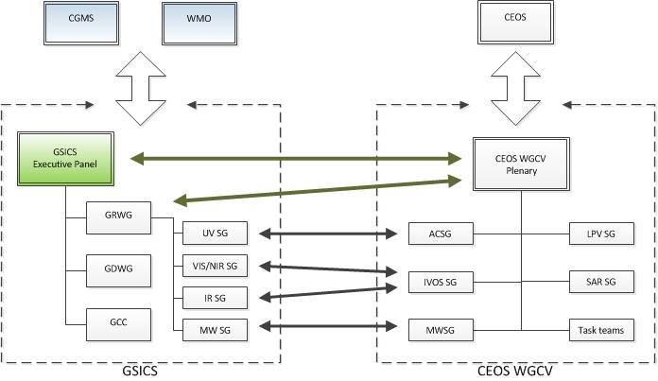
Partnership with WGCV

Slide 8
GRWG Coordination
GSICS Exec Panel
GSICS Coordination Center
GSICS Research Working Group
GSICS Data Working Group
UV Sub-Group
IR Sub-Group
WGCV IVOS
WGCV MWSG
GPM X-CAL
WGCV ACSG
VIS/NIR Sub-Group
Microwave Sub-Group

Slide 9
Partnership with WGCV
GSICS, in partnership with the CEOS WGCV, contributes to the Architecture for Climate Monitoring from Space in multiple ways:
GSICS provides a calibration infrastructure
In orbit references providing traceability
Ground-based calibration sites (CEOS WGCV lead)
Databases and software tools
GSICS develops processes to be implemented by satellite operators
Best practice for pre-launch characterization (Joint GSICS/WGCV Workshop)
Procedures for in-orbit calibration and validation with uncertainty estimation
Procedures for in-orbit comparison and inter-calibration
Procedures for vicarious calibration with ground targets (CEOS WGCV lead)
Algorithms for re-calibration of archive data
Communication and capacity building
CEOS WGCV IVOS discussion:
Each satellite operator would at all times remain responsible for
the calibration,
any updates,
re-processing and
assessment of the uncertainty of their own satellites data products.
However there could be a ‘CEOS agreed harmonisation/correction coefficient’
that can be applied (by a user)
to allow interoperability
(potentially more than one for differing scene types)
building on but potentially generalising further,
what GSICS has been progressing and
exploiting all methods (test-sites, PICS, Rayleigh) & infrastructure (databases)
that we as CEOS have been pursuing over the years.
In essence bias removal
WGCV-41, Tokyo, 6 Sep. 2016
EUMETSAT, Darmstadt, 28 Sep. 2016
*Infrared Visible Optical Sensors (IVOS)
*reference : GSICS-EP-17_Doc_16_Hewison-GSICS-IVOS.pdf

Slide 10
Concrete ideas for cooperative activities
Proceed with joint coordination meetings:
Inviting WGCV chair to GSICS Exec Panel meeting
Inviting GRWG chair to next WGCV plenary
Continue to encourage participation in WG meetings
Proceed with joint meetings planned between sub-groups
Microwave - follow-up
UV + ACSG - follow-up
CEOS-GSICS diagram

Slide 11
Concrete ideas for cooperative activities
Lunar Calibration Workshop - 2017Q4, China
Common tools/analysis of GIRO/GLOD results
Development of inter-calibration methods
Lunar Radiance Modelling
Further ROLO development, based on
Re-analysis of original ROLO data
Addition of new terms to align with other observations (e.g. Pleiades)
New hyperspectral lunar obs (ground-based, airborne or satellite),
Traceable to SI-standards (CLARREO)
Solar reference spectrum definition -
Organising web meeting - to include UVSG + ACSG + IVOS
Joint workshop of provision of pre-launch characterization data
Extension to include post-launch data
Revised best practice for pre-launch characterization

Slide 12
Concrete ideas for cooperative activities
Jointly defining best practices and promoting these through CEOS, WMO and CGMS channels.
Applying GSICS standards and distribution to WGCV products?
WGCV provides expertise, important tools, best practices, terminologies, some of which GSICS aims to use in inter-calibration products.
GSICS could invite WGCV to provide vicarious calibration methods/results and develop into inter-calibration products, based on double-differencing. e.g.
Rayleigh scattering method applied to GEO imagers
Results of comparisons over instrumented sites (e.g. RadCalNet) for “moderate-resolution sensors”
PICTs
These inter-calibration products could be distributed through GSICS channels.
WGCV should be given full recognition for these contribution, labelling derived products in such a way to make this clear.
Terminology

Slide 13
Requirements for pre-launch characterisation
channel names/purpose
SRF (and inter-detector variability), or at least channel central frequency/wavelength and bandwidth
FOV-pixel size or full PSF/MTF,
FOR/swath coverage, repeat cycle /orbit configuration,
pixel sampling distance/time intervals,
radiometric noise, calibration accuracy,
geometric accuracy and band to band calibration/registration (geometric performances),
polarisation sensitivity
radiometric resolution, dynamic range, quantisation,
expected lifetime
uncertainties on all of the above if available
All the above should indicate the maturity of the parameter estimate, according to whether they are specified/expected/modelled/measured values.

Slide 14
Discussion

