Slide 1
GSICS User Requirements and Feedback
Manik Bali¹, Lawrence Flynn² and Tim Hewison³

Slide 2
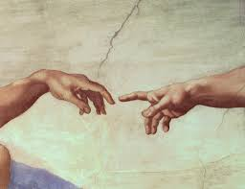
Outline
Introduction
Where are we..
User Requirements
Targeted groups
Requirements from Users of GSICS Products
Survey result summary
Expectation from Reference Instrument
Requirements from climate community
Way forward

Slide 3
Introduction
EP-16 observed 10 years of GSICS existence in Denver, Colorado USA.
GCC presented an overview of User Requirements ( Doc. 9 ) that were gathered from reviews of GSICS Products in the GPPA.
In a major thrust to connect GSICS with scientific community and potential users Ep-16 placed the following actions
Action 16.10: All satellite operators to evaluate their requirements for GSICS resources, products and services to serve their internal users (NRT or climate applications such as SCOPE-CM projects): identify application areas, draft requirement indicating the characteristics of the product needed, quality criteria and delivery mode. Requirements shall be communicated to the GCC who will present a synthesis to the EP.
Action 16.11: GCC and GRWG Chair to organize a discussion on user requirements in the context of the 2015 GSICS User Workshop (Toulouse, 22 September 2015).
Action 16.12: GCC to analyze, in consultation with GCOS/AOPC, the implications of GCOS observation needs on GSICS products.
This presentation is in response to Action 16.11
Notes:
Four demonstration products (NOAA) have ended production.
There are two prototype products.

Slide 4
Targeted Groups
User requirement - Using GSICS Products
Product was made available to experts and opinion was taken as to what they think of the usability of the products and what they expect from GSICS.
GSICS member agencies
Survey questions were posed to members agencies and their responses evaluated.
Climate Monitoring groups ( FIDUCEO)

Slide 5
User Requirements- Using GSICS Products
Basic User Requirements
A clear path towards benefiting from using the product.
Mature ATBD
Product Related Docs and Publications (Perhaps WMO, WIGOS accepted)
User Manual (information on Uncertainties and basic i/o) Easy to understand with examples.
Uncorrected/Corrected Radiances.
Support from producer.
Estimates of the GSICS references quality (Recent submission on IASI/AIRS) and Traceability documentation.
Could be a part of GPPA submission
Products should be easy to use. ( We Score 3 out of 10)
Radiance values with uncertainties.

Slide 6
User requirement survey
Categories of Questions
GSICS Intermediate Data and GEO Ring
GSICS IR Products
GSICS VIS Products
GSICS MW Products
GSICS UV Products
Expectation from GSICS References
Climate Users ( added later)
Response stats

Slide 7
Summary of responses
Summary of response
 | Reponses | Requirement
Do you need GSICS Intermediate Data | Yes (63%) | GEO-LEO, LEO-LEO, Moon data needed
GEO Ring | Yes | Needed for global measurements
IR Products | Yes | Need Diurnal variation of bias and uncertainties
VIS Products | Yes | Frequently update calibration coefficients of each sensor. Aqua MODIS and VIIRS as reference
MW Products | Yes | Need corrected L1B on a global scale, more precise but can be less frequent
UV Products | Yes | In-orbit references are calibrated using Ground based products and other satellite products
Reference Instrument | Yes | Monitored instrument with high accuracy and stability ( scan angle spectral and temporal)
Climate Users | Yes | GSICS expertise , Algorithms and Deliverables can contribute towards meeting climate goals.
Subgroups need to discuss the responses.

Slide 8
Expectation from a reference instrument

Slide 9
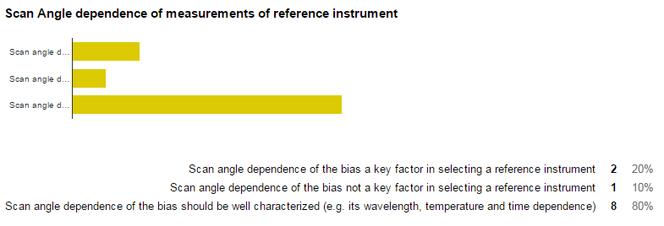
Expectation from a reference instrument

Slide 10
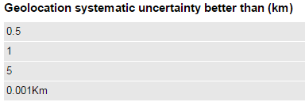
Expectation from a reference instrument

Slide 11
Requirements of Climate Community
Harmonization
Long Term Monitoring across temporal scale
Harmonization-> Techniques developed for Prime product can be used
Uncertainty estimates
FIDUCEO -> GSICS MVIRI-SEVIRI Product can be used. (Ref FIDUCEO User Requirement Report)
MW FCDR -> Just the inter-comparison coefficients are of no help ( Ref Feedback from GSICS User Survey).
Need of bias monitoring at Diurnal and temporal scales of decade and beyond
Example Strawman’s FCDR=AVHRR1+AVHRR2+AVHRR3+AVHRR4….
Should products be a blend of coefficients and intermediate data ?.

Slide 12
Requirements of Climate Community
Eg. Strawman’s FCDR=AVHRR1+AVHRR2+AVHRR3+AVHRR4+……
All known and established corrections for timing, geo-location, and viewing geometry of pixels should be applied in the FCDR record and described in associated documentation. Associated uncertainties should also be included or described
.
Long term monitoring using stable references
Harmonization
Uncertainties estimates of bias
Direct usage of GSICS products may not be possible
…………however……….
However GSICS expertise , Algorithms and Deliverables can contribute towards meeting these goals.

Slide 13
Survey Summary
Survey Summary
 | Reponses | Requirement
Do you need GSICS Intermediate Data | Yes (63%) | GEO-LEO, LEO-LEO, Moon data needed
GEO Ring | Yes | Needed for global measurements
IR Products | Yes | Need Diurnal variation of bias and uncertainites
VIS Products | Yes | Frequently update calibration coefficients of each sensor. Aqua Modis and VIIRS as reference
MW Products | Yes | Need corrected L1B on a global scale, more precise but can be less frequenct
UV Products | Yes | In-orbit references are calibrated using Ground based products and other satellite products
Reference Instrument | Yes | Monitored instrument with high accuracy and stability ( scan angle spectral and temporal)
Climate Users | Yes | GSICS expertise , Algorithms and Deliverables can contribute towards meeting climate goals.

Slide 14
Way forward
GSICS has made huge progress in meeting needs of users of weather climate satellite calibration communities and demands are growing.
Propose to discuss survey results within each subgroup to help in planning future activities and goals of the sub group
It is felt that more communication ( within and outside GSICS ) is needed to meet future needs and to know these needs…
GCC would continue to collect user requirements.
This year targeted groups would be GCOS SCOPE-CM , WMO and member agencies.
A evaluation of requirements is critically needed to move ahead
Tim Hewison proposed here .

Slide 15
Thank you

Slide 16
BACKUP SLIDES

Slide 17
GSICS Intermediate and GEO Ring data

Slide 18
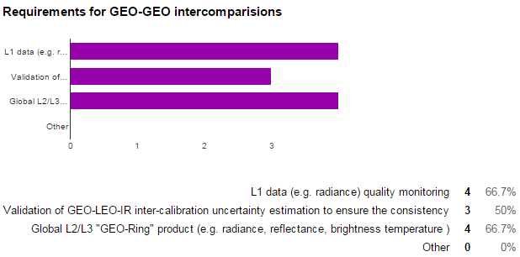
GSICS Intermediate and GEO Ring data

Slide 19
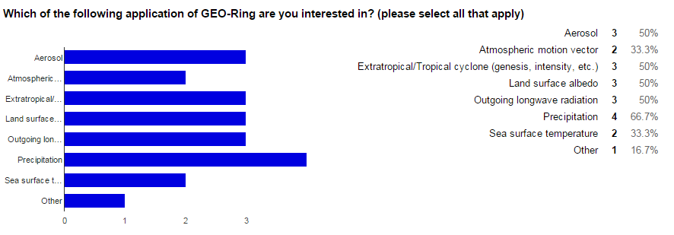
GSICS Intermediate and GEO Ring data

Slide 20
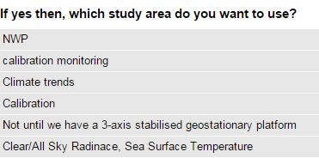
GSICS IR Products

Slide 21
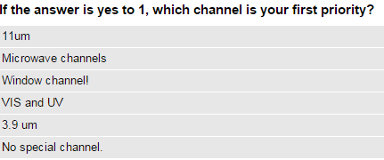
GSICS IR Products

Slide 22
VIS- GSICS Products
We use LUTs to retrieve L2 products. The LUT is created for each sensor spectral band. The observation data (digital count) is tied to radiance based on each sensor's calibration coefficients. So, the differences in sensor calibration and spectral band differences are considered by LUT and calibration coefficients.
I take it as that there are no differences in sensor calibration. About the differences of spectral band, I will use the linearity interpolation to get the spectral resolution I needed.
Frequently update calibration coefficients of each sensor.
Similar to GSICS IR's case, I need relationship between a target sensor and a common reference sensor such as AIRS or IASI in IR bands.
Yes. I think it's useful for calibration (e.g. inter-comparison) and product retrieval. Usually, we have a preferable radiance range for product retrieval or calibration. For instance, a calibration engeneer who adopt DCC as a reference doesn't care dark ocean surface. Such users will prefer SBAF optimised over specific Earth targets.
yes

Slide 23
VIS- GSICS Products
yes
I'm interested in it, because I don't know if the SBAF is effected by geometry angles or humidity. If the effect is negligible, I don't think it is necessary function for the Web site.
yes of course
It will be helpful because Aqua-MODIS and IASI is well calibrated sensor. What sensor will be the next reference after MODIS? VIIRS?
Not yet, that is the orient of our en devour
The scaled radiance is convenient to use multiple sensors, because we don't need to care difference of solar spectra profile between sensors. Thuillier, MODTRAN, new Kurucz, ...
yes

Slide 24
VIS- GSICS Products
yes
Same as above, but not mandatory.
The MODTRAN solar spectra were used as the reference. Providing the GSICS reference solar spectra are more convenient to my opinion
If GSICS decide a solar spectra as reference, the spectra should be the one accessible freely.
The sensor which has high accuracy onboard calibration, wide dynamic ranges, high spectral resolution is required besides MODIS.

Slide 25
GSICS Microwave Survey
GSICS MW Products
Real time use and/or climate use?
Latency vs. precision?
Different spectrum has different use and requirements
Potential application areas

Slide 26
Survey Results 6 responses as of 20 Sept 2015
GSICS MW Products

Slide 27
Survey Results 6 responses as of 20 Sept 2015
GSICS MW Products
Window Channels
Average ~ 0.4 K
O₂ Channels
Average ~ 0.3 K
H₂O Channels
Average ~ 0.4 K

Slide 28
Summary
GSICS MW Products -Summary
Mapping time series of similar sensors but from vastly different heritage (e.g., SSMT2 to AMSU-B) together is of low priority (Q1)
More precise, longer latency correction are preferred (Q2)
It does appear most users would look at time series for global trends (most likely the O₂ & H₂O bands) and use to derive geophysical parameters (most likely window & H₂O bands) (Q3)
The average desired accuracy of the corrections was on the order of 0.4 K (slightly less for the O₂ bands) (Q4)

Slide 29
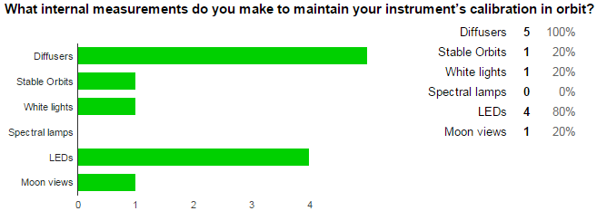
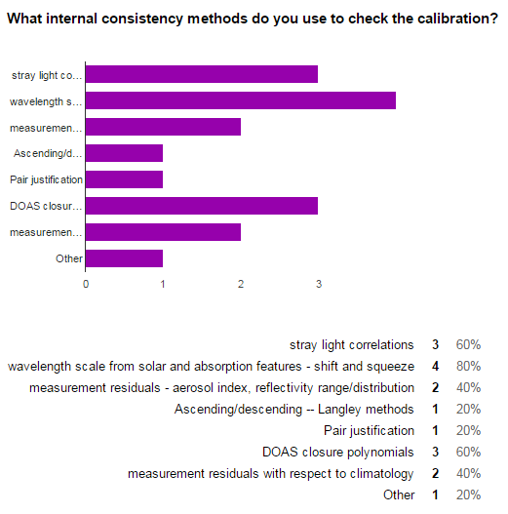
UV Products

Slide 30
UV Products

Slide 31
UV Products

Slide 32
UV Products

Slide 33
Way Forward
GSICS has made huge progress in meeting needs of users of weather climate satellite calibration communities and demands are growing.
It is felt that more communication ( within and outside GSICS ) is needed to meet future needs and to know these needs…
GCC would continue to collect user requirements.
This year targeted groups would be GCOS SCOPE-CM , WMO and member agencies.
A evaluation of requirements is critically needed to move ahead
Tim Hewison proposed here .

Slide 34
THANK YOU

Slide 35
Requirements posted by friends WMO+CEOS+…
EP stressed that GSICS should bring a key contribution to the Architecture for Climate Monitoring from Space in defining a calibration infrastructure and key processes to ensure seamless continuity and consistency of climate records.
Pre-Launch Characterization
Procedures, best practices and calibration resources required to ensure the consistency of data records through accurate and homogeneous calibration should be defined by GSICS and CEOS WGCV as an input to the Architecture for Climate Monitoring from Space.
Increased attention should be given to ground calibration sites;

Slide 36
Summary
User Requirements are central to creating GSICS Products / Deliverables and assigning maturity to GSICS Products.
However these are closely linked to the kind of product being delivered.
Need a plan to find applications of our products
We need a clear plan to communicate with users, collect and document all of the user requirements.
Individual agencies collect requirements to identify product creation priorities, however these are not necessarily shared on GSICS platform.
Is GNU (GMES Network of Users) model of collecting user requirements a way forward ?
)

Slide 37
FIDUCEO Fidelity and uncertainty in climate data records from Earth Observations
Aim is to create four FCDR
MVIRI visible channel time-series from 1982-today (Infrared is done in SCOPE-CM);
HIRS time-series from 1982-2016 (NOAA and METOP);
Microwave Humidity Sounders time-series from 1992-2016 (SSM/T2, AMSU-B, and MHS);
AVHRR infrared and visible channels time-series from 1982-2016 (NOAA and METOP).
Eg. Strawman’s FCDR=AVHRR1+AVHRR2+AVHRR3+AVHRR4+……

Slide 38
FIDUCEO Document
An assessment of user requirements for Fundamental Climate Data Records (FCDRs) was undertaken using two sources: a set of 16 interviews with current FCDR users, and a review of prior literature. From this assessment, requirements for Fidelity and Uncertainty in Climate Data Records from Earth Observation (FIDUCEO) were defined as follows.
But we are looking for what do FCDR producers need .

Slide 39
Eg. Strawman’s FCDR=AVHRR1+AVHRR2+AVHRR3+AVHRR4+……
All known and established corrections for timing, geo-location, and viewing geometry of pixels should be applied in the FCDR record and described in associated documentation. Associated uncertainties should also be included or described
.
Long term monitoring using stable references
Harmonization
Uncertainties estimates of bias
Direct usage of GSICS products may not be possible
…………however……….
However GSICS expertise , Algorithms and Deliverables can contribute towards meeting these goals. Expertise in blending IASI-A IASI-B ( similar to GSICS Prime Ref) can help harmonization.

Slide 40
MVIRI
“ Could use operational Global Space-based Inter-Calibration System (GSICS) inter-calibration factors for SEVIRI. use. Would be impossible to do a per-pixel This exists but I’m not using it. Further information, I probably wouldn’t uncertainty. If it was provided I probably wouldn’t trust it.”

Slide 41
Infrared
AVHRR
“Would be very useful to have clear information about stability, accuracy, and variability of the accuracy (precision). Flag information about how useful/trustworthy the intercalibration information is, on a pixel-basis. (Many problems with early 3.9 μm AVHRR.)”
“Would be very useful to have clear information about stability, accuracy, and variability of the accuracy (precision). Flag information about how useful/trustworthy the intercalibration information is, on a pixel-basis. (Many problems with early 3.9 μm AVHRR.)”

Slide 42
Microwave
AMSU
Uncertainties on the channel radiances. Characterization of across-scan bias. The more detail the better. Historical disconnect between the engineering side and data users
Uncertainties on the channel radiances. Characterization of across-scan bias. The more detail the better. Historical disconnect between the engineering side and data users

Slide 43
Specific Sensors
• AVHRR GAC PRT measurement sequence needs to be checked.
• HIRS needs to be more stable than 0.2 K/decade for the production of CTH.
• HIRS needs to be more stable than 0.05 K/decade for the production of SST.
• AMSU needs to be more stable than 0.1 K/decade for the production of UTH.
• AVHRR harmonization should be better than 50 mK/decade.
• AVHRR harmonization should be better than 1 %, according to an “educated guess” by an AVHRR user.
Can help in achieving these targets

Slide 44
Pre-launch
Instrument calibration for nonlinearity. Antenna pattern measurements. We use what is available. Those are the main things. What was done was adequate for instrument specifications for operational use, but not adequate for climate applications. Disconnect
Harmonization-> Satellites equatorial crossing times differ.

Slide 45
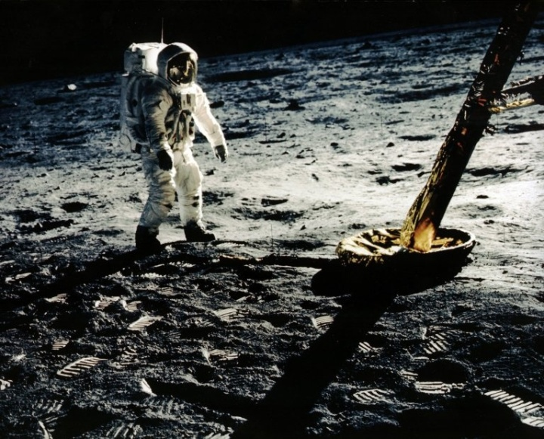
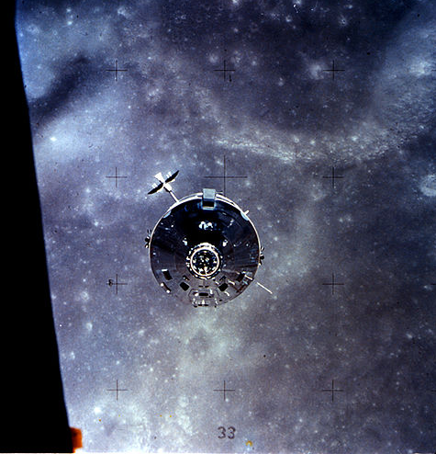
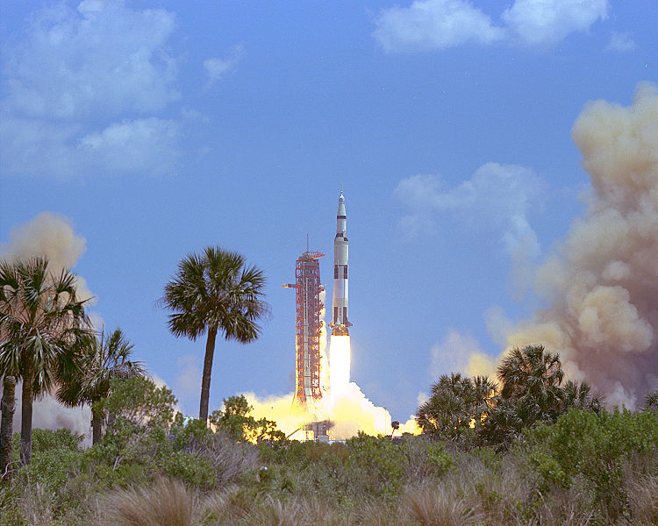
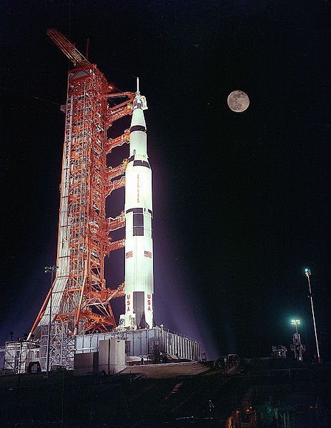
GPPA Maturity-Operational Phase
GPPA Description
Data Producer
(GPAF)
Data
Reviewer
(GPAT/ or EXCEMPT)
Data User
( GPERF)
GSICS Executive Panel
Operational
Phase
Product is fully accepted by GSICS Executive Panel (EP) and maintained within GSICS and
distributed to the public.
Product Logs, Data Usage
Preoperational
Phase
Product version Control Data released with disclaimer
C Operations and distribution plan Data user’s guide T=180 days
GPPA
Guiding Principal
Demonstration Phase
Founding concepts Supporting models Data Archived and Free Access
ATBD Peer-Publications Product quality indicator description
Traceability document T=365 days
Submission Phase
Fill out GSICS Product Acceptance Form ( GPAF )
Users and Reviewers Feedback plays a pivotal role in assigning maturity

Slide 46
THANK YOU

Slide 47
Introduction
EP-16
GSICS user requirements should be more precise and traceable to identified requirements sources, i.e. statements or documents from representative users.
Examples of such sources include: outcome of GSICS workshops, reports from GSICS beta-testers, requirements for GSICS by the GCOS-SC Chair (GSICS-EP-14), satellite instrument calibration for measuring global climate change (Ohring G. et al., BAMS, Sept 2005),
GCOS Systematic observation requirements for satellite-based data products for climate (GCOS-154). For instance, GCOS-154 action C8 calls for “Use of GSICS bias-corrected coefficients and bias adjustment information from reanalysis”.
GUW -15
GCC is to draft a strawman User Requirements’ document and send it out for review.

Slide 48
Introduction
GSICS has 37 Inter-calibration products spanning IR and VIS wavelengths.
Products have bias, offset and uncertainty estimates.
Users of GSICS products play a central GSICS in defining GSICS current and future course of actions and we need their feedback from time to time to meet their requirements.
A survey was sent out to gather user expectations from GSICS
It can be accessed at here and we present here feedback we received so far
Proposed form for users to indicate their requirements for GSICS Corrections ( Tim Hewison)

Slide 49
User Requirements
Application specific Requirements
SST retrieval – User need constant flow of (uncorr) TOA Radiances along with GSICS correction Coefficients and Uncertainty. Also wants to experiment with the smoothing period to optimize performance (GSICS products currently provide this flexibility).
Cloud Height Retrieval. User needs TOA Radiances and RTM runs (initialized by GCM forecasts).
SRF Retrieval. User needs GSICS correction Coefficients and TOA Radiances Uncertainty as well as intermediate collocated data (Hyper spectral radiances over the broad band)
Climate Applications. User needs intermediate cross calibrations as well as re-calibrated coefficients (multi step corrections) and a reference for long term validation of the TOA measurements.
“Just the calibration coefficients are of no use”,
need ancillary information to use them.

Slide 50
New Developments
Climate and Weather communities have placed a need to calibrate in-orbit instruments to a higher level of precision and stability of the instrument.
Cross calibration of range of instruments in IR, VIS, UV and MW wave lengths with concurrently flying instruments, In-situ targets (DCC, Deserts) , Solar and Lunar targets, ray matching has given more opportunity to quantify and correct in-orbit biases.
Thresholds of climate accurate L1 measurements have increased to accuracy better than .1 K and stability better than 0.05K/decade .
New techniques of In-Orbit Calibration have given opportunity to better calibrate instrument
Need of better accuracy and stability
Need to monitor instrument measurements at different times of the day
Requirements of the calibration community are growing

Slide 51
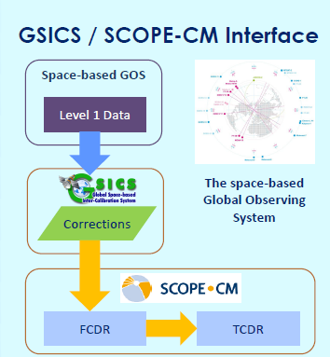
Strawman’s list – Who are the users of In-Orbit Cross Calibration monitoring
The producers of cross calibration data are the first users of the cross calibration monitoring.
The rest of the users are scattered in the community and mainly are the ones who need L1 radiances for applications that are sensitive to L1 radiance anomalies. Some examples are
NRT, RAC Monitoring such as at GSICS
Climate Users (FCDR, TCDR)
Recalibration
Downstream services
SST Retrieval
Cloud Height Retrieval
SRF Retrieval
Monsoon Studies (ITCZ Movement)
List is growing and
User Requirements depends on the purpose for which the L1 corrections are applied

Slide 53
GSICS Introduction
GSICS Members
WMO
ROSHYDRO
EUMETSAT
CNES
KMAA
USGS/NOAA
NASA/NIST
KMA
CMA
JMA/JAXA
IMD/ISRO
Obs. ESA + CEOS
ASSO. GPX
14 Members Worldwide

