Slide 1
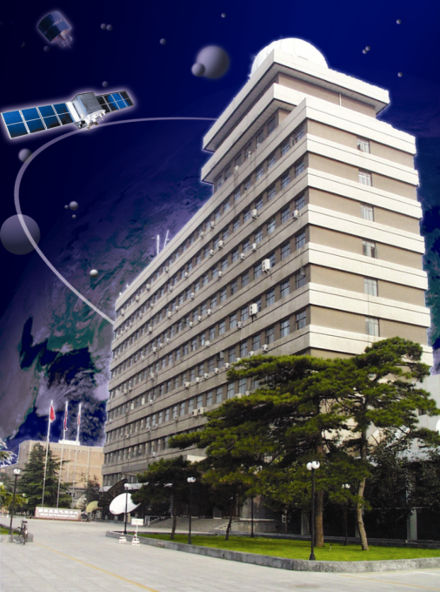
CMA Preparation for 2nd Lunar Calibration Workshop
Xiuqing(Scott) Hu, Lin Chen
National Satellite Meteorological Center(NSMC), CMA
26, April, 2017

Slide 2
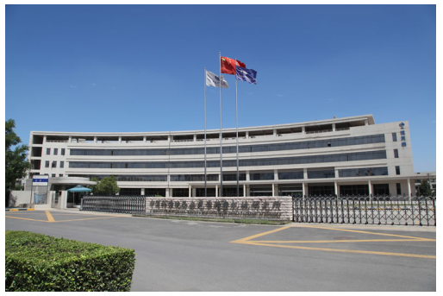
Place and Possible Date
Local hoster: Xi’an Institute of Optics and Precision Mechanics of CAS (XIOPM)
Place: Xi an(fixed)
Best Date: last 10d of October - first 10d of Nov. 10 Nov. to 20 Nov may be not suitable for CMA. (TBD)
Flight: Direct flight from Beijing, Shanghai(about 3hours);
Xianyang International airport
Weather: it is cool but not cold

Slide 3
Where is Xi'an?

Slide 4
Flight to Xi'an
No direct flight from Frankfurt to Xi'an. But only one transfer stop.
Dozens of flights from Beijing or Shanghai to Xi'an per day.

Slide 5
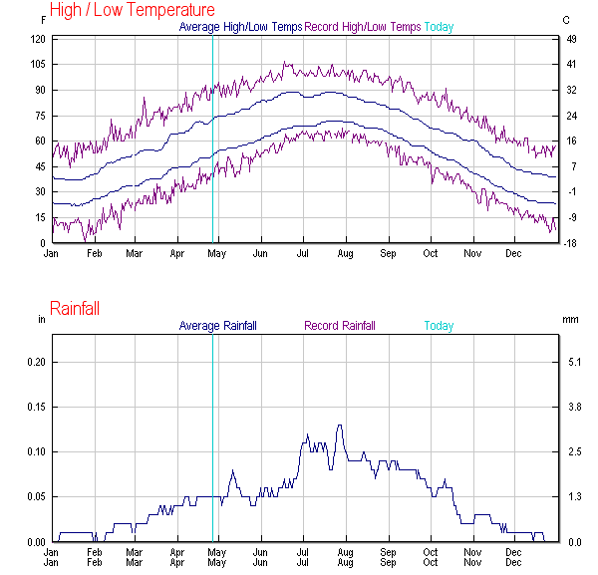
Weather of Xi an on Nov.
5centigrade- 15centigrade on the first 10 days of Nov.

Slide 6
Overview of City Xi'an
Start point of Ancient Silk Road
New West Window of Chinese “One Belt, One Road”
Famous Tour city

Slide 7
Tour Places :
City Wall;
Great Wild Goose Pagoda;
Museum of Emperor Qinshihuang's Tomb Figures of Soldiers and Horses;

Slide 8
Thanks

