Slide 1
GRUAN / GSICS
Cheng-Zhi Zou and Tony Reale
NOAA/STAR
GRWG Microwave Sub-group
Web Meeting
June 22, 2017

Slide 2
GSICS/GRUAN Actions from
March 2017 Annual GSICS Meeting
Action: GMW.2017.6f.2: Tony Reale (NOAA) to provide a draft of uncertainty analysis examples to determine feasibility of monitoring satellite microwave instruments using GRUAN observations (radiosonde) – by the next annual meeting
Cheng-zhi Zou, Bomin Sun, Isaac Moraldi, Viju John, Vinia Mattioli, Mark Liu, Ralph Peterson …
Action: GIR.2017.7d.1: ​ Tony Reale (NOAA) to provide a draft of uncertainty analysis examples to determine feasibility of monitoring satellite infra-red instruments using GRUAN observations (radiosonde) – by the next annual meeting
Xavier Calbet, Bomin Sun, Isaac Moraldi, Tim Hewison, Nick Nalli …

Slide 3
GRUAN ICM-9
9th GCOS Reference Upper Air Network (GRUAN) Implementation-Coordination Meeting (ICM-9) was held in Helsinki, Finland on June 12-16, 2017
Excerpts from presentation from A. Reale entitled “Integration (and assessment) of GRUAN v2 uncertainty using NPROVS+” are provided
Primary focus of GRUAN at this time is to manage pending transition from Vaisala RS92 to RS41 radiosonde will delay pending implementation of v3 GRUAN radiosonde processing
V3 recommended as basis of any pending GRUAN / GSICS analysis … but v2 can be used as placeholder for developing analytic strategies
Plan supported … Viju John (EUMETSAT) is designated focal point of GRUAN / GSICS coordination (was not in attendance) …

Slide 4
Guidelines for Uncertainty Measurements (GUM)
for k.le.2 … in more than 95% of cases, the uncertainties are likely to be smaller than estimated …
for k .gt. 2 … the uncertainties are likely to be larger than estimated …
If k < 1 …
from Immler (2010)

Slide 5
… understanding the vertical correlation of GRUAN uncertainties is important when propagating to the radiance space (the above plot is for IR sensors; a similar plot for MW sensors maybe needed)

Slide 6
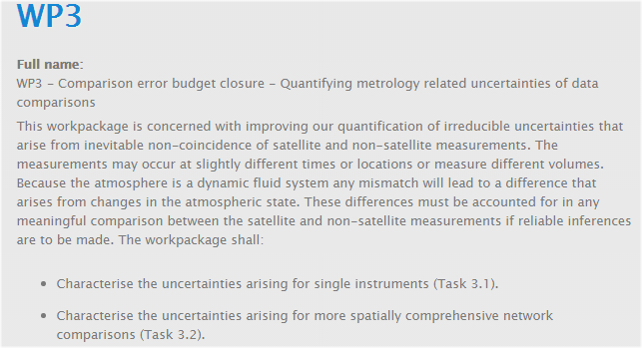
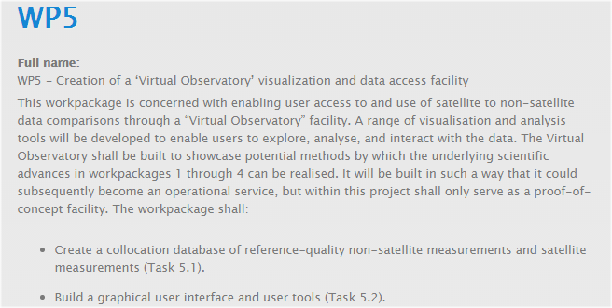
… coordination with ongoing GAIA-CLIM under EU Horizon 2020 (Copernicus) Program recommended … tbd

Slide 7
Preliminary Experiment Straw-man
GSICS Calibrated Sensor Data
(IR, MW)
“Other” Calibrated Sensor Data
(ICVS … )
(IR, MW)
GRUAN (NPROVS+)
Radiosonde
Sampling Constraints
Sigma
Propagate to Radiance (LBL, RTM …)
Consistency Testing (Immler)
Double Difference
Candidate Collocation
Dataset(s) for Assessment
(IR)
Union Collocation Dataset(s)
(IR + MW)
Candidate Collocation
Dataset(s) for Assessment
(MW)
Objective: Can GRUAN help verify the “accuracy/uncertainty” of GSICS adjustments

Slide 8
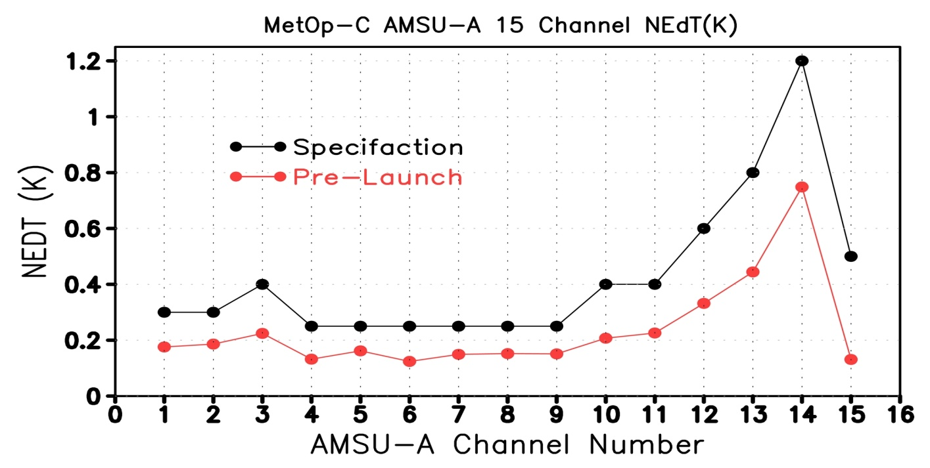
Uncertainty Analysis for the MW Sensors
Uncertainty = Calibration bias + Instrument Noise (NeDT)
Current MW sensor noises are well known from pre-launch calibration
and monitored by satellite operational agencies (e.g., STAR ICVS)

Slide 9
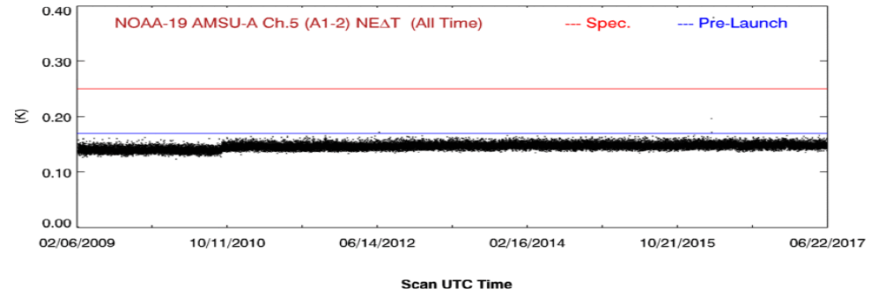
Uncertainty Analysis for the MW Sensors
Noise monitoring for NOAA-19 AMSU-A channel 5 (from STAR ICVS)

Slide 10
Instrument noises can be used to determine the distance criteria when collecting collocated datasets between GRUAN and MW Sensors
Minimum STD = √2 *0.3K=0.42K
Maximum distance for collocated datasets ~40Km

Slide 11
Using GRUAN to Monitor MW Sensors or Vice Versa
Need to know GRUAN noise, which should be provided by vendors
RTM WM reaches 0.1K accuracy (Chen et al. 2010)
WM sounder inter-calibration bring inter-sensor biases to be close to
0.1K (Zou et al. 2011)
183GHz inter-satellite biases are much larger
GRUAN maybe used to monitor the absolute biases in WM sensors
If GRUAN biases are unknown, MW sensors could be used to verify
GRAUN biases
GPSRO could be used to determine biases in GRUAN and then to
determine the absolute biases in WM sensors

Slide 12
Summary
GSICS action items to test whether GRUAN (and uncertainty) can be used to assess/monitor satellite IR and MW sensors (and associated GSICS uncertainty estimates)
Presentation by A. Reale at GRUAN ICM-9 GRUAN introducing this work …
MW sensor noise are well known from pre-launch calibration and monitored by satellite agencies
Viju John as the designated GRUAN / GSICS interface will be involved with coordinating this work.

