Slide 1
GAIA-CLIM project
The GAIA-CLIM project (2015-2018)
…aims to improve the use of non-satellite measurements to characterize, calibrate and validate satellite climate data records of Essential Climate Variables

Slide 2
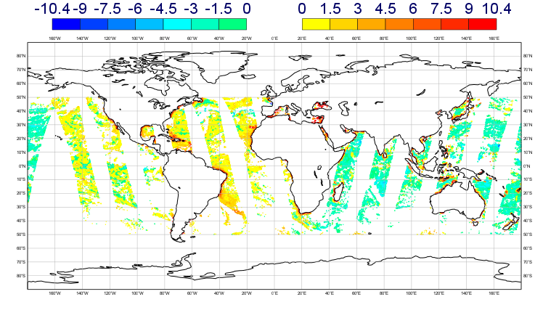
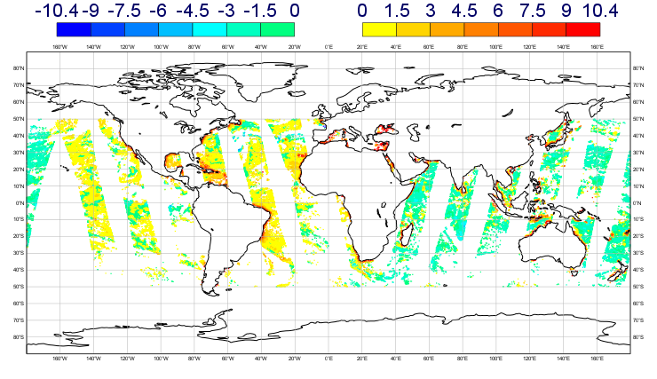
GAIA-CLIM project – cal/val using NWP
1. Demonstrate satellite cal/val with NWP:
Compare a satellite observations to NWP short-range forecasts, e.g. for MWRI:
ECMWF O – B minus global average
Met Office O – B minus global average
10H channel

Slide 3
GAIA-CLIM project – cal/val using NWP
2. Use Reference data to quantify NWP model background uncertainty in radiance space
GRUAN
T_{B}^{GRUAN}
GRUAN processor
∆T_{B}^{GRUAN-NWP}
NWP
T_{B}^{NWP}

Slide 4
GAIA-CLIM project – outputs
Gaps Analysis and Impact Document (GAID)
Document gaps in our ability to perform cal/val to reference standards
‘Virtual Observatory’
Freely available website for performing collocations between satellite data, NWP and reference in-situ data
http://www.gaia-clim.eu/page/gaid

