Slide 1
GSICS MW products and a path forward
Manik Bali, Ralph Ferraro, Larry Flynn, and Cheng-Zhi Zou
MW Subgroup Meeting
July 25, 2017

Slide 2
Outline
Introduction
Classical GSICS Products
Pros and Cons
Results of the User Feedback
MW In-Orbit references
Proposed MW GSICS Products
Potential GSICS MW deliverables
Summary
Reference=>Today’s discussion follows two Actions generated in the GSICS Annual Meeting 2017 in Madison, Wisconsin
A.GMW.2017.6c.1 | Microwave imager CDR |  |  | Determine feasibility of extracting the inter-calibration algorithms and coefficients from the FCDR and making them a GSICS product. | Karsten Fennig | Analysis | 2018-03-01
A.GMW.2017.6d.1 | Microwave sounder CDR |  |  | Determine feasibility of extracting the inter-calibration algorithms and coefficients from the FCDR and making them a GSICS product. | Cheng-Zhi Zou | Analysis | 2018-03-01

Slide 3
Introduction
Do we currently have MW cross calibration products ? NO
The MW subgroup was re-formed in 2013.
The GPM-X Cal and the CEOS-WGCV are closely linked with GSICS MW subgroup activities.
Factors that help in identification of MW products
=+
GSICS Goals
User Requirements
Vision of GRWG
Commitment from agency
A verification/validation report.
-impact assessment ->
How does the product help the agency
A Review Board report.

Slide 4
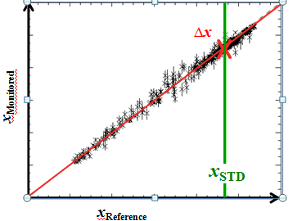
Introduction-Classical GSICS Products
Classical GSICS products are Correction Products
Bias
Offset
Uncertainty Estimate ( Algorithm)
Figure above shows comparison of reference and monitored instrument fro m which regression coefficients are computed.
Pros
GSICS Community has Experience in creating, Accepting, Assigning maturity and distribution of the correction products.
SNO Algorithms available.
Cons
Need In-orbit references.
Products have very limited users even within the agency.
Difficult to use-> Monitored instrument measurements lie outside the product files and have to be taken from data providers.
Cannot be used for re-calibration, removing scan angle dependence of bias etc..

Slide 5
Results of User Feedback survey
To begin with → Need a platform for providing corrected radiances
Platform could consist of in-orbit references & algorithm to meet
& backed by tools such as ICVS to enable root cause analysis.

Slide 6
In-orbit references
Do we currently have in-orbit references for MW ? NO
The AMSU/MSU L1B FCDR for O₂ bands resembles a typical in-orbit reference that is stable and accurate.
Has scan angle corrected radiances
Trends have been removed
Undergone stringent quality assurance test
Real time quality flags for each pixel come with the product

Slide 7
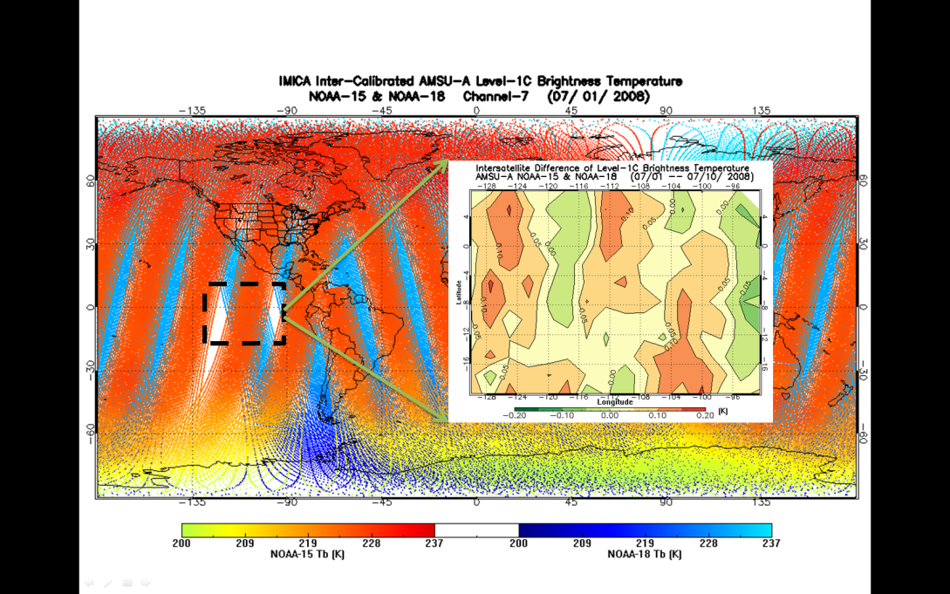
AMSU-A FCDR as a Reference for Cross-Calibration
AMSU-A onboard six POES satellites were inter-calibrated using Integrated Microwave Inter-Calibration Approach (IMICA)
5 calibration errors were removed/minimized: nonlinearity, bias drift, frequency shift, sun-heating induced temperature variability in radiances;
Inter-satellite Biases were reduced to 0.1-0.2K
19 years of swath data
Dataset available from NCEI CDR website
AMSU-A brightness temperature s for overlapping NOAA-15 and
NOAA-18. Their differences for randomly selected region
(e.g., within the dashed square ) are within 0.1-0.2K.

Slide 8
Overlap with Monitored instruments
AMSU/MSU
FCDR
AMSR (2/E)
JAXA
SSMI
DOD
GMI
NASA
ATMS
NASA
MTVZA
ROSCOSMOS/Ukraine
MWTS-2
China
MSU/AMSU-A FCDR channels overlap with majority of MW instruments
Source: https://www.wmo-sat.info/oscar/instruments

Slide 9
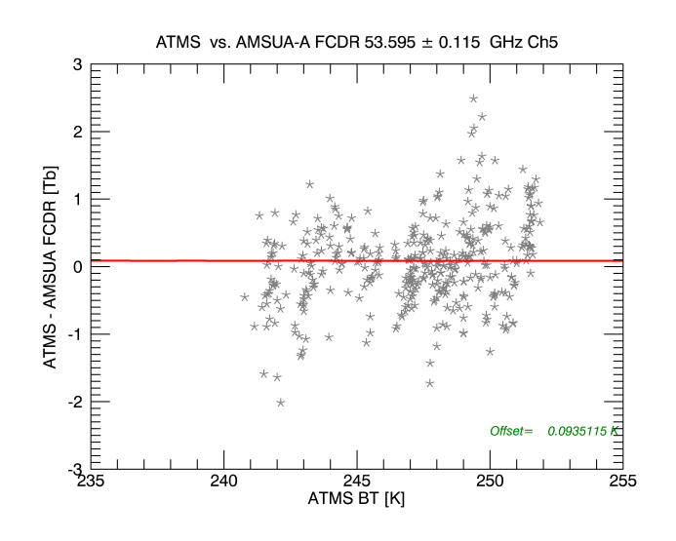
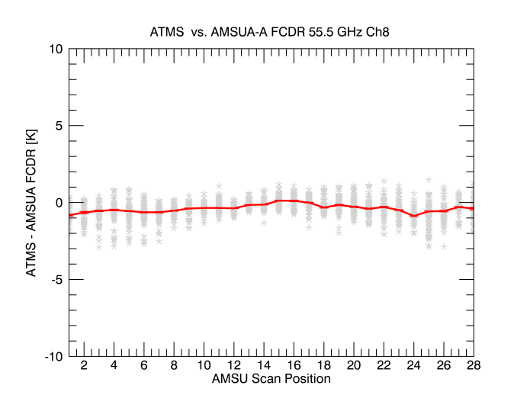
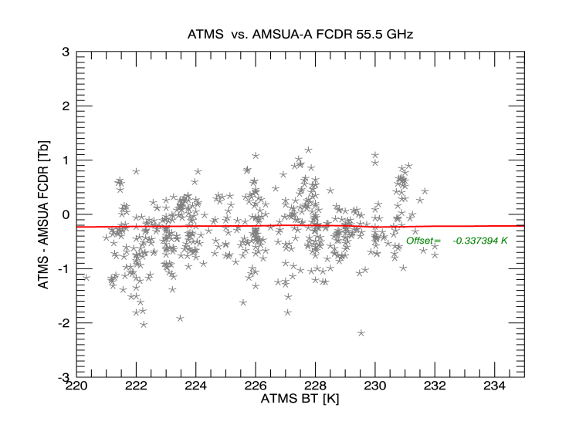
Monitoring ATMS-SDR by SNO inter- comparison with N18
Inter- comparison of ATMS-SDR with FCDR show
Low scan angle dependence of ATMS-SDR
Post launch ATMS-SDR maintains nearly pre-launch level of accuracy.

Slide 10
Proposed MW Product
In addition to meeting above user requirements the products shall also ( and not be limited to classical GSICS products)
Product shall be able to reveal the full scale of Scan Angle, Geographical, Temporal and Temperature dependent bias.
Product shall aid in re-calibration ( User should be able to transition between Count –Radiance – BT space).
Onboard health information (from ICVS) about the instrument health encoded into the product or link to ICVS.
Plug and play model ( product shall be self consistent).

Slide 11
Potential GSICS MW Products
We could monitor the following and create monitoring product
AMSU, ATMS(NPP and J1), SSMI, GMI, MHS as GSICS products
MW products can be classified as:
Retrospective type products (FCDR “components” – geolocation, scan biases, intersatellite corrections, etc.)
Forward looking (quasi-real time) products
Larry, GSICS Annual Meeting, Delhi, April 2015

Slide 12
More possible MW deliverables
Level 1 adjustments and corrections (Result in Classical products)
Methods (e.g., SNO or double difference)
Need to address
References, transfers, stability
Spectral region idiosyncrasies
Satellite and Instrument Data Bases
OSCAR (SRF -> product, etc.)
Provide Geolocation and FOVs
Identify and catalog anomalies and periods of coverage
FCDRs and ECVs
Users for reanalysis versus real time
Components, homogenization approach (Documented, reviewed algorithms)
MW FCDR to GSICS Product example for discussion
References (These cover all spectral regions not just MW.)
Solar
Lunar (ROLO and GIRO)
DCC (radiance levels, frequencies?)
Targets (Surfaces emissions and reflectivities?)
Tools (SNO identifier, Display Graphics, Communication, Notification …)
Documents (Journal articles, ATBDs, Users’ manuals)
RTMs (Vicarious calibration, Error analysis, O-B bias, and comparisons studies)
Stability versus Traceability
Larry, EP -16+
Range of deliverables can be identified
Notes:
In looking over old presentations on GSICS products, Manik provided me with a couple on the GSICS Information Services and Products Roster (GISPR). I'm attaching one to show that we are just following a natural evolution. I do want to make it clear that I am not proposing that most of these all go through the GPPA or other reviews or become named, blessed, hosted GSICS products.
http://www.star.nesdis.noaa.gov/smcd/GCC/documents/GRWG/200901/DAY1_1445_Iacovazzi_GCC_GISPR.pdf

Slide 13
Summary
User needs/feedbacks have been presented
Possible Microwave instrument monitoring Products have been discussed .
In-orbit reference has been proposed that can help create products.

Slide 14
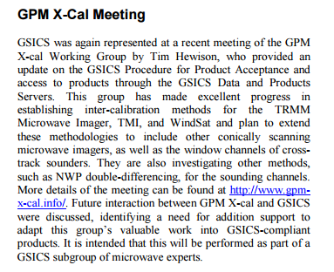
Interaction with GPM-X Cal and CEOS WGCV
In terms of developing GSICS Products for Microwave instruments, the considerations should be:
1. What are the user’s requirements for inter-calibration products?
2. What can we do to meet the desired performance?
3. Can we make products that fit within existing GSICS Conventions and systems?
Cheng-Zhi Zou leading the interaction with WGCV
MWSG Chair to have a communication with GSICS on how WGCV can offer support on best practices.
WGCV Secretariat to send out the list of potential GSICS-WGCV Cooperation items outlined by GSICS to each subgroup chair
WGCV (Completed) Subgroup Chairs to identify and prioritize specific activity areas for interaction with GSICS.
MW subgroup has close links with GPM-X Cal and CEOS-WGCV and will focus on building these relationships in 2016

Slide 15
THANK YOU

