Slide 1
GSICS MW SubGroup 12 October 2017 – 1100 UTC
GSICS Microwave Sub-Group web meeting
Thursday, 12. October 2017
13:00 | Europe Summer Time (Berlin, GMT+02:00) | 1 hr 30 mins
Meeting number (access code): 956 685 636
Host key: 337684
Meeting password: gsics
https://eumetsat.webex.com/eumetsat/j.php?MTID=mfa30afe9937324be29f436d4ce59e8bb
Join by phone
Global call-in numbers: https://eumetsat.webex.com/eumetsat/globalcallin.php

Slide 2
Agenda for Today
Welcome and general business (Ralph) (10 min)
Old Actions
Updates from the topical area leads? (Methodologies, Reference Standards, LUT/Correction Tables)
New Members
Status of 2017 GDWG+GRWG Action Items (45 min)
GMW2017.6a.1 -"Checking on the Uniformity of Sounding Channels With the Moon” – M. Burgdorf
GMW2017.6c.1 and 6c.2 - Feasibility of FCDR's as products - R. Ferraro
GMW2017.6f.1 - MW Sensor Inventory - R. Ferraro
GMW2017.6f.2 - GRUAN - T. Reale
Science/Agency Reports (30 min)
AMSR-2 Status – M. Kachi (JAXA)
CMA Update – S. Hu (TBC)
AOB, wrap up, next meetings, etc. (5 min)

Slide 3
Action Items
Action Id | Item | Effort Level | Urgency | Summary | Lead | What to Do | Expected Completion | Actual Completion | Deliverable Usage | Status
A.GMW.2017.6b.1 | ATMS on JPSS-1 |  |  | Priovide an update on the status after launch (currently Sept 2017) | Ed Kim | Information | 2017-12-01 |  |  | Open
A.GMW.2017.6c.1 | Microwave imager CDR |  |  | Determine feasibility of extracting the inter-calibration algorithms and coefficients from the FCDR and making them a GSICS product. | Karsten Fennig | Analysis | 2018-03-01 |  |  | Open
A.GMW.2017.6d.1 | Microwave sounder CDR |  |  | Determine feasibility of extracting the inter-calibration algorithms and coefficients from the FCDR and making them a GSICS product. | Cheng-Zhi Zou | Analysis | 2018-03-01 |  |  | Open
A.GMW.2017.6f.1 | MW Sensor inventory |  |  | MW Subgroup chair to develop candidate satellite/sensor (inventory), perhaps in the form of a graphical aid, as in orbit references for specific channels (based on some predetermined set of parameters that Manik has outlined...) and note pros and cons, other attributes (publications, etc.)? It should include timelines of sensors and overlap periods. | Ralph Ferraro | Information | 2018-03-01 |  |  | Open
A.GMW.2017.6f.2 | GRUAN Study |  |  | Tony Reale (NOAA) to provide a draft uncertainty analysis describing the comparison of example (microwave) instruments to GRUAN sondes. | Tony Reale | Analysis | 2018-03-01 |  |  | Open
A.GMW.2017.6g.1 | MW RTM comparison |  |  | MW co-chair to develop set of specific tasks to be performed by the Subgroup to intercompare RTM output over static references and surface models. Tasks to be identified within 6 months (Sep. 2017). | Ralph Ferraro | Information | 2017-09-30 |  |  | Open
A.GMW.2017.5g.1 | MW Naming Convention/Metadata |  |  | MW subgroup would contact NOAA GDWG to get support for product creation if needed. | Ralph Ferraro | Tech Support | 2018-03-01 |  |  | Open
R.GMW.2017.6a.1 | MW Lunar Calibration |  |  | Get an update from Martin in approx. 6 months. | Martin Burgdorf | Information | 2017-09-30 |  |  | Open
R.GMW.2017.6e.1 | NIST calibration reference |  |  | Get an update from Derek in approx. 6 months. | Derek Houtz | Information | 2017-09-30 |  |  | Open

Slide 4
Members Signed up as of September 2017
Representation from ~12 space institutions and their related affiliates
NOAA (and affiliates) - Ralph Ferraro (Chair), Huan Meng, Cheng-Zhi Zou, Tony Reale, Manik Bali (Univ. Maryland), Isaac Moradi (Univ. Maryland), Hu (“Tiger) Yang (Univ. Maryland), Wenze Yang (Univ. Maryland), Johnny Luo (City College New York)
EUMETSAT (and affiliates) – Tim Hewison, Karsten Fennig, Viju John, Jörg Ackermann, Sabatino DiMichele, Sante Laviola, Vinia Mattoli, Sreerekha Thonipparambil, Christophe Accadia, Martin Burgdorf, Imke Hans, Ralf Bennartz
NASA (and affiliates) – Ed Kim (GSFC), Tanvir Islam (JPL), Linwood Jones (Univ. of Central Florida), Rachael Kroodsma (Univ. of Maryland), Wes Berg (Colorado State Univ.), Thomas Holmes
NIST – Derek Houtz, David Walker
ECMWF – Steve English, Heather Lawrence
CMA (and affiliates) – Songyan Gu, Qifeng Lu, Lin Chen, Hu Yang, Xiaolong Dong, Shengli Wu
KMA (and affiliates) – Jun Park, Dong-Bin Shin (Yonsei University, South Korea), Dohyeong Kim, Minju Gu
JAXA (and affiliates) - Misako Kachi, Takashi Maeda
IISC – Ram Ratan

Slide 5
In response to Action Items (1/3) A.GMW.2017.6c.1 and 6d.1
An ad-hoc team was formed and first met on 25 July 2017, with several email threads since….
Ferraro, Bali, Fennig, Zou, Takahashi (GDWG)
Issues we are struggling with:
No MW standard – where do we start?
Different channel classes that can be treated differently
Sounders and imagers – incidence angles, polarization, …
What EXACTLY do users want and need?
Climate type corrections cannot necessarily be unraveled into near real time type of corrections
ICDR’s are now being generated…will 1-2 month lag suffice? Things don’t change that quickly, esp. for “mature” sensors

Slide 6
In response to Action Items (2/3) A.GMW.2017.6c.1 and 6d.1
Let’s recall some basic GSICS principles
Instrument monitoring
Standardized tools/methodologies/best methods for all agencies to adopt
Path forward
Get clarification on user needs (Ralph, Manik)
Redo user survey
Determine core set of operational users from agencies, include diversity (e.g., Data assimilation, weather, climate, …)
Define short term (~1 year) and long term (~3 year) goals
Standardize tools (Karsten, Cheng-Zhi, Tony, …)
SNO, use of GRUAN, use of GPSRO, etc.
Use CDR (ICDR?) as references?

Slide 7
In response to Action Item (1/2) A.GMW.2017.6f1
Goal – develop a useful matrix of sensor information that ultimately, could be in a query type format for easy use for comparison
Useful information supplied by:
Wes Berg (X-CAL), Thomas Holmes (internal) use, WMO/OSCAR
Ralph developed a draft matrix; Jun has filled some this in
Need feedback

Slide 8
In response to Action Item (2/2) A.GMW.2017.6f1

Slide 9
Backup Slides

Slide 10
Scope of Microwave Sub-Group
Understanding the users’ requirements for inter-calibration products for microwave instruments
Imagers + sounders – passive only (initially, but eventually consider active if there is a need…)
Retrospective calibration (CDR’s and their components like geolocation, scan biases, inter-satellite)
Forward looking calibration (near-real time uses)
Identifying existing products that could meet those requirements, but first….
Need to define criteria…Reference standards (sensor(s), models, calibration methodologies….)
And then a process that adheres to GSICS principles
We should also focus on tools/algorithms like SNO, Double Difference, RTM, etc.
Might be something more feasible in near term?
Define data standards (jointly with GDWG)
Encourage the creators of those products to submit them to the GSICS Procedure for Product Acceptance (GPPA), once its defined for MW
Candidates include Cheng-Zhi Zou (MSU-AMSU), Karsten Fennig (SSMI), GPM X-Cal LUT’s
Coordination with other groups (e.g., CEOS WGCV MW, GPM X-Cal) would also be required to generate standards and best practices

Slide 11
Focus Topics for 2017-2018
Defining CLEAR PATH for GSICS MW products and algorithms
Methodologies (Jun Park, Rachel Kroodsma)
SNO, Double difference, etc.
Reference Standards (Manik Bali, Isaac Moradi, David Walker)
A particular sensor? Likely to be wavelength dependent (e.g., window, O₂, H₂0); A RTM?
LUT/Correction Tables (Karsten Fennig, Cheng-Zhi Zou, Viju John)
Near real-time and climate; they will be different
Tying together other groups/opportunities
Engaging more closely GPM X-Cal (Wes, Rachel)
Participation our 2016 GUW; Participation at this meeting!
Formalizing linkages to CEOS MW subgroup (Cheng-Zhi, Xiaolong Dong)
CEOS-GSICS Microwave Coordination Meeting – 2016 July 5-6, Beijing, China
Expanding active participation (Manik, Ralph)
Continued participation by subgroup at meetings of relevance:
GSICS; CEOS;CALCON, Microrad 2017, AMS Sat. Met, EUMESAT Satellite, etc.

Slide 12
GSICS MW Questions
Manik Bali, Ralph Ferraro, Larry Flynn, and Cheng-Zhi Zou
MW Subgroup Meeting
18 Sept 2017

Slide 13
Outline
Introduction
Classical GSICS Products
Pros and Cons
Results of the User Feedback
MW In-Orbit references
Proposed MW GSICS Products
Potential GSICS MW deliverables
Summary
Reference=>Today’s discussion follows two Actions generated in the GSICS Annual Meeting 2017 in Madison, Wisconsin
A.GMW.2017.6c.1 | Microwave imager CDR |  |  | Determine feasibility of extracting the inter-calibration algorithms and coefficients from the FCDR and making them a GSICS product. | Karsten Fennig | Analysis | 2018-03-01
A.GMW.2017.6d.1 | Microwave sounder CDR |  |  | Determine feasibility of extracting the inter-calibration algorithms and coefficients from the FCDR and making them a GSICS product. | Cheng-Zhi Zou | Analysis | 2018-03-01

Slide 14
Introduction
Do we currently have MW cross calibration products ? NO
The MW subgroup was re-formed in 2013.
The GPM-X Cal and the CEOS-WGCV are closely linked with GSICS MW subgroup activities.
Factors that help in identification of MW products
=+
GSICS Goals
User Requirements
Vision of GRWG
Commitment from agency
A verification/validation report.
-impact assessment ->
How does the product help the agency
A Review Board report.

Slide 15
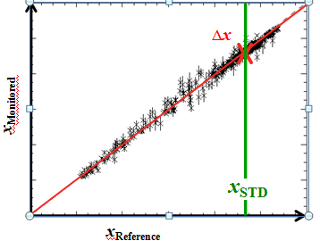
Introduction-Classical GSICS Products
Classical GSICS products are Correction Products
Bias
Offset
Uncertainty Estimate ( Algorithm)
Figure above shows comparison of reference and monitored instrument fro m which regression coefficients are computed.
Pros
GSICS Community has Experience in creating, Accepting, Assigning maturity and distribution of the correction products.
SNO Algorithms available.
Cons
Need In-orbit references.
Products have very limited users even within the agency.
Difficult to use-> Monitored instrument measurements lie outside the product files and have to be taken from data providers.
Cannot be used for re-calibration, removing scan angle dependence of bias etc..

Slide 16
Results of User Feedback survey
To begin with → Need a platform for providing corrected radiances
Platform could consist of in-orbit references & algorithm to meet
& backed by tools such as ICVS to enable root cause analysis.

Slide 17
In-orbit references
Do we currently have in-orbit references for MW ? NO
The AMSU/MSU L1B FCDR for O₂ bands resembles a typical in-orbit reference that is stable and accurate.
Has scan angle corrected radiances
Trends have been removed
Undergone stringent quality assurance test
Real time quality flags for each pixel come with the product

Slide 18
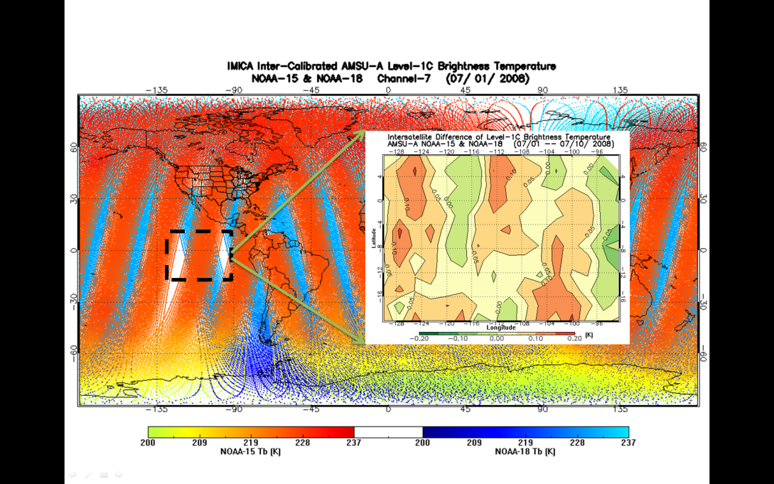
AMSU-A FCDR as a Reference for Cross-Calibration
AMSU-A onboard six POES satellites were inter-calibrated using Integrated Microwave Inter-Calibration Approach (IMICA)
5 calibration errors were removed/minimized: nonlinearity, bias drift, frequency shift, sun-heating induced temperature variability in radiances;
Inter-satellite Biases were reduced to 0.1-0.2K
19 years of swath data
Dataset available from NCEI CDR website
AMSU-A brightness temperature s for overlapping NOAA-15 and
NOAA-18. Their differences for randomly selected region
(e.g., within the dashed square ) are within 0.1-0.2K.

Slide 19
Overlap with Monitored instruments
AMSU/MSU
FCDR
AMSR (2/E)
JAXA
SSMI
DOD
GMI
NASA
ATMS
NASA
MTVZA
ROSCOSMOS/Ukraine
MWTS-2
China
MSU/AMSU-A FCDR channels overlap with majority of MW instruments
Source: https://www.wmo-sat.info/oscar/instruments

Slide 20
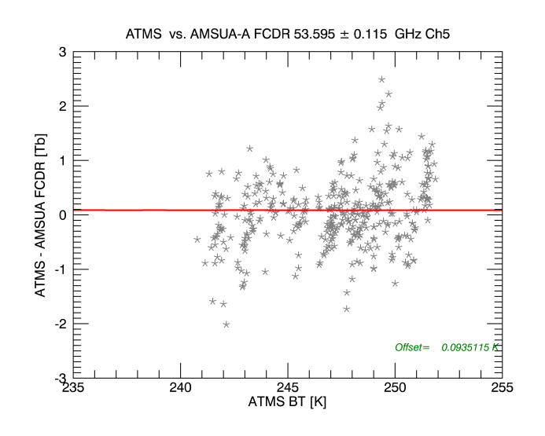
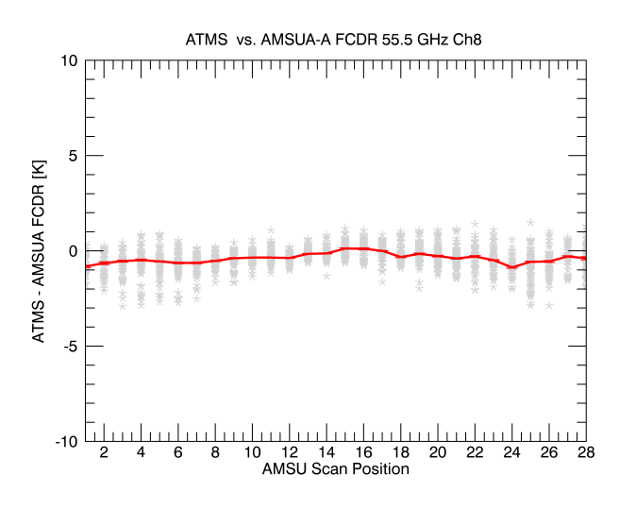
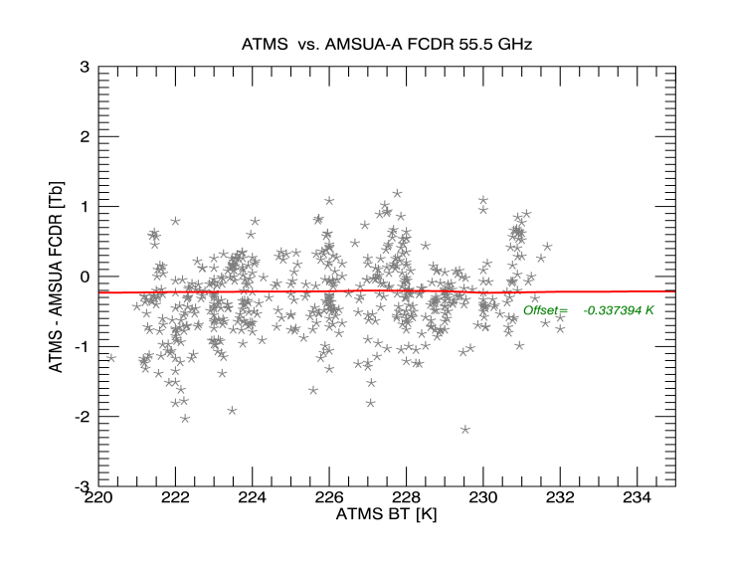
Monitoring ATMS-SDR by SNO inter- comparison with N18
Inter- comparison of ATMS-SDR with FCDR show
Low scan angle dependence of ATMS-SDR
Post launch ATMS-SDR maintains nearly pre-launch level of accuracy.

Slide 21
Proposed MW Product
In addition to meeting above user requirements the products shall also ( and not be limited to classical GSICS products)
Product shall be able to reveal the full scale of Scan Angle, Geographical, Temporal and Temperature dependent bias.
Product shall aid in re-calibration ( User should be able to transition between Count –Radiance – BT space).
Onboard health information (from ICVS) about the instrument health encoded into the product or link to ICVS.
Plug and play model ( product shall be self consistent).

Slide 22
Potential GSICS MW Products
We could monitor the following and create monitoring product
AMSU, ATMS(NPP and J1), SSMI, GMI, MHS as GSICS products
MW products can be classified as:
Retrospective type products (FCDR “components” – geolocation, scan biases, intersatellite corrections, etc.)
Forward looking (quasi-real time) products
Larry, GSICS Annual Meeting, Delhi, April 2015

Slide 23
More possible MW deliverables
Level 1 adjustments and corrections (Result in Classical products)
Methods (e.g., SNO or double difference)
Need to address
References, transfers, stability
Spectral region idiosyncrasies
Satellite and Instrument Data Bases
OSCAR (SRF -> product, etc.)
Provide Geolocation and FOVs
Identify and catalog anomalies and periods of coverage
FCDRs and ECVs
Users for reanalysis versus real time
Components, homogenization approach (Documented, reviewed algorithms)
MW FCDR to GSICS Product example for discussion
References (These cover all spectral regions not just MW.)
Solar
Lunar (ROLO and GIRO)
DCC (radiance levels, frequencies?)
Targets (Surfaces emissions and reflectivities?)
Tools (SNO identifier, Display Graphics, Communication, Notification …)
Documents (Journal articles, ATBDs, Users’ manuals)
RTMs (Vicarious calibration, Error analysis, O-B bias, and comparisons studies)
Stability versus Traceability
Larry, EP -16+
Range of deliverables can be identified
Notes:
In looking over old presentations on GSICS products, Manik provided me with a couple on the GSICS Information Services and Products Roster (GISPR). I'm attaching one to show that we are just following a natural evolution. I do want to make it clear that I am not proposing that most of these all go through the GPPA or other reviews or become named, blessed, hosted GSICS products.
http://www.star.nesdis.noaa.gov/smcd/GCC/documents/GRWG/200901/DAY1_1445_Iacovazzi_GCC_GISPR.pdf

Slide 24
Prepare a Questionnaire to get an idea of requirements of MW community
What are the channels you wish to monitor
Do you have the algorithms to monitor
If yes..do they follow maturity matrix and or unit tested etc
If not..would you like to collaborate ->( participate in webmeetings, exchange ideas and algorithms . Shall we have a GIT to upload/download codes.
Best Combination of references are available
In-orbit
Ground based
RTM
RTM+GRUAN
COSMIC (GPS-RO)
Lunar

Slide 25
Questions on each of the topics and communities
What are the channels you wish to monitor---AMSU SSMI ATMS??
Do you have the algorithms to monitor
If yes..do they follow maturity matrix and or unit tested etc
If not..would you like to collaborate ->( participate in webmeetings, exchange ideas and algorithms . Shall we have a GIT to upload/download codes.
Best Combination of references are available
In-orbit ->>> Are FCDR Good for you
Ground based ->>> What are the Ground based targets..do you need new ones from google earth??
RTM->>> What is the optimum RTM , LBL settings
RTM+GRUAN ->>>Travelling references?
COSMIC (GPS-RO) ->>>What is the best method
Lunar ->>> Method for lunar
What are the channels you wish to monitor

Slide 26
Summary
User needs/feedbacks have been presented
Possible Microwave instrument monitoring Products have been discussed .
In-orbit reference has been proposed that can help create products.

Slide 27
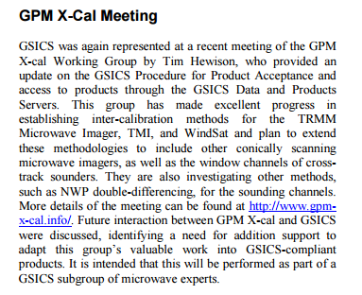
Interaction with GPM-X Cal and CEOS WGCV
In terms of developing GSICS Products for Microwave instruments, the considerations should be:
1. What are the user’s requirements for inter-calibration products?
2. What can we do to meet the desired performance?
3. Can we make products that fit within existing GSICS Conventions and systems?
Cheng-Zhi Zou leading the interaction with WGCV
MWSG Chair to have a communication with GSICS on how WGCV can offer support on best practices.
WGCV Secretariat to send out the list of potential GSICS-WGCV Cooperation items outlined by GSICS to each subgroup chair
WGCV (Completed) Subgroup Chairs to identify and prioritize specific activity areas for interaction with GSICS.
MW subgroup has close links with GPM-X Cal and CEOS-WGCV and will focus on building these relationships in 2016

