Slide 1
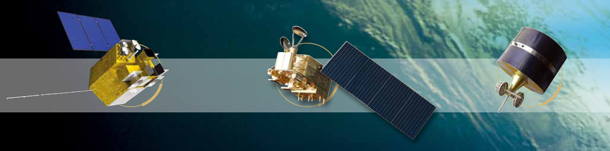

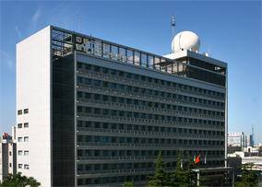


Introduction to Chinses Project:
Solar Bands Calibration Based on Lunar Radiance Source
13-16 November 2017, Xi’an, China
Peng ZHANG
National Satellite Meteorological Center,
China Meteorological Administration
(NSMC/CMA)

Slide 2
Outline
Project Background
Moon Prediction
Ground-based Lunar Observation
Lunar Modeling
Application to FY satellite
Summarization

Slide 3
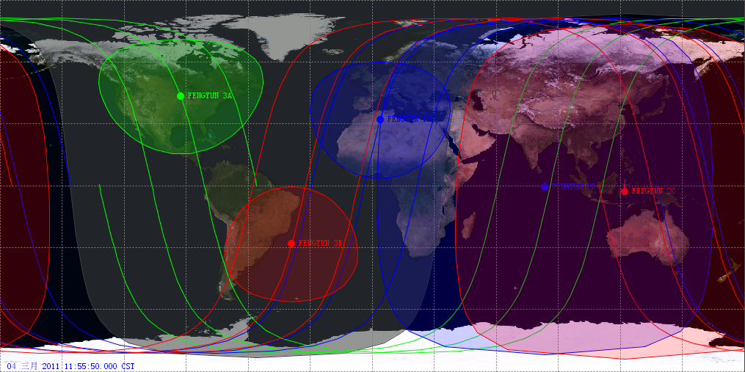
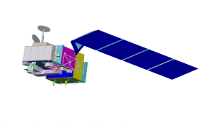
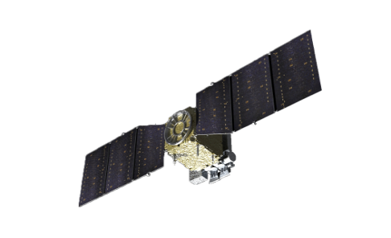
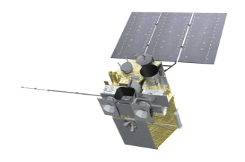
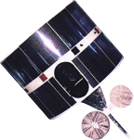
1. Project Background
FY Program: 8 on the orbit, 5 in operation, 1 in trial operation
Joint program: TanSat in commission test
FY-3A
FY-3C
Tansat
FY-4A
104.5
FY-2F
112
FY-2E
86.5
FY-2G
105
FY-2D
123.5
FY-3B

Slide 4
Launched Satellites
Before 2000s: emphasizing to develop the satellite
2000 – 2010 : emphasizing the transition from the R&D to the operational satellite
After 2010s : emphasizing the calibration and validation for the operational satellite

Slide 5
Calibration Procedure
Observed DN
Prelaunch Calibration
laboratory test with on board calibration System
RT Calibration
On-orbit operational calibration
On-orbit Performance Monitoring
Offline Calibration/ Re-Calibration
Validation and Correction with SI-traceable Reference
SDR
FCDR

Slide 6
Status of RT Calibration
Spectrum | On board Calibration System | Instrument | Accuracy of RT Calibration
UV | Solar + diffuser mercury lamp | TOU/FY-3 SBUS/FY-3 | 5% ～ 10%
SRB | VOC | MERSI/FY-3 | can’t work Field Calibration per year, 7% Lunar Calibration since FY-3C, 3% ～ 5%
 | halogen tungsten lamp | ERM/FY-3 | ?
 | absolute radiometers | SIM/FY-3 | ?
TEB | blackbody | VISSR/FY-2 VIRR/FY-3 MERSI/FY-3 IRAS/FY-3 | 0.5 ～ 1K
 | blackbody | ERM/FY-3 | 0.5K ～ 1K
WM | blackbody | MWTS/FY-3 MWHS/FY-3 MWRI/FY-3 | 1K ～ 2K

Slide 7








Joint Project
  FY Polar Satellite Program
  National High Technology Research & Development Program of China (863 program)
National Satellite Meteorological Center (NSMC), CMA
National Astronomical Observatories Of China (NAOC), CAS
Jilin University
Nanjing University
Changchun Institute of Optics, Fine Mechanics and Physics (CIOMP), CAS
Xi'an Institute of Optics and Precision Mechanics (XIOPM), CAS
Anhui Institute of Optics and Fine Mechanics (AIOFM), CAS
Shanghai Institute of Technical Physics (SITP), CAS

Slide 8
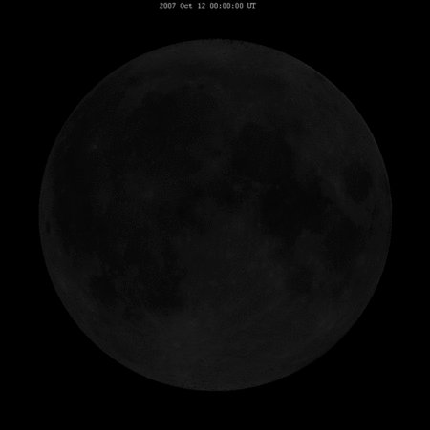
Key Issues to be involved
Grant time: 2015.04
Moon prediction, registration for FY satellite
High-precision ground-based lunar observation
Lunar Modeling (Irradiance Model + Radiance Model)
Radiometric calibration based on reflected lunar light for FY satellite

Slide 9
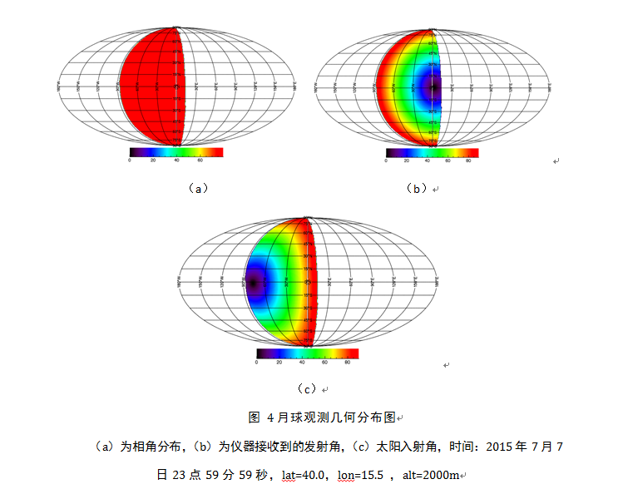
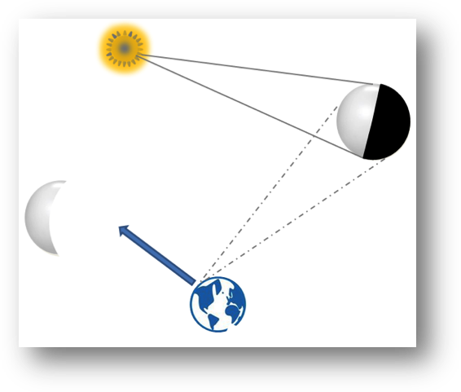
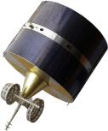
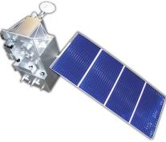
2. Moon Prediction
Ground-based /Space-based
lunar observation
Phase angle
View angle
Lunar prediction (phase angle + geometry condition) based on the NASA JPL SPICE tool and ephemeris, which can be used for ground/space-based lunar observation.
Solar incidence angle

Slide 10
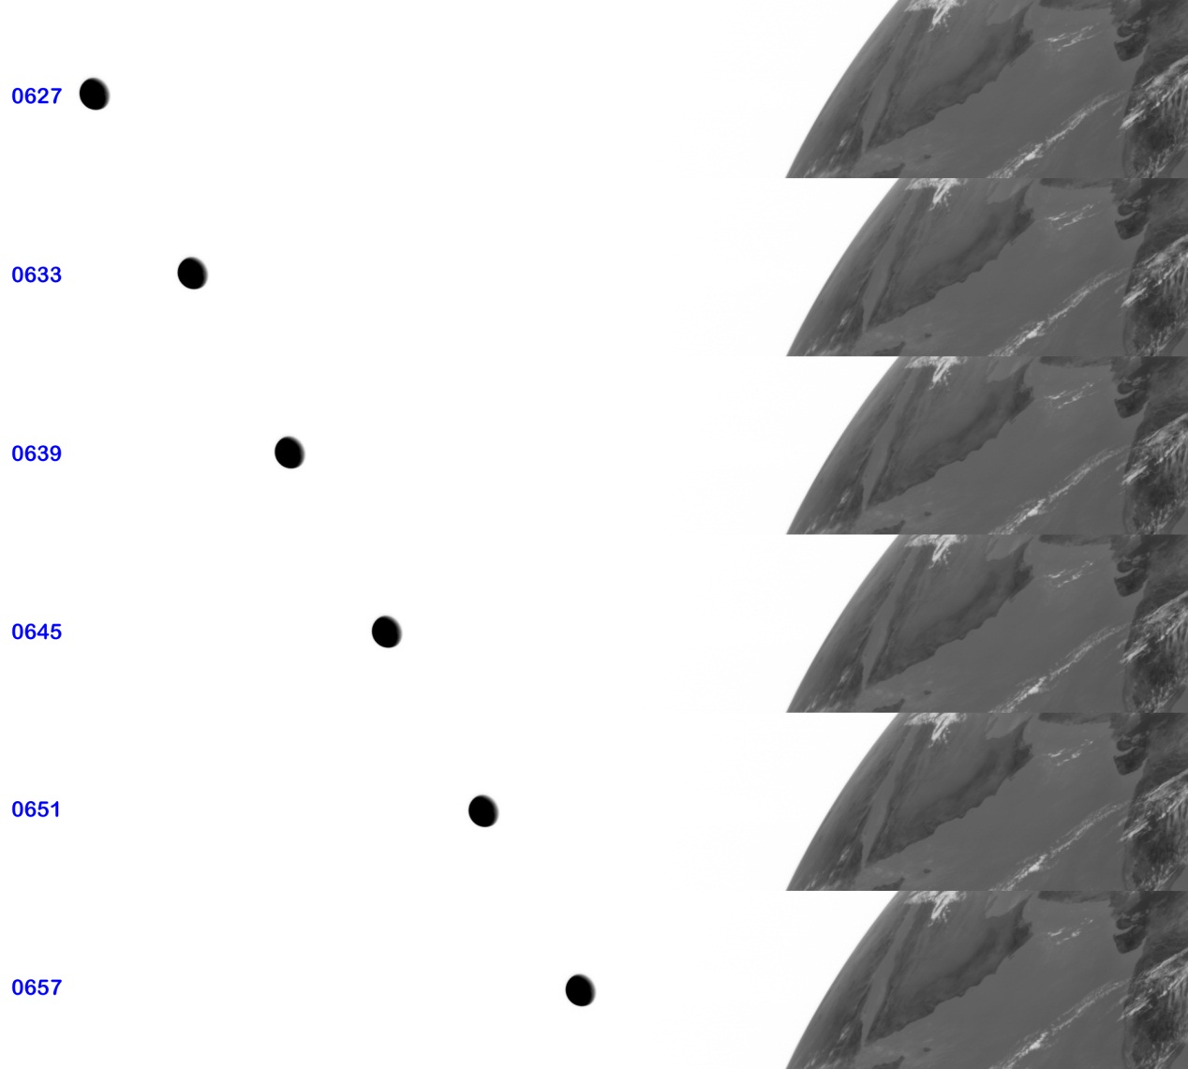

Lunar image observed by FY-2G on Feb. 7 2015 after changing observation area
Guiding satellite conducts a lunar observation
Lei Yang (CMA): Moon prediction, registration and navigation for FY satellite
Matched Lunar Image

Slide 11
FY-3 visible band calibration
FY-3C lunar observation mode and data
lunar image observed by different FY-3C/MERSI bands
R H Wu (CMA): Lunar data preparation for MERSI/TanSat

Slide 12
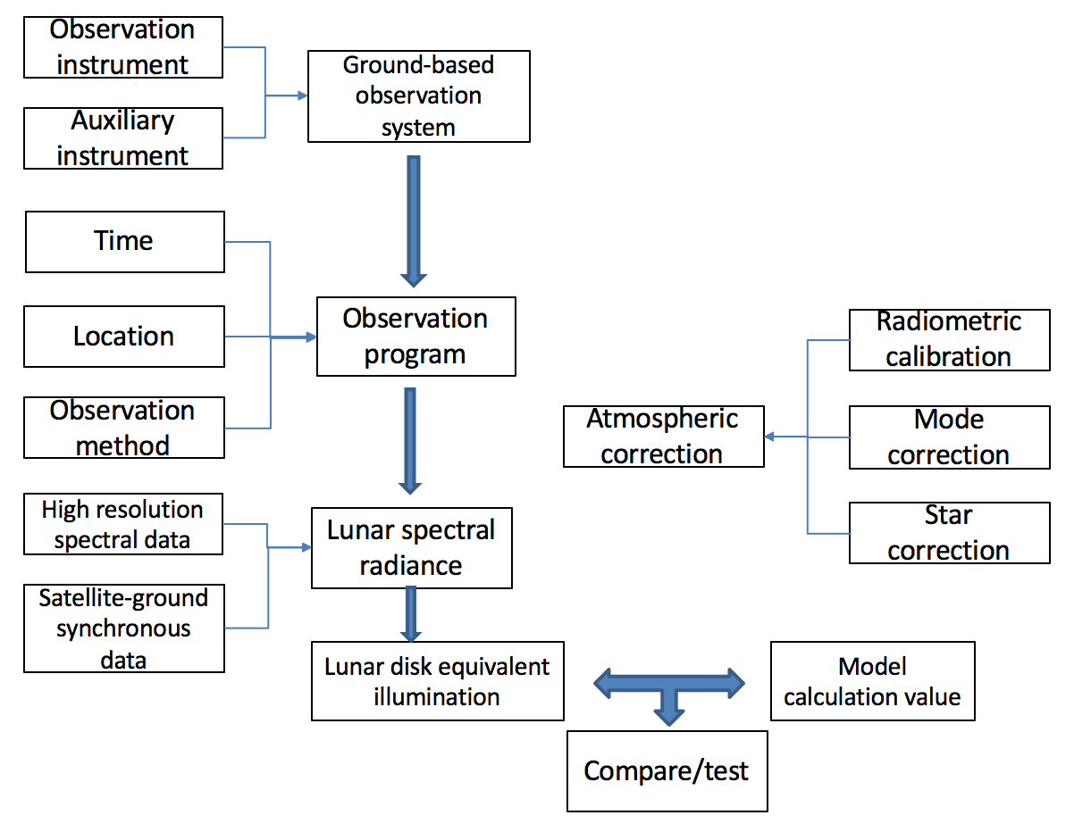
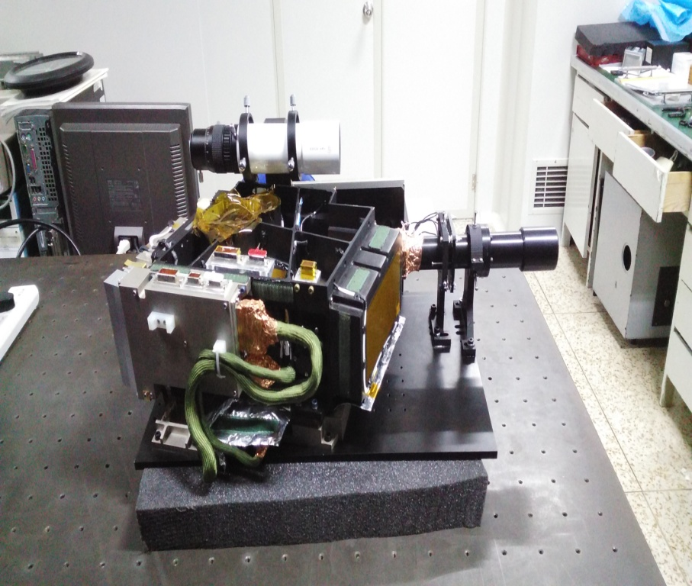
3. Ground-based Lunar Observation
Lunar spectral imager
Lunar Spectral Imager | Specification
Spectral range | 400-1000nm
Spectral channels | >260
Spectral sampling width | 2-10nm
Field of view | 0.7 degree
Instantaneous Field of view | 0.0056 degree
Pixels across track | 253

Slide 13
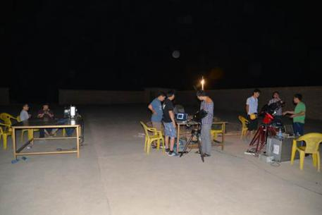
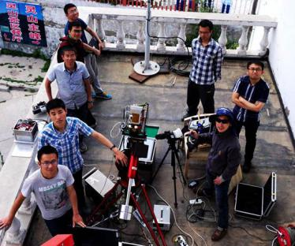
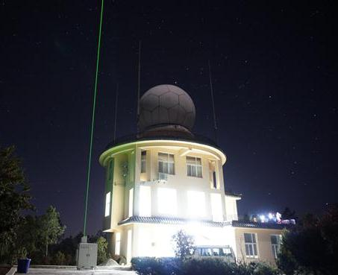
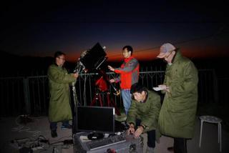
Lingshang Experiment（24 June ～ 3 July, 2015)
Dunhuang Experiment（20 Aug ～ 3 Sept, 2015)
Lijiang Experiment (17 Dec, 2015 ～ 1 March, 2016)
Dunhuang, Gansu
Lingshang, Beijing
Lijiang, Yunnan

Slide 14
 | Instrument | manufacturer | Spectrum | Experiment
Lunar | Lunar Spectral Imager | CIOMP | 400-1000nm with 2~10nm | Lingshan, Dunhuang, Lijiang
 | Lunar Spectral Imager | SITP | 450nm~1000nm with 2~8nm | Lingshan, Dunhuang
 | Lunar Spectral Imager | XIOPM | 900nm~2500nm, 60 channel | Lijiang
 | Lunar Spectral Photometer | CIOMP | 350-1100nm with 1~5nm | Lingshan, Dunhuang, Lijiang
 | Lunar photometer | CIMEL | 10 channel | Dunhuang, Lijiang
Atmosphere | Lidar | 704 | 532nm; 1064nm | Lijiang
 | CE318 Sun photometer | CIMEL | 9通道 | Lingshan, Dunhuang, Lijiang
 | Radiosonde | VISALA |  | Lijiang
Ref. | ASD FieldSpec® 3 | ASD | 350-2500nm | Lingshan, Dunhuang, Lijiang

Slide 15
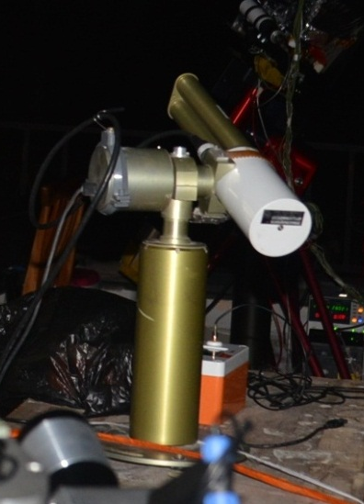
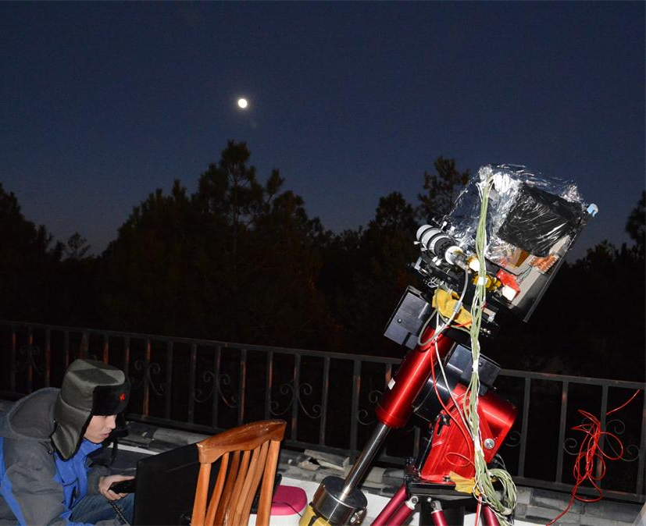
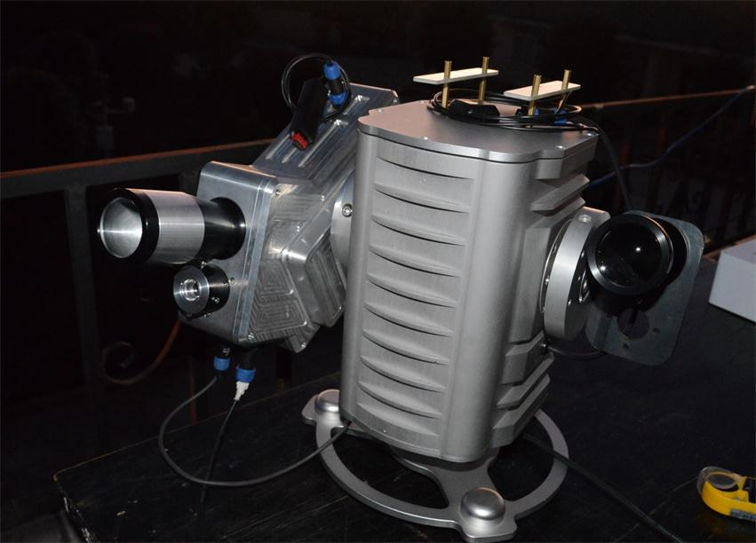
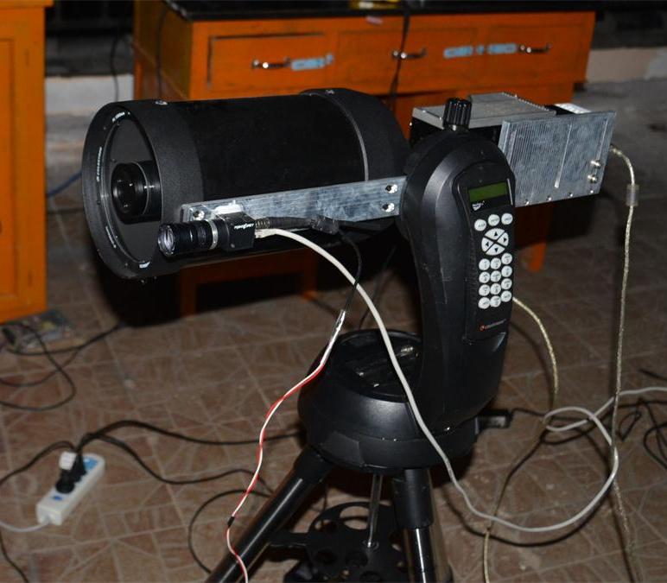
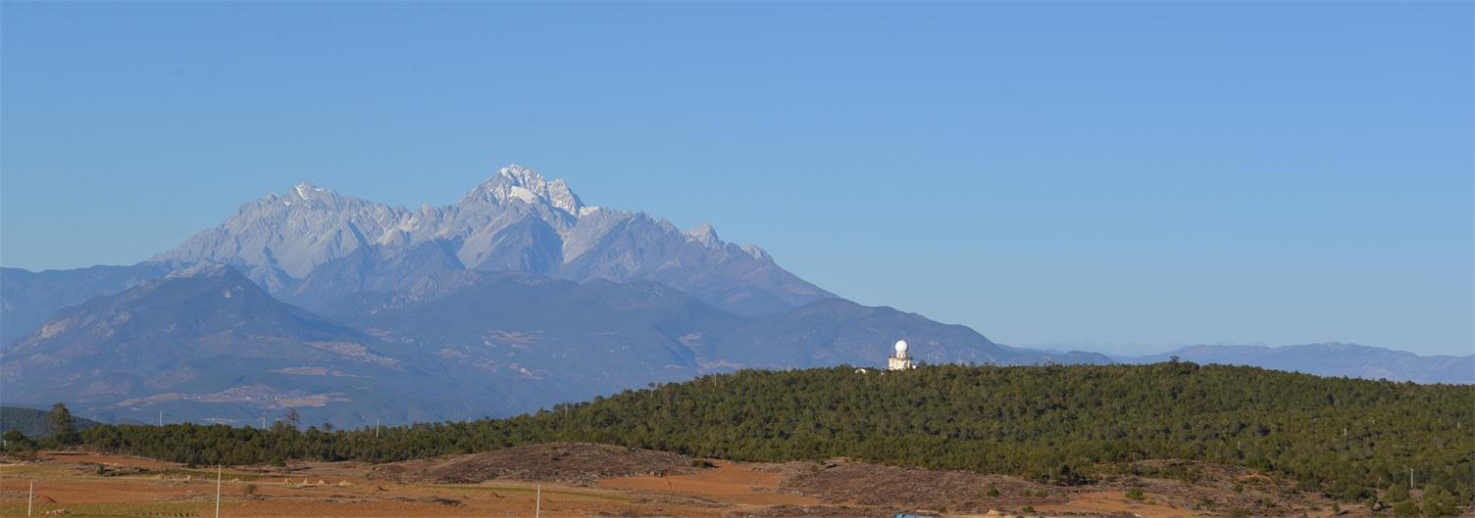
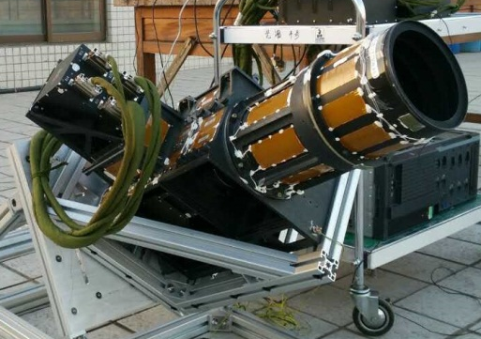
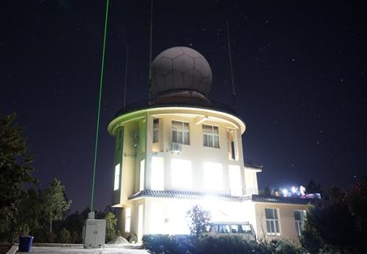
Lunar radiance observation experiment at Lijiang, Yunnan
high-spectral lunar photometer
Lunar imager
AOTF imager
CE318U Lunar-photometer
HSFTS
Jade Dragon Snow Mountain
Lijiang Radar Station

Slide 16
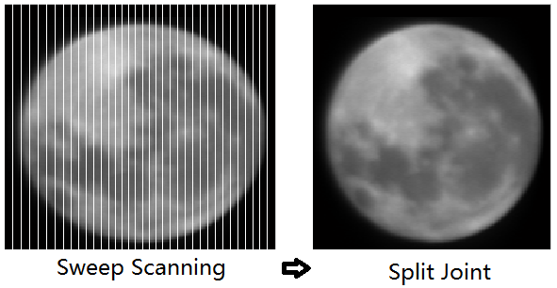
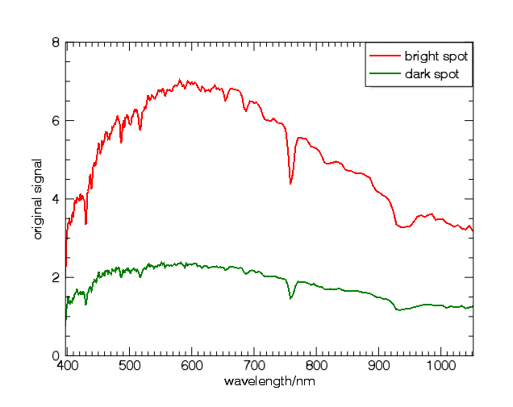
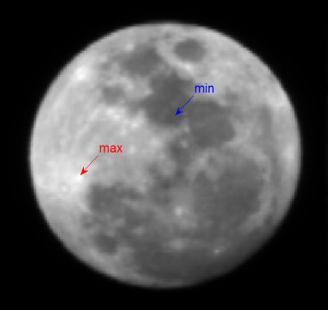
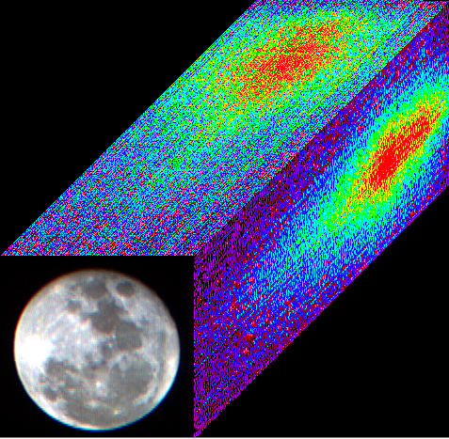
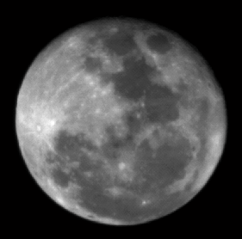
Lunar Spectral Imager
400nm-1000nm continuous spectrum lunar image
Y. Wang, Y. Huang, S.R. Wang, Z.F Li, Z.H. Zhang, X.Q. Hu, P. Zhang, 2017: Ground-based Observation System Development for the Moon Hyper-spectral Imaging. Publications of the Astronomical Society of the Pacific, 129:055002(13pp).
CCD
Spectral imager

Slide 17
Signal comparison between CE318-lunar and lunar imager
(1) wavelength
(2) time
Normalized signals
（1）2015.12.23 : 440，500，677，870nm
（2）500nm: 2015.12.21，201512.23，2015.12.26, 2016.2.17
consistency stability of lunar observation instruments

Slide 18
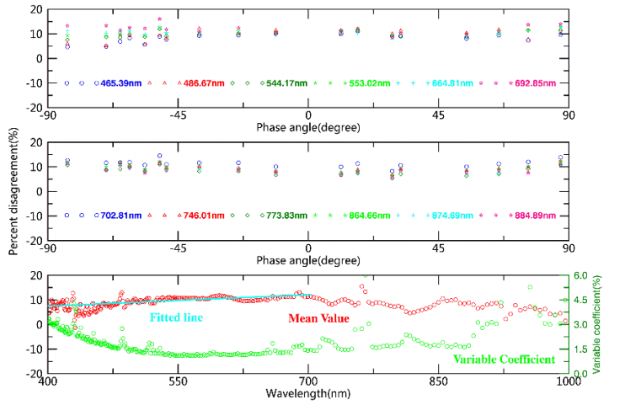
Model validation and Comparison
Using ground-based measurement
ROLO model——GIRO model
Bias between model and measured data by instrument:
International:
Accuracy: on-orbit 5-10%, ground-based 13%
Uncertainty: 1-1.5%
Lijiang：
Difference: 7-12%
Uncertainty: 1-3%
Xiuqing Hu (CMA): Ground-based Lunar observation and results in Lijiang, China

Slide 19
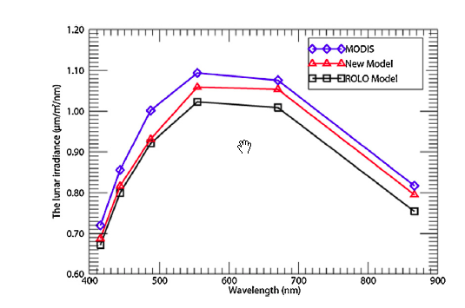
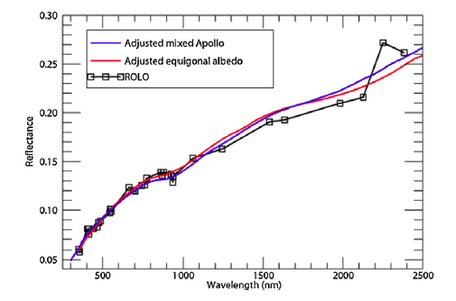
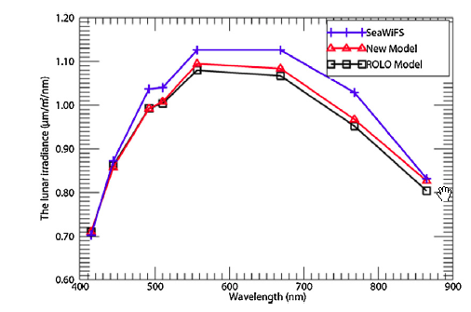
L. Zhang, P. Zhang*, X.Q. Hu, L. Chen, M. Min, 2017: A novel hyperspectral lunar irradiance model based on ROLO and mean equigonal albedo. Optik – International Journal for Light and Electron Optics, 142, 657-664.

Slide 20
4. Lunar Modeling
Data name | Type | Time range | Size | Application
SP | lunar satellite observation data | 2007-2009 | 1.4TB | Model development
M3 | lunar satellite observation data | 2008-2009 | 4.8TB | Model development
CE spectral data | lunar satellite observation data | 2007-2010 | 1.3TB | Model development
FY-3C/MERSI | lunar observation data from Earth LEO satellite | 2013-2014 | 500GB | Operational calibration
MODIS | lunar observation data from Earth LEO satellite | 2000-2004 | 100GB | Operational calibration
FY-2 | lunar observation data from Earth LEO satellite | 2012-present | 1.2TB | Operational calibration
Apollo soil data | lunar soil spectrum | - | 100M | Model Validation
Simulated lunar soil data | lunar soil spectrum | - | 400GB | Model Validation
Ground-base lunar observation data | Lunar observation data | 2015.12-2016.3 | 12.5TB | Model Validation
Lunar image data | Cover 100% lunar surface | - | 800GB | Model Validation
Lunar elevation data | Cover 100% lunar surface, with resolution=500m and 20m | - | 500GB | Model Validation
Mineral distribution | Simulating lunar spectral data | - | 200GB | Model Validation

Slide 21
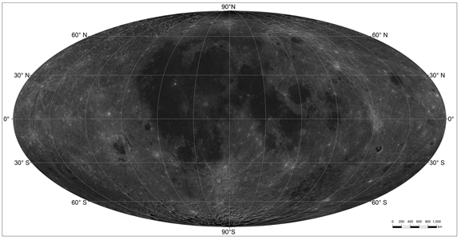
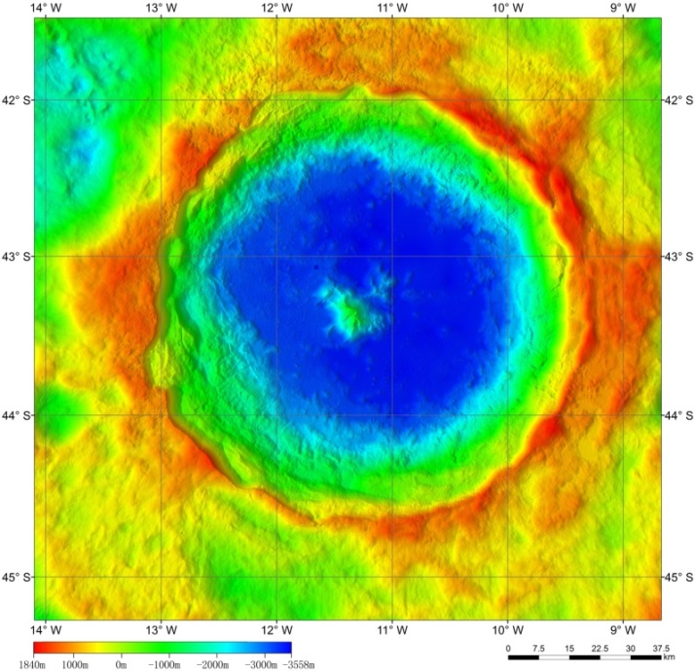
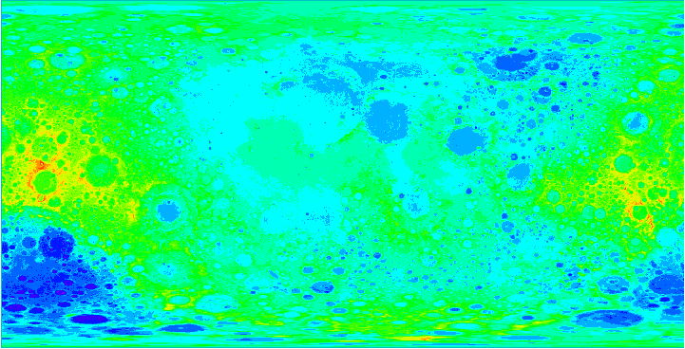
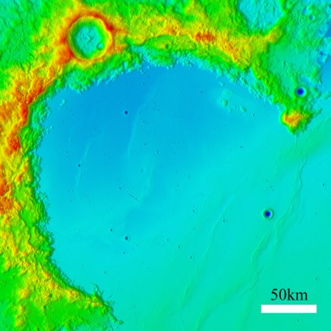
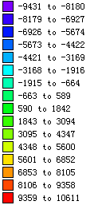
CE-2 full lunar surface DEM within 7m resolution
Tycho crater terrain color map
Rainbow Bay color map
CE-1 DEM within 500m resolution
DEM uses a lunar sphere surface based on a reference plane with a radius of 1737.4km. Accuracies of plane position and DEM: 445m (1σ) and 60m (1σ)
Cited from NAOC

Slide 22
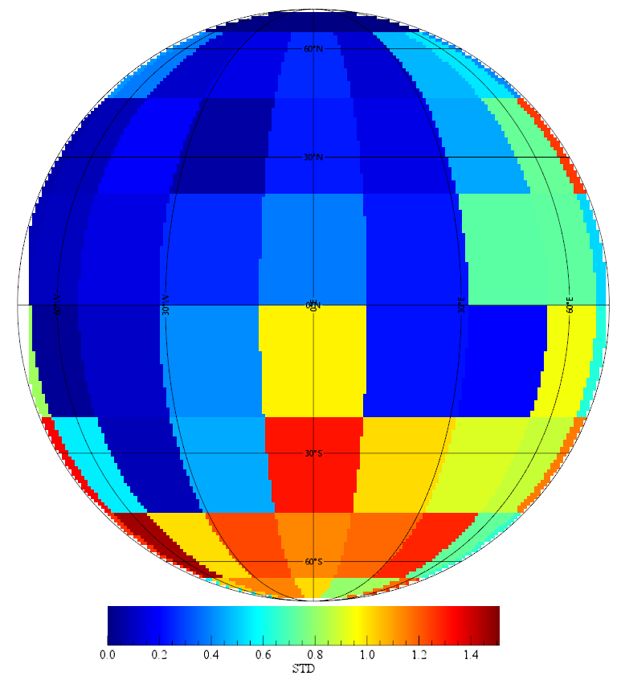
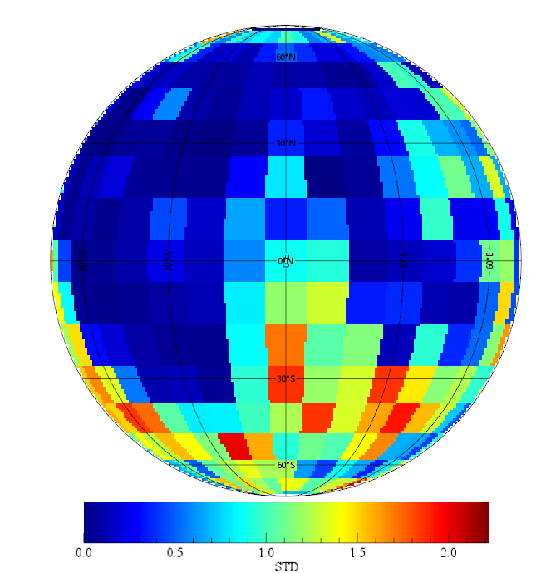
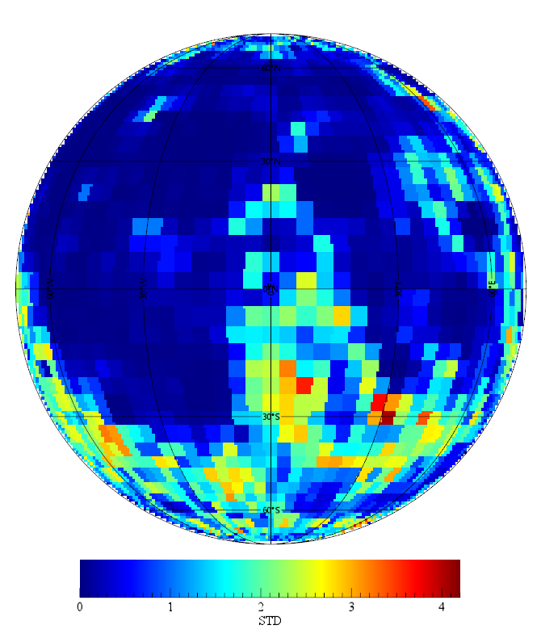
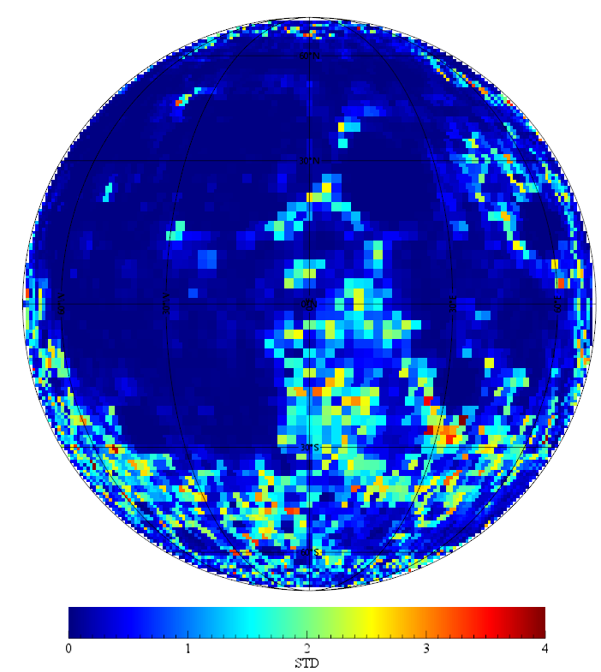
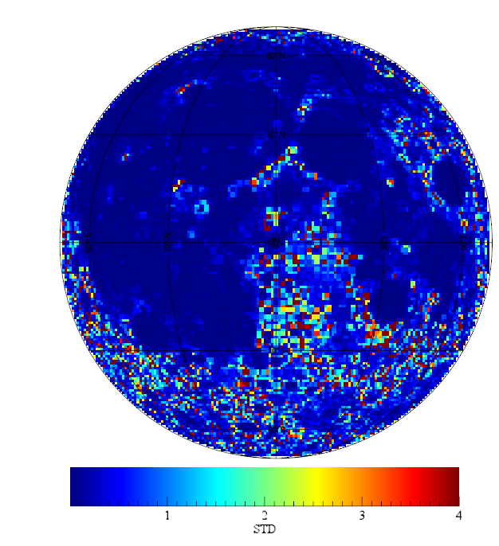
LUT Target Selection: DEM-STD
20º*20º
10º*10º
4º*4º
2º*2º
1º*1º

Slide 23
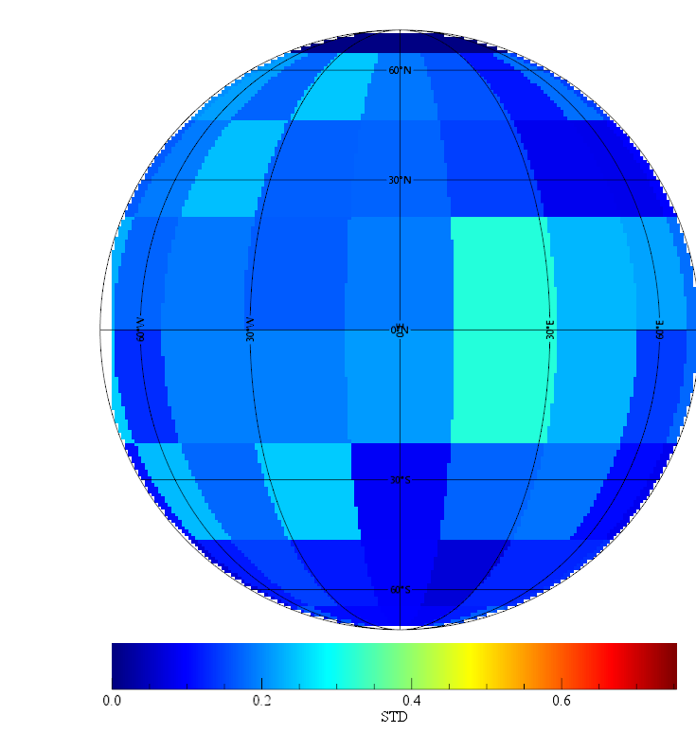
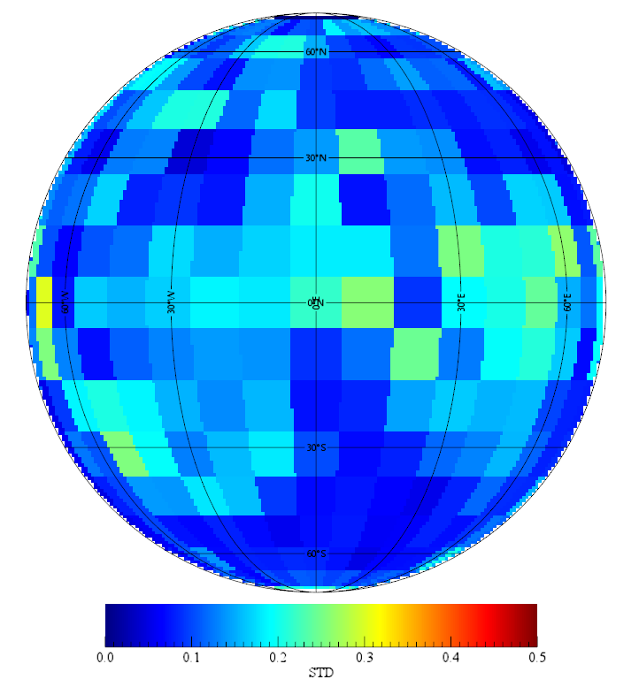
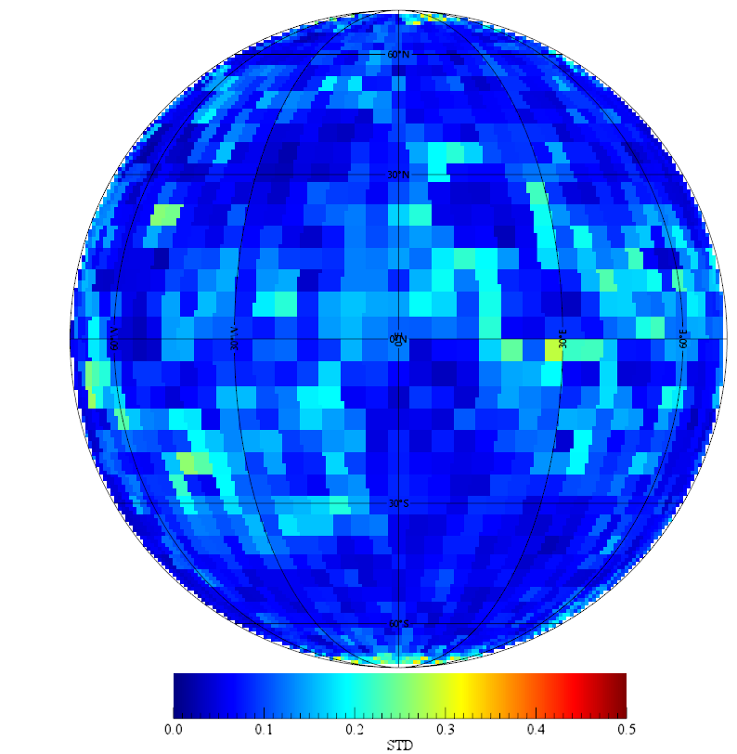
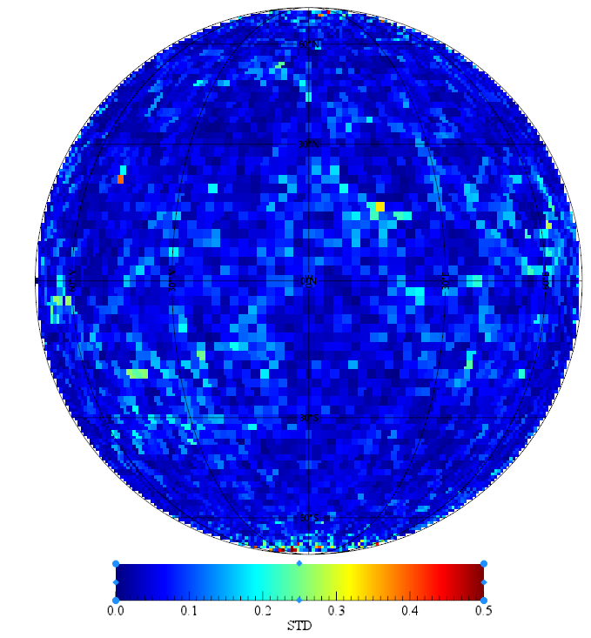
LUT Target Selection: REDF-STD
20º*20º
10º*10º
4º*4º
2º*2º

Slide 24
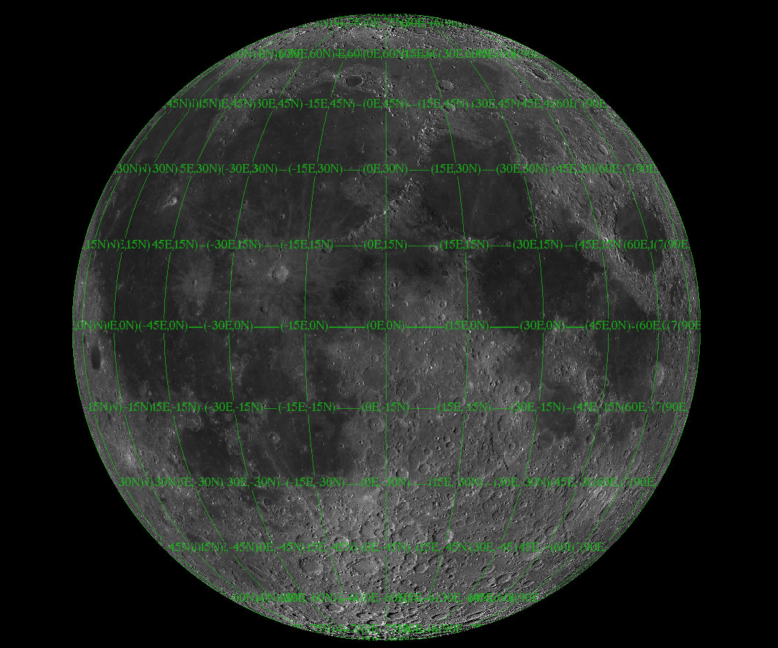
15^{O}N-25^{O}N
15^{O}W-25^{O}W
15^{O}N-25^{O}N
15^{O}E-25^{O}E
15^{O}S-25^{O}S
15^{O}W-25^{O}W
25^{O}S-35^{O}S
15^{O}W-25^{O}W
Based on DEM and RADF

Slide 25



Model Resolution
1⁰*1⁰ gridded lunar model
752.8nm
512.6nm
（a）
（b）
Lunar albedo (a) simulated results, (b) observed result by imager at Lijiang, Yunnan province at Local time 22:21, Feb 19 of 2016
Lunar diameter=10916 km, 1.0°=10916/360≈30km
L. Zhang (CMA): New Lunar model establishment based SELENE/SP observation with incorporated into lunar DEM data

Slide 26



5. Application to FY satellite
FY-2 visible band calibration
Forcast the Moon Event
Extract the Moon
from the image
Calculation the position
information
ROLO Model
Time Period | Lunar Events | Phase angle from
Jan.2010-Otc.2014 | 130（49 without straylight,81 with straylight） | -96.84°~93.48°

Slide 27


Moon
DCC
Blue window: Lunar and DCC are consistent during this period
Red window: Lunar and DCC are not consistent
Line Chen(CMA): Lunar data preparation for FY-2

Slide 28

FY-3 visible band calibration
MERSI trend of Lunar irradiance band ratio

Slide 29
band | Monomial coef | zeroth order coef | F test significance level | Degradation/year/%
1 | -6.56E-05 | 9.28E-01 | 0.00230 | 2.58
2 | 1.44E-05 | 1.02E+00 | 0.15822 | -0.51
3 | ---- | ---- | ---- | ----
4 | 2.15E-06 | 7.62E-01 | 0.88208 | -0.1
6 | -5.08E-05 | 3.93E-01 | 0.00223 | 4.72
7 | -9.16E-06 | 1.60E-01 | 0.24369 | 2.09
8 | -2.55E-04 | 6.40E-01 | 0.00000 | 14.55
9 | -1.80E-04 | 7.82E-01 | 0.00009 | 8.42
10 | -9.40E-05 | 9.59E-01 | 0.00057 | 3.58
11 | -4.16E-05 | 9.33E-01 | 0.03141 | 1.63
12 | -2.38E-06 | 1.02E+00 | 0.93479 | 0.09
13 | -1.00E-05 | 9.63E-01 | 0.45506 | 0.38
14 | -1.60E-05 | 9.34E-01 | 0.40373 | 0.63
15 | -1.09E-05 | 8.64E-01 | 0.44799 | 0.46
16 | -6.73E-05 | 7.03E-01 | 0.03354 | 3.49
17 | 2.29E-05 | 5.99E-01 | 0.16314 | -1.4
18 | -1.74E-05 | 6.34E-01 | 0.71147 | 1
19 | -1.65E-05 | 5.23E-01 | 0.00784 | 1.15
20 | -1.04E-05 | 3.97E-01 | 0.52340 | 0.96
图9 深对流云方法针对通道6和通道7的跟踪结果
Fig. 9 results of Band 6 and 7 by DCC method
Wu R H, Zhang P, Yang Z D, Hu X Q, Ding L and Chen L. 2016. Monitor radiance calibration of the remote sensing instrument with reflected lunar irradiance[J]. Journal of Remote sensing, 20(2): 278-289.

Slide 30
6. Summarization
From this project
CMA initiate lunar calibration algorithm development and make it as one of main calibration methods for all FY optical sensor onboard GEO and LEO satellites.
Initiate to establish the ground-based measurement system of the radiance and irradiance of full disk moon using the hyper-spectral imager and photometer which was developed and keeping improvement step by step.
Conduct the validation and comparison of lunar model using the ground-based measurement data through data processing chain. The result shows that difference from current model is 5~10% and less than 2% uncertainty.
Attempt the lunar model establishment based on the observation from lunar orbit satellites such as IIM/ChangE and SP/SELENE satellites.
Above all are the fundamental jobs for establish Chinese space-borne calibration system based on lunar observation

Slide 31
Future Plan
Conduct more and more measurements by ground-based and space-borne methods, especially long term automatic observation.
Further improve Lunar Radiance Model and Lunar Irradiance Model.
Develop utilization of lunar observation in other alternative application in space-borne sensor characterization.

Slide 32

谢谢！

