Slide 1
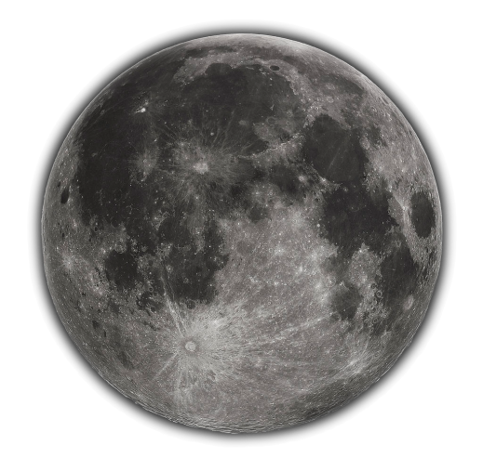
Study on validation of spectral band adjustment factors using lunar hyperspectral measurements
Activity 4: GOME2
Matthijs Krijger
Ralph Snel
Pieter van der Meer
Study funded by

Slide 2
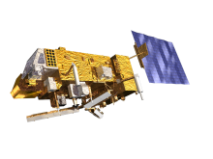
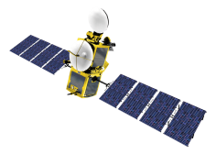
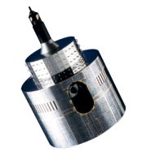
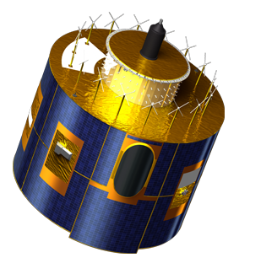
The GOME-2 Lunar observations
Ruediger Lang, Roger Huckle, Christian Retscher, Gabriele Poli, Rasmus Lindstrot, Antoine Lacan, Ed Trollope and Rosemary Munro

Slide 3
Teaser

Slide 4
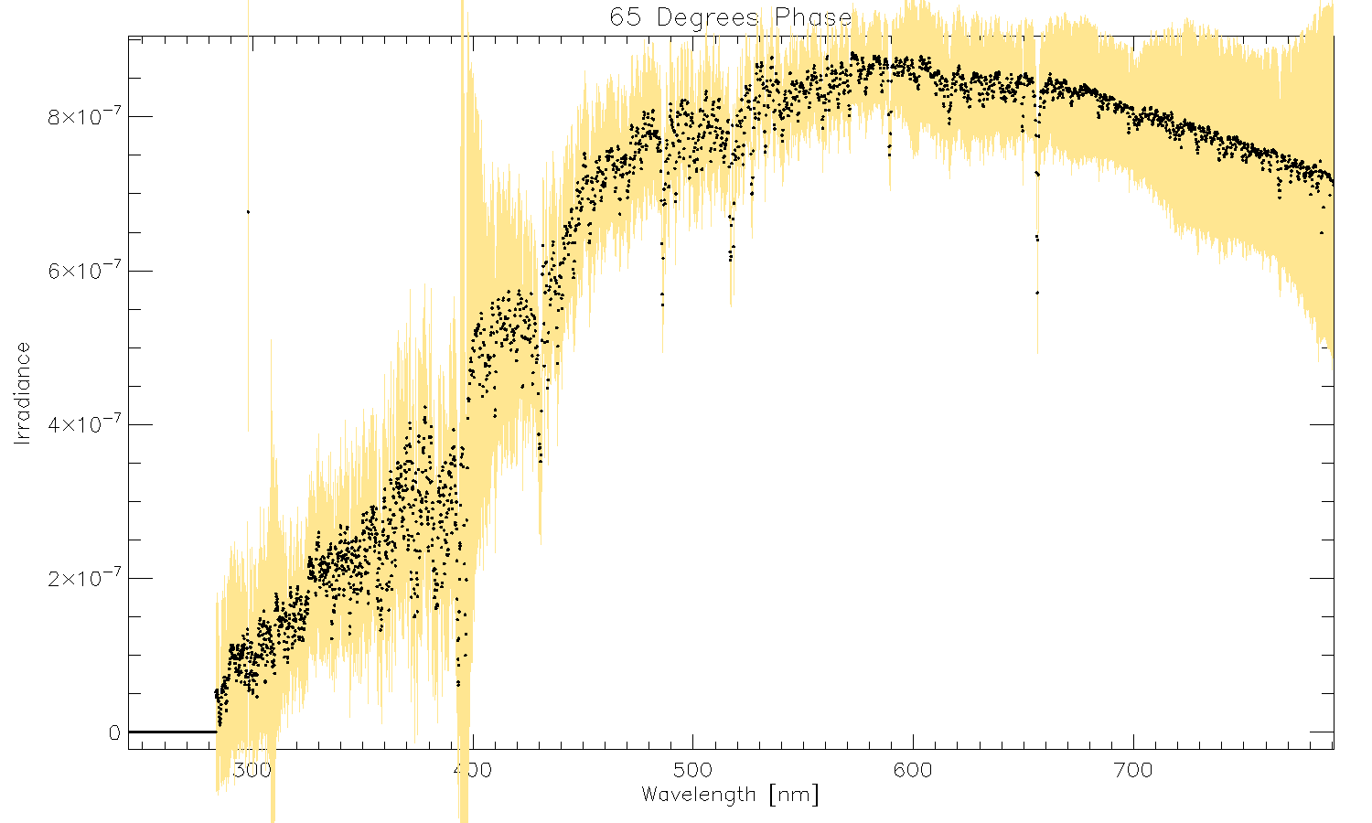
Lunar Irradiance

Slide 5
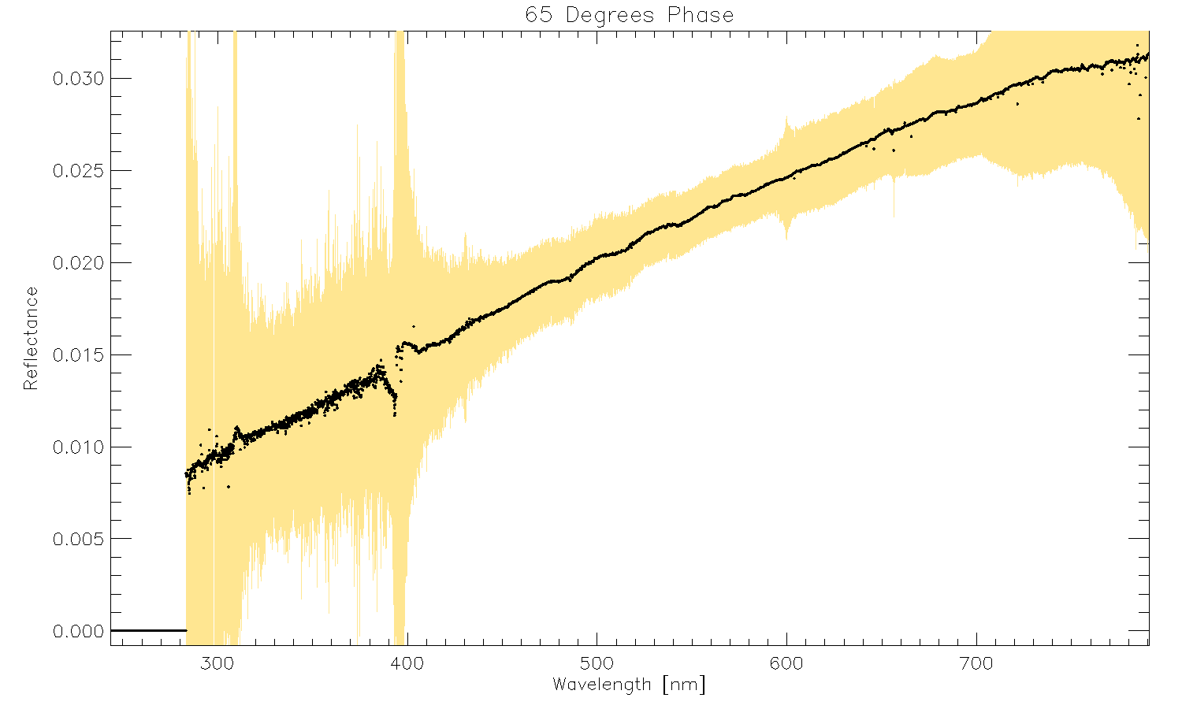
Lunar Reflectance

Slide 6
Content
GOME2
GOME2 Lunar observations
Lunar Irradiance derivation
Lunar variation model
Issues
Results
Comparison GIRO

Slide 7
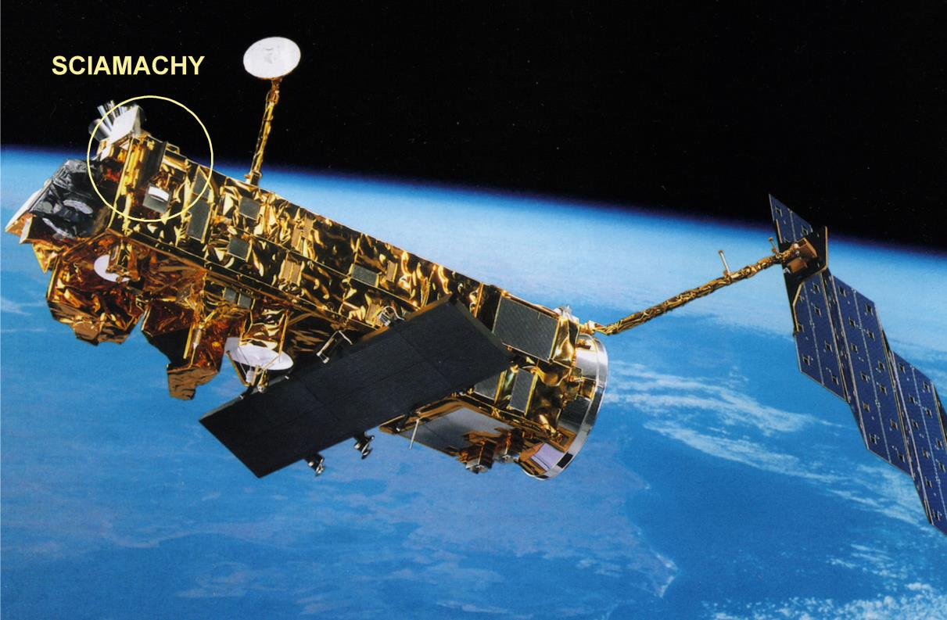
SCIAMACHY

Slide 8
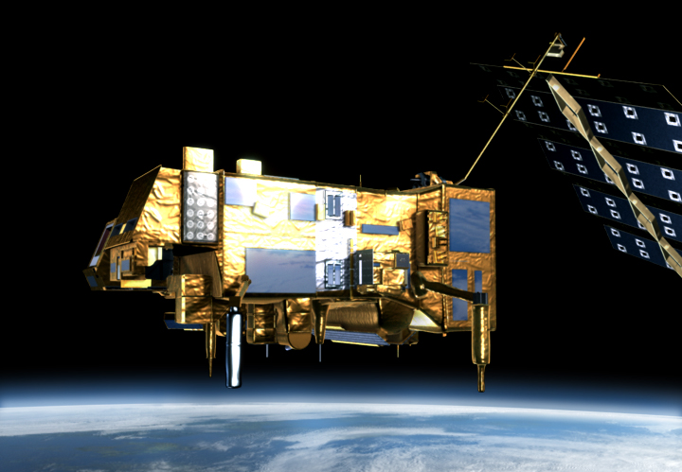
Objective Activity 4
Derive stable lunar irradiance from GOME2

Slide 9
GOME2

Slide 10
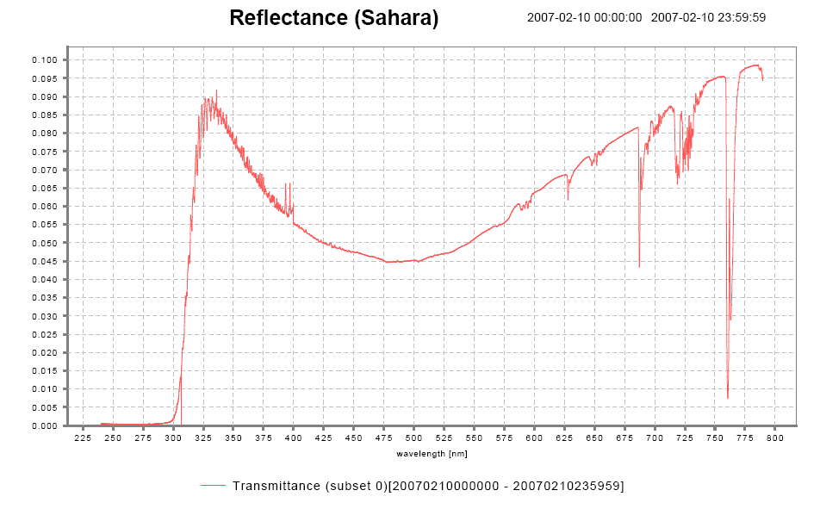
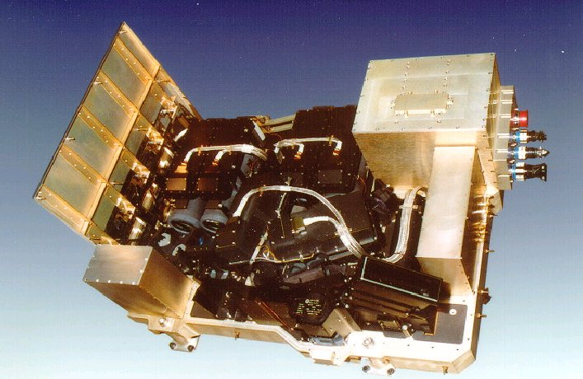
The GOME-2 UVN instrument on Metop Measuring atmospheric composition
GOME-2 main channel transmittance
GOME-2:
series of 3 instruments on Metop (Metop A launched in 10/2006)
sun-synchronous orbit, 09:30
412 orbits (29 days) repeat cycle
Global coverage 1.5 days
240 nm to 800 nm
0.25 to 0. 5 nm spectral resolution (FWHM)
4 channels with 4098 energy measurements of polarisation corrected radiances (40 x 80 km²)
2 channels with 512 energy measurements of linear polarised light in perpendicular direction (S/P) (40 x 10 km²)
HCHO
Aerosol
SO₂
NO₂
O₃
BrO
I/I₀
H₂O
O₃
(O₂)₂
OClO
O₂
240
790
Wavelength [nm]
Orbit file sizes
GOME-2 L1B ~ 1GB
IASI L1C ~ 2GB

Slide 11
Sun Mode
Diffusor
GOME2
NOTE:
“Irradiance” is Lunar Irradiance
not solar irradiance unless explicit

Slide 12
Earth Mode
Scanning Mirror
GOME2

Slide 13
Lunar Mode
Fixed Mirror
GOME2

Slide 14
Lunar Mode
Moon
IFOV
Moon motion

Slide 15
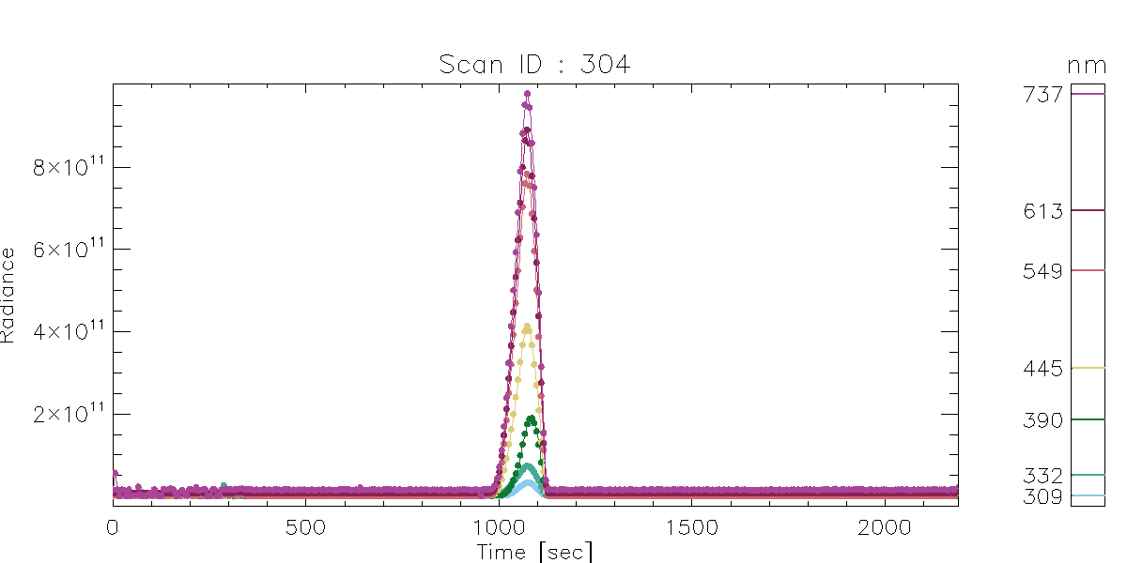
Nominal Lunar Measurement

Slide 16
Measurements

Slide 17
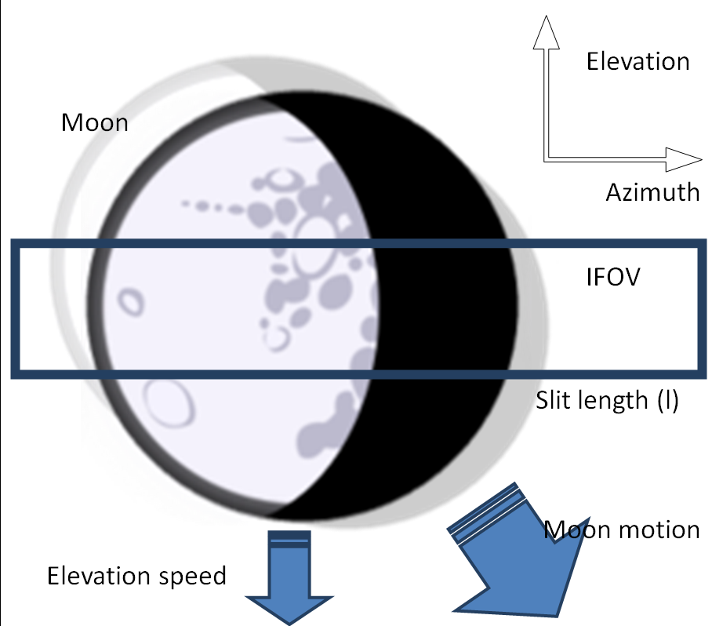
Irradiance Derivation
(all per nm per m2)
R = #photons/sec/sr
S = #photons = R*(L*B)*T
Sum Scan ΣR
I = #photons/sec
I = ΣS / (B/V)
I = ΣR*L*B*T / (B/V)
I = ΣR*L*V*T

Slide 18
Modelling Lunar Variation

Slide 19
4 Models
GOME2 Irradiance
GOME2 Reflectance
GOME2/GIRO Irradiance
GOME2/GIRO Reflectances

Slide 20
Model (for each wavelength)
Reproduces GIRO
P[0]*
1+P[1]* (√(lunar_phase)- √(65°))
1+P[2]*Libration_latitiude
1+P[3]*Libration_longitude
1+P[4]*Solar_longitude
Exp(MJD*P[5]+MJD^2*P[6]*MJD^3*P[7])
Distance_sun_moon^P[8]
Distance_sat_moon^P[9]
Not used
MJD-4720
(Dec 2012)
Fixed
Fixed

Slide 21
Fitting
Weight invalid measurements to zero
Fit degradation relative to GIRO (seed)
Fit model (incl degradation) relative to GIRO
Add distance dependence (P[8:9]=-2)
Fit model (incl degradation) to data
Remove channel overlaps
Both for Reflectance and Irradiance

Slide 22
P[0]
MJD 4720, No libration, Phase 65°

Slide 23
Issues
Degradation
Missing Data
Pointing
Duration
Background
Straylight

Slide 24
Degradation

Slide 25
Fitted Degradation
Wav [nm]
Conclusion: Degradation is there, but can be fitted

Slide 26
Model
as verification
Max
lunar signal
Lunar Slit Model

Slide 27
Sample contaminated Lunar measurement
Channel averages

Slide 28
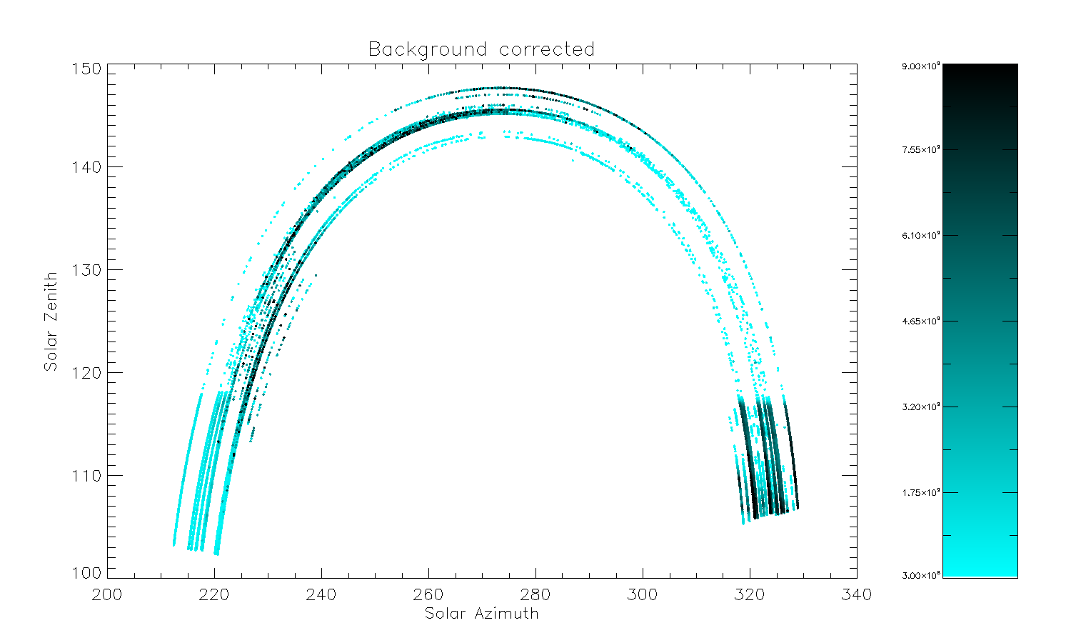
Signal as function of solar position relative to satellite
Remaining
signal
Scatter

Slide 29
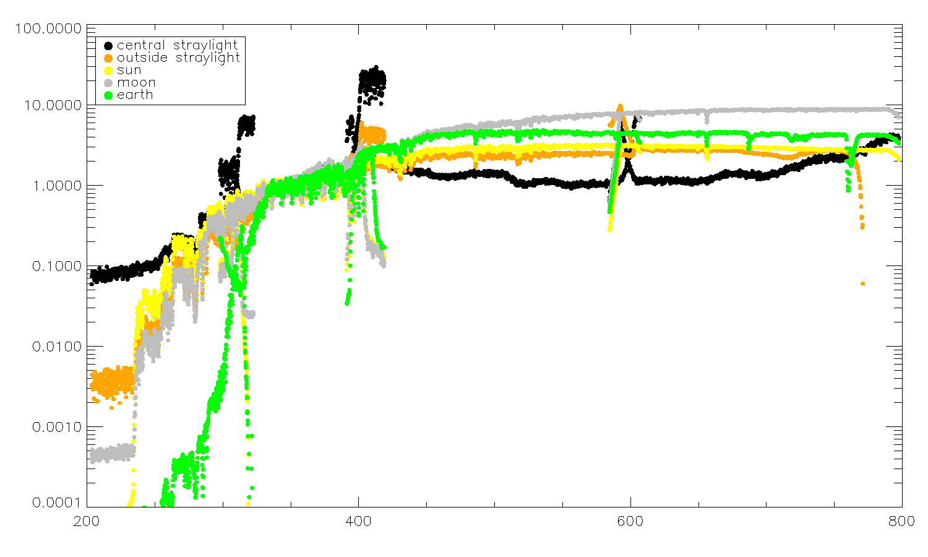
Straylight Spectra compared to know sources
Not Moon
Looks like sun
Incorrect background
Central
Not Earth
Outside

Slide 30
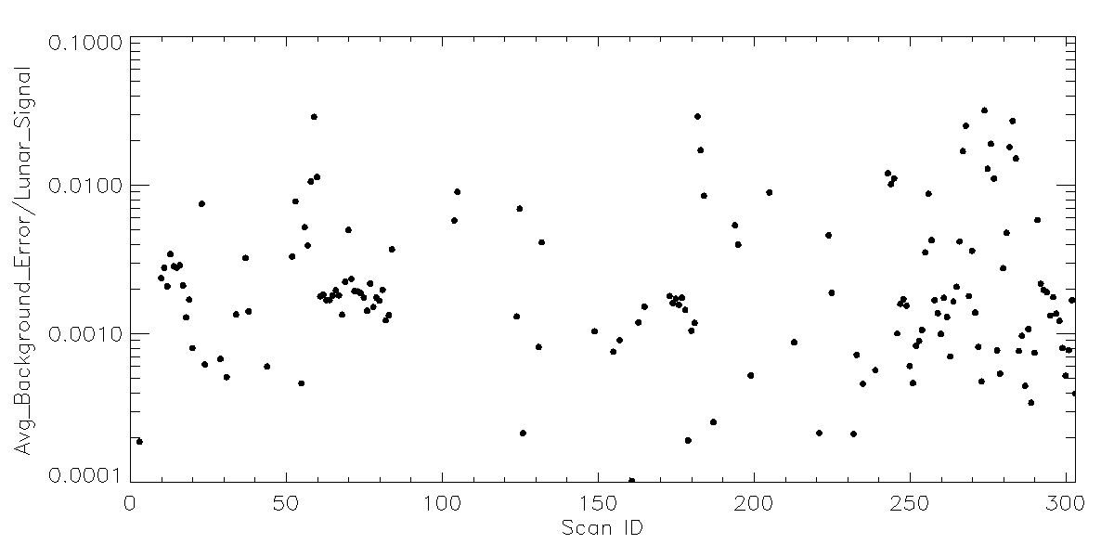
Impact estimate
Conclusion: Straylight will impact relative accuracy
Note: Straylight not random error!

Slide 31
Results

Slide 32
Model (for each wavelength)
Reproduces GIRO
P[0]*
1+P[1]* (√(lunar_phase)- √(65°)) [radians]
1+P[2]*Libration_latitiude [degrees]
1+P[3]*Libration_longitude [degrees]
1+P[4]*Solar_longitude
Exp(MJD*P[5]+MJD^2*P[6]*MJD^3*P[7])
Distance_sun_moon^P[8]
Distance_sat_moon^P[9]
Not used
MJD-4720
(Dec 2012)
Fixed
Fixed

Slide 33
Lunar Reflectance
Dec 2012, No libration, Phase 65°
Lunar Irradiance

Slide 34
Compare to GIRO

Slide 35
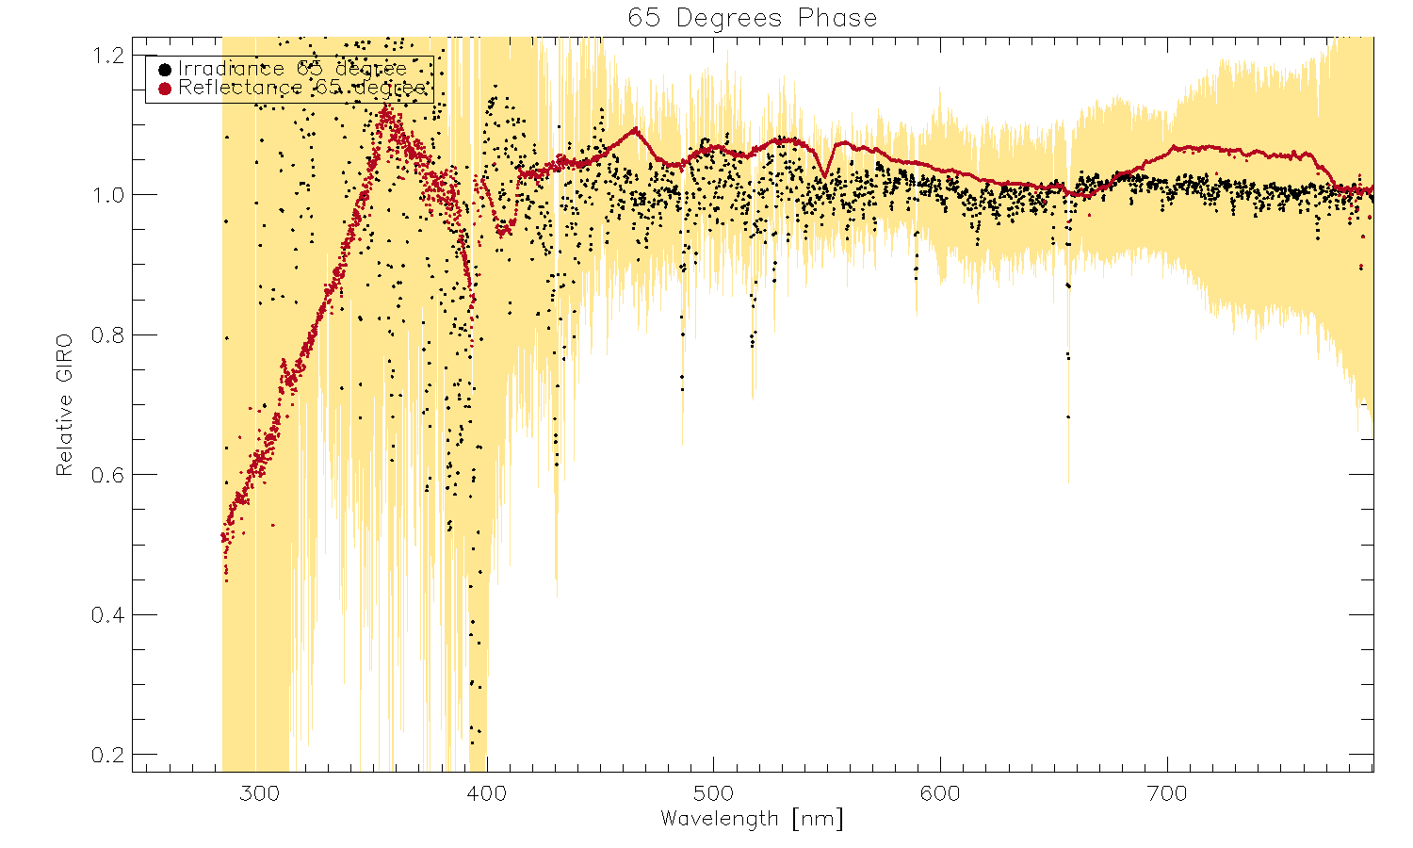

Slide 36
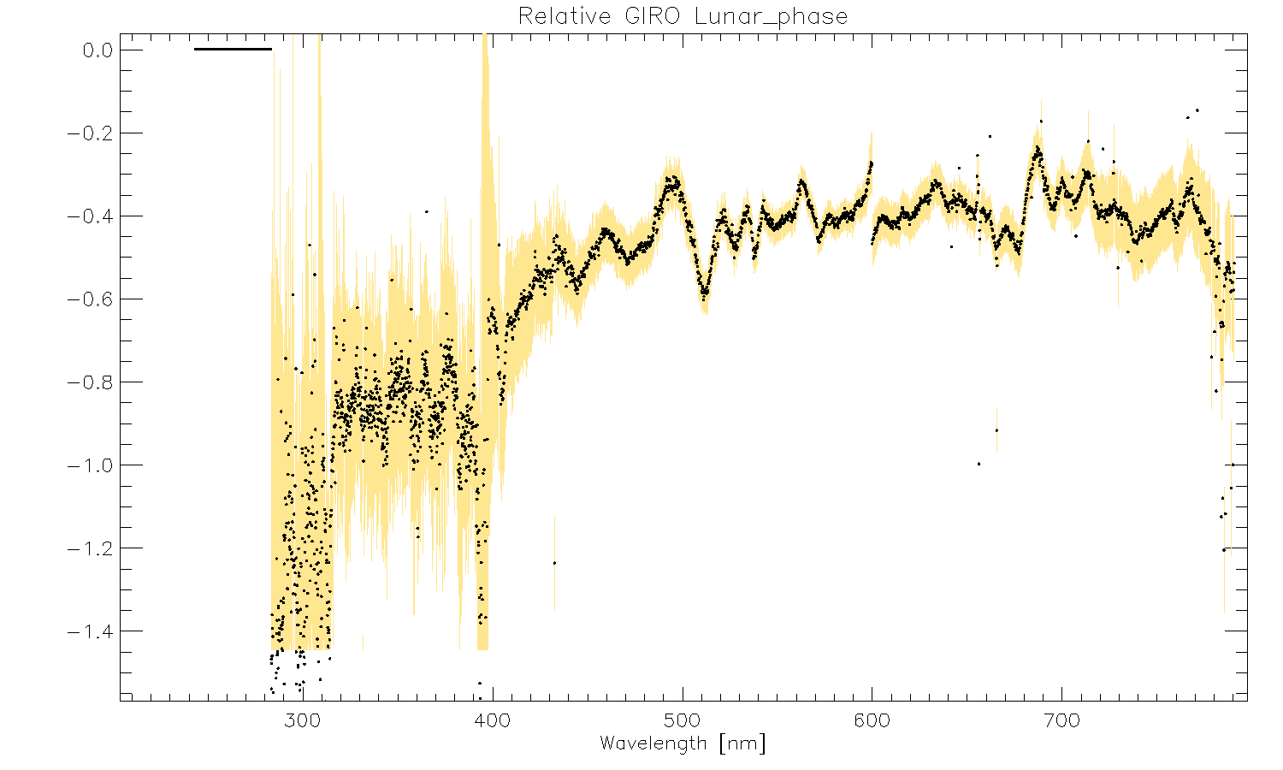
$Δ$/√radian

Slide 37
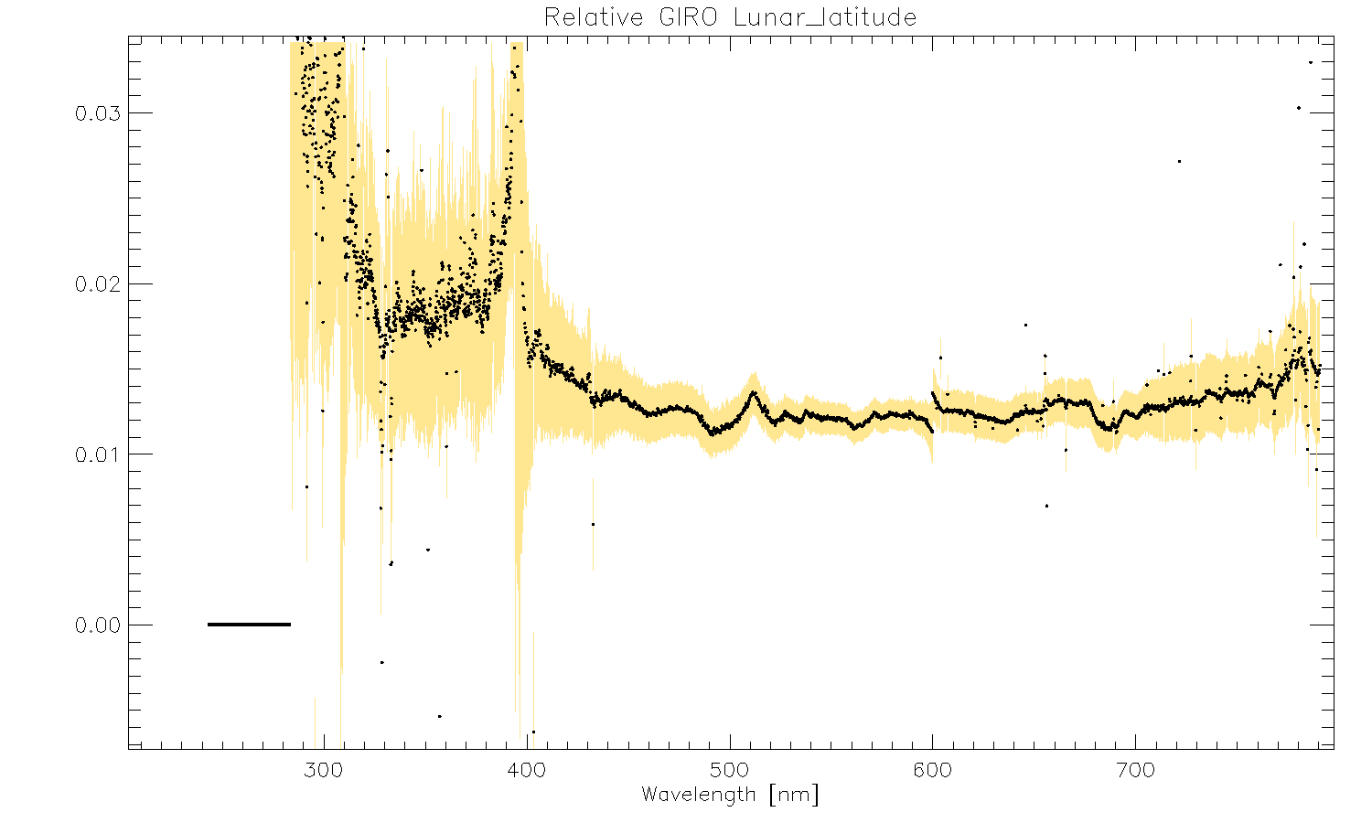
$Δ$/Deg

Slide 38
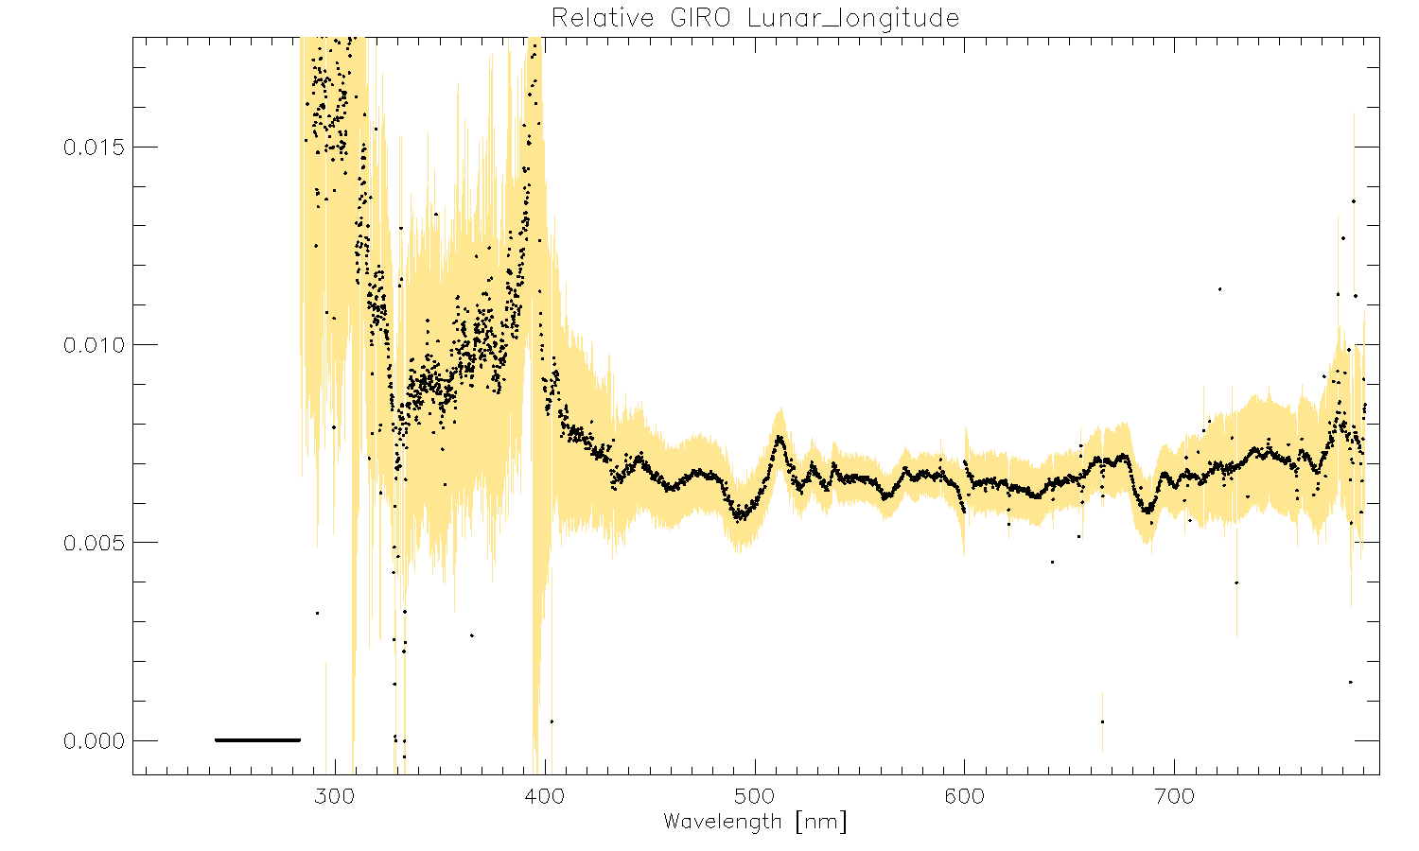
$Δ$/Deg

Slide 39
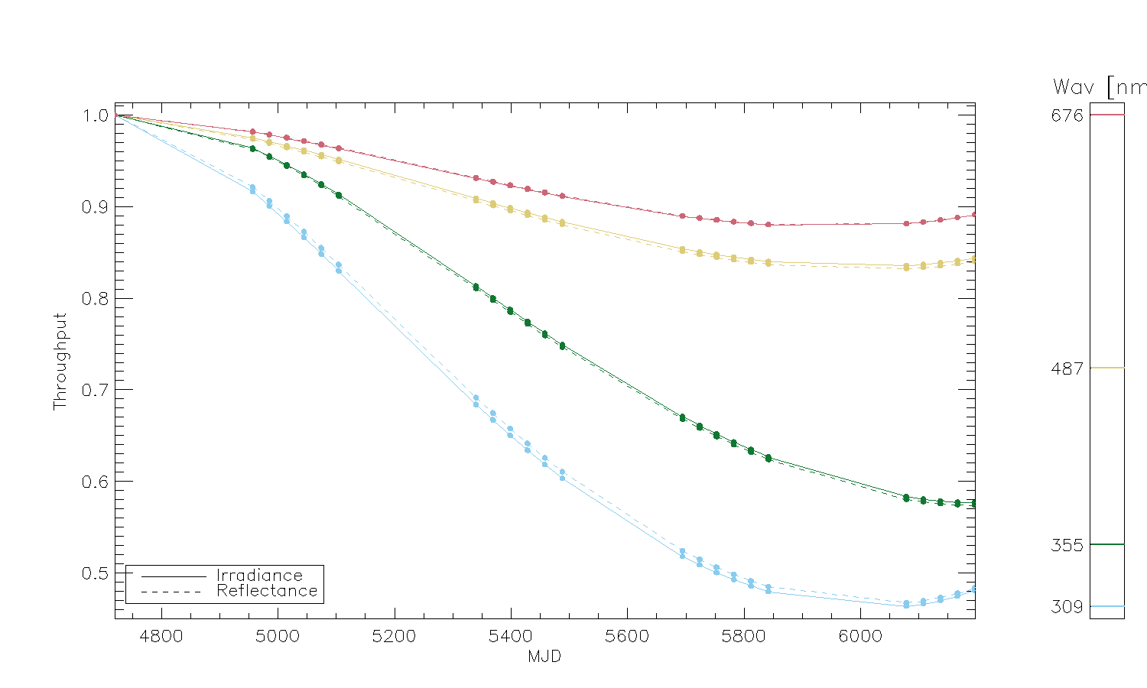

Slide 40
SCIAMACHY vs GOME2
550nm
Lunar phase
Libration

Slide 41
550nm
GOME2 very small phase and libration range compared SCIAMACY

Slide 42
Conclusions
Issues
Degradation
Missing Data
Pointing
Duration
Background
Straylight
Stable lunar irradiance derived
Differences relative GIRO due limited geometries

Slide 43
Thank you!

Slide 44
Extra Slides

Slide 45
Channel Edges

Slide 46
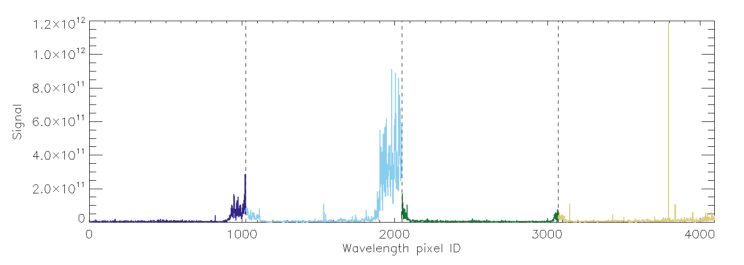

Slide 47
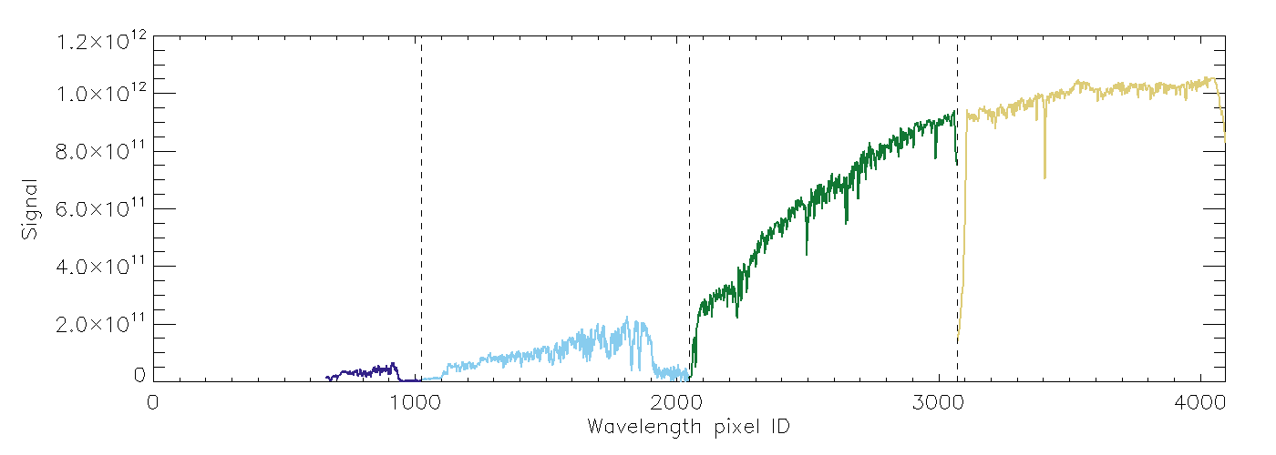

Slide 48
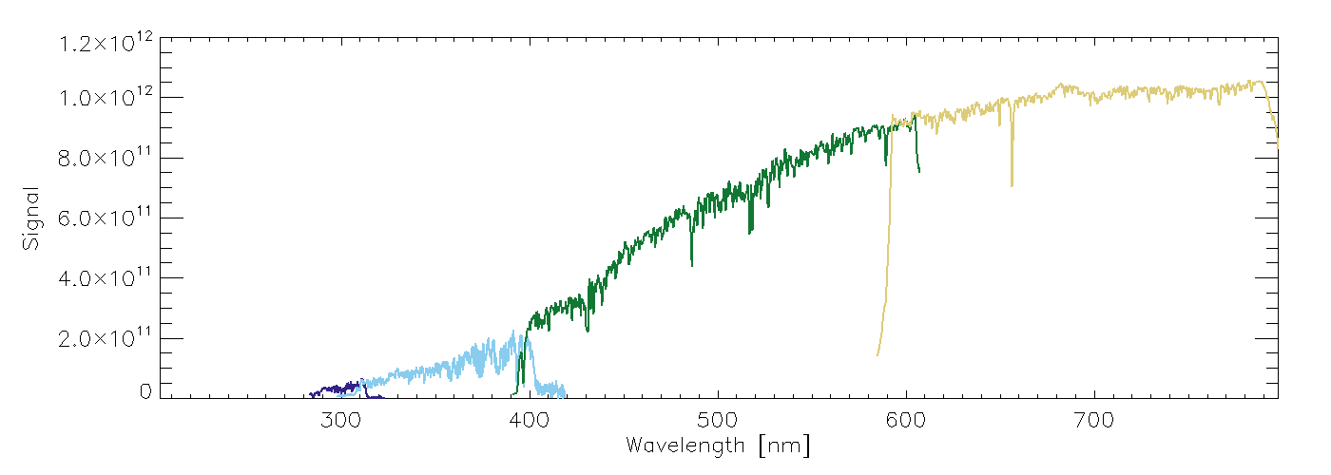

Slide 49
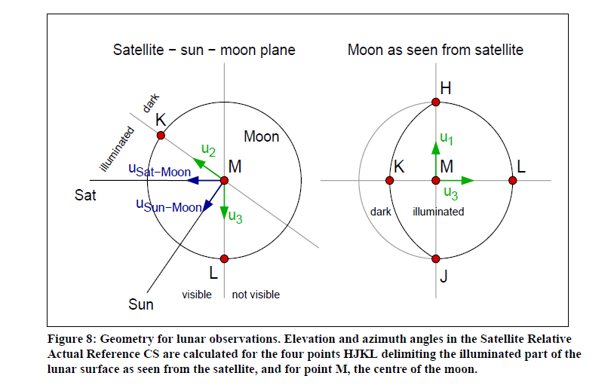
GOME-2 Level-0 to 1b specifications: PGS 7
Lunar observation geometry: Section 5.2.8

Slide 50
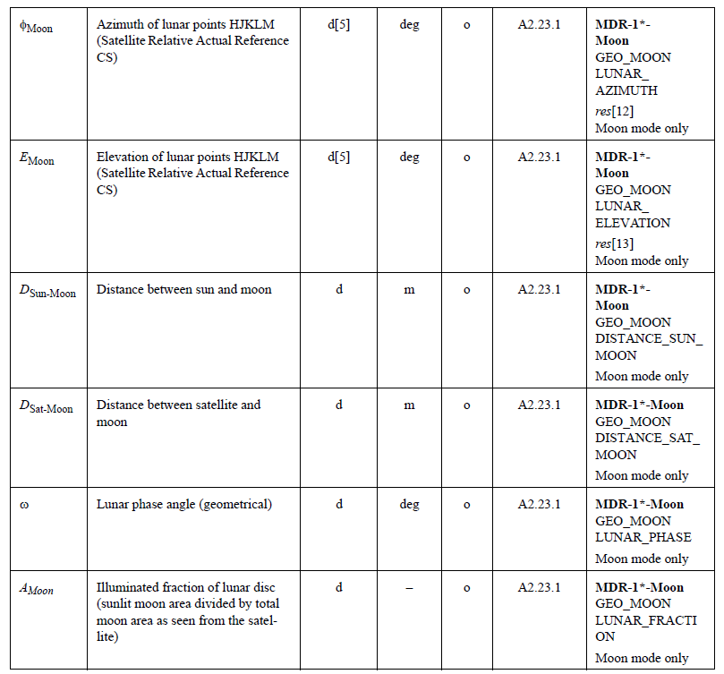
GOME-2 Level-0 to 1b specifications: PGS 7/PFS 9
Lunar observation geometry: PGS Section 5.7.2 (AG.2)
Geometries provided in the
L1B product
MDR-1B-Moon / GEO_MOON

Slide 51
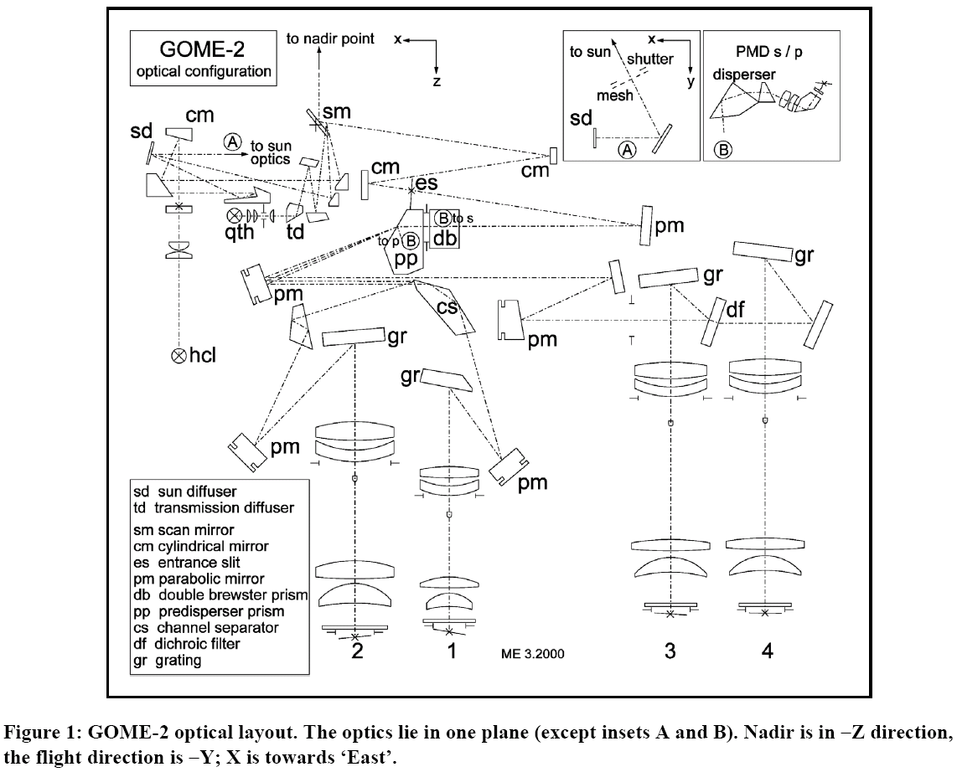
GOME-2 optical layout
Scanning grating spectrometer with a random-access linear silicon photodiode array
Earthshine
Sun I₀ (daily)
Scan Mirror
Solar diffuser
White Light Source
WLS (daily)
Calibration
Unit
Spectral Light Source
SLS (daily)
Common (Earth/Solar/Cal) path

Slide 52
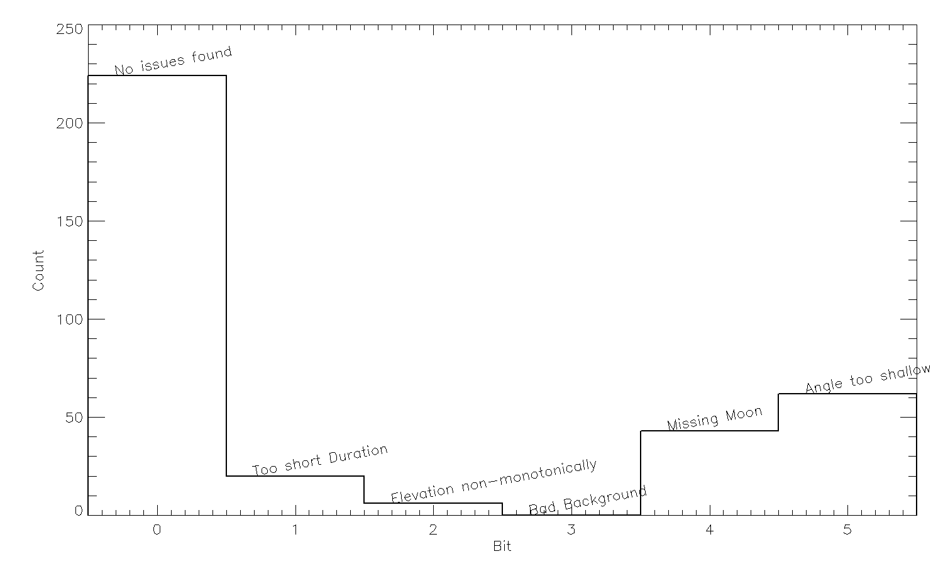

Slide 53
Spectral variation
Date: 04 March 2005 Satellite: Rosetta Depicts: Three lunar spectra Copyright: ESA
Three spectra of three different regions on the Moon:
Blue | = Kepler crater
Green | = Mare Humorum
Red | = Oceanus Procellarum

Slide 54
GOME2A
Simular results (not shown here)
Additional uncertainty
Step-function degradation (2nd Throughput test)
Calibration problem early mission

Slide 55
Recommendations
Degradation
Fact of life
Missing Data
Check Lv0/1 for missing data
Pointing
Check Flight Dynamics
Duration
Extend lunar measurement by 30-60sec both direction
Background
Investigate background from Lv0 (not Lv1)
Straylight
Investigate straylight at Lv0

