Slide 1
Measurements of the Moon by CLARREO Pathfinder and ARCSTONE
Thomas C. Stone ‒ USGS, Flagstaff, AZ
Constantine Lukashin ‒ NASA Langley Research Center, Hampton, VA
GSICS/IVOS 2nd Lunar Calibration Workshop
Xi’an, China
13-16 November 2017

Slide 2
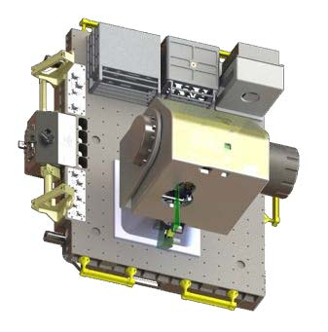
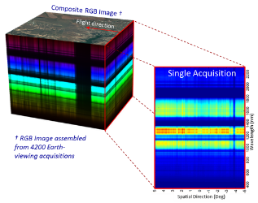
CLARREO Pathfinder Mission
CLARREO Pathfinder will demonstrate essential measurement technologies for the Reflected Solar portions of the CLARREO Tier 1 Decadal Survey Mission
Demonstrate on orbit, high accuracy, SI-Traceable calibration
Demonstrate ability to transfer this calibration to other on-orbit assets
Formulation, implementation, launch, operation, and analysis of measurements from a Reflected Solar (RS) Spectrometer, launched to the International Space Station (ISS)
Category 3 / Class D Mission, nominal 1-year mission life + 1 year science data analysis
Targeted for launch to ISS in early CY2021
Instrument Payload
CLARREO Pathfinder is not the end, it is a critical step along the way to a full CLARREO Mission.
Spectrally-Resolved Earth Reflectance

Slide 3
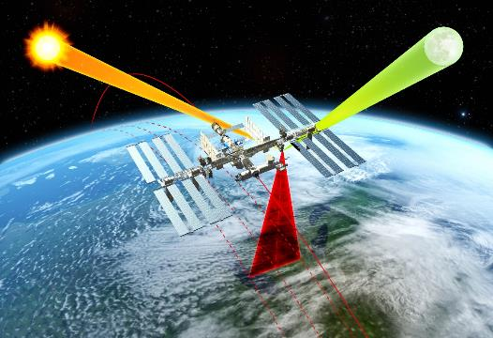
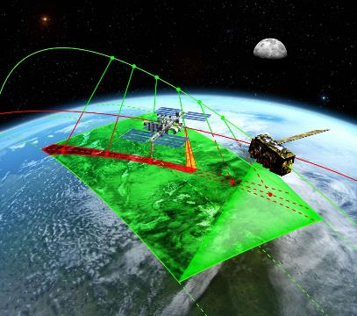
CLARREO Pathfinder — Baseline Mission Objectives
Demonstrate high accuracy SI-Traceable Calibration
Demonstrate Inter-Calibration Capabilities
Objective #1: Demonstrate the ability to conduct, on orbit, SI-Traceable calibration of measured scene spectral reflectance with an advanced accuracy over current on-orbit sensors using a reflected solar spectrometer flying on the International Space Station.
Objective #2: Demonstrate the ability to use that improved accuracy to serve as an in orbit reference spectrometer for advanced intercalibration of other key satellite sensors across the reflected solar spectrum (350-2300 nm).

Slide 4
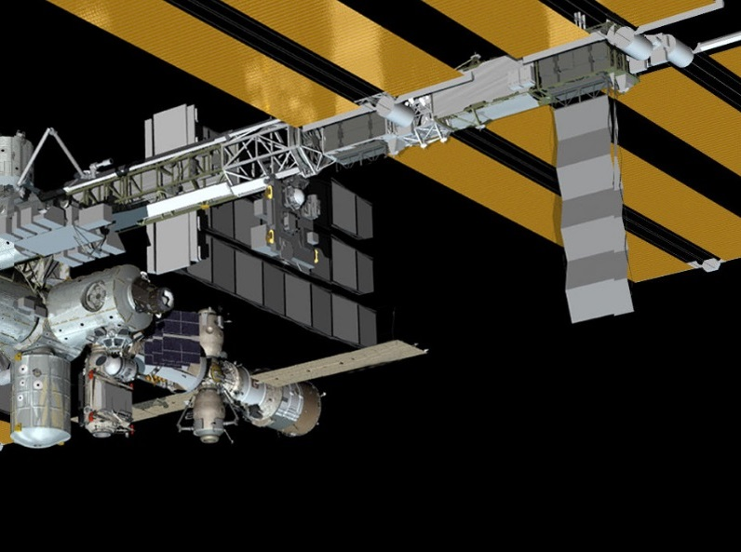
CPF Reflected Solar (RS) Instrument Accommodation on ISS
ExPRESS Logistics Carrier ELC-1 Site 3:
ISS port side nadir location, outboard- facing pallet

Slide 5
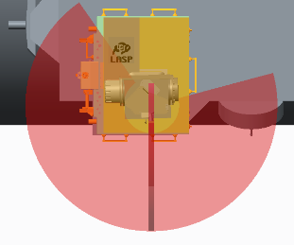
RS Instrument Field of Regard: Pointing for Solar, Lunar, Inter-calibration
Accommodations on ISS at Express Logistics Carrier #1 (ELC-1) Site 3 provides adequate viewing to meet CLARREO Pathfinder mission objectives.
Pitch
145º
Wake
Roll
-105º
Ram
Port
100º
100º
Starboard
+x
0º
+z
-50º
Accommodation studies by the NASA LaRC
Engineering team: J. Leckey, C. Boyer, T. Jackson
0º
+y
Gimbal configuration: pitch - roll
Approximate gimbal range of motion at ISS ELC-1 Site 3.
Not all pointing angles are available due to ISS accommodation.
+z

Slide 6
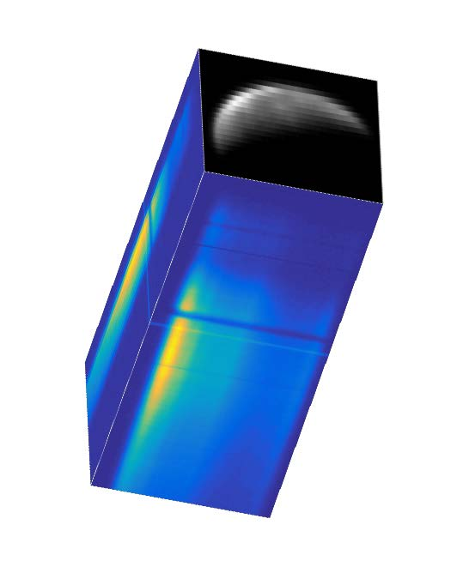
CPF Instrument Views of the Moon
On ISS, the RS spectrometer slit will be oriented perpendicular to the roll or elevation gimbal axis
aligned with the ISS ±Y body axis (starboard/port) when nadir-viewing
to accommodate primary mission objective: pushbroom imaging of Earth
Two scanning modes will be used for RS lunar views:
along-slit scans
to sample the same slice of the Moon with all detectors in the spatial direction, for flatfielding
accomplished with elevation (roll) gimbal movements
across-slit scans
to build spectral images, for lunar radiometry
accomplished with azimuth (pitch) gimbal movements
CPF applications of lunar radiometry:
inter-calibration with other instruments, using the Moon as a common reference target
contributing to a database of high-accuracy lunar radiometric measurements, to refine and constrain the lunar calibration reference
HySICS spectral image acquired 18 Aug. 2014 on high-altitude balloon

Slide 7
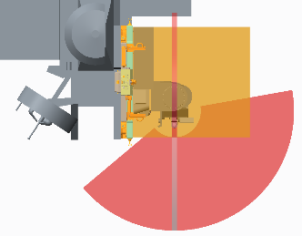
Moon Viewing Constraints
The CPF instrument location on the nadir side of the ISS restricts views above the horizon.
A simulation of potential Moon view opportunities provided preliminary data on possible lunar acquisitions
ISS in stable circular orbit at 51.6° inclination, LVLH attitude: +XVV
space-viewing constraints imposed as limits on gimbal motions
no accommodation for temporary obstructions or attitude variations
simulation was run for one-year flight (nominal CPF mission)
starboard-side views will not extend to space
port-side views will be partially obstructed by the ISS truss above 100° from nadir
moveable objects (e.g. solar panels) will cause temporary obstructions
Port
Starboard
100º
-50º

Slide 8
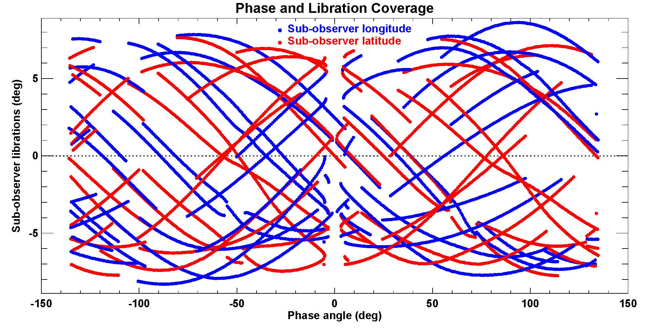
Moon Viewing Opportunities
To build a database of lunar measurements for a calibration reference, extensive coverage of the geometric parameter space (phase angles and lunar librations) is essential.
Preliminary results from the CPF Moon view simulation:
Substantial coverage in one year !
plot shows all potential opportunities; not likely all will acquire the Moon
3502 points = view opportunities with > 4 minutes duration
>80% have less than 10 minutes duration

Slide 9
ARCSTONE Mission
The ARCSTONE mission goals:
To deliver lunar spectral reflectance data with a level of uncertainty
sufficient to establish lunar spectral reflectance as an SI-traceable
absolute calibration standard.
To enable on-orbit high-accuracy calibration for reflected solar sensors in low and geostationary orbits by developing a new empirical Lunar spectral irradiance model as function of given satellite geometry and specified wavelength.
The ARCSTONE mission constraints:
Defined by the NASA Earth Venture Instrument (EVI)/Cubesat solicitation as a targeted opportunity with the best chances for selection:
Cubesat platform, ideally 6U spacecraft (size, mass, power, etc.);
Class D mission or Tech Demo;
Low Earth sun synchronous orbit at 500 km – 600 km altitude range.

Slide 10
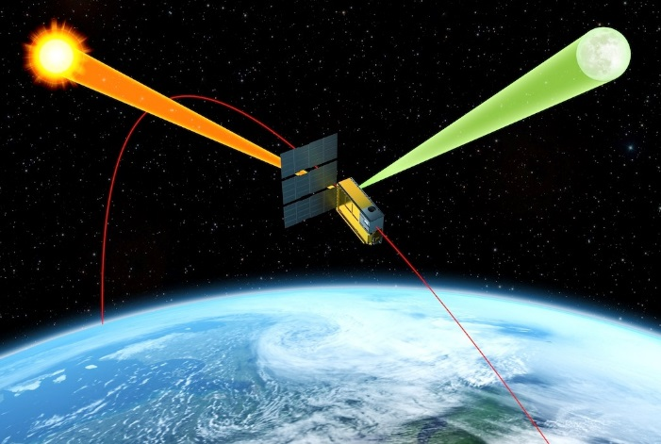
ARCSTONE Mission Concept of Operations
Concept of Operations and Data Products:
Data to collect: Lunar spectral irradiance every 12 hours
Data to collect: Solar spectral irradiance for calibration (at least weekly)
Collection within 10 min every 12 hours to achieve combined accuracy < 0.5% (k=1)
Spectrometer with single field-of-view about 0.52º
Spectral range from 350 nm to 2300 nm
Spectral sampling 4 nm or better
Sun synchronous orbit at 500 – 600 km altitude
Key Technologies to Enable the Concept:
Approach to orbital calibration via referencing Sun using TSIS measurements:
Demonstration of lunar and solar measurements with the same optical path
using integration time to reduce solar signal
Pointing ability of small spacecraft now permits obtaining required measurements
with instrument integrated into spacecraft

Slide 11
ARCSTONE Instrument Performance Parameters
Key Performance Parameters (KPP) | Threshold Value | Goal Value
Accuracy (reflectance) | 1.0% (k=1) | 0.5% (k=1)
Stability | < 0.15% (k=1) per decade | < 0.1% (k=1) per decade
Orbit | Sun-sync orbit | Sun-sync orbit
Time on-Orbit | 1 year | 3 years
Frequency of sampling | 24 hours | 12 hours
Instrument pointing | < 0.2º combined | < 0.1º combined
Spectral Range | 380 nm – 900 nm | 350 nm – 2300 nm
Spectral Sampling | 8 nm | 4 nm
Reference for radiometric requirements:
Lunar Phase Angle = 75º
Irradiance = 0.6 (micro W / m² nm)
Wavelength = 500 nm

Slide 12
CLARREO Pathfinder and ARCSTONE Mission Status
CLARREO Pathfinder
System Requirements Review conducted July 2017
Current funding for mission risk reduction activities, next ~6 months
Awaiting direction from NASA (and U.S. Congress) on future funding
ARCSTONE
Current funding from NASA Earth Science Technology Office (ESTO) for EDU instrument development
Mission design and operations planning supported by NASA Langley Research Center

