Slide 1
2nd GSICS/IVOS Lunar calibration workshop
Characterization,calibration and traceability for lunar observation
Benyong Yang
byyang@aiofm.ac.cn
Anhui Institute of Optics and Fine Mechanics,Chinese Academy of Science

Slide 2
Outline
Background
Field calibration and atmospheric correction
for ground lunar observation
Lab calibration and comparison for ground lunar observation instrument
Summarization
(Just propose a preliminary calibration plan for ground lunar observation)

Slide 3
Background
2nd GSICS/IVOS Lunar calibration workshop
For Current lunar observation and irradiance model, The absolute accuracy is not meet the need of in-flight calibration for satellite remote sensors.
The primary consideration is absolute accuracy with SI traceability
A new lunar measurement set and high accuracy and calibration system become more and more important for lunar observation instruments
Combination between Field calibration and Lab calibration is very necessary

Slide 4
Field calibration for lunar observation instruments using sun as reference on Mountain Twilight condition
Using the sun as iradiance calibration reference
Using lanley_plot method to correct atmosphere effect and esteblish response relation between response voltage of instruments/V0 and TOA solar irradiance
Scale can be traced from TOA solar spectral irradiance
Calibration be performed in dawn and dusk (sun zenith angle >60°,airmass 3~) when the direct sunlight is weak ,close to lunar and meet the response dynamic range of observation instruments)
Calibration site will be selected on high moutain: altitude high ,for example:
Bright summit in yellow moutain,1860 meters above sea level;
Ling moutain in Beijing, about 2000 meters avove sea level;
Stable atmosphere during the calibration observation procedue

Slide 5
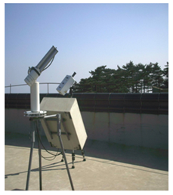
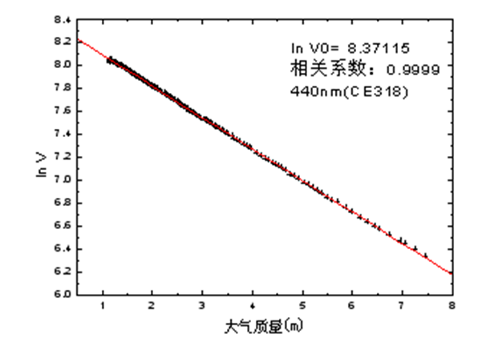
Field calibration for lunar observation instruments 1.Retrieval irradiance response coefficient
Step1: continuously auto-measurements will be permormed (dawn of a day )
Step2: Lanley_plot using measurement value vs airmass and get V₀ (response voltage of instruments for TOA solar iradiance)
Ground lunar observation instrument:lunar photometer(CE-318U)
Step3:Irradiance response coefficient will be retrieved : k(λ）=E₀(λ)/V₀ (λ）
A brief summary:
Calibration result: Irradiance response coefficient :k(λ）
Traceabilit : TOA solar irradiance
Disadvantage: Time consuming and regorous conditions, few opportunities
May low accuracy because of response dynamic range

Slide 6
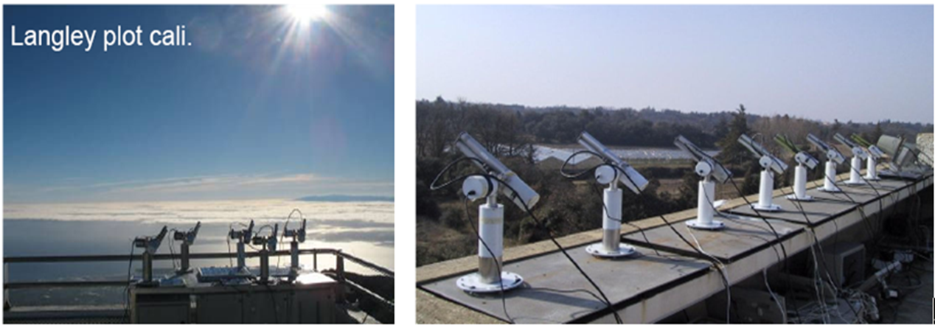
Field calibration for lunar observation instruments
Field Cross-calibration to transfer solar irradiance scale
Field inter calibration for lunar observation instrument using standard lunar photometer as reference;
For business and operation?

Slide 7
A novel lunar Langley_plot observation by time phase correction based on lunar irradiance model
Although the absolute radiometric uncertanty is high(5%~10%) but the temporal relative uncertanty is low(about 1% maybe) for Current lunar irrdiance model (ROLO or GIRO)
Using Time phase correction method based on ROLO model, the moon become a irradiance relatively invariant planet for the ground observator
Perform the langley_plot lunar observation using the post timephase-correction lunar irradiance as relative stability reference.
Nomalizing refrence V₀ through the whole night lunar observation will be retrieved by langley_plot procedue.
Using time-phase nomalized measurement V and instrument’s irradiance response coefficent (k) ,the lunar TOA irradiance will be retrieved.
A brief summary:
Retrieve :lunar TOA Irradiance and V₀ (observation reference time)
Irradiance sponse coefficient k(λ) ; relative time phase accuracy of lunar irradiance model is need, not need low uncertanty for absolue accuracy.
Traceabilit : TOA solar irradiance
Advantage: effective correction of atmosphere , maybe low uncertainty.

Slide 8
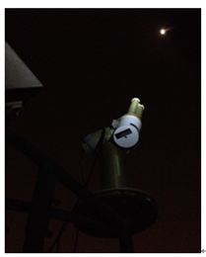
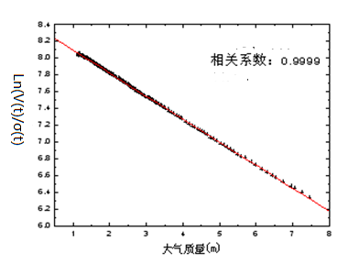
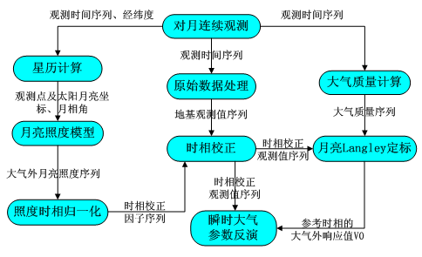
A novel lunar Langley_plot observation by time phase correction based on lunar irradiance model
V₀(t₀) and τ was retrieved based on Langley_plot equation
V₀(t₀): Instrument’s response voltage of lunar TOA irradiance in t₀ ;
Τ: night aerosol optical depth
σ(t): time phase correction factor based on Lunar model
TOA Lunar irradiance at t₀ was retrieved based on V₀(t₀) and irradiance response coeffitient k
Lunar langley_plot observation and algorithm flow

Slide 9
Lab calibration for lunar observation instruments
Field calibration using sun and lunar as reference is time consuming , regorous conditions and few opportunities ; lab calibration system for business operation must be developed;
Irradiance calibration system based on tunable laser illuminated integrating sphere: monochromatic and modulate intensity meet the weak light detect;
The scale can be transfered by trap detector and traced from cryogenic radiometer(low uncertainty 0.02 %)
FOV of instrument will be measured based on fine spatial scan using laser as reference ;Fov will be used to realize transferation between irradiance coefficient and radiance coefficient.
A moon simulator has been developed using tunable laser illuminated integrating sphere.

Slide 10
Lab calibration for lunar observation instruments
Radiance and Irradiance responsibility coefficient : C(λ) k(λ) will be retrieved:
1.Calibration will be performed using tunabe laser illumunated integrating sphere as reference resource;
2.Standard transfer will be realized using trap detector ;
3.Standard quantity will be Traced from high accuracy cryogenic radiometer
cryogenic radiometer
(absolute power scale)
Radiance geometrical factor (solid angle , aperture area)
Irradiance geometrical factor (aperture area)
TRAP detector
(power responsivity)
Standard radiance photometer
(radiance responsivity)
Standard irradiance photometer
(irradiance responsivity)
tunable laser illumunated integrating sphere
Standard radiance source
(spectral radiance)
lunar Irradiance simulator
Standard irradiance source (spectral irradiance)
FOV measurement sit
lunar photometer
(radiance responsivity)
Solid angle
lunar photometer
(irradiance responsivity)
Standard quantity transfer and traceability flow

Slide 11
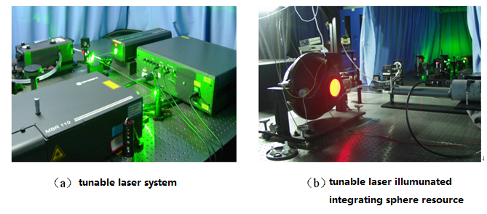
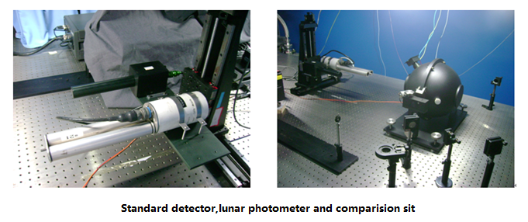
Lab calibration for lunar observation instruments

Slide 12
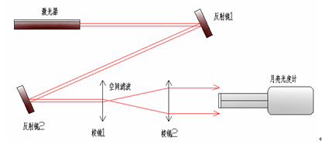
Lab calibration for lunar observation instruments
FOV measurement sit Based on spacial scan using laser resource
Transfer between irradiance responsivity and radiance responsivity

Slide 13
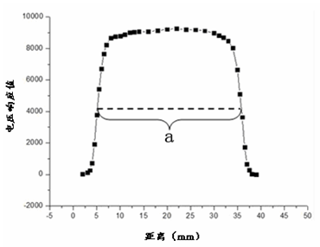
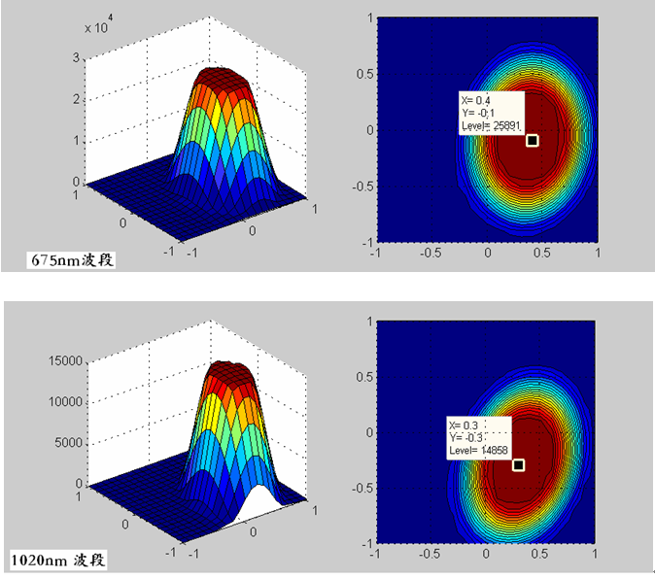
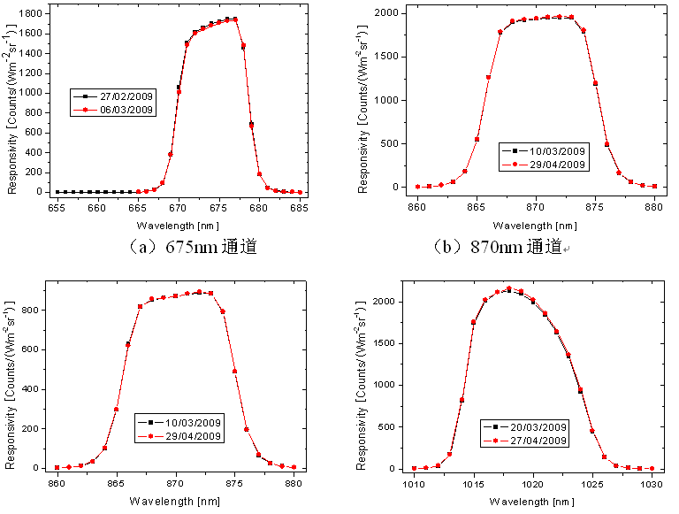
Lab calibration for lunar observation instruments
LAB FOV measurement result using laser as reference
Field FOV measurement result using sun as reference
Absolute Spectral responsivity using irradiance calibraion

Slide 14
Lab calibration for lunar observation instruments
Calibration and scale transfer using Field calibrated lunar photometer based on langley_plot observation as reference;
Calibration based on lab irradiance calibration system (equation 1) or lab radiance calibration system (equation 2) ;
Inter comparison and testify between lab calibration and field calibration.
(1)
(2)

Slide 15
summarization
Lunar observation calibration and traceability based on Lab system: Irradiance calibration system based on tunable laser illuminated integrating sphere, the scale trace from cryogenic radiometer by trap detector.
Lunar observation atmosphere correction based on a novel lunar langley_plot method by the moon itself (time phase corrected moon)based on ROLO model.

Slide 16
Thanks for attention ！

