Slide 1
Lunar Dataset Cataloging
Fangfang Yu¹ and Xiangqian Wu²
1: ERT, Inc@NOAA/NESDIS/STAR
2: NOAA/NESDIS/Center for Satellite Application and Research (STAR)

Slide 2
Outlines
Outcome of the data survey from 1st workshop
New data survey for 2nd workshop
Goal
Irradiance
New applications
New data
New satellite instruments
Ground measurements
Expansion from radiometric calibration of VNIR wavelength
Feedbacks
GEO: GOES-16/ABI, Himawari-8/AHI, COMS/MI, FY2-VISSR
LEO: GCOM-C/SGLI, Terra/ASTER, MERBE, NOAA and Metop MHS
Ground: NIST

Slide 3
Objectives of New Data Survey
Collect information of new lunar observation data since after 1st workshop at Darmstadt, Germany in December 2014
GIRO irradiance model as a common reference physical model for inter-calibration
Collect data to work on common method for the new applications of the Moon in VNIR bands
MTF
Radiance model
Other new applications of the Moon

Slide 4
Outcome of the Data Survey from 1st Workshop
Courtesy of Fougnie, B.

Slide 5
Data Survey Contents
General description of the satellite (orbit, mission duration, etc.)
General description of the sensor (spectral bands, spatial resolution, quantization, etc.)
Calibration method
reference/document, if available
Lunar observations (or in plan)
Description of the Moon acquisition (Maneuver)
Phase angle range
Sample images
Sample data (including the observation time) and data accessibility (GLOD, public available?)
Image processing procedure to derive smoothly edged moon or actual physical lunar images, if any
Lunar irradiation calculation (or in plan)
Integration step
Dark signal handling
Oversampling consideration

Slide 6
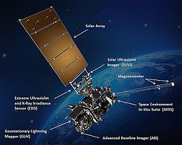
GOES-16
First NOAA Geostationary Operational Environmental satellite in the GOES-R Series
Launched on November 19, 2016
Key payload: Advanced Baseline Imager (ABI)
Locations:
Parked at 89.5W for PLT/PLPT tests.
Moved from 89.5W to 89.3W between August 8, 2017 and Sept. 3, 2017.
Plan to move from 89.3W to 75.2W for operation in December 2017.

Slide 7
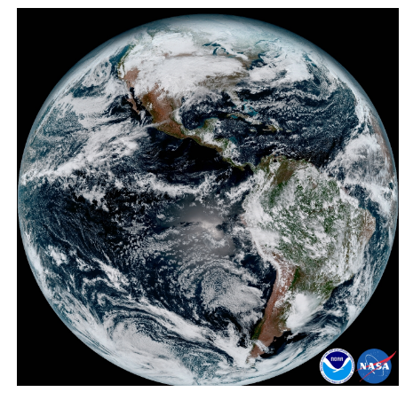
GOES-16 ABI
ABI Band | Wavelength range (µm) | Central Wavelength (µm) | Angular Sample Distance (µrad) | Nominal earth image resolution (km) | Bit Depth
1 | 0.45-0.49 | 0.47 | 22x22.9 | 1 | 12
2 | 0.59-0.69 | 0.64 | 11x10.5 | 0.5 | 12
3 | 0.846-0.885 | 0.865 | 22x22.9 | 1 | 12
4 | 1.371-1.386 | 1.378 | 44x42 | 2 | 12
5 | 1.58-1.64 | 1.61 | 22x22.9 | 1 | 12
6 | 2.225-2.275 | 2.25 | 44x42 | 2 | 12
7 | 3.80-4.00 | 3.90 | 44x44.7 | 2 | 14
8 | 5.77-6.6 | 6.19 | 44x44.7 | 2 | 12
9 | 6.75-7.15 | 6.95 | 44x44.7 | 2 | 12
10 | 7.24-7.44 | 7.34 | 44x44.7 | 2 | 12
11 | 8.3-8.7 | 8.5 | 44x44.7 | 2 | 12
12 | 9.42-9.8 | 9.61 | 44x44.7 | 2 | 12
13 | 10.1-10.6 | 10.35 | 44x38.1 | 2 | 12
14 | 10.8-11.6 | 11.2 | 44x38.1 | 2 | 12
15 | 11.8-12.8 | 12.3 | 44x38.1 | 2 | 12
16 | 13.0-13.6 | 13.3 | 44x38.1 | 2 | 12
GOES-16 ABI SRF: https://ncc.nesdis.noaa.gov/GOESR/ABI.php
GOES-16 ABI MTF: to be presented in the coming 2nd workshop

Slide 8
GOES-16 ABI VNIR Band Calibration
Two-point on-orbit calibration targets:
Spectralon Solar Diffuser
Deep space
Quadratic detector responsivity correction
Quadratic term (q) determined on-ground
Dalta et al. 2016, Comparison of the calibration algorithms and SI Traceability of MODIS, VIIRS, GOES and GOES-R ABI Sensors, Remote Sensing, 8(126), doi:10.3390/rs8020126, http://www.mdpi.com/2072-4292/8/2/126

Slide 9
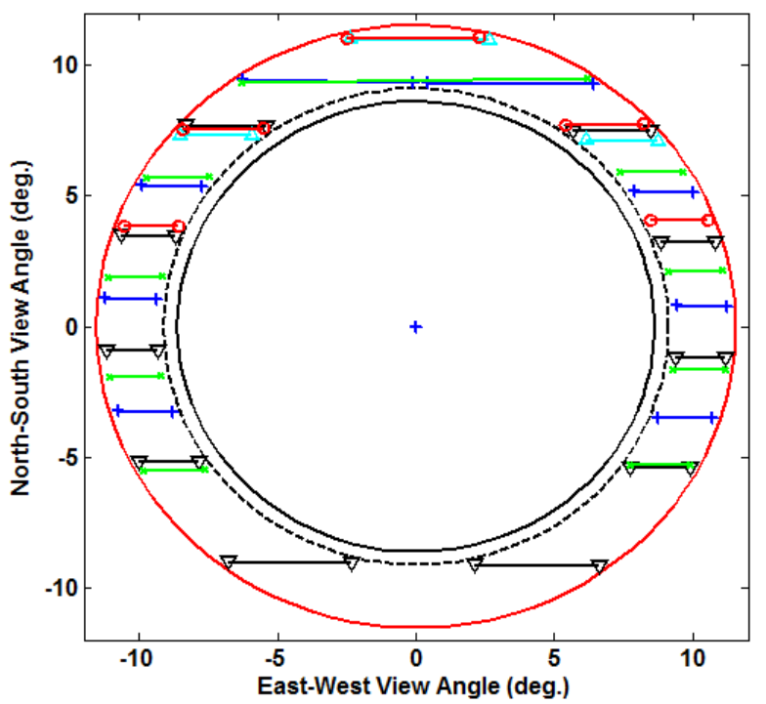
Moon Observations from GOES-16 ABI
Tracing or trending the Moon when the Moon transits across the ABI Field of Regard
Phase angle range: -90º – 90º
L1alpha data in netCDF format available at NOAA/CLASS
To be provided to GLOD
Earth

Slide 10
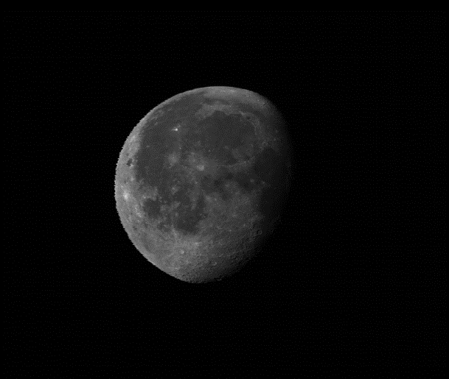
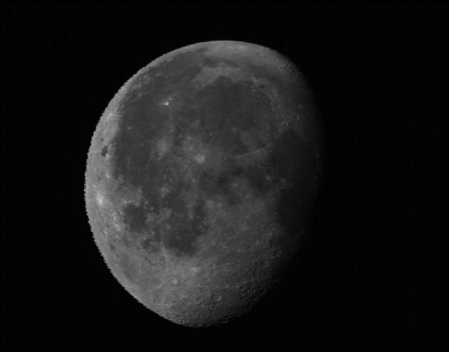
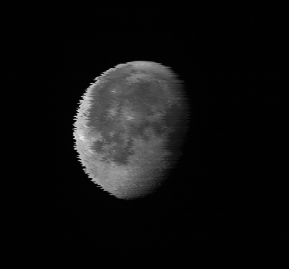
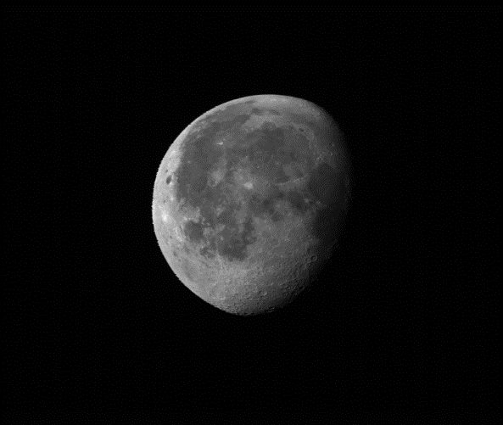
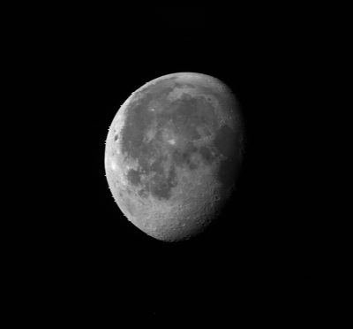
ABI Lunar Images, Radiometrically Calibrated …
B1 (047)
B2 (064)
B3 (087)
B5 (161)
B4 (138)
B6 (225)

Slide 11
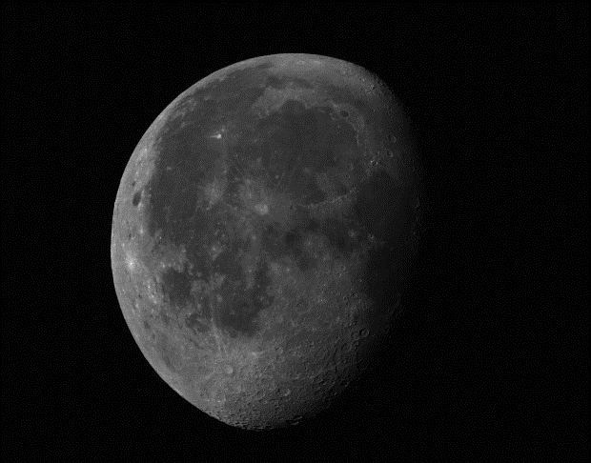
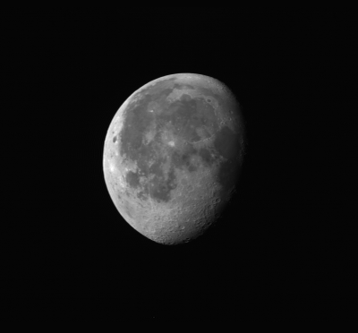
… and Aligned with Relative Detector Position RDP)
B1 (047)
B2 (064)
B3 (087)
B5 (161)
B4 (138)
B6 (225)

Slide 12
Irradiance Calculation
Irradiance:
Ω: Sample solid angle
Radiance_{i,j} : calibrated radiance at (i,j) image coordinate
Calculations of the measured and physical areal sizes of the Moon, and estimation of the oversampling factor for the ABI-like instruments will be presented and discussed during the workshop on Nov. 14 (#2m)

Slide 13
New Data Set for Solar Reflective Wavelengths

Slide 14
Application in New Wavelength
Chair of MW GRWG sub-group encourages introducing MHS and planned ground observations provided by Dr. Burgdorf as the first cases in this workshop
MHS Lunar observations
Moon appears in deep space view in certain months
Narrow phase angle range (Phase angle >90º) for given local equator crossing time of satellite
“Light curve” can be fitted with Gaussian
Particularly suited for checks of inter-channel uniformity and photometric stability, since flux differences easier measured than absolute level
Also useful for determination of pointing accuracy for sounding channels, because they cannot see Earth’s surface (Bonsignori 2017)
Model (Mo & Kigawa, 2007) of brightness temperature of Moon gives maximum values at full moon, independent of frequency
Improvement requires observations over large range of phase angles
All phase angles available with observations from ground
Test observations planned with Swedish Kiruna Millimeter Wave Radiometer
- Courtesy of M. Burgdorf

Slide 15
Summary
New high quality lunar observation data to enrich the data collection for calibration purpose
Two new next-generation GEO satellite instruments
More high spatial observations of the Moon
New observation schemes of GEO and LEO instruments
Extension from multiple to hyperspectral measurements
Extension from spacecraft to ground
SI-traceable measurements
New uses of the Moon
Common MTF method
Radiance model
Microwave calibration

Slide 16
Discussions
Mistakes in the data presented?
…
Missing instrument / dataset?
…
Desirable information that may be available?
BRDF for radiance calibration
Merging AHI/ABI/AMI
Other data?
…
…
…

