Slide 1
The GSICS Lunar Observation Dataset
S. Wagner, EUMETSAT

Slide 2
Scope and purpose of the benchmark
Definition of a reference synthetic dataset
Assessment of the GIRO performances with respect to the current lunar calibration reference model ROLO:
Verification / Validation of new developments
Uncertainty assessment
➔ Traceability
Uncertainty assessment / traceability to the GIRO for local implementations
Possibility to perform a similar assessment for newly developed models with respect to the GIRO

Slide 3
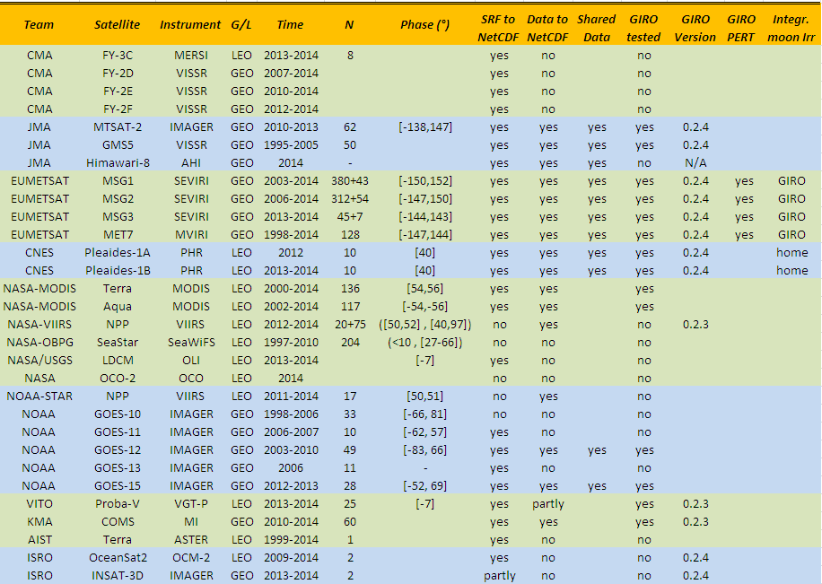
From the Lunar Calibration Workshop in 2014

Slide 5
Datasets currently in the GLOD… or could be…
AIST
Terra ASTER: 1 image (v1.0) + 1 image (v1.1) + 1 image (v1.2) – Problem for processing it with the GIRO
CMA:
FY2E: 130 images – Phase = [-92, 92]
FY3C: 6 images – Phase = [44, 57]
CNES:
Pleiades 1A: 10 images – Phase = [-41,-37] + [38, 40]
Pleiades 1B:10 images – Phase = [-42,-39] + [39, 41]
ESA:
SCIAMACHY – 1133 raw spectra (not GIRO-formatted) – Phase = [-85, 20] – Not yet part of the GLOD (to be agreed)
EUMETSAT:
Meteosat-7 – 483 images – Phase = [-92,92]
Meteosat-8 – 1092 images – Phase = [-92,92]
Meteosat-9 – 1051 images – Phase = [-92,92]
Meteosat-10 – 422 images – Phase = [-92,92]
Meteosat-11 – 19 images (low resolution channels) + 18 images (high resolution) - Phase = [-7,12] ➔ dedicated scan during commissioning – Not yet part of the GLOD
GOME-2A (not GIRO-formatted): 305 raw spectra (224 valid meas.) - Phase = [55, 80] – Not yet part of the GLOD
GOME-2B (not GIRO-formatted): 566 raw spectra (333 valid meas.) - Phase = [55, 80] – Not yet part of the GLOD

Slide 6
Datasets currently in the GLOD… or could be…
GIRO Benchmark ➔ See presentation 3b (Tuesday afternoon)
ISRO:
INSAT-3D: 2 images – Phase = [8, 11]
OCM-2: 2 images – Phase = [7, 9]
JAXA:
GLI: 5 images (QK) + 8 images (SW) + 8 images (VN) ➔ Do not have the SRFs
JMA
GMS5: 50 images – Phase = [-79, 85]
MTSAT2: 98 images – Phase = [-92, 92] (many images have a phase outside that range ➔ not applicable)
Himawari-8: 1 image (but more images shared with EUM in bilateral) – Problem of input file size. [-92, 92]
KMA:
COMS1: 78 images – Phase = [-88, 80]

Slide 7
Datasets currently in the GLOD… or could be…
NASA
Aqua MODIS: 24 images – Phase = [-56, -51]
Terra MODIS: 29 images – Phase = [50, 56]
Suomi NPP VIIRS:
v1.0.0 ➔ 1 image
V2.0.0 ➔ 7 images
V2.1.0 ➔ 41 images
NOAA
GOES-12: 53 images (v1) + 52 images (v2) – Phase = [-80, 67]
GOES-15: 31 images (v1) + 31 images (v2) – Phase = [-52,70]
VIIRS: 19 images – Phase = [-54,-50]
USGS:
OLI: 3 images – Phase = [5.5, 9.5]
VITO:
PROBAV: 116 images – Phase = [-7.5, 7.5]

Slide 8
GOES-10, -11 and -13? What about ABI?
FY-2D and 2F? Other data sets
AHI-9?
Possibility to share more data?
Not all are in the GLOD…
No data provided
Any updates? What about Landsat-8?
Can we investigate what is available? For 2014 LCWS, contact point was Lars Chapsky
Investigate what is the problem with the data…
Any updates? What about interaction with IMD?

Slide 9
Discussion points
How to handle the updates of the GLOD?
Users of the GIRO shall send data for EACH instrument they apply the GIRO to.
Do we want to change the scope of the GLOD?
Currently: static dataset for improving the lunar calibration reference + verification/validation/comparisons for new developments
Potential: inter-calibration:
The GLOD can provide a database of instruments for inter-calibration cross-calibrations

