Slide 1
Data Preparation for Using the ROLO / GIRO Model
Objectives of the session, and topics for presentation and discussion:
Methods for measuring lunar irradiance from images
to identify potential sources of error
covering all aspects of lunar irradiance measurements from images
Comparisons of lunar irradiance measurements to model outputs
individually, for each instrument
collectively, to identify common characteristics that may indicate potential errors in the lunar model
New developments toward advancing lunar models for a calibration reference

Slide 2
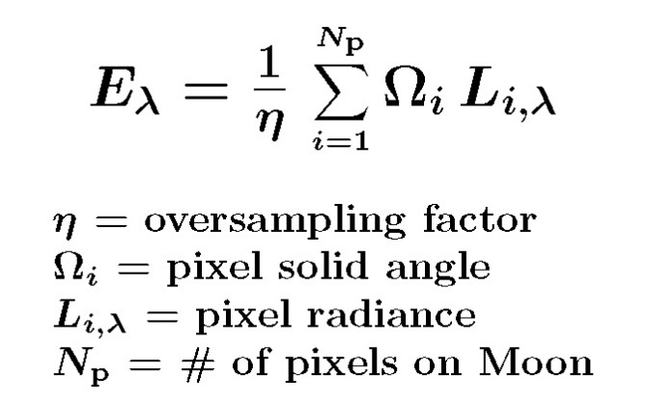
Lunar Irradiance Measurements from Images
The irradiance summation equation:
We will discuss each component of the equation as applied for preparing data for using the GIRO or ROLO, including oversampling:
Oversampling η
Method used for determining the oversampling factor
Accounting for non-uniform spatial sampling
e.g. motion of the Moon disk relative to the line of sight, including rotation
potential rotating or accelerating scans

Slide 3
Lunar Irradiance Measurements from Images
Radiance L_{i}
Level of image processing, e.g. raw DN (level 0), level 1A, level 1B
Calibration used to convert DN to physical units
Dark/space-level evaluation and subtraction
Handling extraneous signals, e.g. ghost images, stray light, electronic crosstalk, light from the Earthlimb
Pixel IFOV Ω_{i}
Method for evaluating, and uncertainty in its value
Possible dependence on the detector position in the focal plane array
Moon pixel selection N_{p}
Method for determining pixels on the Moon, e.g. limb-fitting, threshold
Method for eliminating cosmic hits
Other requirements for using the GIRO or ROLO
Determining the observation time and spacecraft position
Finding Moon images in a data archive

Slide 4
Part 2: Lunar Model Development
Current status of ROLO and its future development at USGS
Validation against ROLO: the GIRO benchmark
currently in development phase
to be used by GSICS lunar model developers
New models developed using recent lunar measurements
including radiance models

