Slide 1
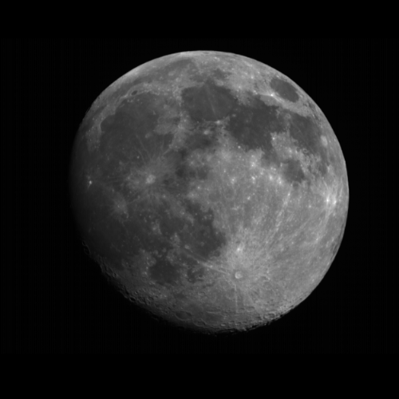
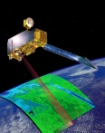
Data Preparation for ASTER
Terra / ASTER
Toru Kouyama, Soushi Kato (AIST), Masakuni Kikuchi, Fumihiko Sakuma (JSS)
ASTER science team/Calibration team
2nd Lunar calibration workshop in Xi’an

Slide 2
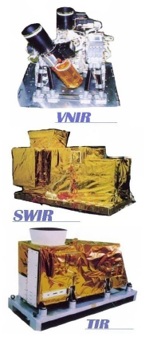
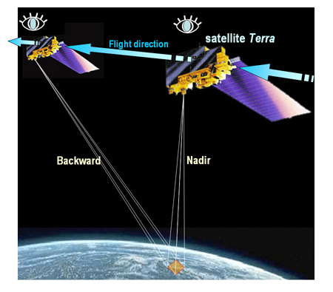
  General description of “Terra” and “ASTER”
Terra
Operation: 1999 ~ (Current)
1999~
Sensors: ASTER, MODIS, MISR, CERES, MOPITT
Orbit Type | Polar, Sun Synchronous
Mean Altitude | 705 km +/-5km
Orbit Period | 98.8 minutes
Orbit Inclination | 98.2 degrees
Equatorial Crossing | 10:30 AM +/- 15 minutes
Ground Track Repeat | 16 days (233 orbits)
LEO
From JSS’s brochure
ASTER
(Advanced Spaceborne Thermal Emission and Reflection Radiometer)
operated by METI/JSS & NASA
Push broom sensor composed of three instruments
(VNIR, SWIR, TIR)
VNIR has nadir and backward cameras for taking stereo images
Notes:
Accoding to the guide line, at first I introduce terra and aster
You know terra has several sensors such as aster and modis and
Its orbit type is polar sun synchronous orbit.
Terra was launched in 1999 and the mission has been continued.
And aster is not one sensor, aster is composed of three sensors
As for vnir and weir these are pushbroom sensors
And vnir has nadir and backward camera for taking steleo images
The one of important products of aster is digital elevation model from these steleo images
Ground track repeat cycle:16 days, i.e. every 16 days (or 233 orbits) the pattern of orbits repeats itself

Slide 3
  ASTER
Sensor | Band | Wavelength (μm) | Res. (μrad) | GSD (m) | Swath (km) | Quantization (bit)
VNIR (Visible & Near Infrared) | 1 | 0.52-0.60 | 21.6 | 15 | 60 | 8
 | 2 | 0.63-0.69
 | 3N | 0.76-0.86
 | 3B | 0.76-0.86 | 18.6
SWIR (Short wave Infrared) | 4 | 1.600-1.700 | 43.2 | 30 | 60 | 8
 | 5 | 2.145-2.185
 | 6 | 2.185-2.225
 | 7 | 2.235-2.285
 | 8 | 2.295-2.365
 | 9 | 2.360-2.430
TIR (Thermal Infrared) | 10 | 8.125-8.475 | 128 | 90 | 60 | 12
 | 11 | 8.475-8.825
 | 12 | 8.925-9.275
 | 13 | 10.25-10.95
 | 14 | 10.95-11.65

Slide 4
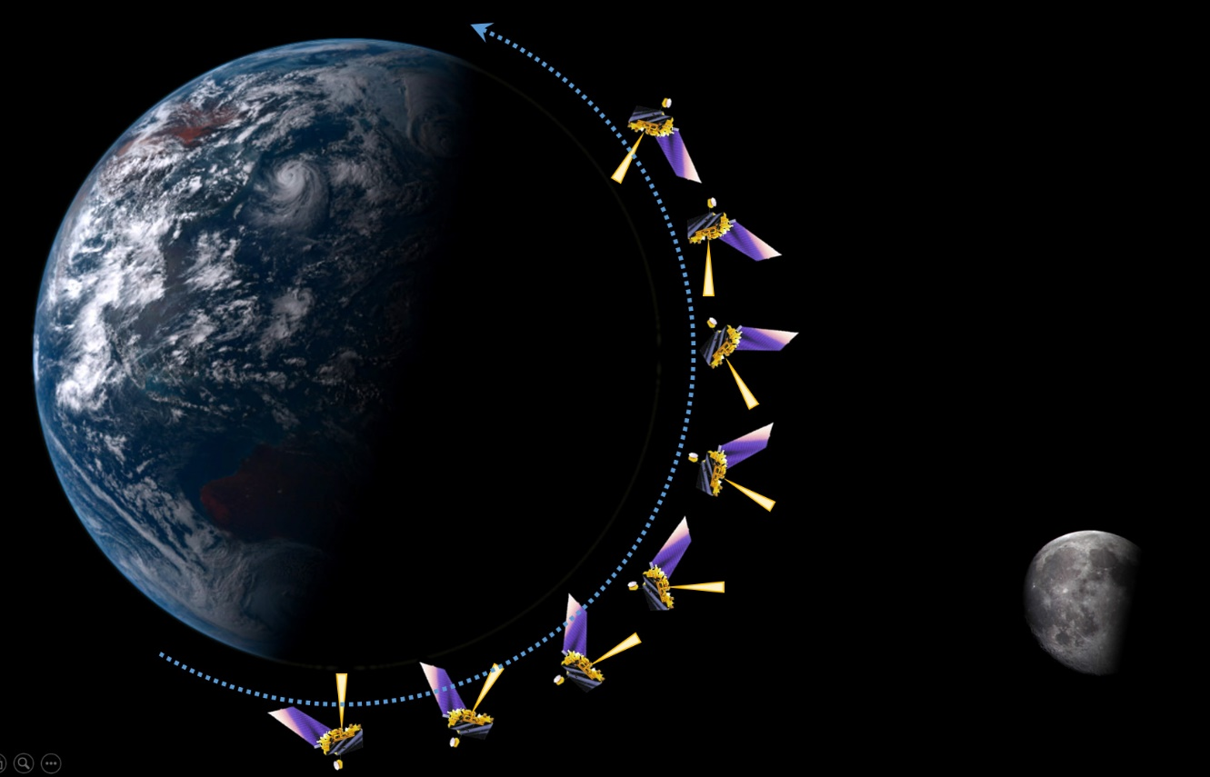
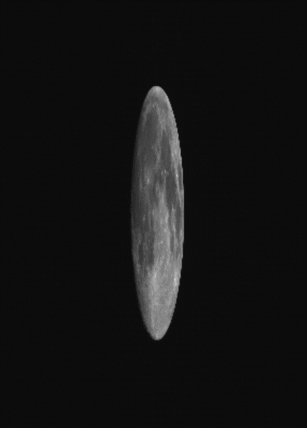
Moon Observations from ASTER/Terra
Pitch maneuver
Raw image sample
Oversampling factor
~ 4.6
Scan direction
Image from Japan space systems
Observation geometries in 2003 and 2017 (← new!)
SPICE/TLE
Date | 2003-04-14 | 2017-08-05
Phase angle | -27.7° | -20.3°
Sub solar lon. | 22.1° | 17.5°
Sub solar lat. | -0.9° | -0.3°
Sub observer lon. | -5.1° | -2.6°
Sub observer lat. | -6.8° | -4.2°
Dist. Sun-Moon | 1.005 AU | 1.017 AU
Dist. Moon-Terra | 359,021 km | 394,856 km

Slide 5
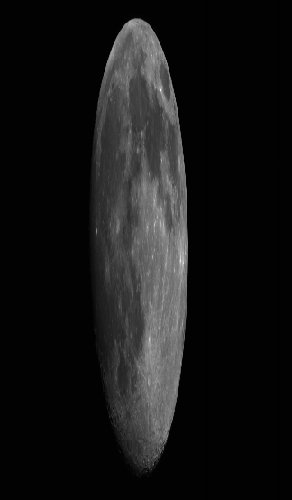
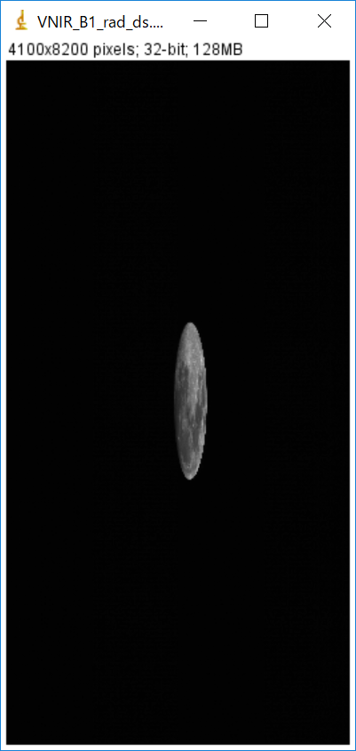
  ASTER lunar images
How is the Moon located in the image?
How is the extraction performed?
How are the Moon pixels selected/integrated?
Oversampling ratio: 4.57 / 4.55
Moon Diameter:
Cross track: ~450 pix
Along track: ~2,100 pix
Observation period: ~5 sec
Image size:
Cross track: 4,100 pixels
Along track:
(Original) > 100,000
-> 8,200 pixels
8200
Along track
Integrating all pixels for measuring irradiance
4100
Due to the Pitch maneuver observation, Earth is out of image frame.
Cross track

Slide 6
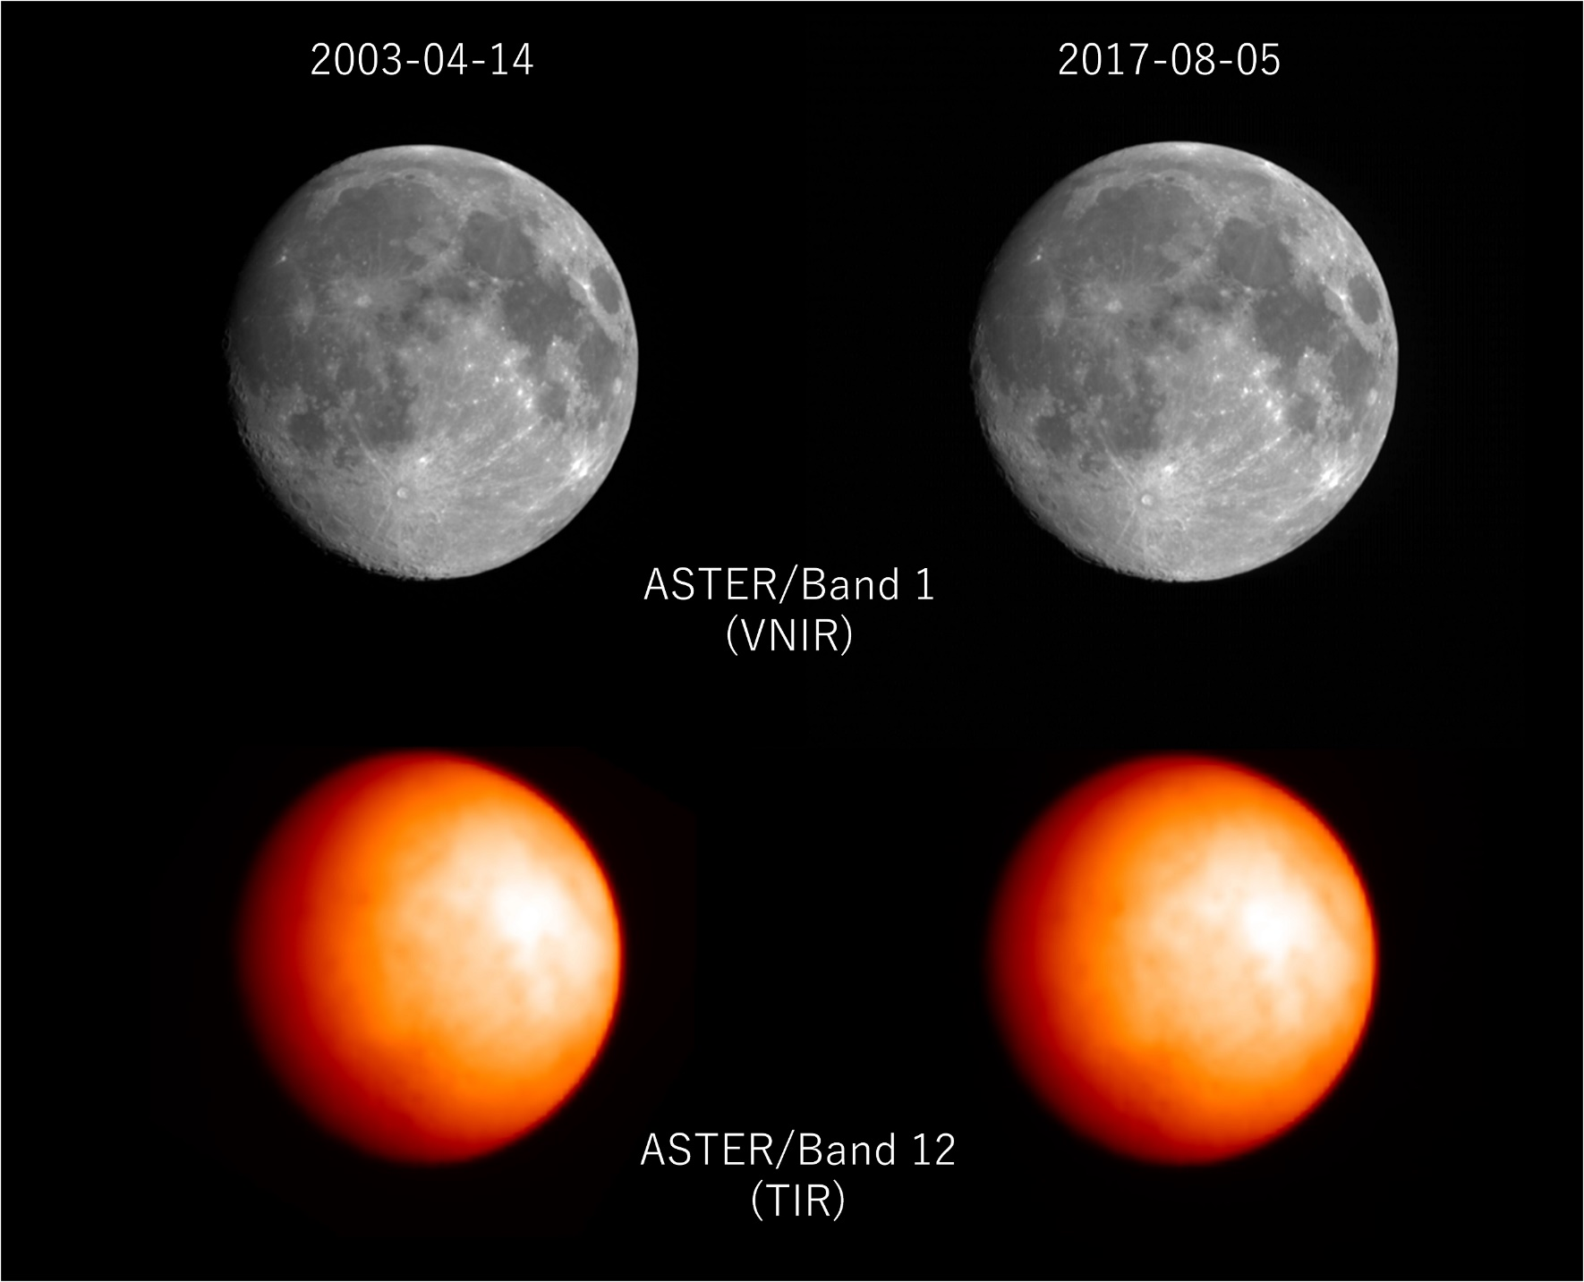
Image samples (after correcting oversampling effect)
Japanese Remote
Sensing journal

Slide 7
At what level of processing is the image data extracted?
  Product levels of ASTER
L0B
L1A
L1R
Raw data
(non-calibrated)
Raw data
(non-calibrated)
Calibrated Data
+ Calibration
parameters
Dark signal level correction
Coefficients for converting count to radiance
Degradation correction can be selected to be performed or not to be performed.

Slide 8
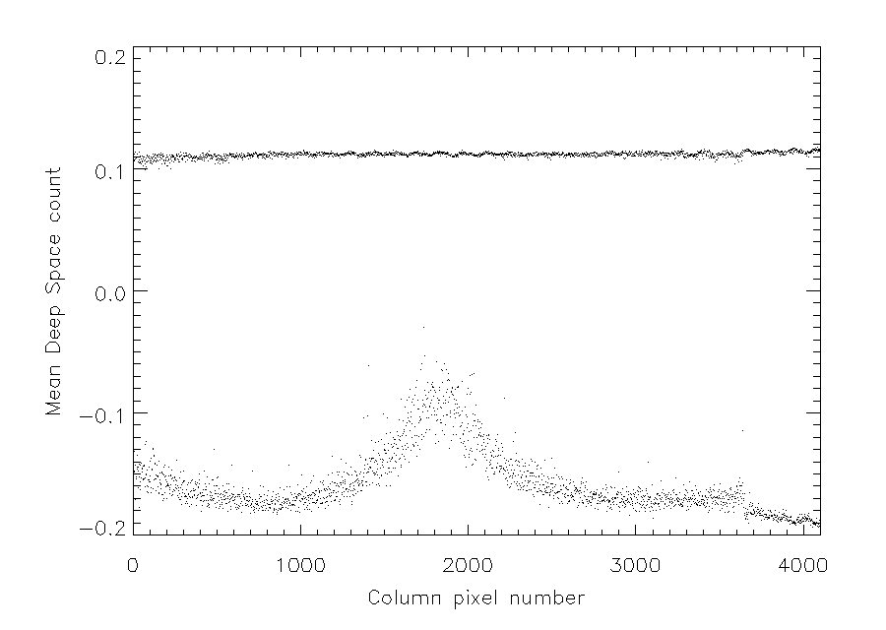
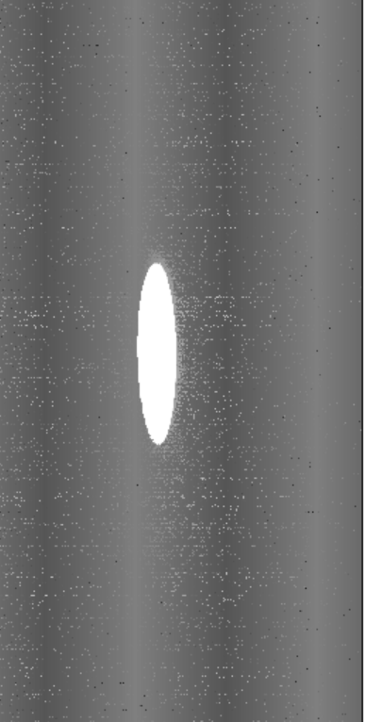
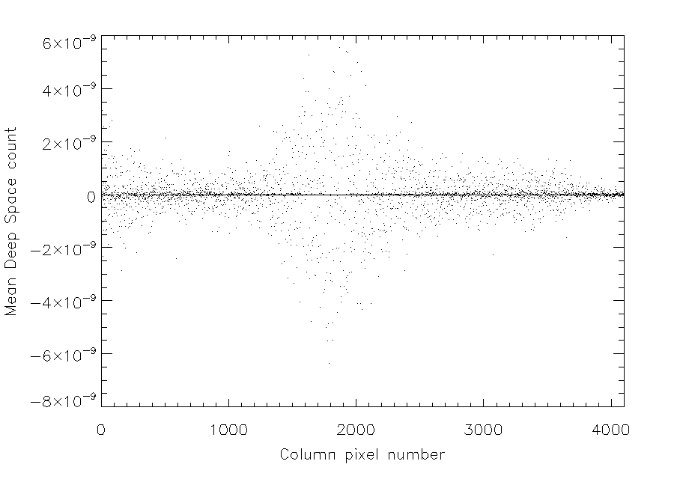
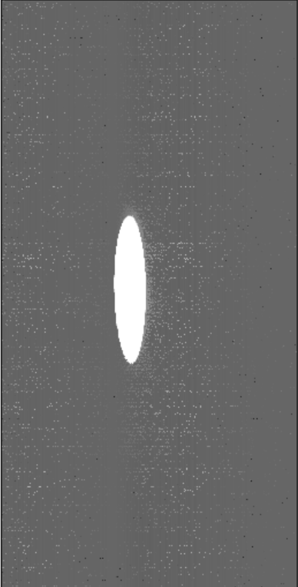
What is the deep space offset and dark signal level? How is it determined?
Dark signal handling:
Dark level was measured from mean deep space radiance for each line
(below and above Moon position), and subtracted.
Different offsets
in even / odd pixels
After subtraction

Slide 9
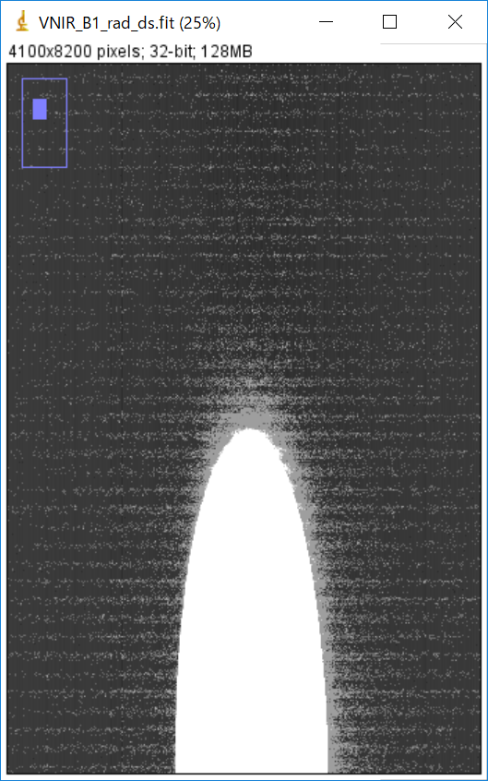
What is the deep space offset and dark signal level? How is it determined?
Dark signal handling:
Dark count (offset) was reduced, but some patterns were still remaining…
Source of uncertainty?
We integrated all pixels for measuring irradiance
Statistically uncertainty from the patterns should be reduced.

Slide 10
Irradiance Calculation
Calculation of the total irradiance:
Irradiance:
Ω: Sample solid angle (IFOV: 21.6” from ASTER’s specification document)
Radiance_{i,j} : calibrated radiance at (i,j) image coordinate
We integrated all image pixels.
Oversampling factor:
Measured from attitude information from onboard attitude sensors provided from NASA flight operation team. Based on their report, oversampling factor was stable (=constant) during the observation.
Also we have performed an image analyzing procedure (ellipse fitting to the Moon limb) to validate the oversampling factor.
They showed good agreement.

Slide 11
Are there known issues with straylight or cross-talk?
How are the Moon imaging time and the spacecraft position determined?
No in VNIR instrument
SWIR has cross-talk issues
TIR has straylight issue
We used the scheduled Moon acquisition time.
The observation times were confirmed in real time operation

Slide 12
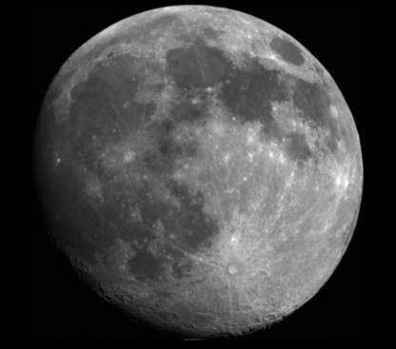
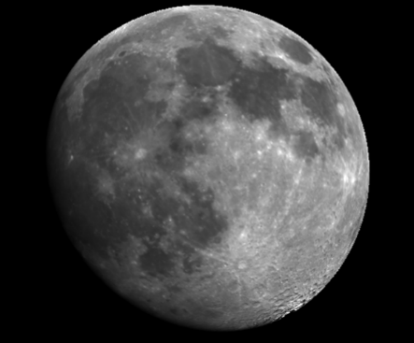
Irradiance Calculation
Date |  | 2003-04-14 |  | 2017-08-05
OS factor |  | 4.57 |  | 4.55
Degradation Correction |  | Non | Corrected (RCC v4.14) | Non | Corrected (RCC v4.14)
Irradiance (μW/m2/nm) | B1 | 2.097965 | 2.594057 | 1.961157 | 2.494914
 | B2 | 2.140942 | 2.510323 | 1.950643 | 2.319944
 | B3N | 1.711176 | 1.911712 | 1.537224 | 1.861272
Irradiance comparison between observations and models
 | Lunar Calibration (SELENE/SP)
Band 1 (Green) | 3.0 %
Band 2 (Red) | 5.2 %
Band 3N (Near infrared) | 5.7 %
Observation
SP model

Slide 13
ASTER VNIR Band Calibration issues
Discrepancy between Onboard calibration
and Vicarious/Cross calibration
Vicarious + Cross
Onboard Cal.
2017-008-05
2003-04-14
[Tsuchida, 2012]
Degradation of onboard calibration system?

Slide 14
ASTER VNIR Band Calibration issues
Comparison with Onboard and Vicarious calibrations
Degradation rate from 2003 to 2017
 | Onboard | Vicarious [Obata et al., 2015] | Lunar Calibration (SELENE/SP)
Band 1 (Green) | 9.9 % | 2.8 % | 3.0 %
Band 2 (Red) | 11.2 % | 5.1 % | 5.2 %
Band 3N (Near infrared) | 11.2 % | 5.8 % | 5.7 %
Lunar calibration result supports vicarious calibration result.
Current ASTER RCC is generated from a combination of onboard, vicarious, and cross calibrations.
=> We now reconsider the RCC.

Slide 15
Summary
ASTER successfully observed the Moon in 2017 again, and it has two lunar images in 2003 and 2017.
Lunar calibration result provides a good reference to reconsider RCC for ASTER mission.
Lunar image in 2003 has been provided to GIRO (last WS), but 2017 is not. ASTER calibration team basically agreed to share. We will discuss this with ASTER team leaders.

Slide 16
Thank you
Backup slides..

Slide 17
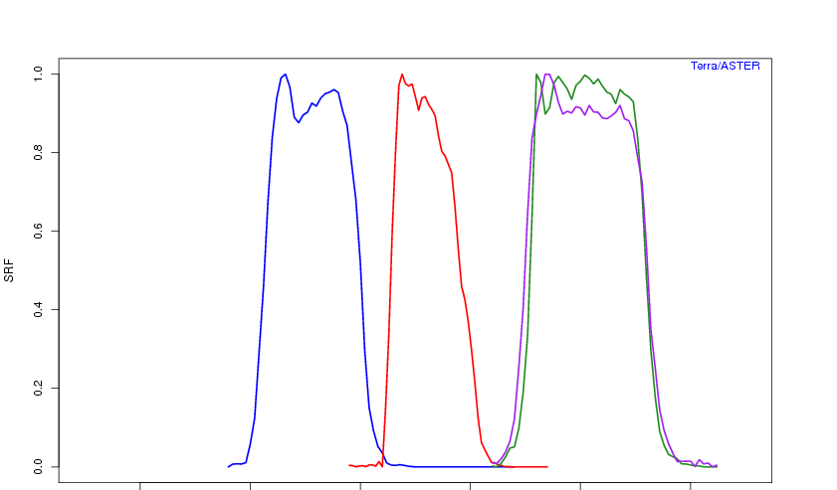
  ASTER
Spectral Response Functions
3N
3B
Band 1
Band 2
Band 3N/B
0.4
0.5
0.6
0.7
0.8
0.9
Wavelength [μm]

Slide 18
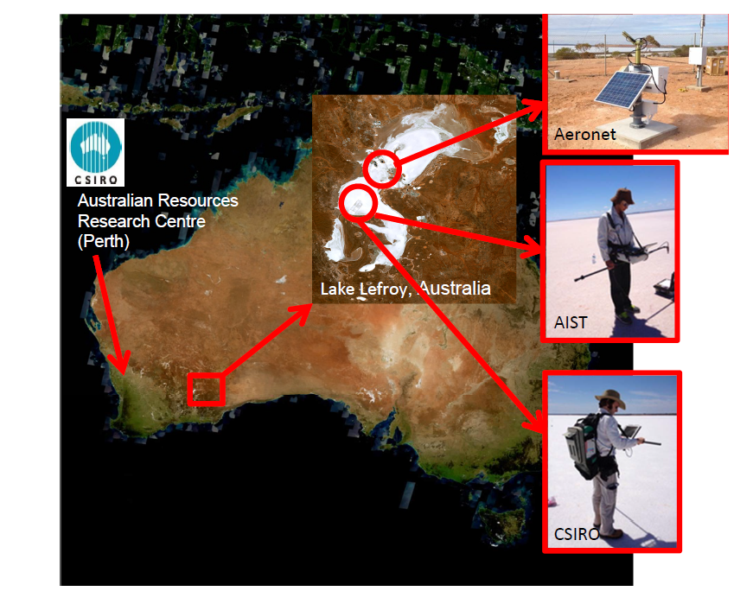
Vicarious calibration

Slide 19
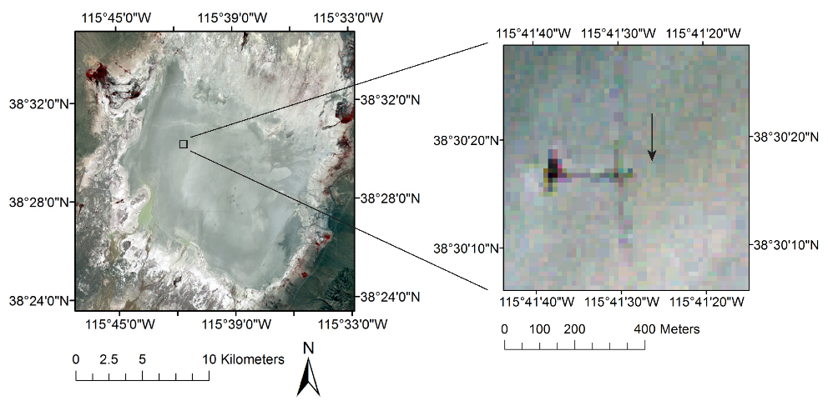
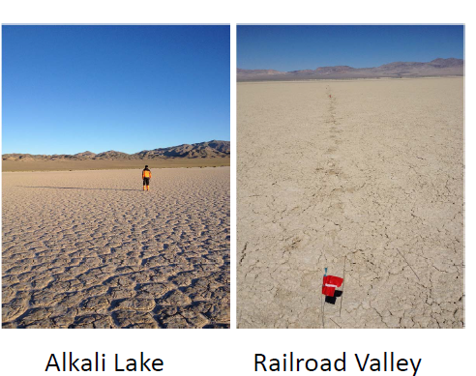
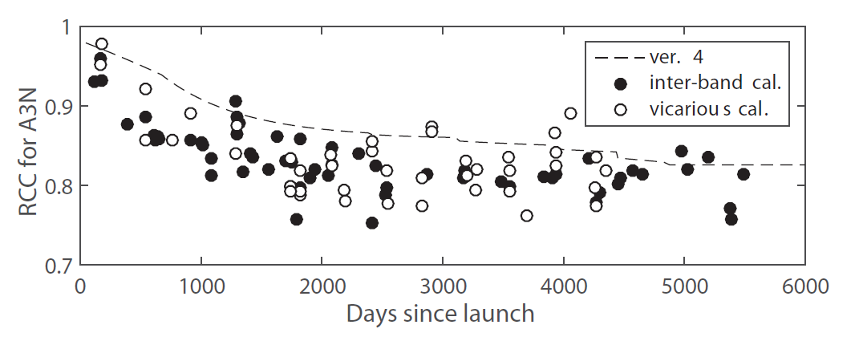
Vicarious calibration
Nevada case
16 years

Slide 20
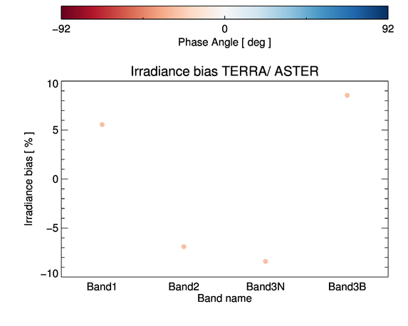
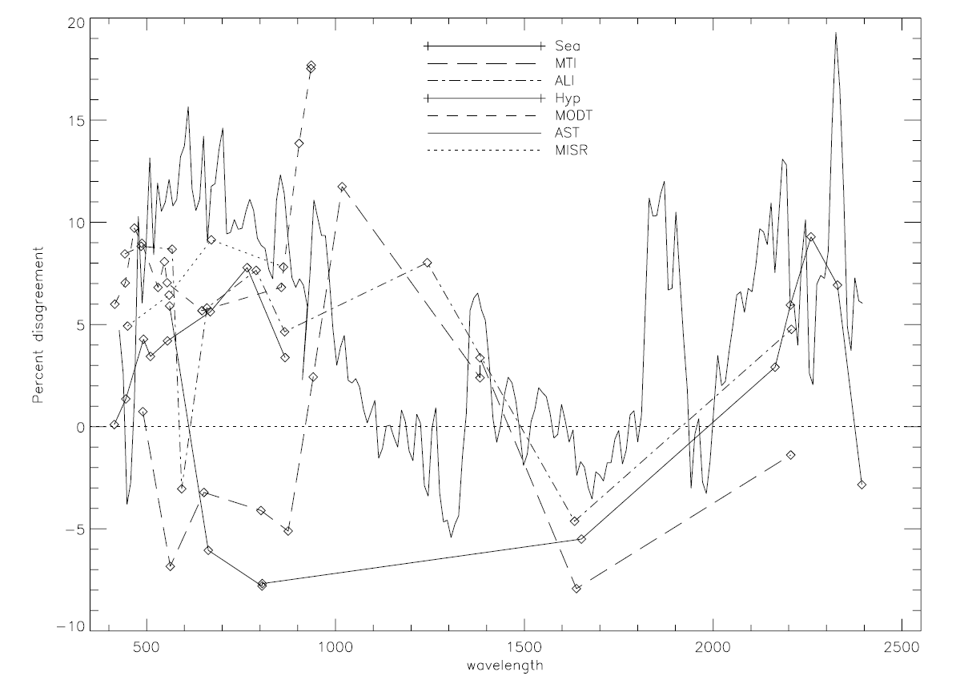
  Operation of the GIRO: status and calibration results
-27.7
10
5
0
-5
Onboard calibration
-10
[Kieffer & Stone, 2005]

Slide 21
ASTER VNIR Band Calibration issues
Comparison of Onboard and Vical+Cross calibrations
Degradation ratio from 2003 to 2017

Slide 22
ASTER VNIR Band Calibration issues
Discrepancy between Onboard and Vicarious/Cross calibrations:
  Onboard calibration:
  Onboard lamp, but lamp itself is suspected to be degradation
  Lunar and Deep space observation was conducted once, but has not been included
  Current official Radiometric Correction Coefficients (RCC) are combination of parameters from three calibration methods.
  → Lunar calibration is expected to provide well determined RCC.
References:
- Sakuma et al., (2005) Onboard calibration of the ASTER instrument (TGRS)
- Kurt et al (2008) Vicarious Calibration of ASTER via the Reflectance-Based Approach (TGRS)
- Obata et al (2017) Cross-Calibration between ASTER and MODIS Visible to Near-Infrared Bands for Improvement of ASTER Radiometric Calibration (Sensors)

Slide 23
Comparison of Onboard, Vical, and Cross calibrations
[Tsuchida, 2012]

Slide 24
Comparison of Onboard, Vical, and Cross calibrations
[Tsuchida, 2012]

