Slide 1
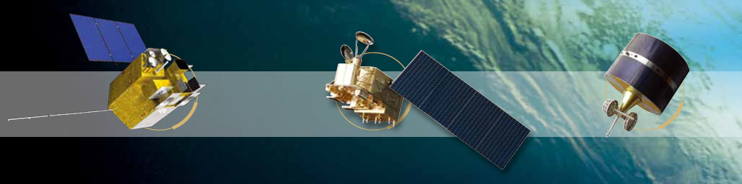


Based on Lunar Data
Tracing FY-3C/MERSI And TanSat/CAPI
Solar Bands radiance response
Wu Ronghua
FY-3C/MERSI:
Zhang Peng, Yang Zhongdong, Hu Xiuqing, Chenlin, Xu Na, Ding Lei
TanSat/CAPI:
Zhang Peng, Yang Zhongdong, Gu Songyan, Yang Lei, Liu Chengbao,
Yan Changxiang, Shao Jianbing,
Hu Yuan, Wang Yacheng, Zhang Ping, Zhang Lu
National Satellite Meteorological Centre
Notes:
Morning,
Next I will introduce 2 sensors lunar calibration
One is FY-3C/MERSI which is a MODIS like instrunment.
The other one is TanSat is Chinese CO2 monitoring satellite and CAPI is one of its payload which can provide aerosol information.

Slide 2
  content
  FY-3C/MERSI Lunar Data Preparation
    Specifications of MERSI
    Lunar Data of MERSI
  TanSat/CAPI Lunar Data Preparation
    Specifications of CAPI
    Lunar Data of CAPI

Slide 3
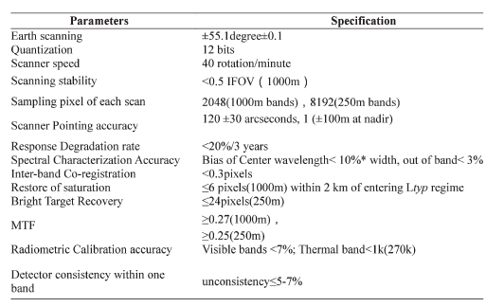
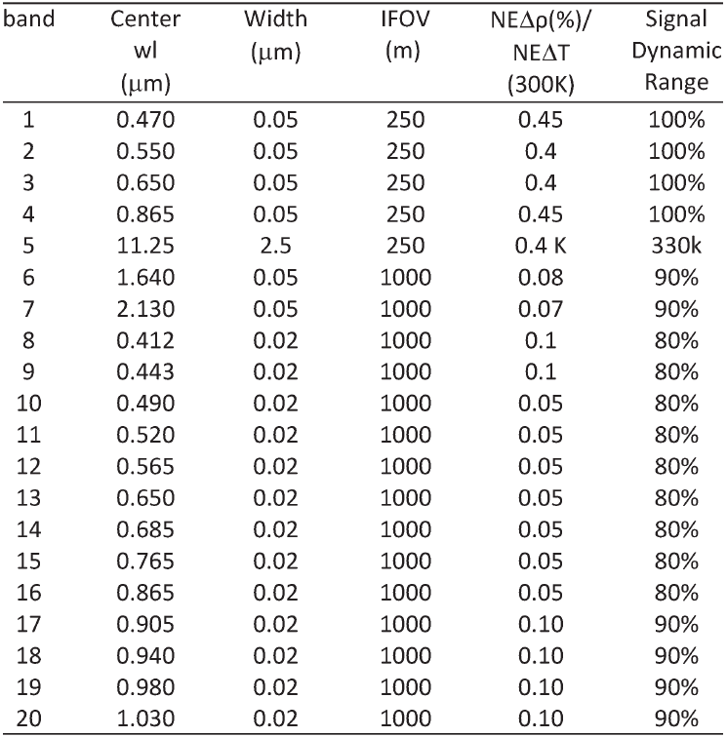
General description of MERSI
Notes:
MERSI has 20 bands, 19 is visible and near infrad spectrum and 1 thermal band

Slide 4
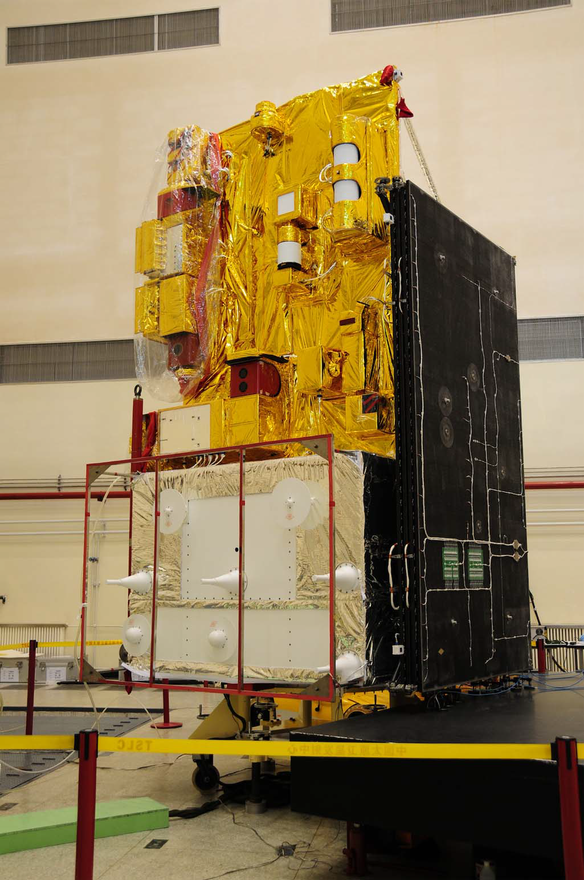
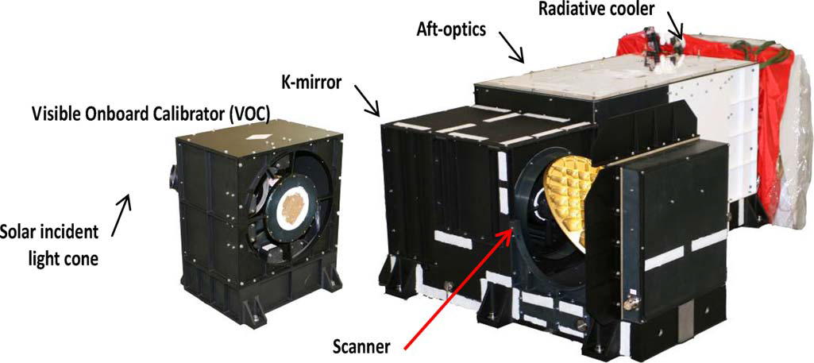
General description of MERSI
Real instrument photograph of two MERSI modules. (1) Left is the VOC seeing from the front.
(2) Right is the instrument main optical–mechanical
component.

Slide 5
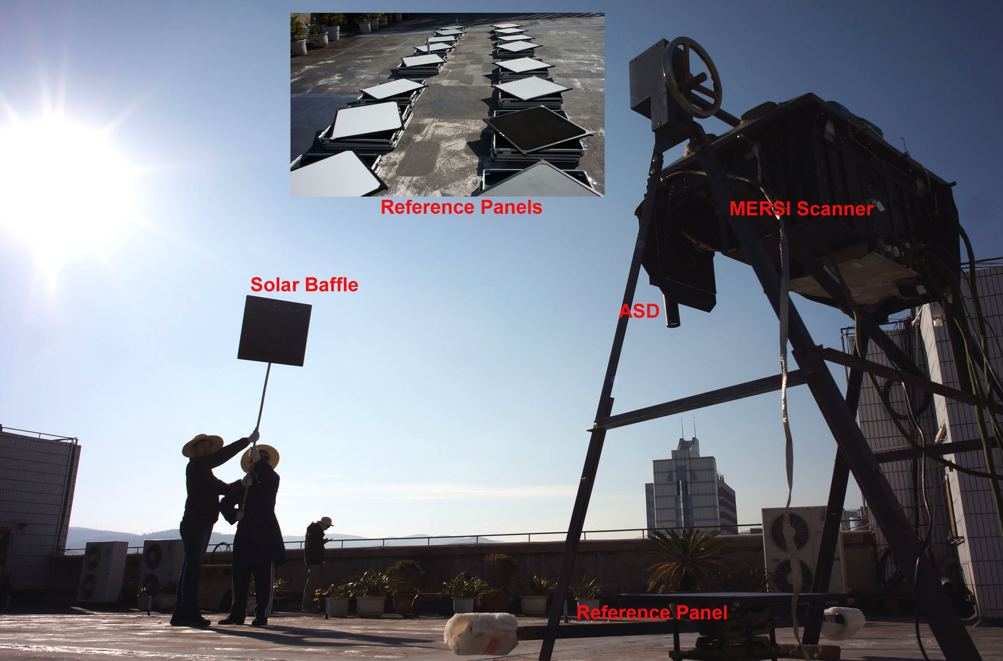
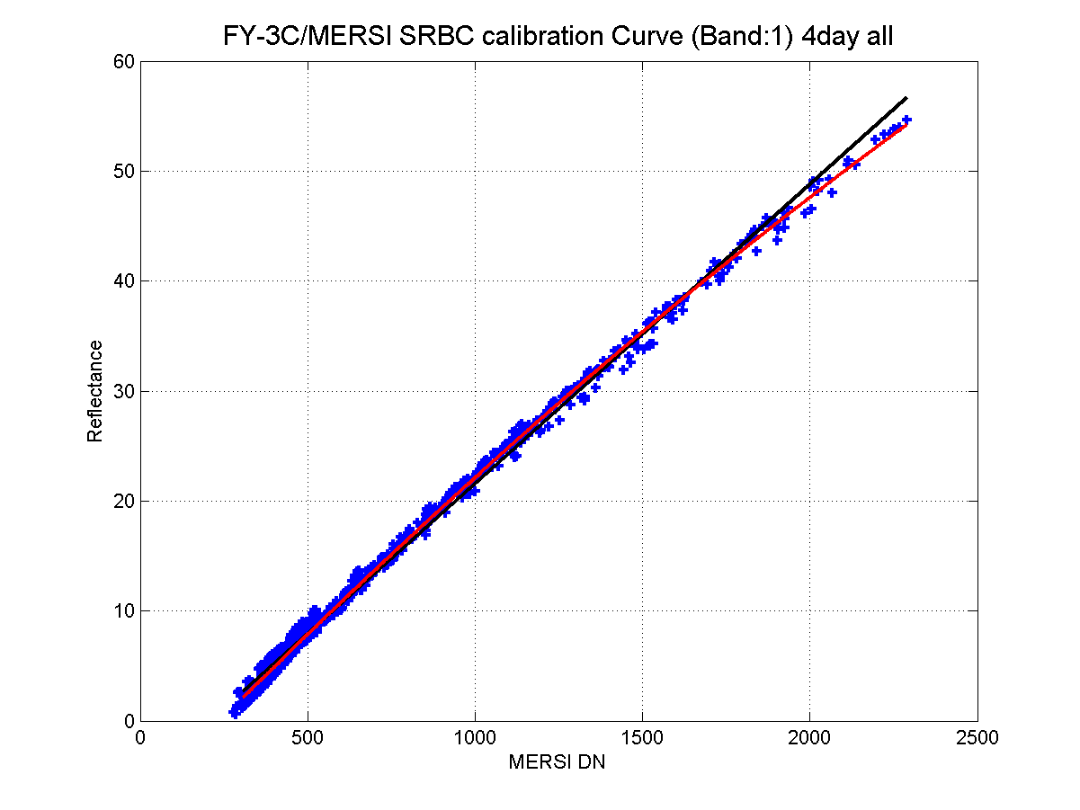
Absolute calibration
The photo of the pre-launch calibration for FY-3C/MERSI at Dali, on March, 2013
Notes:
Using Quadratic polynomial fitting

Slide 6
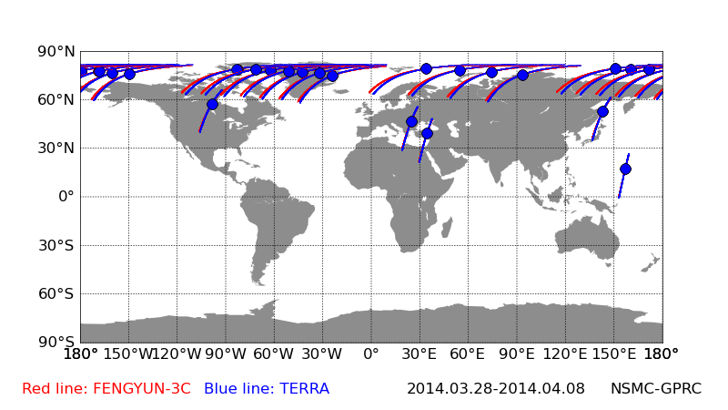
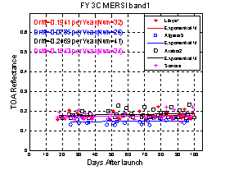
Absolute calibration
Multi-source calibration data to regress coefficient
Notes:
Operational Phase,
Vicarious calibration

Slide 7
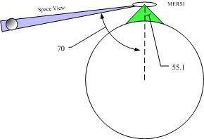
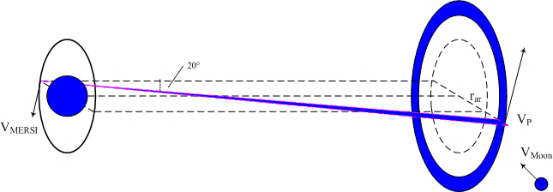
Description of the Moon acquisition
SV is on the right side along track and 70゜ to nadir
24 samples(@1000m)
96samples(@250m)
SV scans construct a circle

Slide 8
Example of an image
the geometry relationship of the sun-moon-satellite is similar
phase angle varies not too much around 50゜

Slide 9
FY-3C/MERSI Lunar Data Set
Date | Absolutely Phase angle | Selenographic longitude (sun) | Selenographic longitude (observer) | Selenographic latitude (observer)
2013-10-23 | 48.21 | -46.43 | 1.64 | 3.92
2013-11-21 | 45.71 | -46.84 | -1.35 | 6.05
2013-12-21 | 43.18 | -46.88 | -3.92 | 6.72
2014-1-20 | 44.42 | -50.18 | -5.84 | 5.59
2014-6-17 | 57.08 | -54.60 | 2.47 | -4.94
2014-7-16 | 49.15 | -45.34 | 3.81 | -3.96
2014-8-14 | 47.39 | -42.00 | 5.40 | -1.56
2014-9-12 | 48.94 | -42.66 | 6.217 | 1.851
2014-10-12 | 49.58 | -43.74 | 5.683 | 4.728
2014-11-10 | 48.45 | -44.31 | 3.95 | 6.288
2014-12-10 | 45.3 | -43.58 | 1.572 | 6.346
Notes:
geometric angle
Such as
So on
And et cetera.

Slide 10
Integration step
Select the frames which contain full moon disk image
Make moon mask using mean of dark digital number (DN) as the threshold
Calculate radiance of each moon pixel using calibration formula and coefficients.
Calculate the irradiance and integrate all of moon pixels.

Slide 11
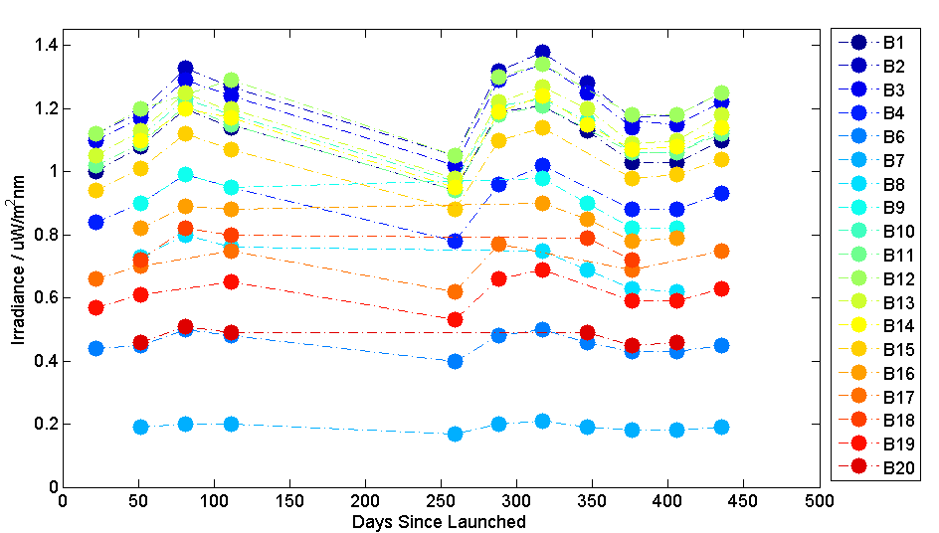
Lunar Irradiance
$$I_{moon}=\sum_{moon}{{{dm}^{2}L}_{pixel}ω_{pixel}}=\frac{{ds}^{2}{dm}^{2}ω_{pixel}Es}{π}\sum_{moon}{\left[\left(k_{2}DN^{2}+k_{1}DN\right)−\left(k_{2}DN_{0}^{2}+k_{1}DN_{0}^{}\right)\right]}$$
吴荣华, 张鹏, 杨忠东,等. 基于月球反射的遥感器定标跟踪监测[J]. 遥感学报, 2016, 20(2):278-289.
Notes:
Equation
Formula
We can see that irradiance of all band change in a same pattern, this is caused Geometric factors influence all band in the same way.

Slide 12
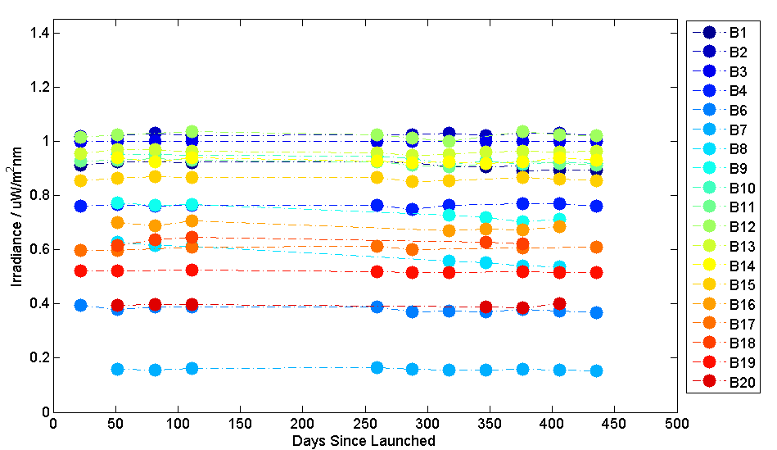
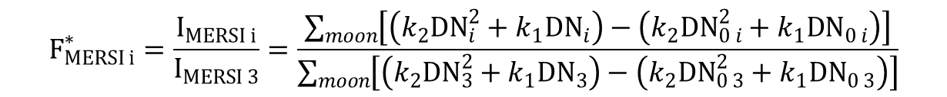
Lunar Relative Irradiance
$$F_{MERSI i}^{∗}=\frac{I_{MERSI i}^{}}{I_{MERSI 3}^{}}=\frac{\sum_{moon}{\left[\left(k_{2}{DN}_{i}^{2}+k_{1}{DN}_{i}^{}\right)−\left(k_{2}{DN}_{0 i}^{2}+k_{1}{DN}_{0 i}^{}\right)\right]}}{\sum_{moon}{\left[\left(k_{2}{DN}_{3}^{2}+k_{1}{DN}_{3}^{}\right)−\left(k_{2}{DN}_{0 3}^{2}+k_{1}{DN}_{0 3}^{}\right)\right]}}$$
Notes:
In order to Remove the Geometric influence, calculate the relative irradiance. And this is picture shows the relative irradiance time series.
We can see that most bands are stable

Slide 13
Uncertainty

Slide 15
Degradation
Band | Slope | Offset | Significance level of F test | Annual Degradation Rate /%
1 | -6.56E-05 | 9.28E-01 | 0.00230 | 2.58
2 | 1.44E-05 | 1.02E+00 | 0.15822 | -0.51
3 | ---- | ---- | ---- | ----
4 | 2.15E-06 | 7.62E-01 | 0.88208 | -0.1
6 | -5.08E-05 | 3.93E-01 | 0.00223 | 4.72
7 | -9.16E-06 | 1.60E-01 | 0.24369 | 2.09
8 | -2.55E-04 | 6.40E-01 | 0.00000 | 14.55
9 | -1.80E-04 | 7.82E-01 | 0.00009 | 8.42
10 | -9.40E-05 | 9.59E-01 | 0.00057 | 3.58
11 | -4.16E-05 | 9.33E-01 | 0.03141 | 1.63
12 | -2.38E-06 | 1.02E+00 | 0.93479 | 0.09
13 | -1.00E-05 | 9.63E-01 | 0.45506 | 0.38
14 | -1.60E-05 | 9.34E-01 | 0.40373 | 0.63
15 | -1.09E-05 | 8.64E-01 | 0.44799 | 0.46
16 | -6.73E-05 | 7.03E-01 | 0.03354 | 3.49
17 | 2.29E-05 | 5.99E-01 | 0.16314 | -1.4
18 | -1.74E-05 | 6.34E-01 | 0.71147 | 1
19 | -1.65E-05 | 5.23E-01 | 0.00784 | 1.15
20 | -1.04E-05 | 3.97E-01 | 0.52340 | 0.96
Notes:
Confidence
F Test

Slide 16
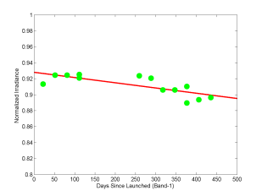
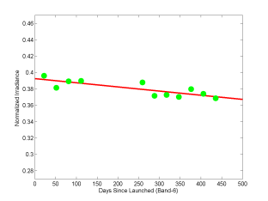
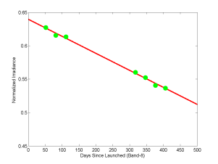
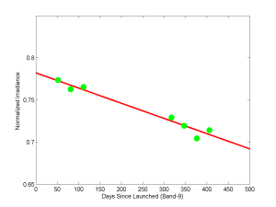
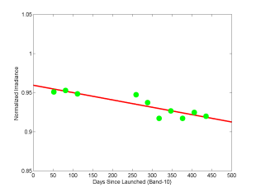
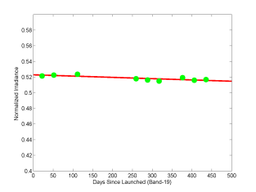
Degradation

Slide 17
Results of Relative Irradiance
14.55% and 8.42% for band 8 and band 9
1.15% and 4.72% for band 1, 6, 10, 11, 16 and 19
no degradation found for the rest bands

Slide 18
Operation of the GIRO
Irradiance:
  MERSI<ROLO (short wave length)
  MERSI>ROLO (long wave length)
  Ratio between MERSI and ROLO
  Band 6 is about 1.29
  Band 20 is about 0.58
*2013-10-23

Slide 19
Operation of the GIRO
Time series of Ratio varies 0.52%~6.76%
Band 8 degradation is very obvious

Slide 20
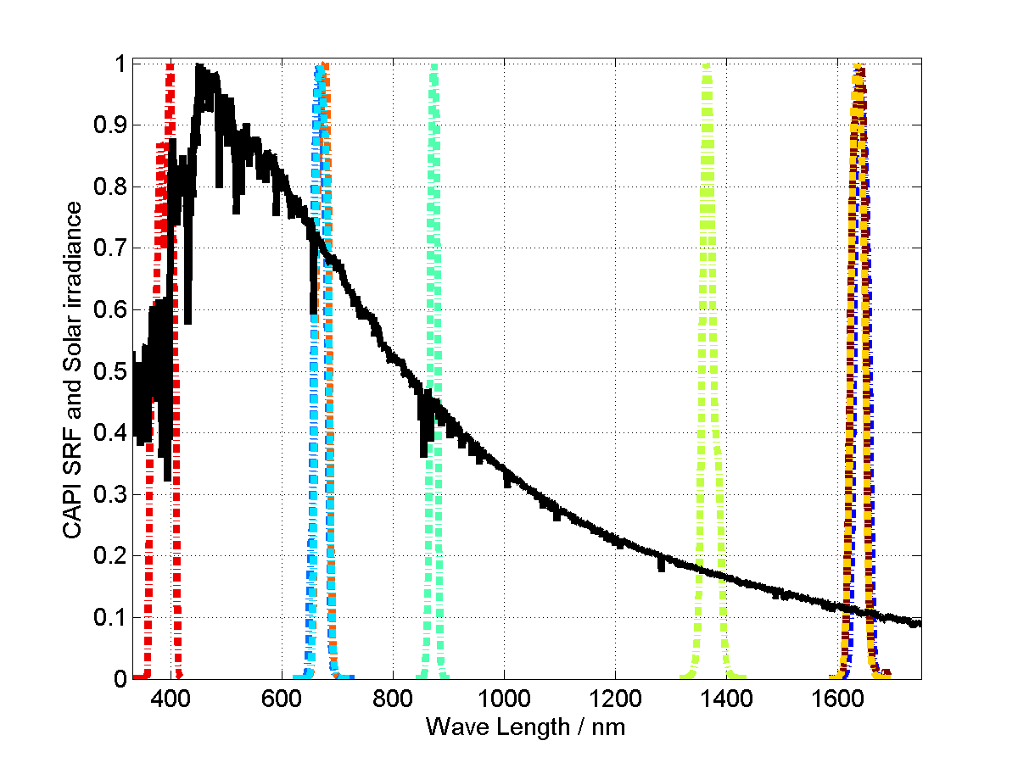
General description of CAPI
TanSat is Chinese Global Carbon Dioxide Monitoring Scientific Experimental Satellite, launched in 2016.12.22.
CAPI is one of the satellite's payloads, which is the first Cloud and Aerosol Polarization Multispectral Imager in China.
CAPI provides the necessary information about cloud and aerosol observation for the inversion of CO2 and is useful to conduct research on polarization remote sensing.
Parameters | Specification
Swath | 375km±10km
Sampling pixel of each scan | 1600@VIS, 800@NIR
IFOV | 0.25km@VIS, 1km@NIR
Calibration method | Solar diffuser, Lunar
Inter-band Co-registration | <0.25 pixel
Radiometric Calibration accuracy | <5%
Detector consistency within one band | <1%
Band | Center WL (µm) | WL Range (µm) | SNR | Typical radiance (W/m²µmsr) | Polarizing angle | IFOV (m)
1 | 0.38 | 0.365-0.408 | 260 | 28.0 | NP | 250
2 | 0.67 | 0.66-0.685 | 160 | 22.0 | 0° | 250
3 | 0.67 | 0.66-0.685 | 160 | 22.0 | 60° | 250
4 | 0.67 | 0.66-0.685 | 160 | 22.0 | 120° | 250
5 | 0.87 | 0.862-0.877 | 400 | 25.0 | NP | 250
6 | 1.375 | 1.36-1.39 | 180 | 6.0 | NP | 1000
7 | 1.64 | 1.628-1.654 | 110 | 7.3 | 0° | 1000
8 | 1.64 | 1.628-1.654 | 110 | 7.3 | 60° | 1000
9 | 1.64 | 1.628-1.654 | 110 | 7.3 | 120° | 1000

Slide 21
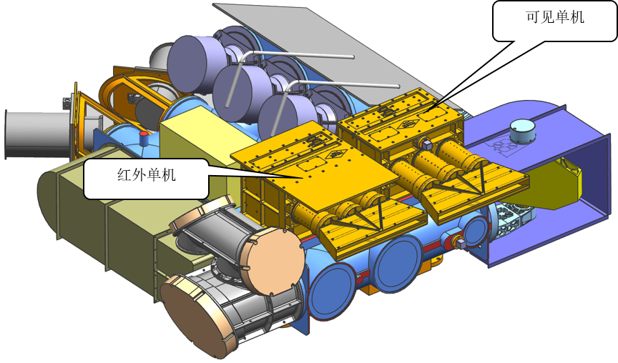
General description of CAPI
VIS
NIR
CAPI are divided into VNIR components (0.38μm, 0.67μm, 0.87μm) and SWIR components (1.375μm, 1.64μm band).

Slide 22
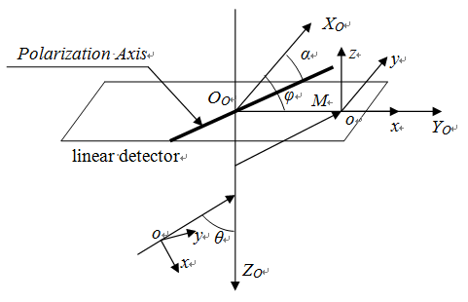
Absolute calibration
In the simplest case, the total energy changes as polarized light (I, Q, U) passes through the polarizer
In practical application, each device may polarized or depolarized the light
Notes:
理想状态下，偏振光经过起偏器后，总能量变化如公式
实际光学系统，各器件都会产生或消减偏振，实际公式如下
P1
P2
P3
Theda，Phy，alpha=Polarizer angle，eta=Polarization extinction ratio，epsilon=Polarizer rate
在实际工程应用中，光学成像系统的各视场不同菲涅耳损失、非完美透镜、分光棱镜、滤光片以及偏振片产生的偏振效应都影响测量结果的精度，需要消除偏振相机自身的偏振效应对测量结果影响。
In practical application, each field is different, Fresnel loss of the optical imaging system of non polarization effect, perfect lens, beam splitter, filters and polarizing plate produced will influence the accuracy of measurement results, to eliminate the polarization effect of polarization on the measurement results of the camera's own influence.

Slide 23
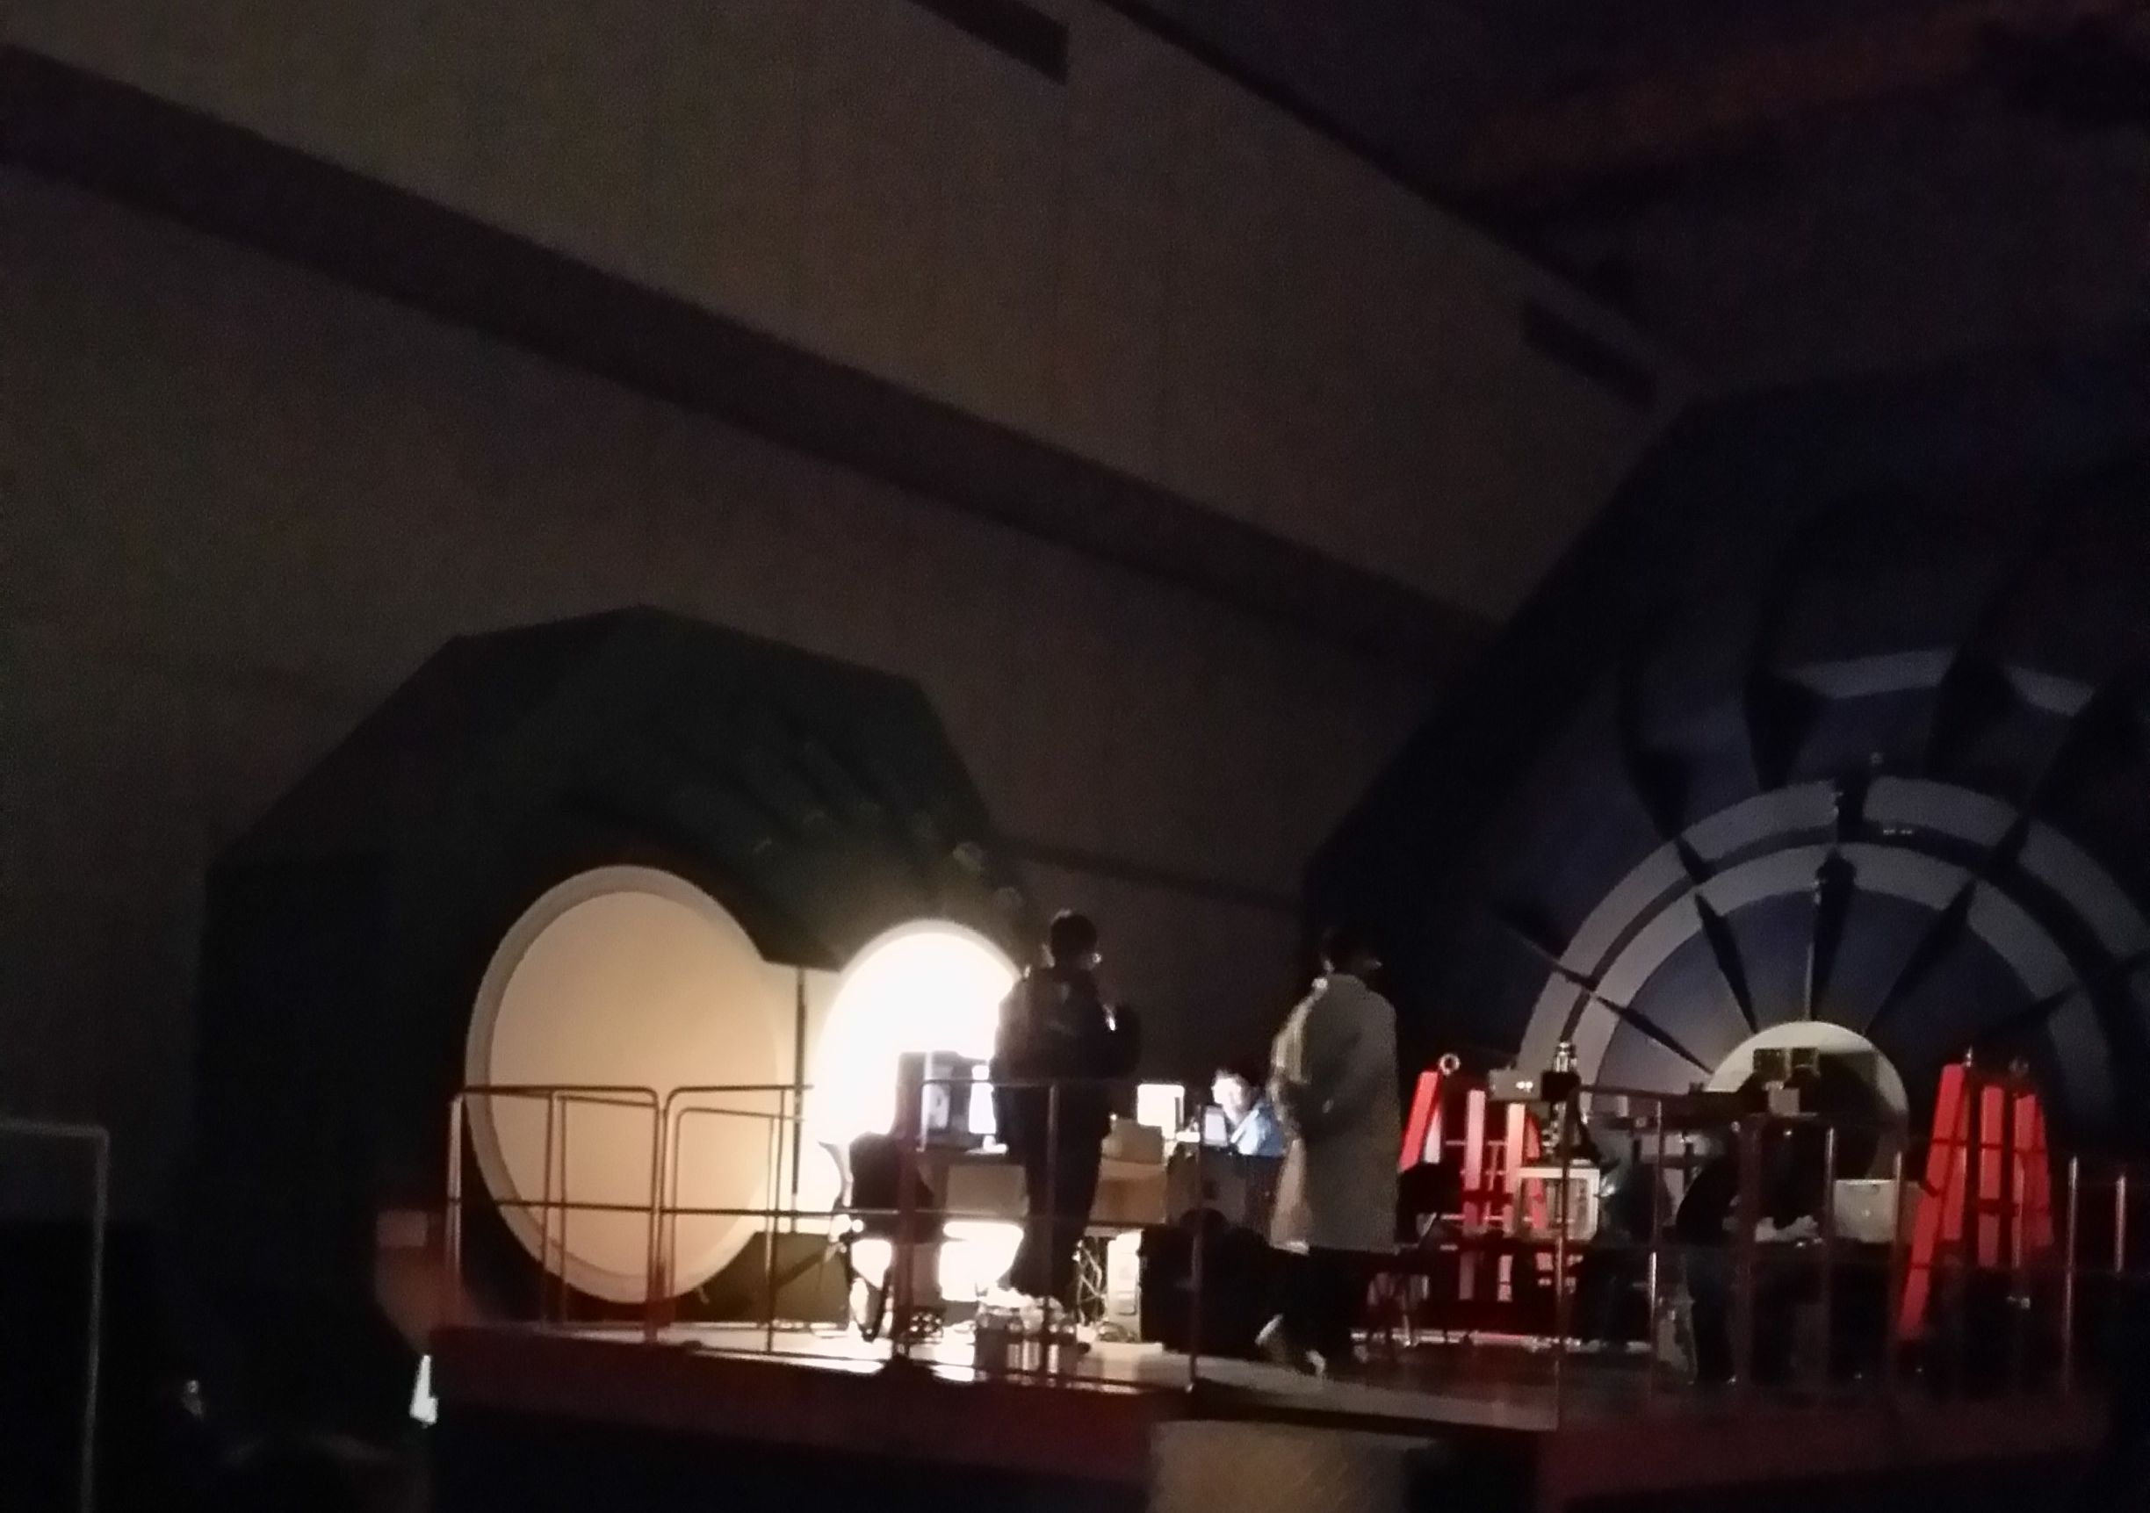
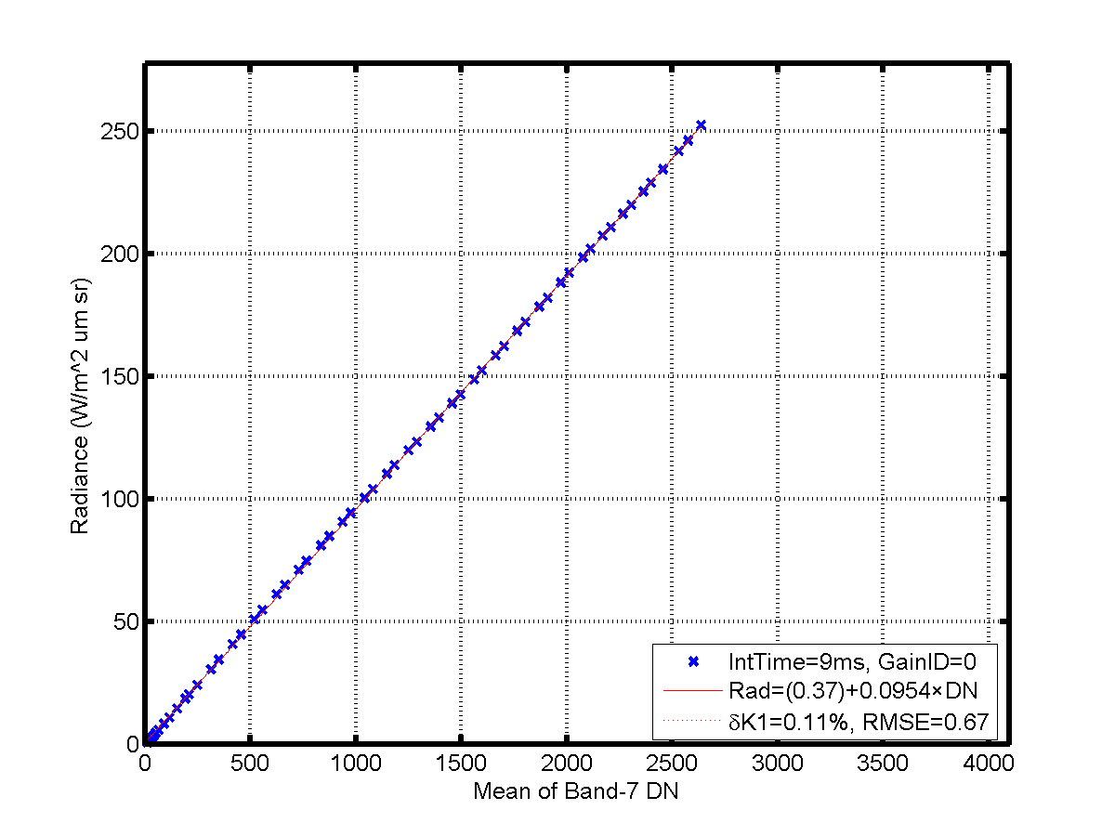
Absolute calibration
spherical integrating source light is non-polarized: Q=0, U=0
Central field of view, device polarized effect can be ignored
Notes:
积分球为非偏振光，非偏振光入射，视场中心像元，辐射定标公式简化

Slide 24
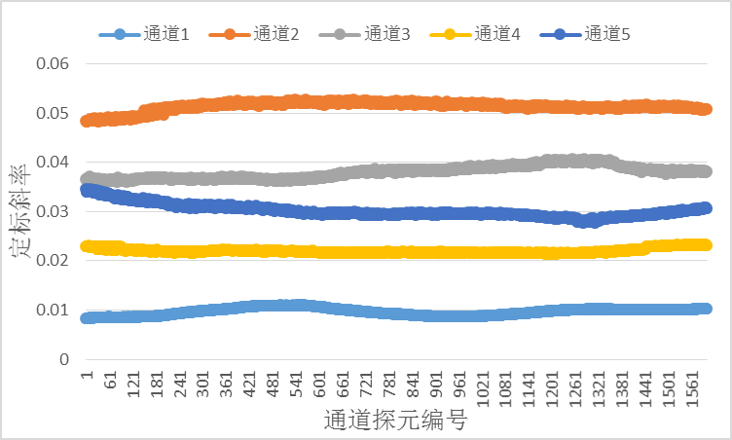
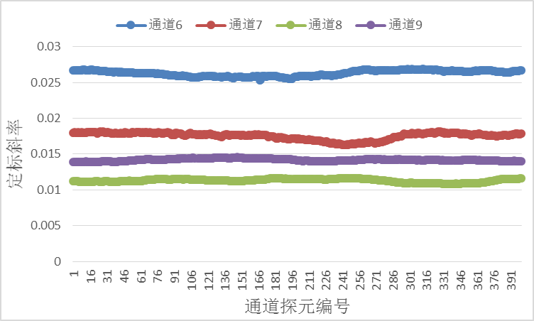
Absolute calibration
Pre-launce calibration results
Band | Slope | Offset | Uncertainty （%） | correlation coefficient
1 | 0.00922 | -0.59 | 0.78 | 0.99745
2 | 0.05205 | -1.60 | 0.96 | 0.99844
3 | 0.03819 | -0.56 | 0.60 | 0.99946
4 | 0.02171 | -0.55 | 1.15 | 0.99842
5 | 0.02954 | -0.40 | 0.63 | 0.99948
6 | 0.00854 | 0.08 | 0.14 | 0.99998
7 | 0.04913 | 0.48 | 0.17 | 0.99988
8 | 0.03404 | 0.24 | 0.24 | 0.99982
9 | 0.04078 | 0.52 | 0.22 | 0.99983

Slide 25
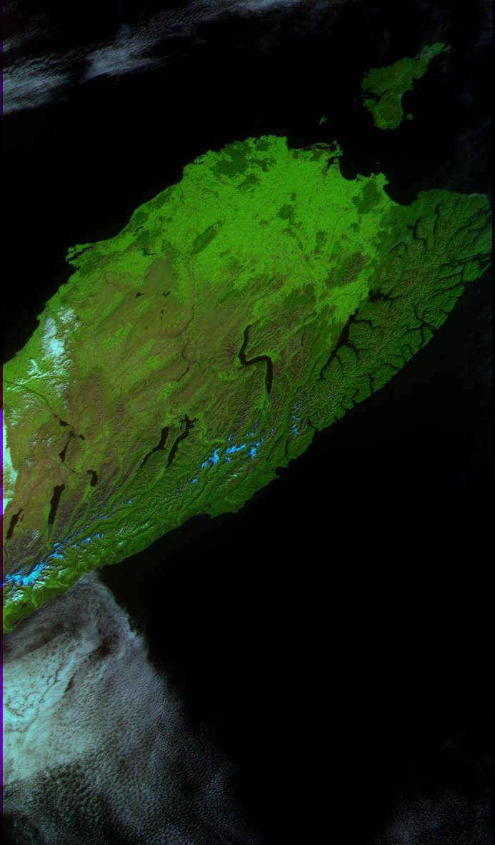
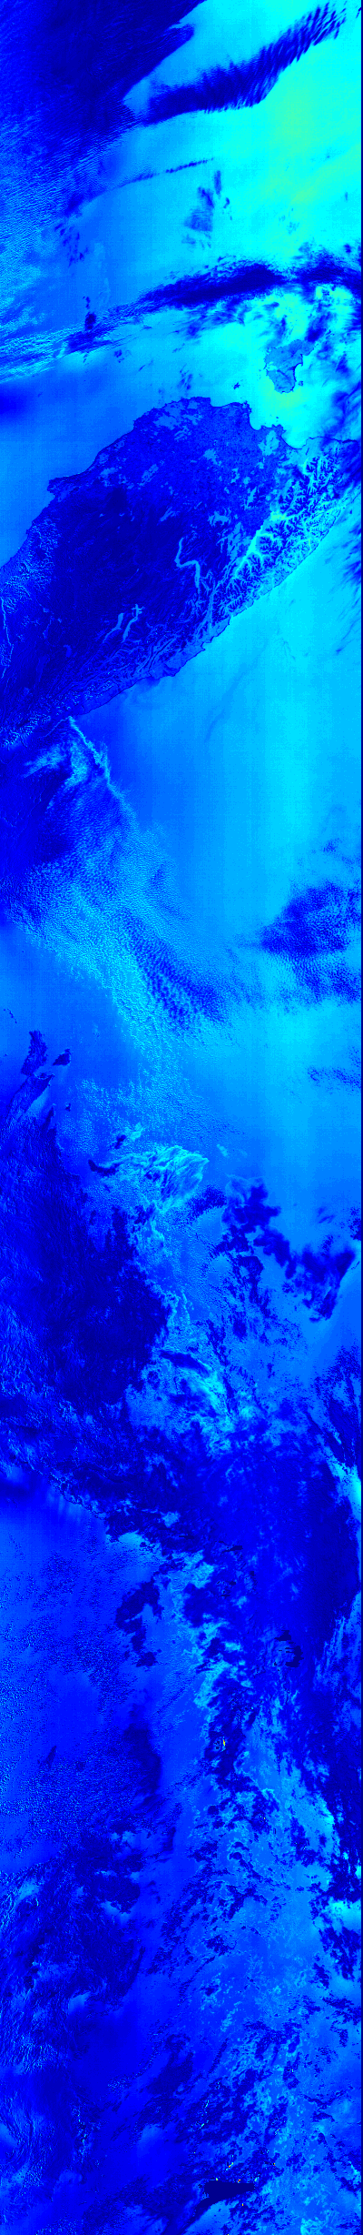
Example of a CAPI image and degree of polarization (670nm)
D
Water(A)
Land(B)
Cloud(C)
Cloud(D)
B
A
C

Slide 26
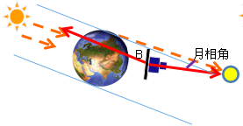
Example of a lunar image
TanSat turns around and points to the moon in the shadow zone of the earth
Observing the lunar image data by vibrating pitch angle

Slide 27
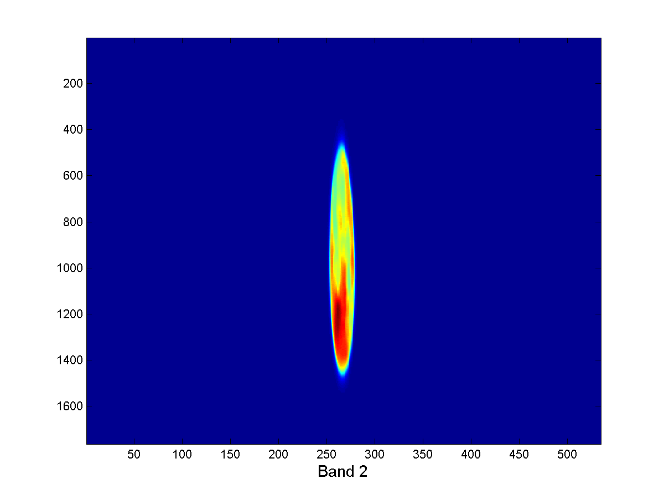
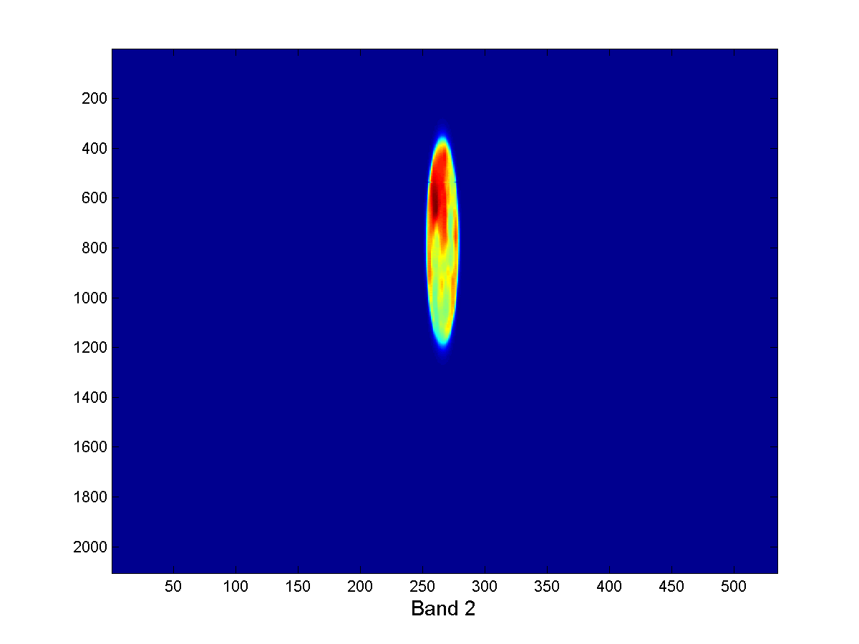
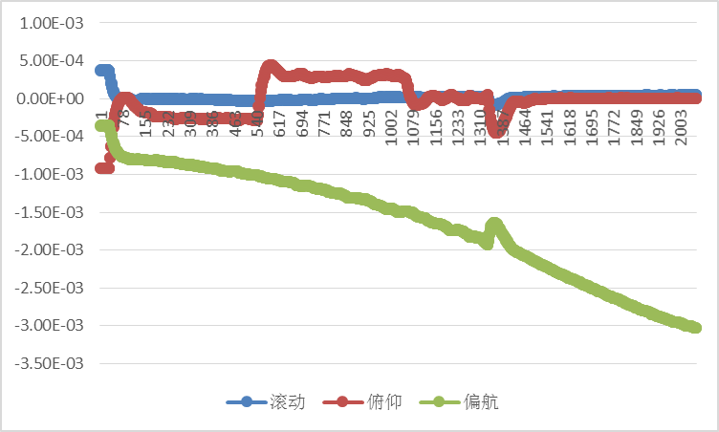
Example of a lunar image
Moon observation mode
  Single observation last about 10 minutes
  2 pictures are taken in one orbit
Scanning image
scan
fly back
Attitude angular velocity
Fly back image

Slide 28
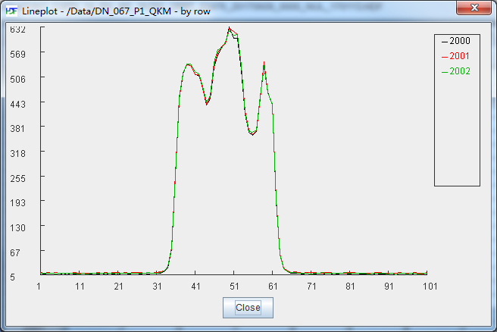
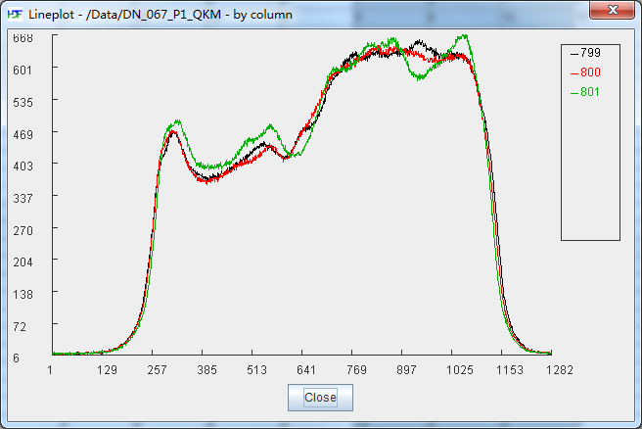
Example of a lunar image
Detector direction, about 32 moon pixels @250m (4 pixels @1000m)
Sweeping direction, about 1150 moon pixels @250m (287 pixels @1000m)
Detector direction DN
Sweeping direction DN
*2017-6-9

Slide 29
Integration step
Select the frames which contain moon disk image
Subtract the dark digital number and make moon mask
Calculate radiance of each moon pixel using calibration formula and coefficients
Calculate the irradiance and integrate all of moon pixels.
Correct the over sample factor

Slide 30
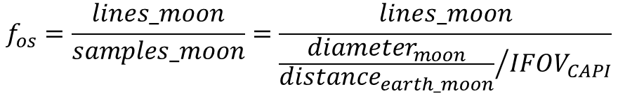
Over sample factor
lines
samples
$$f_{os}=\frac{lines_moon}{samples_moon}=\frac{lines_moon}{{\frac{{diameter}_{moon}}{{distance}_{earth_moon}}}/{{IFOV}_{CAPI}}}$$

Slide 31
Lunar Irradiance
CAPI lunar irradiance
  Irradiance spectrum shape is similar to the Sun’s
5 months lunar images have been collected
  Irradiance of different bands changes in a same pattern
*2017-6-9

Slide 32
Lunar Irradiance
Irradiance vs absolute phase angle
  Phase angle: 0.9~4.2 degree
Reflectance vs wave length
  Reflectance increases with wavelength
*2017-6-9

Slide 33
Lunar Relative Irradiance
Normalized Irradiance
  Band 6 (1375nm) as the reference band
  Uncertainty is about 0.6%~ 1.5%
  No obvious degradation for each of band

Slide 34
Operation of the GIRO
CAPI vs GIRO
  Irradiance of CAPI is much smaller than GIRO
  Ratio of CAPI/GIRO is negative correlation to wavelength
 | Ratio
Band 1 | 0.518
Band 2 | 0.605
Band 3 | 0.519
Band 4 | 0.553
Band 5 | 0.424
Band 6 | 0.439
Band 7 | 0.360
Band 8 | 0.379
Band 9 | 0.379

Slide 35
Operation of the GIRO
Irradiance ratio
  Ratio is stable, varied in 0.7%～2.0%
  No significant degradation for CAPI bands

Slide 36
Results of CAPI Lunar Calibration
Based on CAPI lunar observation data
  Inter-band radiation response varies 0.6%~1.5%
  Absolute response is stable, and varies in the range of 0.7%～2.0% during 2017.5~2017.9
  CAPI lunar irradiance is much smaller than GIRO’s, so there are still some problems for CAPI lunar calibration

Slide 37
Thank you for your time!
The End!
Notes:
Details

