Slide 1
The Second Joint GSICS/IVOS Lunar Calibration Workshop, 13~16 November 2017, Xi’an China
Lunar calibration of COMS visible channel using GIRO
Tae-Hyeong Oh (hyoung0203@korea.kr)
Dohyeong Kim (dolong@korea.kr)

Slide 2
Lunar Data Process
and Sensitivity Test

Slide 3
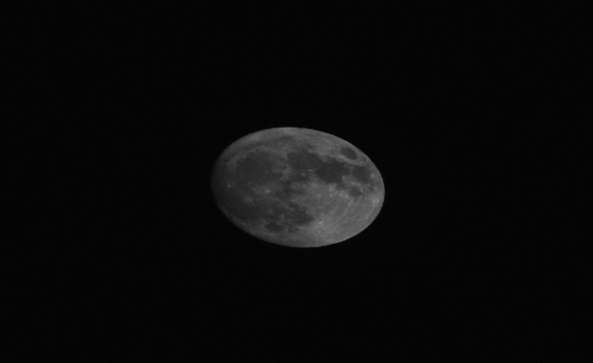
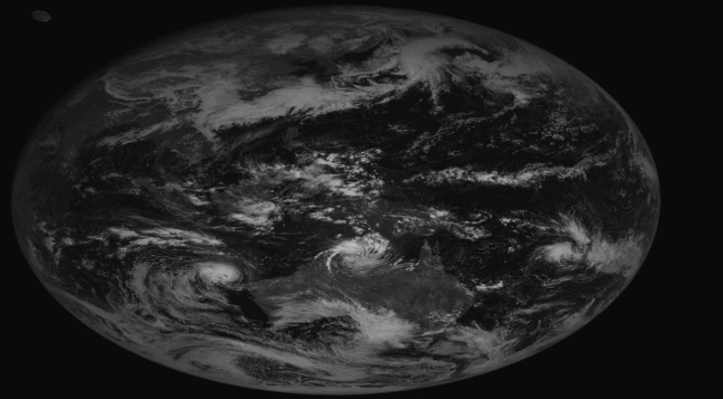
Moon Observation
COMS has observed moon for visible channel monitoring since April 2011
For observing moon, KMA choose two kind of moon observation method by using Local Area observation mode for moon and Full disk observation with moon
Normally, COMS MI observe the moon using Local Area mode twice per month when the moon locate in Field of Regard(FOR)
To process the observed data, KMA has used the Moon Processing system in IMPS (Level 0 → Level 1A)
* IMPS : Image Preprocessing System

Slide 4
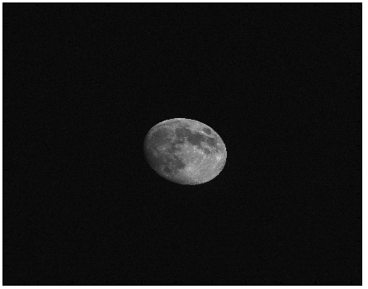
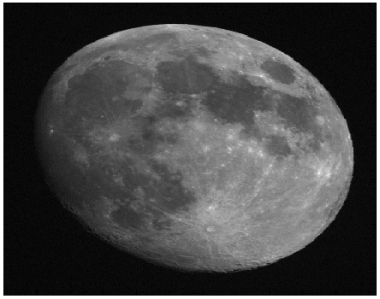
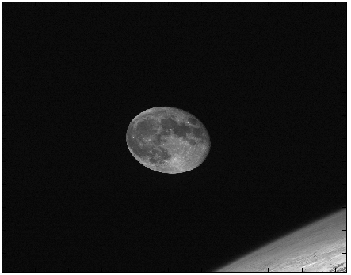
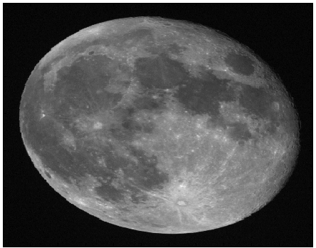
Level 1A Moon Data
COM MI radiometrically calibrated L1A Lunar Images
L1A Lunar Image
(2080*1200 pixels)
GIRO Input Image
(560*330 pixels)
2017-05-09
01-28-24
2017-02-12
04-13-11

Slide 5
GIRO (GSICS Implementation of the ROLO model)
Process of Moon data
L1A Moon data (2080*1200)
GIRO Input data (560*330)
Moon observation Data (Level1A)
(2080*1200 pixels)
Re-make a Moon data
(560*330)
Input data to the GIRO
Observed irradiance
DC offset
ROLO irradiance (GIRO)
Phase angle
and ect
Calculate a imager response with the observed irradiance and ROLO irradiance from the GIRO
$$P= \frac{I_{observed}}{I_{ROLO}}$$

Slide 6
Irradiance Calculation
Irradiance:
where
N_{P}: the total number of pixels in the lunar disk image (560*330pixels)
R_{P} : an individual radiance measurement(i.e. pixel) on the Moon
Ω: the solid angle of a pixel (sr) (7.84X10⁻¹⁰ sr), corresponding to one visible detector
28/16 : the oversampling rate of MI along E-W axis

Slide 7
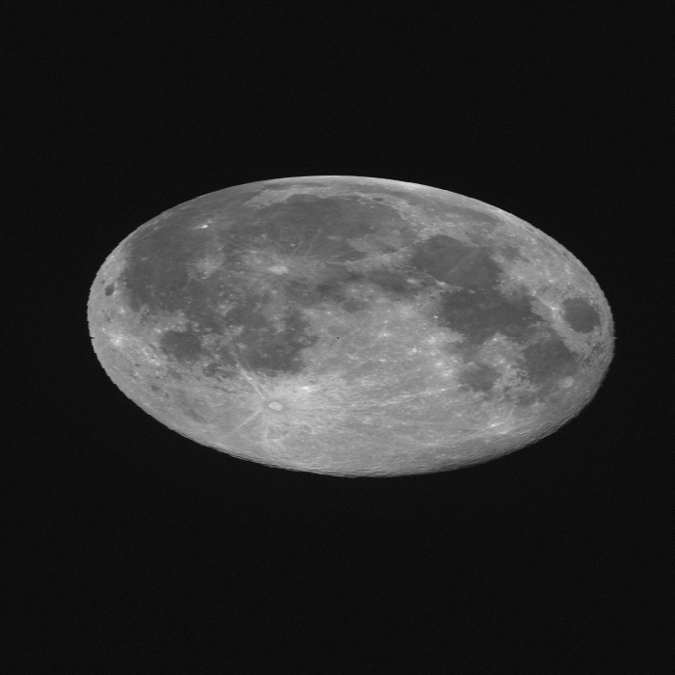
Sensitivity test (I)
To define the moon box including the background (space area)
Period : April 2011 ~ December 2014
Difference of the ratio or degradation through the Moon box size
Define moon box (a) to minimize the background effect
(d) 700 * 700
(c) 700 * 600
(b) 700 * 500
Moon area | No. of Pixel | degradation
(a) 560*330 | 183,911 | -4.04 %
(b) 700*500 | 348,801 | -3.91 %
(c) 700*600 | 418,701 | -3.87 %
(d) 700*700 | 488,601 | -3.77 %
(a) 560 * 330

Slide 8
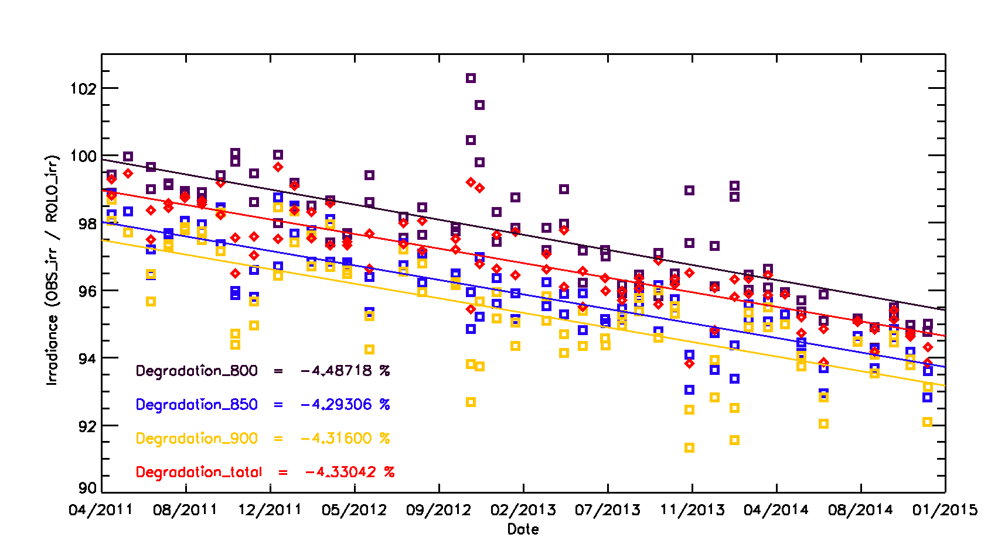
Sensitivity test (II)
Sensitivity test for the threshold to select the moon pixel
Period : April 2011 ~ December 2014
Variation greatly depend on the threshold, especially in phase angle of observation data is closed to 90〫
Calculate the observation irradiance using total moon pixels
Annual drift (%/yr)
thld 800 : -1.235 ± 0.1082
thld 850 : -0.9938 ± 0.0767
thld 900 : -1.1881 ± 0.1178
Total pix : -1.192 ± 0.0756

Slide 9
Results Using GIRO

Slide 10
The Dataset (GIRO)
Satellite | Time Coverage | Observations | channel | Phase-angle range [deg] | Useful Observation for ROLO calibration
COMS | Apr. 2011 ~ Sep. 2017 | 146 | 1 | -92〫~ 92〫 | 142
142 COMS MI - VIS observations available
Instrument | Channel | SRF in GIRO NetCDF format
COMS MI | VIS06 | Yes

Slide 11
Result of the Lunar calibration
Time series of the ratio (Obs_irr/ROLO_irr) (%)
Calculate a Observed Irradiance for total pixels of Moon box (560*330 pixels)
Degradation is about -8 % (-1.35%/year)
Low illumination
Full Moon
Low illumination
Degradation = -1.35%/year

Slide 12
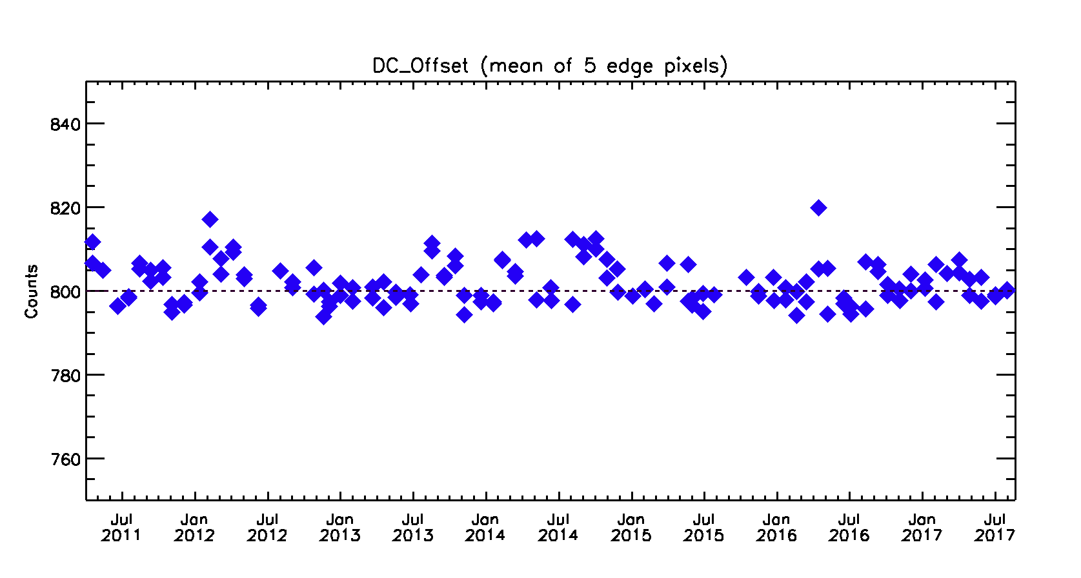
Result of the Lunar calibration
Time series of DC offset
Calculate the mean of 5 edge pixels
Period : April 2011 ~ September 2017
DC offset : about 790~820 counts (mean = 801.9)
Not apply for calculating Moon irradiance

Slide 13
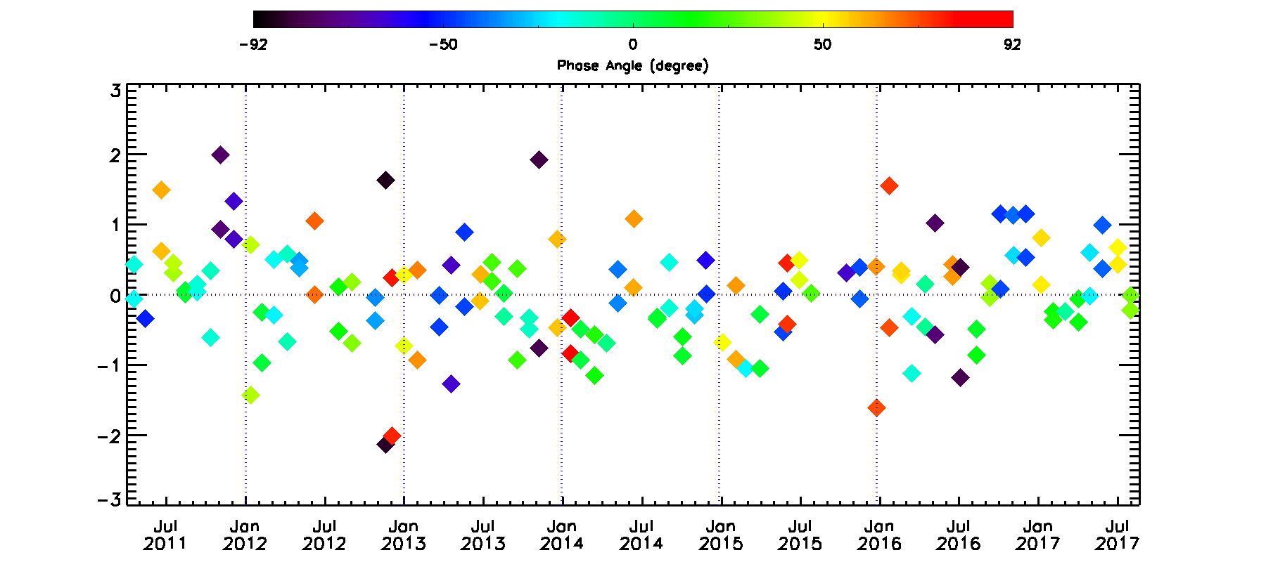
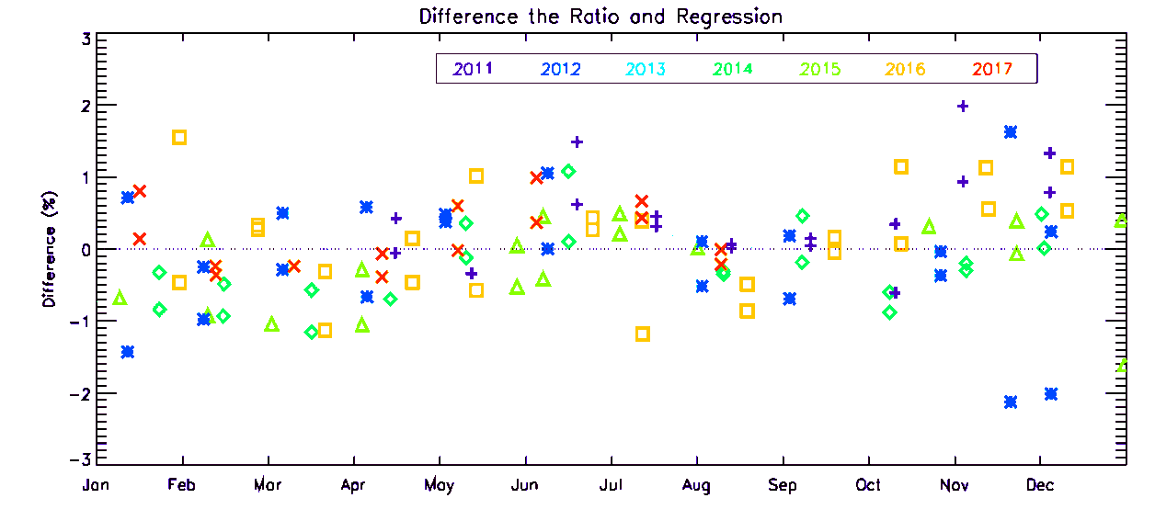
Phase angle dependence
calculate the difference Ratio and regression line
R(Irr_{obs}/Irr_{ROLO}) – R’[y=mx+b]
Total period
(Apr. 2011 ~ Sep. 2017)
Annual variation

Slide 14
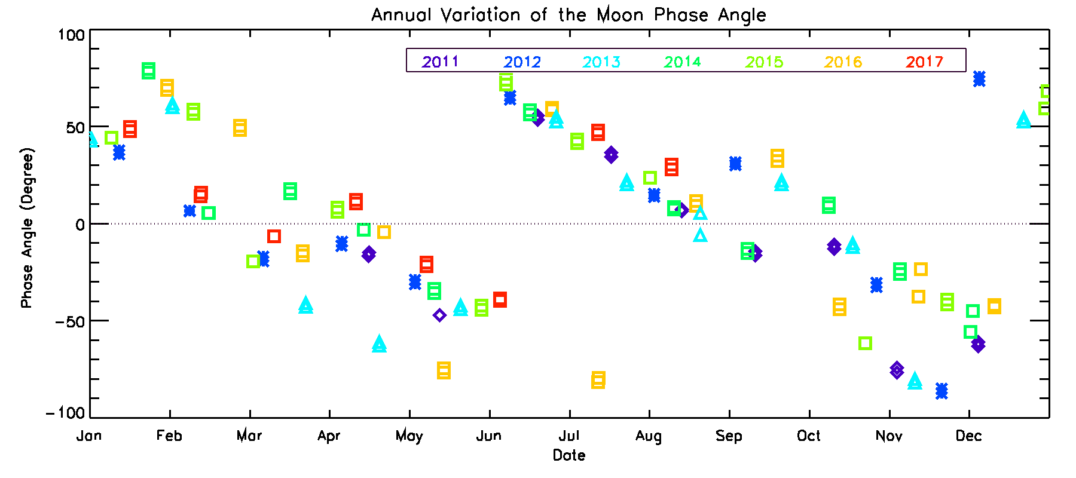
Seasonal variation of the Phase angle
Phase angle is varied as a 6 month periodicity
Related with a observation schedule of COMS MI

Slide 15
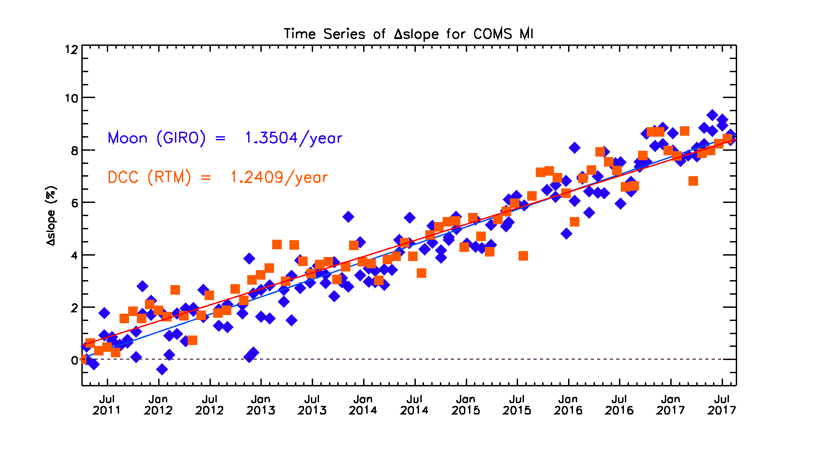
Result of Moon and DCC(RTM)
Compare with moon and DCC(RTM) result
Period : April 2011 ~ September 2017
Moon : -1.35 % /year (Blue)
DCC(RTM) : -1.24% / year (Orange)
F_{PIX} : Oversampling factor
Ω_{PIX} : Pixel solid angle [sr⁻¹]
Dc_{i} : Digital count of the Moon pixel
Off_{DC} : Averaged deep space DC
N_{PIX} : Number of the Moon pixels
[W m⁻² µm⁻¹ DC⁻¹]
Notes:
.

Slide 16
Summary
KMA/NMSC has been monitoring COMS visible channel performance using Moon observation data from April 2011 to September 2017
In the sensitivity test, KMA define moon box size(560*330) to minimize a effect from space pixels and use total pixel to get the observed irradiance
The degradation rate[%/year] using the Moon measurements and GIRO method is about -1.35 which is relatively higher value compared with the DCC(RTM) result(-1.24)
It has a seasonal variation due to a Moon phase angle in the moon calibration result.
phase angle show similar pattern every year
It is depend on a moon observation schedule
After launch GK-2A AMI, it will observe the moon more frequently than COMS MI
Reduce or remove a seasonal variation of the Moon ratio by several test using numerous moon observation data

Slide 17
Questions
In the sensitivity test, KMA define moon box size(560*330) to minimize a effect from space pixels and use total pixel to integrate the instrument irradiance
Is it reasonable?
Phase angle of COMS MI show similar pattern every year
It is depend on a moon observation schedule
I would like to know the results of other instrument especially GOES-15 or MTSAT-2 including GOES-16 or Himawari-8, because these satellite is equipped similar instrument with COMS MI (or GK-2A AMI)
For lunar calibration
How many times observe the moon per week or month?
or how often observe the moon ?
or phase angle range ?

Slide 18
Thank You.

Slide 19
Back-up Slide

Slide 20
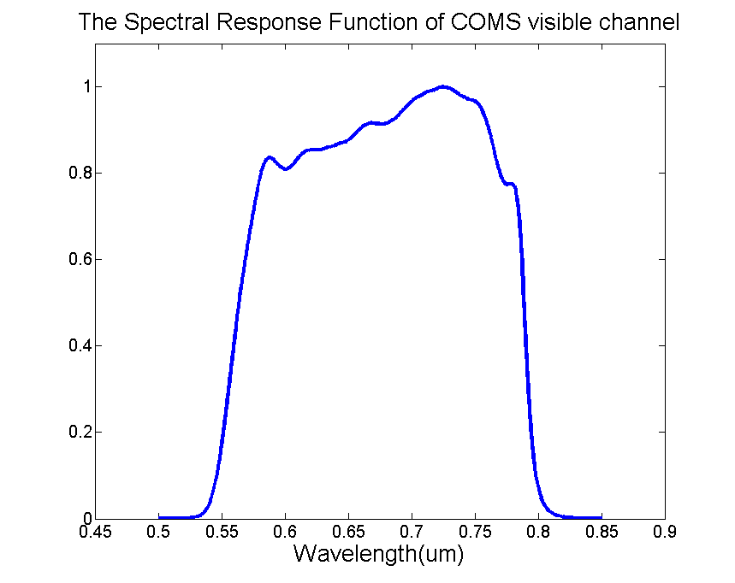
COMS MI visible channel
Radiance: R = m∙X + b ( W∙m⁻²∙sr ⁻¹∙μm ⁻¹ )
where X = digital counts
m = linear calibration coefficient, i.e. the slope (pre-launch determined)
b = intercept (measured by the count values of space-look data)
Channel | wavelength(㎛) | Spatial Resolution(km)
Visible | 0.55 ~ 0.80 (0.67) | 1

Slide 21
MI radiometric calibration
Radiometric Calibration concept (IMPS *on NMSC)
Spacecraft Effects
Radiance
@ Imager
Level 0
L1A
L1B
Orbit & Attitude/
Thermo-Elastic/Platform Jitter
Radiometric
Correction
R = m∙X + b
( W∙m⁻²∙sr ⁻¹∙μm ⁻¹ )
Instrument Effects
Geometric
Correction
Scan Mirror/Detector/
Focal Plane/Electronics
* IMPS : Image Preprocessing System

Slide 22
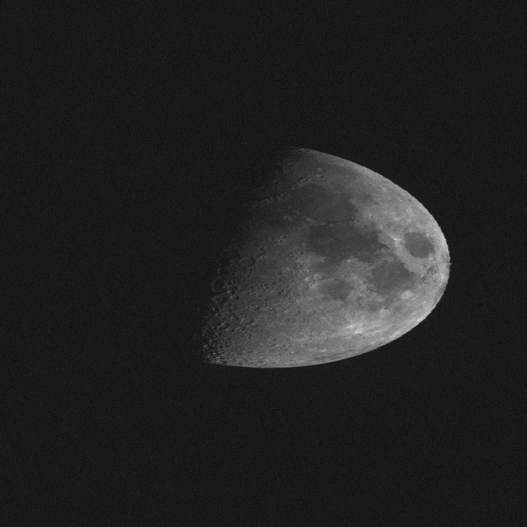
Sensitivity test for threshold
20131110 21:28:22
20140811 03:13:12
800
850
800
850
900
950
900
950

Slide 23
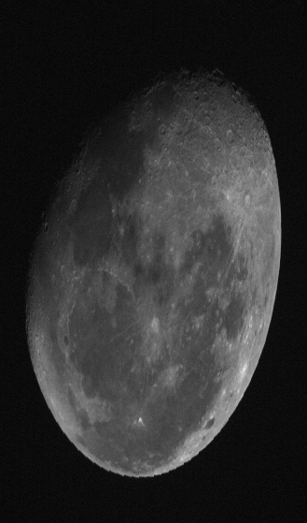
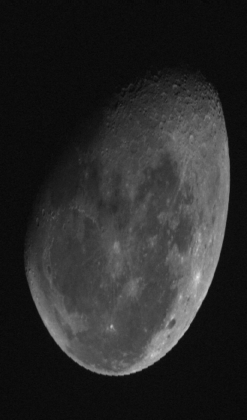
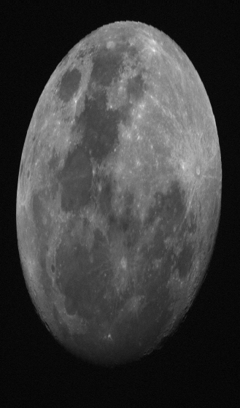
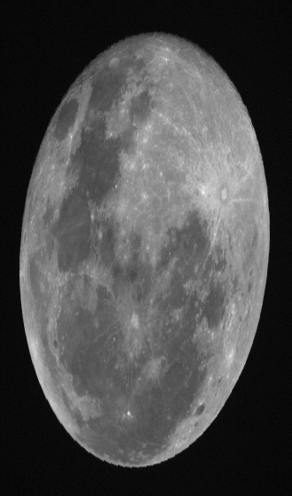
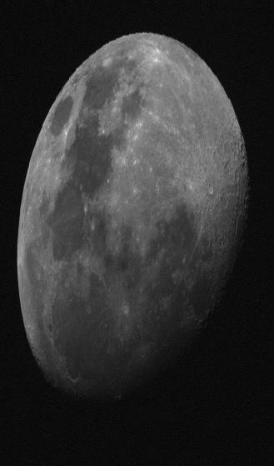
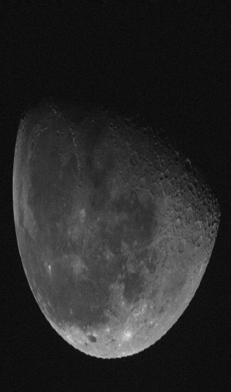
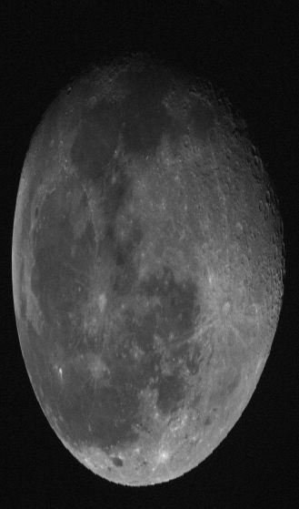
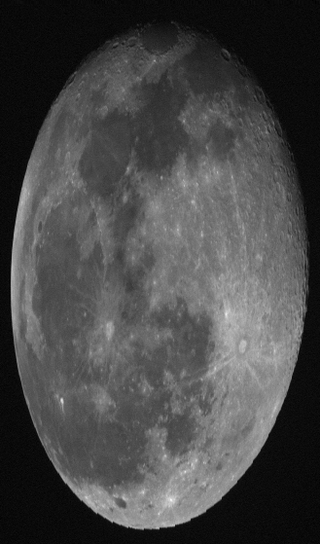
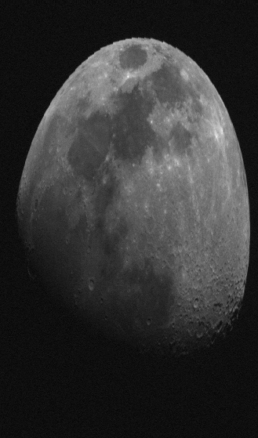
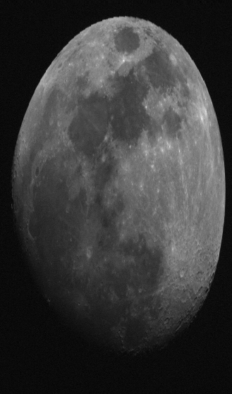
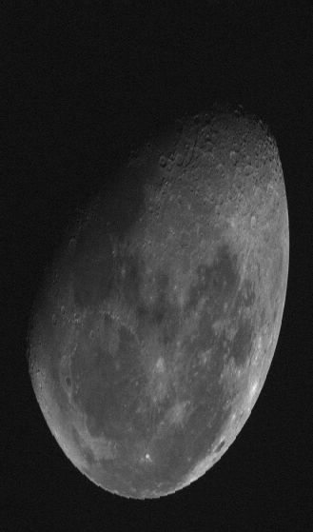
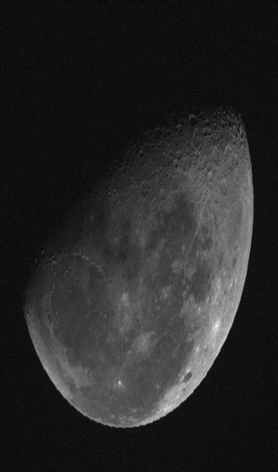
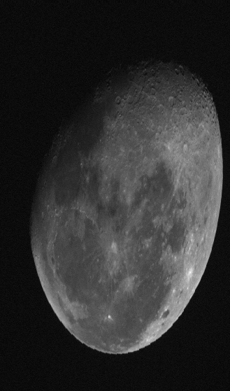
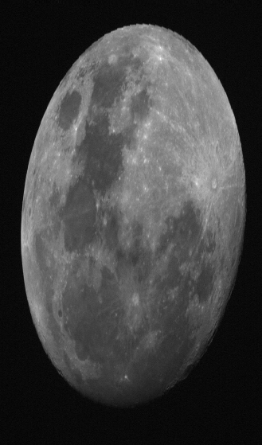
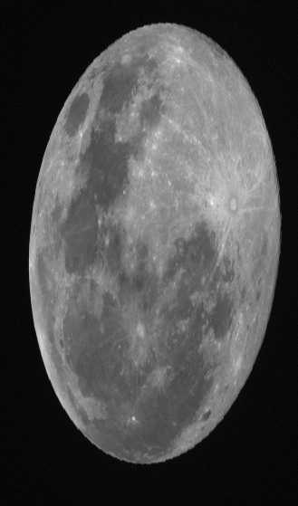
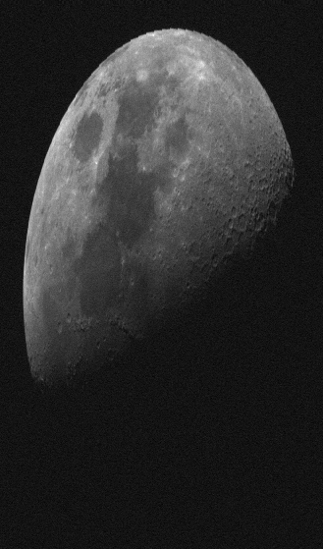
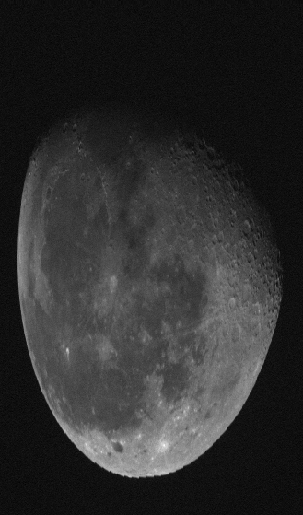
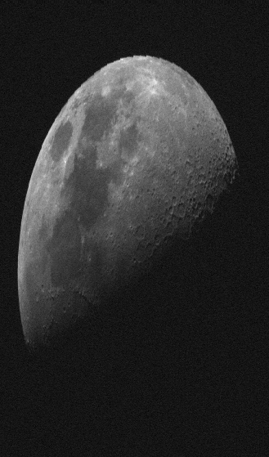
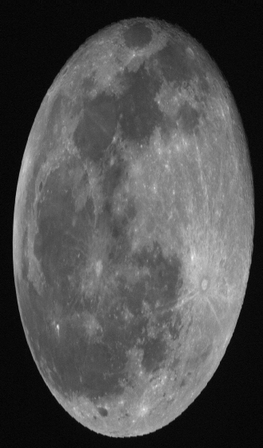
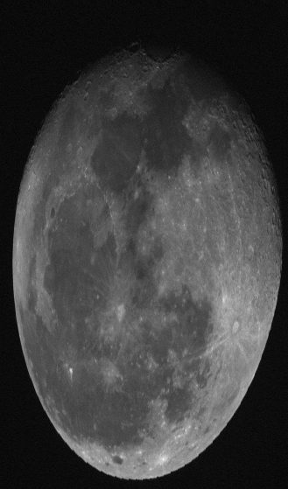
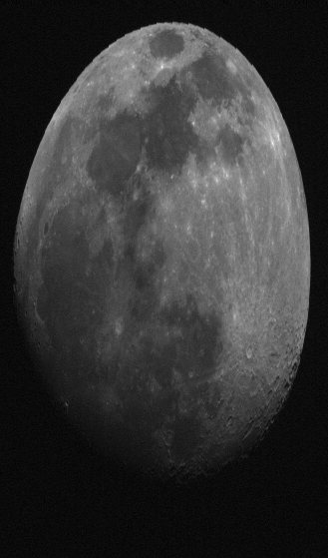
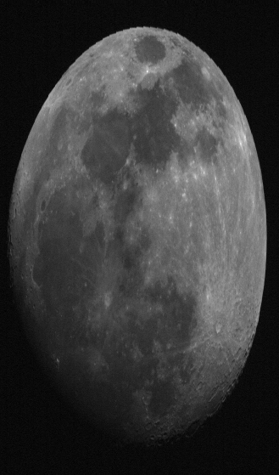
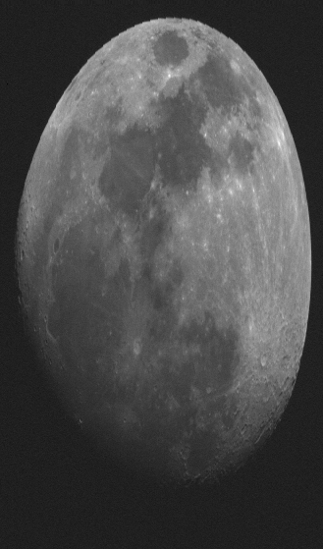
20150109 055844
20150209 064334
20150304 014335
20150405 032544
20150529 235823
20150608 074333
20150705 054337
20150802 042846
20151022 234332
20151122 235843
20151230 075844
20160130 072846
20160227 061336
20160322 015846
20160422 025845
20160514 215847
20160625 071335
20160712 212845
20160819 032845
201609190 45842
20161012 235845
20161112 001336
20161211 001332

Slide 24
Date | Phase Angle | Date | Phase Angle
20150109 055844 | 44.4135931898 | 20160130072846 | 68.9587991043
20150209 064334 | 56.5028440442 | 20160227061336 | 48.3258603159
20150304 014335 | -19.3849272660 | 20160322015846 | -16.1986840367
20150405 032544 | 6.2421681872 | 20160422025845 | -4.3454742886
20150529 235823 | -44.1865147446 | 20160514215847 | -76.6446995602
20150608 074333 | 71.6981086535 | 20160625071335 | 58.3771277310
20150705 054337 | 41.4580901864 | 20160712212845 | -81.4814451221
20150802 042846 | 23.6635046956 | 20160819032845 | 9.3380522629
 |  | 20160919045842 | 32.4448523551
20151022 234332 | -61.4661465769 | 20161012235845 | -43.9419250674
20151122 235843 | -41.5659020239 | 20161112001336 | -37.5012318895
20151230 075844 | 59.2794028030 | 20161211001332 | -43.1995018085

Slide 25
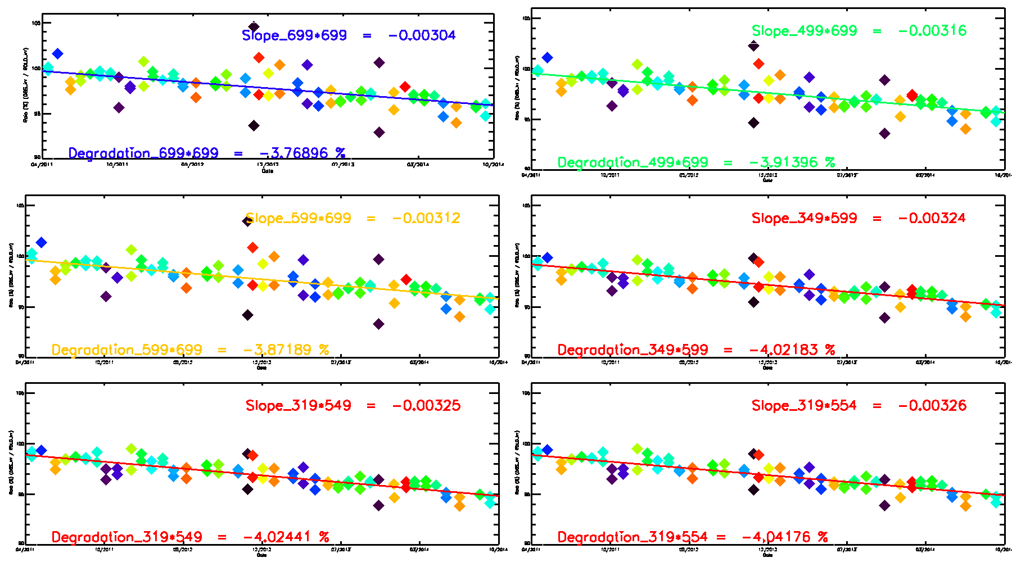
Moon Box Test

