Slide 1
Lunar Data Preparation for MVIRI and SEVIRI
S. Wagner, B. Viticchie, T. Hewison
Acknowledgement: T. Stone - USGS

Slide 2
Contents
Brief Description of the EUMETSAT operational satellites
Moon identification and extraction procedure
Calculation of the observables
Some results

Slide 3
EUMETSAT operating satellites
Satellite | Time span | Pixel resolution at SSP | Bands | VIS/NIR bands | Service
Meteosat-7 (MET7) | 1997-2017 | 2.5 km in VIS 5 km in WV and IR | VIS (0.3-1.05 µm) WV (5.4-7.5 µm) IR (10.0-13.1 µm) | VIS | 30 min repeat cycle 18.4 deg x 18.4 deg FOR
Meteosat-8 (MSG1) | 2002-present | 3 km low-res 1 km high-res | VIS006 (0.6 µm) VIS008 (0.8 µm) HRVIS (0.7 µm) NIR016 (1.6 µm) IR039 (3.9 µm) IR062 (6.2 µm) IR073 (7.3 µm) IR097 (9.7 µm) IR108 (10.8 µm) IR120 (12.0 µm) IR134 (13.4 µm) | VIS006 VIS008 HRVIS NIR016 | 15 min repeat cycle 18.4 deg x 18.4 deg FOR or 5 min cadence (RSS, reduced FOR centred on Europe)
Meteosat-9 (MSG2) | 2005-present
Meteosat-10 (MSG3) | 2012-present
Meteosat-11 (MSG4) | 2015-present [currently stored in orbit]

Slide 4
EUMETSAT operating satellites
Satellite | Time span | Pixel resolution at SSP | Bands | VIS/NIR bands | Service
Meteosat-7 (MET7) | 1997-2017 | 2.5 km in VIS 5 km in WV and IR | VIS (0.3-1.05 µm) WV (5.4-7.5 µm) IR (10.0-13.1 µm) | VIS | 30 min repeat cycle 18.4 deg x 18.4 deg FOR
Meteosat-8 (MSG1) | 2002-present | 3 km low-res 1 km high-res | VIS006 (0.6 µm) VIS008 (0.8 µm) HRVIS (0.7 µm) NIR016 (1.6 µm) IR039 (3.9 µm) IR062 (6.2 µm) IR073 (7.3 µm) IR097 (9.7 µm) IR108 (10.8 µm) IR120 (12.0 µm) IR134 (13.4 µm) | VIS006 VIS008 HRVIS NIR016 | 15 min repeat cycle 18.4 deg x 18.4 deg FOR or 5 min cadence (RSS, reduced FOR centred on Europe)
Meteosat-9 (MSG2) | 2005-present
Meteosat-10 (MSG3) | 2012-present
Meteosat-11 (MSG4) | 2015-present [currently stored in orbit]
All satellites are spin-stabilized GEO satellites with no dedicated observation of the Moon ➔ the Moon goes across the FOR
Level 1.0 raw data need to be checked since the operational image processing keeps only the Earth in Level1.5 (equivalent to Level 1c).

Slide 5
EUMETSAT operating satellites
Satellite | Time span | Pixel resolution at SSP | Bands | VIS/NIR bands | Service
Meteosat-7 (MET7) | 1997-2017 | 2.5 km in VIS 5 km in WV and IR | VIS (0.3-1.05 µm) WV (5.4-7.5 µm) IR (10.0-13.1 µm) | VIS | 30 min repeat cycle 18.4 deg x 18.4 deg FOR
Meteosat-8 (MSG1) | 2002-present | 3 km low-res 1 km high-res | VIS006 (0.6 µm) VIS008 (0.8 µm) HRVIS (0.7 µm) NIR016 (1.6 µm) IR039 (3.9 µm) IR062 (6.2 µm) IR073 (7.3 µm) IR097 (9.7 µm) IR108 (10.8 µm) IR120 (12.0 µm) IR134 (13.4 µm) | VIS006 VIS008 HRVIS NIR016 | 15 min repeat cycle 18.4 deg x 18.4 deg FOR or 5 min cadence (RSS, reduced FOR centred on Europe)
Meteosat-9 (MSG2) | 2005-present
Meteosat-10 (MSG3) | 2012-present
Meteosat-11 (MSG4) | 2015-present [currently stored in orbit]
Moon identification + extraction performed operationally with a time delay of 15 days.
For the data acquired before 2013 a systematic analysis of the operational data archive has been performed to look for the Moon.
Offline processing required for MVIRI instruments prior to Meteosat-7

Slide 6
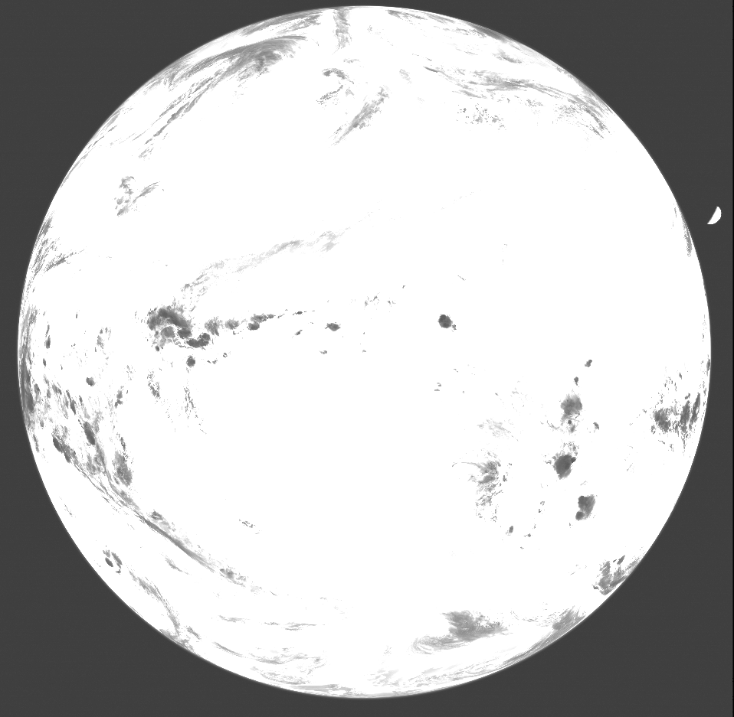
Moon observations from EUMETSAT operating satellites: MSGs
IR087 observation clipped between [min(Im), max(Im)/5]
Step 1 – Spot the Earth : patch detection
Define a two-level image with 1 where the Level 1.0 pixel is above
Space Count_{IR087} + Std_dev Space Count_{IR087} (from the Trailer)
and 0 elsewhere.
➔ The two-level image has two patches at 1 (the Earth and the Moon) and one region at 0 (the deep-space). The largest one is (for sure) the Earth.
Step 2 – Locate the off-Earth content of the image: removing the Earth
From Step 1 one gets the Earth patch; what is out of this patch is considered the off-Earth content of the Level 1.0 data (the Moon is in this part of the image).
Step 3 – Spot the Moon
Use the off-Earth content of the Level 1.0 data to define a two-level image with 1 where the Level 1.0 pixel is above:
Space Count_{IR087} + 3 x Std_dev Space Count_{IR087} (from the Trailer) and 0 elsewhere. The largest remaining patch is (for sure) the Moon, the other patches are residuals pixels.

Slide 7
Moon observations from EUMETSAT operating satellites: MSGs
Knowing the relative position of the channels on the focal plane one can use the information obtained in the IR087 to spot the Moon in the Solar Channels (VIS006, VIS008, NIR016 and HRVIS)

Slide 8
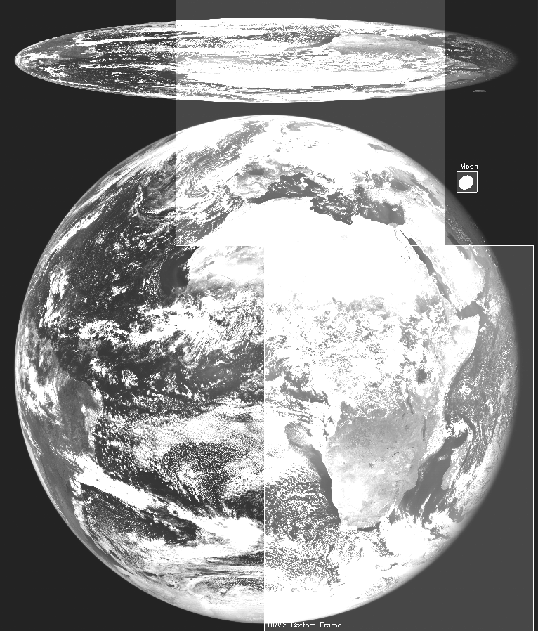
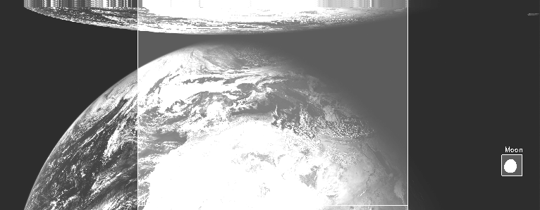
Moon observations from EUMETSAT operating satellites: MSGs
High-res observation and Moon detection
Low-res observation and Moon detection

Slide 9
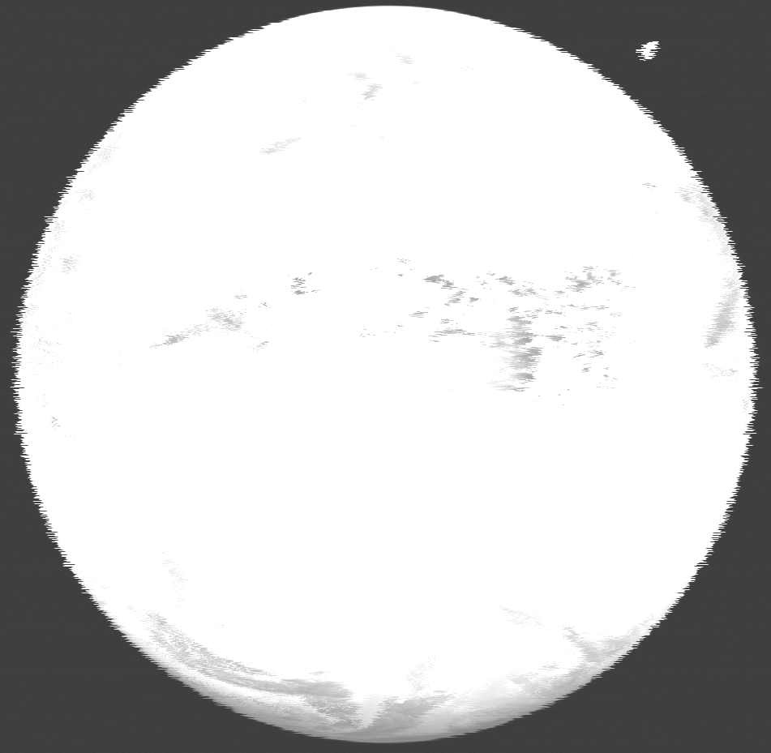
Moon observations from EUMETSAT operating satellites: MSGs
Complication due to acquisition anomalies:
strong jitter in Level 1.0 data
The shapes of both the Moon and the Earth are strongly affected by the anomaly, this can create problems in the identification and extraction!
IR087 observation clipped between [min(Im), max(Im)/5] affected
by the high jitter

Slide 10
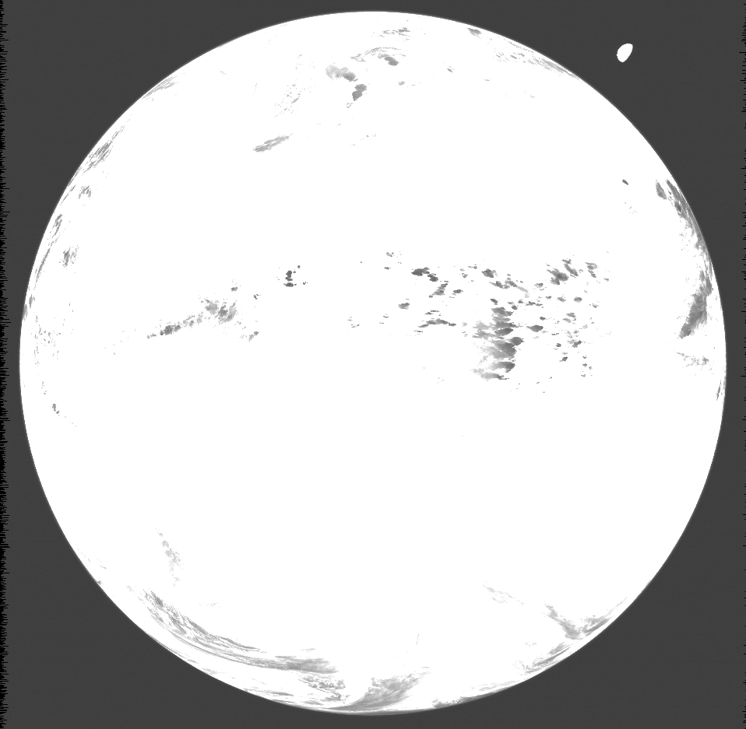
Moon observations from EUMETSAT operating satellites: MSGs
IR087 observation clipped between [min(Im), max(Im)/5] after the correction by using the jitter files provided by the image processing

Slide 11
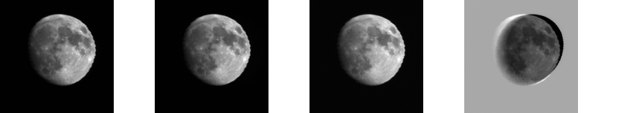
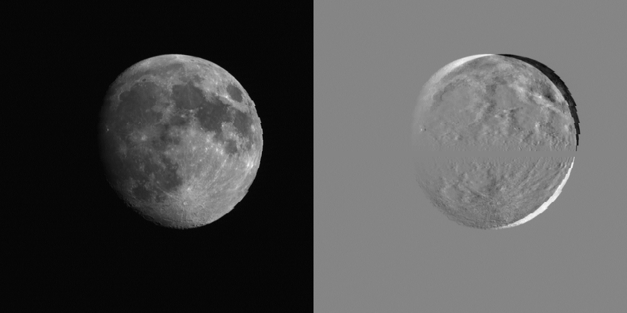
Moon observations from EUMETSAT operating satellites: MSGs
Example of Level 1.0 DC (raw) imagettes from MSG1 VIS/NIR channels
(corrected for the relative motion satellite-Moon)
VIS006
VIS008
NIR016
HRVIS
A margin of 20 pixels is set around the moon

Slide 12
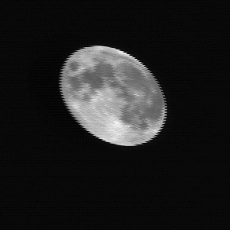
Moon observations from EUMETSAT operating satellites: MSGs
The same procedure has been applied successfully to Meteosat 7 data by using the IR channel as reference (imagette not corrected for the relative motion satellite-Moon).
VIS006
VIS008
NIR016
VIS
HRVIS
Example of Level 1.0 DC (raw) imagettes from MSG1 VIS/NIR channels
(corrected for the relative motion satellite-Moon)

Slide 13
Moon observations from EUMETSAT operating satellites
Moon observations are available ONLY
in Level 1.0 data

Slide 14
Moon observations from EUMETSAT operating satellites: MSGs
Moon observations are available ONLY
in Level 1.0 data
Level 1.0 DC raw imagette

Slide 15
Moon observations from EUMETSAT operating satellites: MSGs
Moon observations are available ONLY
in Level 1.0 data
Level 1.0 DC raw imagette
Equalization and non linearity correction (LUT)
Level 1.5 DC
Process mimicking part of the image processing

Slide 16
Moon observations from EUMETSAT operating satellites: MSGs
Moon observations are available ONLY
in Level 1.0 data
Level 1.0 DC raw imagette
Equalization and non linearity correction (LUT)
Level 1.5 DC
Process mimicking part of the image processing
Level 1.5 Radiance imagette
Calibration equation (linear)

Slide 17
Moon observations from EUMETSAT operating satellites: MSGs
Moon observations are available ONLY
in Level 1.0 data
Level 1.0 DC raw imagette
Equalization and non linearity correction (LUT)
Level 1.5 DC
For Meteosat 7 we use only Level 1.0 DC imagettes. We calibrated the data on the ROLO/GIRO scale to estimate the instrument drift.
No radiance imagettes are used.
Process mimicking part of the image processing
Level 1.5 Radiance imagette
Calibration equation (linear)

Slide 18
Calculation of the observables for the VIS/NIR bands at EUMETSAT

Slide 19

Computation of the digital count signal
Computation of the digital count signal and total number of pixels: integration over a mask on the illuminated portion of the Moon
In the case of MVIRI, allowed us to reject some ghost signal seen away from the moon
DC > DeepSpace_Threshold (idea = the instrument cannot make the difference between deep space and dark moon pixels)
$$Total_{DC}=\sum_{i ∈ Mask}{{Imgt}_{DCi}}$$

Slide 20
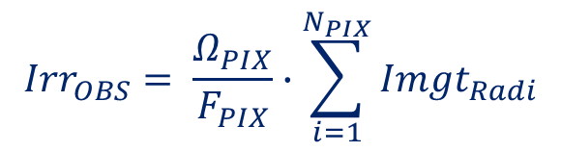
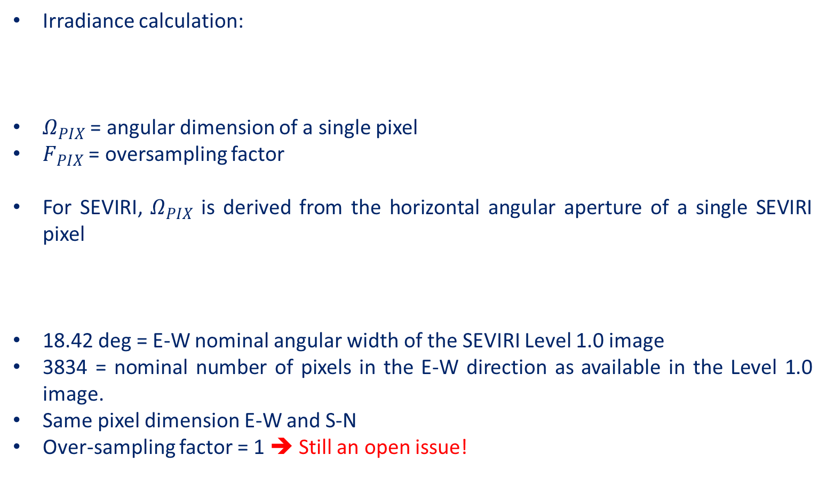
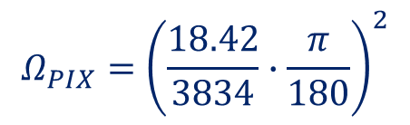
Computation of the irradiance
Irradiance calculation:
$Ω_{PIX}$ = angular dimension of a single pixel
$F_{PIX}$ = oversampling factor
For SEVIRI, $Ω_{PIX}$ is derived from the horizontal angular aperture of a single SEVIRI pixel
18.42 deg = E-W nominal angular width of the SEVIRI Level 1.0 image
3834 = nominal number of pixels in the E-W direction as available in the Level 1.0 image.
Same pixel dimension E-W and S-N
Over-sampling factor = 1 ➔ Still an open issue!
$${Irr}_{OBS}= \frac{Ω_{PIX}}{F_{PIX}}∙\sum_{i=1}^{N_{PIX}}{{Imgt}_{Radi}}$$
$$Ω_{PIX}={\left(\frac{18.42}{3834}∙\frac{π}{180}\right)}^{2}$$

Slide 21




Calculation of the offset and calibration on the ROLO/GIRO scale
Mean value of the digital counts contained in the margin around the Moon (currently 5 pixel-wide margin)
${Off}_{DC}=〈{Imgt}_{DCi}〉, i∈Border$ [DC]
$${Irr}_{OBS}=\frac{Ω_{PIX}}{F_{PIX}}∙\sum_{i=1}^{N_{PIX}}{\left({DC}_{i}−{Off}_{DC}\right)}∙Slope$$
Imposing leads to:
$${Irr}_{OBS}={Irr}_{ROLO}$$
$${Slope}_{ROLO}=\frac{F_{PIX} ∙ {Irr}_{ROLO}}{\left.Ω_{PIX} ∙ (\sum_{i=1}^{N_{PIX}}{\left({DC}_{i}\right)−N_{PIX}{Off}_{DC}}\right)}$$

Slide 22
Some additional info
Meteosat platform = spin-stabilized platforms ➔ spin velocity is monitored and is stable
Scan is “parallel” to the displacement of the Moon in the FOR (it will not be the case for MTG/FCI).
Ghost effect only observed for MVIRI, away from the lunar disc ➔ effect removed with the integration method
Coordinates of the satellite = provided by the Level 1.5 header
Acquisition time = calculated using the On-Board-Time for the line where the Moon centre is located and correcting for the position
Each line of detectors (3 in the Low Res) is acquired in less than 1.6 seconds.
Uncertainty assessment still to be done…

Slide 23
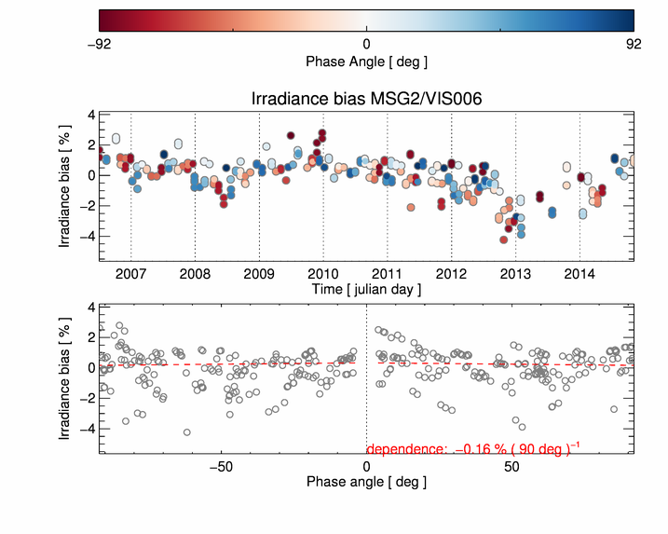
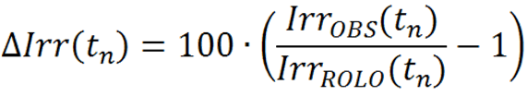
Some (old) results to illustrate…
MSG2/VIS006 time variation of the irradiance bias:
Calibration coefficients updated in time: monitoring of the instrument + calibration combined (no trend clearly visible)

Slide 24
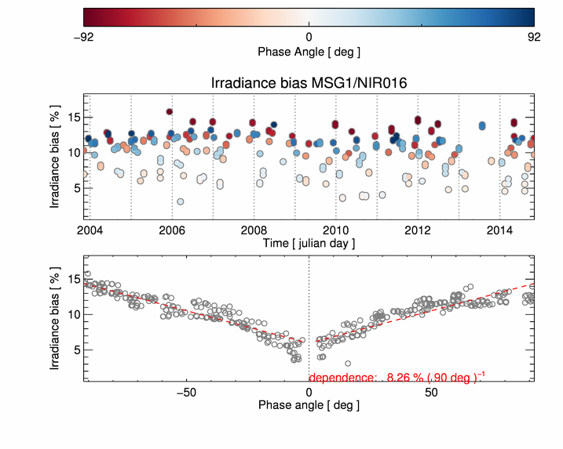
Some (old) results to illustrate…
MSG1/NIR016 time variation of the irradiance bias:
Phase dependence of the irradiance bias

Slide 25
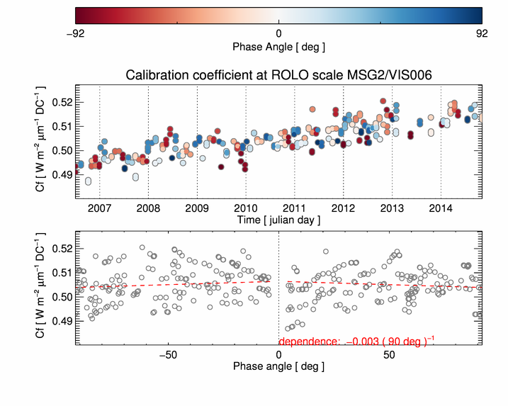

Some (old) results to illustrate…
MSG2/VIS006 time variation of the irradiance bias:
Calibration coefficient at the ROLO scale: monitoring of the detector
THE TREND IS CLEARLY VISIBLE

Slide 26
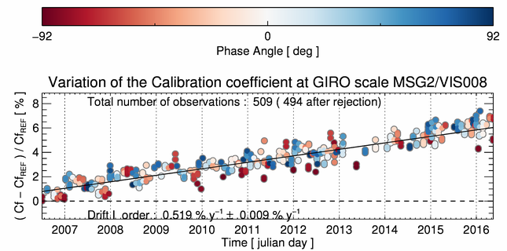
Some results to illustrate…
Example: monitoring of the VIS0.8 channel of MSG2.
IMPORTANT CONCLUSION: SEVIRI CHANNELS BEHAVE AS EXPECTED (AS REQUIRED).
True for all platforms!

Slide 27
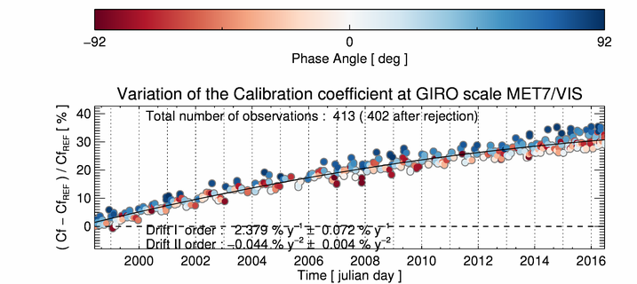
Example of drift monitoring, using the ROLO scale: Meteosat-7

Slide 28
Conclusions
EUMETSAT Moon observation dataset:
Meteosat-7, Meteosat-8, Meteosat-9, Meteosat-10 and Meteosat-11.
Extensive collection of observations covering a wide range of both phase and libration angles covering the full applicability range of the GIRO ([-92°,92°]).
Lunar imagery is operational performed on all operational missions (Meteosat-8, Meteosat-9, Meteosat-10 and soon Meteosat-11 again).
GIRO calibration:
The GIRO calibration tool is run operationally to monitor the satellite radiometric performances.

