Slide 1
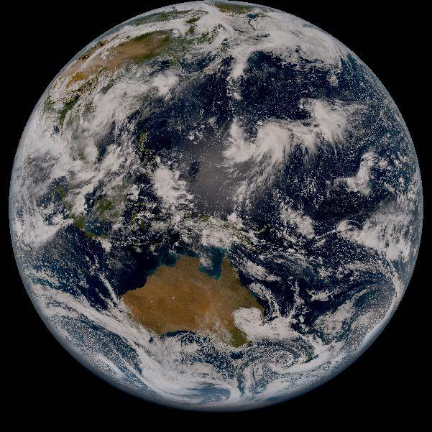
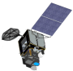
Lunar Data Preparation for
Himawari-8/-9 AHI
Masaya Takahashi
Meteorological Satellite Center
Japan Meteorological Agency
2nd GSICS/CEOS Lunar Calibration Workshop, 13-16 November, Xi’an, China

Slide 2
Contents
Overview
  Mission Life Time, Sensor Configuration/Characteristics
  Himawari-8/-9 AHI Lunar Observation
Computation of Observed Lunar Irradiance
  Oversampling, Pixel IFoV, Radiance Calculation, Moon Pixel Selection
  Preliminary Lunar Calibration Results
Summary and Future Plans

Slide 3
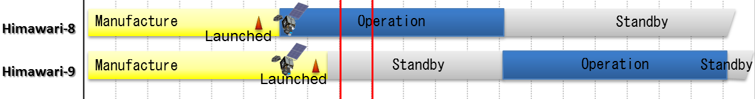
Mission Overview
Himawari-8
  Advanced Himawari Imager (AHI): next-gen. GEO imager w/ 3 VIS, 3 NIR, 10 IR bands
  Solar diffuser is equipped for VNIR calibration (but w/o SDSM)
  Full-disk observation every 10 minutes + 5 regional observations every 2.5/0.5 minutes
  Has been operational since July 2015, located at ~140.7 E
Himawari-9
  Launched on 2 Nov. 2016, Located at ~140.7 E, ~0.1 degrees apart from Himawari-8
  10 Mar. 2017: the satellite was put into in-orbit standby as back up for Himawari-8
  “Health Check” observations are periodically (~2 weeks, a few times / year) performed before the switchover in 2022
FY 2010 2015 2017 2020 2025 2029

Slide 4
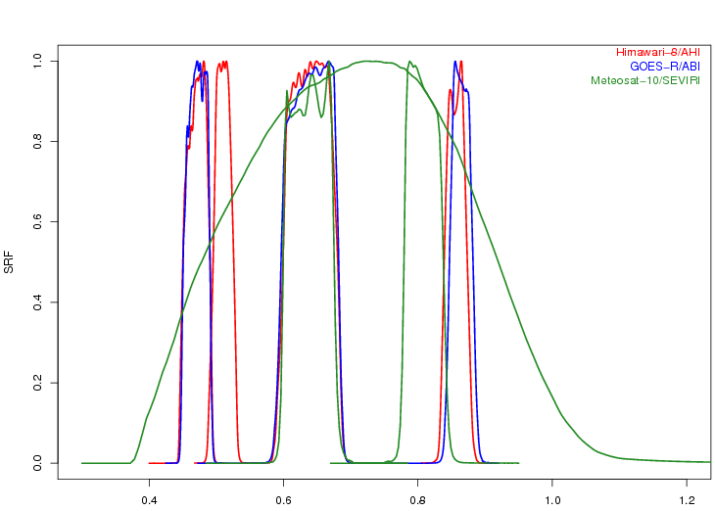
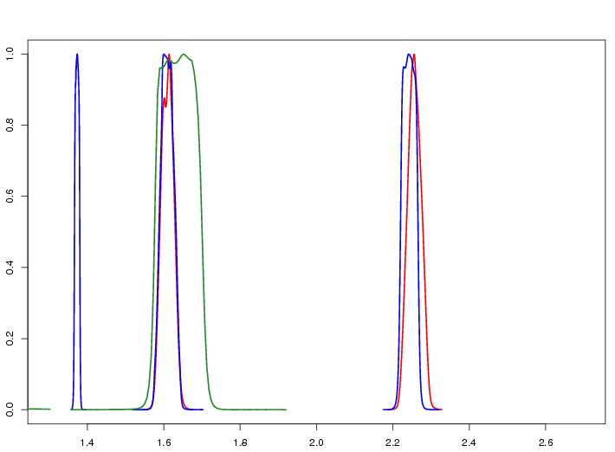
Himawari-8/-9 AHI
AHI Band Configuration
 | B01 | B02 | B03 | B04 | B05 | B06 | B07 | B08 | B09 | B10 | B11 | B12 | B13 | B14 | B15 | B16
Central Wlen [μm] | 0.47 | 0.51 | 0.64 | 0.86 | 1.6 | 2.3 | 3.9 | 6.2 | 6.9 | 7.3 | 8.6 | 9.6 | 10.4 | 11.2 | 12.4 | 13.3
Spatial Reso. [km] | 1 | 1 | 0.5 | 1 | 2 | 2 | 2 | 2 | 2 | 2 | 2 | 2 | 2 | 2 | 2 | 2
# of detectors | 676 | 676 | 1460 | 676 | 372 | 327 | 332 | 332 | 332 | 332 | 332 | 332 | 408 | 408 | 408 | 408
Spectral Response Functions of Himawari-8/AHI, GOES-16/ABI and Meteosat-10/SEVIRI
Wavelength [μm]
Wavelength [μm]

Slide 5
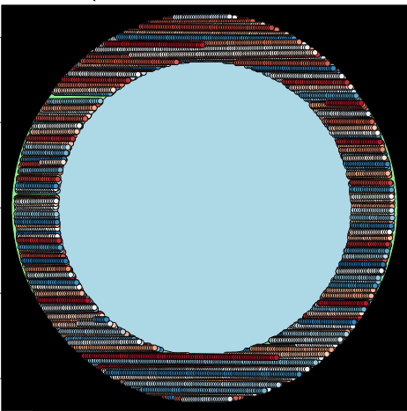
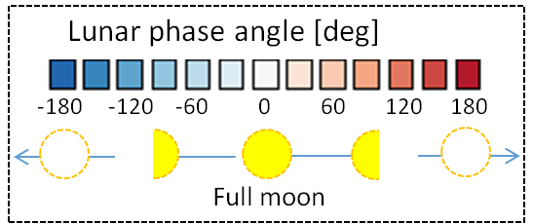
Himawari-8/-9 AHI Lunar Observation
Lunar observation: based on the prediction of its position within AHI’s Field of Regard
Regional observation mode (1000 x 500 km for the earth scene) is used
1 observation / 30 seconds
Just one scan to observe the Moon
All 6 VNIR bands (0.47, 0.51, 0.64, 0.86, 1.6, 2.3 µm) are used for GIRO
Himawari-8/AHI
(4 Mar. 2015 – 30 Oct. 2016)
26167 Obs. / 20 months
Earth disk
AHI FoR

Slide 6
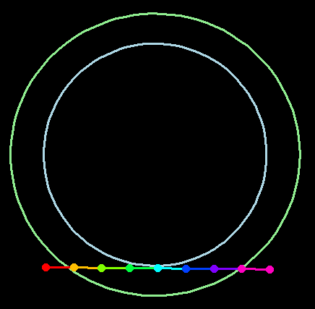
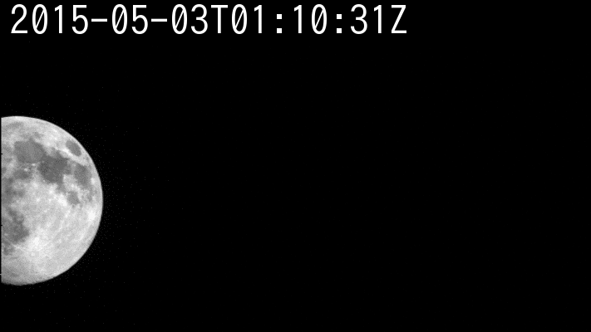
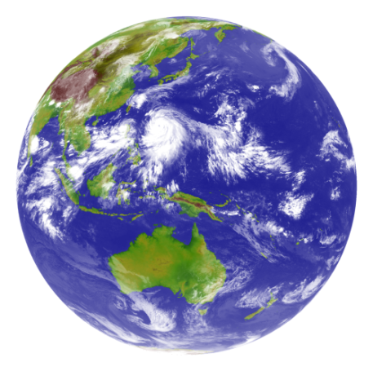






Full Disk / Regional Observation in 10 minutes Repeat Cycle
AHI FoR
Region 4, 5: mainly used for landmark observation, but region 5 is also used for lunar observation
Earth edge
Lunar observations
Band5 (1.6μm)
Pre-defined area
Flexible observation area
Full Disk Observation
every 10 min. (23 swaths)
Region 1
2000 x 1000km
(NE Japan)
Every 2.5 min.
Region 2
2000 x 1000km
(SW Japan)
Every 2.5 min.
Region 3
1000 x 1000 km
(Target Area)
Every 2.5 min.
Region 4
1000 x 500 km
(Landmark Area)
Every 30 sec.
Region 5
1000 x 500 km
(Landmark Area)
Every 30 sec.

Slide 7
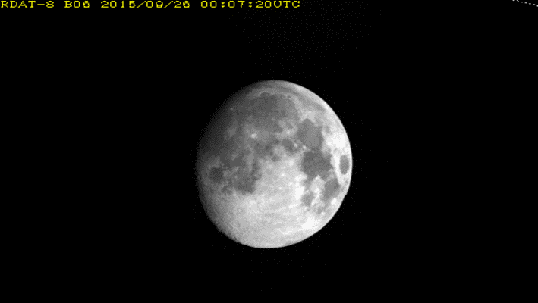
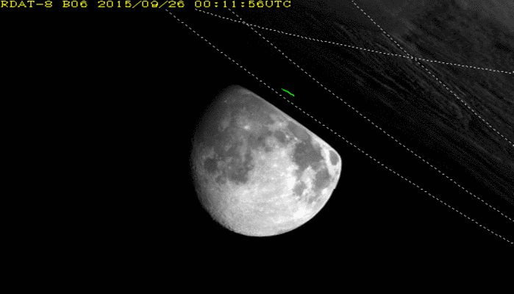
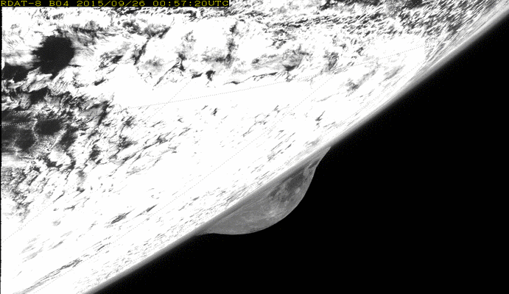
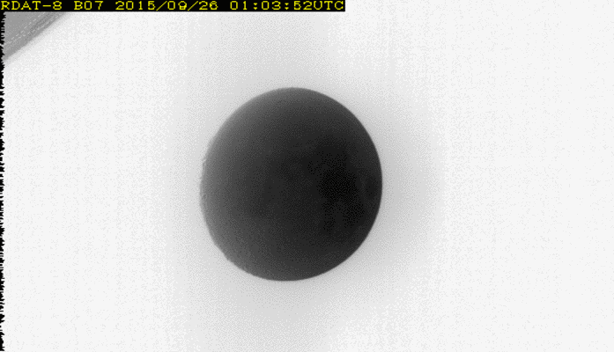
Himawari-8/AHI Lunar Observations

Slide 8
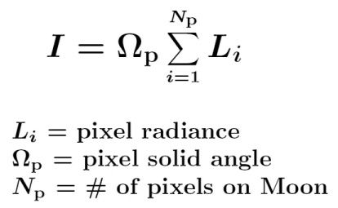
Oversampling, Pixel Solid Angle
Oversampling factor
N-S IFoV / N-S Sampling Distance
No E-W oversampling is assumed because E-W IFoV < E-W Sampling Distance
Pixel solid angle
E-W Sampling Distance * N-S IFoV
Both oversampling/Pixel IFoV: assumed to be constant
Future plans
Revisit of the definition of oversampling factor and pixel solid angle
Under-discussion within NOAA-JMA bilateral collaboration on ABI/AHI Cal/INR
Calculation of alternative factor (e.g. effective moon solid angle (Choi et al. 2016))
Validation of the pre-launch determined IFoV using on-orbit observation data

Slide 9
Radiance
Level of image processing
Level 1A/1.0 equivalent data
Calibration used to convert DN to radiance
Quadratic calibration equation
Quadratic term: pre-launch determined value
Slope: solar diffuser / pre-launch determined value
Offset: deep space observation (updated at each full-disk swath / each lunar obs.)
Handling extraneous signals
Out-of-Filed Anomalous Response (OFAR, Griffith 2017)
Appears in Band 1 -3 (0.47, 0.51 and 0.64 μm)
P. Griffith, 2017: Himawari08 Out-of-Field Anomalous Response (OFAR), 8th Asia/Oceania Meteorological Satellite Users’ Conference, 18 - 20 October 2017, Vladivostok, Russia.

Slide 10
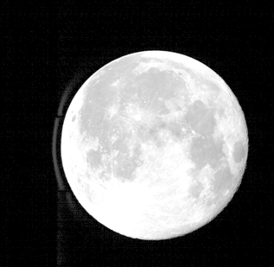
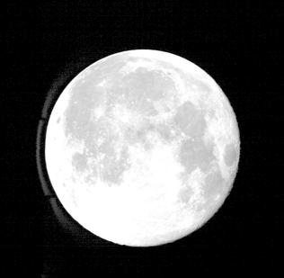
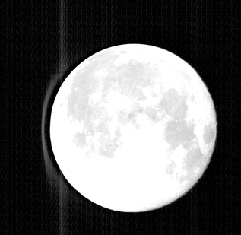
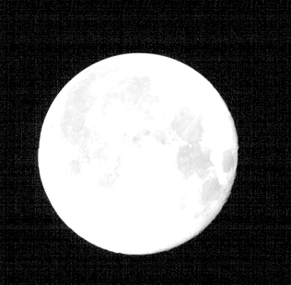
Moon Pixel Selection
Based on DC thresholds
Needs to discriminate the Moon and Out-of-Field Anomalous Response (Griffith 2017)
OFAR: blurring occurs in Bands 1-3 (0.47, 0.51, 0.64 μm) which use silicon detectors
No effect in other bands which use HgCdTe detectors
Appears west of the Moon under the current observation configuration
GOES-R/ABI and GK-2A/AMI are unaffected by OFAR
Enhanced Himawari-8/AHI lunar observation image (color scale: 0.1 – 30 % of reflectivity)
Band1 (0.47 μm) Band2 (0.51 μm) Band3 (0.64 μm) Band4 (0.86 μm)
19 August 2016

Slide 11
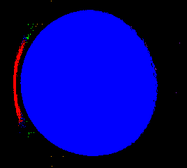
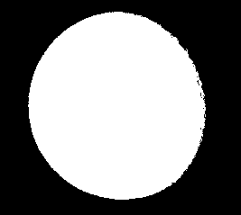
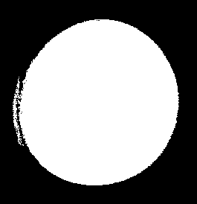
Moon Pixel Selection using Connected-component Labeling
DC threshold + Connected-component Labeling method is used
Connected-component Labeling method
Assign the same number (label) to adjacent pixels which exceed the threshold (e.g. DC=25)
Choose the label w/ the biggest # of pixels as the Moon pixels
Effectively distinct OFAR for positive lunar phase angles, but difficult for negative phase angles
Labelled pixels
Selected Moon pixels
Phase angle: -28.2 deg.

Slide 12

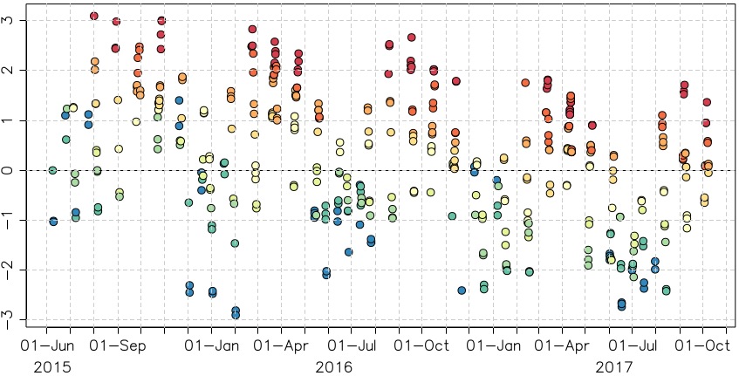
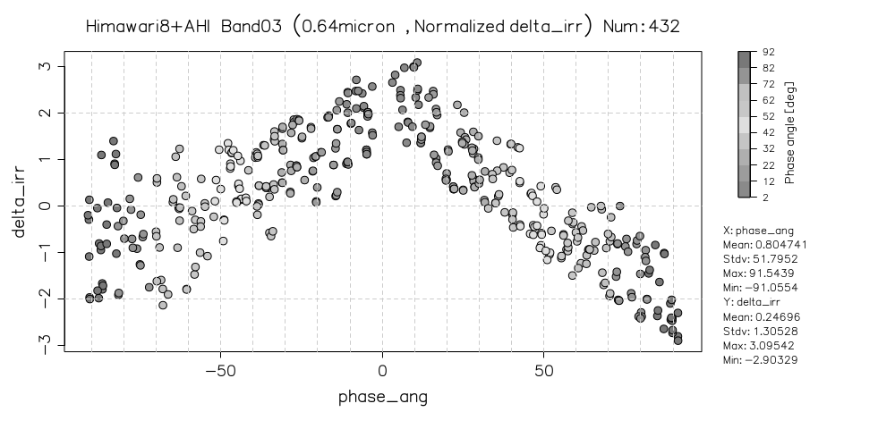
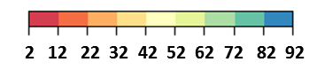
Impacts of Moon-masking DC Threshold on Lunar Calibration
Difference of lunar irradiance between the observation and GIRO [%]
Initially, large DC thresholds (=35) were used to screen out pixels affected by OFAR
Deep space counts: ~20
Loss of dark pixels on the Moon -> incorrect phase angle dependence in AHI/GIRO (ΔIrr)
Band3 (0.64 μm)
Band3 (0.64 μm)
ΔIrr (%)
ΔIrr (%)
Color: lunar phase angle [deg]
Lunar phase angle [deg]

Slide 13
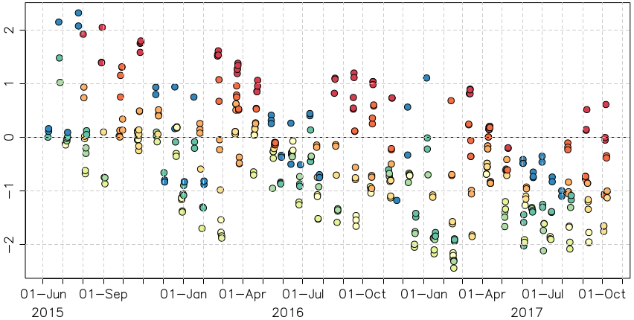
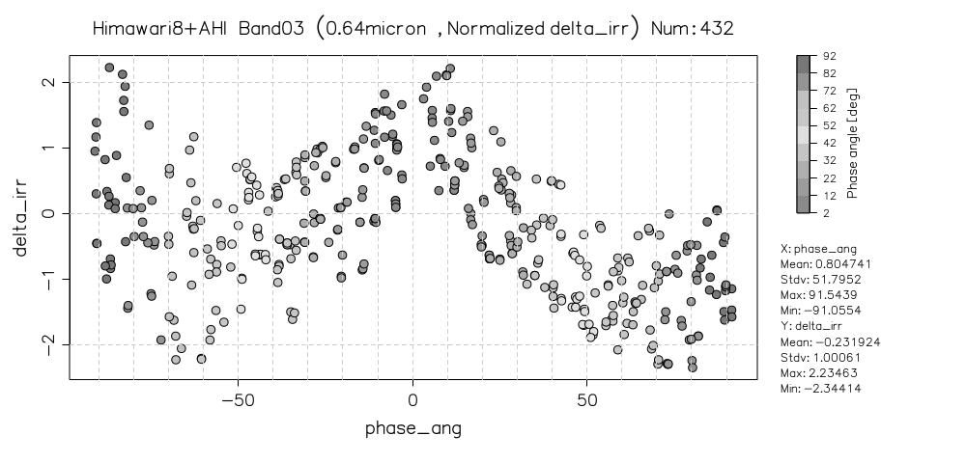
AHI lunar irradiance vs. GIRO
Difference of lunar irradiance between the observation and GIRO [%]
DC threshold (=25) + Connected-component Labeling approach for the Moon masking
Unexpected phase angle dependence exists
Further lower DC threshold (~20) should be ideally used
Nonlinearity in AHI ? - to be investigated
Band3 (0.64 μm)
Band3 (0.64 μm)
ΔIrr (%)
ΔIrr (%)
Color: lunar phase angle [deg]
Lunar phase angle [deg]
Notes:
Sub-sampled lunar observations (#439) are shown
ΔIrr is normalized by ΔIrr (t=0; 2015-06-08)
Calibration slope from solar diffuser obs. (mean of Mar-May 2015 results) is used for all the lunar obs.

Slide 14
Summary and Future Plans
Himawari-8/-9 AHI lunar observation
  6 VNIR bands (0.47, 0.51, 0.64, 0.86, 1.6, 2.3 μm)
  Available since March 2015 (Himawari-8)
  Himawari-9/AHI lunar observation: the quality is under checking
AHI lunar calibration
Revisit of oversampling / pixel IFoV is needed in collaboration w/ NOAA
Moon pixel selection should be updated (e.g. use of further lower DC threshold and lunar shape fitting)
Root cause of phase angle dependence in band 1-3 needs to be investigated
Himawari-8/AHI lunar observation data for GLOD
500-1000 lunar observation data are planned to be shared
Contents (e.g. observed lunar irradiance) will be periodically updated

Slide 15
Thanks for your attention!

Slide 16
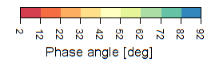
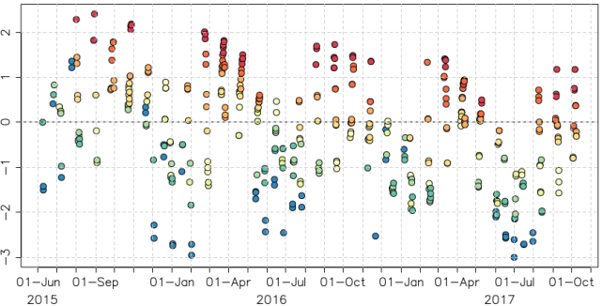
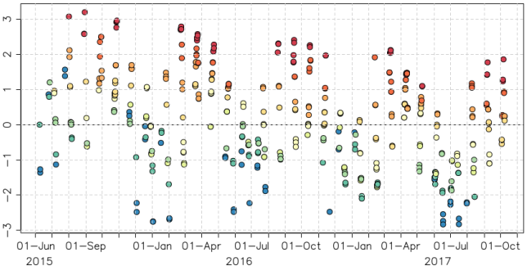

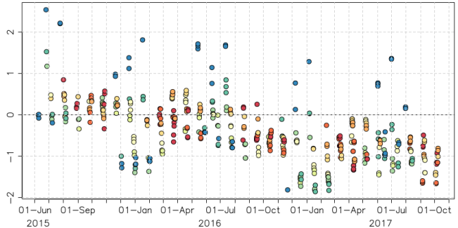
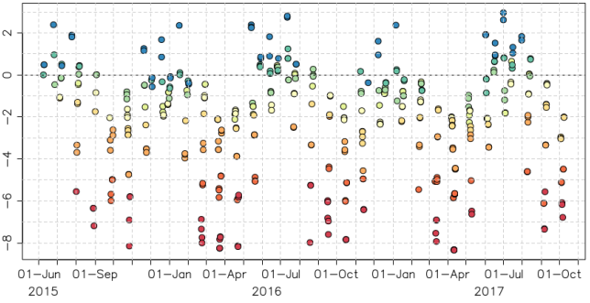
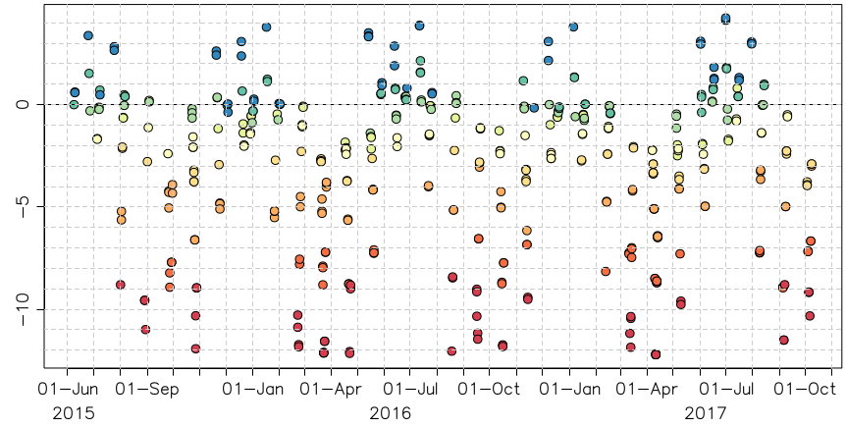
Time Series of ΔIrr of Himawari-8/AHI
Difference of lunar irradiance between the observation and GIRO [%]
Moon pixel selection
Larger DC threshold (=30)
Sensor degradation trend
Good agreements with other Cal/Val approaches
2 12 22 32 42 52 62 72 82 92
Phase angle [deg]
Band1 (0.47μm) Band2 (0.51μm) Band3 (0.64μm)
ΔIrr (%)
Band4 (0.86μm) Band5 (1.6μm) Band6 (2.3μm)
ΔIrr (%)

Slide 17
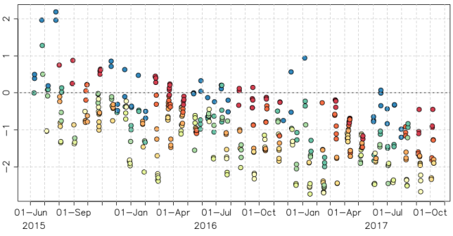

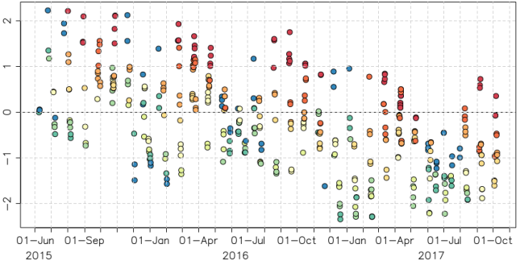
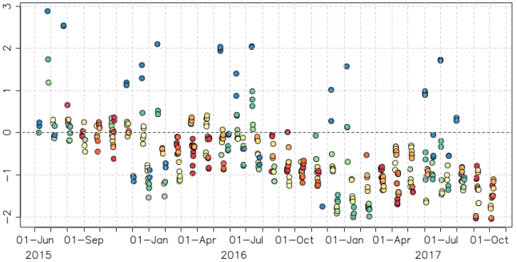
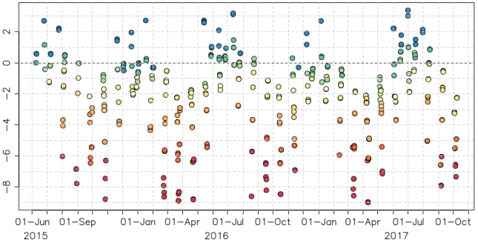
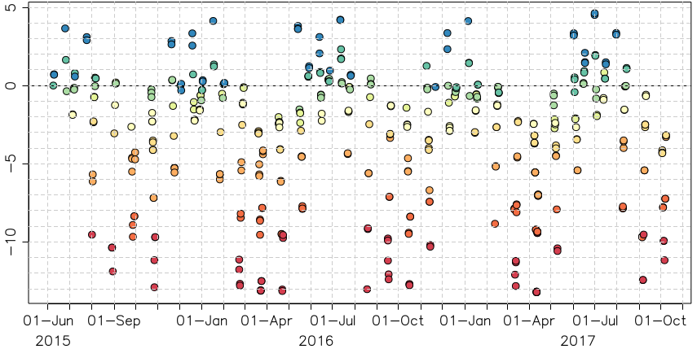
Time Series of ΔIrr of Himawari-8/AHI
Difference of lunar irradiance between the observation and GIRO [%]
Moon pixel selection
Lower DC threshold (=25) + Connected-component labeling
Sensor degradation trend
Good agreements with other Cal/Val approaches
2 12 22 32 42 52 62 72 82 92
Phase angle [deg]
Band1 (0.47μm) Band2 (0.51μm) Band3 (0.64μm)
ΔIrr (%)
Band4 (0.86μm) Band5 (1.6μm) Band6 (2.3μm)
ΔIrr (%)

Slide 18
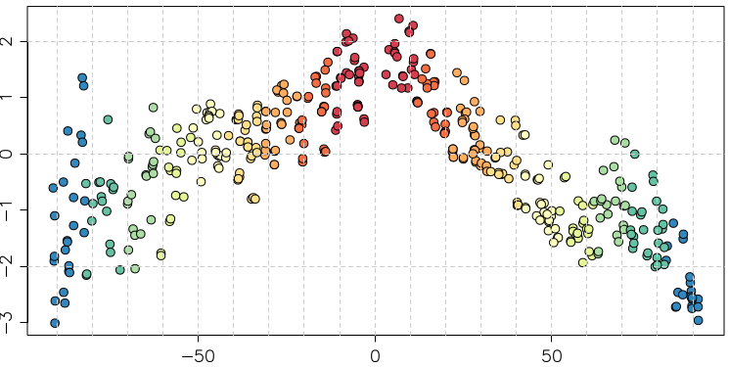
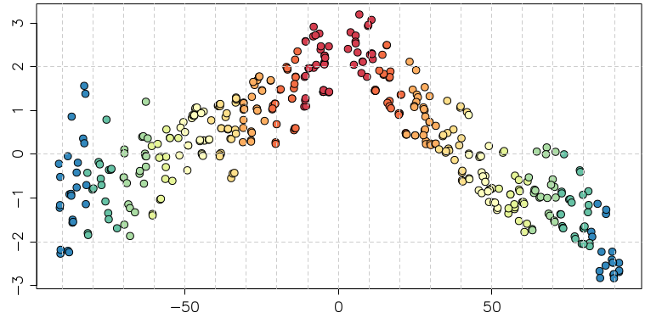
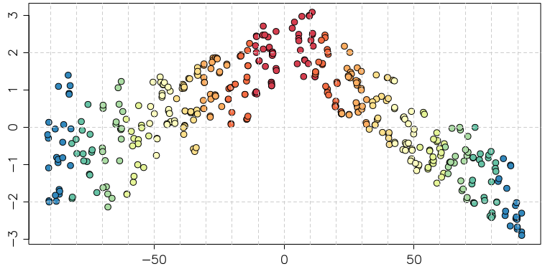
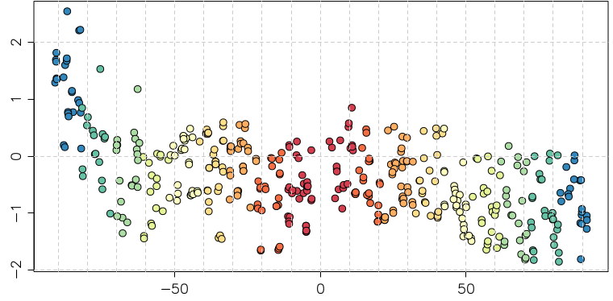
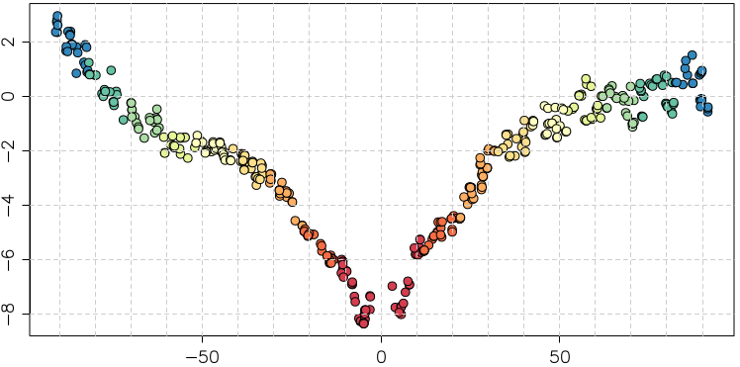
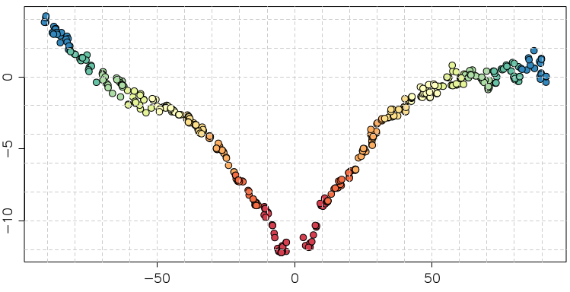
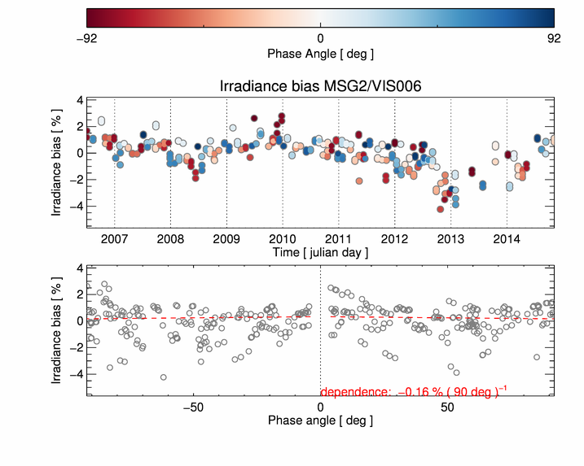
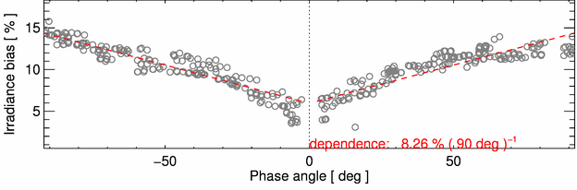
Himawari-8/AHI lunar phase angle dependence in ΔIrr
Good agreement with SEVIRI NIR1.6, but not with SEVIRI VIS 0.6
Moon pixel selection w/ larger DC threshold (~30)
ΔIrr (%)
Band1 (0.47μm) Band2 (0.51μm) Band3 (0.64μm)
Band4 (0.86μm) Band5 (1.6μm) Band6 (2.3μm)
ΔIrr (%)
Lunar phase angle [deg]
Lunar phase angle [deg]
Lunar phase angle [deg]
MSG1/SEVIRI VIS 0.6
MSG1/SEVIRI NIR1.6
Difference of lunar irradiance between the observation and GIRO [%]
SEVIRI results from B. Viticchie at the Lunar Calibration Workshop in Dec. 2014

Slide 19
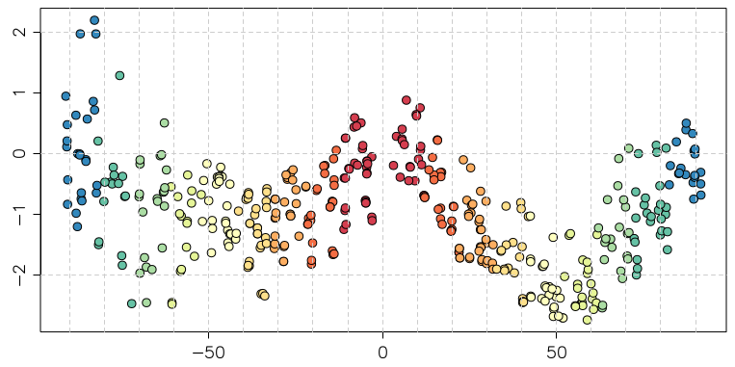
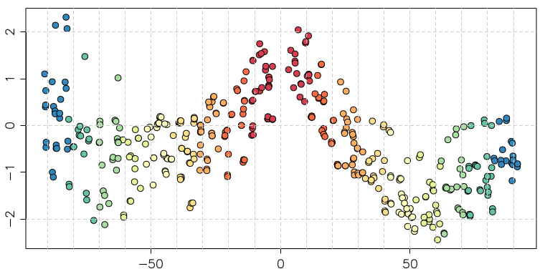
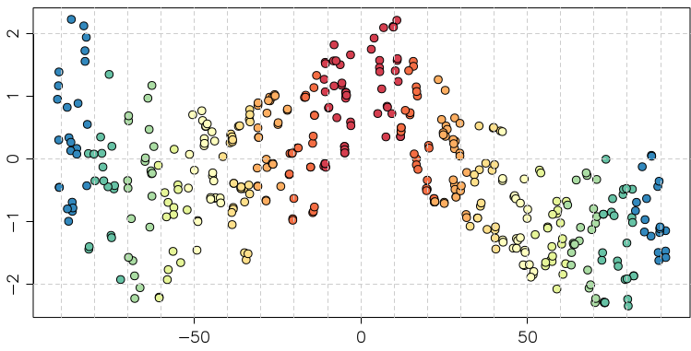
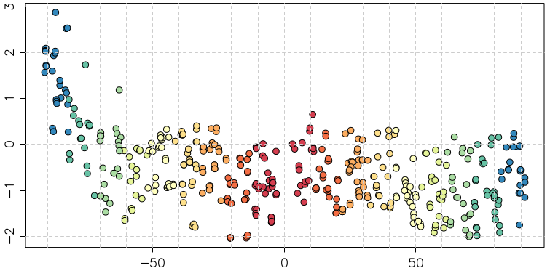


Himawari-8/AHI lunar phase angle dependence in ΔIrr
Good agreement with SEVIRI NIR1.6, but not with SEVIRI VIS 0.6
Moon pixel selection w/ lower DC threshold (=25) + Connected-component labeling
ΔIrr (%)
Band1 (0.47μm) Band2 (0.51μm) Band3 (0.64μm)
Band4 (0.86μm) Band5 (1.6μm) Band6 (2.3μm)
ΔIrr (%)
Lunar phase angle [deg]
Lunar phase angle [deg]
Lunar phase angle [deg]
MSG1/SEVIRI VIS 0.6
MSG1/SEVIRI NIR1.6
Difference of lunar irradiance between the observation and GIRO [%]
SEVIRI results from B. Viticchie at the Lunar Calibration Workshop in Dec. 2014

Slide 20








JMA geostationary satellites
GMS (Geostationary Meteorological Satellite)
GMS
GMS-2
GMS-3
GMS-4
GMS-5
(GOES-9)
Satellite | Operation period
GMS | 1978 – 1981
GMS-2 | 1981 – 1984
GMS-3 | 1984 – 1989
GMS-4 | 1989 – 1995
GMS-5 | 1995 – 2003
GOES-9 | 2003 – 2005
MTSAT-1R | 2005 – 2010
MTSAT-2 | 2010 – 2015
Himawari-8 | 2015 – 2022
Himawari-9 | 2022 – 2029
(Himawari)
(Himawari-2)
(Himawari-3)
(Himawari-4)
(Himawari-5)
Back-up operation of GMS-5 w/ GOES-9 by NOAA/NESDIS:
2003/05/22-2005/06/28
ⒸNASDA
ⒸNASDA
ⒸNASDA
ⒸNASDA
ⒸNASDA
Jul 1977
Aug 1981
Aug 1984
Sep 1989
Mar 1995
MTSAT (Multi-functional Transport SATellite )
MTSAT-1R
MTSAT-2
(Himawari-6)
(Himawari-7)
Himawari
Himawari-8
launched on 7 Oct. 2014
Operation started on 7 July 2015
Himawari-9
2014
2016
ⒸSS/L
ⒸMELCO
launched on 2 November 2016
Planned to be back up of Himawari-8 in March 2017
Feb 2005
Feb 2006

Slide 21

Advanced Himawari Imager (AHI)
Band | Central Wavelength [μm] | Spatial Resolution [km] | # of detectors (*) | Levels of digital count [bit]
1 | 0.47 | 1 | 676 (3) | 11
2 | 0.51 | 1 | 676 (3) | 11
3 | 0.64 | 0.5 | 1460 (3) | 11
4 | 0.86 | 1 | 676 (6) | 11
5 | 1.6 | 2 | 372 (6) | 11
6 | 2.3 | 2 | 372 (6) | 11
7 | 3.9 | 2 | 332 (6) | 14
8 | 6.2 | 2 | 332 (6) | 11
9 | 6.9 | 2 | 332 (6) | 11
10 | 7.3 | 2 | 332 (6) | 12
11 | 8.6 | 2 | 332 (6) | 12
12 | 9.6 | 2 | 332 (6) | 12
13 | 10.4 | 2 | 408 (6) | 12
14 | 11.2 | 2 | 408 (6) | 12
15 | 12.4 | 2 | 408 (6) | 12
16 | 13.3 | 2 | 408 (6) | 11
AHI Field of View Center (VNIR)
ITT EXELIS(2013): AHI-8 EQUIPMENT MANUAL 2
CALIBRATION AND ALIGNMENT HANDBOOK Rev. J
*Number of redundant detector columns per side

Slide 22

Typical Observation Schedule in 10 minutes Repeat Cycle
Full Disk | Region 1 (NE Japan)
BB Obs. | Region 2 (SW Japan)
Space Look | Region 3 (Target Area)
 | Region 4 (Landmark Area)
 | Region 5 (Landmark Area)
Blackbody Obs.
[sec]
[sec]

Slide 23

VIS/NIR on-board Calibration using Solar Diffuser (SD)
Quadratic calibration equation in “L1A (L1.0) equivalent data” processing
$$R_{{obs}_{n}}=\frac{q_{n}{(C_{An}−C_{spn})}^{2}+m_{n}(C_{An}−C_{spn})}{ρ_{ns}{\left(θ\right)ρ}_{ew}(φ)}$$
R_{obsn}: Observed radiance
C_{An}: Raw digital count
C_{spn}: Deep space raw digital count
q_{n}, m_{n}: Coefficients
n: Detector ID
ρ : Scan mirror reflection coef.
θ, φ : Incidence angle to SM
q_{n}: pre-launch test value
m_{n}:
Pre-launch test value (until 7 June 2015)
Values based on solar diffuser (SD) observations (since 8 June 2015). SD observation is performed every 2 weeks
C_{sp}: updated by deep space observation at each Full-disk swath
aa

Slide 24

VNIR Calibration Slopes derived from Solar Diffuser (SD) observations
SD observation: performed twice / month
June 2015: VNIR calibration slopes in L1 data were updated using Mar-May 2015 SD obs.
~0.5% degradation trends in Band1-4 (no SD degradation is assumed)
Time series of inverse of detector-averaged calibration slope from SD observations
Band1 Band2 Band3
(0.47μm) (0.51μm) (0.64μm)
Band4 Band6
(0.86μm) (2.3μm)
Band5
(1.6μm)

Slide 25

Validation of On-board Calibration Slope
~0.5%/year of degradation trends in Band1-4
~6% bias for Band5, ~4 % bias for Band6 based on ray-matching validation
Time series of ratios between Himawari-8/AHI observations and reference values
Band1 (0.47μm) Band2 (0.51μm) Band3 (0.64μm)
Updates of Cal. slope
Band4 (0.86μm) Band5 (1.6μm) Band6 (2.3μm)
Error bar: stdv. of slopes

Slide 26

Validation of On-board Calibration
Method 1) Vicarious Calibration using RT Simulation
Comparison of observed and simulated radiance for multiple targets (collaboration research with the University of Tokyo and JAXA/EORC [Prof. Nakajima])
Targets:
Cloud-free ocean (rayleigh scattering) , liquid water cloud, *cloud-free land and *deep convective cloud
Radiative transfer calculation:
RSTAR (Nakajima and Tanaka [1986,1988])
Input data: Independent from GEO data
JMA Re-Analysis atmos. profiles (JRA-55/JCDAS)
Aerosol/Cloud optical thickness retrieved from MODIS L1B (M[O,Y]D02SSH)
MODIS BRDF (MCD43C2) for land target
Aura/OMI total column ozone, …
August 2015
Simulated reflectivity
Observed reflectivity
*Not implemented for Himawari-8/-9 AHI as of June 2017

Slide 27



Validation of On-board Calibration
Method 2) Ray-matching with S-NPP/VIIRS
Inter-calibration based on AHI-VIIRS collocation (Quasi-SNO)
Calibration target: cloud pixels
Low radiance scene (e.g. cloud-free ocean) : not used
Spectral Band Adjustment Factor (SBAF) accounting for the spectral mismatch
Band1-5: from NASA Langley SBAF based on SCHIAMACHY (http://cloudsgate2.larc.nasa.gov/SBAF)
Band6: computed using RSTAR simulation
Band1 Band3 Band5
(0.47 μm) (0.64 μm) (1.6 μm)
Stats from 17 to 31 Oct. 2016

Slide 28
Comparison of VNIR Calibration between AHI-8/-9
Results for AHI-8/-9 vicarious calibration, ray-matching and GEO-GEO comparison
Converted to (AHI-9/AHI-8 – 1) x 100 [%]
Good agreements among the three validation methods
Band1: AHI-9 is 4-6% brighter than AHI-8
Band2-4, 6: AHI-8/-9 diffs. are within 2%
Band5: AHI-9 is ~6% darker than AHI-8
Notes on calibration slope
AHI-8: derived from solar diffuser obs. in Mar-May 2015
AHI-9: pre-launch determined value
Could cause AHI-8/-9 discrepancies in the validation
(AHI-9/AHI-8-1) x 100 [%]
0.47 0.51 0.64 0.86 1.6 2.3 [μm]
Observation data: 14-28 Feb. 2017

Slide 29

AHI-8 vs. VIIRS direct comparison (ray-matching)
AHI Band 1 (0.47 µm)
Brighter VIIRS at dark scenes
AHI-8 Band1 (0.47 μm) vs. VIIRS M03 (0.46 µm)

