Slide 1
GOES-16 ABI Lunar Data Preparation to GIRO
Fangfang Yu¹, Xiangqian Wu², and Xi Shao¹
1: ERT, Inc@NOAA/NESDIS/STAR
2: NOAA/NESDIS/Center for Satellite Application and Research (STAR)
GOES-16 is not declared operational yet. The ABI data are currently experimental and still undergoing testing.

Slide 2
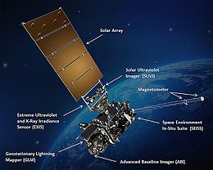
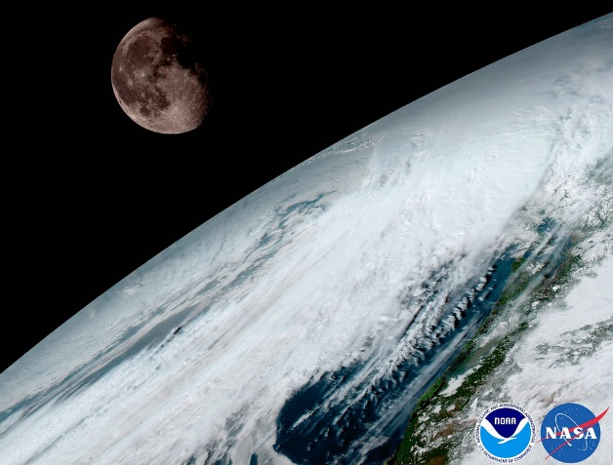
GOES-16
First NOAA Geostationary Operational Environmental satellite in the GOES-R Series
Launched on November 19, 2016
Key payload: Advanced Baseline Imager (ABI)
Locations:
Parked at 89.5W for PLT/PLPT tests.
Moved from 89.5W to 89.3W between August 8, 2017 and Sept. 3, 2017.
Plan to move from 89.3W to 75.2W for operation in December 2017.

Slide 3
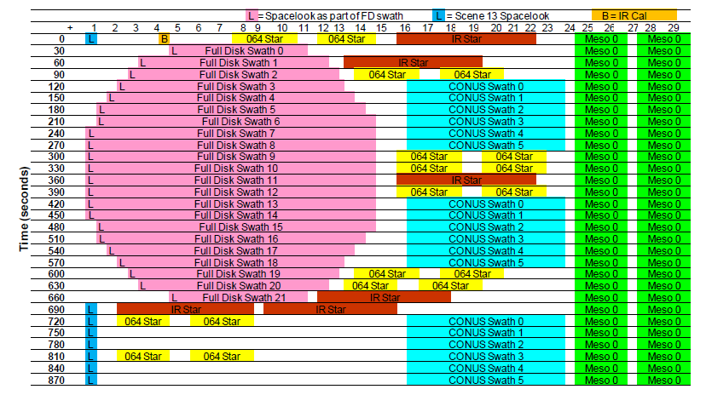
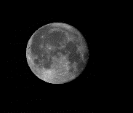
Normal Lunar Scans
ABI Mode 3 timeline
MESO scan in mode 3 is used to collect the Moon data.
Each MESO scan consists of two swaths
The Moon is scanned with one of the two swaths
ABI Moon data is in Level1Alpha format – calibrated but not navigated data
G16 ABI uses FPM Side 2 detectors
ASD: Angular sample distance
Band name | Central Wavelength (µm) | EW ASD (µrad) | NS ASD (µrad) | #Det per Column | #Det per Swath
B01 | 0.47 | 22 | 22.9 | 3 | 676
B02 | 0.64 | 11 | 10.5 | 3 | 1460
B03 | 0.87 | 22 | 22.9 | 3 | 676
B04 | 1.38 | 44 | 42.0 | 6 | 372
B05 | 1.61 | 22 | 22.9 | 6 | 676
B06 | 2.25 | 44 | 42.0 | 6 | 372
swath
Best Detector Selection (BDS)

Slide 4
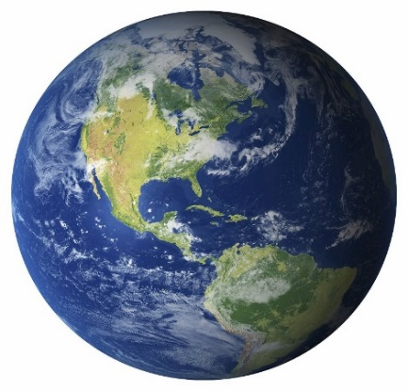
Normal Lunar Scans: Chasing and Trending
Chasing:
ABI consecutively scans the Moon as it transits across the space within the Field of Regard (FOR).
Used for the scan mirror response vs. scan-angle (RVS) study, as well as trending of instrument degradation analysis.
Mainly conducted during the PLT/PLPT periods.
Trending:
ABI scans the Moon during the meso frame time which is ~2 minutes.
Used for the monitoring and trending of the solar calibration result.
Will be conducted 2-4 times per month throughout the satellite mission life.
Phase angle range: -90º – 90º

Slide 5
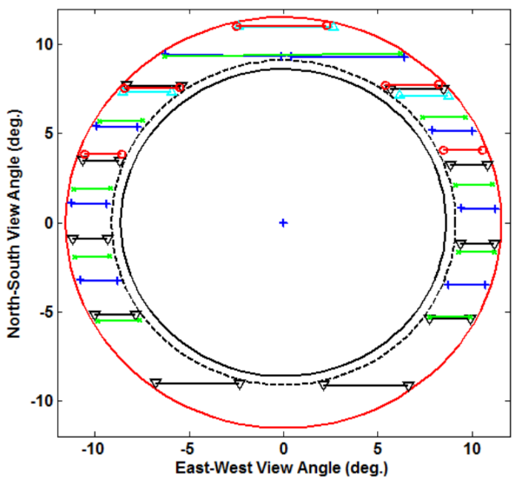
Moon Chasing Images
Earth

Slide 6
Moon Chasing Images
Earth

Slide 7
Moon Chasing Images
Earth

Slide 8
Moon Chasing Images
Earth

Slide 9
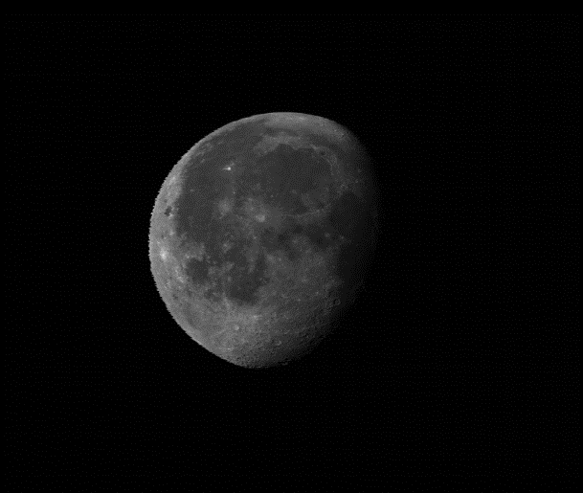
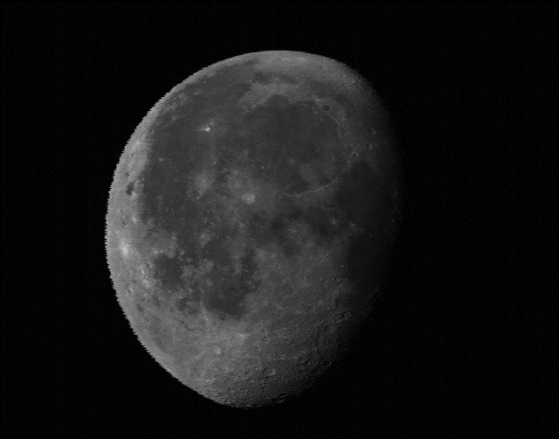
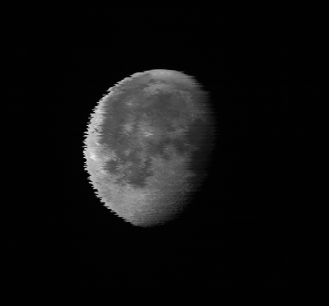
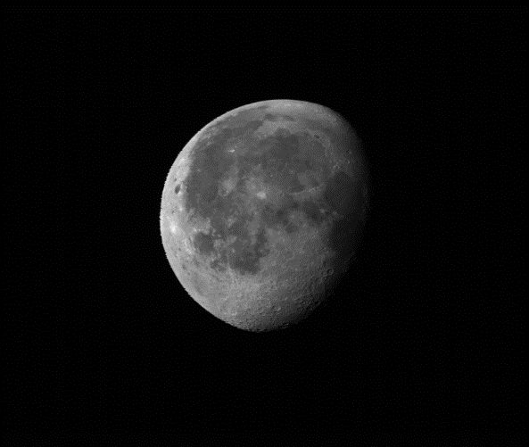
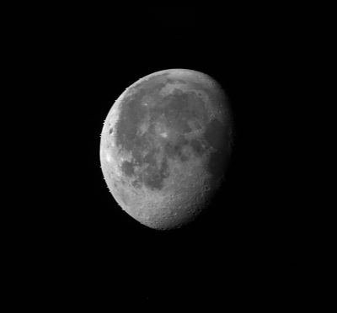
GOES-16 ABI Lunar Images in L1Alpha Data
B1 (047)
B2 (064)
Image processing for the trending analysis
Lunar edge is >0.002 radians away from the FOR boundaries
Lunar edge is >0.013 radians away from the Earth limb
Subset boundary >0.002 radians away from the illuminated moon edge
B3 (087)
B4 (138)
B5 (161)
B6 (225)

Slide 10
GOES-16 ABI VNIR Radiometric Calibration
Two-point on-orbit calibration targets:
Spectralon Solar Diffuser
Deep space
Quadratic detector responsivity correction
Quadratic term (q) determined on-ground
Linear calibration coefficient (m) is determined on-orbit with SD and deep space observations
Where fint,ch is the integration factor for viewing SCT. For ABI fint,ch=9
Dalta et al. 2016, Comparison of the calibration algorithms and SI Traceability of MODIS, VIIRS, GOES and GOES-R ABI Sensors, Remote Sensing, 8(126), doi:10.3390/rs8020126, http://www.mdpi.com/2072-4292/8/2/126

Slide 11
ABI Lunar Irradiance (Currently)
ABI Irradiance:
Ω: Sample solid angle = Sr(EW_ASD * NS_ASD)=EW_ASD*NS_ASD
Radiance_{i,j} : calibrated radiance at (i,j) image coordinate
Band name | Central Wavelength (µm) | EW ASD (µrad) | NS ASD (µrad)
B01 | 0.47 | 22 | 22.9
B02 | 0.64 | 11 | 10.5
B03 | 0.87 | 22 | 22.9
B04 | 1.38 | 44 | 42.0
B05 | 1.61 | 22 | 22.9
B06 | 2.25 | 44 | 42.0

Slide 12
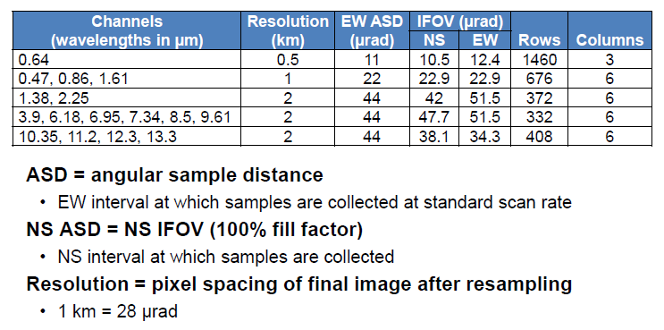
Oversampling Factor – Value by Vendor
Large over-sampling
Large under-sampling
Harris report in EUMETSAT 2015, Toulouse, France
ASD: Angular sample distance, BDS: Best detector selection, RDP: relative detector position

Slide 13
Oversampling Factor – Proposed Calculation
Currently proposed for ABI, need further discussions within NOAA and with JMA:
Determine the image spatial resolution
Scan rate of the EW scan mirror.
It is very stable and constant for ABI
Frame time between two neighboring samples
Mean angular sample distance at NS direction. Derived from RDP map for the BDS detectors
ASD: Angular sample distance, BDS: Best detector selection, RDP: relative detector position

Slide 14
Empirical Method
Considering the illuminated moon area as a pseudo-pixel, the mean oversampling of this pseudo-pixel can be calculated:
Key number!
Uncertainty mainly comes from the threshold to identify the illuminated lunar images.
Blurred moon edges affect the result
Brighter moon preferred
where D_{moon-sat} is the distance between the Moon and GOES satellite, Ω is the sample solid angle, m is the number of illuminated moon samples, r_{moon} is the moon radius (1735.5km), and fraction_{moon} is the fraction of illuminated moon, and φis the phase angle.

Slide 15
Oversampling Factor Values
Band# | Oversampling Factor (Theoretical) | Oversampling Factor (Empirical) | Difference (%)
B01 | 1.0126270 | 1.0134626 | 0.08
B02 | 1.0135615 | 1.0010393 | 1.24
B03 | 1.0125714 | 1.0148494 | 0.22
B04 | 1.0111070 | 1.0110186 | 0.01
B05 | 1.0127543 | 1.0258920 | 1.30
B06 | 1.0117681 | 1.0238764 | 1.12

Slide 16
Summary
Oversampling factor may not be important for trending the instrument degradation when it is a constant.
Important for irradiance-based absolute calibration, sensor-to-sensor and band-to-band inter-calibrations
Also important for accurate MTF analysis (Xi Shao’s report)
For ABI-like instruments, it can be calculated with scan rate, sample frame time and RDP values
Validated with Moon observations with near full moon images
Oversampling factor values for ABI bands are relatively small

