Slide 1
Traceability of the GIRO to the ROLO: Definition of a benchmark
S. Wagner, EUMETSAT
M. Takahashi, JMA
T. Stone, USGS

Slide 2
Scope and purpose of the benchmark
Definition of a reference synthetic dataset
Assessment of the GIRO performances with respect to the current lunar calibration reference model ROLO:
Verification / Validation of new developments
Uncertainty assessment
➔ Traceability
Uncertainty assessment / traceability to the GIRO for local implementations
Possibility to perform a similar assessment for newly developed models with respect to the GIRO

Slide 3
Parameters to vary
Geometry:
Time: possibly the complete 18-year cycle with “feasible” time step (currently every 6 hours)
➔ Libration + phase coverage
Satellite position:
Earth centre (x=0., y=0., z=0.) or at the surface of the Earth
In orbit at 800km or at 36000km from the Earth ground
➔ Extract the cases to cover the parameter space
Spectral Response Functions:
Central wavelengths as for existing Ocean Colour sensors + geostationary imagers + additional bands in between the ROLO bands (in particular for short wavelengths)
Narrow + large SRFs
Spectral resolution down to 1nm at first. May require a higher resolution (0.1nm)!
More shapes of the SRFs

Slide 4
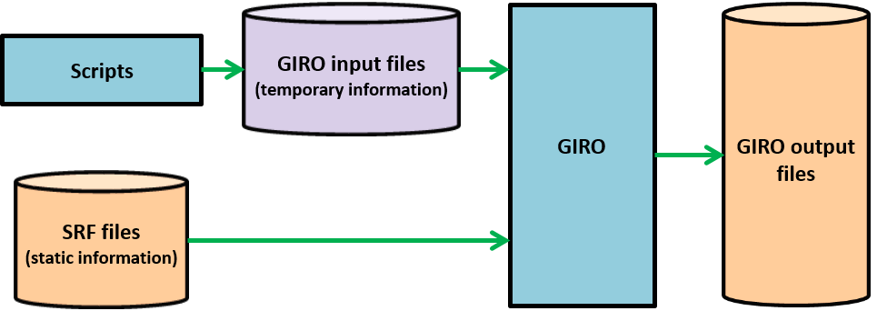
Overview of the benchmark generator
All input / output files: netCDF
➔ Conventions defined by GSICS + first LCWS in 2014)
Scripts: coded in Python + Shell script
Currently input are not saved (generation based on a template)
Only the output are saved
GIRO output = part of the GSICS Lunar Observation Dataset (GLOD)
Availability of the GIRO tool as part of the GLOD = to be discussed

Slide 5
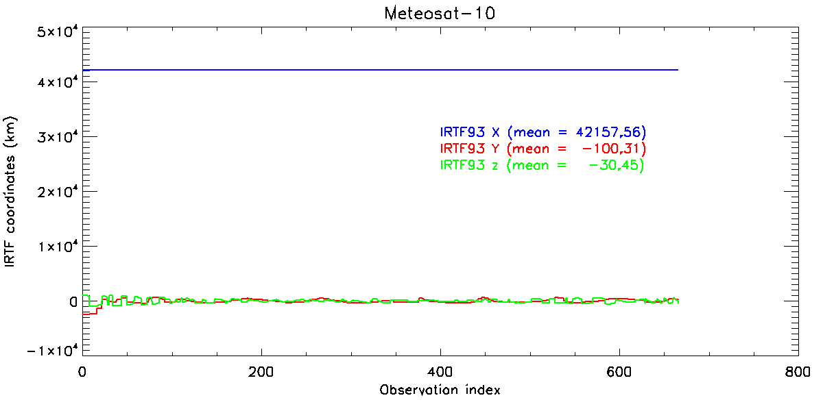
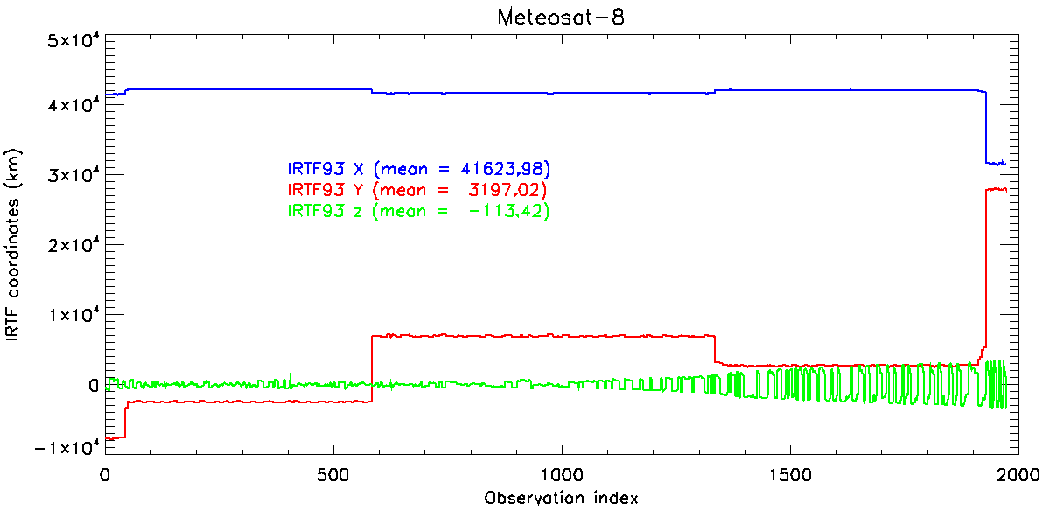
Geometries
Started date: 1 January 2000 at 0:00 UTC
End date: 31 December 2017
Time step: 6 hours
Location:
X: 42000.0
Y: 0.0
Z: 0.0
➔ ~14000 cases in [2°, 92°] range
To check the coverage of the geometries in the selenographic coordinate space, two other locations were tried:
X: 0.0
Y: 0.0
Z: 0.0
X: 31600.0
Y: 28000.0
Z: 0.0

Slide 6
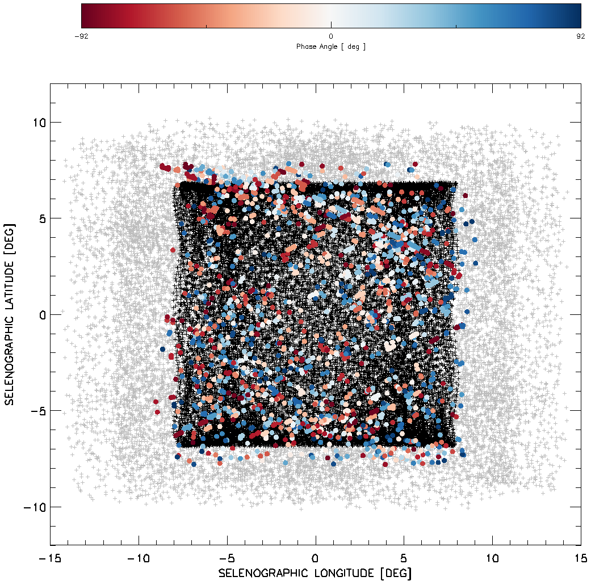
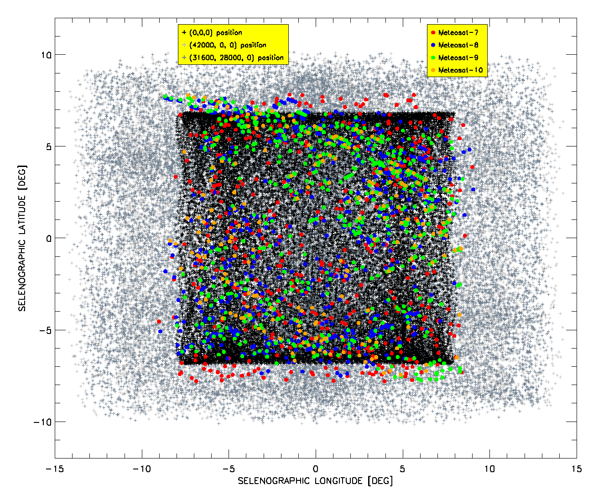
Selenographic coordinates coverage
-92 deg.
0 deg.
Phase angle
92 deg.
(42000,0,0) position
(31600,28000,0) position
(0,0,0) position

Slide 7
Spectral Response Functions
SRF generator = 4th order Chebyshev filter with a pass band ripple
SRF widths:
10nm, e.g. OLCI.
30nm, e.g. MODIS or VIIRS and new generations of geostationary imagers (even though a bit broader).
300nm, e.g. high-resolution panchromatic bands (e.g. PLEIADES) and some (older) GEO visible channel imagers.
SRF spectral resolution = 1nm (as a start) ➔ Planned to reach 0.1 nm
Range = [350nm, 2350nm]
Spectral shift:
2.5 nm in [350nm, 1200nm], i.e about 340 SRFs
10 nm in [1200nm, 2350nm], i.e about 115 SRFs

Slide 8
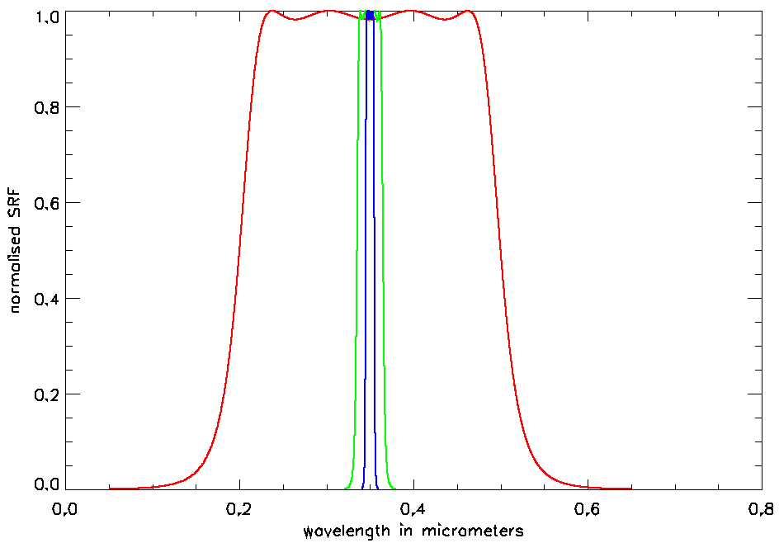
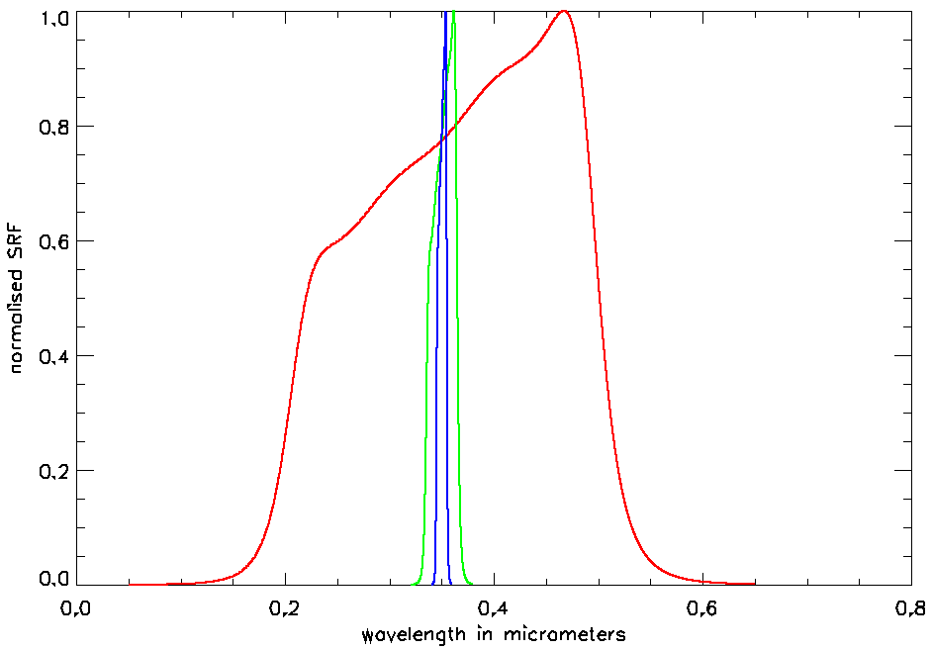
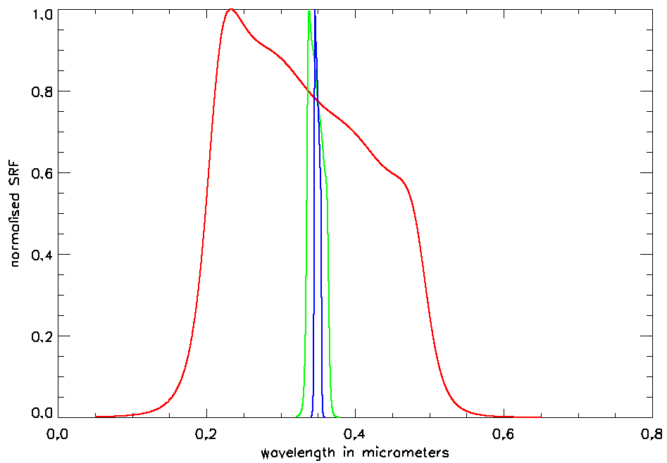
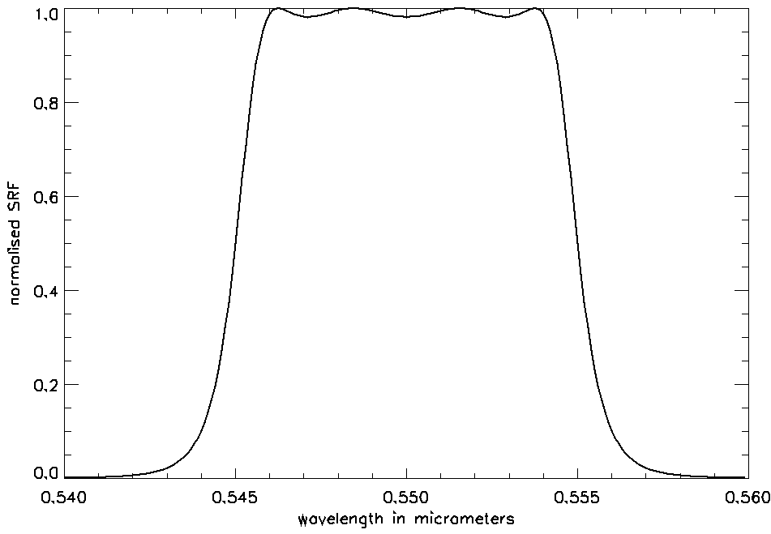
Spectral Response Functions
Solely used at 550nm for the whole Saros cycle

Slide 9
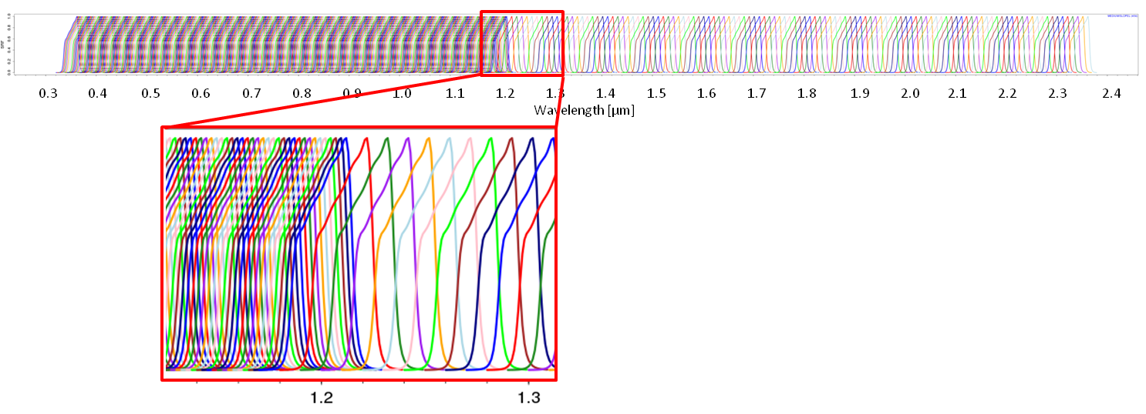
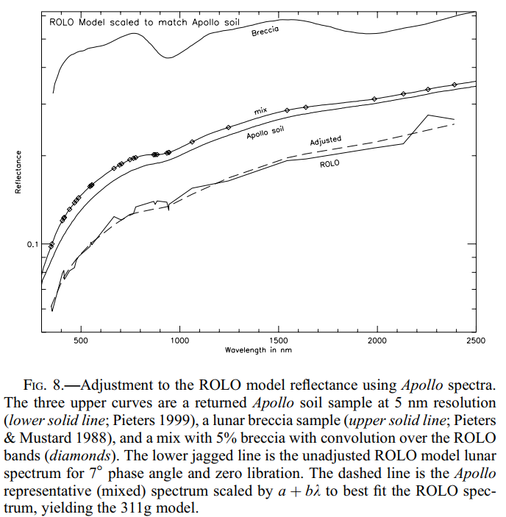
Spectral Response Functions
Example of spectral shift

Slide 10
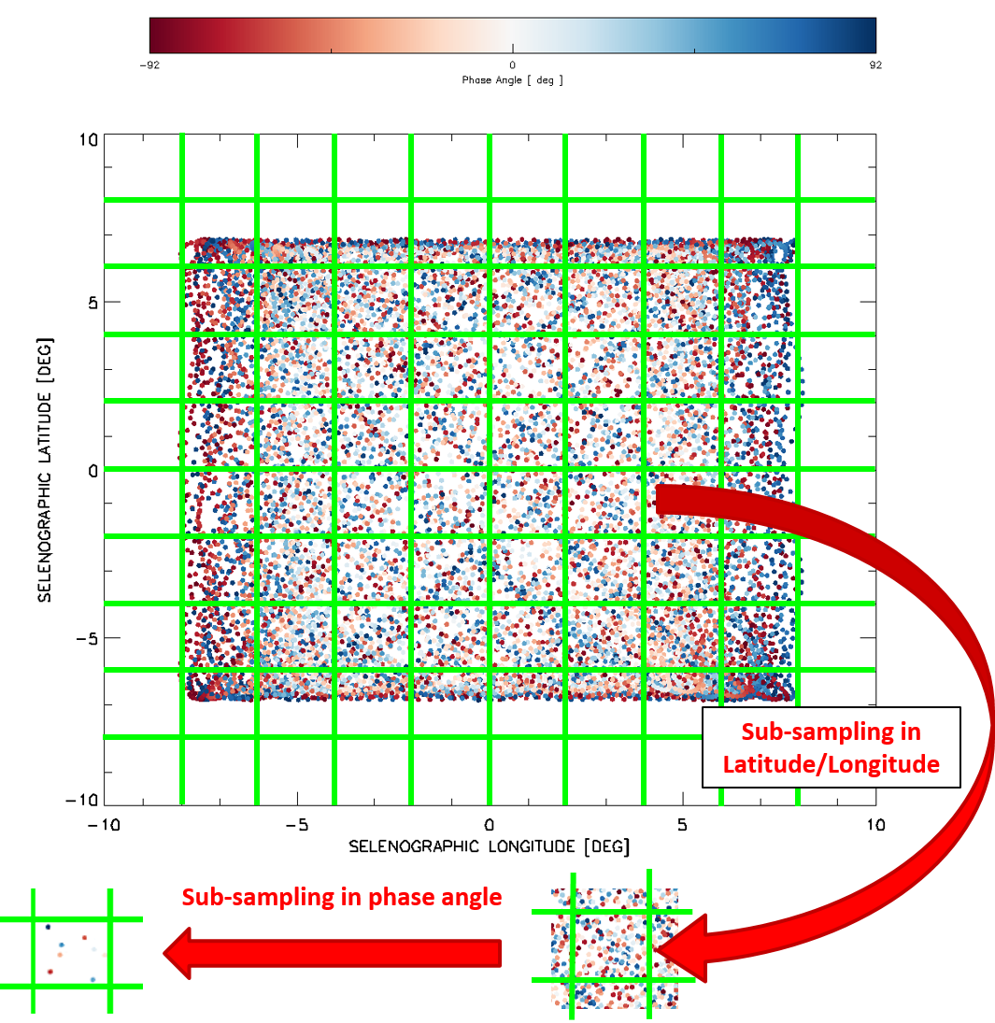
Case reduction for testing all the SRFs + SRF shifts
Idea = sub-sampling of the selenographic space
For each sub-domain, a regular sampling of phase angles is taken
SRFs + SRFs shifts are tested on that subset
➔ Currently ~280 dates / geometries (configurable)

Slide 11
Where are we with the planning?
Framework defined for simulated the cases
Draft documentation ready
Draft dataset provided to USGS (T. Stone)
Still to be done:
Finalising the traceability of the GIRO to the ROLO
Refine the cases (e.g. higher spectral resolution) if needed
Next GSICS annual meeting (TBC)
Prepare a paper to serve a reference for the GIRO
➔ 2018

